Slide 1
High-Performance Holistic XML Twig Filtering Using GPUs
Ildar Absalyamov, Roger Moussalli, Walid Najjar and Vassilis Tsotras

Slide 2


Outline
Motivation
Related work
  Software approaches
  Hardware approaches
Proposed approach & detailed algorithm
Optimizations
Experiments
Conclusion

Slide 3
Motivation
Filtering engine is the heart of pub-sub systems
  Used to deliver news, blog updates, stock data, etc
XML is standard format for data exchange
  Powerful enough to capture message value as well as its structure using XPath
Growing volume of information requires exploring massively parallel high-performance approaches for XML filtering
Notes:
Publish-subscribe systems, used for information distribution, consist of several components, out of which filtering engine is the most important one. Examples of data disseminated by the following systems include news, blog updates, financial data and many other types of deliverable content.
Adoption of the XML as the standard format for message exchange allowed to use Xpath expressions to filter particular message based on it’s content as well as on it’s structure.
However existing pub-sub systems are not capable to of effective scaling, which is required because of growing amount of information. Therefore massively parallel approaches for XML filtering should be proposed.

Slide 4
Related work (software)
XFilter (VLDB 2000)
  Creates separate FSM for each query
YFilter (TODS 2003)
  Combines individual paths, creates single NFA
LazyDFA (TODS 2004)
  Uses deterministic FSMs
XPush (SIGMOD 2003)
  Lazily constructs deterministic pushdown automaton
FSM-based approaches
Notes:
A number of previous research works study the problem of XML filtering using software methods. They could be divided into 3 groups.
The first uses final-state machines to match Xpath queries against given documents. Query is considered to be matched if final state of FSM is reached
Xfilter converts each query into FSM, where query node corresponds to individual state in one of the FSMs.
Yfilter exploits commonalities between queries to construct single nondeterministic final automaton.
LazyDFA uses deterministic automaton representation, constructed in lazy way.
Xpush create pushdown automaton for the same purposes.

Slide 5
Related work (software)
FiST (VLDB 2005)
  Converts XML document into Prüfer sequences and matches respective sequences
XTrie (VLDB 2002)
  Uses Trie-based index to match query prefix
AFilter (VLDB 2006)
  Leverages prefix as well as suffix query indexes
sequence-based approaches
others
Notes:
The second type - sequence-based approaches is represented by FiST, which converts XML document and queries into Prufer sequences and applies substring search algorithm with additional postprocessing to determine if the original query was matched.
Lastly, the third type of software consist of systems, which use different indexing techniques to match Xpath queries. Xtrie builds a trie-like index to match query prefix. Afilter uses couple of similar indexes, to match query prefix as well as it’s suffix.

Slide 6
Related work (hardware)
“Accelerating XML query matching through custom stack generation on FPGAs” (HiPEAC 2010)
  Introduced dynamic-programming XML path filtering approach for FPGAs
“Massively parallel XML twig filtering using dynamic programming on FPGAs” (ICDE 2011)
  Extended algorithm to support holistic twig filtering on FPGAs
“Efficient XML path filtering using GPUs” (ADMS 2011)
  Modified original approach to perform path filtering on GPUs
Notes:
A number of our previous works studies hardware approaches to solve stated problem.
The first paper proposed streaming dynamic programming approach for XML path filtering and proposed FPGA implementation of this algorithm.
ICDE paper extended this work by supporting twig queries.
Paper presented on ADMS in 2011 used original approach to implement path filtering system on GPUs
All these works on hardware acceleration of XML filtering showed significant speedup over state-of-the-art software analogs.

Slide 7
Why GPUs
This work proposes holistic XML twig filtering algorithm, which runs on GPUs
Why GPUs?
  Highly scalable, massively parallel architecture
  Flexibility as for software XML filtering engines
Why not FPGAs?
  Limited scalability due to scarce hardware resources available on the chip
  Lack of query dynamicity - need time to reconfigure FGPA hardware implementation
Notes:
The following work studies the problem of holistic XML twig filtering on GPUs.
The nature of the problem allows it to fully leverage massively parallel GPU hardware architecture for this task.
In ICDE paper we have already studied problem of twig filtering on FPGAs, but despite the significant speedup, which we were able to achieve on FPGAs, this approach had some significant drawbacks.
Firstly FPGA chip real estate is expensive, therefore the number of queries, which we can filter is limited.
The second drawback is the lack of query dynamicity, since changing queries requires reprogramming of FPGA, the process which takes time, effort and cannot be done online

Slide 8
XML Document Preprocessing
To be able to run algorithm in streaming mode XML tree structure needs to be flattened
XML document is presented as a stream of open(tag) and close(tag) events
XML Document
a
b
d
c
...
...
Event Stream
open(a) – open(b) – open(c) – close(c) – … –close(b) – open(d) – … – close(d) – close(a)
Notes:
The proposed filtering approach requires some preliminary work.
First of all we need to convert original XML document into a parsed stream, which will be fed to our algorithm.
XML stream is obtained by using SAX XML parser, which traverses XML document and generates open(tag) event, whenever it reads opening of the tag, and close(tag) event in case when closing tag is observed.
Twig filtering algorithm consists of two parts: a) matching individual root-to-leaf paths and b) reporting those matches back to root along with joining them at split nodes.

Slide 9
Twig Filtering: approach
a
Twig processing contains two steps
  Matching individual root-to-leaf paths
  Report matches back to root, while joining them at split nodes
b
d
c
...
...
a
b
d
c
...
...

Slide 10
Dynamic programming: algorithm
Every query is mapped to DP table
DP table - binary stack
Each node in query is mapped to stack column
Every column has prefix pointer
Open and close events map to push and pop actions on the top-of-the-stack (TOS)
Query: /a[//c/]/d/*
a
c
d
*
Query length
XML Max depth
$ | /a | //c | /d | /*
Prefix pointers
Notes:
To capture those matches our algorithm uses dynamic programming strategy, where the role of dynamic programming table is played by binary stack – the stack containing only 0s and 1s (here and later in examples only 1s and shown, 0s are omitted for brevity).
Stacks are generated during preprocessing step. Each stack is mapped to single XPath query. Every column within the stack is mapped to query node. The length of the stack is equal to the length of the query. Depth of the stack should be at least the maximum depth of XML document.
During query parsing every node determines it’s prefix in the twig, which is saved as a stack column prefix pointer.
Matches are always saved on the current top-of-the-stack (TOS). TOS is updated (increased of decreased) in reaction to events read from XML stream, open event translates into stack push operation, close event – into pop operation accordingly.

Slide 11
Dynamic programming: stacks
Two different types of stack are used for different parts of filtering algorithm: push stack (for matching root-to-leaf paths) and pop stack (for propagating leaf matches back to root)
TOS values of push stack are updated only during open events
TOS values of pop stack are updated both on open and close events (overwrite existing information)
Notes:
To perform two stages of the algorithm (root-to-leaf and reversed match propagation) we introduce 2 types of stacks: push stack and pop stack, which would capture matches for each algorithm stage accordingly.
Values in the push stack are updated only in response to open events (on close event only TOS is decreased).
On contrary values in pop stack are updated both on open and close events, where open forces values on pop stack TOS to be erased.

Slide 12
Push stack: Example
XML Document
Dummy root node (‘$’) is always matched in the beginning
‘1’ is propagated diagonally upwards if
  Prefix holds ‘1’
  Relationship with prefix is ‘/’
  Open event tag matches column tag
a
d
b
e
c
d
Open(a)
 | 1
1
$ | /a | //c | /d | /*
TOS
Notes:
The following example shows match propagation rules in push stack.
When the stack is generated from parsed XPath query the first column is reserved for dummy root node (which is referred as $). In the beginning of root-to-leaf path matching values on TOS for column corresponding to root node are set to 1, whereas all other values on TOS are 0.
On open event 1 can be propagated diagonally upwards to the node’s column if
it’s prefix column has 1 on the old TOS
relationship between node and it’s prefix parent-child(/)
tag in open event equals to the node’s tag name

Slide 13
Push stack: Example
XML Document
If query node tag is wildcard (‘*’) then any tag in open event qualifies to be matched
Since ‘/*’ is a leaf node matched this fact is saved in special binary array
a
d
b
e
c
d
Open(e)
TOS
 |  |  |  | 1
 |  |  | 1
 | 1
1
$ | /a | //c | /d | /*
Notes:
(open(d) is omitted)
In the case when node has wildcard tag (*) the same diagonal propagation rules apply, but tag name check is omitted.
If the leaf node if matched it is saved in match array, which later will be used on the second phase of the algorithm.

Slide 14
Push stack: Example
XML Document
‘1’ propagates upwards in prefix column if
  Prefix holds ‘1’
  Relationship with prefix is ‘//’
  Tag in open event could be arbitrary
a
d
b
e
c
d
Open(b)
TOS
 | 1
 | 1
1
$ | /a | //c | /d | /*
Notes:
To address ancestor-descendant semantics we introduce 1 upwards propagation, which applies if the following is true:
node’s prefix has 1 on the old TOS
Relationship between node and it’s prefix is ancestor-descendant(//)
tag in open event equals to the node’s tag name
Note that match is propagated not in node’s column, but in it’s prefix

Slide 15
Push stack: Example
XML Document
If ‘1’ propagated to query leaf node (‘//c’ in example) is saved as matched
a
d
b
e
c
d
Open(c)
TOS
 |  | 1
 | 1
 | 1
1
$ | /a | //c | /d | /*
Notes:
Another example of upward diagonal propagation, where leaf node is saved in match array

Slide 16
Push stack: Example
XML Document
Node ‘/d’ is not updated, since ‘/a’ is a split node, whose children have different relationships (‘//’ with ‘c’ and ‘/’ with ‘d’)
Split node maintain different fields for these two kinds of children
a
d
b
e
c
d
Open(d)
TOS
 | 1
 | 1
1
$ | /a | //c | /d | /*
Notes:
Note that 1 do not propagate from node /a to /d despite the fact that all requirements for upwards diagonal propagation holds.
The reason is the following: node /a is a split node and has 2 children: //c and /d with different types of parental relationships. In this case stack column for node /a is split into 2 columns: one for children with / relationship, and one for children with // relationship.
In the example /a column have 0 in /-children field and 1 in //-children field on TOS. Since nodes /a and /d are connected with parent-child relationship only value from the respective field (which is 0 in this case) could be propagated.

Slide 17
Pop stack: Example
XML Document
Leaf nodes contains ‘1’ if this node has saved in match node array during 1st algorithm phase
‘1’ is propagated diagonally downwards if
  Node holds ‘1’ on TOS
  Relationship with prefix is ‘/’
  Close event tag matches column tag or column tag is ‘*’ (shown in example)
a
d
b
e
c
d
Close(e)
TOS
 |  |  |  | 1
 |  |  | 1
$ | /a | //c | /d | /*
Notes:
The second phase of the algorithm saves it’s match information in pop stack.
Propagation starts in leaf nodes, if this nodes where saved in match array during the 1st phase of the algorithm.
On open event 1 can be propagated diagonally downwards to the node’s column if
it’s prefix column has 1 on old TOS
relationship between node and it’s prefix parent-child(/)
tag in open event equals to the node’s prefix tag name or if node’s prefix tag is wildcard (as it is shown in example).

Slide 18
Pop stack: Example
XML Document
‘1’ is propagates downwards in descendant node if
  Node holds ‘1’ on TOS
  Relationship with prefix is ‘//’
  Close event tag matches column tag
a
d
b
e
c
d
Close(c)
TOS
 |  | 1
 |  | 1 | 1
$ | /a | //c | /d | /*
Notes:
Strict downwards propagation, applies if the following is true:
node’s has 1 on old TOS
Relationship between node and it’s prefix is ancestor-descendant(//)
tag in open event equals to the node’s tag name
This time match is propagated in node’s column not in it’s prefix (unlike the same situation in push stack)

Slide 19
Pop stack: Example
XML Document
Split node (‘/a’ in example) is matched only if all it’s children propagate ‘1’
As with push stack split node has two separate fields for children with ‘/’ and ‘//’ relationships
Final match is obtained by and’ing these fields
a
d
b
e
c
d
Close(b)
 |  | 1 | 1
 | 1
$ | /a | //c | /d | /*
TOS
Notes:
The following example shows the situation when we need to combine matches from several paths in a split node. Since we want to match twig holistically we 1 is propagated into prefix node if all it’s children have 1 on TOS simultaneously.
Again since split node could have children with different parental relationships we need to take onto account /-children and //-children fields.

Slide 20
Pop stack: Example
XML Document
Full query is matched if dummy root node reports match
a
b
d
c
d
e
Close(a)
 | 1
1
$ | /a | //c | /d | /*
TOS
Notes:
Finally 2nd phase of the algorithm is completed when dummy root node is matched.

Slide 21
GPU Architecture
Grid
SM
SM
Block1
IU
IU
SM is a multicore processor, consisting of multiple SPs
SPs execute the same instructions (kernel)
SPs within SM communicate through small fast Smem
Block is a logical set of threads, scheduled on SPs within SM
SP
SP
SP
SP
Block2
SP
SP
SP
SP
SP
SP
SP
SP
SP
SP
SP
SP
…
BlockN
SFU
SFU
SMem
SMem
Global memory
Notes:
GPUs have very specific architecture.

Slide 22
Filtering Parallelism on GPUs
Intra-query parallelism
  Each stack column on TOS is independently evaluated in parallel on SP
Inter-query parallelism
  Queries scheduled parallely on different SMs
Inter-document parallelism
  Filtering several XML documents as a time using concurrent GPU kernels (co-scheduling kernels with different input parameters)
Notes:
It turns out that twig path filtering problem is especially well suited for this type of parallel architecture, since it uses several types of inherent parallelism, provided by GPUs:
Intra-query parallelism allows us to evaluate all stack columns simultaneously, executing them on streaming processors (SP). This type of parallelism is useful because in practice thread block (a set of threads scheduled to execute in parallel) co-allocates several queries, thus all these queries obtain their result simultaneously.
Inter-query parallelism allows concurrent scheduling of thread blocks on the set of streaming multiprocessors (SM), which again allows to execute queries in parallel, if they were not co-allocated in the same thread block in the first place.
Concurrent kernel execution feature of the latest Fermi GPU architecture allows us to use inter-document parallelism. This mean several GPU kernels with different parameters (XML documents) could be executed in parallel.

Slide 23
XML Event & Stack Entry Encoding
XML document is preprocessed and transferred to the GPU as a stream of byte-long events
Event streams reside in global memory
XML event
push/pop
tagID
1 bit
7 bits
Notes:
To minimize slow communication between CPU and GPU all preprocessing (XML parsing, Xpath query parsing) is done on CPU side and transferred to GPU in compressed format.
XML document is represented as a stream of 1-byte-long XML event records. 1 bit of this record encodes type of XML event (either push or pop) and the rest 7 bits encode tag name of the event.
Event streams reside in the pre-allocated buffer in GPU global memory.

Slide 24
GPU Kernel Personality Encoding
Each GPU kernel, maps to one query node
Kernel receives the description of this node as an input parameter, called personality
Query parser creates personalities
Once personality is received it is stored GPU registers
GPU personality
isLeaf
prefix
relation
children with ‘/’
children with ‘//’
…
prefixID
tagID
1 bit
1 bit
1 bit
1 bit
10 bits
7 bits
Notes:
Since GPU kernel is the code, executed by each query node we need to store node-specific information in some parameter, which is passed to GPU kernel. This parameter is called personality. Personality is a 4-byte record produced by Xpath query parser on CPU, which transmitted to GPU in the beginning of kernel execution.
Personality stores all properties of particular query node: whether it is a leaf node or not, what parental relation (/ or //) it has with it’s prefix, if the node has children nodes this / or // relationship (in case when the node is a split node), pointer to the node’s prefix and tag name, corresponding to this node.

Slide 25
Stack entry Encoding
To address semantics of the split node, having children with different types of relationship we need to have 2 fields within stack entry
Stacks reside in shared memory
Stack entry
‘/’-children
‘//’-children
1 bit
1 bit
Notes:
In the previous examples we have seen that there are certain cases (involving split nodes) where having a single stack field in the stack entry is not enough to correctly address the semantics of the situation. Thus every entry in our stacks have 2 fields for children with parent-child and ancestor-descendant relationship (note that we maintain this separation for all nodes, not only for split nodes).
Since nodes capture match information for the whole query, which involves reading stack values from adjacent nodes we save stacks in shared memory, which can be accessed from every thread within a thread block (this imposes that queries could not cross thread block boundaries)

Slide 26
GPU Optimizations
Physically merging push and pop stacks to save shared memory
Coalescing global memory reads\writes
Caching XML stream items in shared memory
  Reading stream in chunks by looping in strided manner, since XML stream cannot be placed in shared memory as a whole
Avoiding usage of atomic functions
  Calling non-atomic analogs in separate thread
Notes:
A number of specific optimizations were applied to maximize GPU performance.
Firstly since stacks reside in shared memory, which is very limited in size we merge push and pop stacks into single data structure, however maintaining their logical separation.
Coalescing accesses to global memory is another common GPU optimization technique, which decreases GPU bus contention. We use memory coalescing when GPU personality is read in the beginning of kernel execution.
Since every thread within thread block reads the same XML stream it would be perfect if XML stream would reside in shared memory, however this is not possible due to tiny shared memory size. In order to tolerate this we cache small part of the stream into shared memory and loop through XML stream in strided manner, caching new block from the stream on each iteration.
Finally to apply path merging semantic in the 2nd phase of the algorithm it is natural to call atomic functions to avoid race conditions. However our tests have shown that use of atomics results in huge performance drop, therefore we use a dedicated thread (split node thread) which executes merging logic in serial manner.

Slide 27
Experiment Setup
GPU experiments
  NVidia Tesla C2075(Fermi architecture),448 cores
  NVidia Tesla K20(Kepler architecture),2496 cores
Software filtering experiments
  YFilter filtering engine
  Dual 6-core 2.30GHz Intel Xeon E5 machine with 30 GB of RAM
Notes:
In the experimental evaluation we have used two GPUs (NVidia Tesla C2075 and NVidia Tesla K20) to compare the effect of different GPU architectures and different number of computational cores.
As a reference implementation of software filtering system we have chosen YFilter engine as a state-of-the-art software filtering approach.
To measure performance of software filtering he have used the server with two 6-core 2.30GHz Intel Xeon processors and 30 GB of memory.

Slide 28
Experiment Datasets
DBLP XML dataset
  Chunks of varied size 32kB-2MB from original dataset
  Synthetic documents of size 25kB
  Maximum XML depth - 10
Queries, generated by YFilter XPath generator with varied parameters
  Query size: 5,10 and 15 nodes
  Number of split points: 1,3 and 6
  Probability of ‘*’ node and ‘//’ relation 10%,30%,50%
  Number of queries 32-2k
Notes:
As an experimental dataset we have used DBLP bibliography xml. To study the effect of document size we trimmed original dataset into chunks of variable size (32kB-2MB). We have also used synthetic 25kB XML documents, generated with ToXGene XML generator from DBLP DTD schema. Since maximum depth of the DBLP xml is known we limite depth of our stacks to 10.
Query dataset was generated with YFilter XPath generator from DBLP DTD. We have used different parameters while generating queries to study their effect on XML filtering performance:
Query size (number of nodes in the query) varied from 5 to 15
Number of split points in the twig varied from 1 to 6
Probability of wildcard node and probability of having ancestor-descendant relationship between node and it’s prefix varied from 10% to 50%
Total number of queries, executed in parallel varied from 32 to 2048

Slide 29
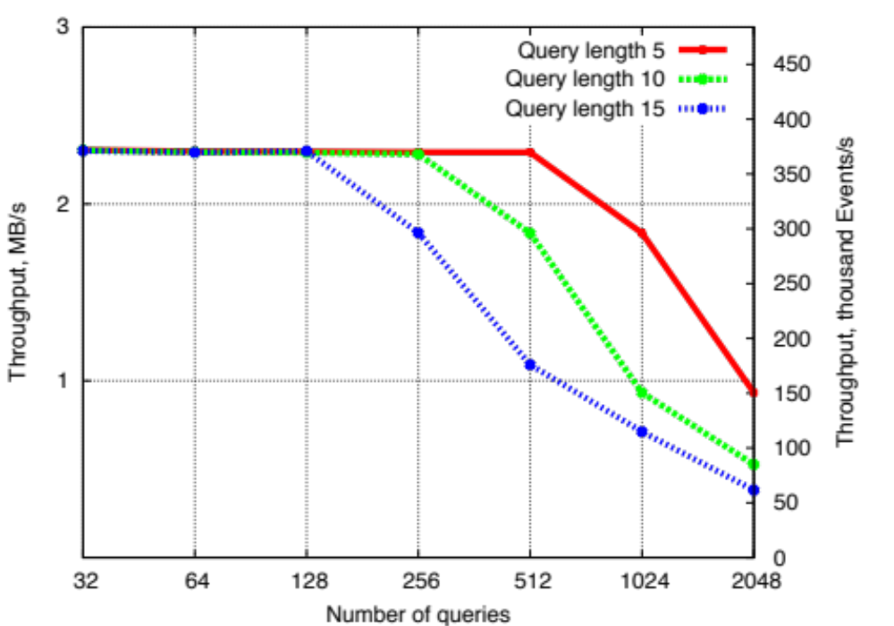
Experiment Results: Throughput
GPU throughput (for 1MB document) is constant until “breaking” point – point where all GPU cores are occupied
Number of occupied cores depends on number of queries and query length
Notes:
The following graph shows us filtering throughput on GPU (graph shown for 1MB document, but the graph is the same for documents of other sizes).
We can see that GPU throughput is constant up until some point, which we call breaking point. At that point all available GPU cores are occupied and having more queries results in their linear execution, which is described by rapid drop in throughput.
Up until breaking point GPU is underutilized, therefore some computation cores are just wasted.
The number of occupied GPU cores depend on query length and number of queries. This correlation is clearly shown on the plot.

Slide 30
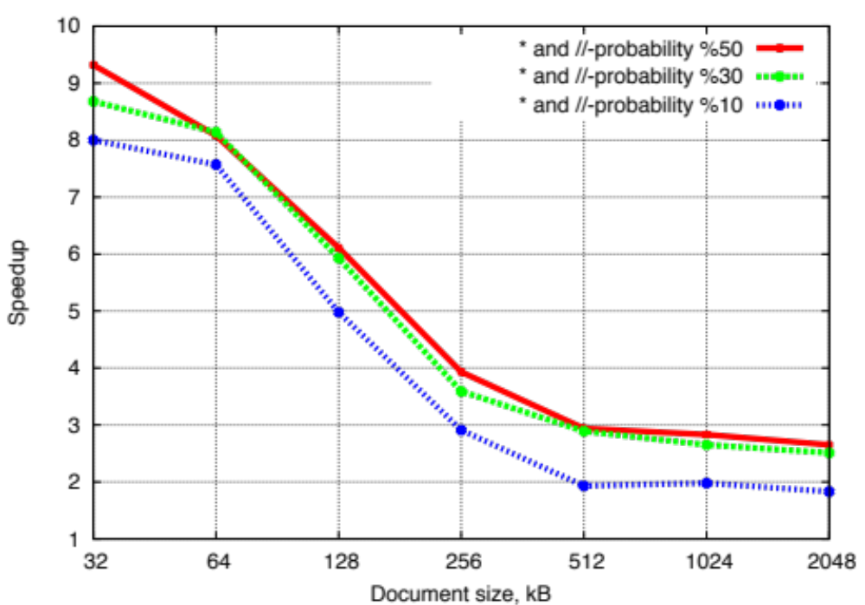
Experiment Results: Speedup
GPU speedup depends on XML document size: larger docs incur greater global memory read latency
Speedup up to 9x
‘*’ and ‘//’-probability affects speedup since it increases YFilter NFA size
Notes:
The following graph shows us speedup of GPU filtering over software filtering approach. The largest speedup (~9x) is obtained on small documents (32Kb), for bigger documents it rapidly drops to constant value.
This effect could be explained by the global memory latency overhead which is an issue with bigger documents.
Higher probability of wildcard nodes and //-relationships increase speedup, since filtering on GPU is not sensitive to these parameters at all, YFilter on contrary is affected by them, since they result in bigger NFA size.

Slide 31
Batch Experiments
Batched experiments filter multiple XML documents
  Shows usage of intra-document parallelism
  Batches of size 500 and 1000 were used
It is nor fair to compare against single-threaded Yfilter in batch experiments
“Pseudo”-multicore YFilter version: distributes document load across different copies of program
  Could not be done for query load, would affect NFA size
Notes:
In order to study effect of intra-document parallelism we performed a number of batch experiments where we were filtering a set of XML documents through given set of fixed queries (size of document set in our experiments was 500 and 1000 docs).
In the previous single-document experiments performance measurements were not really “fair” because YFilter is implemented as a single threaded program and cannot load all CPU cores on our experiment server. In the batch experiments we introduce “pseudo”-multicore version of YFilter, which just start a number of Yfilter copies (equal to the number of available CPU cores), each with a subset of original document set. In other words we split document load across these copies. Note that we cannot apply the same technique for query load, since it will decrease amount path commonalities, used to build compact unified NFA.

Slide 32
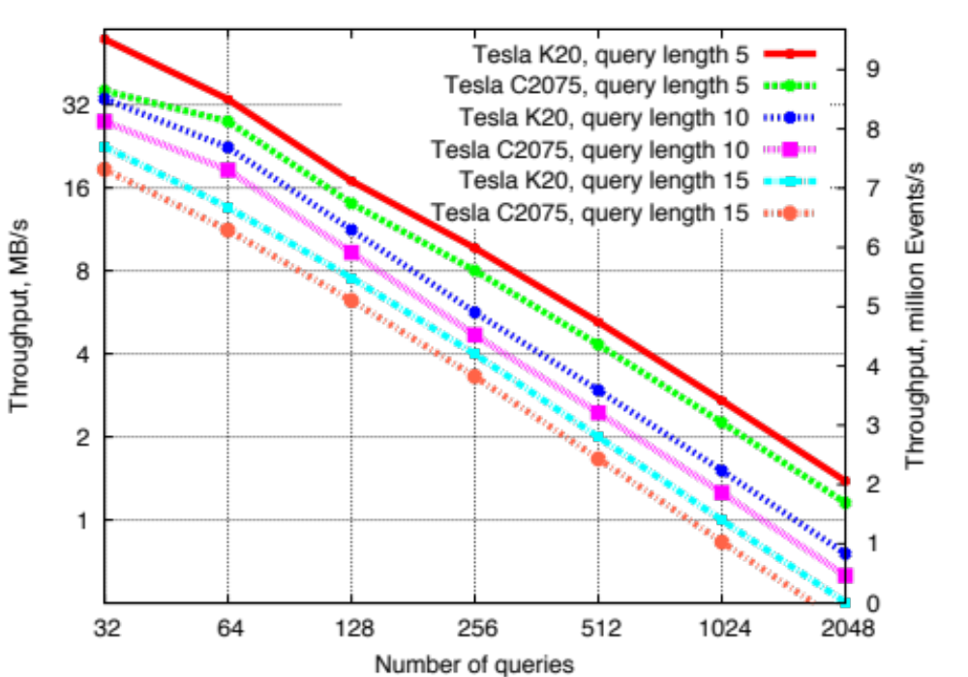
Batch Experiments: Throughput
No breaking point – GPU is always fully occupied by concurrently executing kernels
Throughput increased up to 16 times in comparison with single-document case
Notes:
Throughput graph in batch experiments differs from the one, which we have seen in single-document case. There is no more breaking point on the plot, throughput just degrades linearly with increasing query load. The reason is the following: no more GPU core are wasted now (as in case prior to the breaking point in single-document case), now they are used for concurrent kernel execution, where different kernels filter different XML streams.
Another observation is that concurrent kernel execution increases maximum GPU throughput almost by the factor of 16 in comparison to single-document experiment.
Query length and query load (number of queries) are still major factors, influencing the throughput.
We can also see that Tesla K20, which have more computational cores than Tesla C2075 shows better results, although they do not differ by the factor of 6 (the ratio of the cores in these GPUs) because the amount of concurrent kernel overlapping is limited by GPU architecture.

Slide 33
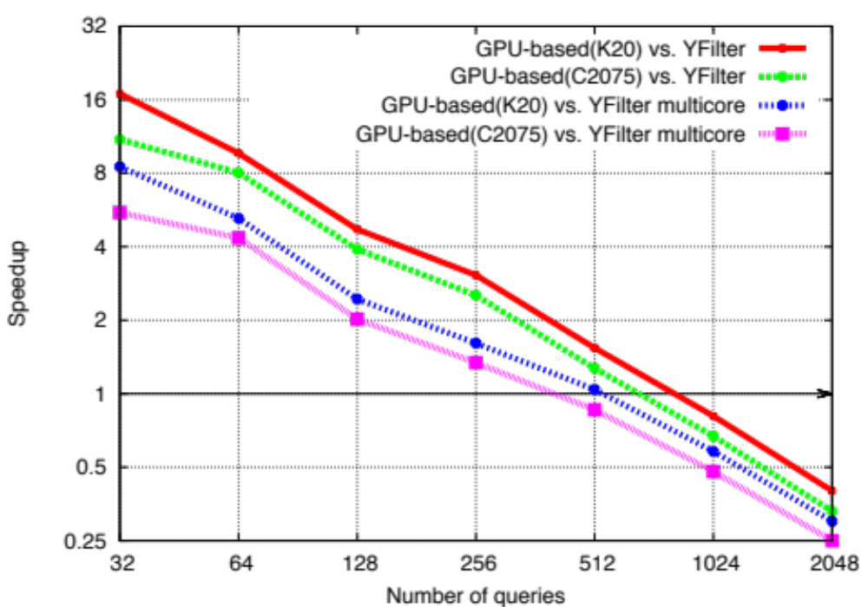
Batch Experiments: Speedup
GPU fully utilized – increase in query length\number yields speedup drop by factor of 2
Achieve up to 16x speedup with slowdown after 512 queries
Multicore version performs better than ordinary
Notes:
Speedup graph for batch experiments also shows us a different picture: the maximum speedup is up to 16x and instead of flattening out for greater number of queries the graph continues to drop by factor of 2. Moreover after 512 queries we see that GPU performance is even worse than the performance of Yfilter. This could be explained by the nature of throughput shown in previous plot.
Again Tesla K20 performs better then Tesla C2075.
“Pseudo”-multicore version also performs better then the regular one, however again we do not see 12x difference (number of used cores) because of the startup overhead, incurred by executing additional Yfilter copy.

Slide 34
Conclusions
Proposed holistic twig filtering using GPUs, effectively leveraging GPU parallelism
Allowed processing of thousands of queries and dynamic query updates (vs. FPGA)
Up to 9x speedup over software systems in single-document experiments
Up to 16x speedup over software systems in batch experiments
Notes:
In conclusion we have proposed an algorithm for holistic twig filtering tuned to execute effectively on massively parallel GPU architecture, which uses all available sources of hardware parallelism provided by GPUs.
Unlike the FPGA analog this approach allows processing theoretically unlimited number of queries, which could be changed on the fly without hardware reprogramming.
We have shown that our approach is capable to reach speedup up to 9x in single-document usage scenario and up to 16 in batch document case.

Slide 35
Thank you!

