Slide 1
Project in Practical Machine Learning
Radar image clustering
Marko Hassinen

Slide 2
Machine Learning
Clustering
Predictive clustering so far
Implemented algorithms: k-means, k-means++ and k-medoids

Slide 3
Data provider
Data from Finnish Meteorological Institute (FMI)
Offers open data in many formats
FMI uses Web Map Service (WMS) to provide Weather Radar images
WMS has different options to shape the data: for example style, resolution and format

Slide 4
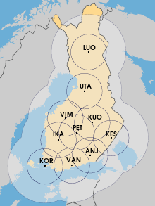
FMI's Radars
Ten weather radars around Finland
Cover almost all of Finland
Four different measures: radar reflectivity, radial velocity, rain classification and cloud top height
Anjalankoski, Ikaalinen,
Kesälahti, Korpo, Kuopio,
Luosto, Petäjävesi,
Utajärvi, Vantaa ja Vimpeli

Slide 5
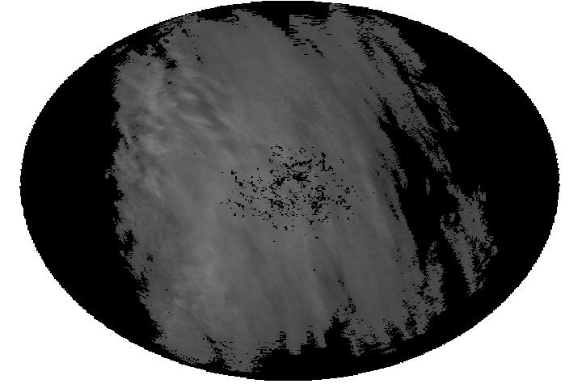
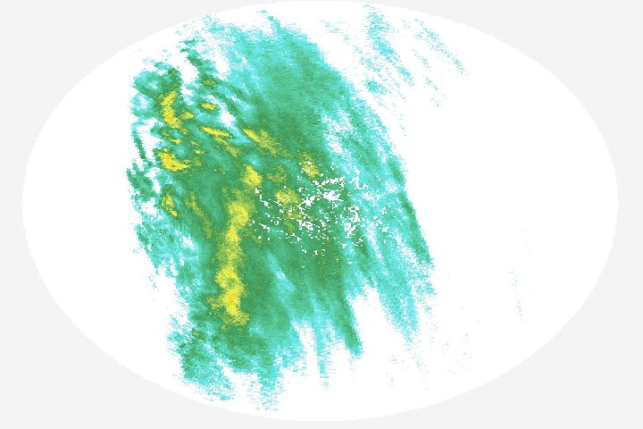
Data
Image resolution: 300x250 and 720x480
Different resolution is used to compare machine learning algorithms performance
Style options: raster and Radar dbz Summer

Slide 6
Machine Learning algorithms
K-means with maximum iterations and initial cluster centers are selected randomly
K-means++: only difference compared to k-means is the way that the inital cluster centers are selected
K-medoids, the slowest (this fact was also discussed briefly in IML)

Slide 7
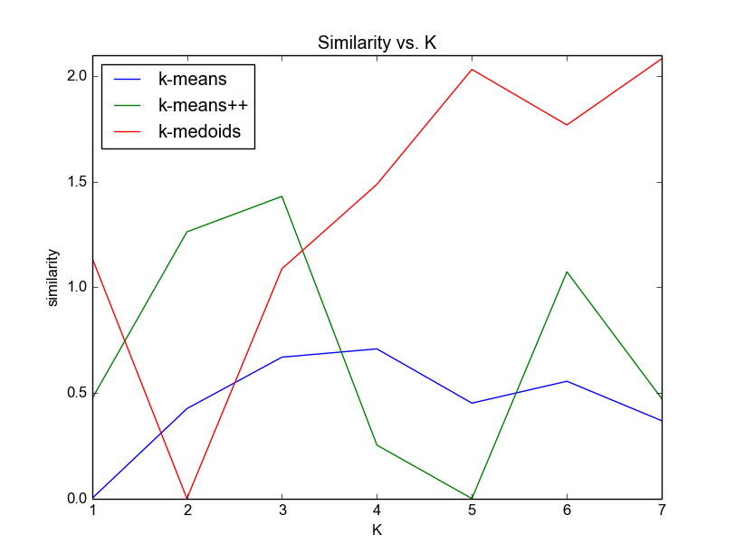
Similarity within clusters

Slide 8
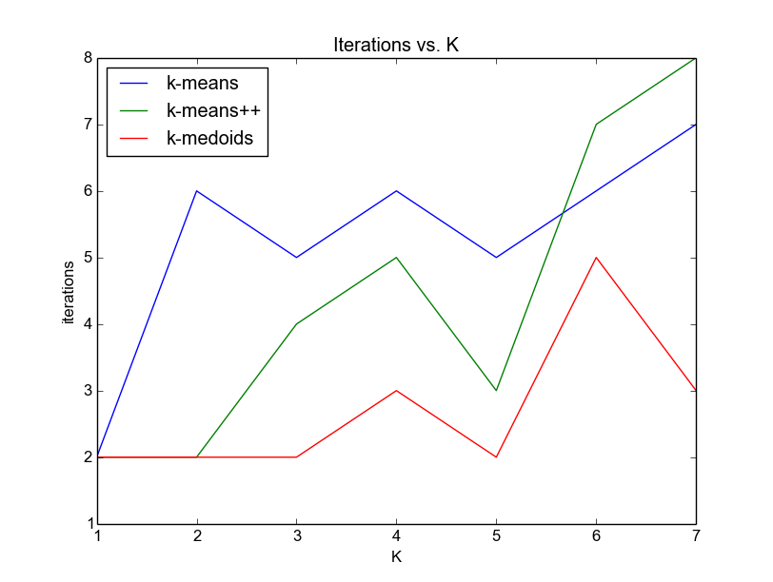
Iterations

Slide 9
Sources
ilmatieteenlaitos.fi
en.wikipedia.org
http://theory.stanford.edu/~sergei/papers/vldb12-kmpar.pdf
Flach, P. (2012). Machine Learning: The Art and Scinece of Algorithms that Make Sense of Data. Cambridge: Cambridge Univ. Press. (IML course book)

