Slide 1

New Feature Enablement Presentation: Customize HTTP Headers
Presenter: Miheer Salunke
Time to complete: 20 mins

Slide 2
Table of Contents
Add here your presentation title + current topic (if you have more than one)
Purpose and Goals
Feature Use Case 1
Feature Use Case 2
Feature Use Case 3
Demo

Slide 3
Purpose and Goals
Goal: Extend the IngressController and Route APIs to allow setting and deleting HTTP request and response headers.
Motivation: Enable an application owner or cluster admin
to meet security compliance requirements;
to protect against cross-site scripting attacks;
to provide client connection information to backend servers; and
to hide information about backend servers from clients.

Slide 4
Feature Use case 1
As a cluster admin or route owner, I want to enable mutual TLS but replace the "x-ssl-client-der" request header that OpenShift router adds with an "x-forwarded-client-cert" request header that my application checks for, so that I can migrate my applications that rely on mutual TLS and use the latter header name.
The following example replaces "x-ssl-client-der" with "x-forwarded-client-cert":
Pre-requisites:
Enable mtls as per https://rcarrata.com/openshift/mtls-ingress-controller/
Notes:
Accept: text/html, application/xhtml+xml, application/xml;q=0.9, */*;q=0.8

Slide 5
Route YAML file
Feature Use Case 1 Continued
spec:
host: myapp-service-demo.apps.misalunk-demo.qe.devcluster.openshift.com
httpHeaders:
actions:
request:
- action:
set:
value: '%{+Q}[ssl_c_der,base64]'
type: Set
name: x-forwarded-client-cert
- action:
type: Delete
name: x-ssl-client-der
response: null
- httpHeaders: Defines the list of the HTTP request and response on which we want to set or delete.
- actions: Defines list of actions to set or delete the HTTP request and response.
- request: Defines the type of the HTTP headers.
- action: Defines the action for the header in detail.
- set: Defines the details for action set if the type of the action was `Set`
- value: Defines the value for the header if the type of the action was `Set`
- type: Defines type of the action either `Set` or `Delete`
- name: Defines the name of the header on which the action shall be performed.

Slide 6
Representation in haproxy.config file
Feature use case 1 continued
# Plain http backend or backend with TLS terminated at the edge or a
# secure backend with re-encryption.
backend be_edge_http:demo:myapp-service
http-request set-header 'x-forwarded-client-cert' '%{+Q}[ssl_c_der,base64]'
http-request del-header 'x-ssl-client-der'

Slide 7
DEMO

Slide 8
Feature Use Case 2
As an application or route owner, I want to enable a web application to serve content of an alternative location for providing language translation.
The following procedure creates a route that sets the Content-Location HTTP header so that response to the https://app.example.com mentions to the client that https://app.example.com/lang/en-us is available to access the content in Chinese.

Slide 9
Feature Use 2 continued
Run oc edit route and add the following under spec as follows:
response:
- action:
set:
value: /lang/zh-cn
type: Set
name: Content-Location

Slide 10
Representation in haproxy.config file
Feature use case 2 continued
# Plain http backend or backend with TLS terminated at the edge or a
# secure backend with re-encryption.
backend be_edge_http:demo:myapp-service
http-response set-header 'Content-Location' '/lang/zh-cn'

Slide 11
DEMO

Slide 12
Over-ride behavior
When the same HTTP header is modified both in the Ingress Controller and in a route, HAProxy prioritizes the actions in certain ways depending on whether it is a request or response header.
* For HTTP response headers, actions specified in the Ingress Controller are executed after the actions specified in a route. This means that the actions specified in the Ingress Controller take precedence.
* For HTTP request headers, actions specified in a route are executed after the actions specified in the Ingress Controller. This means that the actions specified in the route take precedence.
This prioritization occurs because the haproxy uses a logic in which for HTTP response frontend rules are applied after backend rules where the actions specified in the Ingress Controller are applied to the front end section
of haproxy.config and the actions specified in the individual routes are applied to the backend section of the haproxy.config.

Slide 13
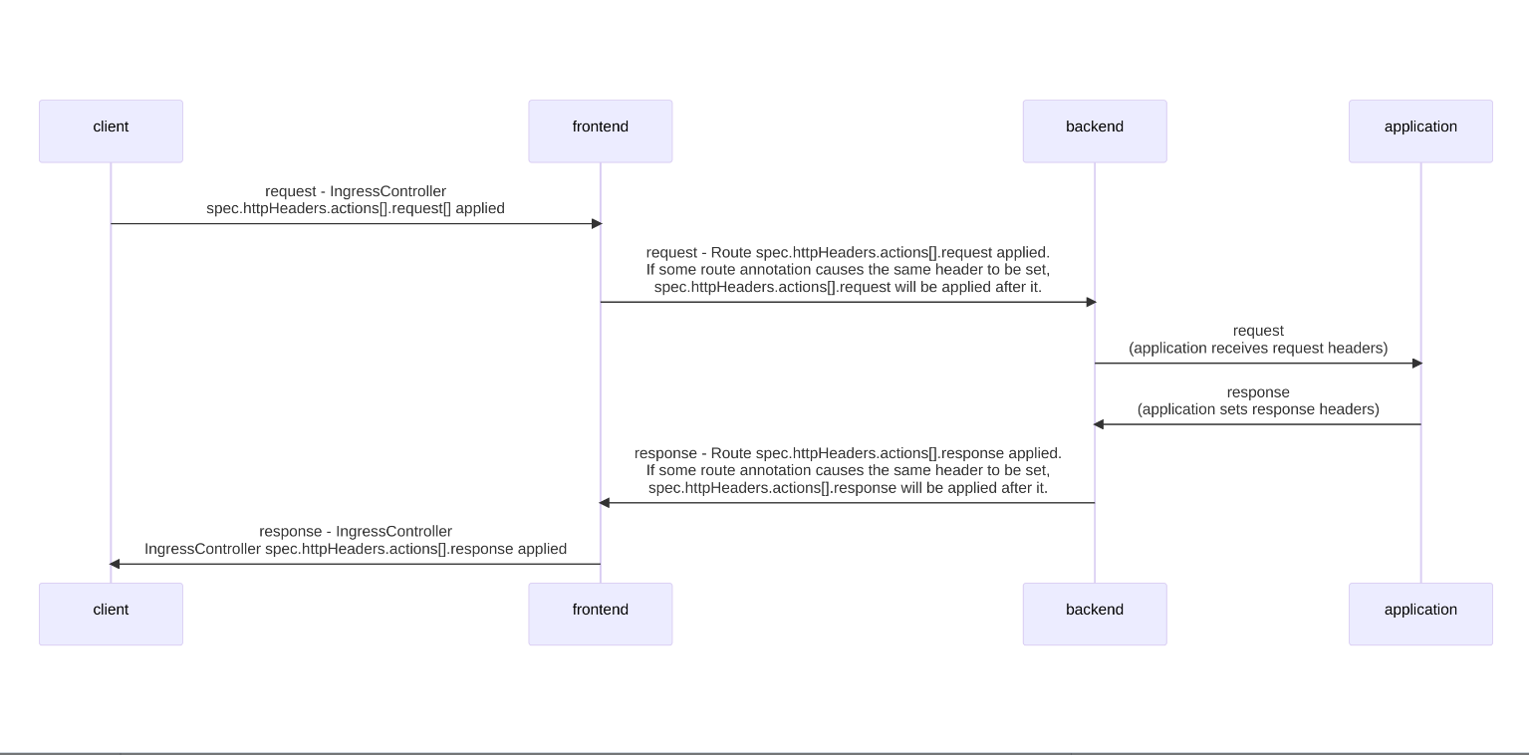
Sequence Diagram

Slide 14
Feature Use Case 3
As a cluster admin for security and compliance reasons, I want to DENY X-Frame-Options for all routes the Ingress controller is managing
In the route following will be set:
response:
- action:
set:
value: SAMEORIGIN
type: Set
name: X-Frame-Options
In the ingress controller following will be set:
httpHeaders:
actions:
response:
- action:
set:
value: DENY
type: Set
name: X-Frame-Options
Notes:
When the same HTTP header is modified both in the Ingress Controller and in a route, HAProxy prioritizes the actions in certain ways depending on whether it is a request or response header.
* For HTTP response headers, actions specified in the Ingress Controller are executed after the actions specified in a route. This means that the actions specified in the Ingress Controller take precedence.
* For HTTP request headers, actions specified in a route are executed after the actions specified in the Ingress Controller. This means that the actions specified in the route take precedence.
When both the `IngressController` spec and `Route` spec are configuring the X-Frame-Options header, then the value set for this header at the global level in the Ingress Controller will take precedence, i.e X-Frame-Options will be denied even if a specific route allows frames.
This prioritzation occurs because the `haproxy.config` file uses the following logic, in which for HTTP response frontend rules are applied after backend rules where the actions specified in the Ingress Controller are applied to the front end section
Of haproxy.config and the actions specified in the individual routes are applied to the backend section of the haproxy.config.

Slide 15
Representation in haproxy.config file
Feature use case 3 continued
frontend public
http-response set-header ‘X-Frame-Options’ 'DENY'
frontend fe_sni
http-response set-header ‘X-Frame-Options’ 'DENY'
frontend fe_no_sni
http-response set-header ‘X-Frame-Options’ 'DENY'
backend be_edge_http:demo:myapp-service
http-response set-header ‘X-Frame-Options’ 'SAMEORIGIN'

Slide 16
DEMO

Slide 17
Restrictions
Headers cannot be modified for TLS passthrough.
Any actions defined defined using this new API are applied after any actions related to cache-control, spec.clientTLS, spec.httpHeaders.forwardedHeaderPolicy, spec.httpHeaders.uniqueId and spec.httpHeaders.headerNameCaseAdjustments
Headers set using this API cannot be captured for use in access logs.
The following header names are reserved and may not be modified via this API:
Strict-Transport-Security, Proxy, Host, Cookie, Set-Cookie.
Maximum of 20 actions may be defined each for HTTP request and response.
Dynamic values are supported, however with limitations. Allowed sample fetchers are res.hdr and ssl_c_der for response headers and req.hdr and ssl_c_der for request headers. Allowed converters are lower and base64.
If you set the x-frame-options response header to the value "%[res.hdr(server)] if { req.hdr(user-agent) -m sub evil}", then the response value will include the literal "if" condition: "x-frame-options: Apache/2.4.37 (centos) if { req.hdr(user-agent) -m sub evil}".
Append action is not available using this API.
Max header value size is 16384
Max header name size is 255
Notes:
When the same HTTP header is modified both in the Ingress Controller and in a route, HAProxy prioritizes the actions in certain ways depending on whether it is a request or response header.
* For HTTP response headers, actions specified in the Ingress Controller are executed after the actions specified in a route. This means that the actions specified in the Ingress Controller take precedence.
* For HTTP request headers, actions specified in a route are executed after the actions specified in the Ingress Controller. This means that the actions specified in the route take precedence.
When both the `IngressController` spec and `Route` spec are configuring the X-Frame-Options header, then the value set for this header at the global level in the Ingress Controller will take precedence, i.e X-Frame-Options will be denied even if a specific route allows frames.
This prioritzation occurs because the `haproxy.config` file uses the following logic, in which for HTTP response frontend rules are applied after backend rules where the actions specified in the Ingress Controller are applied to the front end section
Of haproxy.config and the actions specified in the individual routes are applied to the backend section of the haproxy.config.

Slide 18
Documentation
PR https://github.com/openshift/openshift-docs/pull/56177
https://docs.openshift.com/container-platform/4.14/networking/routes/route-configuration.html#nw-http-header-configuration_route-configuration
https://docs.openshift.com/container-platform/4.14/networking/ingress-operator.html#nw-http-header-configuration_configuring-ingress

