Slide 1
OPTIMAL OMNITIG LISTING

Slide 2
The Plan
Collection of fragments as usual, but with strong hypothesis
Genome graph
Safe strings becomes OMNITIG of the graph
Listing all maximal OMNITIG:
- brute force (first paper about omnitigs), trivially parallelizable
- first understand what they are, then try to list them:
optimal sequential algorithm, still to be «parallelized»

Slide 3



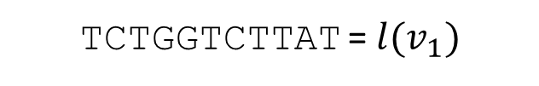


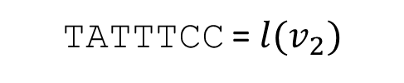
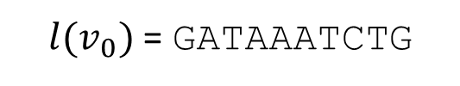

Genome Graph
Node: $u$ String: $l(u)$
Edge: $e=(u, v)$ of weight $c(e)$ Overlapping:$suf\left(u, c\left(e\right)\right)=pre(v, c\left(e\right))$
Walk: $w=(v_{0},e_{0},v_{1},e_{1},…, v_{t}, e_{t}, v_{t+1})$ Merge: $spell\left(w\right)=l(v_{0})⊕c(e_{0})$ $l(v_{1})$ $⊕$ $c(e_{1})$ …
$$w :$$
$$e_{0}$$
$$e_{1}$$
v₀
v₁
v₂
$l(v_{0})$ = GATAAATCTG
TATTTCC = $l(v_{2})$
TCTGGTCTTAT = $l(v_{1})$
$$c\left(e_{0}\right)=4$$
$$c\left(e_{1}\right)=3$$
$spell\left(w\right)=$ GATAAATCTGGTCTTATTTCC

Slide 4

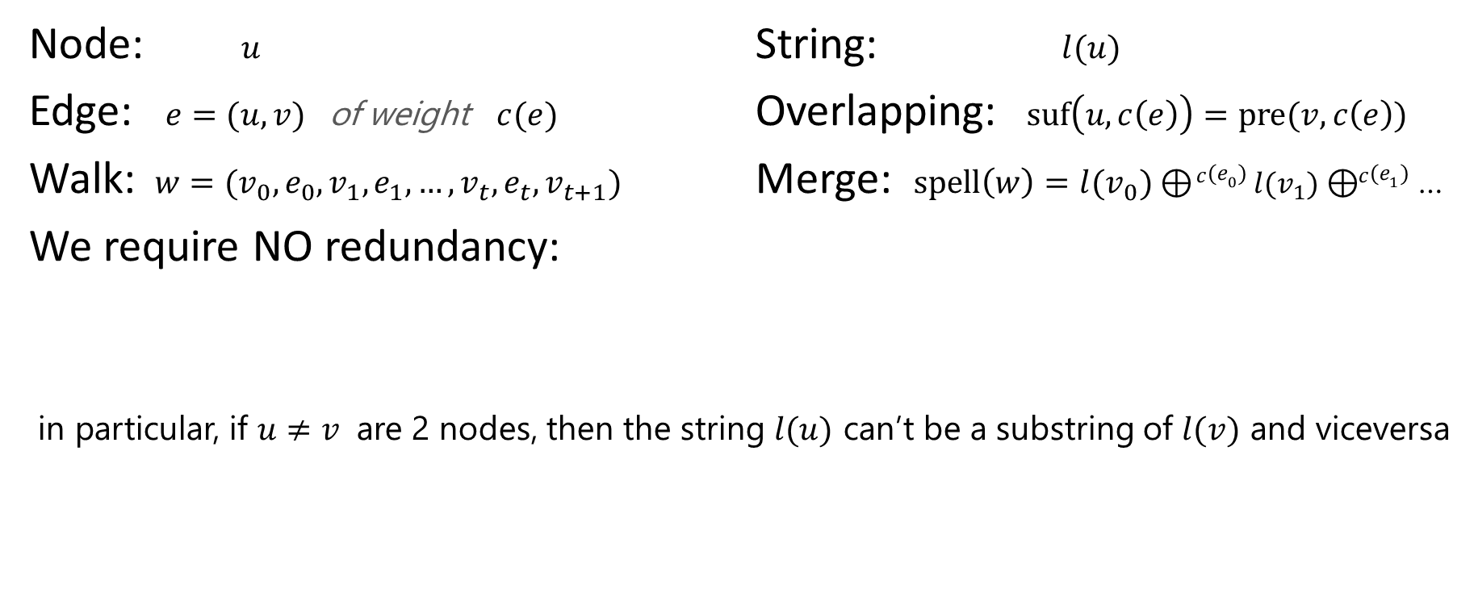
Genome Graph
Node: $u$ String: $l(u)$
Edge: $e=(u, v)$ of weight $c(e)$ Overlapping:$suf\left(u, c\left(e\right)\right)=pre(v, c\left(e\right))$
Walk: $w=(v_{0},e_{0},v_{1},e_{1},…, v_{t}, e_{t}, v_{t+1})$ Merge: $spell\left(w\right)=l(v_{0})⊕c(e_{0})$ $l(v_{1})$ $⊕$ $c(e_{1})$ …
We require NO redundancy:
in particular, if $u≠v$ are 2 nodes, then the string $l(u)$ can’t be a substring of $l(v)$ and viceversa
$$w_{1}⊂w_{2} ⇔ spell(w_{1})⊂spell(w_{2})$$

Slide 5
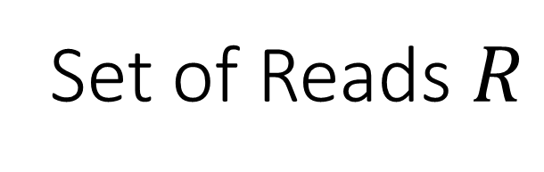

Genome Graph
Set of Reads $R$
$$𝓖\left(R\right)$$
Graph Model
Genomic Reconstruction
Algorithm that, from the set $R$ of reads, builds the genome graph $𝓖\left(R\right)$
Rule to determine whether a walk in $𝓖\left(R\right)$ is a genomic reconstruction

Slide 6
Genomic Reconstructions:
there could be many

Slide 7
Can we find all the safe strings, that is the strings that are guaranteed to be substrings of all possible genomic reconstructions compatible with the given reads?
Genomic Reconstructions:
there could be many

Slide 8
Can we find all the safe strings, that is the strings that are guaranteed to be substrings of all possible genomic reconstructions compatible with the given reads?
Genomic Reconstruction
In some settings yes, and we can do it optimally.

Slide 9
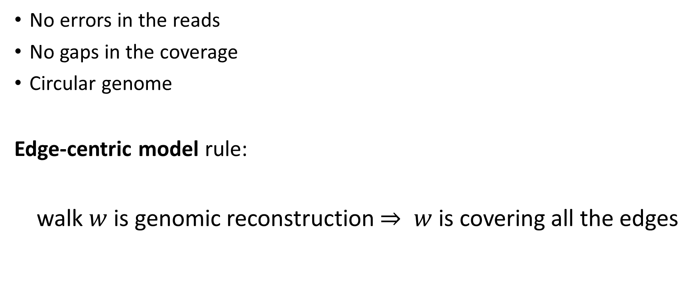
Hypothesis
No errors in the reads
No gaps in the coverage
Circular genome
Edge-centric model rule:
walk $w$ is genomic reconstruction $⇒ w$ is covering all the edges

Slide 10
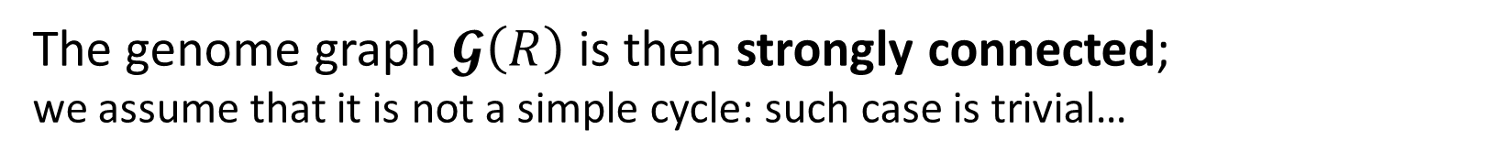
Safe Strings = Common Subwalks
Looking for the common substrings of all the strings spelled by the circular edge-covering walks…
Any string that is spelled by a walk which is contained in all the circular edge-covering walks
No redundancy ⇒
The genome graph $𝓖\left(R\right)$ is then strongly connected;
we assume that it is not a simple cycle: such case is trivial…

Slide 11
A graph problem
Given a strongly connected graph,
assume it is not a simple cycle (trivial case),
which are the longest common subwalks of all the edge covering walks (ecw)?
Can we recognize them someway?
Let’s explore their zoology…

Slide 12


Safe Strings Omnitig
1 edge
1 edge
is in all ecw

Slide 13
Safe Strings Omnitig
0+ edges
1 edge
A path whose vertices have
in degree 1
out degree 1
is in all ecw

Slide 14
Safe Strings Omnitig
0+ edges
1 edge
A path whose vertices have
in degree 1
out degree 1+
is in all ecw

Slide 15
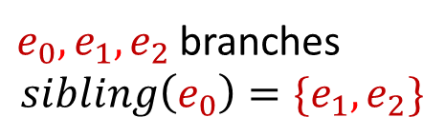




Safe Strings Omnitig
0+ edges
1 edge
$$e_{0}$$
$$e_{1}$$
$v$
$$e_{2}$$
A path whose vertices have
in degree 1
out degree 1+
is in all ecw
$e_{0},e_{1},e_{2}$ branches
$$sibling\left(e_{0}\right)={\{e}_{1},e_{2}\}$$
path without branches = univocal

Slide 16
Safe Strings Omnitig
0+ edges
1 edge
A path whose vertices have
in degree 1+
out degree 1
is in all ecw

Slide 17
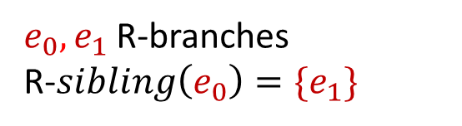


Safe Strings Omnitig
$e_{0},e_{1}$ R-branches
R-$sibling\left(e_{0}\right)={\{e}_{1}\}$
0+ edges
1 edge
$$e_{0}$$
$$e_{1}$$
A path whose vertices have
in degree 1
out degree 1+
is in all ecw
path without R-branches = R-univocal

Slide 18


Safe Strings Omnitig
0+ edges
1 edge
$v_{i}$
$v_{j}$
A path whose vertices have
in degree 1+
out degree 1+
is in all ecw ?

Slide 19

Safe Strings Omnitig
0+ edges
1 edge
$v_{i}$
$v_{j}$
A path whose vertices have
in degree 1+
out degree 1+
is in all ecw ? Not always… so when?

Slide 20

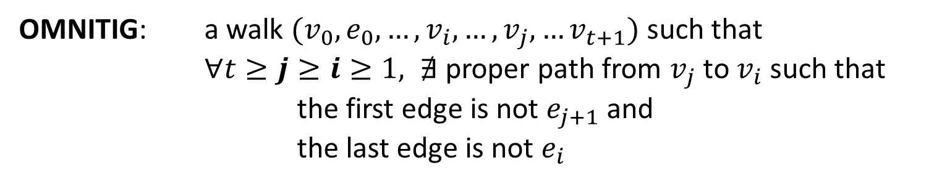
Safe Strings Omnitig
0+ edges
1 edge
$v_{i}$
$v_{j}$
OMNITIG: a walk $(v_{0},e_{0},…, v_{i},…, v_{j}, …v_{t+1})$ such that
$∀t≥j≥ⅈ≥1, ∄$ proper path from $v_{j}$ to $v_{i}$ such that
the first edge is not $e_{j+1}$ and
the last edge is not $e_{i}$

Slide 21
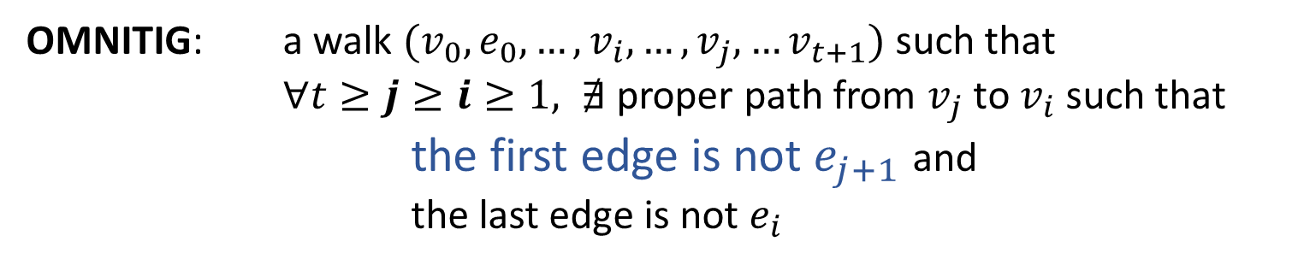

Safe Strings Omnitig
0+ edges
1 edge
$v_{i}$
$v_{j}$
OMNITIG: a walk $(v_{0},e_{0},…, v_{i},…, v_{j}, …v_{t+1})$ such that
$∀t≥j≥ⅈ≥1, ∄$ proper path from $v_{j}$ to $v_{i}$ such that
the first edge is not $e_{j+1}$ and
the last edge is not $e_{i}$

Slide 22
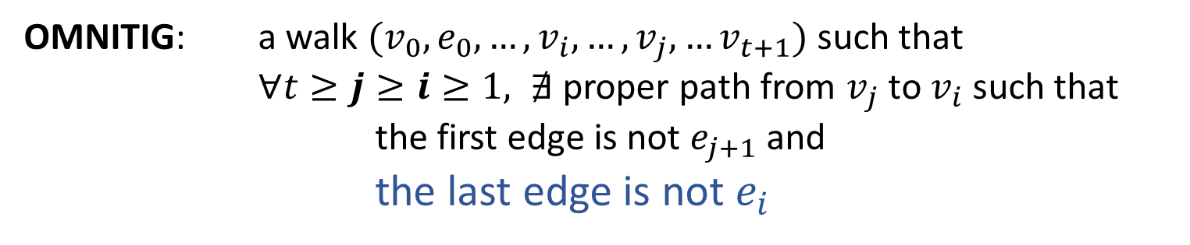

Safe Strings Omnitig
0+ edges
1 edge
$v_{i}$
$v_{j}$
OMNITIG: a walk $(v_{0},e_{0},…, v_{i},…, v_{j}, …v_{t+1})$ such that
$∀t≥j≥ⅈ≥1, ∄$ proper path from $v_{j}$ to $v_{i}$ such that
the first edge is not $e_{j+1}$ and
the last edge is not $e_{i}$

Slide 23
Safe Strings Omnitig
0+ edges
1 edge
$v_{i}$
$v_{j}$
OMNITIG: a walk $(v_{0},e_{0},…, v_{i},…, v_{j}, …v_{t+1})$ such that
$∀t≥j≥ⅈ≥1, ∄$ proper path from $v_{j}$ to $v_{i}$ such that
the first edge is not $e_{j+1}$ and
the last edge is not $e_{i}$
OMNITIG = COMMON SUBWALKS of all e.c.w.

Slide 24
Safe Strings Omnitig
0+ edges
1 edge
$v_{i}$
$v_{j}$
OMNITIG: a walk $(v_{0},e_{0},…, v_{i},…, v_{j}, …v_{t+1})$ such that
$∀t≥j≥ⅈ≥1, ∄$ proper path from $v_{j}$ to $v_{i}$ such that
the first edge is not $e_{j+1}$ and
the last edge is not $e_{i}$
.With this definition you can write down a straightforward algorithm for listing all maximal omnitig. Still not competitive with respect to other apprx. alg.

Slide 25
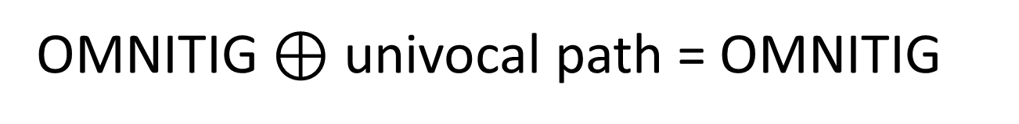
Maximal Omnitig
OMNITIG
OMNITIG $⊕$ univocal path = OMNITIG

Slide 26
Maximal Omnitig
?
OMNITIG
OMNITIG $⊕$ univocal path = OMNITIG

Slide 27
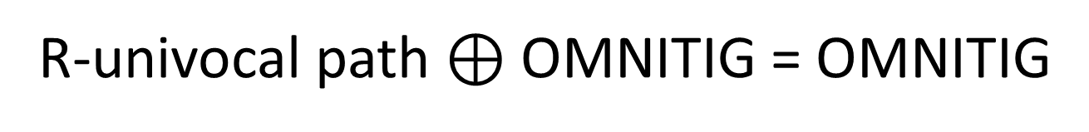
Maximal Omnitig
OMNITIG
R-univocal path $⊕$OMNITIG = OMNITIG

Slide 28
Maximal Omnitig
?
OMNITIG
R-univocal path $⊕$OMNITIG = OMNITIG

Slide 29
Maximal Omnitig
Each maximal omnitig has a branch

Slide 30
Maximal Omnitig
Each maximal omnitig has a branch
The last branch is unique… of course

Slide 31

Maximal Omnitig
Each maximal omnitig has a branch
The last branch is unique… of course
Each branch is the last branch of at most 1 maximal omnitig!
(Theorem 8 of paper)

Slide 32

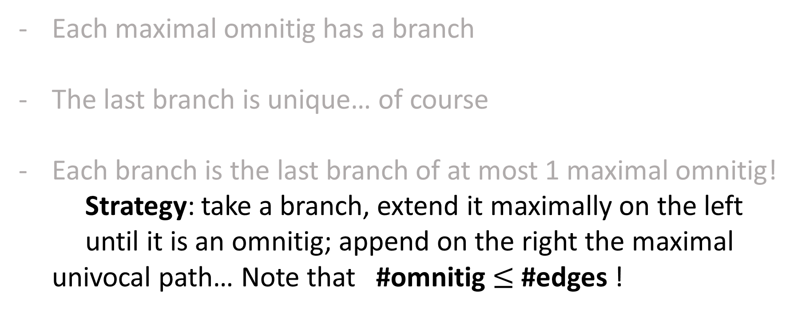
Maximal Omnitig
Each maximal omnitig has a branch
The last branch is unique… of course
Each branch is the last branch of at most 1 maximal omnitig!
Strategy: take a branch, extend it maximally on the left
until it is an omnitig; append on the right the maximal univocal path… Note that #omnitig $≤$ #edges !

Slide 33
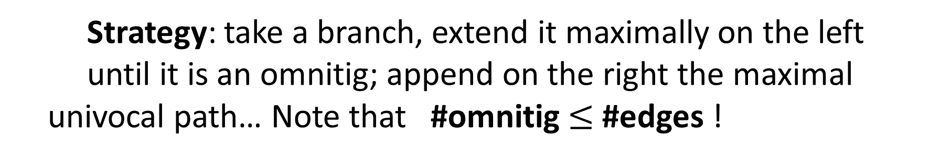
Maximal Omnitig
Strategy: take a branch, extend it maximally on the left
until it is an omnitig; append on the right the maximal univocal path… Note that #omnitig $≤$ #edges !

Slide 34


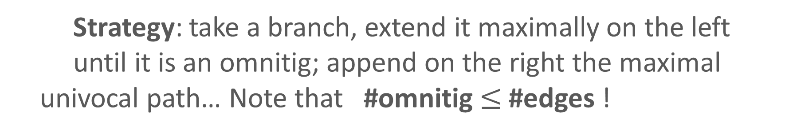
Maximal Omnitig
Strategy: take a branch, extend it maximally on the left
until it is an omnitig; append on the right the maximal univocal path… Note that #omnitig $≤$ #edges !
Intuitively, while extending to the left we could meet other branches, so… memoization!

Slide 35



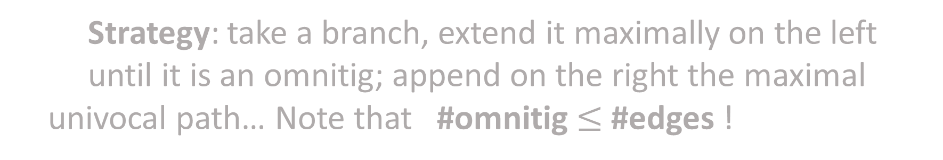
Maximal Omnitig
Strategy: take a branch, extend it maximally on the left
until it is an omnitig; append on the right the maximal univocal path… Note that #omnitig $≤$ #edges !
Intuitively, while extending to the left we could meet other branches, so… memoization!
The most interesting part is still in the details.
Here is a glimpse at how things are working:

Slide 36

Optimal Listing of Maximal Omnitig
For each branch $e$
$$e$$
main

Slide 37

Optimal Listing of Maximal Omnitig
For each branch $e$
- calculate the unique omnitig $we$ which is maximally extended to the left
OmnitigEndigWith(e)
$$w$$
OMNITIG
$$e$$
main
OMNITIG maximally extended to the left

Slide 38
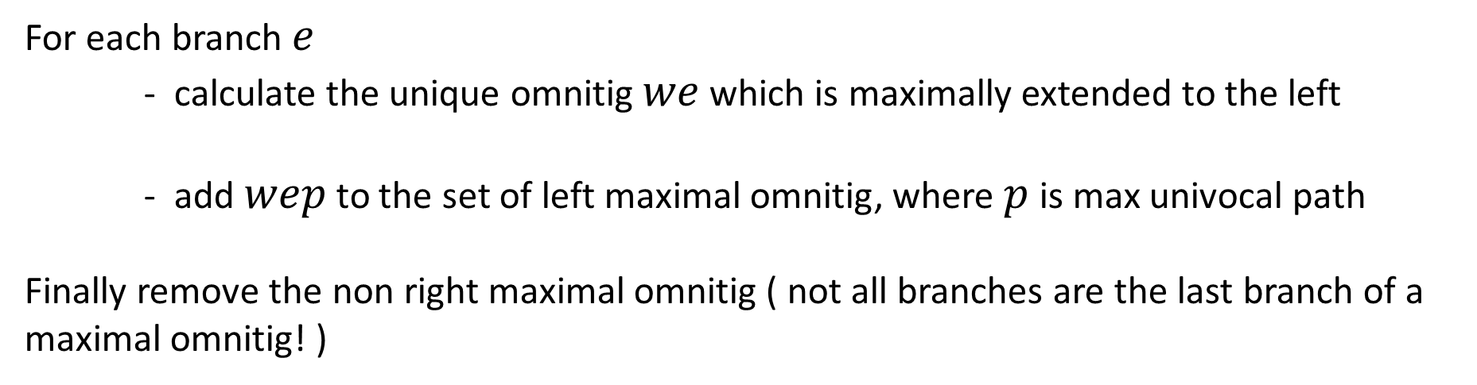
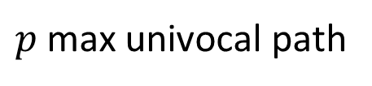
Optimal Listing of Maximal Omnitig
For each branch $e$
- calculate the unique omnitig $we$ which is maximally extended to the left
- add $wep$ to the set of left maximal omnitig, where $p$ is max univocal path
Finally remove the non right maximal omnitig ( not all branches are the last branch of a maximal omnitig! )
OmnitigEndigWith(e)
$$w$$
OMNITIG
$$e$$
$p$ max univocal path
main

Slide 39



Optimal Listing of Maximal Omnitig
Given the branch $e$, consider a sibling $e′$
$$e′$$
$$v$$
$$e$$
OmnitigEndingWith(e)

Slide 40

Optimal Listing of Maximal Omnitig
$$p$$
Given the branch $e$, consider a sibling $e′$ and a closed path $e^{′}p$
$$e′$$
$$v$$
$$e$$
OmnitigEndingWith(e)

Slide 41

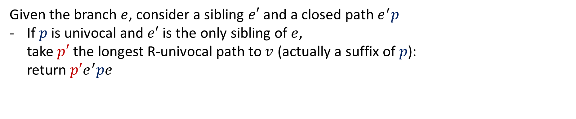
Optimal Listing of Maximal Omnitig
$$p$$
Given the branch $e$, consider a sibling $e′$ and a closed path $e^{′}p$
If $p$ is univocal and $e′$ is the only sibling of $e$, take $p′$ the longest R-univocal path to $v$ (actually a suffix of $p$): return $p′e^{′}pe$
$$p′$$
$$e′$$
$$v$$
$$e$$
OmnitigEndingWith(e)

Slide 42
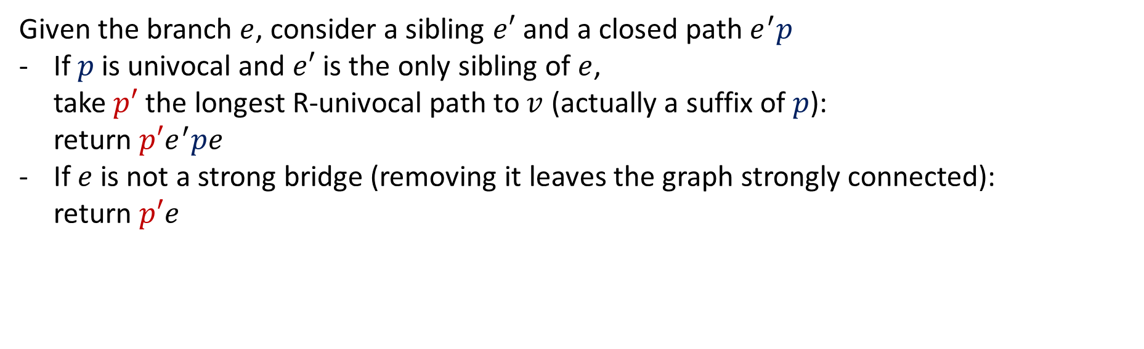
Optimal Listing of Maximal Omnitig
$$p$$
Given the branch $e$, consider a sibling $e′$ and a closed path $e^{′}p$
If $p$ is univocal and $e′$ is the only sibling of $e$, take $p′$ the longest R-univocal path to $v$ (actually a suffix of $p$): return $p′e^{′}pe$
If $e$ is not a strong bridge (removing it leaves the graph strongly connected):
return $p′e$
$$p′$$
$$e′$$
$$v$$
$$e$$
OmnitigEndingWith(e)

Slide 43






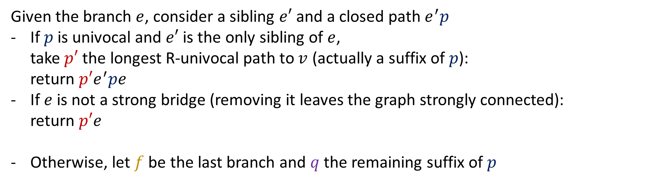
Optimal Listing of Maximal Omnitig
$$p$$
Given the branch $e$, consider a sibling $e′$ and a closed path $e^{′}p$
If $p$ is univocal and $e′$ is the only sibling of $e$, take $p′$ the longest R-univocal path to $v$ (actually a suffix of $p$): return $p′e^{′}pe$
If $e$ is not a strong bridge (removing it leaves the graph strongly connected):
return $p′e$
Otherwise, let $f$ be the last branch and $q$ the remaining suffix of $p$
$$p′$$
$$e′$$
$$v$$
$$e$$
$$p$$
$$f$$
$$q$$
$$e′$$
$$v$$
$$e$$
OmnitigEndingWith(e)

Slide 44
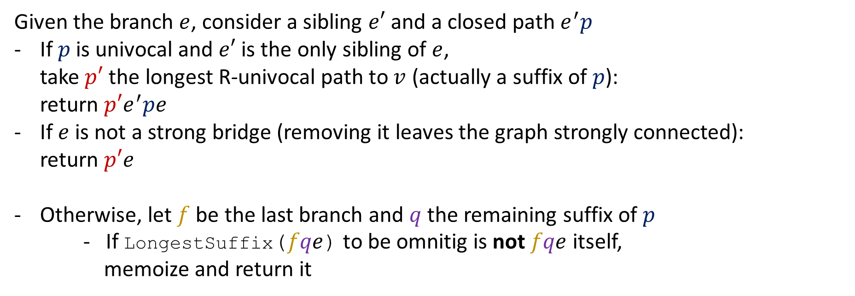
Optimal Listing of Maximal Omnitig
$$p$$
Given the branch $e$, consider a sibling $e′$ and a closed path $e^{′}p$
If $p$ is univocal and $e′$ is the only sibling of $e$, take $p′$ the longest R-univocal path to $v$ (actually a suffix of $p$): return $p′e^{′}pe$
If $e$ is not a strong bridge (removing it leaves the graph strongly connected):
return $p′e$
Otherwise, let $f$ be the last branch and $q$ the remaining suffix of $p$
- If LongestSuffix($fqe$) to be omnitig is not $fqe$ itself,
memoize and return it
$$p′$$
$$e′$$
$$v$$
$$e$$
$$p$$
$$f$$
$$q$$
$$e′$$
$$v$$
$$e$$
OmnitigEndingWith(e)

Slide 45
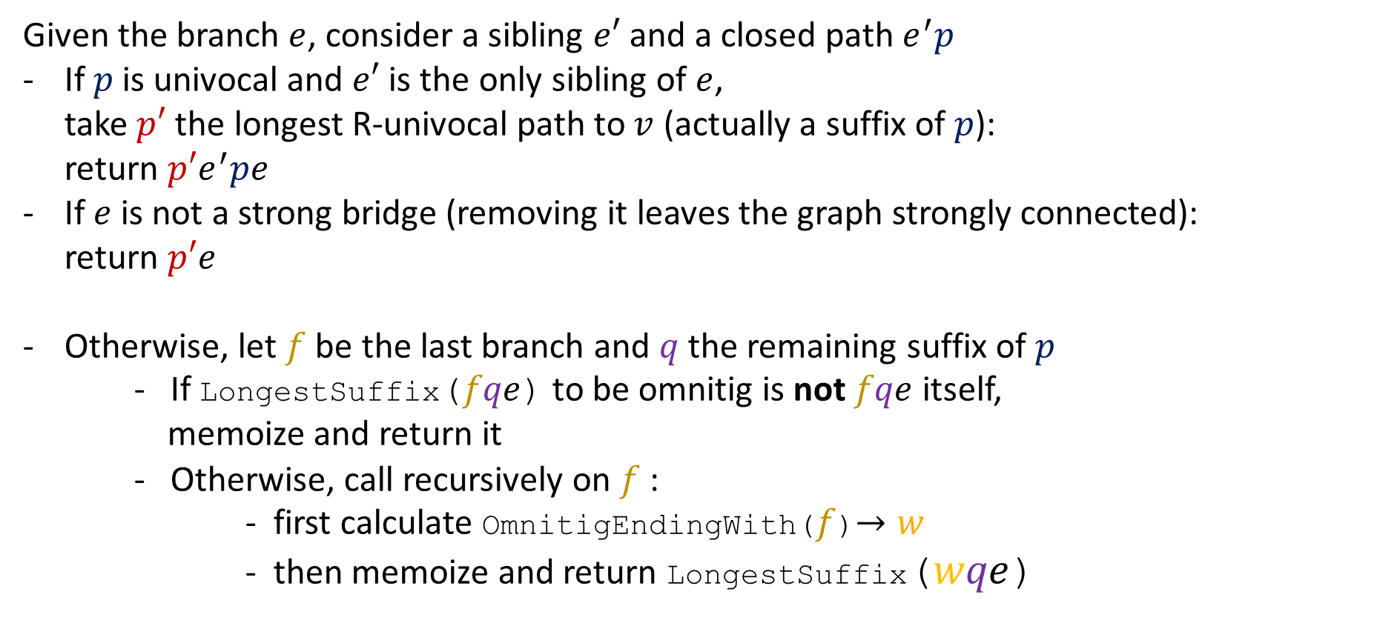
Optimal Listing of Maximal Omnitig
$$p$$
Given the branch $e$, consider a sibling $e′$ and a closed path $e^{′}p$
If $p$ is univocal and $e′$ is the only sibling of $e$, take $p′$ the longest R-univocal path to $v$ (actually a suffix of $p$): return $p′e^{′}pe$
If $e$ is not a strong bridge (removing it leaves the graph strongly connected):
return $p′e$
Otherwise, let $f$ be the last branch and $q$ the remaining suffix of $p$
- If LongestSuffix($fqe$) to be omnitig is not $fqe$ itself,
memoize and return it
- Otherwise, call recursively on $f$:
- first calculate OmnitigEndingWith($f$)$→w$
- then memoize and return LongestSuffix($wqe$)
$$p′$$
$$e′$$
$$v$$
$$e$$
$$p$$
$$f$$
$$q$$
$$e′$$
$$v$$
$$e$$
OmnitigEndingWith(e)

Slide 46


Optimal Listing of Maximal Omnitig
$$p$$
Given the branch $e$, consider a sibling $e′$ and a closed path $e^{′}p$
If $p$ is univocal and $e′$ is the only sibling of $e$, take $p′$ the longest R-univocal path to $v$ (actually a suffix of $p$): return $p′e^{′}pe$
If $e$ is not a strong bridge (removing it leaves the graph strongly connected):
return $p′e$
Otherwise, let $f$ be the last branch and $q$ the remaining suffix of $p$
- If LongestSuffix($fqe$) to be omnitig is not $fqe$ itself,
memoize and return it
- Otherwise, call recursively on $f$:
- first calculate OmnitigEndingWith($f$)$→w$
- then memoize and return LongestSuffix($wqe$)
$$p′$$
$$e′$$
$$v$$
$$e$$
$$p$$
$$f$$
$$q$$
$$e′$$
$$v$$
$$e$$
OmnitigEndingWith(e)

Slide 47

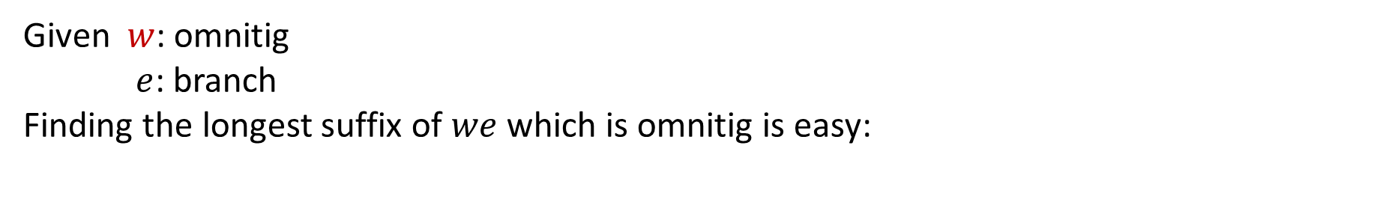

Optimal Listing of Maximal Omnitig
Given $w$: omnitig
$e$: branch
Finding the longest suffix of $we$ which is omnitig is easy:
$$e$$
$$w$$
LongestSuffix(we)

Slide 48

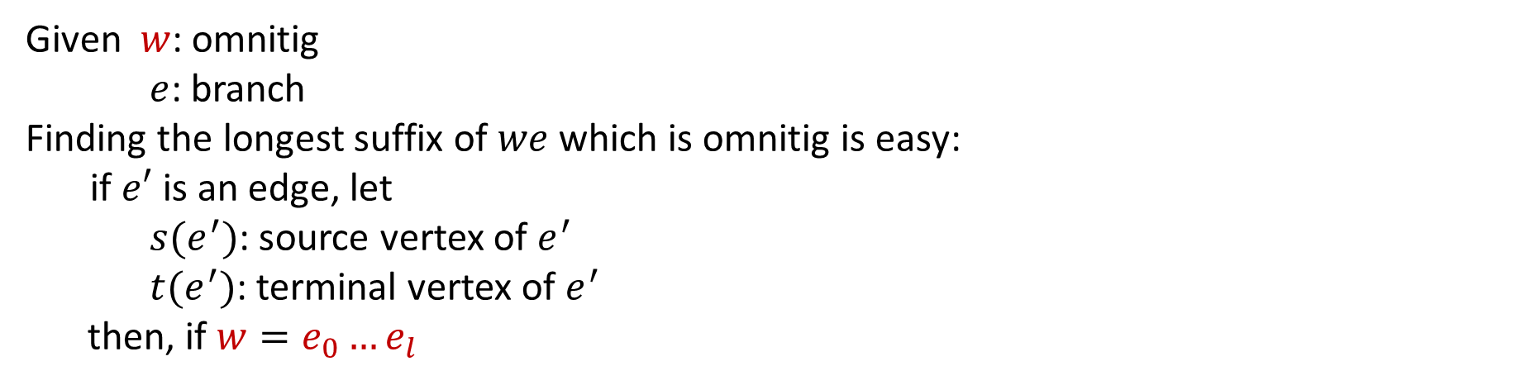
Optimal Listing of Maximal Omnitig
Given $w$: omnitig
$e$: branch
Finding the longest suffix of $we$ which is omnitig is easy:
if $e′$ is an edge, let
$s(e^{′})$: source vertex of $e^{′}$
$t(e^{′})$: terminal vertex of $e^{′}$
then, if $w=e_{0}…e_{l}$
$$e_{i}$$
$$e$$
$$w$$
LongestSuffix(we)

Slide 49
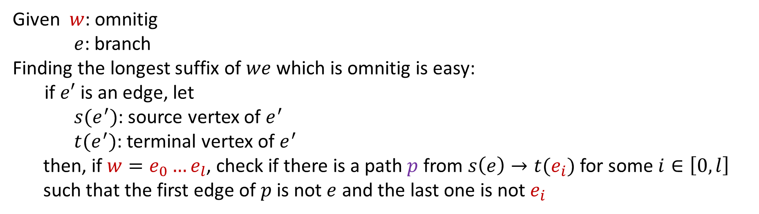

Optimal Listing of Maximal Omnitig
Given $w$: omnitig
$e$: branch
Finding the longest suffix of $we$ which is omnitig is easy:
if $e′$ is an edge, let
$s(e^{′})$: source vertex of $e^{′}$
$t(e^{′})$: terminal vertex of $e^{′}$
then, if $w=e_{0}…e_{l}$, check if there is a path $p$ from $s\left(e\right)→t(e_{i})$ for some $i∈\left[0,l\right]$
such that the first edge of $p$ is not $e$ and the last one is not $e_{i}$
$$p$$
$$e_{i}$$
$$e$$
$$w$$
LongestSuffix(we)

Slide 50
Optimal Listing of Maximal Omnitig
Given $w$: omnitig
$e$: branch
Finding the longest suffix of $we$ which is omnitig is easy:
if $e′$ is an edge, let
$s(e^{′})$: source vertex of $e^{′}$
$t(e^{′})$: terminal vertex of $e^{′}$
then, if $w=e_{0}…e_{l}$, check if there is a path $p$ from $s\left(e\right)→t(e_{i})$ for some $i∈\left[0,l\right]$
such that the first edge of $p$ is not $e$ and the last one is not $e_{i}$
Time Cost: O(E)
LongestSuffix(we)

Slide 51
Optimal Listing of Maximal Omnitig
Given $w$: omnitig
$e$: branch
Finding the longest suffix of $we$ which is omnitig is easy:
if $e′$ is an edge, let
$s(e^{′})$: source vertex of $e^{′}$
$t(e^{′})$: terminal vertex of $e^{′}$
then, if $w=e_{0}…e_{l}$, check if there is a path $p$ from $s\left(e\right)→t(e_{i})$ for some $i∈\left[0,l\right]$
such that the first edge of $p$ is not $e$ and the last one is not $e_{i}$
Time Cost: O(E) since there are O(V) strong bridges, the total time spent in this function is O(VE)
LongestSuffix(we)

Slide 52
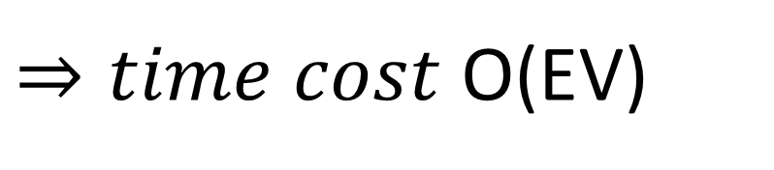
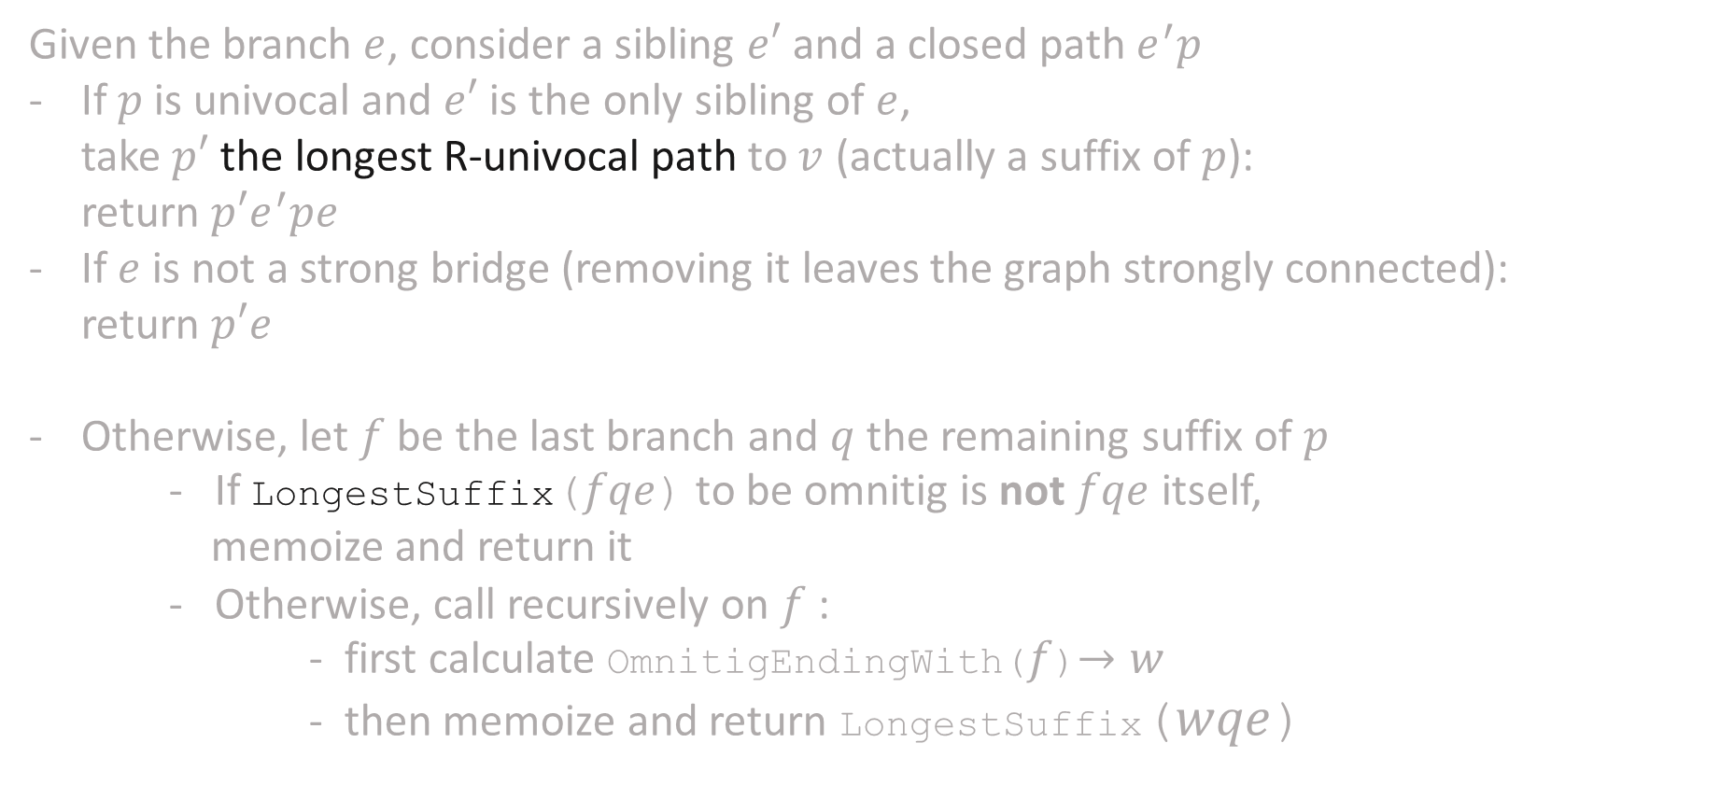
Optimal Listing of Maximal Omnitig
Time cost
# calls
Given the branch $e$, consider a sibling $e′$ and a closed path $e^{′}p$
If $p$ is univocal and $e′$ is the only sibling of $e$, take $p′$ the longest R-univocal path to $v$ (actually a suffix of $p$): return $p′e^{′}pe$
If $e$ is not a strong bridge (removing it leaves the graph strongly connected):
return $p′e$
Otherwise, let $f$ be the last branch and $q$ the remaining suffix of $p$
- If LongestSuffix($fqe$) to be omnitig is not $fqe$ itself,
memoize and return it
- Otherwise, call recursively on $f$:
- first calculate OmnitigEndingWith($f$)$→w$
- then memoize and return LongestSuffix($wqe$)
O(V)
O(E) times
O(V)
O(E) times
O(E)
O(V) times
$⇒time cost$O(EV)
OmnitigEndingWith(e)

Slide 53
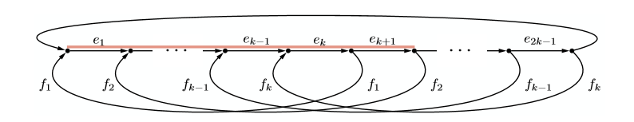

O(EV) worst case is optimal
The total length of maximal omnitig can be $Ω\left(EV\right)$:
Here, as an example, there are $k−1$ maximal omnitig of length $k+1$

Slide 54
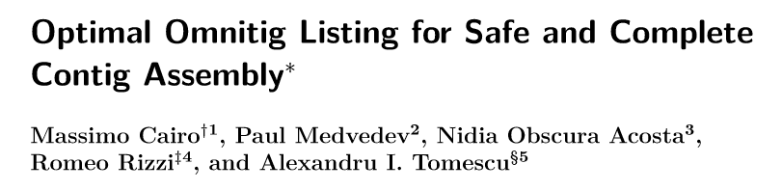
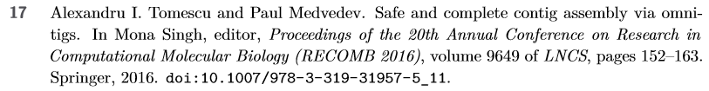
For more fun, get in touch with authors:
referring mainly to

