Slide 1

SAIL IT Helpdesk System
IILM UNIVERSITY
Greater Noida, Uttar Pradesh
Enterprise IT Ticket Management System for Steel Authority of India Limited
Student Name
MIHIT NANDA
Enrollment / Roll No.
CS-2341238
School of Computer Science
& Engineering
Program & Semester
7th Semester, Section 4CSE2
Organization
Steel Authority of India Limited (SAIL)

Slide 2
OVERVIEW
Agenda
1
About SAIL & the Problem Statement
6
Screenshots — Login & Admin Dashboard
2
Objectives & Scope
7
Security Implementation
3
Technology Stack
8
Testing, Deployment & Challenges
4
System Architecture & Database Design
9
Learnings, Future Scope & Conclusion
5
RBAC & Ticket Lifecycle
2

Slide 3
BACKGROUND
About SAIL & the Problem
Organization
The Problem
Steel Authority of India Limited (SAIL) is one of India's largest state-owned steel producers, operating multiple integrated plants and subsidiary units across the country. Its day-to-day operations rely heavily on internal IT infrastructure.
IT support requests were handled through informal phone calls and emails, with no centralized system to track ticket status, enforce SLAs, or maintain an audit trail — resulting in:
Delayed resolutions
Lack of accountability
No visibility into IT support performance
Internship Details
Duration: 1st June 2026 – 13th July 2026 (6 Weeks)
Mentor: Ms. Rajni Kapoor, GM (C&IT), SAIL Corporate Office
Department: IT / Corporate Office, New Delhi
3

Slide 4
GOALS
Objectives & Scope
Design and develop a centralized, web-based IT helpdesk system for SAIL
Implement secure RBAC across Employee, Agent, Admin, and Super Admin roles
Automate SLA tracking via priority-based due-date computation
Provide complete traceability through an audit trail & ticket history log
Integrate automated email notifications across the ticket lifecycle
Build an administrative reporting & analytics dashboard
4

Slide 5
IMPLEMENTATION
Technology Stack
Frontend
Backend
Database
React 18, Tailwind CSS,
Recharts, React Router v6
Node.js 18+, Express 4,
JWT, Multer
Oracle Database
19c / 21c / XE
Auth & Security
Email
Logging
JWT + bcryptjs, rate
limiting, account lockout
Nodemailer (SMTP)
4 template types
Winston — full
audit trail
5

Slide 6
DESIGN
System Architecture
Three-tier architecture separating presentation, business logic, and persistence
Frontend
Backend API
Database
React SPA
Port 3000
Express REST API
Port 5000
Oracle DB
Connection Pool
Request Pipeline
Repository Layout
Axios client attaches JWT to every call
Helmet security headers
Rate limiting
JWT verification & role extraction
Route-specific validation → business logic
sail-helpdesk/
├── frontend/ React + Tailwind
├── backend/ Node.js + Express
├── database/ Oracle SQL scripts
└── docs/ Architecture & API docs
6

Slide 7
DESIGN
Database Design & Access Control
Core Tables (10)
RBAC Matrix
DEPARTMENTS
CATEGORIES
Feature | Emp | Agt | Adm | S.Ad
View own tickets | ✓ | ✓ | ✓ | ✓
View all tickets | — | ✓ | ✓ | ✓
Update status | — | ✓ | ✓ | ✓
Assign tickets | — | — | ✓ | ✓
User management | — | — | ✓ | ✓
View audit logs | — | — | — | ✓
PRIORITIES
USERS
TICKETS
TICKET_REPLIES
TICKET_ATTACHMENTS
TICKET_HISTORY
NOTIFICATIONS
AUDIT_LOGS
TICKET_REF auto-generated via Oracle trigger (e.g., SAIL-1000); DUE_DATE auto-computed from priority-level SLA at insert time.
7

Slide 8
WORKFLOW
Ticket Lifecycle & Notifications
1
2
3
4
5
6
Created
→
Agent Notified
→
In Progress
→
Reply Sent
→
Resolved
→
Feedback (1–5★)
4 automated email templates: ticketCreated · ticketUpdated · ticketClosed · newReply — sent via Nodemailer at every stage, keeping the requester informed end-to-end.
8

Slide 9
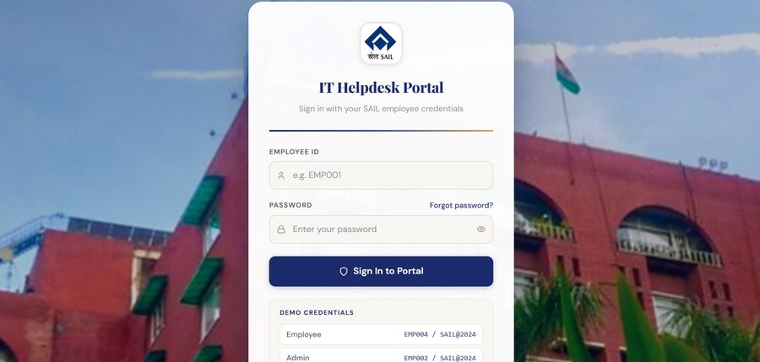
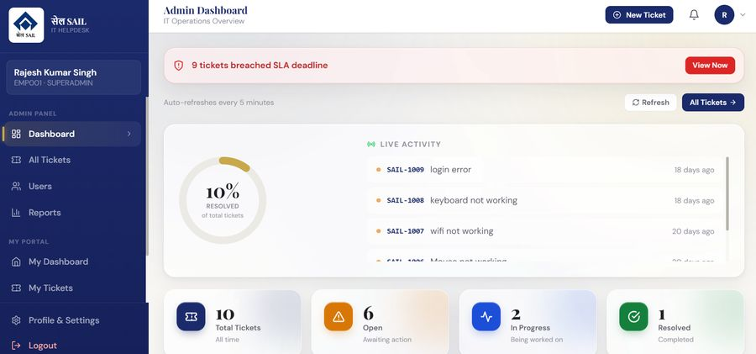
PRODUCT
System Screenshots
Login Portal — SAIL Employee ID authentication with masked password entry & demo credentials panel
Admin Dashboard — SLA alert banner, live KPI widgets, and resolution-rate tracking
9

Slide 10
HARDENING
Security Implementation
1
JWT auth, 8-hour token expiry
2
Account lockout after 5 failed attempts (30-min cooldown)
3
API rate limiting — 100 req/15min, 20 req/15min on login
4
Helmet.js secure HTTP headers
5
bcryptjs password hashing (10 salt rounds)
6
Server-side validation via express-validator
7
File upload MIME whitelist + 10 MB cap
8
RBAC at API route & business-logic layers
9
Full audit logging to Oracle AUDIT_LOGS
10

Slide 11
DELIVERY
Testing, Deployment & Challenges
Testing & Deployment
Key Challenges
Seeded demo accounts across all 4 roles for evaluation
PM2 process management + Nginx/Apache SSL termination
Docker Compose config for backend, frontend & Oracle XE
Cross-platform Oracle Instant Client configuration
SLA due-date computation tied to priority at creation
Field-level audit trail without write overhead
Multi-stage email workflow consistency
Balancing rate limiting/lockout with usability
11

Slide 12
WRAP-UP
Learnings, Future Scope & Conclusion
Learning Outcomes
Future Scope
Conclusion
Full-stack React/Node/Oracle development
Auth, RBAC in a multi-role system
Secure coding & audit logging
PM2, reverse proxy, Docker deployment
Mobile app / PWA for field staff
AI-assisted ticket triage
Chatbot self-service layer
AD/LDAP SSO integration
Multi-language support
The SAIL IT Helpdesk System replaces unstructured, untracked IT support with a centralized, secure, auditable platform — automating SLA enforcement and giving IT management full visibility into support performance.
12

Slide 13
Thank You
Questions & Discussion
MIHIT NANDA | CS-2341238 | B.Tech CSE (AI/ML)
SAIL IT Helpdesk System — Internship Presentation

