Slide 1

Mental Health Analytics in Workplace
NFO 523: Data Mining & Discovery
Final Project by Group 2
Mihika Kubadia
Jayneet Jain
Spoorthy Nagendra

Slide 2
Introduction
Our project analyzes mental health treatment-seeking behaviors in the workplace using clustering, classification, and association algorithms. By identifying key factors like work interference and family history, we uncover patterns and insights to support organizations in fostering better mental health outcomes.

Slide 3
Dataset Overview
Dataset description
Workplace mental health survey dataset.
Number of Observations: 1259
Number of Features: 27
Unique Data Types: Numeric, character, factor

Slide 4
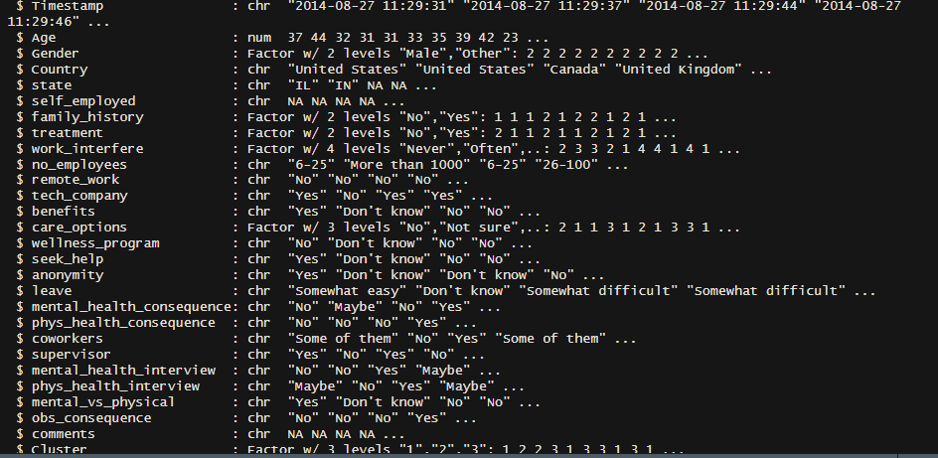
Data Structure

Slide 5
Dataset Cleaning and Initial Analysis
1. Handling Missing Values
For work_interfere missing values were imputed with mode
2. Datatype conversion
Variables such as Gender, family_history, treatment and care_options were converted to factors for categorical analysis
3. Outlier detection
Age variable contained unrealistic values.
4. Standardization
- Numeric columns were scaled to standardize dataset for clustering and predictive modeling.

Slide 6

Exploratory Data Analysis
Exploratory data analysis (EDA) is an important step in the data mining process. It involves visualizing and summarizing the data to gain insights and identify patterns. In the context of the Instacart dataset, EDA can help us understand customer behavior, preferences, and shopping patterns. Some common techniques used in EDA include data visualization, summary statistics, and correlation analysis.
Data Visualization
Data Visualization is a powerful tool for exploring and understanding complex datasets . It allows us to visually represent the data in the form of charts , graphs and plots.
Summary Statistics
Summary statistics provide a concise summary of the main characteristics of a dataset. They include measures such as mean, median, mode,,standard deviation, and range.
Correlation Analysis
Correlation analysis helps us to understand relation between different variables in the dataset. It measures the strength and direction of the linear relationship between two variables
.

Slide 7
Analytical Methods and Algorithms
1. Clustering Algorithms
K-means
Hierarchical Clustering
2. Association Mining
Aprori Algorithm
FP-growth
3. Classification Algorithms
- Logistic Regression
- Random Forest Classification

Slide 8
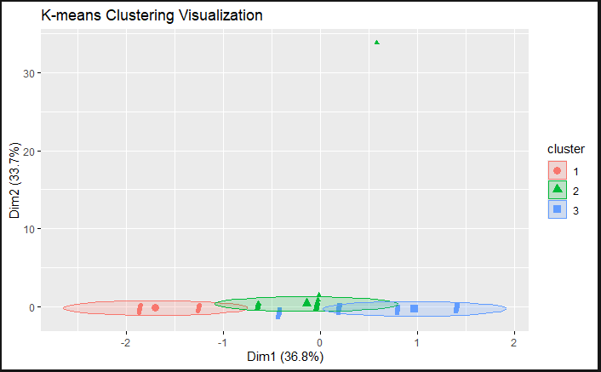
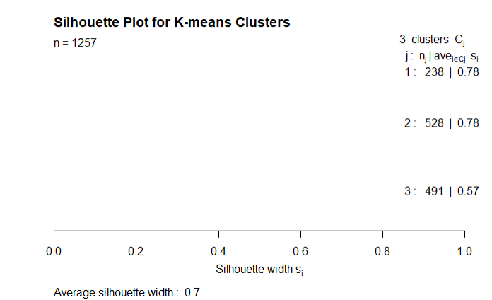
Clustering Algorithms
K-means Clustering:
Algorithm: K-means partitions the dataset into k clusters by minimizing the sum of squared distances between data points and the centroids of their assigned clusters.
Sensitivity to Outliers: K-means is sensitive to outliers because it minimizes the sum of squared distances, making it susceptible to being pulled towards outliers.
Shape of Clusters: K-means assumes that clusters are spherical and equally sized, which may not always be the case in real-world data.
Silhouette Score (K-Means): 0.7

Slide 9
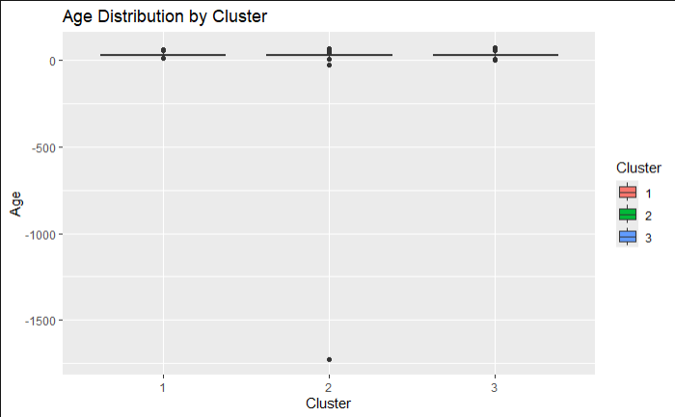
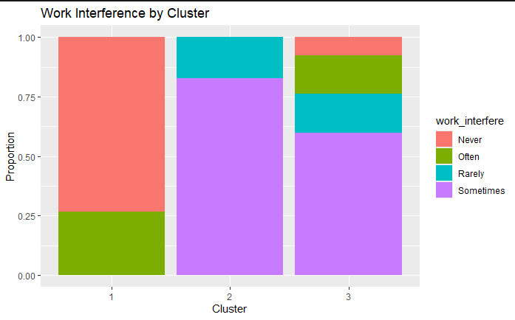

Slide 10
Key Observations:
Cluster 3 stands out due to its strong association with family history of mental health conditions. This cluster may represent a vulnerable group more likely to seek treatment or require intervention.
Clusters 1 and 2 are differentiated primarily by work interference levels and age, suggesting that work interference and age play a significant role in influencing mental health behaviors.
Actionable Insights:
Cluster 3 may require targeted mental health awareness and support interventions, as it combines a high rate of family history with moderate work interference.
Cluster 2 highlights a younger demographic facing moderate work interference, possibly requiring workplace accommodations or stress management programs.

Slide 11
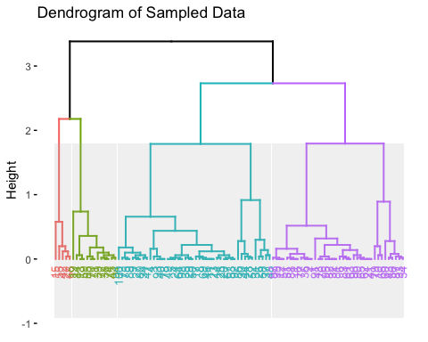
Clustering Algorithms
Hierarchical Clustering:
Algorithm: Hierarchical clustering builds a tree of clusters, either agglomerative (bottom-up) or divisively (top-down), based on the similarity between data points
Dendrograms: Hierarchical clustering provides a visual representation of the clustering structure through
dendrograms, making it easier to interpret the hierarchy of
clusters.
Number of Clusters: Hierarchical clustering doesn't require specifying the number of clusters beforehand, which can be an advantage. It allows you to explore different levels of granularity.
Silhouette Score (Hierarchical Clustering): 0.7

Slide 12
Key Observations
Cluster 1:Represents individuals with minimal work interference and no family history of mental health issues, indicating a lower likelihood of seeking treatment.
Clusters 2: Highlights younger individuals experiencing moderate work interference, requiring workplace attention.
Cluster 3: Strong association with family history, reflecting a vulnerable group needing targeted mental health support.
Cluster 4: Balanced group with mixed work interference and care options, leaning towards treatment-seeking.

Slide 13
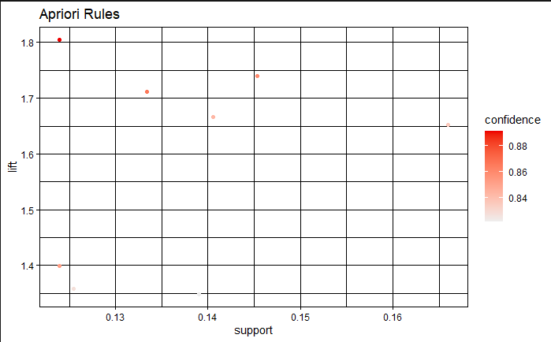

Association Mining
FP Growth
The FP Growth algorithm is a popular method for frequent pattern mining in data mining. It works by constructing a frequent pattern tree (FP-tree) from the input dataset. The FP-tree is a compressed representation of the dataset that captures the frequency and association information of the items in the data.

Slide 14
Key Observations
Rule 1: If `family_history = No` and `work_interfere = Never`, there is an **89.1% likelihood** of `treatment = No`. This indicates that individuals without a family history of mental health issues and no work interference are less likely to seek treatment.
Rule 2: If `work_interfere = Never`, there is an **85.9% likelihood** of `treatment = No`. Lack of work interference alone strongly correlates with treatment avoidance.
Rule 3: If `care_options = Yes` and `work_interfere = Sometimes`, there is an **86.6% likelihood** of `treatment = Yes`. Availability of care options positively influences treatment-seeking behavior for individuals with moderate work interference.
Rule 4: If `family_history = Yes` and `care_options = Yes`, there is an **84.3% likelihood** of `treatment = Yes`. Having a family history and accessible care options significantly increases the likelihood of treatment-seeking.
Rule 5: If `family_history = Yes` and `work_interfere = Sometimes`, there is an **83.6% likelihood** of `treatment = Yes`. Moderate work interference combined with a family history encourages treatment-seeking behavior.

Slide 15



Actionable Insights
Risk Awareness:
Educate individuals without a family history of mental health issues on the importance of seeking treatment.
Enhance Care Accessibility
Ensure mental health care options are easily accessible, especially for those facing moderate work interference.
Support High-Risk Groups
Programs addressing work interference and care availability could improve treatment-seeking behavior in individuals who might otherwise delay or avoid treatment.

Slide 16
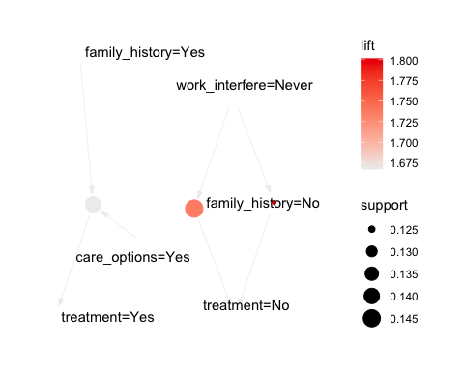
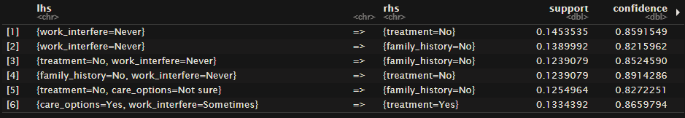
Association Mining
Apriori Algorithm
- The Apriori algorithm is a machine learning algorithm that identifies frequent itemsets and association rules in relational databases

Slide 17
Key Observations
Rule 1: If `work_interfere = Never`, there is an 85.9% likelihood of `treatment = No`. Work interference plays a key role in treatment-seeking behavior.
Rule 2: If `work_interfere = Never`, there is an 82.2% likelihood of `family_history = No`. Lack of work interference often correlates with no family history of mental health issues.
Rule 3: If `treatment = No` and `work_interfere = Never`, there is an 89.1% likelihood** of `family_history = No`. This highlights a strong connection between these factors.
Rule 4: If `family_history = No` and `work_interfere = Never`, there is an 89.1% likelihood of `treatment = No`. People without family history and work interference often avoid treatment.
Rule 5: If `treatment = No` and `care_options = Not sure`, there is an 82.7% likelihood of `family_history = No`. Uncertainty about care options correlates with no family history of mental health issues.
Rule 6: If `care_options = Yes` and `work_interfere = Sometimes`, there is an 86.6% likelihood of `treatment = Yes`. Availability of care options positively influences treatment-seeking in cases of moderate work interference.

Slide 18
Actionable Insights
Education and Awareness:
For individuals with no family history of mental health issues, there might be a need to raise awareness about the importance of seeking treatment when needed, as they may not consider treatment a priority.
Targeted Interventions:
Employers should focus on providing care options and workplace accommodations, especially for employees experiencing moderate work interference.
Customized Support Plans:
Programs addressing work interference and care availability could improve treatment-seeking behavior in individuals who might otherwise delay or avoid treatment.

Slide 19
Classification- Pre processing
Cluster Integration: Added cluster assignments from K-Means as a feature for enhanced predictions.
Factor Conversion: Converted key variables like family_history and treatment to factors for classification compatibility.
Gender Standardization: Consolidated gender data into Male, Female, and Other categories for clarity.
Data Splitting: Divided data into 70% training and 30% testing sets using stratified sampling.
Model Preparation: Cleaned and prepared the dataset for classification algorithms like Logistic Regression and Random Forest.

Slide 20
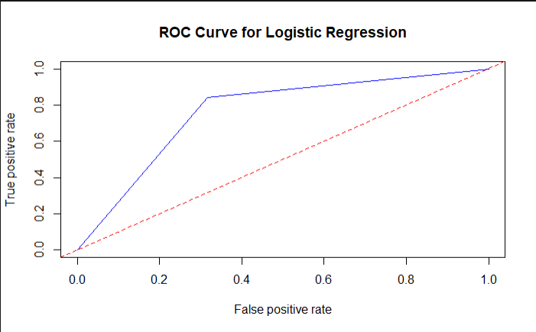
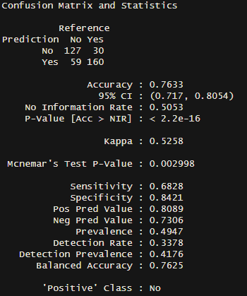
Classification Techniques
Logistic Regression
Algorithm: Logistic Regression models the probability of a binary outcome using the logistic function. It's a simple and widely used algorithm for binary classification.
Interpretability: Logistic Regression provides interpretable coefficients that indicate the impact of each feature on the log-odds of the predicted outcome.
Assumption: Assumes a linear relationship between features and the log-odds of the outcome.

Slide 21
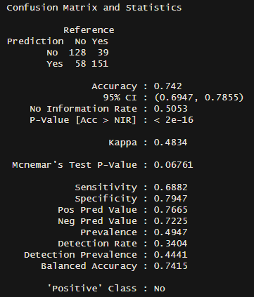
Classification Techniques
Random Forest
Algorithm: Random Forest is an ensemble learning method that builds multiple decision trees and combines their predictions to improve overall performance.
Robustness: Random Forest is robust to overfitting and can handle a large number of features. It also provides feature importance scores.
Non-linearity: Random Forest can capture nonlinear relationships between features and the target variable.

Slide 22
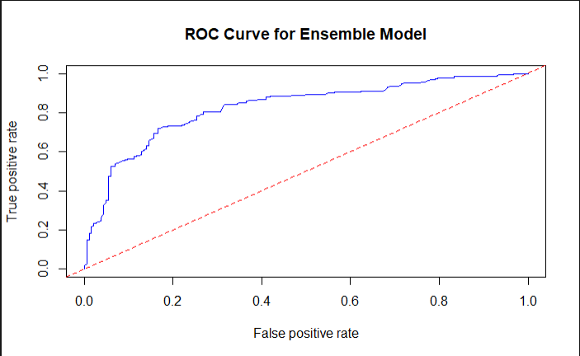
Ensemble Model

Slide 23
Conclusion
Mental Health Insights: Work interference ("Often" or "Sometimes") and family history of mental health issues emerged as the most influential factors in treatment-seeking behavior, highlighting the need for targeted workplace interventions.
Clustering Effectiveness: K-means clustering successfully identified distinct groups with unique behavioral patterns, such as the association of family history with increased treatment-seeking in Cluster 3.
Rule-Based Patterns: Association rule mining and FP-growth algorithms reinforced the role of workplace factors (e.g., work interference and care options) in influencing mental health outcomes, providing actionable patterns.
Classification Models: Logistic regression and random forest models offered robust predictive capabilities for identifying treatment-seeking individuals, with an ensemble approach improving overall accuracy and balanced performance.
Actionable Recommendations: Workplace policies should emphasize accessible care options, proactive mental health awareness, and support programs tailored to high-risk groups, such as those with a family history or significant work interference.

Slide 24
Thank You !

