Slide 1
Word Sense Disambiguation
Team 64

Slide 2


Introduction
Word Sense Disambiguation (WSD) is the task of determining the appropriate meaning of an ambiguous word based on its context, is a long-standing challenge in Natural Language Processing (NLP).
Accurately disambiguating word senses is crucial for various NLP applications, such as machine translation, information retrieval, and text summarization.
Despite advancements, WSD remains complex due to the inherent ambiguity of natural language, where word meanings heavily depend on the surrounding context.

Slide 3
Datasets
Brown Corpus: A collection of text samples in American English, compiled by Brown University in the 1960s. Contains 1,014,312 words of running text from diverse sources, including news articles, editorials, interviews, fiction, scientific articles, and academic texts.
SemCor 3.0: A sense-tagged subset of the Brown Corpus, where each word is labeled with its sense according to WordNet 2.0. Contains around 235,000 words and is widely used as a benchmark dataset for word sense disambiguation tasks. Considered challenging due to its size, diverse text genres, and the ambiguity of words in context.

Slide 4
Approaches
Supervised
Unsupervised
For example: KNN, Naive Bayes and Deep learning methods etc.
For example: Lesk Algorithm, Most Frequent Sense etc.

Slide 5
Baselines
1
2
3
KNN
Lesk Algorithm
Naive Bayes
The sense of the input word is predicted based on the most frequent sense among these neighbors
It selects the sense whose definition has the most overlap (in terms of shared words) with the word’s context
It trains a probabilistic model on labeled instances, then uses Bayes’ theorem to calculate the probability of each sense given the input word’s context, selecting the sense with the highest probability.

Slide 6
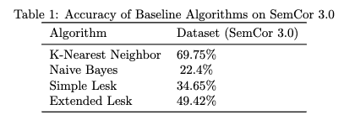
Baseline Results

Slide 7
Our Models
1
2
BiLSTM
BERT based approach
It processes the input context using a bidirectional LSTM and produces a probability distribution over the target word's senses by applying a softmax over the sense labels relevant to the target word's lemma.
Our BERT-based approach for word sense disambiguation, similar to GlossBERT, fine-tunes BERT on a sequence-pair binary classification task using context-gloss pairs, and formulates WSD as a ranking/selection problem by jointly processing all candidate senses to learn better discriminative features between positive and negative context-gloss pairs.

Slide 8

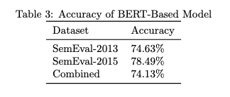
Results

Slide 9
Thank You

