Slide 1

Port Scanner
Department Of Computer Engineering
Cyber Security (Python)
Member Names:
Mihir Joshi
Hiten Bhatia

Slide 2


Problem Statement
To find out redundant ports on a given host/server in order to mitigate an attack and identify network services running on a host.

Slide 3
Abstract
Port scanning is one of the most popular forms of reconnaissance ahead of a hack, helping attackers determine which ports are most susceptible. Port scanning can lead to a hacker entering your network or stealing proprietary data.
A port scanner is an application designed to probe a server or host for open ports. Such an application may be used by administrators to verify security policies of their networks and by attackers to identify network services running on a host and exploit vulnerabilities.
A port scan or portscan is a process that sends client requests to a range of server port addresses on a host, with the goal of finding an active port.
Port scanning provides the following information to attackers:
● What services are running
● Which users own the services
● If anonymous logins are allowed
● What network services require authentication

Slide 4
Detail Project Workflow
We are using Sockets, Time and Thread libraries in python
We will implement python socket programming to scan the ports that are active on the given host.
We will use a loop to scan the active ports on the host for the specified port range given by the user.
If a user enters an URL we automatically convert it to its respective IP address.
There are 2 scanning modes Simple and Comprehensive,
Simple Mode has 1024 Ports and Comprehensive Mode has 64000 Ports to scan.

Slide 5
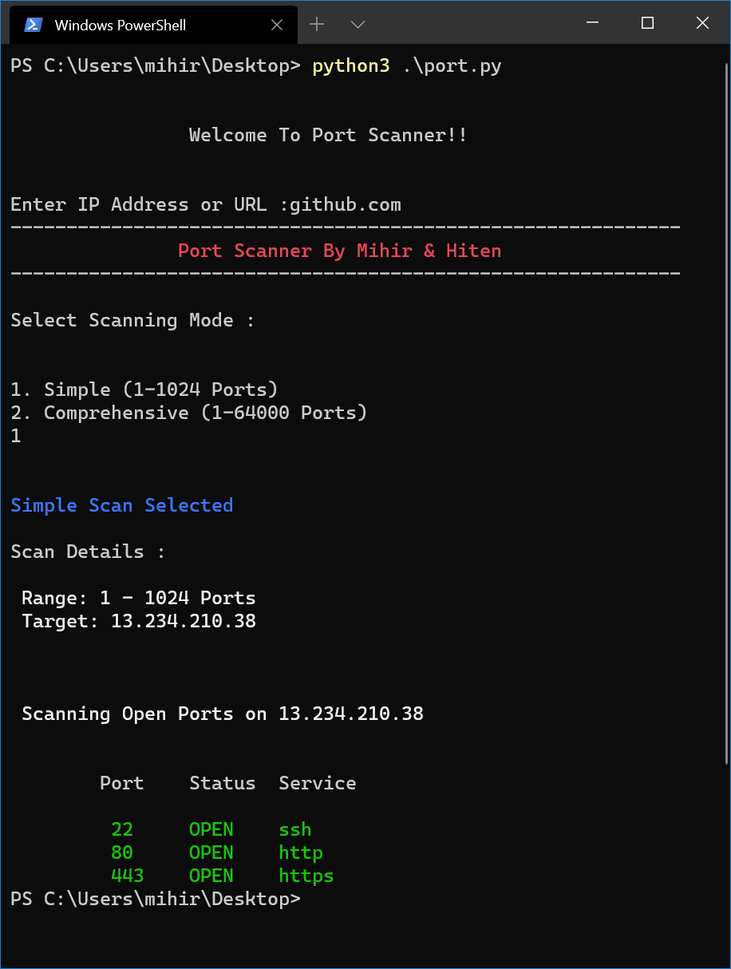
Output Screenshot

Slide 6
References
Tutorials Point
Python Socket Programming
GeeksforGeeks.com
Computer Network Subject

