Slide 1

Computer Engineering Department
A.P. Shah Institute of Technology
G.B.Road,Kasarvadavali, Thane(W), Mumbai-400615
UNIVERSITY OF MUMBAI
Academic Year 2020-2021

Slide 2
A Project Report on
Speech to Sign Language
Submitted in partial fulfillment of the degree of
Bachelor of Engineering(Sem-7)
in
Computer Engineering
By
Mihir Joshi(17102055)
Shambhavi Kulkarni(17102072)
Mansi Maurya(17102073)
Under the Guidance of
Prof. Sachin B. Takmare

Slide 3
1.Project Conception and Initiation

Slide 4
1.1 Abstract
Sign Language communication is the only viable and effective method of communication for deaf people or people with hearing loss. Without it, they cannot communicate and express themselves to others in the world. There is a need for developing useful tools using technology to help and enable people with disabilities to be given every opportunity a normal person gets in real-world scenarios to progress in their life. We hope to provide such tool for improving their lives. Counterintuitively, this tool can also be used to educate people about Sign Language and help them communicate with people with disabilities. By giving Speech input, the tool will display the corresponding Sign Language gestures, thus enabling translation. This project hopes to close the gap between these groups of people and unite them.

Slide 5
1.2 Objectives
Our objective is to offer a speech to Indian sign language translator as another choice of augmenting communication between the Deaf and hearing communities. We seek to implement a mobile application for Android as well as IOS that a user could use as a way to communicate with Deaf community. This application would detect user’s voice and convert them into sentences which would further be used as an input for the application which will then convert them into either manual or non -manual signs.

Slide 6
1.3 Literature Review
2018 Eleventh International Conference on Contemporary Computing (IC3): Automated Sign Language Interpreter Humans are developing innovative ideas every year to aid themselves and those who are impacted by any impairment, while technology advances at a breakneck pace. We want to make it easier for deaf individuals to communicate, so we've created a sign interpreter that automatically turns sign language into audio output. Sign language comprises of a variety of hand movements and gestures, attaining the proper accuracy at a reasonable cost has become a monumental effort. This difficulty can be solved by using instrumented gloves with audio output. For sign interpretation, the gloves are equipped with several sensors. As a result, the proposed solution addresses the issue and assists the deaf in communicating with the rest of the world at a minimal cost.

Slide 7
Vision-based sign language translation device, 2013 International Conference on Information Communication and Embedded Systems (ICICES): This paper describes a mobile VISION-BASED SIGN LANGUAGE TRANSLATION DEVICE that allows hearing and/or speech impaired people to communicate with hearing persons by automatically translating Indian sign language into speech in English. The suggested system is a mobile phone-based interactive application program created with the LABVIEW software. The inbuilt camera of the mobile phone is used to capture sign language gesture photos; vision analysis operations are done in the operating system, and speech is delivered through the inbuilt audio device, reducing hardware needs and costs. Because of parallel processing, there is little lag time between the sign language and the translation. This enables near-instant identification of finger and hand movements, as well as translation. This can recognize one-handed alphabet (A-Z) and number sign representations. The outcomes are shown to be highly consistent, reproducible, and precise and accurate.

Slide 8
1.4 Problem Definition
To provide people with knowledge and resources in Indian sign language.
To create a bridge between deaf and hearing community.
Create a scalable project that can be expanded to capture the entire ISL vocabulary using both manual and non-manual signs.

Slide 9
1.5 Scope
We created a mobile application for both Android, IOS that takes as voice of the user as input which are later converted into text. If the input matches with common phrases then gifs will be shown as output and if it doesn’t match the individual Indian sign language letters will be shown. To create this application we have used Flutter SDK. Flutter is a new application development interface which is multiplatform and highly scalable. It focuses on creating a bridge between deaf and hearing communities. This will help hard to hear people learn and use Indian sign language. It also creates an easy platform for people who are curious and wants to learn Indian Sign language.

Slide 10
1.6 Technology stack
Dart
Flutter SDK

Slide 11
1.7 Benefits for environment & Society
This is a speech-to-text app with some advanced functionality, including the ability to show gifs when common phrases are used which creates a quick communication.
Offers a pleasant amplification and clarification through an easy-to-use interface.
Computers, smartphones, and tablets are becoming more common in almost everyone's life these days, and with the right software and services that we developed, they can be useful resources in assisting people with hearing loss to live well.
The Android and iOS versions both have the benefit of being fully free to use with unlimited service usage.

Slide 12
This app is totally free to use, and unlike most others in this category, it works on a push-to-talk basis, which means it only offers captions when the on-screen mic button is pressed. This could be useful for quick bursts of captioning rather than continuous captioning. Other useful features include the fact that many common phrases (roughly 100) will be given as input which results as gifs.
This software can also be beneficial to people who want to learn Indian Sign Language. This app will assist them in understanding them quicker because it has many gifs. Not only will this app assist those who are curious to understand, but it will also assist those who might lose their ability to hear in the near future in learning language and speeding up their learning process.

Slide 13
2. Project Design

Slide 14
2.1 Proposed System
To have an interactive application that will receive audio input and convert it into text form. The text will then be then checked if it is a commonly used phrase or a unique sentence. If it’s a common phrase, then the respective gif of sign language gesture will be displayed otherwise the text will be split into individual letters and the respective letter’s signs will be shown successively.

Slide 15
2.2 Methodology
This application begins by translating spoken words and sentences (input audio signals) into text using speech to text Flutter package. A library that provides access to device-specific speech recognition. The speech to text process is completely on-device and hence it provides no constraints regarding internet availability and privacy issues. This plugin includes a series of classes that make it simple to use the underlying platform's speech recognition capabilities in Flutter. As Flutter supports Android, iOS and the Web, it is truly a multiplatform application.

Slide 16
The tool is built using Flutter SDK. Flutter is a new application development interface which is multiplatform and highly scalable. The deployment of multiplatform codebases is illustrated by Figure 1.1. This speech to Indian sign language app makes communication easier for users. Since Flutter platform is used to build this app, it can be simultaneously developed for both Android and iOS platforms, thus increasing the target user base.

Slide 17
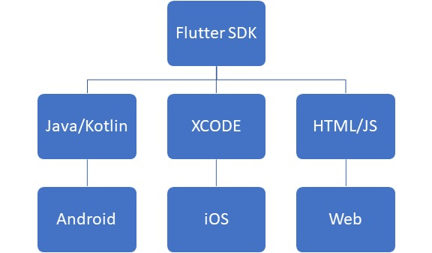
2.4 Class Diagram

Slide 18
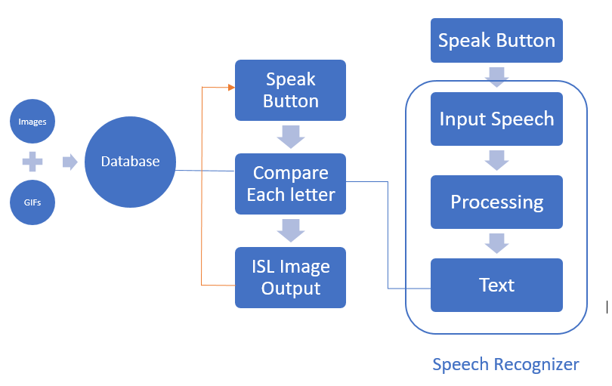

Slide 19
3.Implementation

Slide 20
3. Platforms for Execution
Flutter SDK
Using Flutter SDK it can be run on IOS, Android, Website.

Slide 21
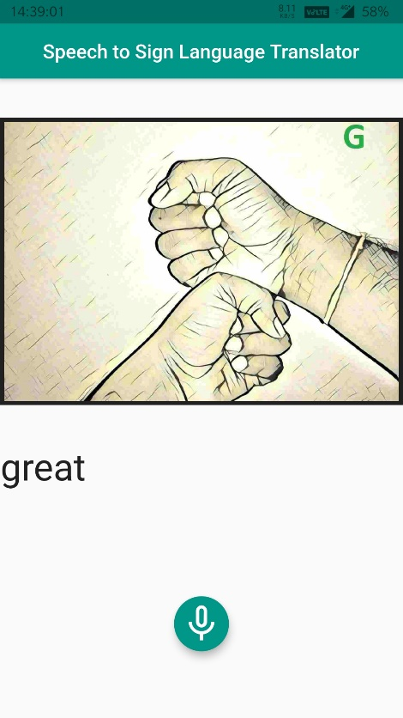
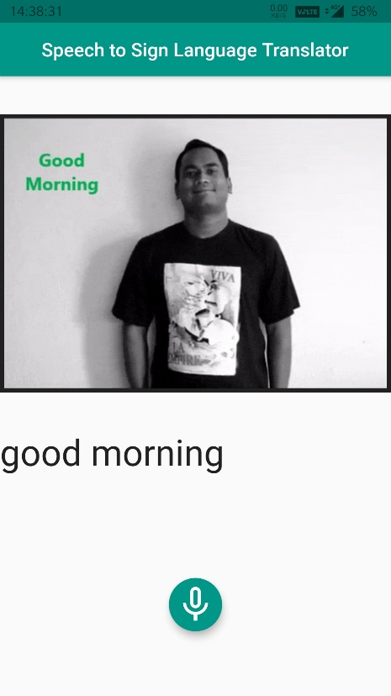
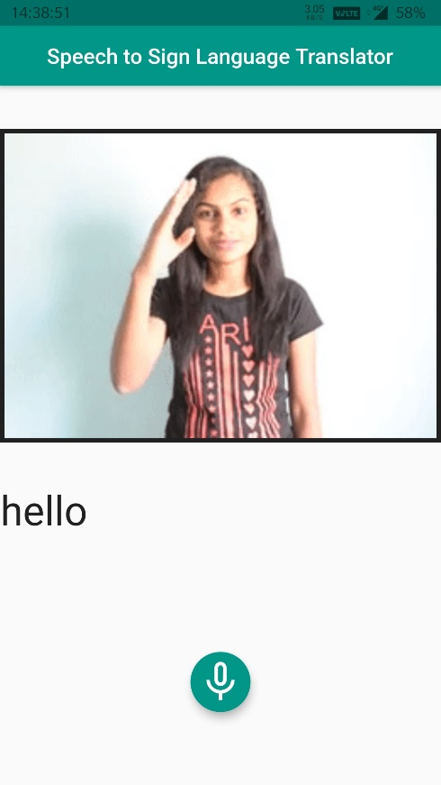
5. Results

Slide 22
4. Conclusion
Sign Language translation is an area with huge potential and all work done for improving it will definitely help and empower people with disabilities and our world will become more inclusive. We hope our tool and research will have a positive impact on society and bridge the gap between people in terms of communication and expression of thoughts and ideas and also educate and spread awareness among the general population.

Slide 23
5. References
A.V. Nair, V. Bindu, "A review on Indian sign language recognition", International Journal of Computer Applications, vol. 73, no. 22, 2013.
"India's First Sign Language Dictionary Released", Republic World Press Trust of India, March 2018
Lucy Sweeney, "Gloves that convert sign language to speech `to empower the deaf community'", ABC News, April 2016.
I.C. Chung, C.Y. Huang, S.C. Yehet et al., "Developing Kinect games integrated with virtual reality on activities of daily living for children with developmental delay", Advanced Technologies bedded and Multimedia for Human-centric Computing Springer Netherlands, vol. 260, pp. 1091-1097, 2014.

Slide 24
6. Bibliography
https://www.geeksforgeeks.org/project-idea-audio-sign-language-translator/
https://www.insider.com/hand-talk-app-translate-speech-sign-language-hugo-brazil-libras-2016-9
https://towardsdatascience.com/using-ai-to-translate-sign-language-in-real-time-96fe8c8223ed
https://wecapable.com/tools/text-to-sign-language-converter/
https://openaccess.thecvf.com/content_cvpr_2018/papers/Camgoz_Neural_Sign_Language_CVPR_2018_paper.pdf

Slide 25
Thank You

