Slide 1
BugTracker
Guided by: Dr. Purvi Prajapati
Presented by:
Mihir Vora (D20IT163)
Anadani Riya(D20IT159)

Slide 2
What is bug tracking?
Bug tracking is the process of logging and monitoring bugs or errors during software testing. It is also referred to as defect tracking or issue tracking. Large systems may have hundreds or thousands of defects.
Each needs to be evaluated, monitored, and prioritised for debugging. In some cases, bugs may need to be tracked over a long period of time.

Slide 3
"Defect tracking is an important process in software engineering, as complex and business-critical systems have hundreds of defects," says Tutorials Point.
One of the challenging factors is managing, evaluating, and prioritising these defects. "The number of defects gets multiplied over a period of time, and to effectively manage them, a defect tracking system is used to make the job easier."

Slide 4







Technology is used to develop BugTracking

Slide 5
Purpose Of The Project
Bug Tracking System is to test the application for the bugs and report it to the project manager and developer.
The main intention behind the Bug Tracking System is that to track bugs and report them.
Store the bug information with a unique id in the database.

Slide 6
How bug tracking works
A software bug occurs when an application or program doesn’t work the way it is designed to function.
Most errors are faults or mistakes made by system architects, designers or developers. Testing teams use bug tracking to monitor and report on errors that occur as an application is developed and tested.

Slide 7
During its lifetime, a single defect may go through several stages or states. They include:
    Active: An investigation is underway.
    Test: Fixed and ready for testing.
    Verified: Retested and verified by quality assurance (QA).
    Closed: Can be closed after QA retesting or if it is not considered to be a defect
    Reopened: Not fixed and reactivated.

Slide 8
For Bug tracking software, it is essential to have:
Reporting facility – complete with fields that will let you provide information about the bug, environment, module, severity, screenshots, etc.
Assigning – What good is a bug when all you can do is find it and keep it to yourself, right?
History/work logs/comments
Storage and Retrieval – Every entity in a testing process needs to be uniquely identifiable. The same rule applies to bugs too. A bug tracking tool must provide a way to have an ID that can be used to store, retrieve (search) and organize bug information.

Slide 9
Features:
Authentication (login/register w/ username & password)
CRUD projects, with ability to add members for group work
CRUD bugs, with title, description & priority
Project members can add, edit, close & reopen bugs etc.
Sort projects/bugs by various parameters like priority, recentely closed etc.
Filter projects/bugs by name/title & other parameters

Slide 10
CRUD notes, for guiding other members
Descriptive color indicators for bug priority & status
Error management with descriptive messages
Toast notifications for actions: creating projects, removing membes etc.
Loading spinners for fetching processes
Dark mode toggle w/ local storage save
Proper responsive UI for all screens

Slide 11
Sort Project By(Newest, Oldest, Name[A-Z], Most Members etc...)
Search Projects
Edit the project name
Delete Project

Slide 12
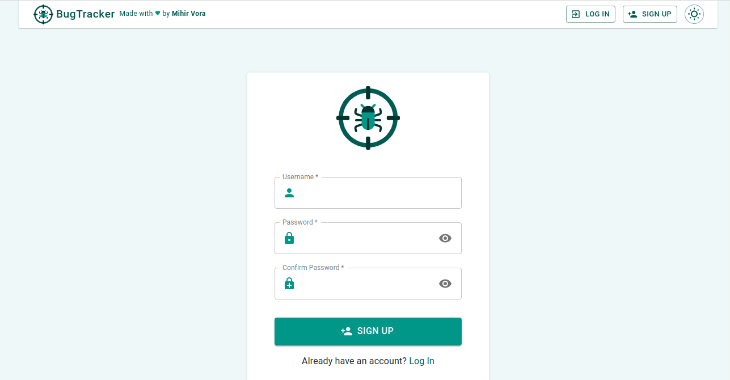
Sign UP

Slide 13
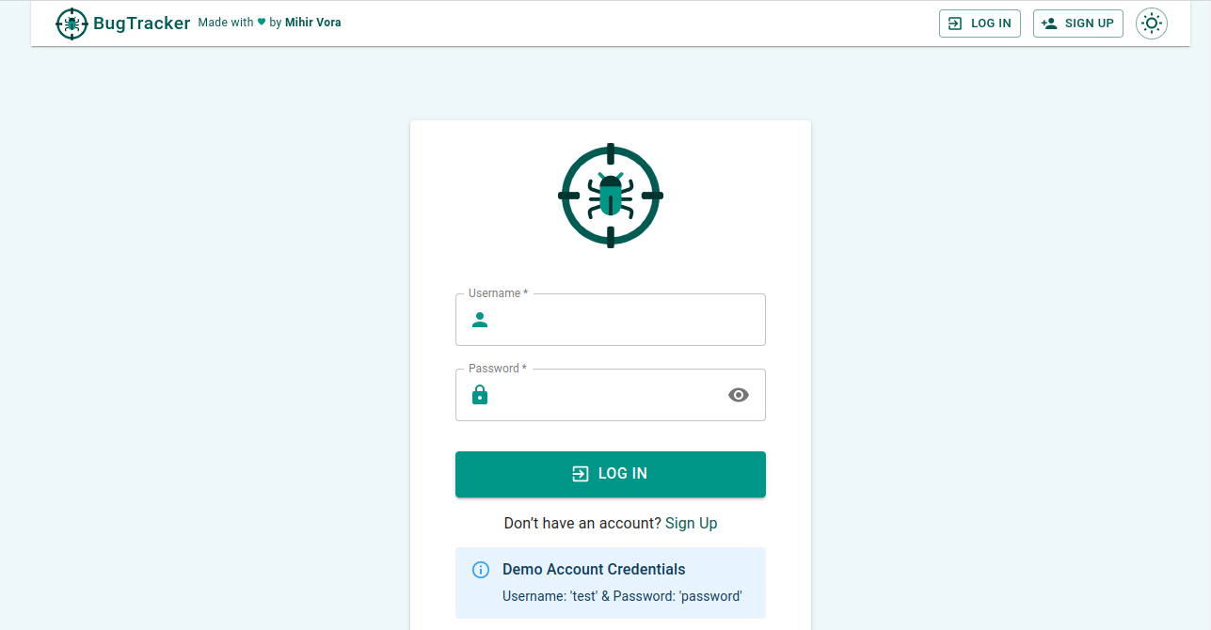
Log in

Slide 14
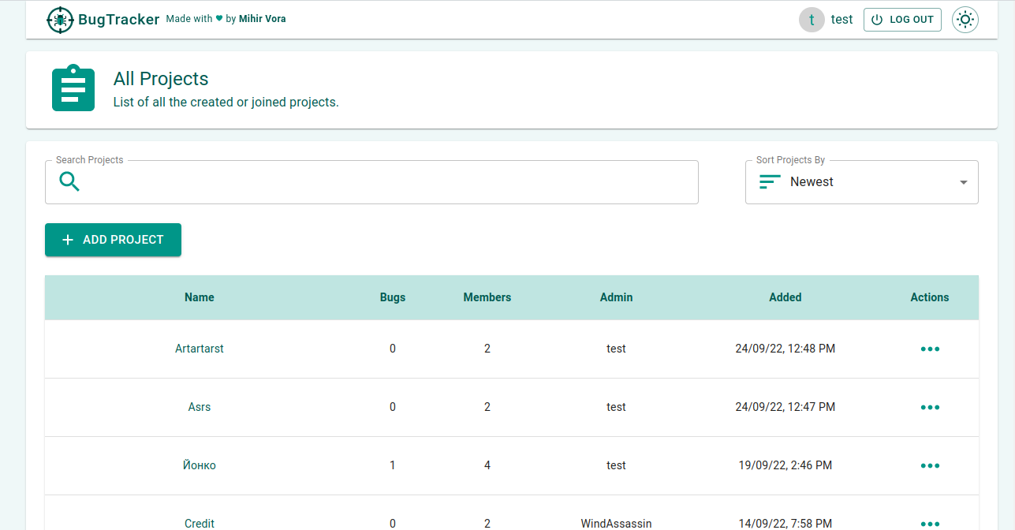
Home Page

Slide 15
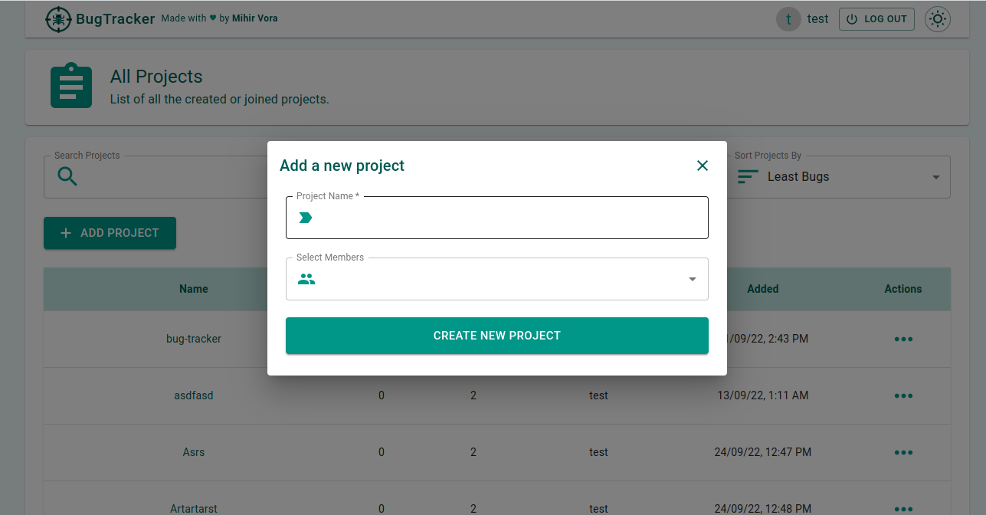
Add New Project

Slide 16
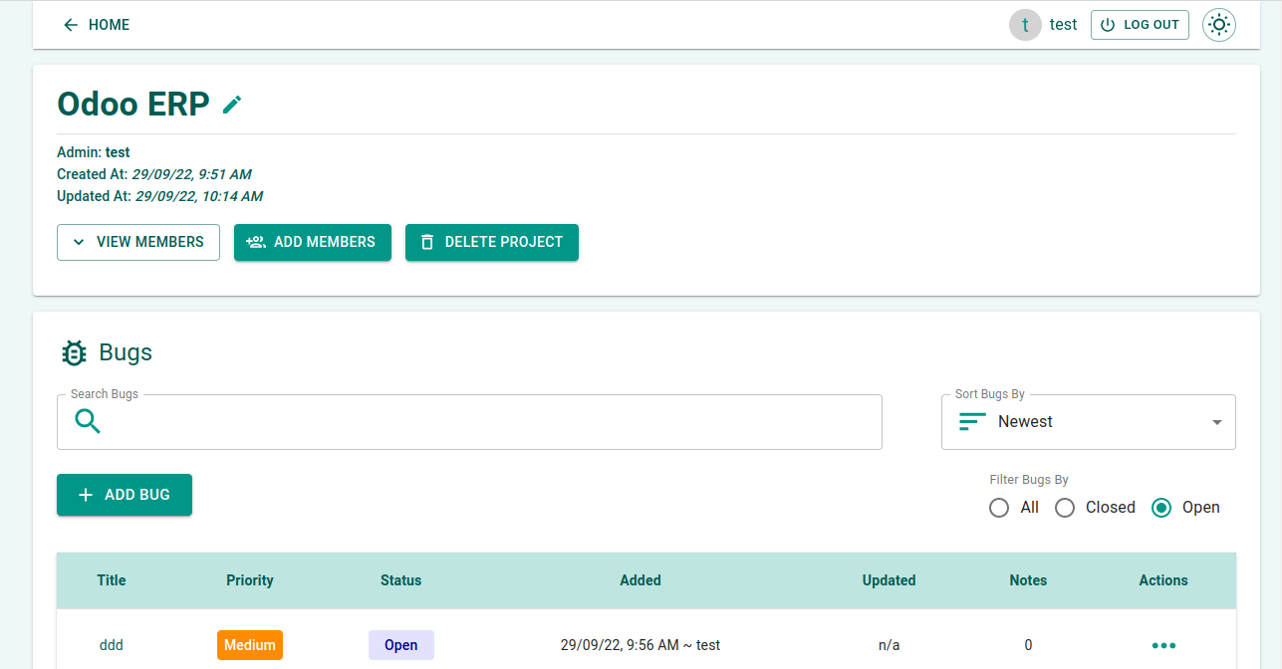
Project Details

Slide 17
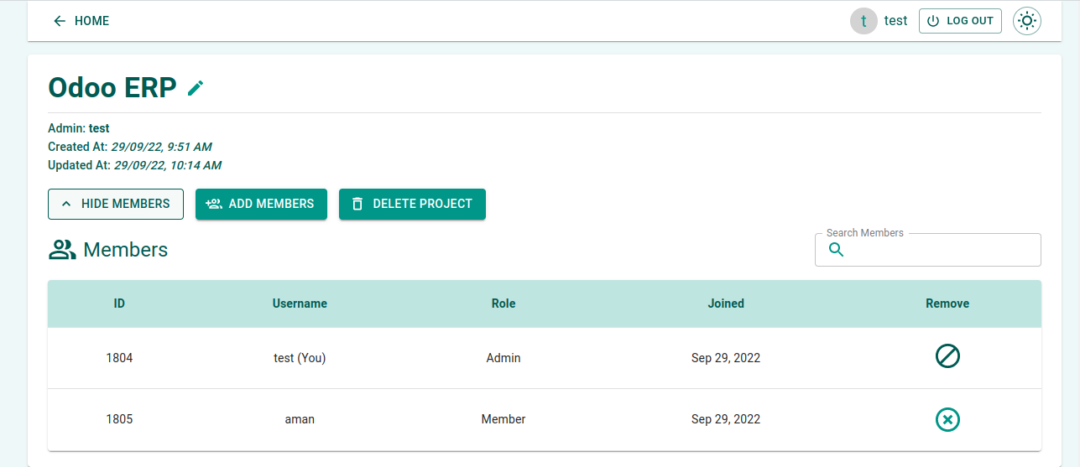
View Project Members

Slide 18
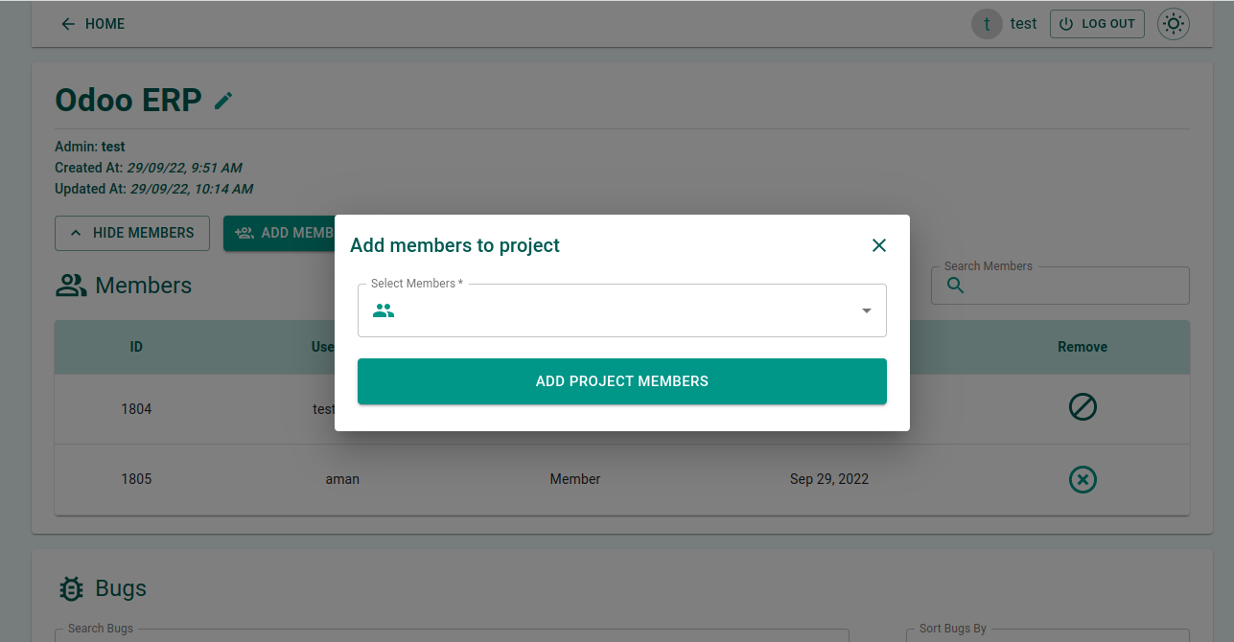
Add Members to Project

Slide 19
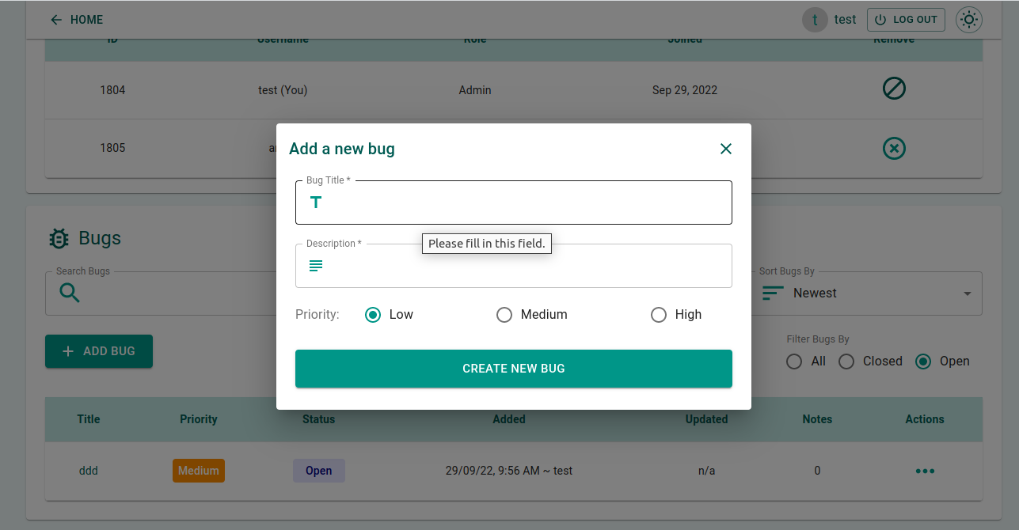
Add New Bug

Slide 20
In Conclusion
Bug Tracking System helps to detect and manage the bugs in software products effectively.
This project BTS can be used to track the bugs in the project modules and assist in troubleshooting errors for testing and for development processes.
This project highly avoids all sources of delay in bugs reporting level within the project modules in the software industry. As application is deployed in a company server, it is much more secure
.

Slide 21
FUTURE ENHANCEMENTS
This Bug Tracking System can be modified and enhanced for performing more complex task related to bug tracking system.
There are many more enhancements that are pending to make this project more interactive and professional, apart from this online facility, chat room, SMS alerts to the user and a separate account will be created for the testing team to compare severity of the incoming bugs.

Slide 22
REFERENCES
https://www.softwaretestinghelp.com/popular-bug-tracking-software/
https://www.ijser.org/paper/Analysis-of-Bug-Tracking-Tools.html
https://www.sciencedirect.com/topics/computer-science/bug-tracking-system

