Slide 1


Area: A.I. And Machine Learning
L J Institutes of Engineering and Technology
Parking Space Detection
Presented By:
Priyank Shah( 170320107097)
Ridham Gandhi( 170320107025)
Mihir Patel( 170320107077)
Guided By:
Ankit K. Patel
Assistant Professor, LJIET

Slide 2
Introduction
Parking Space Detection is an application that detects whether the vehicle is parked appropriately inside its designated parking space or not.
If a vehicle is parked outside of its designated parking area, the vehicle owner gets a text message, alerting him/her of its vehicle being parked inappropriately.
We can also keep records of how many times does a car with particular registration number parks inappropriately.

Slide 3
Limitation of Existing System
The system does not provide text alert or any other type of alert to the owner of the vehicle.
The existing systems do not detect if the vehicles are parked appropriately in the parking box designated for parking.
Current systems do not alert owners of vehicles of Parking in No-Parking Zones.
The systems in current use needs intermediate human interaction.
Current Systems does not focus on warning the owner of vehicles. Rather, it focuses on Penalizing the owners with fine.
There is no mechanism to flag a particular vehicle for breaking rules multiple times.

Slide 4
Objective of The New System
It will utilize parking space effectively.
It will alert users on parking out of designated area.
It does not need any additional infrastructure for mass usage.
It focuses on warning the owner of vehicles rather than penalizing.
It requires minimum human interaction
It will flag the vehicles that constantly keeps breaking the rules.
It can be used publicly or privately as per the needs.

Slide 5
Tools And Technology
Laptop
Desktop
Wifi
Mysql
Sublime text 3
Pycharm
Git
CCTV
Algorithmia
Anaconda
HTML
CSS
Angular JS
Java Script
Python
Twilio

Slide 6
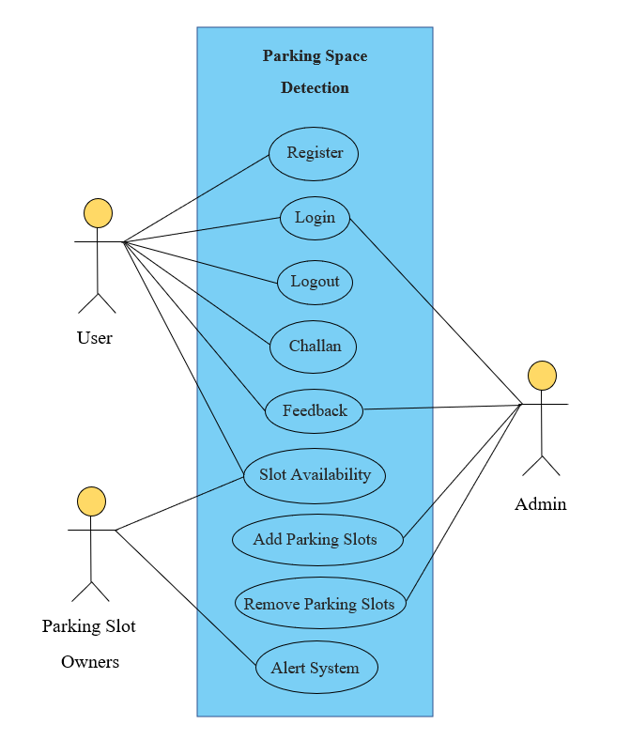
Use Case Diagram

Slide 7
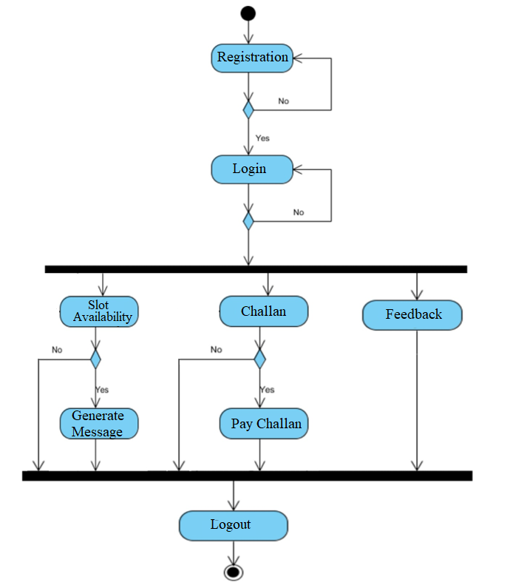
Activity Diagram (User’s)

Slide 8
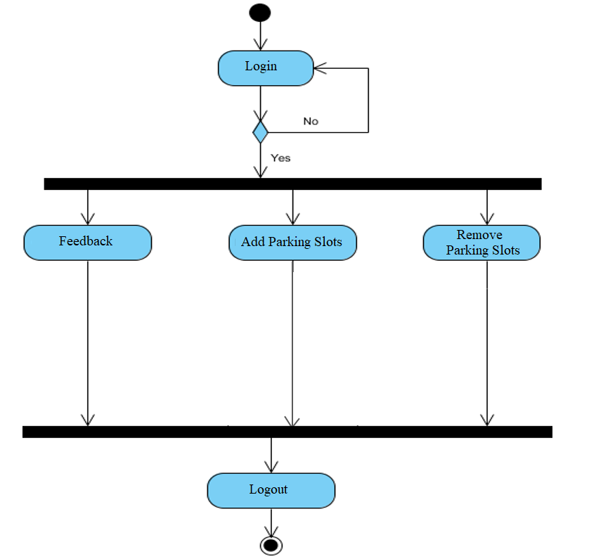
Activity Diagram (Admin’s)

Slide 9
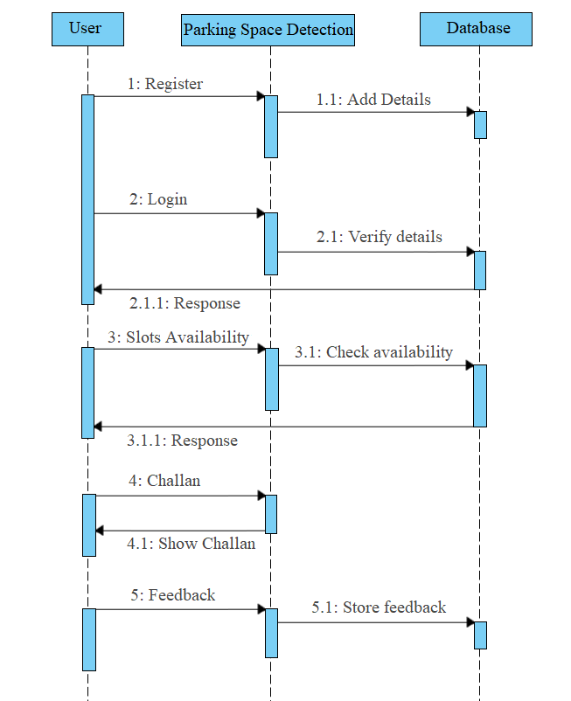
Sequence Diagram (User’s)

Slide 10
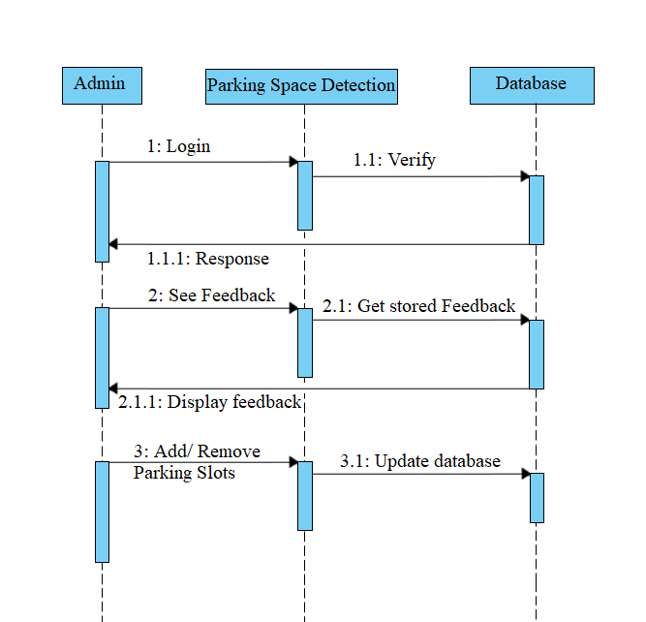
Sequence Diagram (Admin’s)

Slide 11
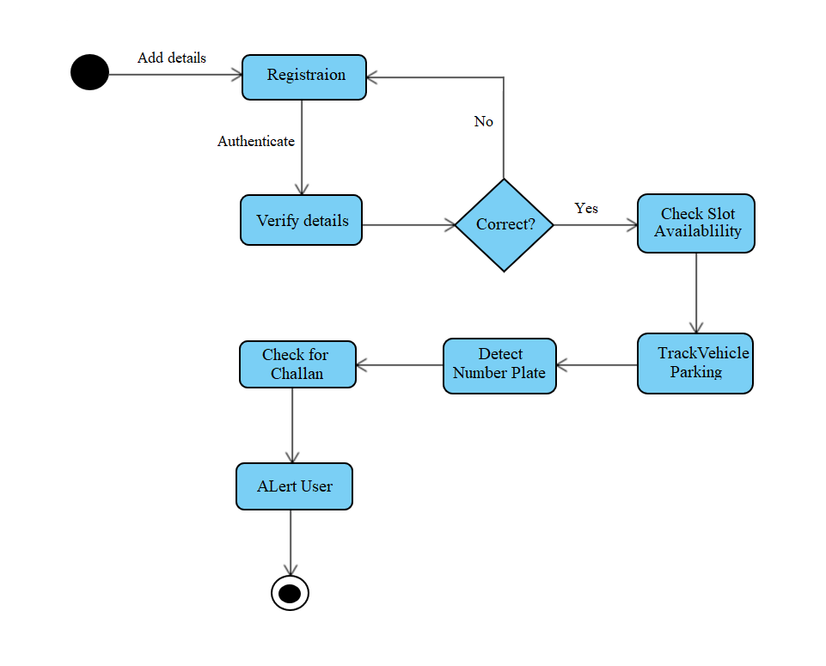
State Diagram

Slide 12
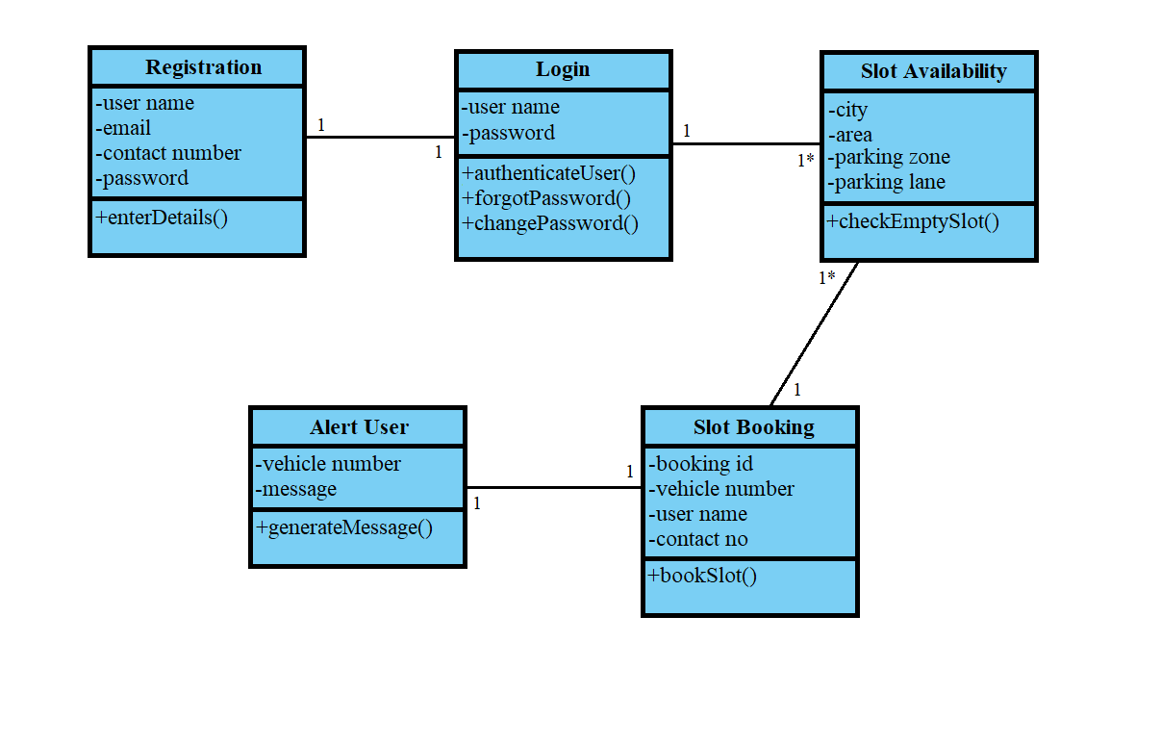
Class Diagram

Slide 13
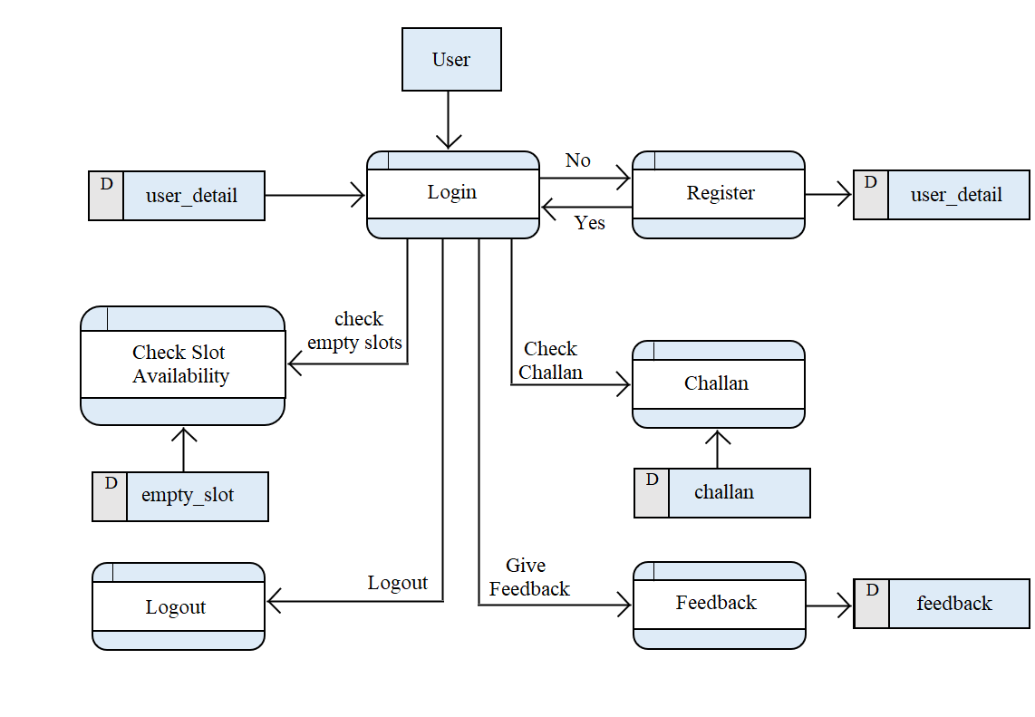
Data Flow Diagram (User’s)

Slide 14
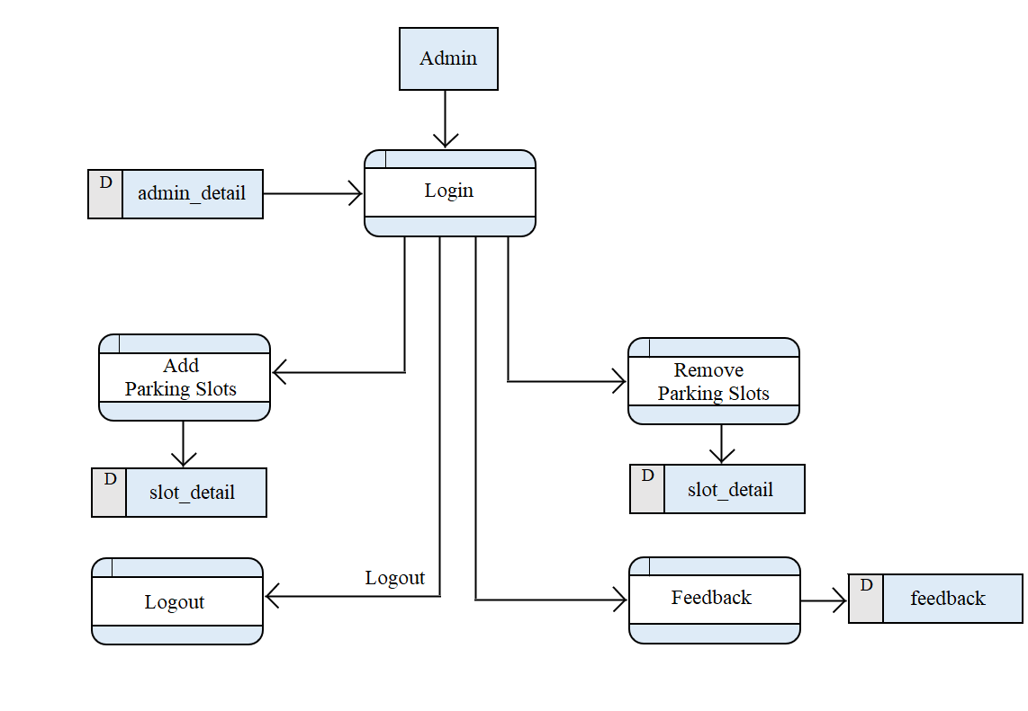
Data Flow Diagram (Admin’s)

Slide 15
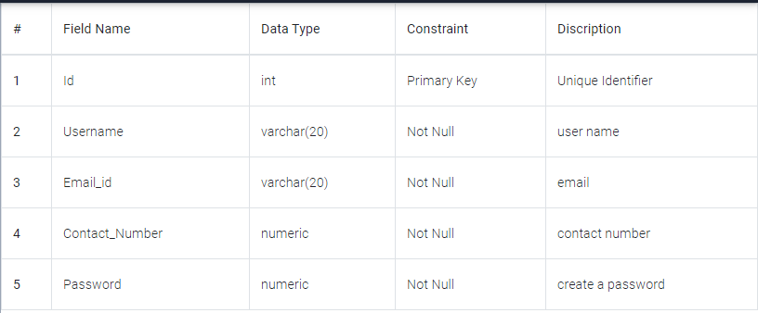
Data Dictionary
Personal_Details Table

Slide 16
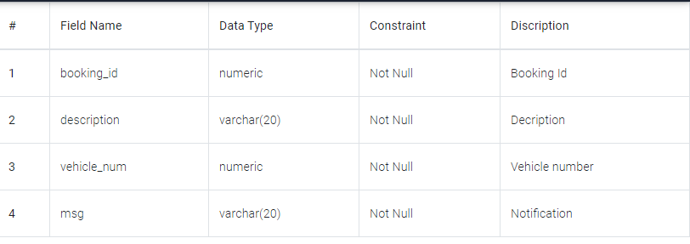
Data Dictionary
Booking_Slot Table

Slide 17
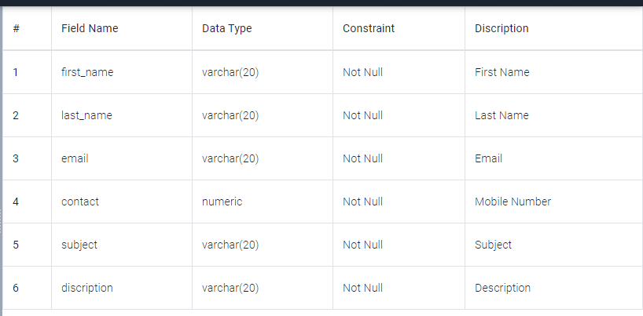
Data Dictionary
Feedback Table

Slide 18
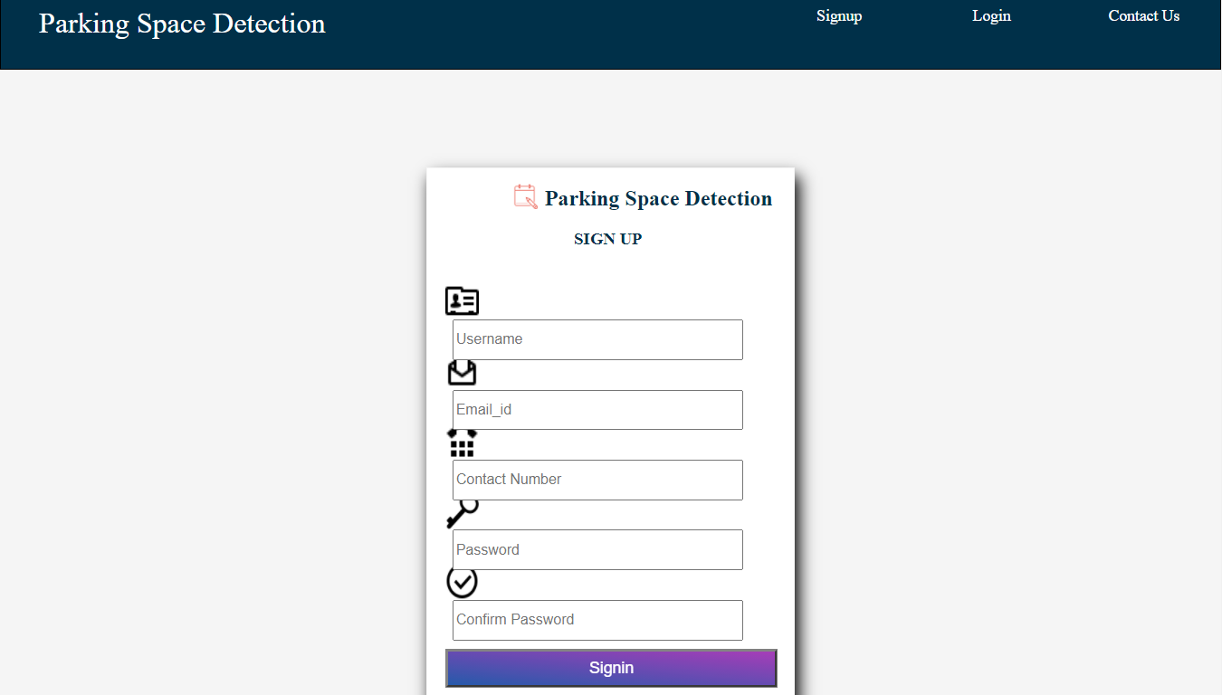
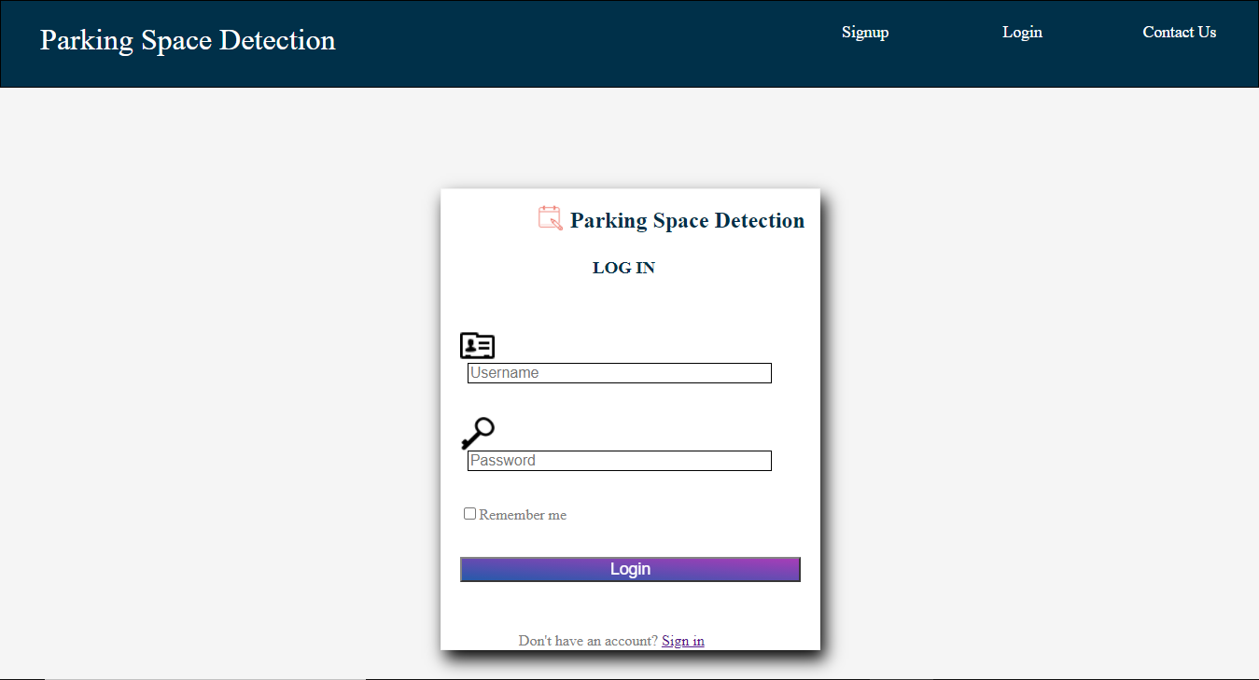
Snapshots
1.) Registration
2.) Login

Slide 19
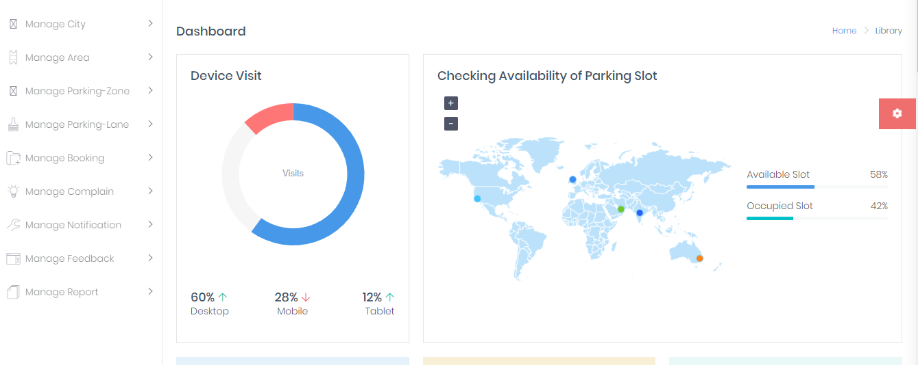
Snapshots
User’s Dashboard

Slide 20
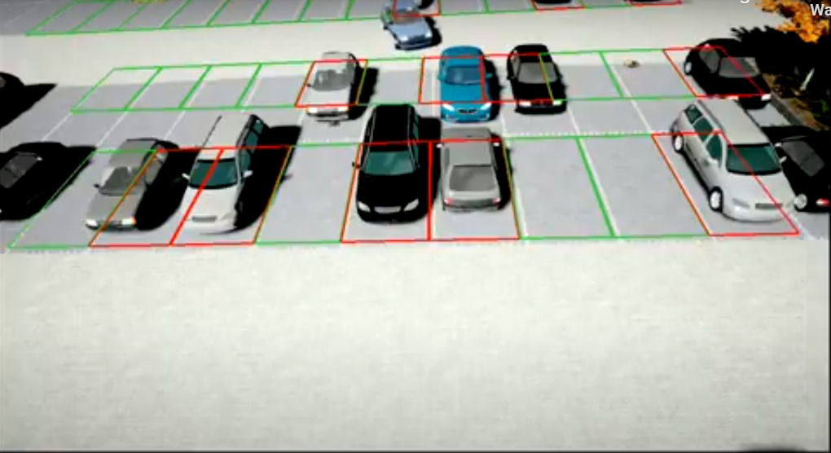
Snapshots
Slot Allocations

Slide 21
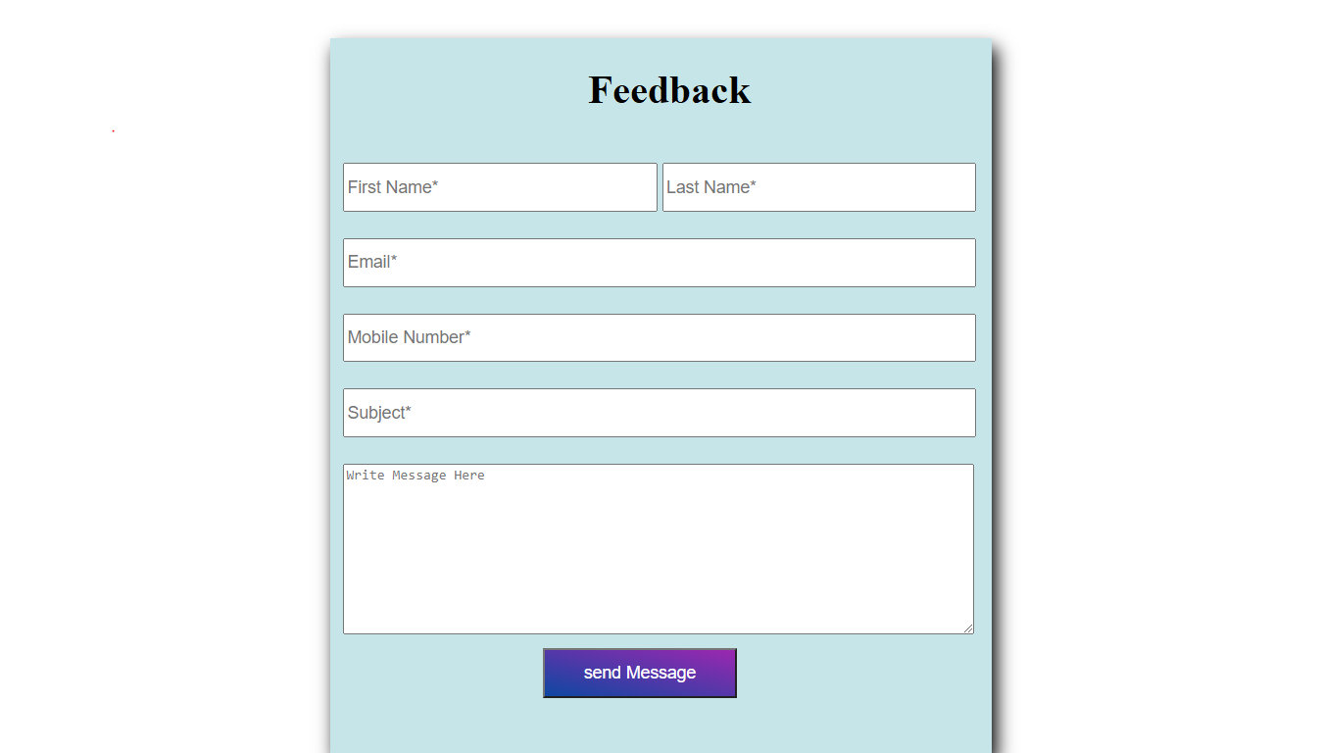
Snapshots
Feedback

Slide 22
Future Enhancements
In future, we will try to update our application to scan and find properties like color, model, registration number, etc. of any desired vehicle and also detect parking spaces without physical boundaries on all four sides.
Currently it detects only the box that is enclosed with physical boundaries and the vehicles. If the vehicle is not parked in the box, it will alert the owner.

Slide 23
Conclusion
Implementation of this project will help greatly in managing parking spaces. In countries with high population, it becomes difficult to find parking spaces or commute due to inappropriate parking. But, using this application, parking spaces will be managed efficiently and also there will be less traffic due to illegal parking in No-Parking zones. And even mass implementation of this application is not difficult as nowadays, there are CCTV cameras available everywhere.

Slide 24
Thank you

