Slide 1


R.K RESTAURANT SYSTEM
Prepared By: Prajapati Mihir Prakashbhai
Submitted To: Aditya Silver Oak Institute of Technology
Enrollment No: 181200107016 Name of Guide
Semester: VIII, BE-CE A/Prof. Apexa Bhavsar

Slide 2
OUTLINE
Introduction
Description Of Project Title
Literature Survey Background Study
Problem Statement
Scope
Objectives
Proposed Flowchart/Proposed Model
Description Of Modules In Your System
System Analysis
Learning Outcomes
Conclusion
References

Slide 3
INTRODUCTION
In this project I am going to develop a Restaurant Management System which involves online restaurant management,billing service and food delivery.
There are mainly three modules: User,Admin and Server.
Users will be able to place online order.
Server will handle all backend and data such as login credentials and user’s holdings.

Slide 4
DESCRIPTION OF THE PROJECT TITLE
R.K Restaurant(Restaurant Management System)
RMS Restaurant Management Systems are the crucial technology components that enable a single outlet or enterprise to better serve its customers and aid employees with food and beverage transactions and controls.

Slide 5
LITERATURE SURVEY/BACKGROUND STUDY
Why RMS is needed?
An easy-to-use restaurant management system allows you to run your establishment like a well-oiled machine. It will enable you to track your cash flow, monitor your inventory, and manage your employees. Simply put, an RMS can help you develop a robust and streamlined workflow for your restaurant.

Slide 6
PROBLEM STATEMENT
Traditionally the method in which customers specify their desired menu to the waiter who takes the order on a paper. Personally, he then takes the order to the kitchen department and then he supply the food item to the customer. So, it was a time-consuming process. It leads to wastage of paper and also it requires reprinting of all menu cards. Also, in many cases for small change to be making in menu card it is not convenient to print all menu cards again and again. Simply saying that the menu card once printed can’t be changed. After some days, the menu card lost its worthy look and attractiveness.

Slide 7
Many of the hotel are managed their workflow and services by paper work and manually which take time and high budget for management. busy day of people schedule and value of time become important day by day so Smart Restaurant handle the system as booking and ordering by digitally which become save manpower and time of staff of hotel. Generating KOT by application is easy to save paper, staff and time. The hotel are services and facilized in a traditional way, from waiters to kitchen also on account. More recently, these system is one of the major problem for hotel to manage their manpower and guests.

Slide 8
SCOPES
Scope:-
Our system will provide the facilities of online food item , purchase order , customer can give order for food item.
Securable storage of data.
It is also possible to have easy and faster searching of data and record online.
In this system user can be create there own profile and they book there food and pay for it.
Objective:-
Recognize the importance of an app.
Understand the types and functions of app.
Learn essentials technologies to implement app.
Understand the ideation and its importance to the design process.

Slide 9
OBJECTIVES
The main objective is to maximize the profit by increasing efficient and decreasing the mistakes that takes place in the kitchen, this will be done without compromising customer satisfaction. At this moment of time, there are still numerous restaurants that still use paper based system to get messages across between the restaurant and the kitchen, this way of communication is one of the least efficient method. However, this approach may be implemented and designed in a successful profitable restaurant but there are numerous problems which might be seen as reducing the restaurants efficiency, they are the following

Slide 10
The lack of communication that is caused by handwriting.
Uncontrolled order logging (poor order taking).
Unproductive communication between restaurant and kitchen.
Faults with order taking and lack of time management.

Slide 11
So, in order to overcome these problems, we have made an application that is restaurant management system that mainly focuses on the above given problems. We have tried to build a user-friendly interface

Slide 12
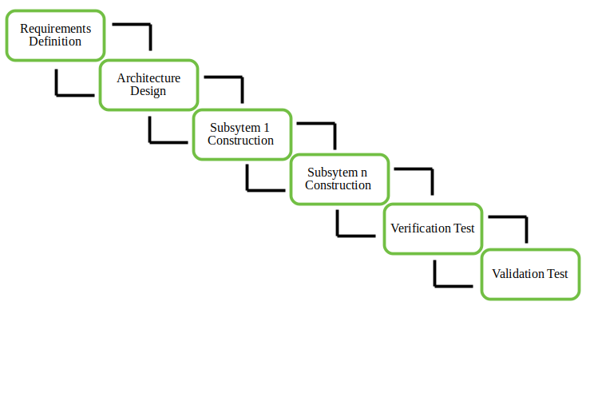
PROPOSED FLOW CHART/PROPOSED MODEL
Incremental Software Model

Slide 13
DESCRIPTION OF MODULES IN YOUR SYSTEM.
Technologies:-
Jquery
Ajax
Visual Studio Code
Express Js
Node Js
My Sql

Slide 14
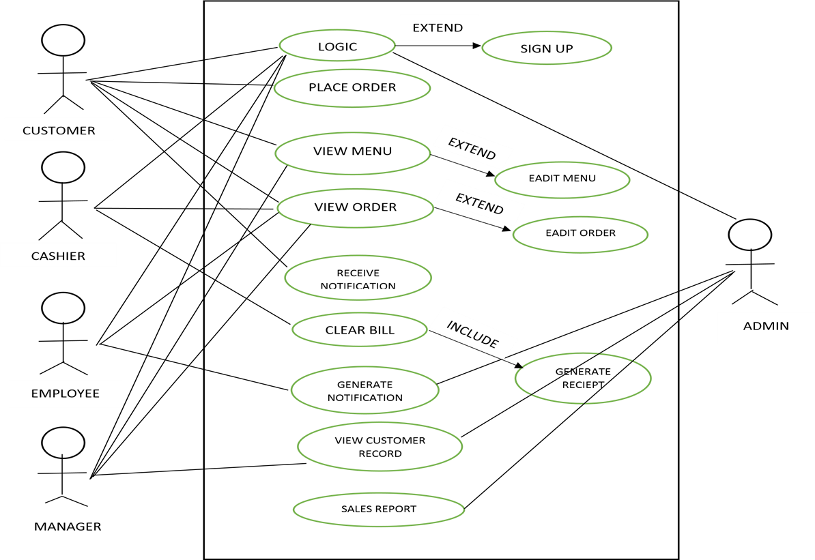
SYSTEM ANALYSIS
Use case diagram:-

Slide 15
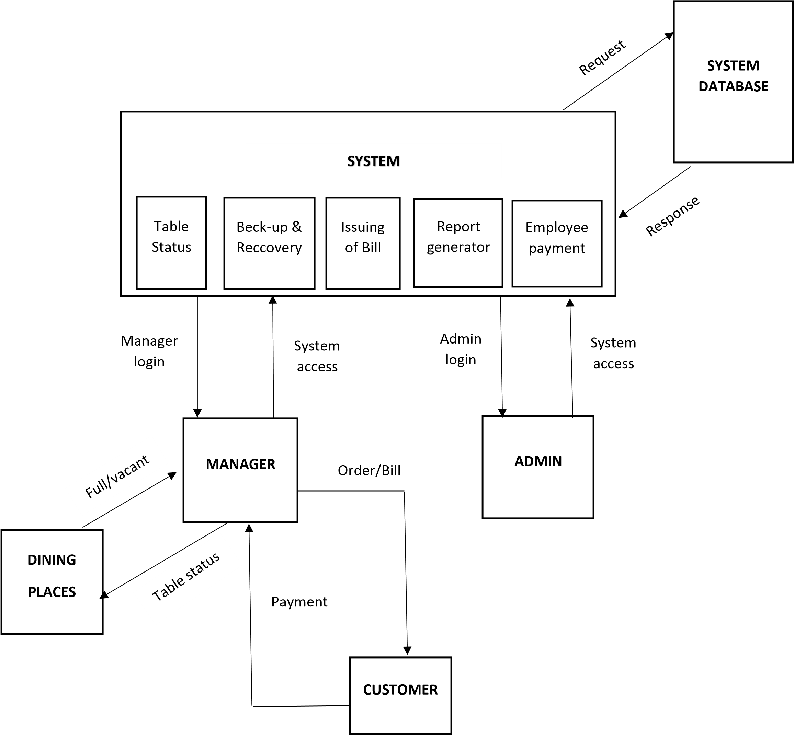
Activity Diagram

Slide 16
Existing System:-
Currently the system is working manually.
Low and poor functionality.
Time consuming.
Lot of time is required for each report generate , so it is time consuming.
Manually maintain the food name , category , price , quantity and order details.
More paperwork.

Slide 17
Need For New System
New system is totally work computerized which is remove drawback of existing system.
User can access information of food price and details any time.
User detail is entered and store easily.
Data are secured for long time.

Slide 18
LEARNING OUTCOMES
Learned concepts till now during an internship
Week 1:-Javascript
Week 2:- Typescript.
Week 3:- Jqury,Dom
Week 4:- Node Js
Week 5:- Express Js
Week 6:- Mongo db,My Sql

Slide 19
CONCLUSION
This internship has been an excellent learning experience for me, it helped me to work with various new software and it lead me to understand each phase of Software Development Life cycle
As a part of the internship, We were assigned to develop the website for restaurant ,management system. The objective of the study is to develop on automated system and to replace the manual operation currently used by the Alton Restaurant. To provide fast, efficient and reliable system by the way of managing the records of all their transaction.To evaluate the acceptability of proposed system.

Slide 20
REFERENCES
https://binaryterms.com (For Activity Diagram)
https://vertabelo.com (For Database Design)
https://dbdesignerweb.net (For Database Diagram Design)
https://www.geeksforgeeks.org/ (For Incremental Process)

Slide 21
Thank you

