Slide 1
An Analysis of Job Attrition
By: Mihir Parikh, Aaron Tomkins, Lokesh Maganti

Slide 2
Introduction - Employee Retention
Retention strategies are important because they help create a positive work environment and strengthen an employee's commitment to the organization.
Retention strategies are policies and plans that organisations follow to reduce employee turnover and attrition and ensure employees are engaged and productive long-term. The key challenge for businesses is ensuring a retention strategy aligns with business goals to ensure maximum return on investment.

Slide 3
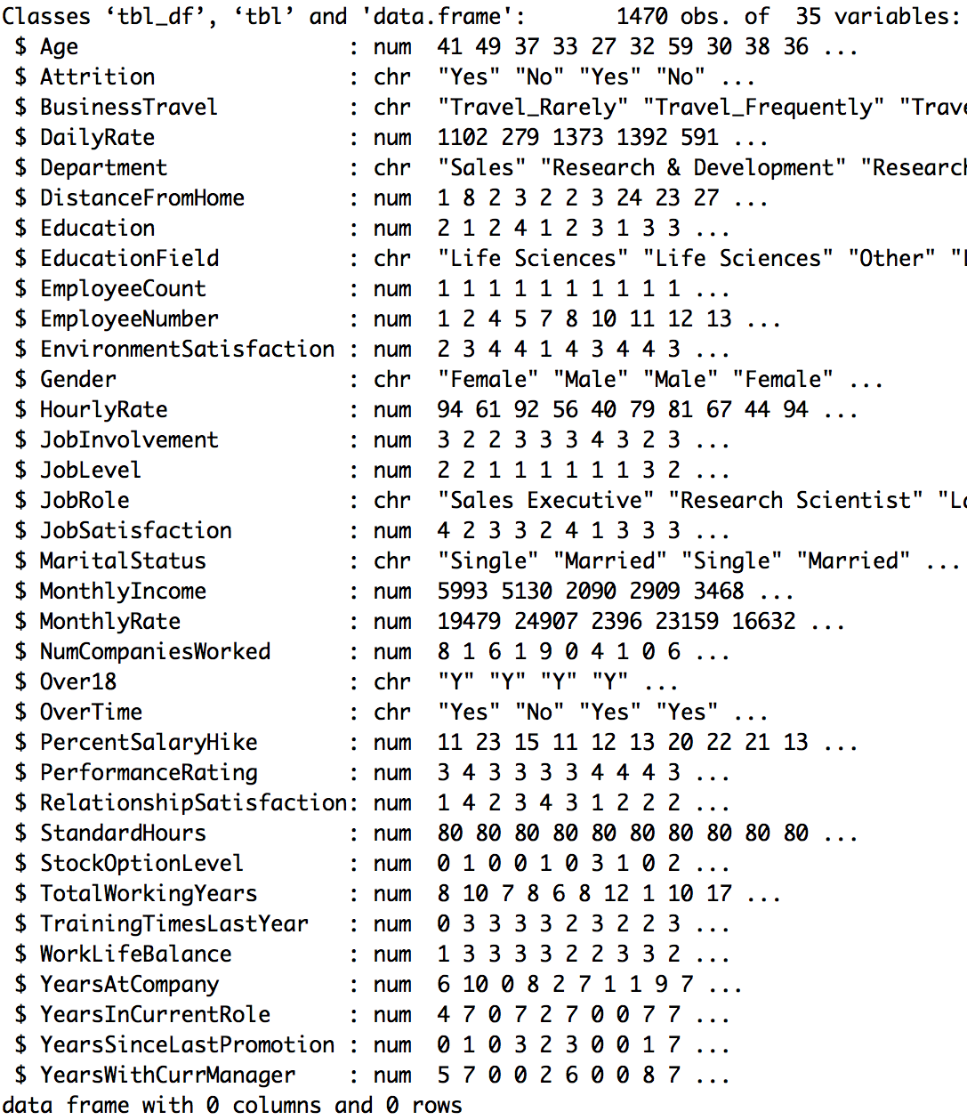
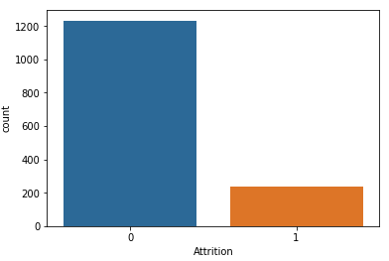
Data Overview
There are 1470 records
There are 35 variables
There are 25 numeric variables and 10 character variables
237 attrition records
1233 retention records

Slide 4
Methods
Logistic Regression:
Is a statistical method for analyzing a dataset in which there are one or more independent variables that determine an outcome. The outcome is measured with a dichotomous variable (in which there are only two possible outcomes).
Linear Discriminant Analysis:
Linear Discriminant Analysis (LDA) is most commonly used as dimensionality reduction technique in the pre-processing step for pattern-classification and machine learning applications. The goal is to project a dataset onto a lower-dimensional space with good class-separability in order avoid overfitting (“curse of dimensionality”) and also reduce computational costs.
Random Forest:
Random Forest is a flexible, easy to use machine learning algorithm that produces, even without hyper-parameter tuning, a great result most of the time. It is also one of the most used algorithms, because it’s simplicity and the fact that it can be used for both classification and regression tasks. In this post, you are going to learn, how the random forest algorithm works and several other important things about it.

Slide 5
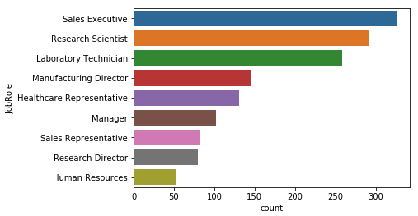
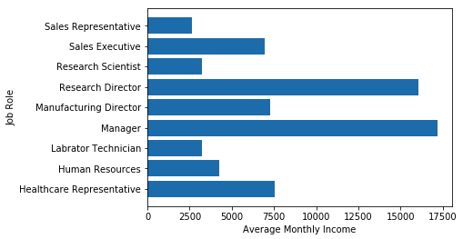
Analysis Process
Step 1: Plot the Data
Step 2: Construct a Model
Step 3: Fit the Model
Step 4: Check Assumptions
Step 5: Interpret
Examples of exploratory plots related to Job Roles

Slide 6
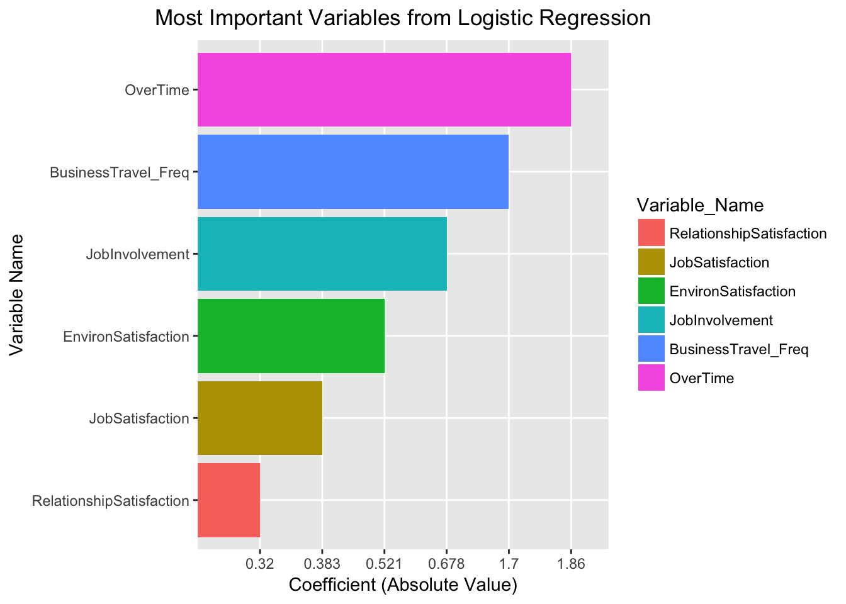
Logistic Regression
Assumptions:
Linearity
Constant variance
Independence
No interaction
Accuracy: 88.44%

Slide 7
Linear Discriminant Analysis
Assumptions:
Multivariate normality
Equal covariances among group variables
Independence
Small collinearity between predictors
Accuracy: 87.07%
May be less accurate due many categorical variables which are dummy encoded and not normally distributed
Variable | Avg Stay | Avg Leave
Monthly Income | 6869.48 | 4720.71
Age | 37.65 | 33.58
OverTime | 0.24 | 0.52
Daily Rate | 811.29 | 750.63

Slide 8
Random Forest
Accuracy: 100% on test set
Random forest utilize decision trees which don’t make assumptions about the data as long as the enough Attrition numbers are represented.
Variable Rank | Variable
1 | MonthlyIncome
2 | Age
3 | Overtime
4 | DailyRate

Slide 9
Comparison of Models in Python
Feature Rank | Random Forest R | ExtraTree Classifier Python | Logistic Reg R | Logistic Reg Python
1 | MonthlyIncome | Overtime | Overtime | DistanceFromHome
2 | Age | Age | BusinessTravel_Frequently | EnvironmentSatisfaction
3 | Overtime | MonthlyIncome | JobInvolvement | JobSatisfaction
4 | DailyRate | JobSatisfaction | EnvironmentSatisfaction | NumCompaniesWorked

Slide 10
Most Influential Features
1. Overtime
2. Age
3. MonthlyIncome
These factors were included both in the Random Forest model and the ExtraTreesClassifier model which were the most accurate models respectively in R and Python.
Notes:
Overtime, Age, and MonthlyIncome

Slide 11
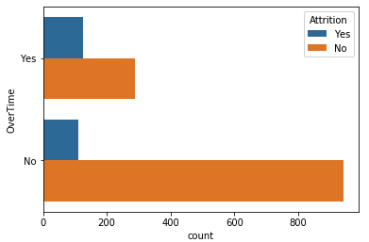
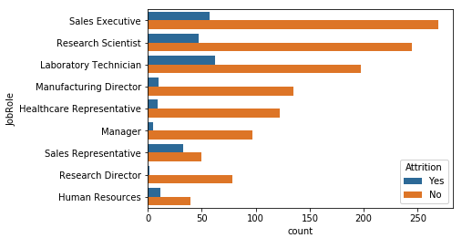
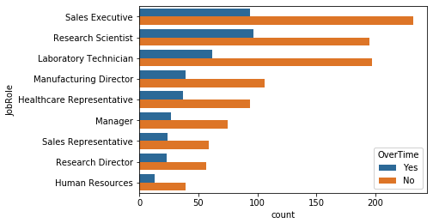
Looking at Role Specific Trends For Overtime
The overall ratio of people who left their job that worked overtime was significantly larger than the ratio of people who did not leave their jobs
The ratio of people who work overtime regardless of their roles is much higher than their attrition rate by role alone.

Slide 12
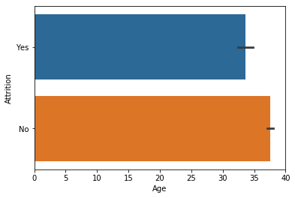
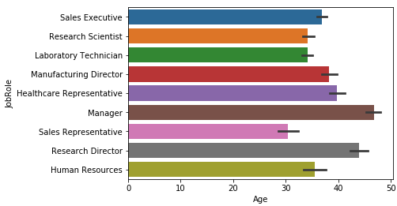
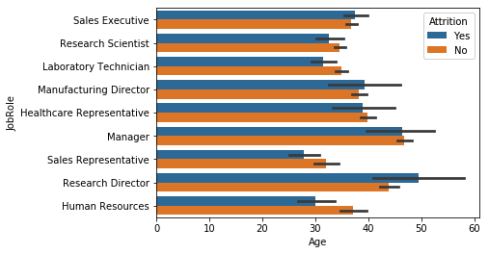
Looking at Role Specific Trends For Age
The average age of attrition for an employee is less than for one that remains
More managerial and higher level roles tend to have older people
Age trends are not apparent based off role. However, roles such as Research Director have a higher age of attrition vs roles such as HR which have a lower age of attrition compared to employees that remained.
Notes:
Age trends are not as apparent based off role. Roles such as Research Directors have a higher average age for people who left their job while in Human Resources the trend is the opposite.

Slide 13
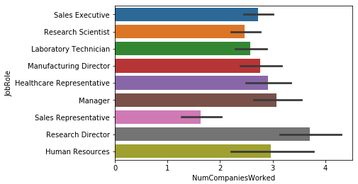
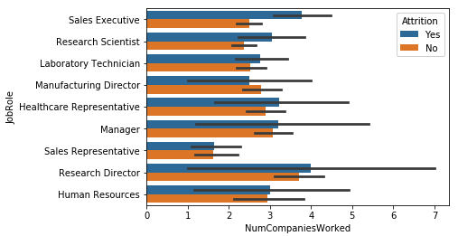
Looking at Role Specific Trends For NumCompaniesWorked
Again more senior roles have higher counts
Sales executives that leave tend to work at over one and half more companies than their counterparts who stay.
Was hoping to see more here. In software, number of companies worked for is a very strong feature that can help determine attrition. For example, in Seattle the average software engineer stays at their job for 2.7 years.
Notes:
Sales executives who leave tend to work for nearly an average of two more companies that their counterparts who remain.

Slide 14
Business Takeaways
Three key factors that impact attrition: Overtime, Age, and Monthly Income
Greater overtime, younger employees, and low monthly incomes contribute significantly to attrition
Next steps include collecting more data. 1470 records are not enough to make a strong model considering the number of variables that were considered.
Get a better sense of less influential factors that could be addressed more easily for quick wins. For example factors such as Job Involvement may be easier to address than Monthly income.
Acquire location data. Cost of living and expected incomes are contingent on location.

Slide 15
Fun Tech Discovery In Python
Utilized Pipenv for package management instead of Anaconda.
Pipenv is lightweight package manager that manages a virtual environment and dependencies.
Easy to get up and running and very easy for collaboration.
Based off Ruby’s Bundler

