Slide 1

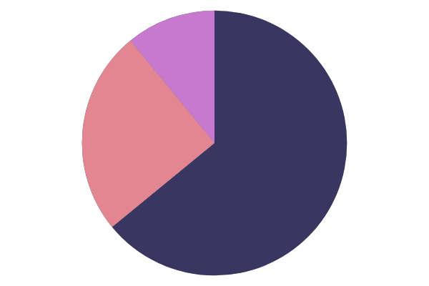
OBJECTIVES
RECRUIT FAST AND IN LARGE NUMBERS
PREDICT PERSONALITY TRAITS USING ML/DL
PROVIDE INSIGHTS AND CONCISE SUMMARY

Slide 2
PROJECT WORKFLOW
Interviewee
Enter personal details, upload resume, attempt a questionnaire wherein the candidate has to rate himself/herself
Personality prediction (based on Big Five Personality Traits model) with OCEAN values and CV analysis
Video recording in browser. The candidate has to answer few questions put up by the HR team on the portal.
Face emotion and Speech Analysis to get insights like confidence level, candidate personality traits
Interviewer/HR team/Admin
View all the registered candidates’ details
View each candidate's profile summary which includes resume, responses to questions, technical skills, personality traits, video and tone analysis result.
Update candidate about selection/rejection, further interview process using one-click mail or phone call

Slide 3
Interviewer/ HR team/ Admin
Interviewer Sign In page
Track Candidates
View Concise insights and summary of the candidate profile
View all the received applicants for different jobs
View each candidate's profile summary which includes resume, responses to questions, technical skills, personality traits, video and tone analysis result.
Send job offer or rejection mails

Slide 4
INTERVIEWEE
Interviewee Sign Up page
Provide Basic Personal Info
Upload Resume/CV
Attempt a questionnaire
Resume Parser
Personality prediction (based on Big Five Personality Traits model) with OCEAN values and CV analysis
Personality Prediction page
Streaming Interview of the candidate
Video recording in browser.
Speech to Text Analysis using
Face emotion and Speech Analysis to get insights like confidence level, candidate personality traits

Slide 5
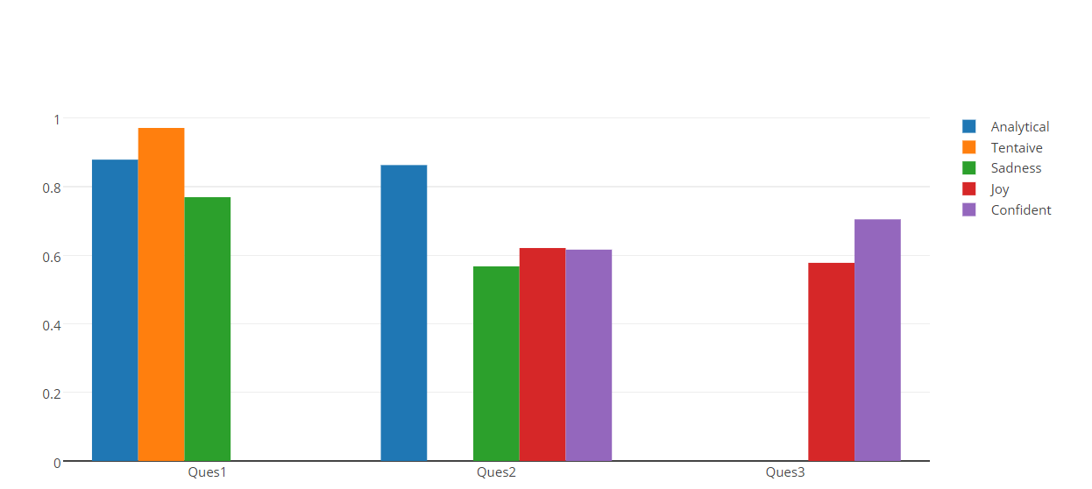

TRAITS FOR EACH QUESTION

Slide 6
WEBSITE PROTOTYPE –
SLIDING LANDING PAGE

Slide 7
WEBSITE PROTOTYPE – ADMIN DASHBOARD

Slide 8
WEBSITE PROTOTYPE – PERSONALITY PREDICTION PAGE
NAME
GENDER
EMAIL
CONTACT DETAILS
UPLOAD RESUME
Openness
GIVE RATING FROM 1-10, COMBINED WITH CV ANALYSIS
PERSONALITY WILL BE PREDICTED USING MACHINE LEARNING
Neuroticism
Conscientiousness
Agreeableness
Extraversion

Slide 9

WEBSITE PROTOTYPE – RECORDING PAGE
START CAMERA
On submitting, video will be send to AWS Cloud for Speech to Text Analysis
RECORD
SUBMIT
AUDIO/MEDIA CONSTRAINTS BUTTON

Slide 10
100+ Questions to Predict personality traits
0 | Tell Me About Yourself
1 | Why do you want to work for X company?
2 | Why do you want to leave your current/last company?
3 | What are you looking for in your next role?
4 | Tell me about a time when you had a conflict with a co-worker.
5 . . .100+ Questions | Tell me about a time in which you had a conflict and needed to influence somebody else.+100

