Slide 1
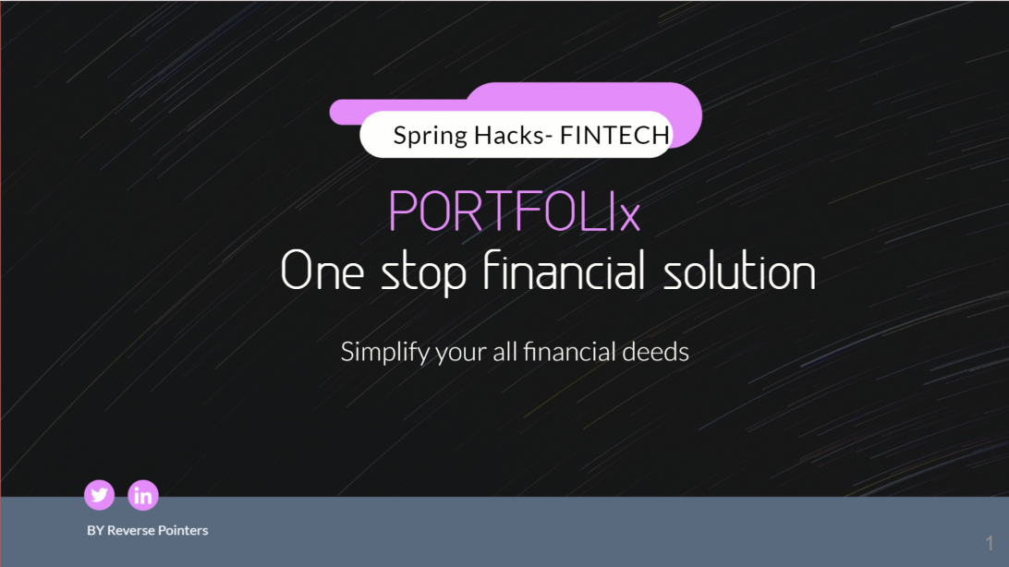

Slide 2




Stages
01
02
03
04
05
End User
Time spent on portal
Financial Literacy
Recommendations
Achieve targeted goals
To make the user more literate about finances by providing special features into the subscription model.
Recommendations about the investment into the stocks and different other policies.
The amount of time spent by user on the portal.
We want to make user financially free.
We will add subscription model for unlocking some features where user can get guidance related to the future investment.

Slide 3



Issues with Financial Management
Money Laundering Risk
Regulations are yet to be improved.
Step 1
Online Hacking
Hackers can gain access to your accounts and can get the details of your finances.
Step 2
Digital identity risks
Security codes and passwords could be easily accessed.
Step 3
Roles and responsibilities of financial advisor.
Whether it is public or private sector undertaking it is most desirable that the finances should be properly checked and controlled
Step 4

Slide 4






Fixed Deposit
PPF
Fixed deposit is an investment tool offered by banks and non-banking financial institutions (NBFCs)
PPF scheme is a long-term investment option that offers an attractive rate of interest and returns on the amount invested
Different Financial Managements
EPFO
Mutual Funds
Pension scheme and an insurance scheme for the workforce engaged in the organized sector in India
A pool of money managed by a professional Fund Manager
SSY
Insurance
The Sukanya Samriddhi Account is designed to provide a bright future for your girl child. It offers a high interest rate of 7.6% and tax benefits under 80c
Insurance is a way to manage your risk.

Slide 5

Market Analysis
Security
Management
FIRMS
MULTI USERS
CRM
END USER
Firms larger scale
03
Multi user for enterprices
02
End User:
Individuals
01

Slide 6
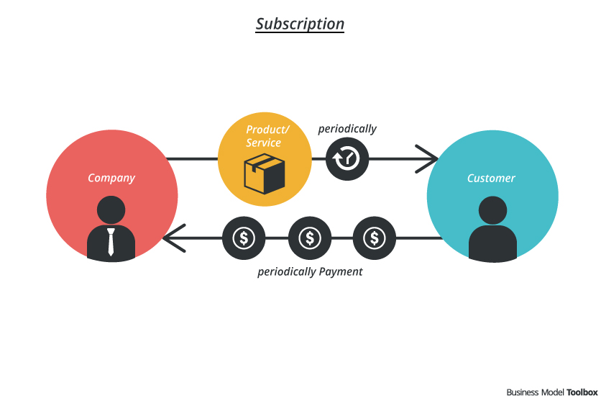


REVENUE MODEL
PLAN
PLAN
1
2
Subscription Based
Time spent on portal
User can take subscription to open advanced features.
The time spent on the portal will can generate revenue.

Slide 7




Future Tech-stacks
02
03
Use of OCR
Tracking user goal using NLP
01
Use of Blockchain for gamification and incentive program
04
Rewards of FinTech-driven Payments

