Slide 1
Reward-Free Exploration for Reinforcement Learning
Mihir Dhanakshirur
Vasisht Vasudevan

Slide 2
Introduction: The Problem
In RL, agents interact with the environment while trying to maximize cumulative reward.
Agent must explore states to investigate their rewards. Exploration is the most significant challenge in RL.
High rewards may require exact sequences of states to be visited. To collect all this information, an agent must spend a lot of time and resources. Randomized exploration can take exponential time to reach a high rewards state.
These have high sample complexity and may also have excessive Data Collection.
In case of reward-based exploration, even small changes in reward functions may lead to higher sample complexity.

Slide 3
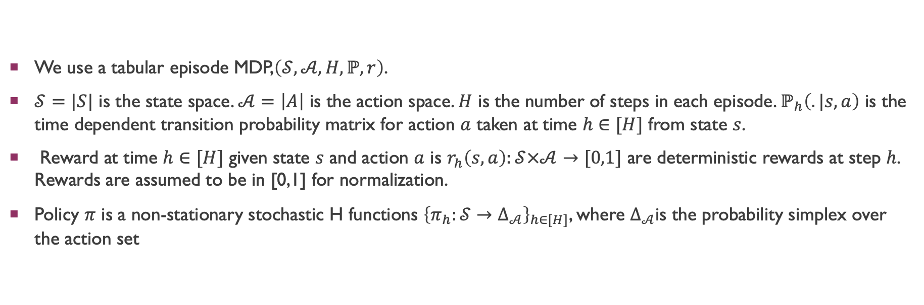
Notation
We use a tabular episode MDP,$\left(𝒮,𝒜,H,ℙ, r\right)$.
$𝒮=|S|$ is the state space. $𝒜=\left|A\right|$ is the action space. $H$ is the number of steps in each episode. $ℙ_{h}\left(.|s,a\right)$ is the time dependent transition probability matrix for action $a$ taken at time $h∈[H]$ from state $s$.
Reward at time $h∈[H]$ given state $s$ and action $a$ is $r_{h}\left(s,a\right):𝒮×𝒜→[0,1]$ are deterministic rewards at step $h$. Rewards are assumed to be in [0,1] for normalization.
Policy $π$ is a non-stationary stochastic H functions ${\left\{π_{h}:𝒮→Δ_{𝒜}\right\}}_{h∈[H]}$, where $Δ_{𝒜}$is the probability simplex over the action set

Slide 4
Reward-Free Exploration: Aim
Exploring the environment without reward functions.
Gather sufficient information in order to compute near optimal policies for ANY reward function afterwards.
An issue: Some states are difficult to reach, and so we cannot get enough Markov chains containing these states.
Fix: Partition the states into ones that such a low probability of reaching that they have negligible reward-optimization contribution, and the rest. We only explore the rest of the states.

Slide 5
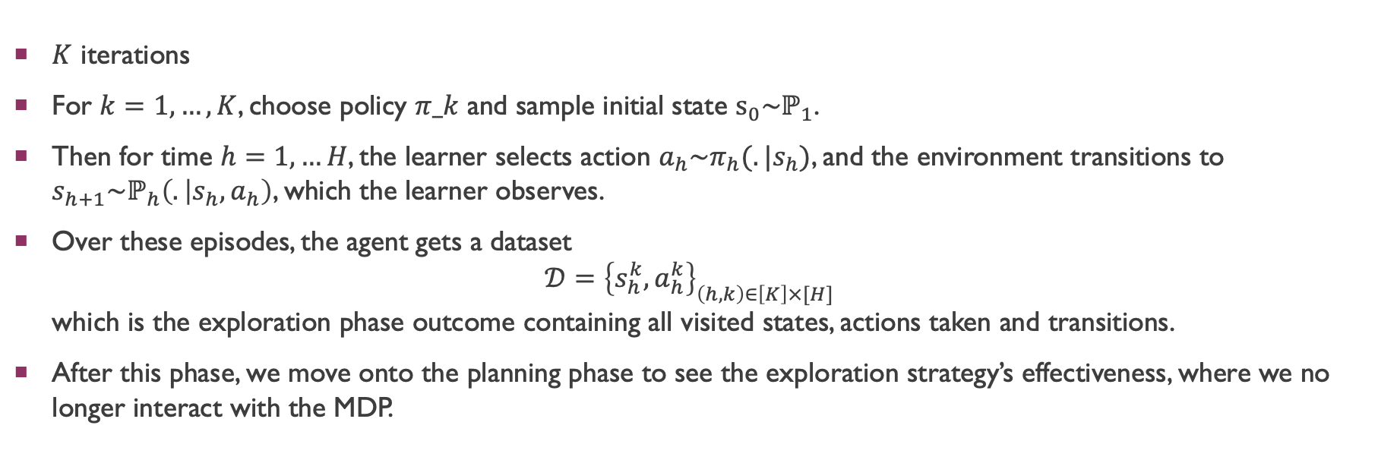
Simple algorithm overview
$K$ iterations
For $k=1, …,K$, choose policy $π_k$ and sample initial state $s_{0}\sim ℙ_{1}$.
Then for time $h=1, …H$, the learner selects action $a_{h}\sim π_{h}(.|s_{h})$, and the environment transitions to $s_{h+1}\sim ℙ_{h}\left(. | s_{h},a_{h}\right)$, which the learner observes.
Over these episodes, the agent gets a dataset $𝒟={\left\{s_{h}^{k},a_{h}^{k}\right\}}_{\left(h,k\right)∈\left[K\right]×[H]}$ which is the exploration phase outcome containing all visited states, actions taken and transitions.
After this phase, we move onto the planning phase to see the exploration strategy’s effectiveness, where we no longer interact with the MDP.

Slide 6
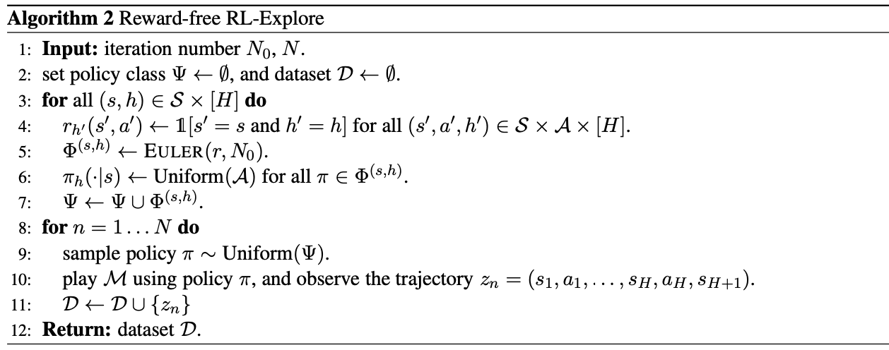
Reward-Free Exploration Algorithm

Slide 7
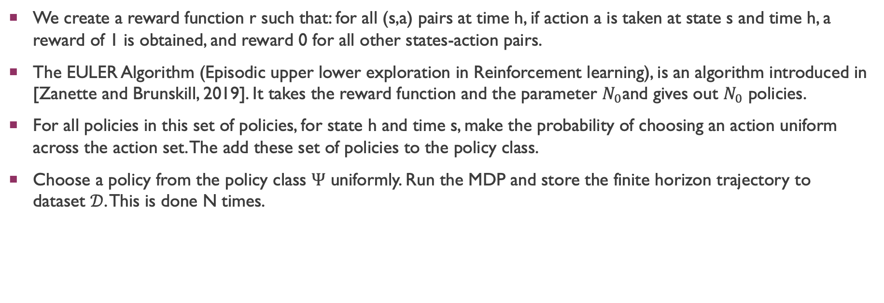
Algorithm Overview
We create a reward function r such that: for all (s,a) pairs at time h, if action a is taken at state s and time h, a reward of 1 is obtained, and reward 0 for all other states-action pairs.
The EULER Algorithm (Episodic upper lower exploration in Reinforcement learning), is an algorithm introduced in [Zanette and Brunskill, 2019]. It takes the reward function and the parameter $N_{0}$and gives out $N_{0}$ policies.
For all policies in this set of policies, for state h and time s, make the probability of choosing an action uniform across the action set. The add these set of policies to the policy class.
Choose a policy from the policy class $Ψ$ uniformly. Run the MDP and store the finite horizon trajectory to dataset $𝒟$. This is done N times.

Slide 8
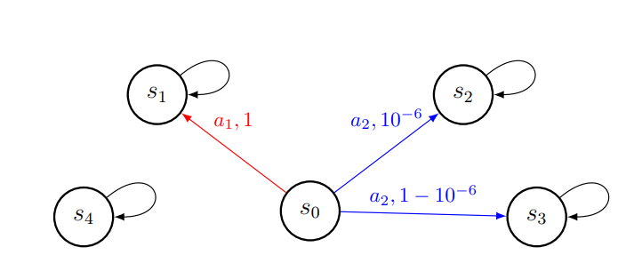
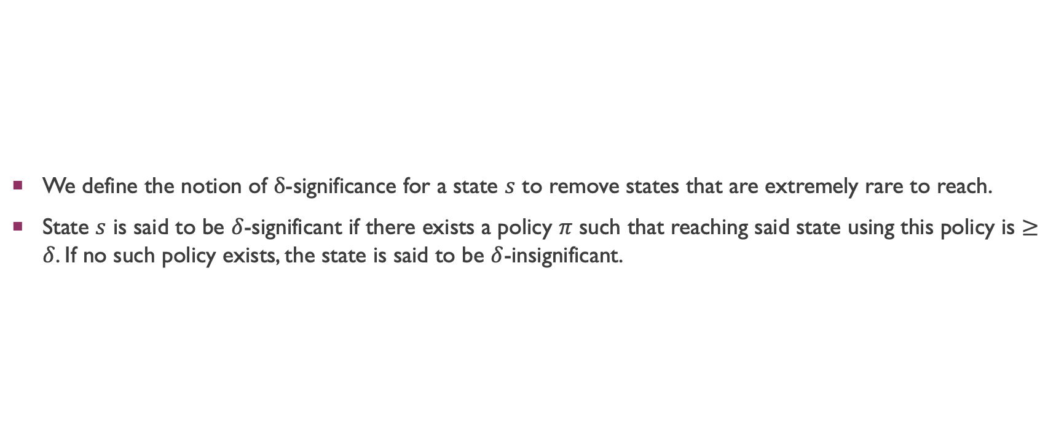
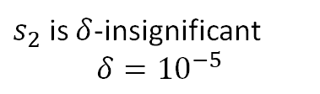
Significant and Insignificant States
We define the notion of $δ$-significance for a state $s$ to remove states that are extremely rare to reach.
State $s$ is said to be $δ$-significant if there exists a policy $π$ such that reaching said state using this policy is $≥δ$. If no such policy exists, the state is said to be $δ$-insignificant.
$s_{2}$ is $δ$-insignificant $$δ={10}^{−5}$$

Slide 9
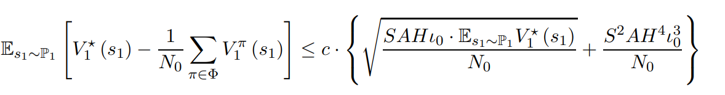

Euler Algorithm
There exists absolute constant $c>0$ such that for any $N_{0}>0$ and $p∈(0,1)$, with probability at least $1−p$, if we run EULER algorithm for $N_{0}$ episodes, it will output a policy set $φ$ with $\left|φ\right|=N_{0}$ that satisfies:
The EULER algorithm suboptimality scales with the optimal policy value. Helps in dealing with states who are significant but have a low probability of being reached

Slide 10
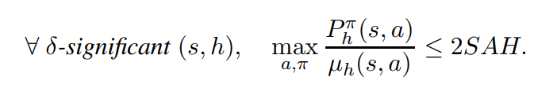
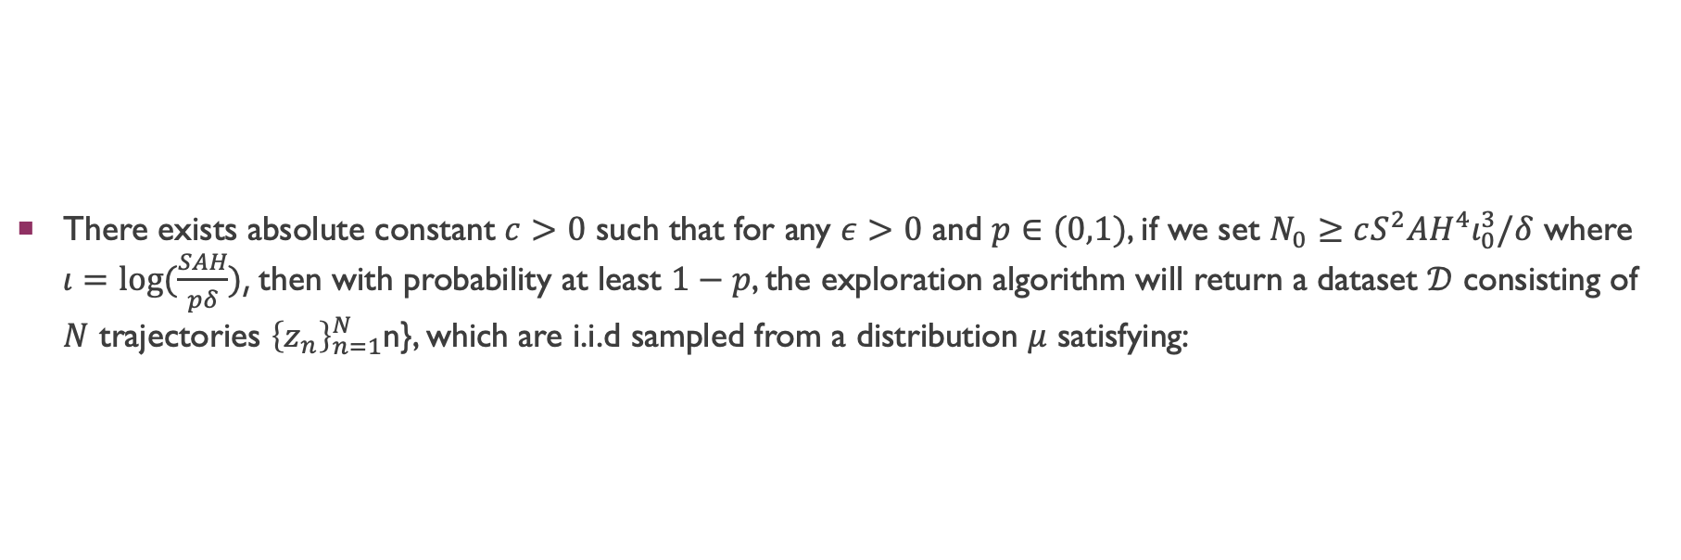
Coverage of Dataset
There exists absolute constant $c>0$ such that for any $ε>0$ and $p∈(0,1)$, if we set $N_{0}≥cS^{2}AH^{4}ι_{0}^{3}/δ$ where $ι=log⁡(\frac{SAH}{pδ})$, then with probability at least $1−p$, the exploration algorithm will return a dataset $𝒟$ consisting of $N$ trajectories ${\left\{z_{n}\right\}}_{n=1}^{N}$n}, which are i.i.d sampled from a distribution $μ$ satisfying:

Slide 11
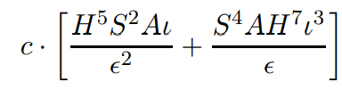
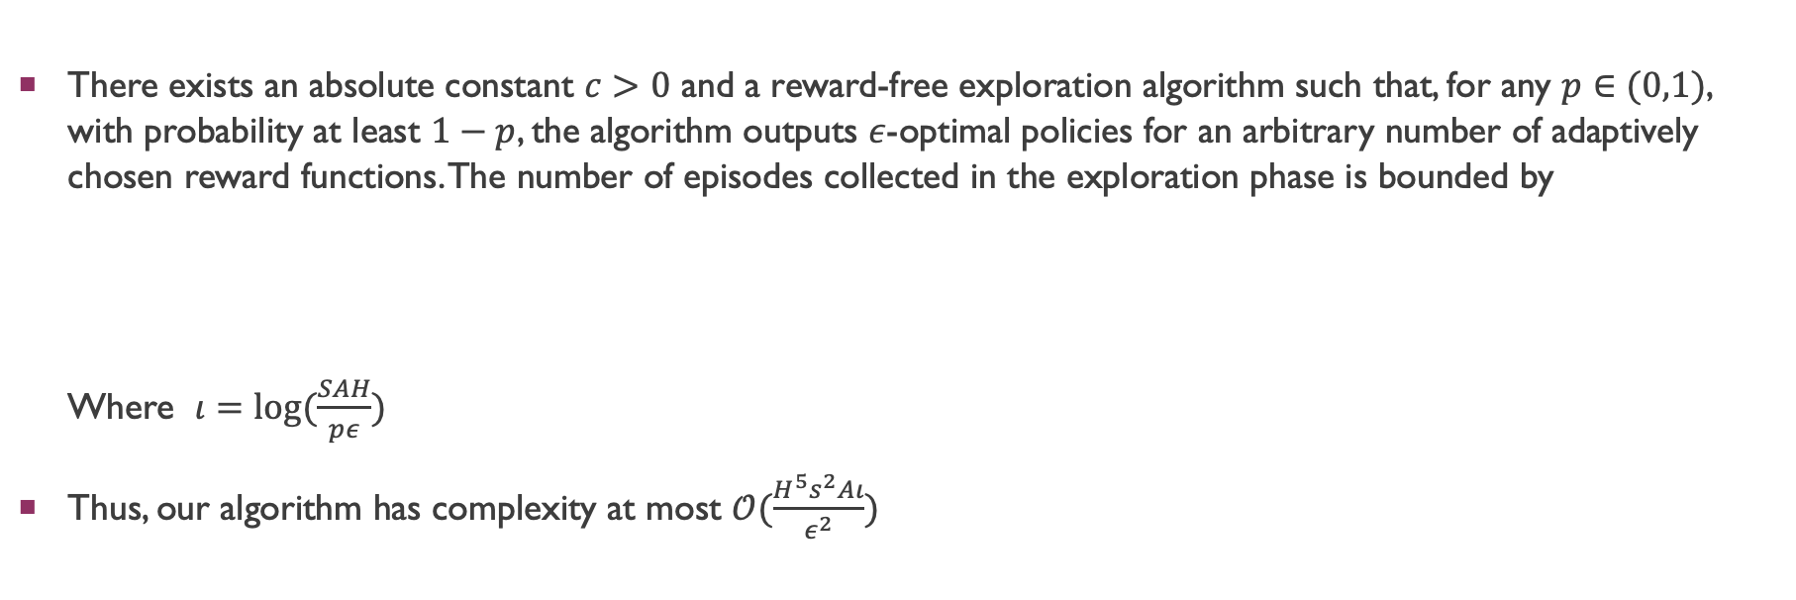
Complexity upper bound
There exists an absolute constant $c>0$ and a reward-free exploration algorithm such that, for any $p∈(0,1)$, with probability at least $1−p$, the algorithm outputs $ε$-optimal policies for an arbitrary number of adaptively chosen reward functions. The number of episodes collected in the exploration phase is bounded by Where $ι=log⁡(\frac{SAH}{pε})$
Thus, our algorithm has complexity at most $𝒪(\frac{H^{5}s^{2}Aι}{ε^{2}})$

Slide 12

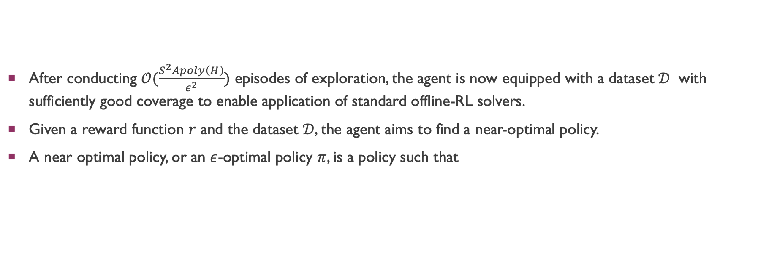
Planning Phase: Aim
After conducting $𝒪(\frac{S^{2}Apoly\left(H\right)}{ε^{2}})$ episodes of exploration, the agent is now equipped with a dataset $𝒟$ with sufficiently good coverage to enable application of standard offline-RL solvers.
Given a reward function $r$ and the dataset $𝒟$, the agent aims to find a near-optimal policy.
A near optimal policy, or an $ε$-optimal policy $π$, is a policy such that

Slide 13
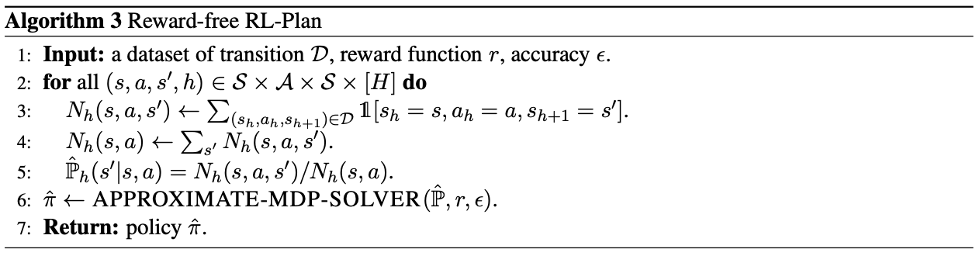
Reward-Free Planning Algorithm

Slide 14
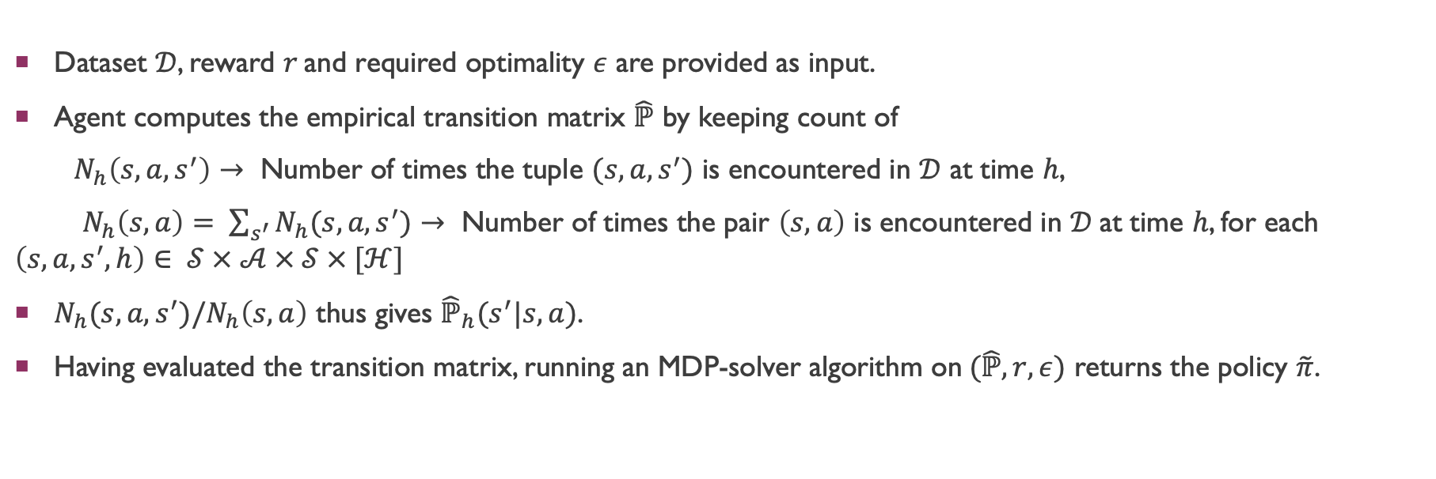
Algorithm Overview
Dataset $𝒟$, reward $r$and required optimality $ε$ are provided as input.
Agent computes the empirical transition matrix $\hat{ℙ}$ by keeping count of
$N_{h}\left(s,a,s^{′}\right)→$ Number of times the tuple $(s,a,s^{′})$ is encountered in $𝒟$ at time $h$,
$N_{h}\left(s,a\right)= \sum_{s^{′}}{N_{h}(s,a,s^{′})}→$ Number of times the pair $\left(s,a\right)$ is encountered in $𝒟$at time $h$, for each $\left(s,a,s^{′},h\right)∈ 𝒮 × 𝒜 × 𝒮 × [ℋ]$
$N_{h}(s,a,s^{′})/N_{h}\left(s,a\right)$ thus gives ${\hat{ℙ}}_{h}(s^{′}|s,a)$.
Having evaluated the transition matrix, running an MDP-solver algorithm on$(\hat{ℙ},r,ε)$ returns the policy $\tilde{π}$.

Slide 15

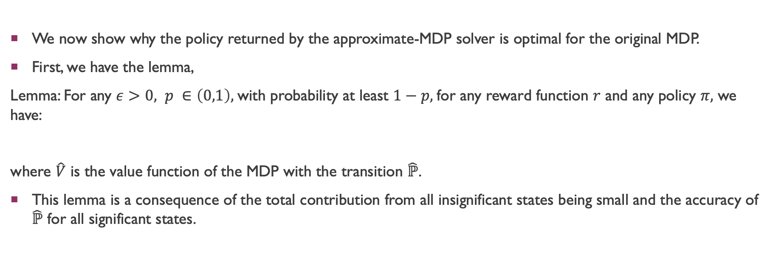
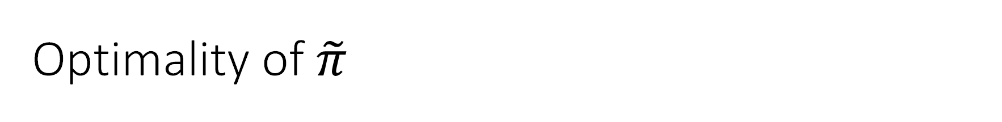
Optimality of $\tilde{π}$
We now show why the policy returned by the approximate-MDP solver is optimal for the original MDP.
First, we have the lemma,
Lemma: For any $ε>0, p ∈\left(0,1\right),$ with probability at least $1−p,$for any reward function $r$ and any policy $π,$ we have:
where $\hat{V}$ is the value function of the MDP with the transition $\hat{ℙ}$.
This lemma is a consequence of the total contribution from all insignificant states being small and the accuracy of $\hat{ℙ}$ for all significant states.

Slide 16
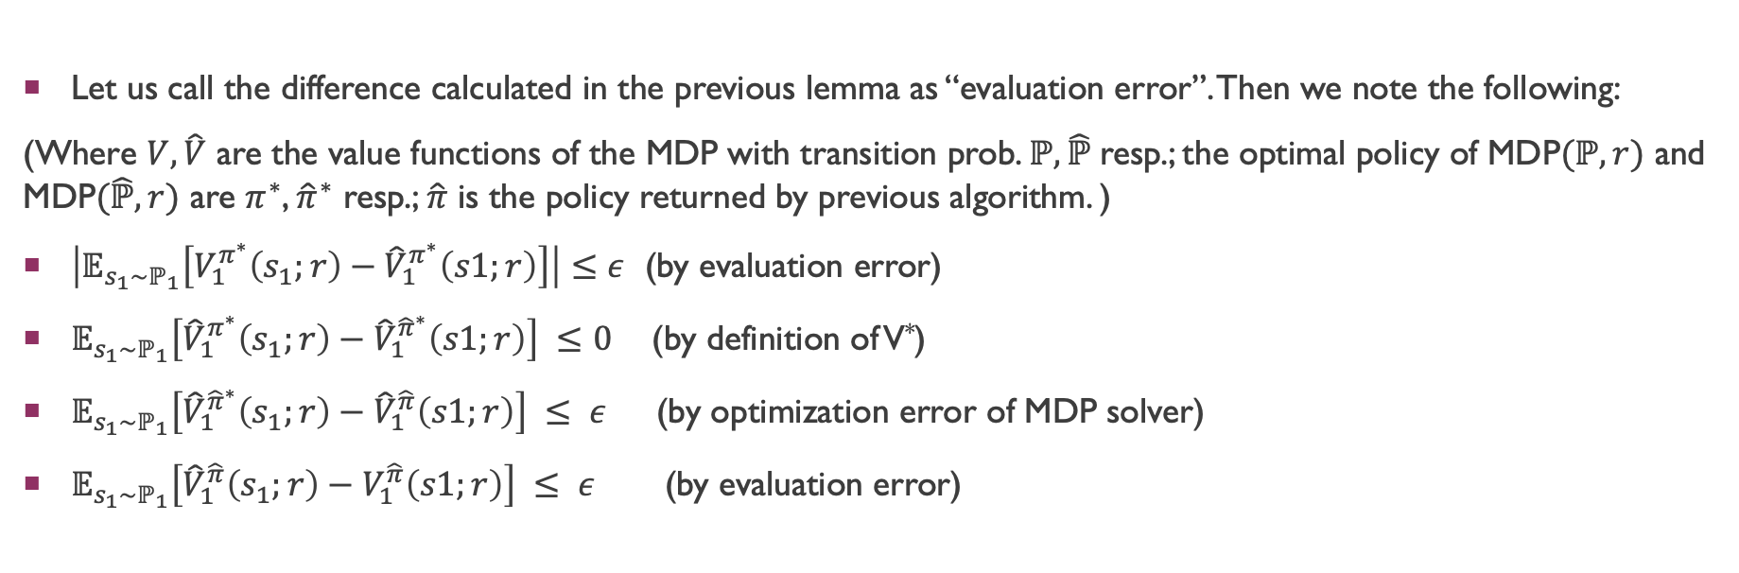
Optimality of $\tilde{π}$
Let us call the difference calculated in the previous lemma as “evaluation error”. Then we note the following:
(Where $V,\hat{V}$ are the value functions of the MDP with transition prob. $ℙ,\hat{ℙ}$resp.; the optimal policy of MDP$(ℙ,r)$ and MDP$(\hat{ℙ},r)$ are $π^{∗}$, ${\hat{π}}^{∗}$ resp.; $\hat{π}$ is the policy returned by previous algorithm. )
$\left|𝔼_{s_{1}\sim ℙ_{1}}\left[V_{1}^{π^{∗}}\left(s_{1};r\right)−{\hat{V}}_{1}^{π^{∗}}\left(s1;r\right)\right]\right|≤ε$ (by evaluation error)
$𝔼_{s_{1}\sim ℙ_{1}}\left[{\hat{V}}_{1}^{π^{∗}}\left(s_{1};r\right)−{\hat{V}}_{1}^{{\hat{π}}^{∗}}\left(s1;r\right)\right] ≤0$ (by definition of V*)
$𝔼_{s_{1}\sim ℙ_{1}}\left[{\hat{V}}_{1}^{{\hat{π}}^{∗}}\left(s_{1};r\right)−{\hat{V}}_{1}^{\hat{π}}\left(s1;r\right)\right] ≤ ε$ (by optimization error of MDP solver)
$𝔼_{s_{1}\sim ℙ_{1}}\left[{\hat{V}}_{1}^{\hat{π}}\left(s_{1};r\right)−V_{1}^{\hat{π}}\left(s1;r\right)\right] ≤ ε$ (by evaluation error)

Slide 17

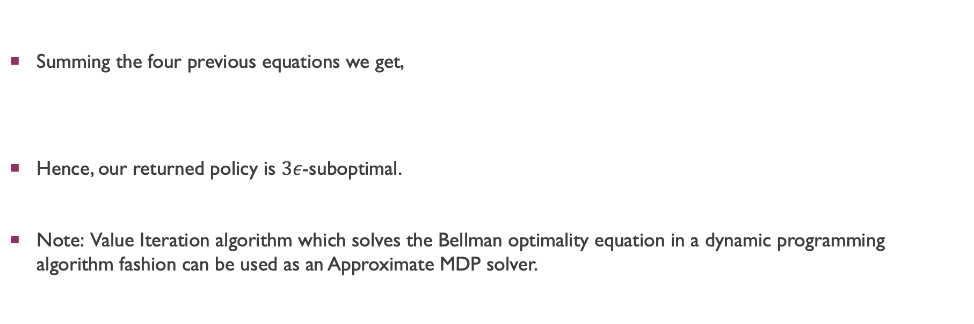
Optimality of $\tilde{π}$
Summing the four previous equations we get,
Hence, our returned policy is $3ε$-suboptimal.
Note: Value Iteration algorithm which solves the Bellman optimality equation in a dynamic programming algorithm fashion can be used as an Approximate MDP solver.

Slide 18
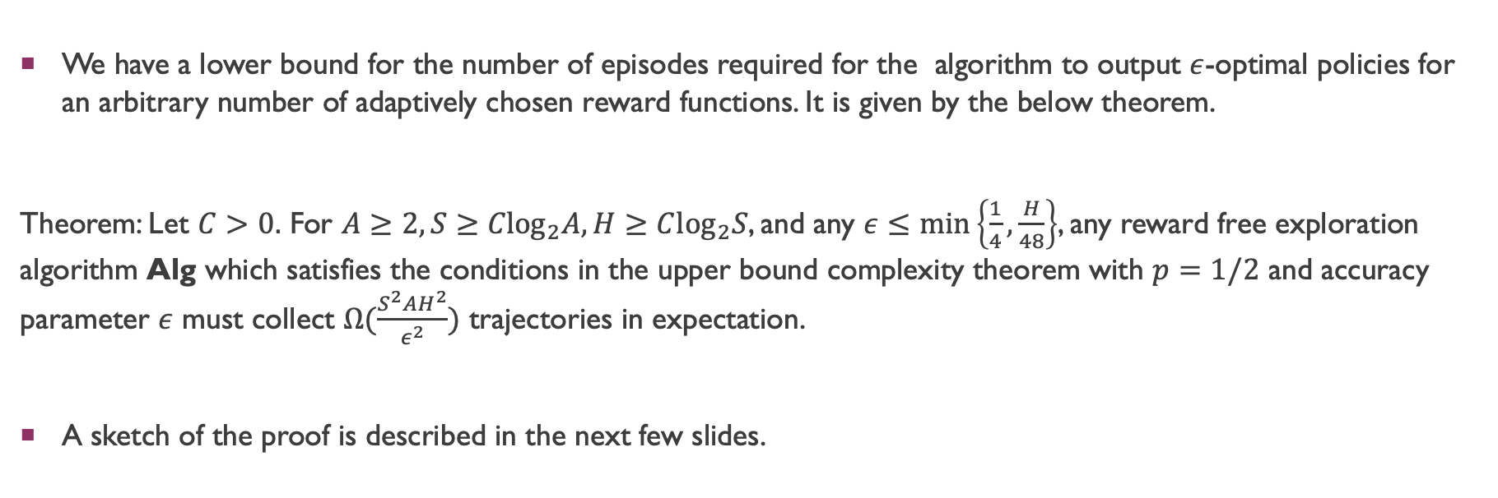
Lower Bound Complexity
We have a lower bound for the number of episodes required for the algorithm to output $ε$-optimal policies for an arbitrary number of adaptively chosen reward functions. It is given by the below theorem.
Theorem: Let $C>0.$ For $A≥2, S≥{Clog}_{2}A, H≥C\log_{2}S$, and any $ε≤\min\left\{\frac{1}{4},\frac{H}{48}\right\}$, any reward free exploration algorithm Alg which satisfies the conditions in the upper bound complexity theorem with $p=1/2$ and accuracy parameter $ε$ must collect $Ω(\frac{S^{2}AH^{2}}{ε^{2}})$ trajectories in expectation.
A sketch of the proof is described in the next few slides.

Slide 19
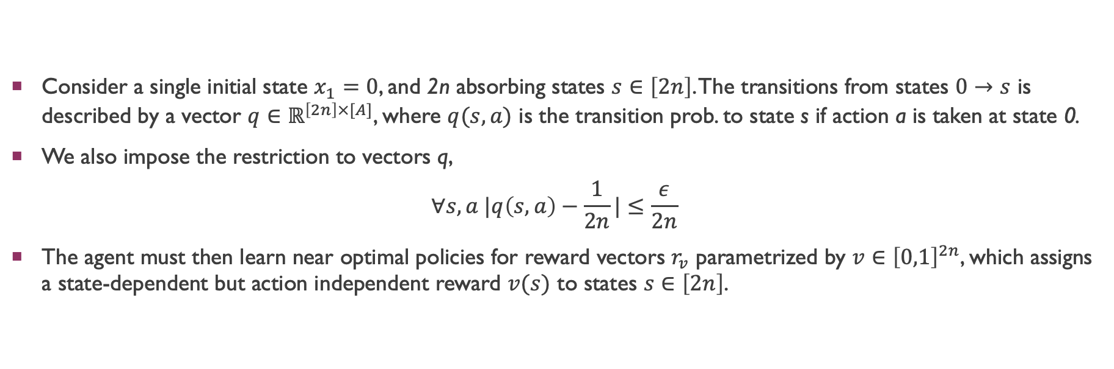
Reward free Exploration at Single State
Consider a single initial state $x_{1}=0$, and 2n absorbing states $s∈\left[2n\right]$. The transitions from states $0→s$ is described by a vector $q∈ℝ^{\left[2n\right]×[A]}$, where $q(s,a)$ is the transition prob. to state s if action a is taken at state 0.
We also impose the restriction to vectors q,
$$∀s,a |q\left(s,a\right)−\frac{1}{2n}|≤\frac{ε}{2n}$$
The agent must then learn near optimal policies for reward vectors $r_{v}$ parametrized by $v∈{\left[0,1\right]}^{2n}$, which assigns a state-dependent but action independent reward $v(s)$ to states $s∈\left[2n\right]$.

Slide 20
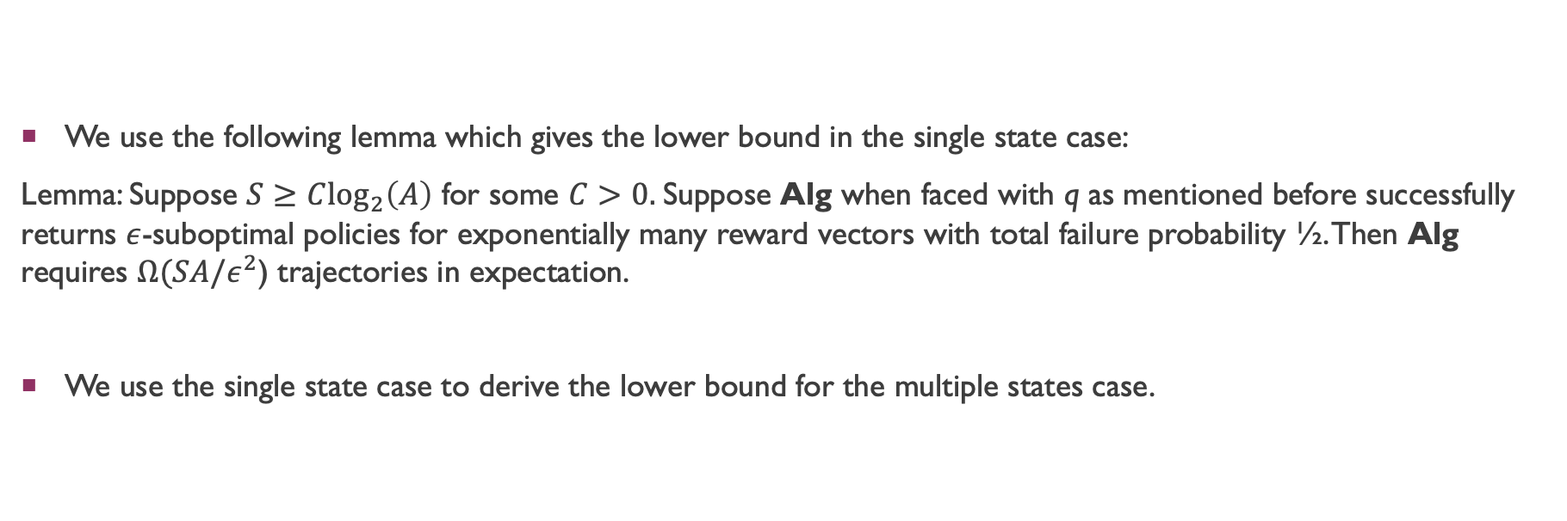
Reward free Exploration at Single State
We use the following lemma which gives the lower bound in the single state case:
Lemma: Suppose $S≥C\log_{2}\left(A\right)$ for some $C>0.$Suppose Alg when faced with q as mentioned before successfully returns $ε$-suboptimal policies for exponentially many reward vectors with total failure probability ½. Then Alg requires $Ω(SA/ε^{2}$) trajectories in expectation.
We use the single state case to derive the lower bound for the multiple states case.

Slide 21
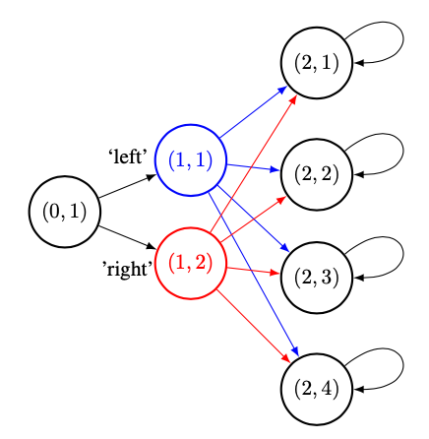
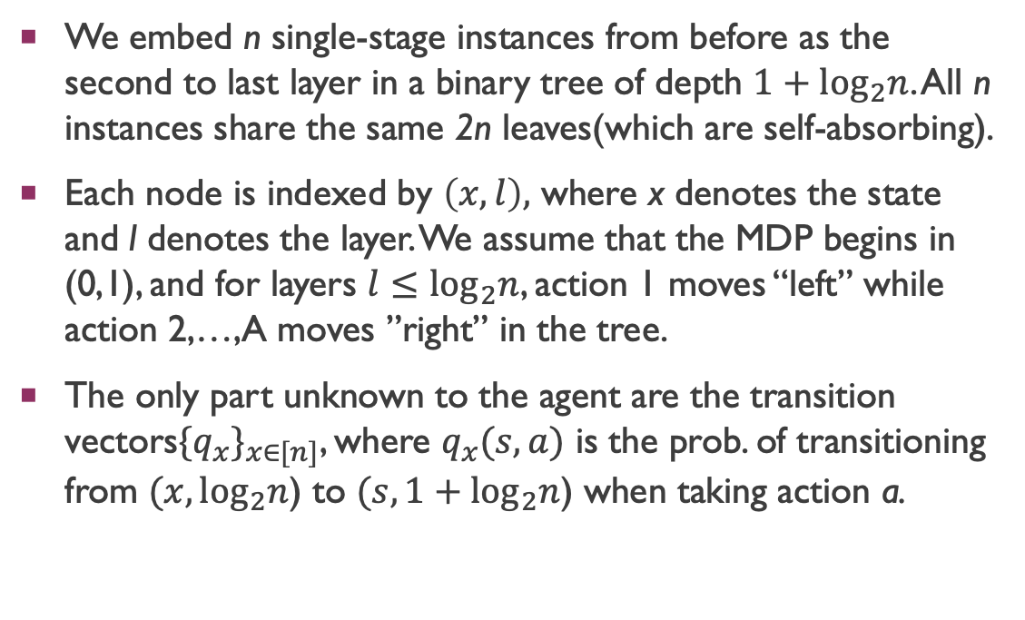
Lower Bound for Multiple States
We embed n single-stage instances from before as the second to last layer in a binary tree of depth $1+\log_{2}n$. All n instances share the same 2n leaves(which are self-absorbing).
Each node is indexed by $\left(x,l\right),$ where x denotes the state and l denotes the layer. We assume that the MDP begins in (0,1), and for layers $l≤\log_{2}n$, action 1 moves “left” while action 2,…,A moves ”right” in the tree.
The only part unknown to the agent are the transition vectors${\{q_{x}\}}_{x∈[n]}$, where $q_{x}(s,a)$ is the prob. of transitioning from $(x,\log_{2}n$) to $(s,1+\log_{2}n$) when taking action a.

Slide 22
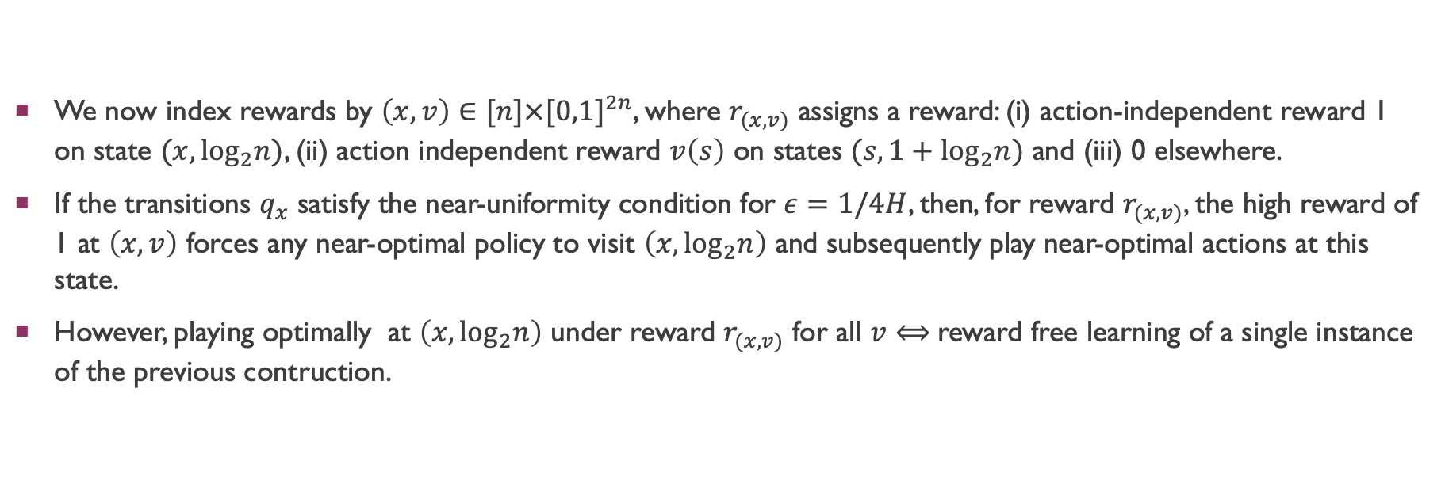
Lower Bound for Multiple States
We now index rewards by $\left(x,v\right)∈[n]×{[0,1]}^{2n}$, where $r_{(x,v)}$ assigns a reward: (i) action-independent reward 1 on state $(x,\log_{2}n)$, (ii) action independent reward $v\left(s\right)$ on states $(s,1+\log_{2}n)$ and (iii) 0 elsewhere.
If the transitions $q_{x}$ satisfy the near-uniformity condition for $ε=1/4H$, then, for reward $r_{(x,v)}$, the high reward of 1 at $\left(x,v\right)$ forces any near-optimal policy to visit $\left(x,\log_{2}n\right)$ and subsequently play near-optimal actions at this state.
However, playing optimally at $\left(x,\log_{2}n\right)$ under reward $r_{(x,v)}$ for all $v$ $⟺$reward free learning of a single instance of the previous contruction.

Slide 23

Lower Bound for Multiple States
By varying $x∈[n]$ for the reward vectors, agent needs to learn n instances. So, the lower bound becomes $Ω\left(n∙\frac{nA}{ε^{2}}\right)=Ω\left(\frac{S^{2}A}{ε^{2}}\right)$.
By using the absorbing states to create a chain of $Ω\left(H\right)$ rewards, we get $Ω\left(\frac{H^{2}S^{2}A}{ε^{2}}\right)$.

Slide 24
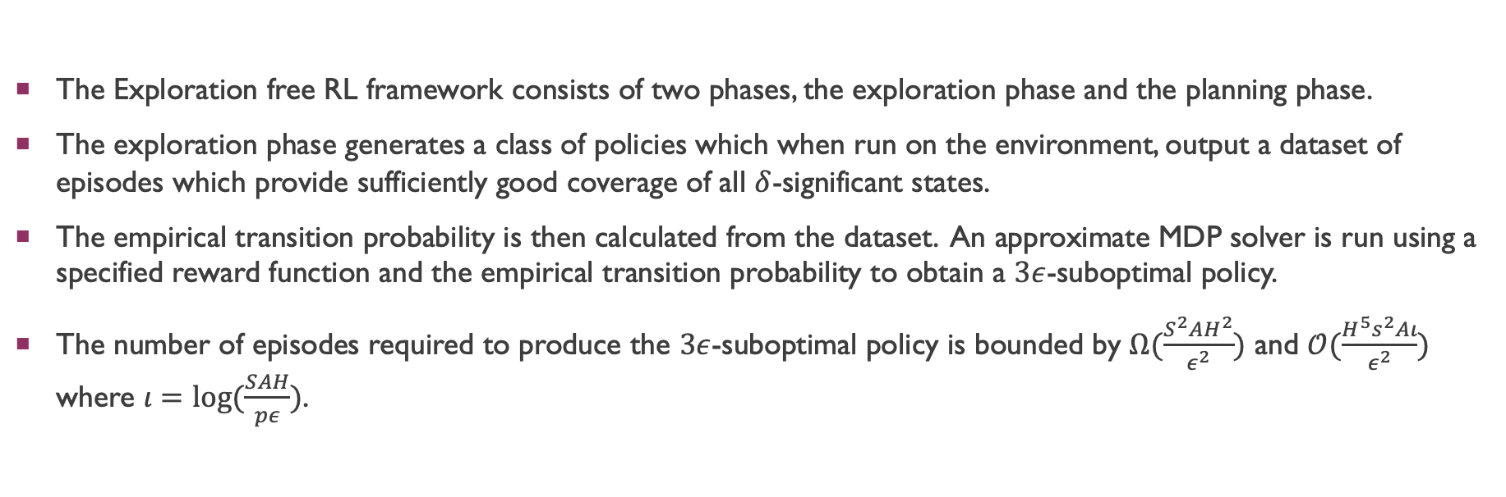
Conclusion
The Exploration free RL framework consists of two phases, the exploration phase and the planning phase.
The exploration phase generates a class of policies which when run on the environment, output a dataset of episodes which provide sufficiently good coverage of all $δ$-significant states.
The empirical transition probability is then calculated from the dataset. An approximate MDP solver is run using a specified reward function and the empirical transition probability to obtain a $3ε$-suboptimal policy.
The number of episodes required to produce the $3ε$-suboptimal policy is bounded by $Ω(\frac{S^{2}AH^{2}}{ε^{2}})$ and $𝒪(\frac{H^{5}s^{2}Aι}{ε^{2}})$ where $ι=log⁡(\frac{SAH}{pε})$.

Slide 25
Bibliography
Reward-Free Exploration for Reinforcement Learning, Jin, Krishnamurthy, Simchowitz, Yu.
Tighter problem-dependent regret bounds in reinforcement learning without domain knowledge using value function bounds, Andrea Zanette and Emma Brunskill.
Sample complexity of episodic fixed-horizon reinforcement learning, Christoph Dann and Emma Brunskill.

