Slide 1
Comm Control
InnovateLA x Dual-Use Hackathon
Comm Control
A spoken report becomes
a response plan.
Mihir Duvedi
Tyler Tran
Shen Tan
October 2026
01
Notes:
[20 seconds]
Comm Control helps an operations desk turn spoken reports into reviewed incidents, team assignments and routes. Mihir Duvedi handles coding and technology, and Tyler Tran and Shen Tan handle business and research. We built the workflow for the person who has to coordinate a response.
Sources: Local v6.6 verification, docs/V6_6_VERIFICATION.md (October 17, 2026), and supplied project handoff. Screenshots from evidence/. Demo reports, equipment and resources are fictional. Map data © OpenStreetMap contributors.

Slide 2
Comm Control
The person at the desk
Every report leaves the desk
with decisions to make
“There’s smoke near City Hall.
Two people are outside.
I don’t know if anyone
is still inside.”
Where is the event?
Who can respond?
Which path is open?
02
Notes:
[25 seconds]
Picture an overnight supervisor. Reports are coming in and teams are already busy. A transcript gives them the words, but they still need to locate the event, find someone who can handle it and check the path. Every new report brings another set of decisions.
Sources: Project handoff and official participant problem statement, https://docs.google.com/document/d/1a6SQQuvQJoI5g6YQUjzOVkruyOI94UwS-c1Wbrz-dsY/edit

Slide 3
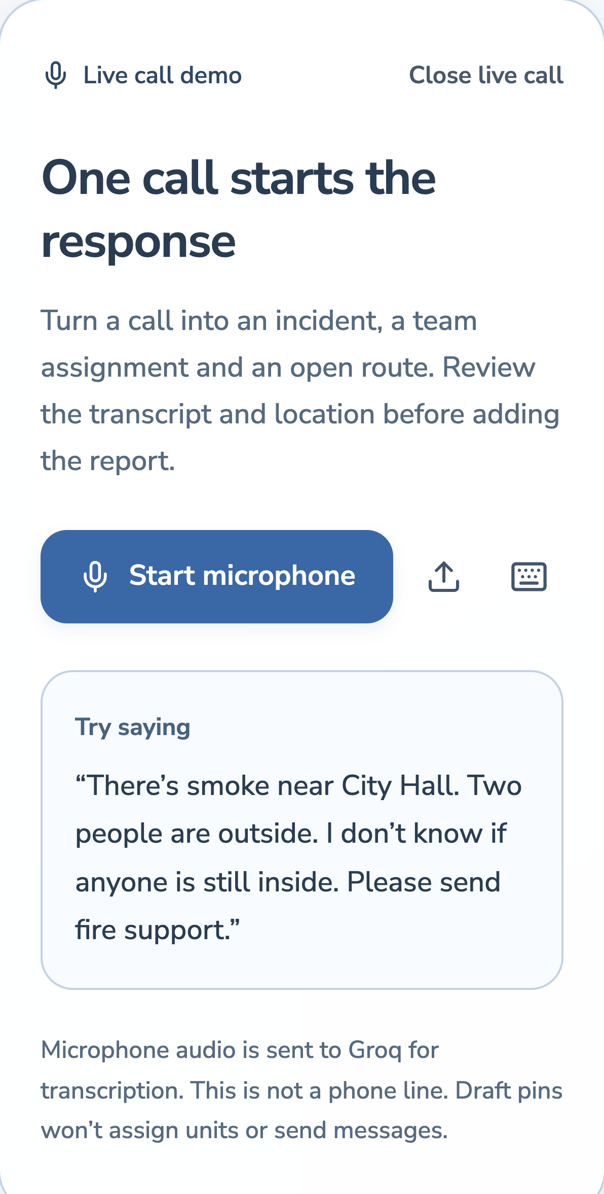
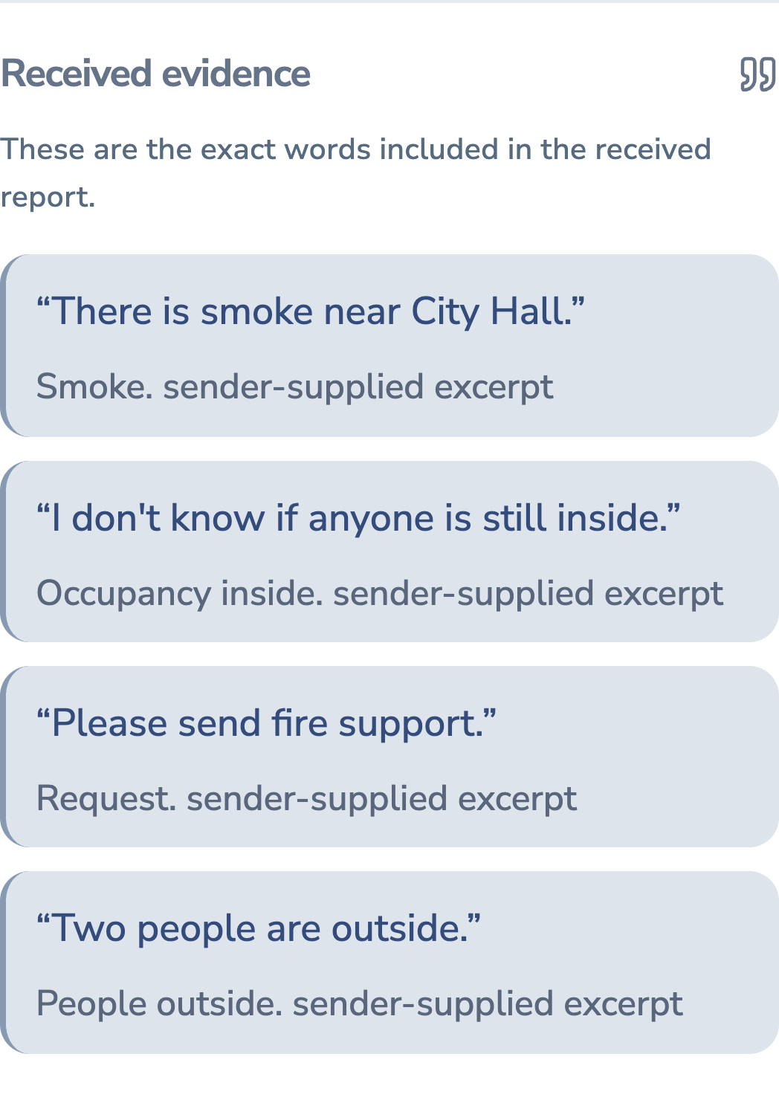
Comm Control
Voice intake and source evidence
The report keeps its source
Speak
Record the report
in the browser.
Review
Check the facts
against the report.
03
Notes:
[40 seconds]
These are actual demo captures. The operator records a report through the browser microphone. Groq transcribes it and extracts the reported facts. The operator reviews the transcript and event location before adding the incident. Here, the source says two people are outside. It does not establish whether anyone is inside. That uncertainty stays visible.
Sources: Local v6.6 verification, docs/V6_6_VERIFICATION.md (October 17, 2026), and supplied project handoff. Screenshots from evidence/. Demo reports, equipment and resources are fictional. Map data © OpenStreetMap contributors.
Fresh high-resolution captures from the locally running prototype, in an isolated synthetic capture workspace on October 17, 2026. Intake and evidence show the same fictional scenario in separate demonstration states.

Slide 4
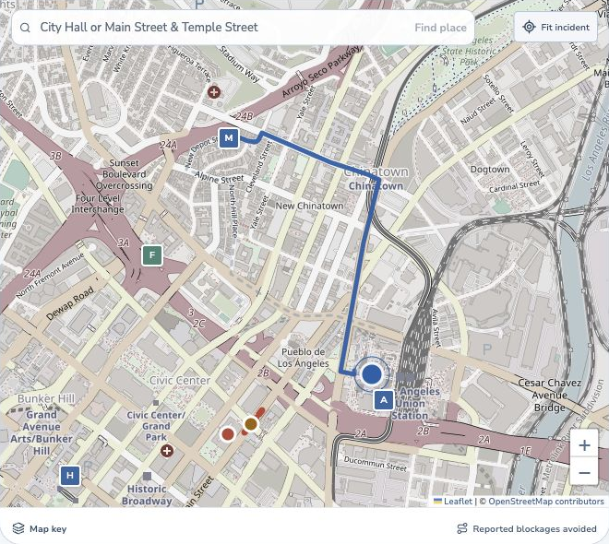
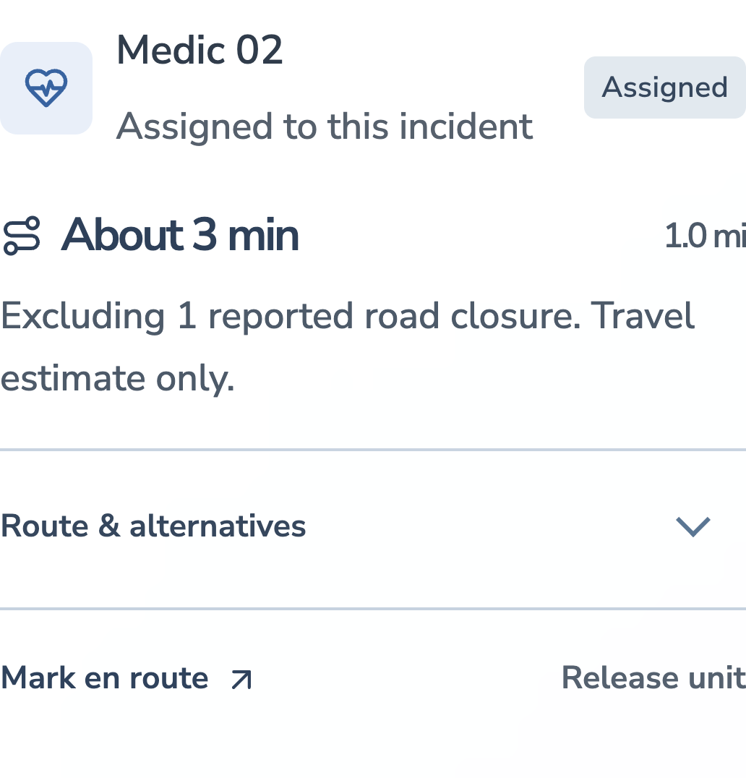
Comm Control
The response plan
A team and a way there
Union Station
A suitable available unit.
A route around the
reported blockage.
Map data © OpenStreetMap contributors.
04
Notes:
[45 seconds]
Once the reviewed incident reaches the desk, Comm Control looks for an available team with the right capability and a usable route. Here, a medical report at Union Station has a team assignment and a route around a reported closure. The operator can inspect the choice and review a reply. The demo resources are simulated and travel times are estimates.
Sources: Local v6.6 verification, docs/V6_6_VERIFICATION.md (October 17, 2026), and supplied project handoff. Screenshots from evidence/. Demo reports, equipment and resources are fictional. Map data © OpenStreetMap contributors.

Slide 5
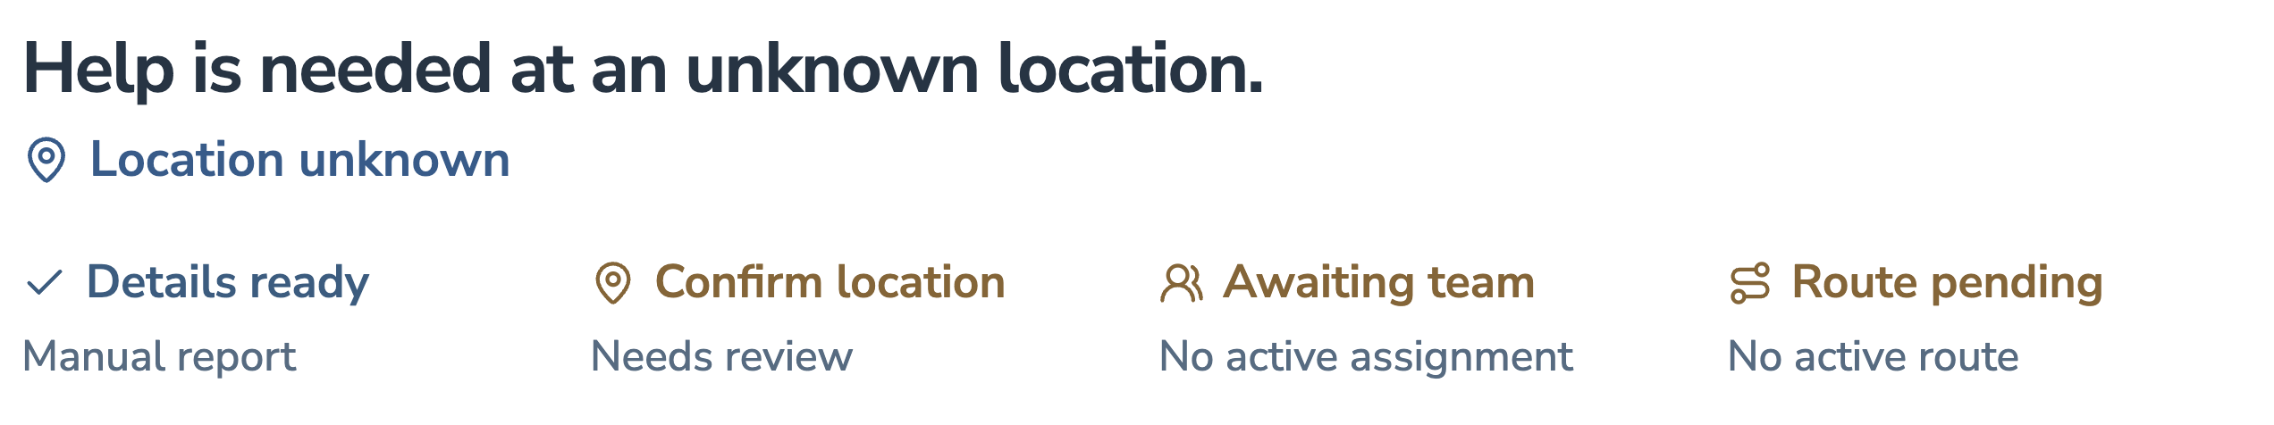
Comm Control
Human review
If the location is missing,
the route waits.
Uncertainty stays in the case until someone resolves it.
05
Notes:
[25 seconds]
When the location is missing, the route waits. The operator can correct the location and inspect the source before proceeding. Outbound instructions require review too. A delivery receipt does not establish understanding, and reported closures stay active until supported clearance or manual reopening.
Sources: Local v6.6 verification, docs/V6_6_VERIFICATION.md (October 17, 2026), and supplied project handoff. Screenshots from evidence/. Demo reports, equipment and resources are fictional. Map data © OpenStreetMap contributors.

Slide 6
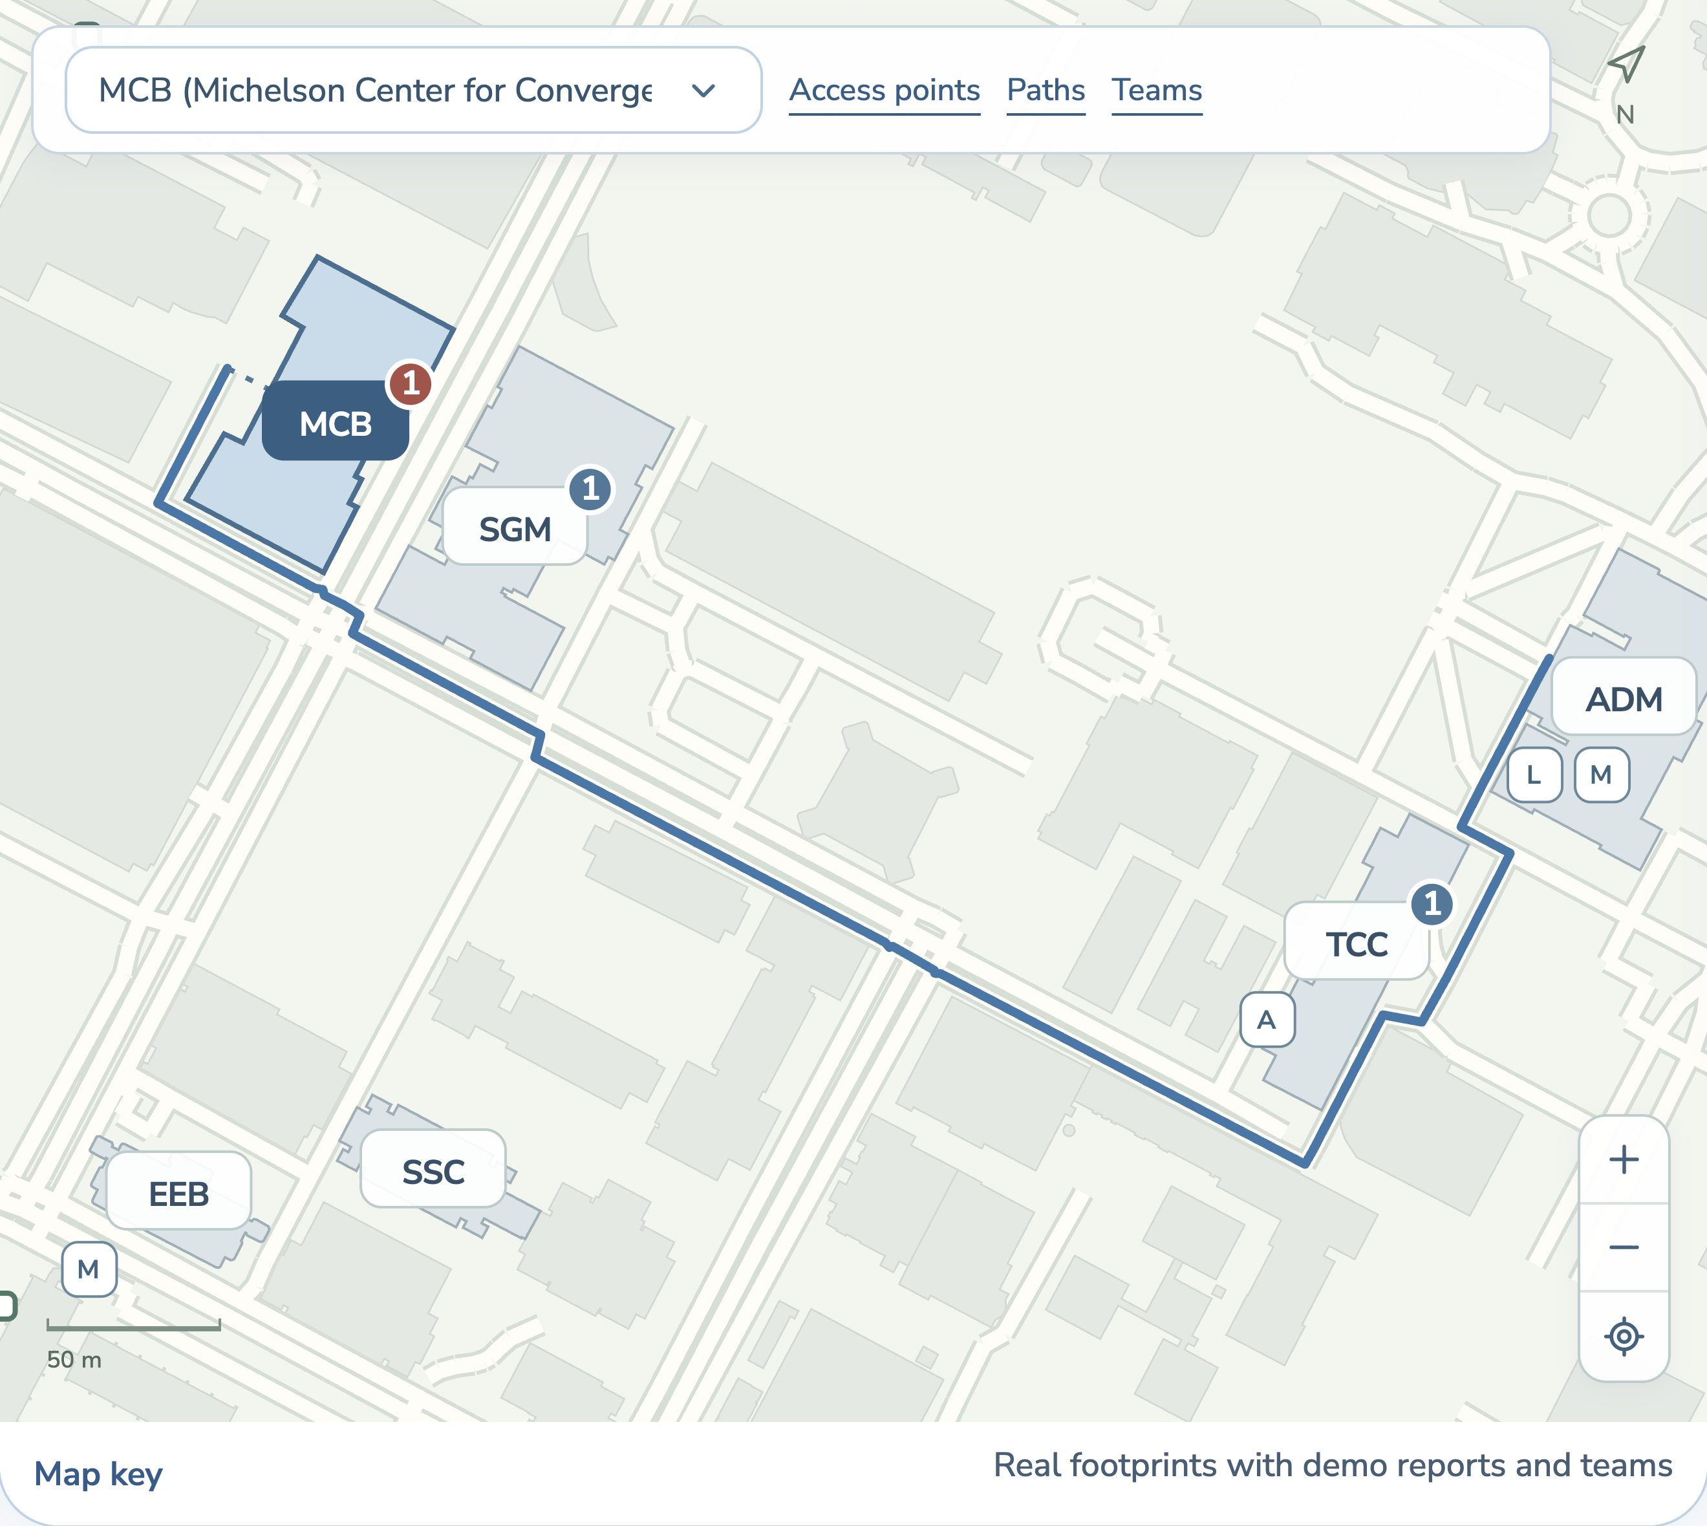
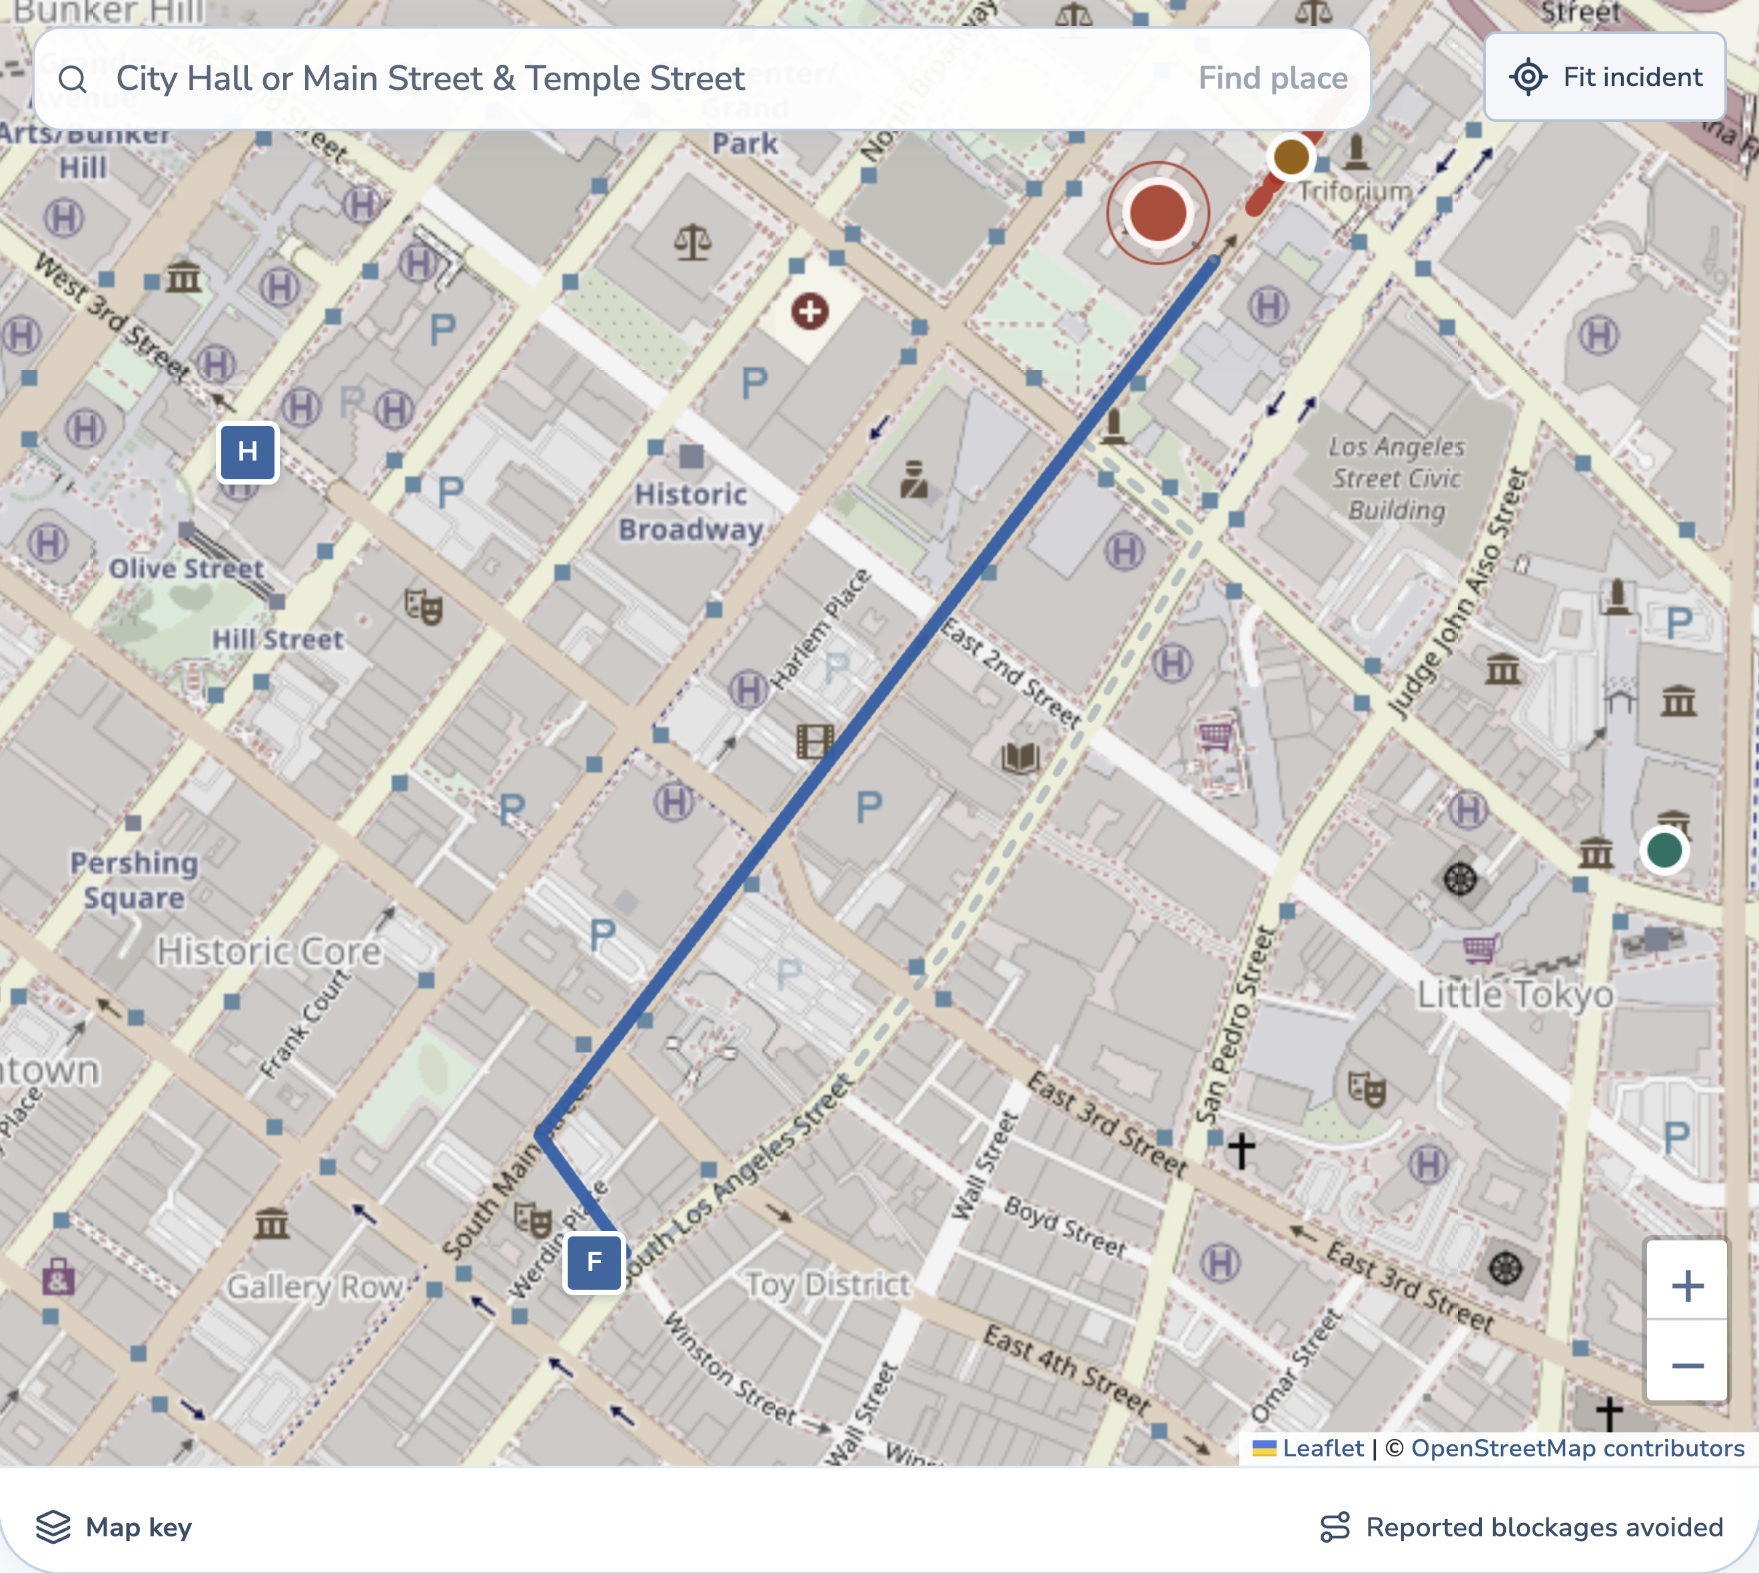
Comm Control
Everyday and government use
Everyday operations and
emergency response
Everyday facilities
Emergency responders
Campuses, warehouses and buildings
Incident surge coordination
Map data © OpenStreetMap contributors.
06
Notes:
[30 seconds]
On an ordinary day, a campus, warehouse or large building could use this desk for equipment checks and access problems. Emergency responders could deploy the same workflow during an incident surge. Both need suitable teams and usable paths. Government deployment would require operational validation. Our USC demo uses fictional reports and teams.
Sources: Local v6.6 verification, docs/V6_6_VERIFICATION.md (October 17, 2026), and supplied project handoff. Screenshots from evidence/. Demo reports, equipment and resources are fictional. Map data © OpenStreetMap contributors.
User confirmed the government twist framing. No agency deployment or partnership is claimed.

Slide 7
Comm Control
What we built
The workflow runs end to end
Voice and extraction
Hosted Groq models. Internet required.
Review and incident records
React, FastAPI and SQLite.
Allocation and routing
Capability, availability and reported closures.
Delivery model
Compact packets, retries and receipts in simulation.
241 backend tests passed
45 distinct browser checks passed
07
Notes:
[25 seconds]
The build combines React, FastAPI and SQLite with hosted Groq speech and extraction. AI needs internet, while saved records, cached maps and routing run locally. Packet loss and retries are simulated. The v6.6 verification records 241 backend tests and 45 browser checks, with four hosted checks skipped. These counts are engineering checks, not accuracy scores.
Sources: Local v6.6 verification, docs/V6_6_VERIFICATION.md (October 17, 2026), and supplied project handoff. Screenshots from evidence/. Demo reports, equipment and resources are fictional. Map data © OpenStreetMap contributors.

Slide 8
Comm Control
The global twist
One site first.
Then more regions.
Expansion roadmap
Language support
Regional maps
First pilot
An LA facilities team first.
Then a Spanish-language
warehouse pilot in Mexico City.
Local response procedures
08
Notes:
[30 seconds]
We would start with one LA facilities team and a permissioned map. For the global twist, a proposed next test is a Spanish-language warehouse workflow in Mexico City. That needs language support, a local site map and local procedures. These are roadmap items. We would validate them with the people using the system.
Sources: User's global-twist direction. Rollout is proposed. Competitive context verified October 17, 2026 at https://relaypro.com/solutions/logistics/ and https://www.prepared911.com/blog/assistive-dispatch-available-nationwide

Slide 9
Comm Control
Revenue and federal funding
Site setup and
a software subscription
Site setup
$2,000
Map, terminology and workflow configuration
Subscription
$500 per site / month
Federal funding route: DHS S&T SBIR Phase I
09
Notes:
[35 seconds]
We would test a two-thousand-dollar setup fee and a five-hundred-dollar monthly site subscription. Those are proposed prices. For the funding twist, an alternative route is a matching DHS Science and Technology SBIR Phase I solicitation for mission-related research. We would need an eligible US small business and a suitable topic. We are not claiming an application or award.
Sources: Proposed pricing and arithmetic: 100 sites × $500 per month × 12 = $600,000 ARR. No current revenue, customers or willingness-to-pay study is claimed. Federal funding pathway: DHS S&T SBIR, subject to small-business eligibility, topic fit and solicitation availability. Sources: https://www.sbir.gov/participating-agencies and https://www.dhs.gov/science-and-technology/small-business-innovation-research, checked October 17, 2026.

Slide 10
Comm Control
Thank you
We’d love to test this
with a real facilities team
Help us learn what makes the desk’s job easier
and where Comm Control needs to improve.
Mihir Duvedi
Tyler Tran
Shen Tan
Coding and technology
Business and research
Business and research
10
Notes:
[20 seconds]
We’d love to test Comm Control with a real facilities team. We want to hear what helps, what gets in the way and what we need to improve. Mihir built the technology, and Tyler and Shen led business and research. Thank you.
Sources: Team names and roles supplied by user. Pilot is proposed. User says the twist-three poster is in progress, so no completed poster is claimed.

