Slide 1
Team: 22
  Ujas Bhuva (40262595)
  Yash Chelaiya (40257682)
  Mihir Gediya (40272399)
  Arik Kantesariya (40272574)
  Pranav Sakariya (40264062)
Distributed System Design - Project
IMAGINE (Image generative AI)

Slide 2
IMAGINE
IMAGINE provides Cutting-edge Image Generation and Prompt-based image browsing functionality powered by AWS OpenSearch.
Using this app users can generate multiple images using SDXL model at a time.
Distributed components of the system ensures the scalability and seamless fault tolerance mechanism. System uses AWS services such as SQS, Lambda, and CloudWatch to efficiently execute image generation requests, maintaining optimal performance and responsiveness.
IMAGINE web-app is built using NextJS as a frontend and FastAPI backend as a service. Here backend is responsible for sending requests to SQS and executing incoming requests from Lambda function. Backend is most crucial component.

Slide 3
Dataset
Dataset of ai-generated-images is a dataset that contains links of images and prompts along with the other data.
It contains multiple images links for a single row, and contains 2.4 million rows in total.

Slide 4
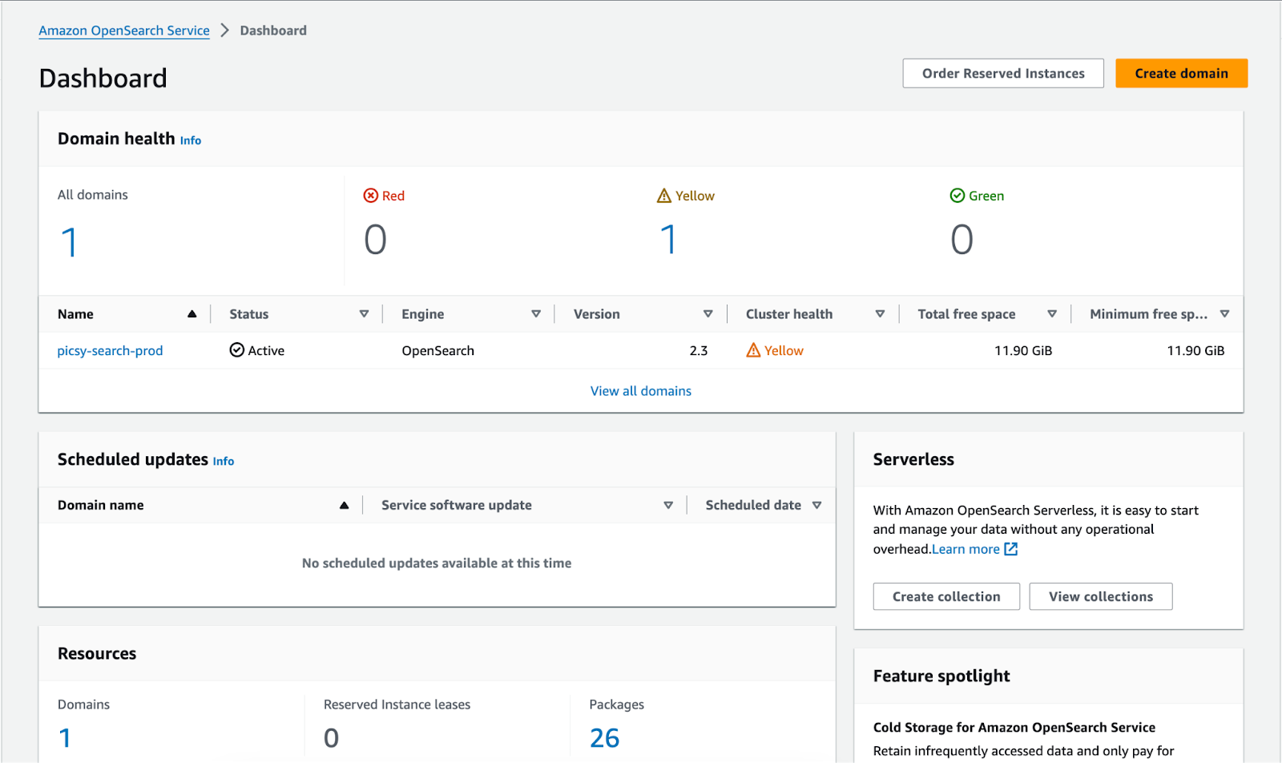
OpenSearch for indexing dataset
OpenSearch is a tool provided by AWS for indexing the data. It uses an ElasticSearch-like approach to make search faster.
For hosting the OpenSearch index, AWS uses EC2 instance to process the incoming query and OpenSearch based storage to store the indexes.
Users can enter the query from frontend to browse AI generated Images. Backend will process that query and make a searchable query and execute that query on OpenSearch.
OpenSearch index hosted in AWS

Slide 5
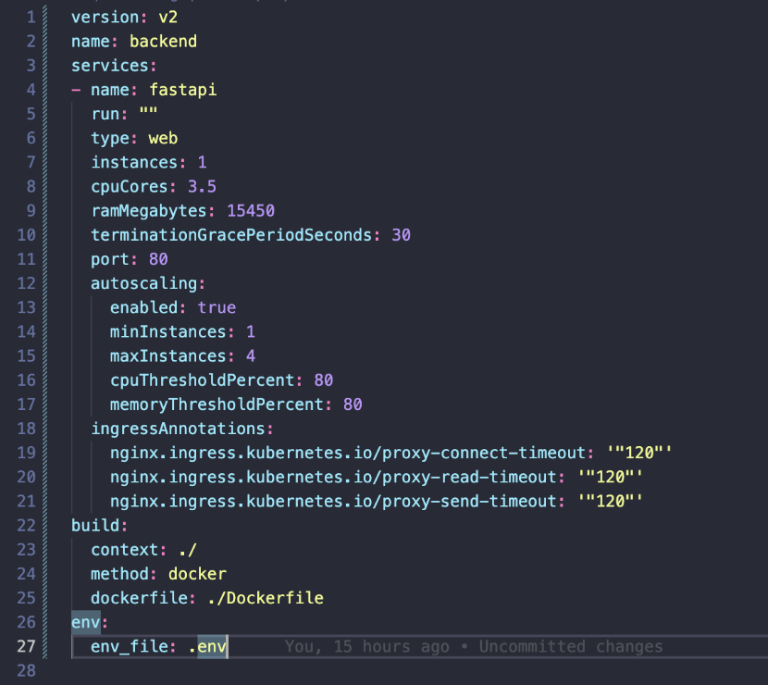
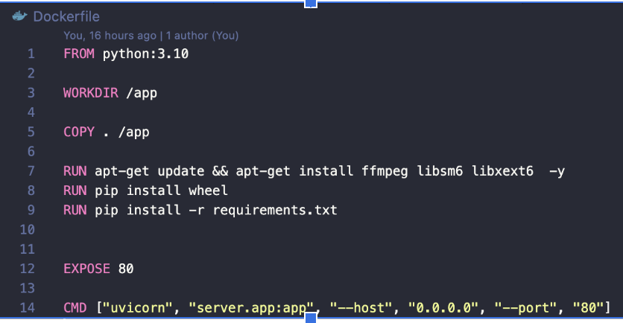
Dockerized FastAPI
This application uses python based FastAPI library to handle the API request, enabling communication between the frontend and database.
Currently this backend service is Dockerized. It uses Google Artifact Registry to save the built images.
Below is the code of Dockerfile, we are using porter_stack_backend.yml to run the deployment pipeline in Kubernetes.
1. Dockerfile code
2. Deployment pipeline

Slide 6
Deploying via Porter
To do automated deployment and monitor the usage we are currently using porter.run service.
Above porter_stack_backend.yml file shows deployment pipeline gets executed when any build creation event triggers, i.e. pushing new code to git repo.
Each deployment builds new image of the backend application and pushes it to the Google Artifact Registry to use the same build on later stage of deploying actual app into cluster.
Porter app provides an interface to analyze the logs of running applications and deployment logs we can check on GitHub Action pipeline.
Porter app deploys FastAPI and also binds port 80 to application as mentioned in cluster configuration to make it available for global HTTP traffic and also provides one subdomain for app.
Along with these steps, initially porter describes steps to deploy whole Kubernetes cluster in GCP.

Slide 7
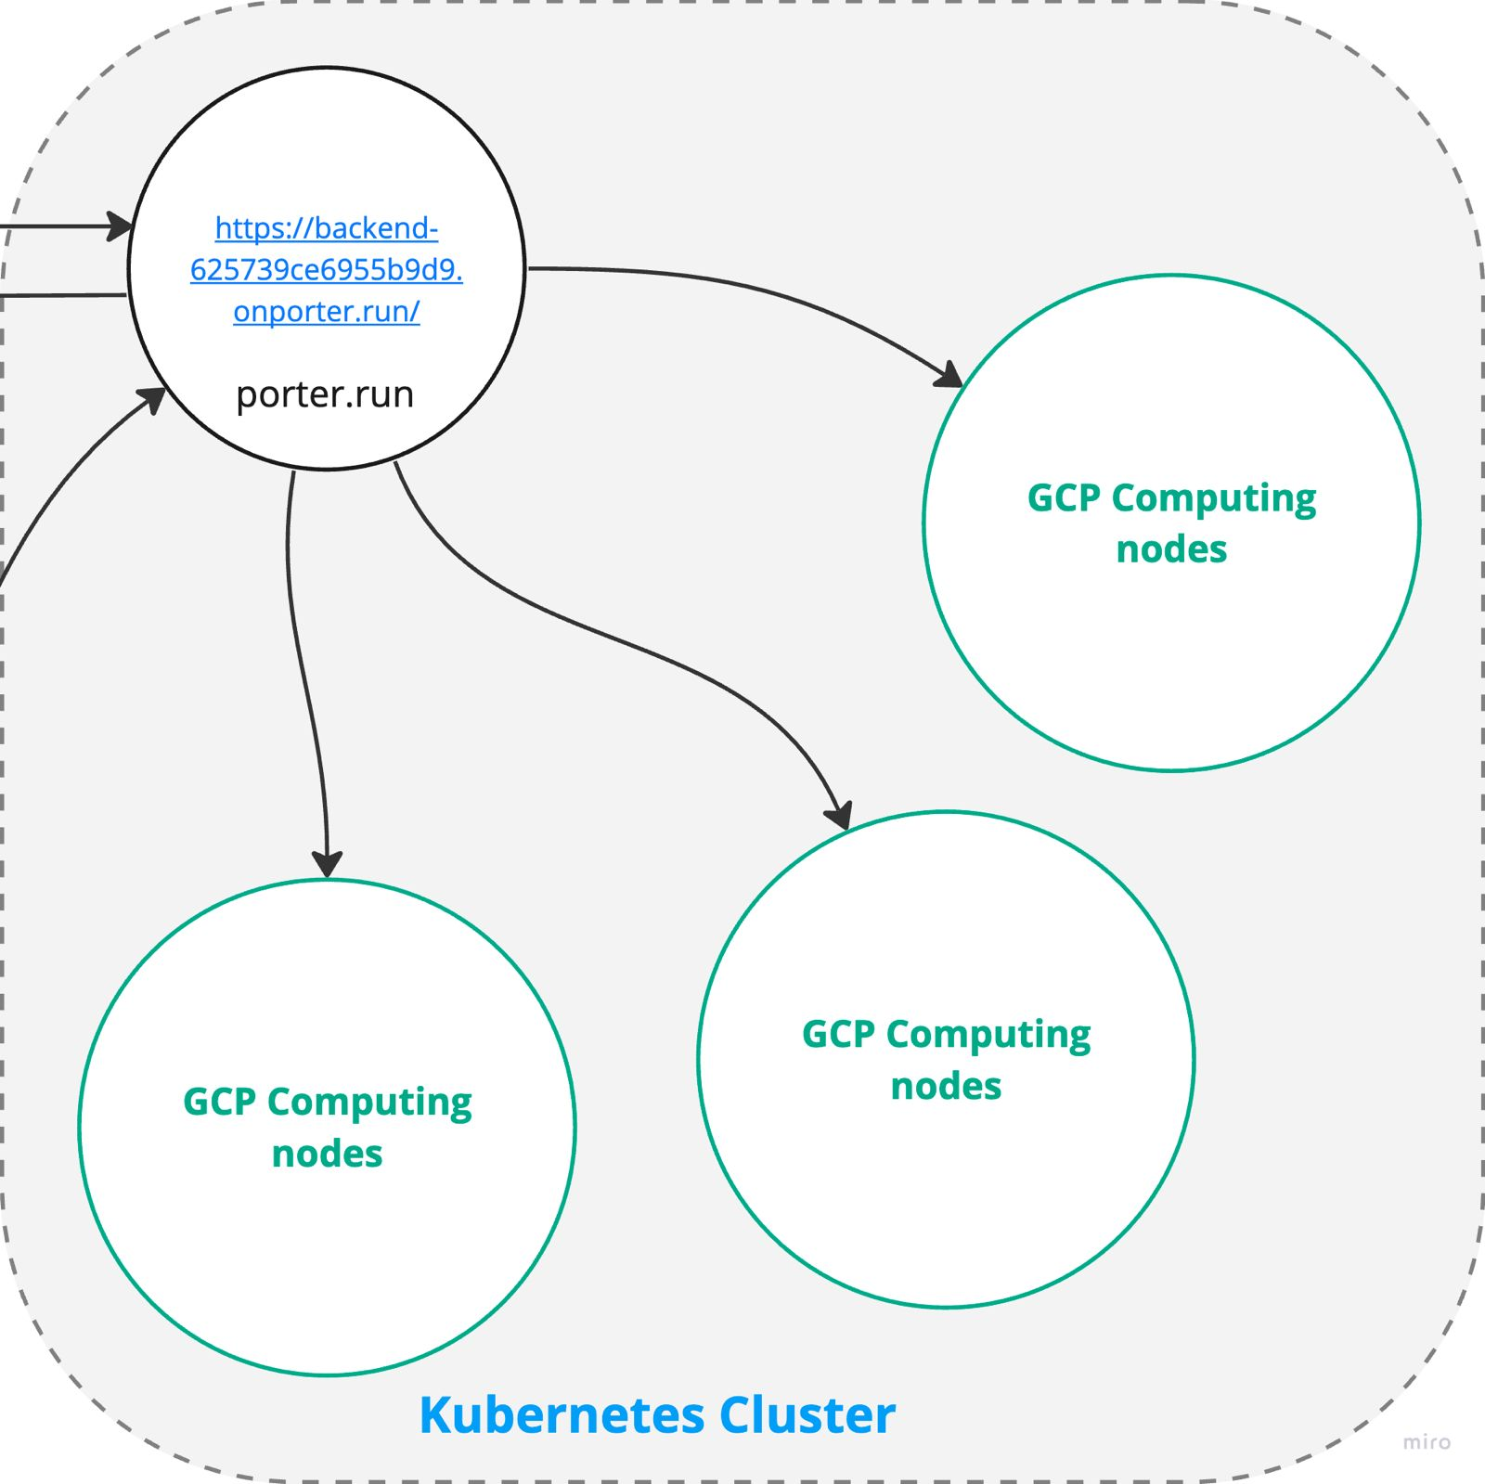
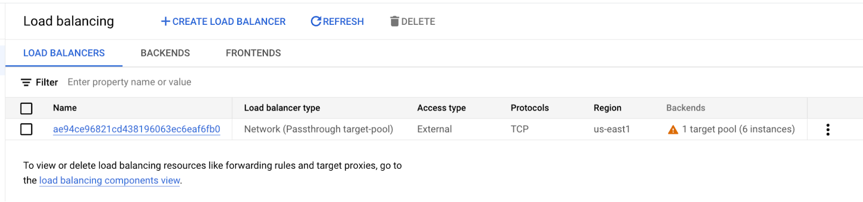
Kubernetes cluster (with load balancer node)
Here we are using GCP to deploy 6 nodes of e2-standard-8 which has 32 GB RAM and 8 vCPUs to handle the load of SDXL model. For demonstration purpose here we have added 4 nodes with 1 load balancer.
4. Load balancer node in GCP’s kubernetes cluster
3. Kubernetes cluster with 4 nodes

Slide 8
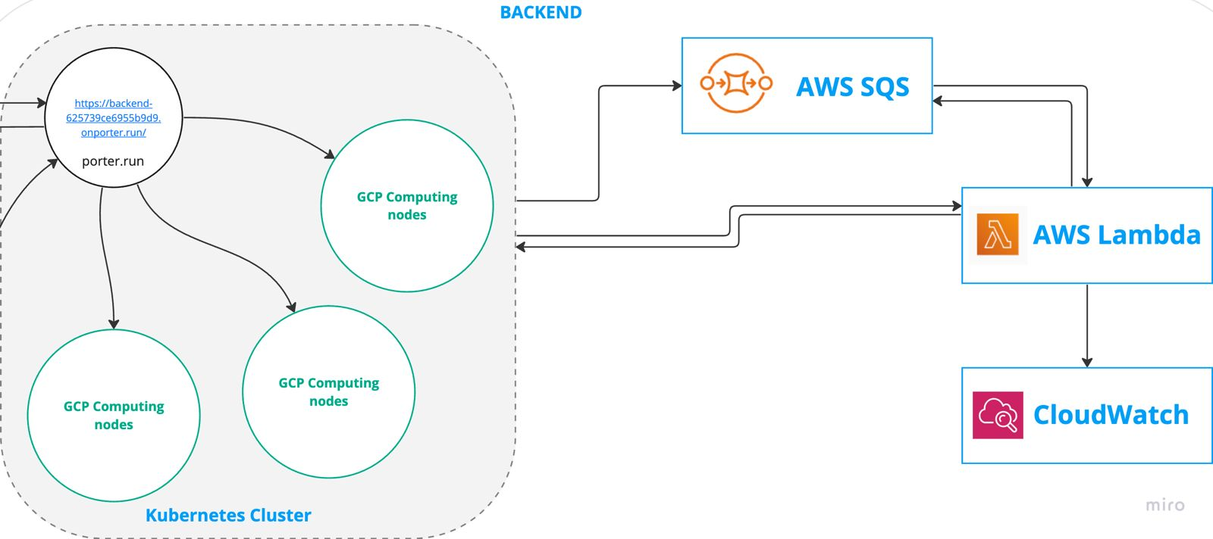
Image Generation
Image generation in application happens using SDXL model, and AWS different services including Lambda, SQS and S3 bucket.
User can add multiple image generation request from web application. This action adds that request message to SQS via backend and it give 200 HTTP OK response to frontend.
SQS then triggers the lambda function with the data in message. This invocation of Lambda function happens automatically by SQS.
Lambda function then calls backend RestFUL APIs according to need (Additionally execution logs are saved to CloudWatch).
5. Executing image generation request

Slide 9
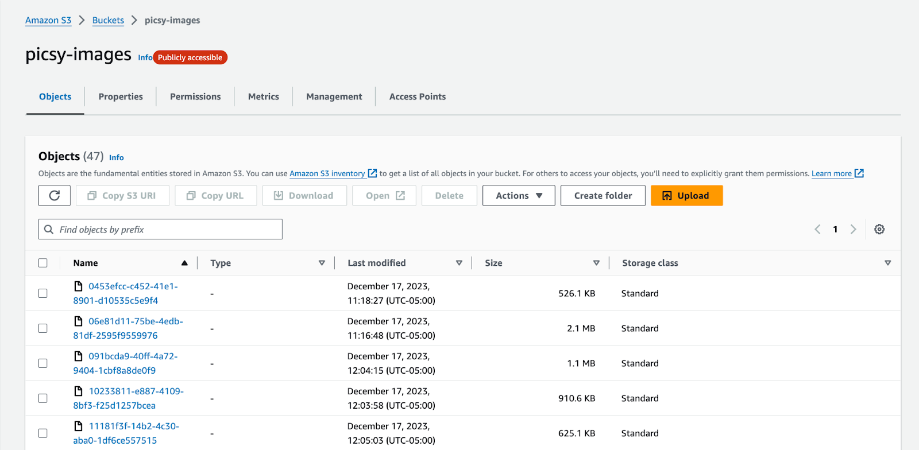
AWS S3 Bucket
AWS S3 Bucket is a platform to manage the content delivery network where we can host different file objects in bucket space.
This service is used here to save the generated Images.
Image below shows the established S3 bucket on AWS.
6. S3 bucket on AWS

Slide 10
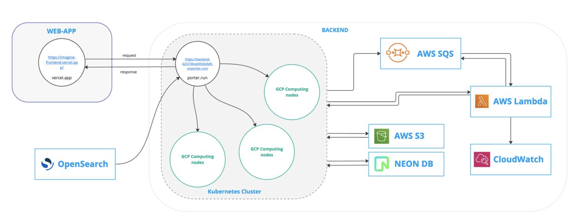
Whole Architecture
7. Architecture diagram of application

Slide 11
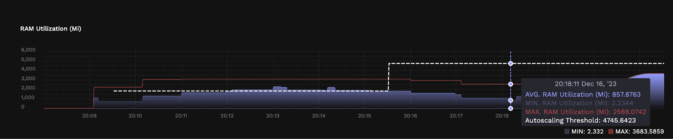
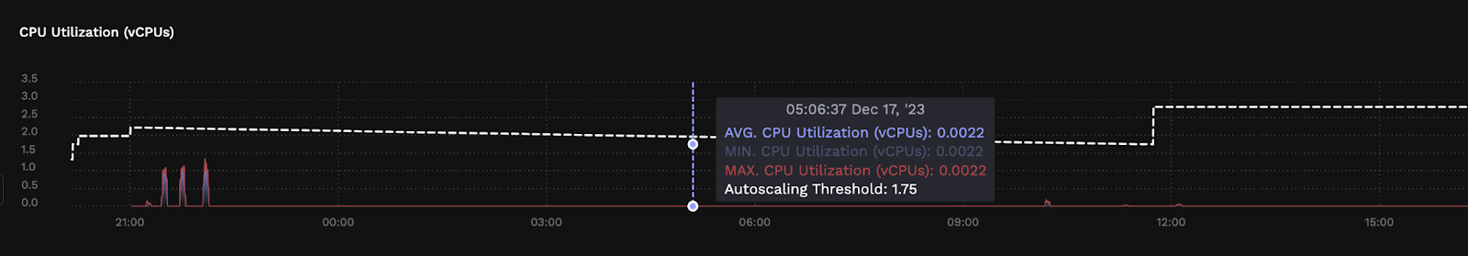
Analysis - Resource Usage
For testing the horizontal scaling we can push many requests to the cluster via SQS and try to hit the threshold value that will deploy the new node in the cluster and note the RAM usage from porter.
Here as the image shows, during the time 20:11 application hit the threshold and application added a new node in the cluster so after a few minutes at 20:15 it deployed a new node and threshold memory became higher. This same applies to CPU usage.
8. Memory usage
9. CPU usage

Slide 12
Analysis - Fault tolerance
By killing one of the nodes in the cluster we can continue generating new images using backend app.
There is one more mechanism added along with this, we can fail request forcefully by selecting force fail from web-app. This flag will raise an error from backend and lambda function will add that message back to SQS with increased fail_count by 1. It will try to execute that request message maximum 3 times, and if it is still failing then it will not further process the message resulting into failure (this scenario we can consider as failure due to programming error).

Slide 13
Conclusion
We can build robust, fault-tolerant, and scalable systems using the distributed system for generating AI images.
  Performance: We can improve the application’s overall performance using many nodes in the cluster because many nodes can handle many requests. Also, by using SQS, we can reduce the waiting time for users to send requests for generating multiple images at a time.
  Scalability: Using the Kubernetes cluster, we can distribute the load of the application among many nodes and make it dynamic to deploy new nodes based on load.

Slide 14
Thank You!

