Slide 1
Building an Image Caption Generator using CNN-LSTM from Scratch
EC9170
DEEP LEARNING FOR ELECTRICAL AND COMPUTER ENGINEERS
MINI PROJECT
A.B.O.P. NANDARATHNA - 2021/E/012
A.M. SHANIKA - 2021/E/014

Slide 2
Key Components:
Feature Extraction: InceptionV3 (2048-dim vectors)
Sequence Model: LSTM with 512 units
Training Data: 40,450 images with cleaned captions
Vocabulary: 10,000 words

Slide 3
Model Architecture
Pipeline:
1. Image → InceptionV3 → Features
2. Text → Tokenization → Embedding
3. Combined → LSTM → Caption
Key Layers:
RepeatVector to align image features with text
TimeDistributed Dense layer for word prediction
Teacher forcing with shifted sequences
Training:
20 epochs (early stopping)
Val accuracy: 83.9%

Slide 4
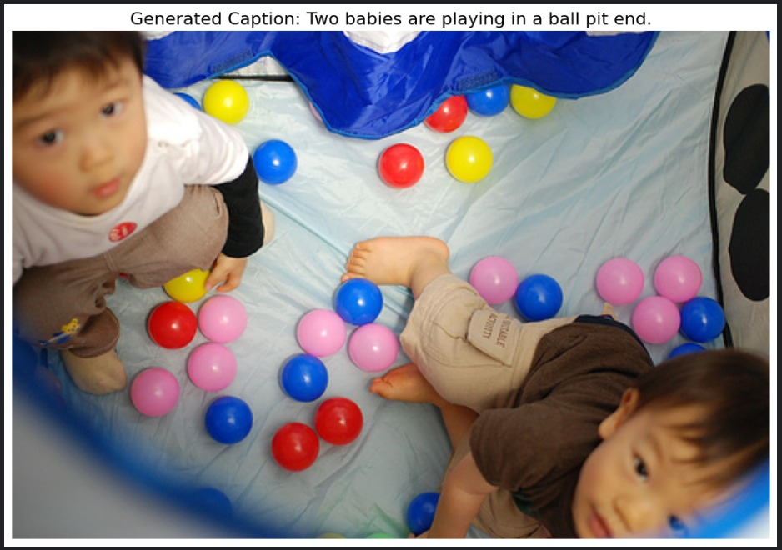
Results

Slide 5
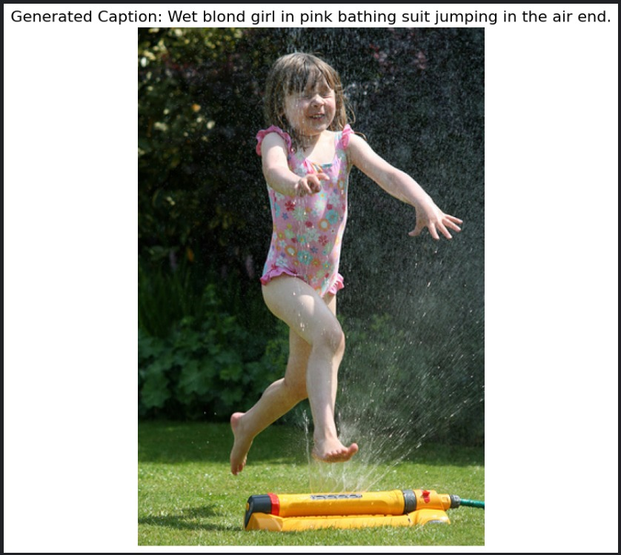
Results

Slide 6
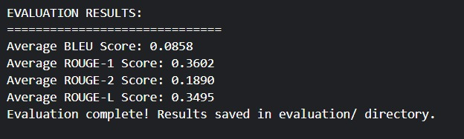
Evaluation Results

