Slide 1
REPLACEMENT ALGORITHM
Presented By: 2021/E/014
2021/E/053

Slide 2
Content
Introduction
Main and Sub Tasks
Objectives
Output Explanation
User Interface
Algorithm Implementation
Conclusion

Slide 3
Introduction
Operating systems use page replacement algorithms to manage memory efficiently.
This project aims to implement and compare FIFO, LRU, LFU and MFU algorithms.
The objective is to determine the best algorithm based on the given reference string.

Slide 4
Main and Sub Tasks
Main Task:
Develop a GUI-based Page Replacement Algorithm Simulator.
Sub Tasks:
Implement FIFO, LRU, LFU and MFU algorithms.
Collect and display step-by-step memory state and page faults in a tabular format.
Compare algorithms based on page faults and efficiency.
Identify the best algorithm for the given reference string.

Slide 5
Objectives
2021/E/014 - Implemented FIFO and LRU algorithms.
2021/E/053 - Developed LFU and MFU logic.
2021/ E / 014 , 053 - Created a summary analysis and best algorithm selection, Designed GUI and user input validation

Slide 6
Output explanation(FIFO)
Reference string: 7, 0, 1, 2, 0, 3, 0, 4, 2, 3, 0, 3, 0, 3, 2
3 frames
7 | 0 | 1 | 2 | 0 | 3 | 0 | 4 | 2 | 3 | 0 | 3 | 2
7 | 7 | 7 | 2 |  | 2 | 2 | 4 | 4 | 4 | 0
 | 0 | 0 | 0 |  | 3 | 3 | 3 | 2 | 2 | 2
 |  | 1 | 1 |  | 1 | 0 | 0 | 0 | 3 | 3

Slide 7
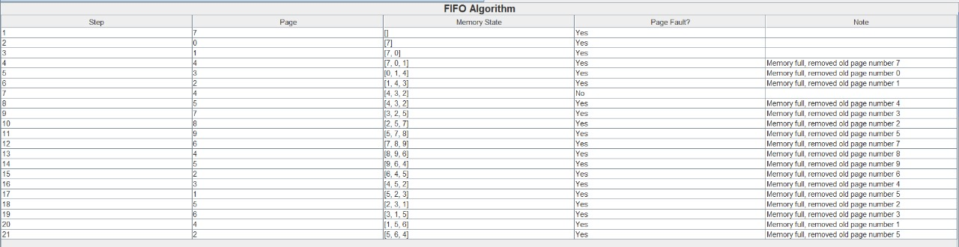
User Interface for FIFO

Slide 8
Output explanation(LRU)
Reference string: 7, 0, 1, 2, 0, 3, 0, 4, 2, 3, 0, 3, 0, 3, 2
3 frames
7 | 0 | 1 | 2 | 0 | 3 | 0 | 4 | 2 | 3 | 0 | 3 | 2
7 | 7 | 7 | 2 |  | 2 |  | 4 | 4 | 4 | 0
 | 0 | 0 | 0 |  | 0 |  | 0 | 0 | 3 | 3
 |  | 1 | 1 |  | 3 |  | 3 | 2 | 2 | 2

Slide 9
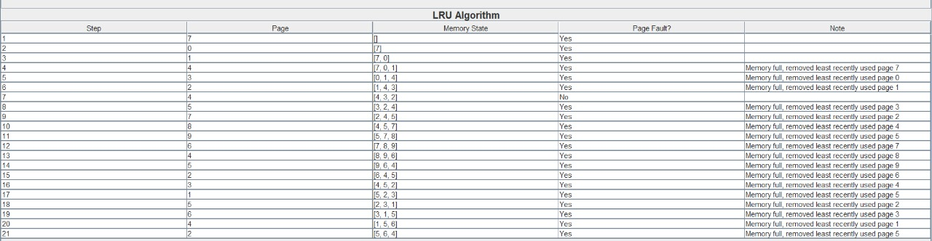
User Interface for LRU

Slide 10
Output explanation(LFU)
String
7
0
1
2
0
3
0
4
2
3
0
3
2
M1
7(F)
7
7
2(F)
2
2
2
4(F)
4
3(F)
3
3
3
M2
0(F)
0
0
0
0
0
0
0
0
0
0
0
M3
1(F)
1
1
3(F)
3
3
2(F)
2
2
2
2
Total Number of Faults = 8
Element
Frequency
7
0
1
1
1
0
0
0
1
1
1
2
2
3
3
3
3
4
4
1
0
1
1
1
0
2
0
1
1
1
1
0
1
1
1
1
3
0
1
1
1
0
1
1
2
4
0
1
1
0

Slide 11
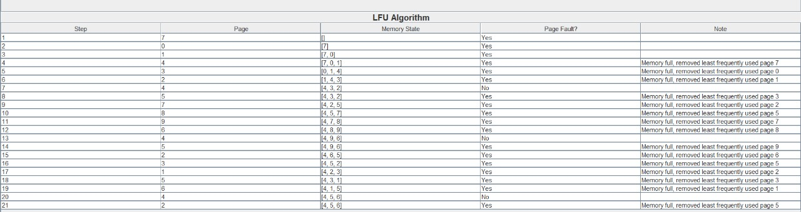
User Interface for LFU

Slide 12
Output explanation(MFU)
String
7
0
1
2
0
3
0
4
2
3
0
3
2
M1
7(F)
7
7
2(F)
2
2
2
4(F)
4
4
0(F)
0
0
M2
0(F)
0
0
0
3(F)
3
3
2(F)
2
2
2
2
M3
1(F)
1
1
1
0(F)
0
0
3(F)
3
3
3
Total Number of Faults = 10
Element
Frequency
7
0
1
1
1
0
0
0
1
1
1
2
0
1
1
1
0
1
1
1
0
1
1
1
1
0
2
0
1
1
1
1
0
1
1
1
1
3
0
1
1
1
0
1
1
2
4
0
1
1
1
0

Slide 13
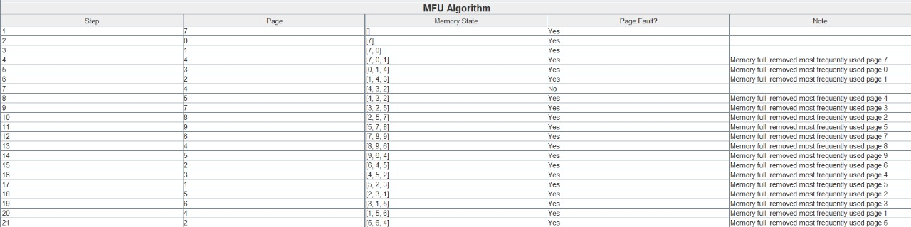
User Interface for MFU

Slide 14
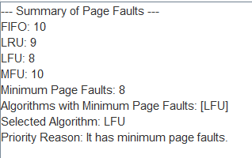
Summary of the algorithms

Slide 15
Algorithm Implementation
FIFO: Uses a queue to replace the oldest page.
LRU: Uses a hash map with timestamps to track usage.
LFU: Maintains a frequency counter for each page.
MFU: Tracks the most used page and replaces it.

Slide 16
Conclusion
Implemented and tested FIFO, LRU, LFU and MFU.
Compared algorithms based on page faults and efficiency.
Best algorithm selection based on:
Lowest page faults
Execution efficiency
Memory management strategy

Slide 17
THANK YOU!

