Slide 1

EDA of Movies Data Using Python

Slide 2
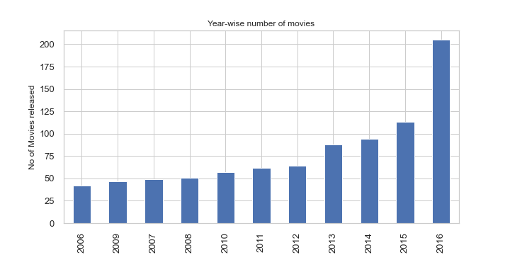
Movies data year-wise
Observation - No of movies year wise in the dataset.
Inference – Not many old movies are there in the dataset.

Slide 3
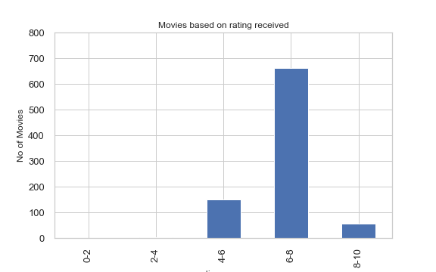
Movies categorized based on rating
Observation – Ratings are grouped using pd.cut function and movies data is plotted.
Inference – Most of the movies fall into rating of 6 to 8. Very few movies got 8+ rating.

Slide 4
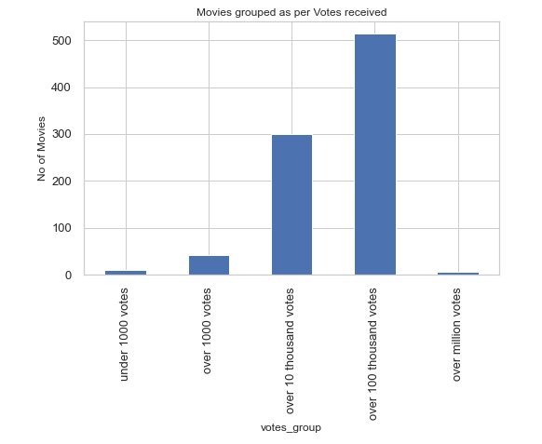
Movies data based on votes received
Observation – Grouped Votes received and plotted against movie data
Inference – Half of the movies in dataset received over 100 thousand votes. There are 6 movies who received over million votes.

Slide 5
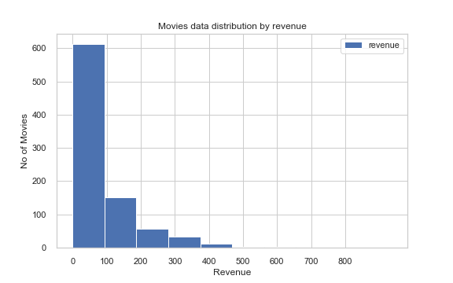
Movies data based on Revenue
Observation – Movies data plotted by Revenue through Histogram
Inference – Most of the movies around 70% have revenues between 0 and 100 millions. Very few movies got higher revenue. Average revenue was 82.95 millions (after cleaning data)

Slide 6
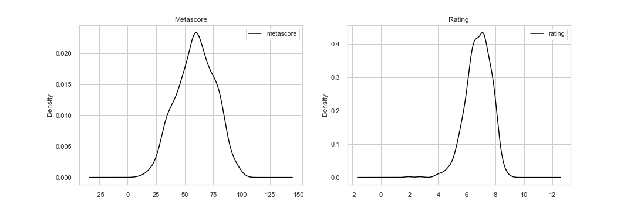
Metascore & Rating – Understanding Distribution
Observation – Drawn kde plot for metascore and rating values to understand distribution
Inference – Metascore have little tip over both ends, but rating is flat and we can see data is between 6-8

Slide 7
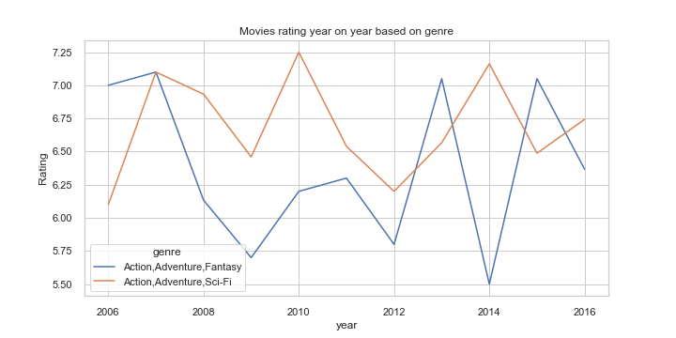
Genre data based on rating Year on year comparison
Observation – We grouped the movies and genre column, plotted a line chart against average rating
Inference – There are ups and down year on year on the average rating for this top 3 genre

Slide 8
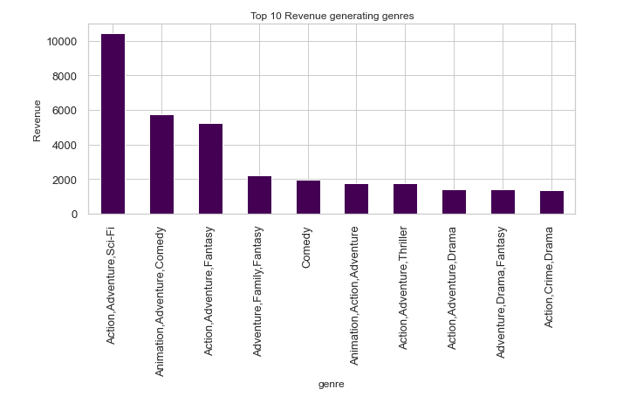
Top 10 revenue generating Genres
Observation – Top 10 genres are sliced and plotted using a bar chart with revenue
Inference – Action, Adventure, Fantasy, Sci-fi are the common genres in top 10 list. These genre movies earn huge revenues

Slide 9
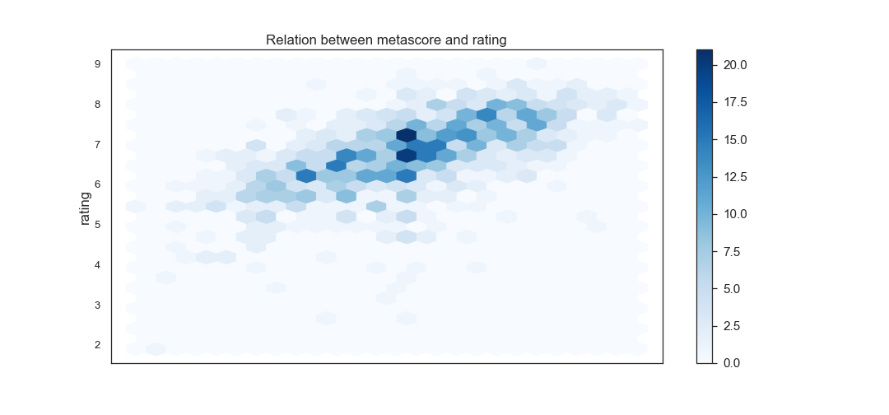
Relation between Metascore and Rating
Positive correlation between metascore and rating

Slide 10
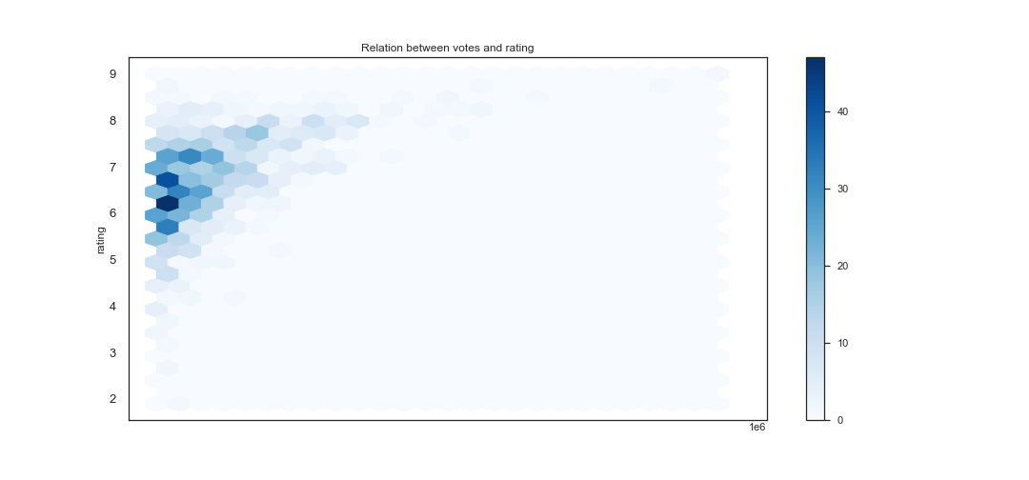
Relation Between Votes and Rating - Hexbin
There is no relation in Votes and Rating

Slide 11
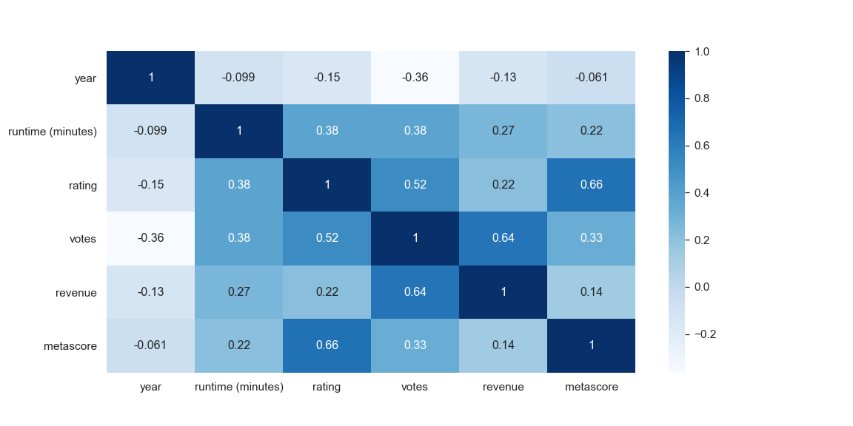
Correlation Matrix for Numerical Variables
High correlation between rating and metascore, user and critics rating have similarity.
High correlation between votes and revenue, which makes sense as more popular a movie is, more revenue it generates.

Slide 12
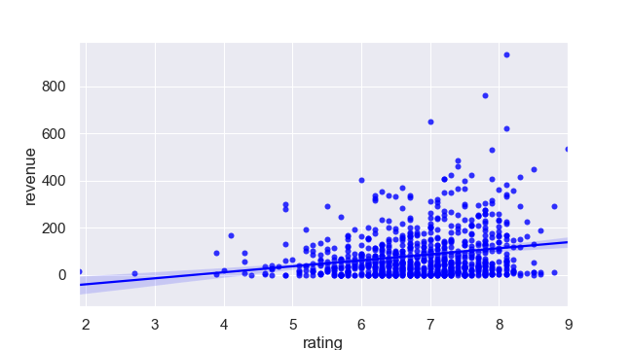
Does revenue depend on rating?
Rating and revenue have no correlation. There are more than half high rated movies with lesser revenues

Slide 13
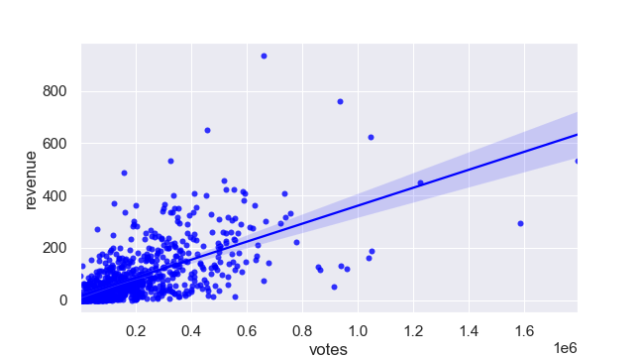
Does revenue depends on Votes?
Votes and Revenue have some correlation. There are movies with high revenue and high votes and vice-versa. But, with increase in vote number, there is some increase in revenue.

Slide 14
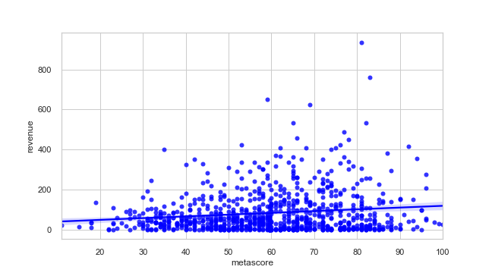
Does revenue depends on Metascore?
Task – Regplot with Metascore and Revenue values
Inference - Metascore doesn't have any direct affect on revenues and neither there is any linear relationship

Slide 15
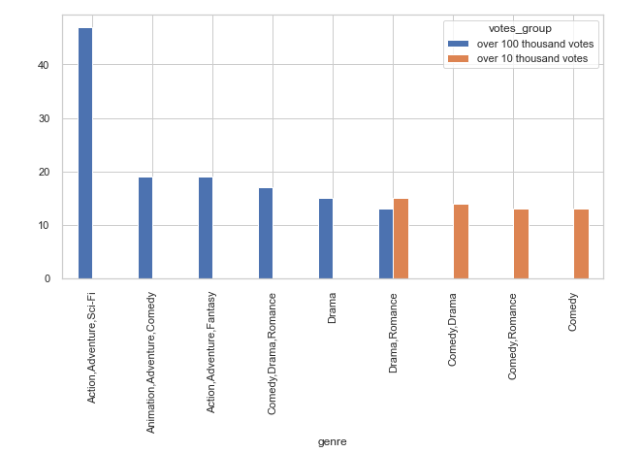
Votes and Genre Relationship
If you see top 3 - Action, Adventure, Sci-fi, Animation, Comedy are the movies that had highest number of votes.
Action seems to be the most liked genre.

Slide 16
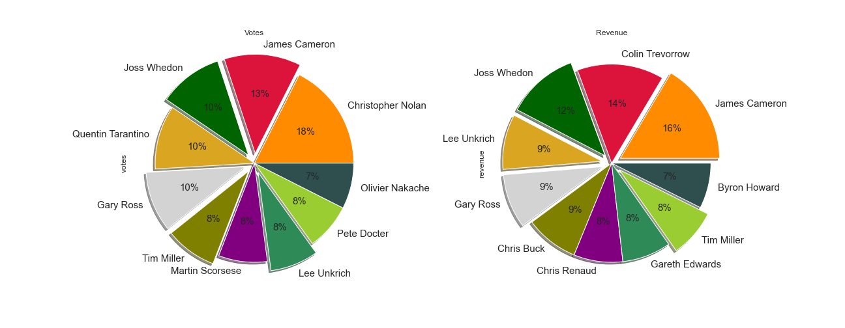
Does Director matter for Revenues?
Observation - We have taken top 10 directors whose movies are getting highest mean votes and revenue
Inference - 5 director movies have got high mean vote share (popularity) and high mean revenues as well.

Slide 17
Conclusion
Movies with a lot of votes (over 1o millions) are a rarity, with the number of votes dropping the number of films also drops.
2. There is a big difference between the maximum and minimum runtime of popular movies, based on genre.
3. New movies are more popular than old movies as observed in the dataset.
4. Rating and Metascore are quite similar, however, metascore is somewhat more uniformly distributed than rating. 5. Most popular movies last between 100 and 123 minutes.
6. Only few popular movies have high revenues.
7. High-rated movies do not give you large incomes or a large number of votes.
8. Few genres like Action, adventure, sci-fi, Drama, have higher votes as well as revenues for their titles.
9. Actors / director play a big role in getting more no of votes. Their popularity also affects revenue generation.
10. Metascore and rating have positive co-relation but revenue and rating doesn't.

Slide 18
Action Points
1. There has to be a Genre based filter in the application for visitors to choose movies as per their likes
2. Every movie which is listed in the app for, it must have few pointers to show - Genre, director, Star Cast (lead roles specially the popular ones)
3. There should be a news feed tab in the app which gives latest info about some popular movie title, actors and directors info.
4. One unique feature we can built in the app is filter based on runtime of a movie. Most people plan their time in a way that they cannot spent 3 hours for movie, based on popular choice, they can select runtime, which will save their time to individually check for movies time on internet.
5. We can have a comments section also, if not there, to understand more about what they like and do not like.
6. Movies with some specific title, director, actor are popular as seen in votes share, such movies alert shoud be created and users can get notification about the same, to engage them with using our platform.
7. Lastly, personalized experience should be provided by notifying the user, your favourite genre, actor, director movie is in theatres, did you watch yet? go ahead and book the tickets.

Slide 19
In [01] : print (‘Thank You’)
Thank You

