Slide 1
Vagrant VMs & Provisioning: Key to efficient scaling of your team

Slide 2
Common
problems faced with team expansions and ramp ups.

Slide 3
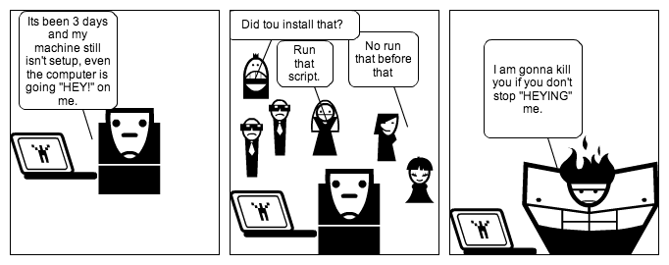
Development Environment
Setup
How easy is it to setup your project's development environment?
What is the delta between a new member joining the team and her/his computer getting development ready?
Notes:
“Run this script, and you are set(not actually)”
“No but install that before doing that
“Make sure this version is installed”
“Did you set this environment variable”
“Did you delete that file from there”
“How complicated is it to add a new member to the team.”
New member already has to understand the codebase and before she/he can even do that they have to setup their machine, which takes a lot of their time and also a lot of the veteran team members's time to help them out with setting up their machine.

Slide 4
Development Environment Setup
Initial dip in team productivity.
Recurring problem whenever someone new joins.
Different operating systems and hardware.
Inconsistencies between procedures to achieve the same result.
Even with completely automated environment setup, there can be huge problems.
Notes:
Initial Dip in Productivity – Whenever a new member joins at that time, an older team member would have to sit with new joinee and help them out with their machine setup, so complicated development environment setups increase the initial dip in productivity.
Recurring Problem – Whenever someone joins, the same procedure is repeated. And project additions during a ramp ups may lead to a heavy loss in team productivity.
Different OS - Different operating systems will have different steps to setup, and some might even be Spikes(looking at you Windows).
Different machines may lead to inconsistencies in the steps to follow to achieve the same result. Like simple installation of Google Chrome on CentOS and Ubuntu.
Automated Scripts First off automation scripts for different OS is extremely difficult to write and also making them completely idempotent and work on dirty environments is also extremely difficult to achieve. Also will require a lot of time.

Slide 5
Inconsistent Environments
There can be huge differences between the development environment and the other environments used in the project. Like the CI, QA environment will always be different to the Development environment.

Slide 6

Global Variables
Notes:
We always are wary of using global variables while writing code and always try to use them when they are absolutely necessary or required.
So one of the many reasons for not using Global Variables is that they can be set any part of the code.
Which also leads to some synchronization issues.

Slide 7
Bigger scheme of things
When you don't trust your own codebase with something that can be set by any part of your codebase. Then why do it for software, which you might or might not have written. Where different software might require different set of global settings or dependencies.

