Slide 1

FARMIE

Slide 2
Team CodingBooth – Our Project
Farmie is a web-app built for the farmers, to help them primarily in monitoring the light intensity at a particular place.
Secondary features include chat, inventory, personal account, a feedback, shop and a help section for every farmer.
Also, the web-app is responsive for all devices and comes in several native languages.

Slide 3
1
MOTIVATION
How determined we are..

Slide 4
The driving force for this project is the necessity of a system to monitor light readings without stepping outside.
Our primary goal is to help farmers, by providing them free training on using our system, and free maintenance of the sensor module at the desired place.
Secondary users include greenhouses, small nurseries and even people with small home gardens.

Slide 5
2
INNOVATION
What’s new?

Slide 6
We’ve used a LDR to read light readings at a place.
The farmer gets a personal and secure account, which is very easy to create based on an average farmer’s knowledge.
The web-app also contains a chat feature, which allows the farmer to talk to other farmers either through pvt. messages or group chat.
The farmer also gets the facility of personal inventory and to monitor the readings.
A weather prediction facility is also provided for the farmer at their location.

Slide 7
3
FUTURE ASPECTS
Our vision..

Slide 8
We can build a mobile application for better user experience and faster usage.
The current market value of fresh harvest can be displayed to the farmer in their inventory itself, to prevent losses.
We aim at providing these facilities to as many farmers as possible, to reduce their burden.

Slide 9
4
BUSINESS PERSPECTIVE
The marketing strategy..

Slide 10
The initial investment will be given in providing the project to large-scale farmers for free, which includes installation as well.
Based on their feedbacks, we can improve our project, add more features and ask them to recommend our project to other farmers on a large-scale.

Slide 11
₹800 - ₹1000
₹10 - ₹30
₹2
Installation cost, initially FREE, later charged based on location, transportation cost and other misc. expenses. Starting from ₹300.
(Including USB Cable and Battery)
Free web-app access. Free on-spot account-making and training on using the web-app. Free maintenance.
Bolt Wi-Fi Module
Light Dependent Resistor
10k Ω resistor
₹1050 - ₹1200
TOTAL
₹230 - ₹280
Battery + USB Cable

Slide 12
₹1200
Income from hardware
₹300 / kit
₹300+
PROFIT
Installation cost

Slide 13
5
MARKET RESEARCH
Why are we better?

Slide 14
There have been researches on similar projects using LDR and there are projects using LDR. But, there is no system in the real world application for the specific purpose of measuring light intensity.
Thus, our project can be accepted as a new idea and after some layers of testing, it can become an established project with real world application.

Slide 15
6
CONFIDENCE
The faith in our work..

Slide 16
We strongly believe, that our project will help farmers grow better harvest and gain better profits in the market.
Our project is based on an incremental model. It will improve with each stage of testing and new features will get included.
It can be used for even checking the suitability of a place for installment of solar panels.

Slide 17
Mobile view
Place your screenshot here

Slide 18
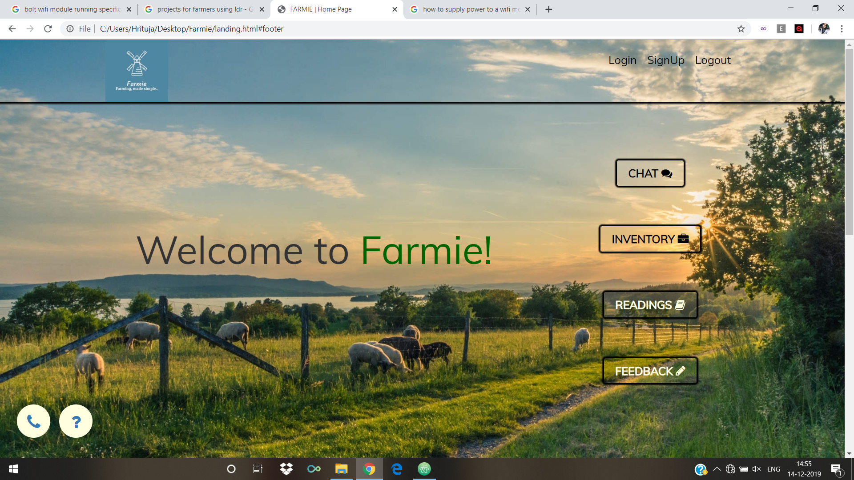
Desktop View

Slide 19
Thanks!
Any questions?

