Slide 1
Electronic accessories
46 – MIHIR MAKWANA

Slide 2
INDEX
Introduction
Technologies Used
Webpages

Slide 3
INTRODUCTION
The Project is based on an E-Commerce website. In this Project the website provides different types of Electronic Accessories to user.
User can buy any products and also keep track of the order.
This Project is build with HTML, CSS, JavaScript and PHP.
In this Project MYSQL Database is used which is available in WAMP server.
PHP is used to connect the database and to update the orders and Login.

Slide 4
Technologies Used
HTML, CSS
PHP
JavaScript
MYSQL

Slide 5
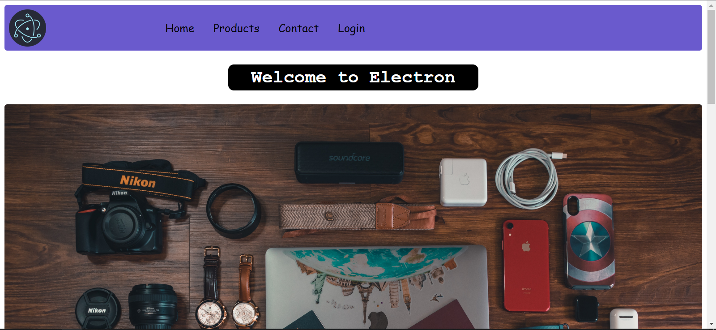
HOME

Slide 6
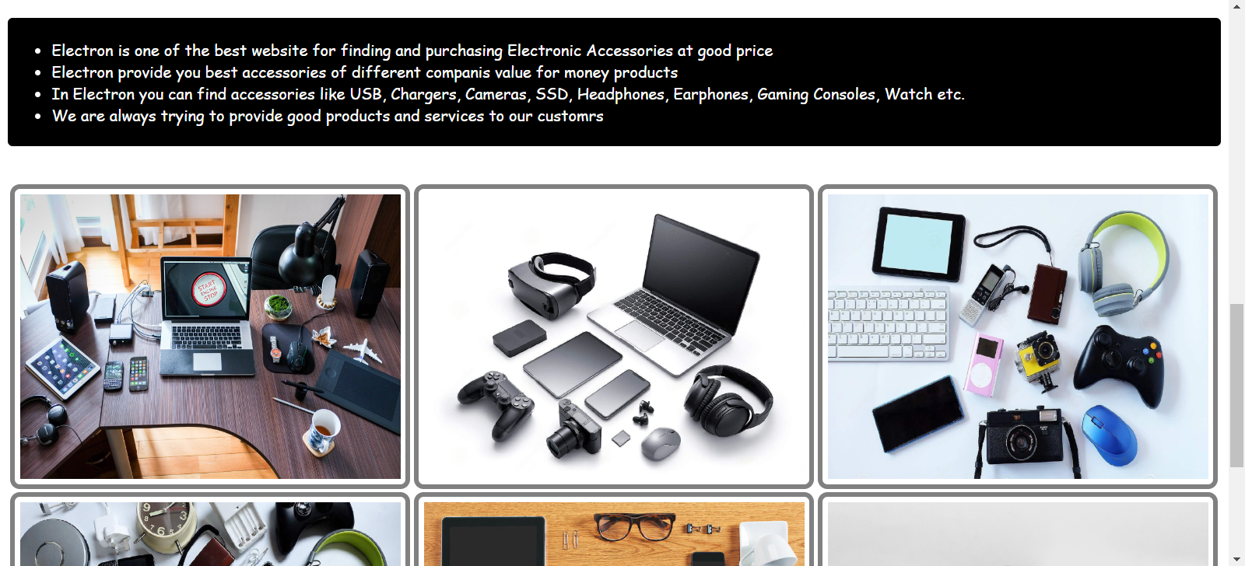

Slide 7
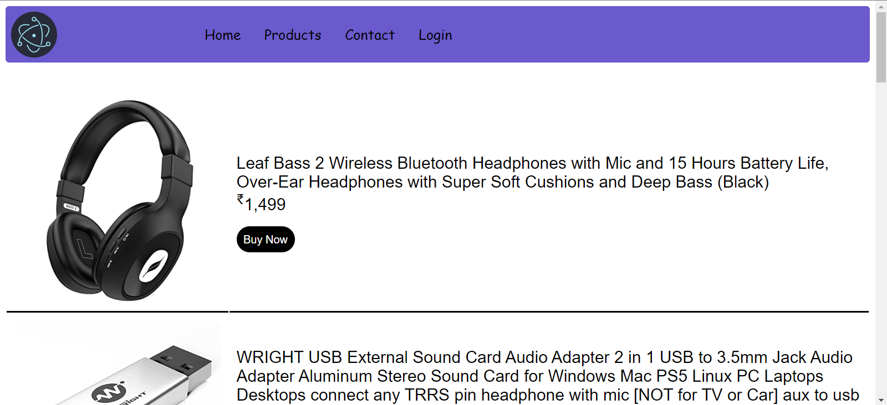
Products

Slide 8
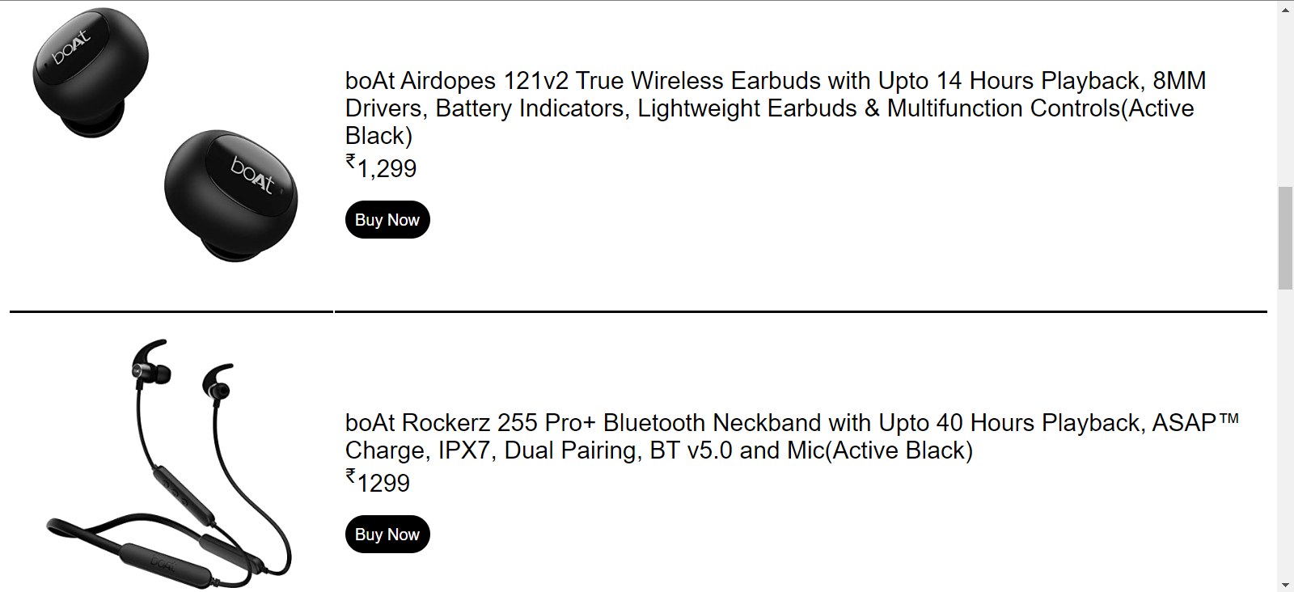

Slide 9
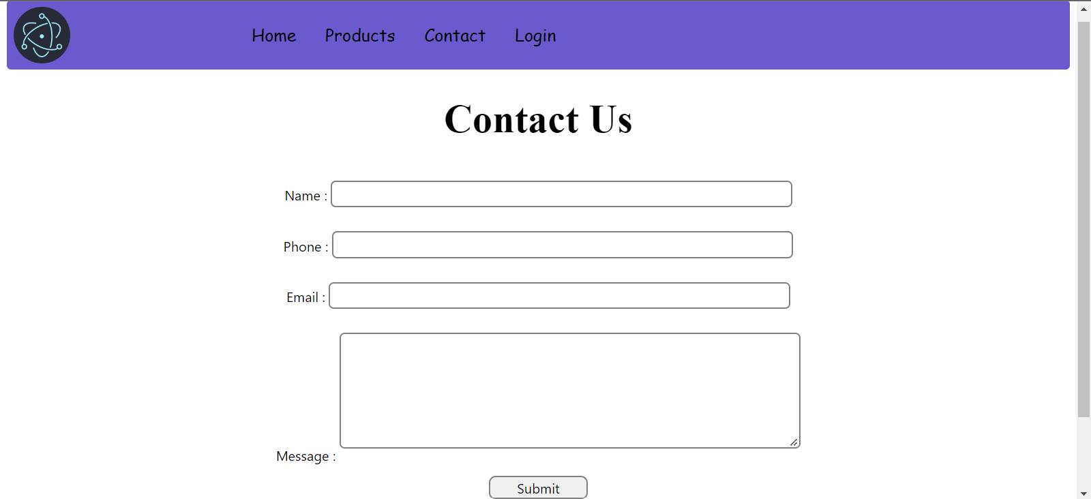
Contact us

Slide 10
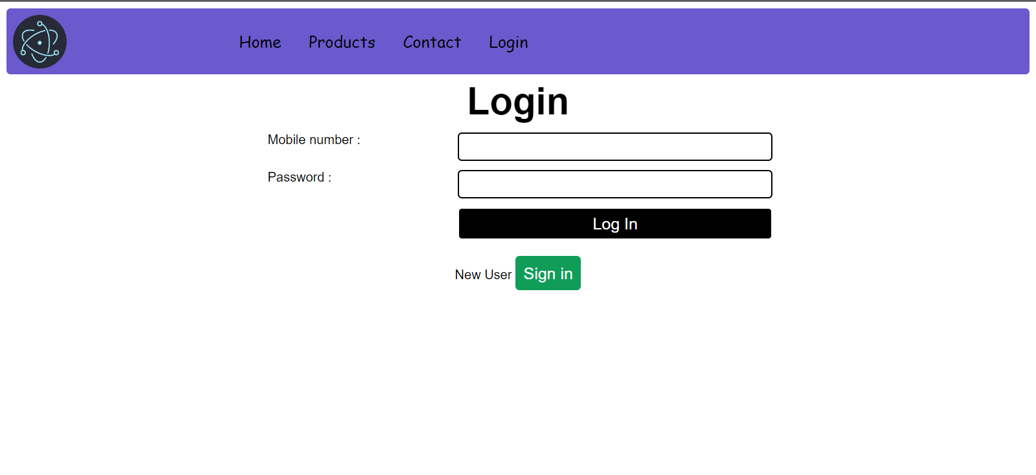
Login

Slide 11
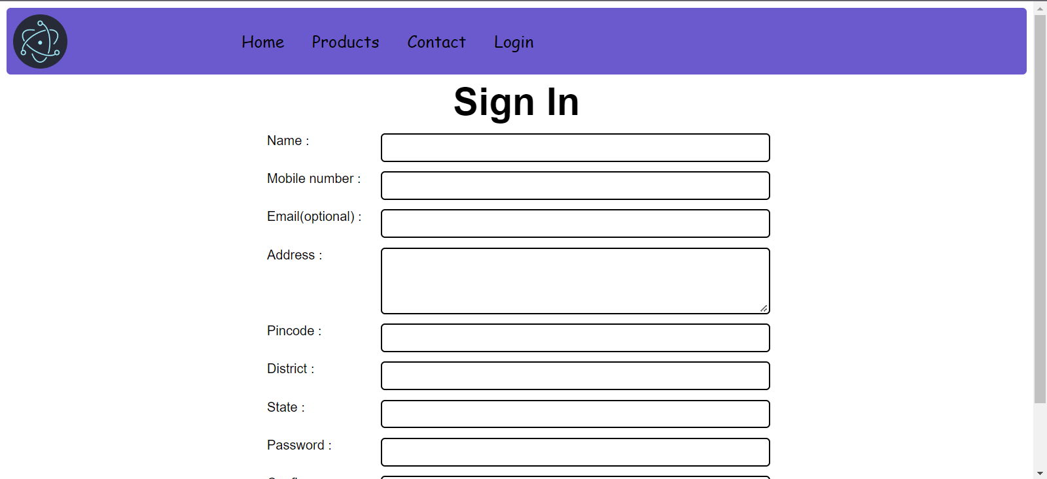
Sign In

