Slide 1
Comparing Bit and Time Efficiency of Coding Algorithms on Real World Data
Mihir Patel and Sidd Phatak

Slide 2
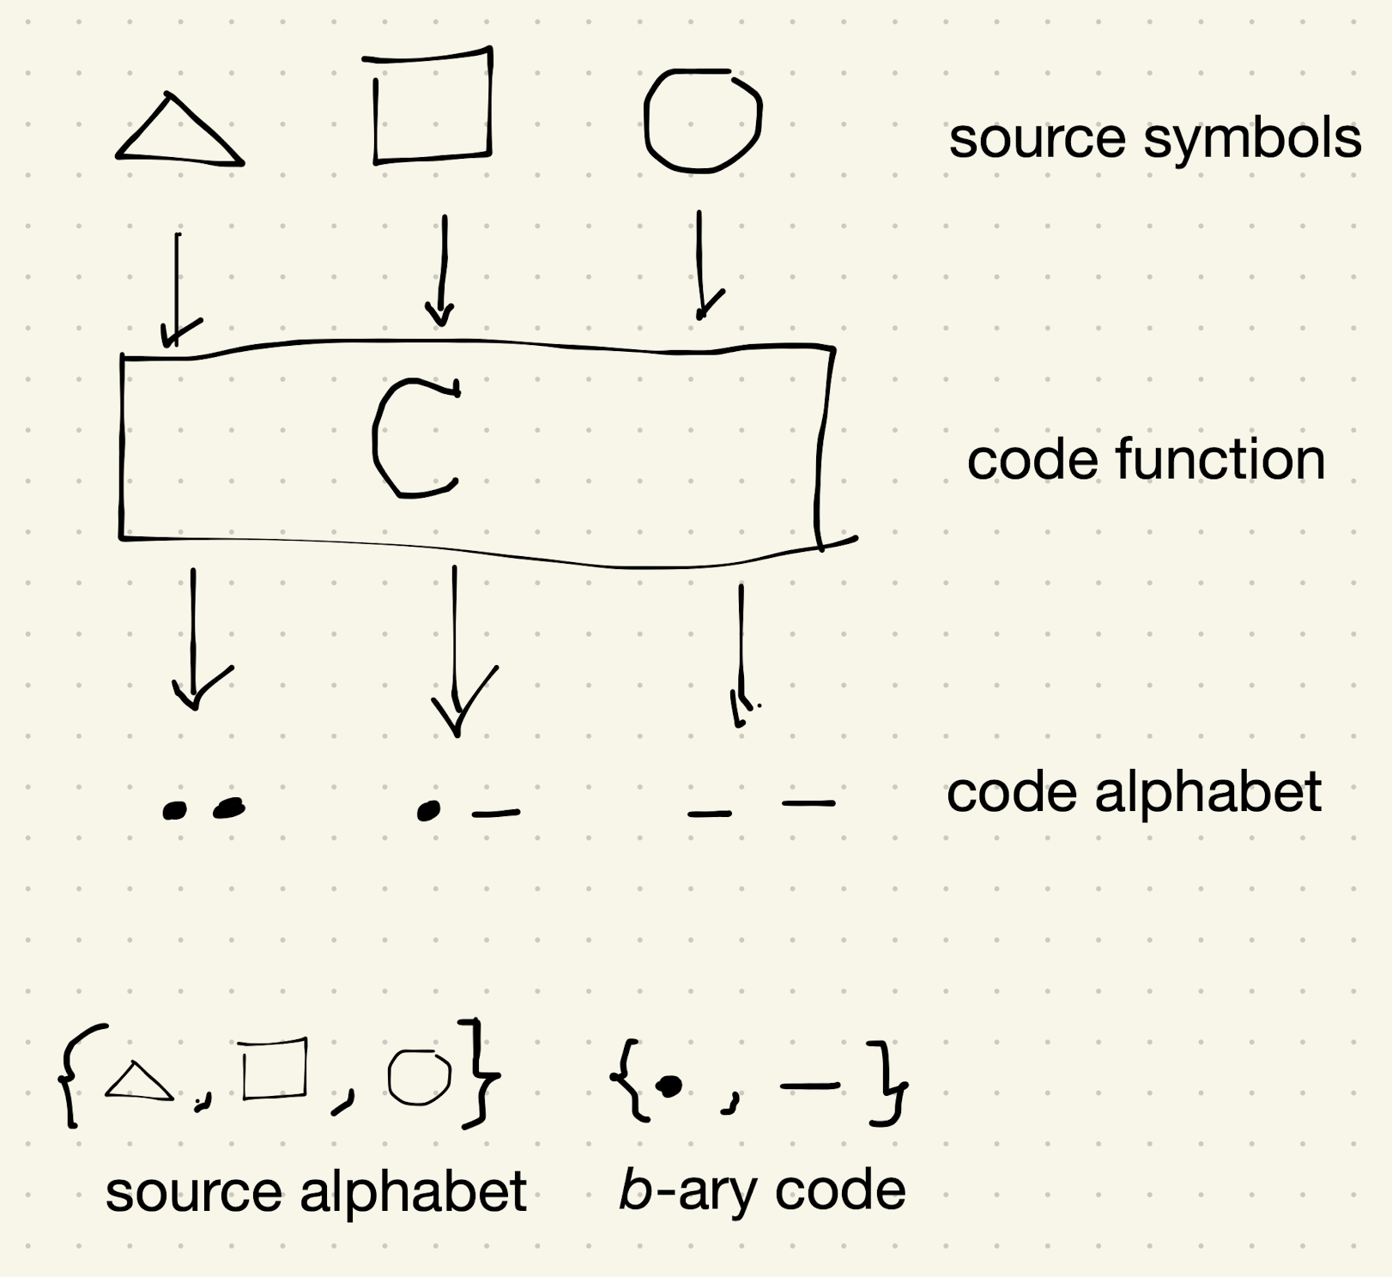
What is a coding algorithm? How can you measure how good a coding algorithm is?
A technique used for data compression/transmission (computers understand binary)
Metrics for comparing coding algorithms – bits and time:
Entropy (weighted average)
Complexity of encoding scheme construction
Speed of encoding/decoding in implementation

Slide 3
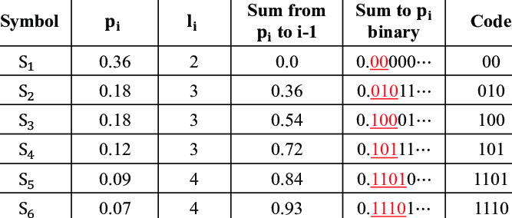
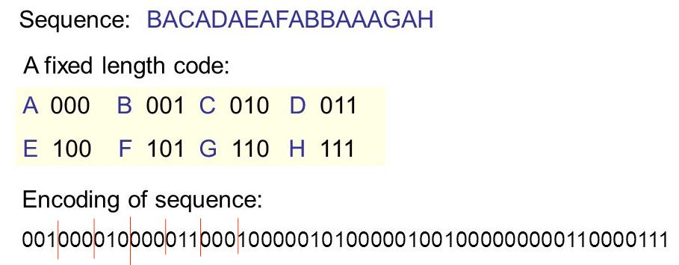
Coding Algorithms We Will Test
Fixed Length
Shannon
Huffman
No code is prefix of another!

Slide 4
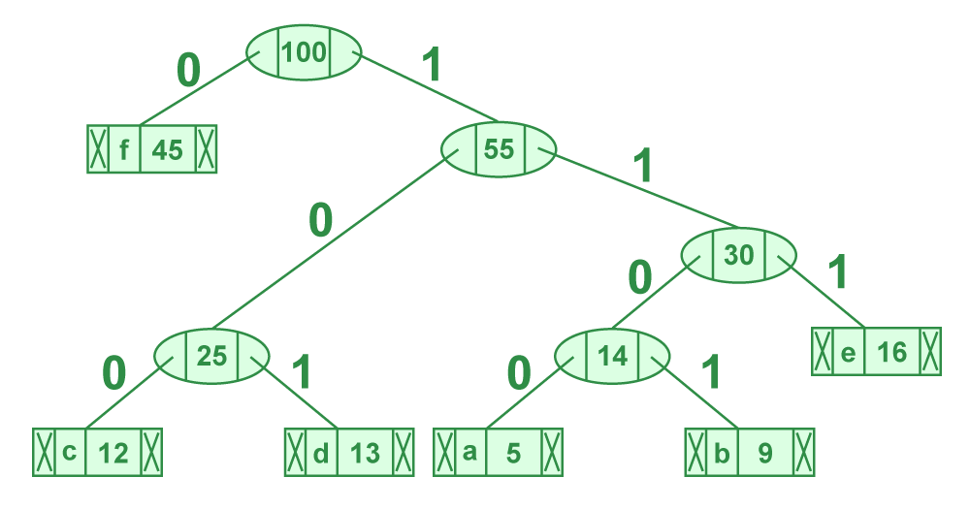
Huffman Coding
f | 0
e | 111
d | 101
c | 100
b | 1101
a | 1100
Greedy Algorithm (provably returns most optimal prefix codes)
Construction complexity for Shannon ≈ Huffman O(nlogn)
Put all the nodes in a priority queue by frequency.
While there is more than one node in the queue: a. Dequeue the first two nodes. b. Create a new node with the sum of the frequencies. c. Reinsert the new node in the priority queue.

Slide 5
How are we going to compare these algorithms?
Entropy on generated data of unique characters
Generating encoding scheme on train data, comparing time of transmitting messages with encoding/decoding on test data.
Training Data : The Great Gatsby
Testing Data : The Harry Potter Series
How well do these algorithms work on “different distributions”
Key Element : length of encodings - what does it rely on?
T-tests on distributions of runtime for Huffman and Shannon encoding

Slide 6
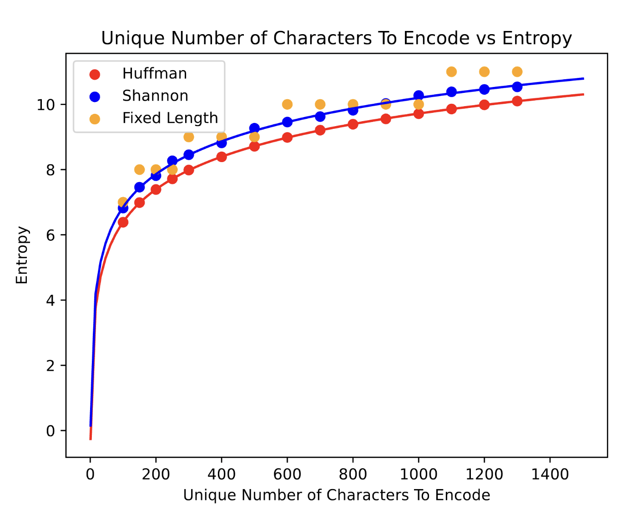
Entropy
Generated data to get more characters – ASCII is <300 characters, generating a hex representation gives us much more capability (≈65,000 characters with 4 hex bits).
For a given number of characters, randomize 100 different associated probabilities and construct the encoding scheme (average of entropy in each)

Slide 7
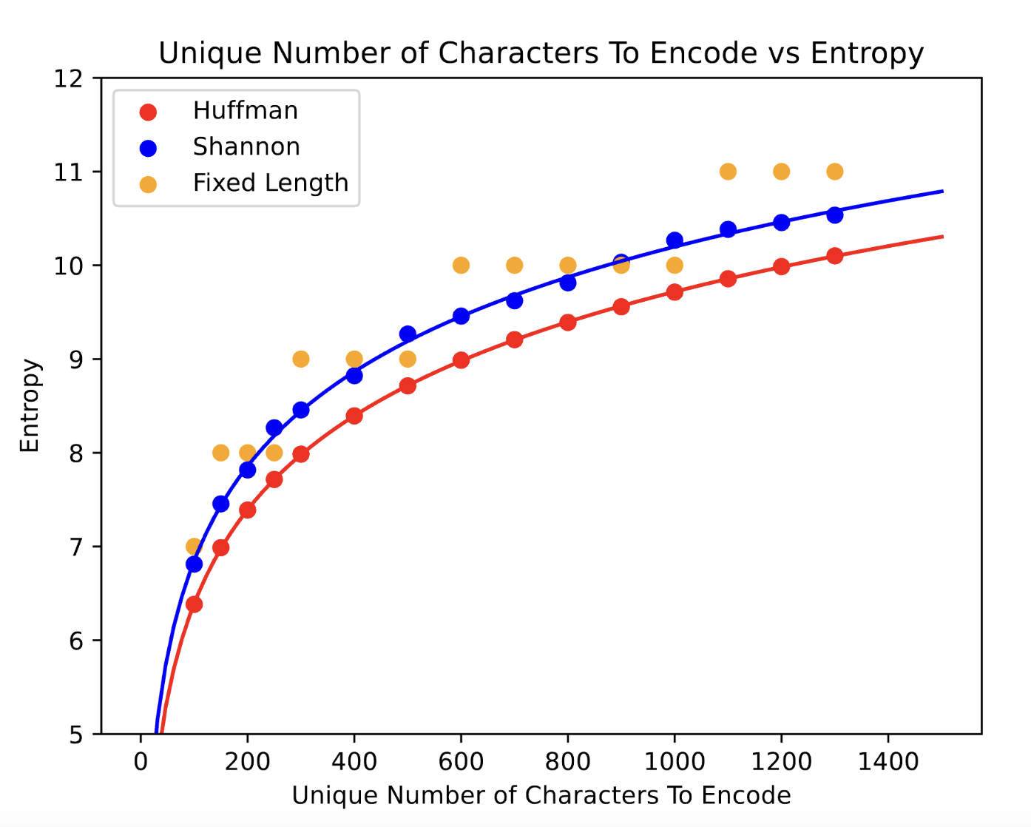

Slide 8
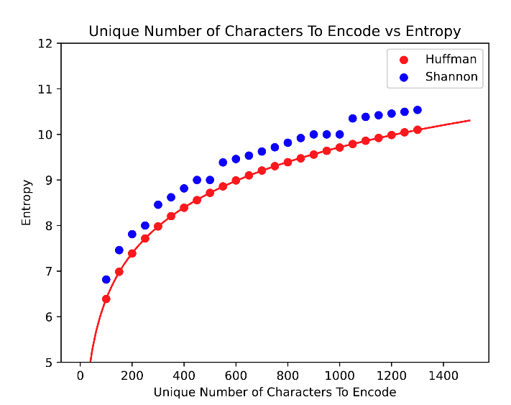
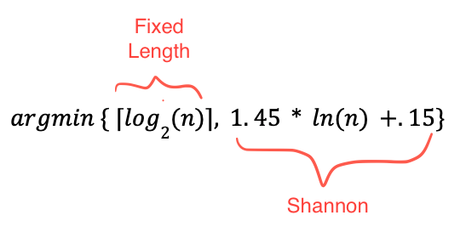
Improved Shannon/Fixed Length
Hybrid algorithm that would choose a different encoding scheme depending on unique number of characters to encode

Slide 9

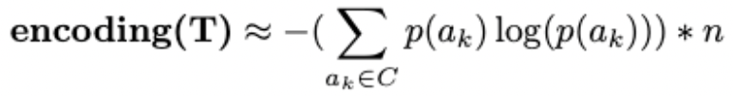
Time Complexity as a Measure of Encoding Lengths…
Assume k is number of letters in alphabet A
Assume n is the number of characters in a given text T
Fixed Length Encoding -
Huffman / Shannon Encoding -
Note : this is an estimation of the average encoding length
Huffman and Shannon do not (theoretically) perform that much better than Fixed Length Encoding if distributions are equal / very different from training
https://cs.stackexchange.com/questions/110108/average-codeword-length-in-a-huffman-tree-is-omega-log-n

Slide 10
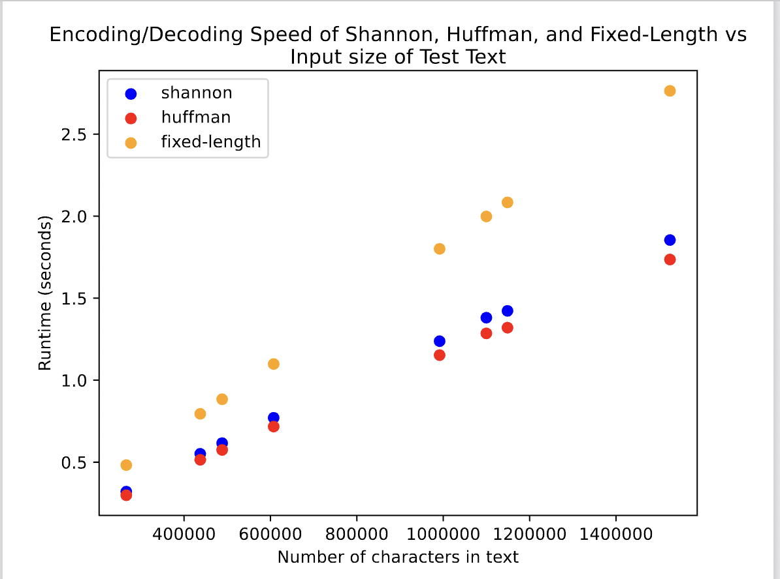
Runtime Graphs: Training with Great Gatsby, Testing with Harry Potter

Slide 11
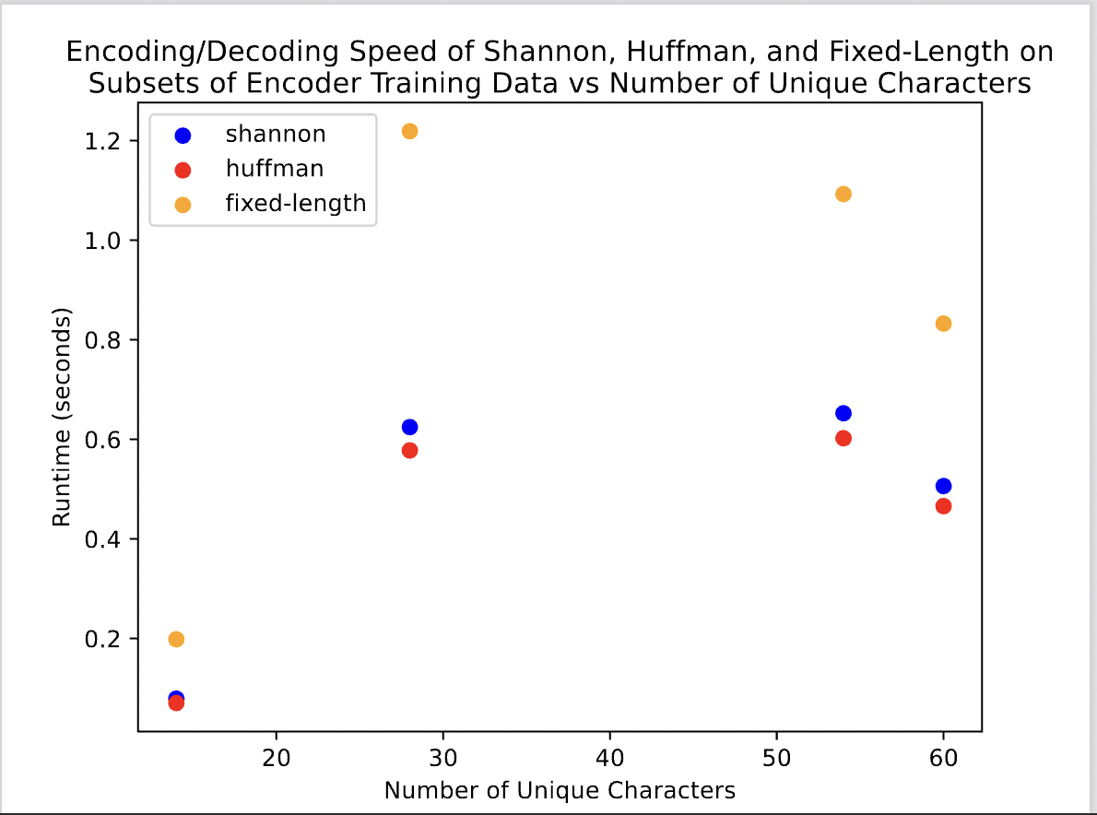
Runtime Graphs: Investigating Unique Character Entropy Patterns, Great Gatsby Train and Harry Potter Test

Slide 12
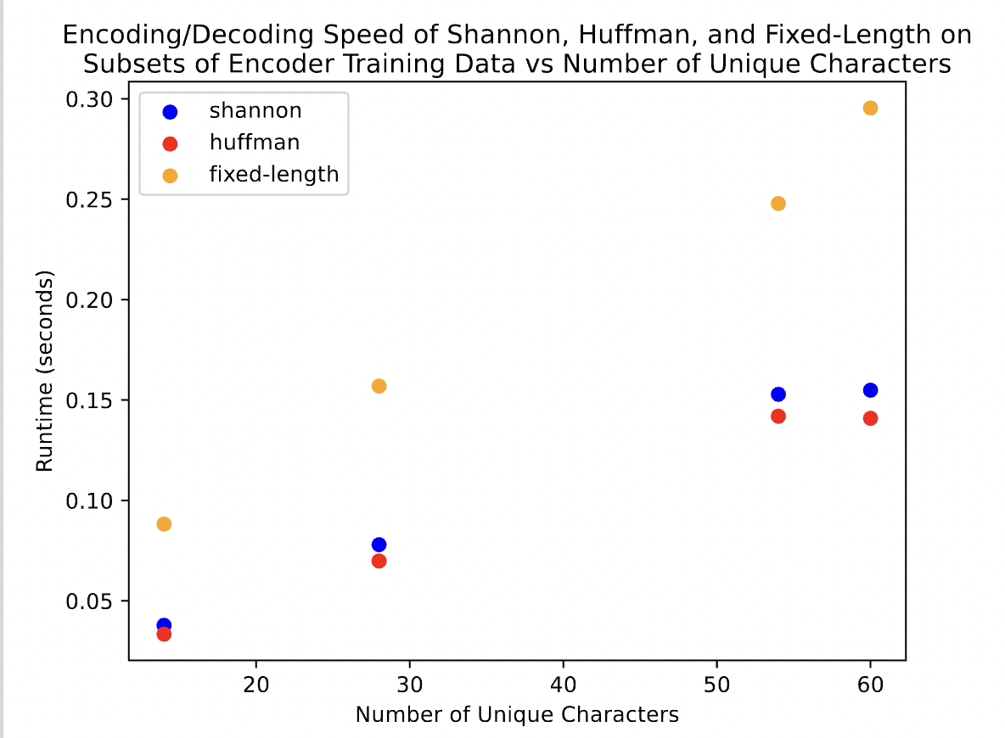
Runtime Graphs: Investigating Unique Character Entropy Patterns, Great Gatsby as Train and Test

Slide 13
Runtime Graphs : Two Sample T-test on Runtime Data
Theoretical runtime-wise, FLE > Huffman ≈ Shannon).
Given two distributions of runtimes, can we determine whether their population means are the same
Assumptions:
Data values must be independent.
Data obtained via random sample
Data in each group are normally distributed
Data values are continuous
The variances for the two independent groups are equal.
Null hypothesis : The runtimes of Huffman and Shannon encoding methods do not have the same population mean
https://www.jmp.com/en_us/statistics-knowledge-portal/t-test/two-sample-t-test.html
Notes:
The two-sample t-test (also known as the independent samples t-test) is a method used to test whether the unknown population means of two groups are equal or not

Slide 14
Process - Using scipy
Train both algorithms on the same data set
Run each algorithm 100 times on the test data, and store the encoding / decoding runtime of each run.
Use scipy.stats
stats.ttest_ind(distribution1, distribution2)
Compare calculated p-value to significance level

Slide 15
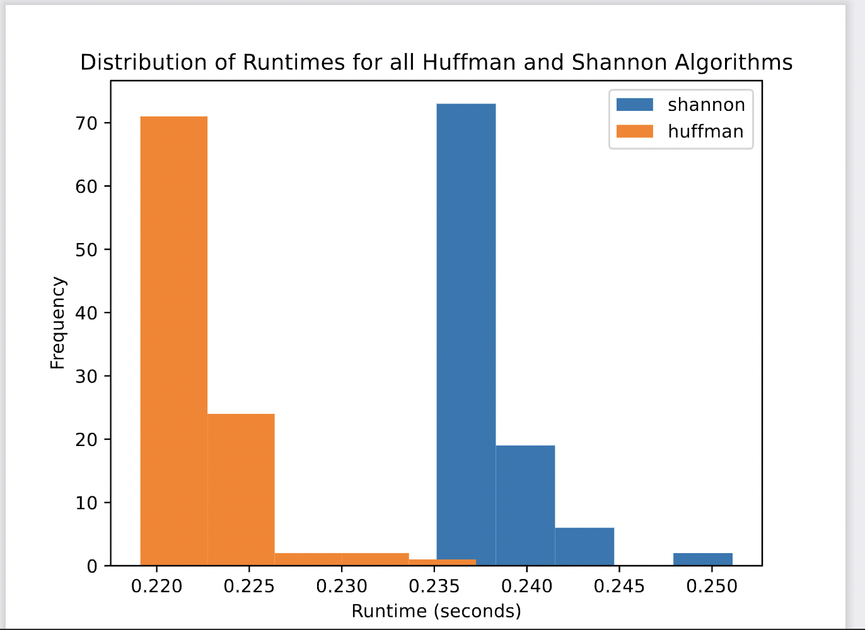
Distribution Graph - Encoders Trained and Tested on Great Gatsby

Slide 16
Results for Test
P-value : 5.045438123213584 x 10⁻¹⁰² < 0.05
Thus, we can reject the null hypothesis
In this case, we have the caveat that the test and train data are the exact same
Thus, we can conclude that average runtime of Huffman < average runtime of Shannon when they are tested on the same data set as they are trained on
Significance of Conclusion
If we have similar test data to train, Huffman is better
Note : distribution is not very normal, but variance is similar
6.43 x 10⁻⁶ for Huffman, 6.60 x 10⁻⁶ for Shannon

Slide 17
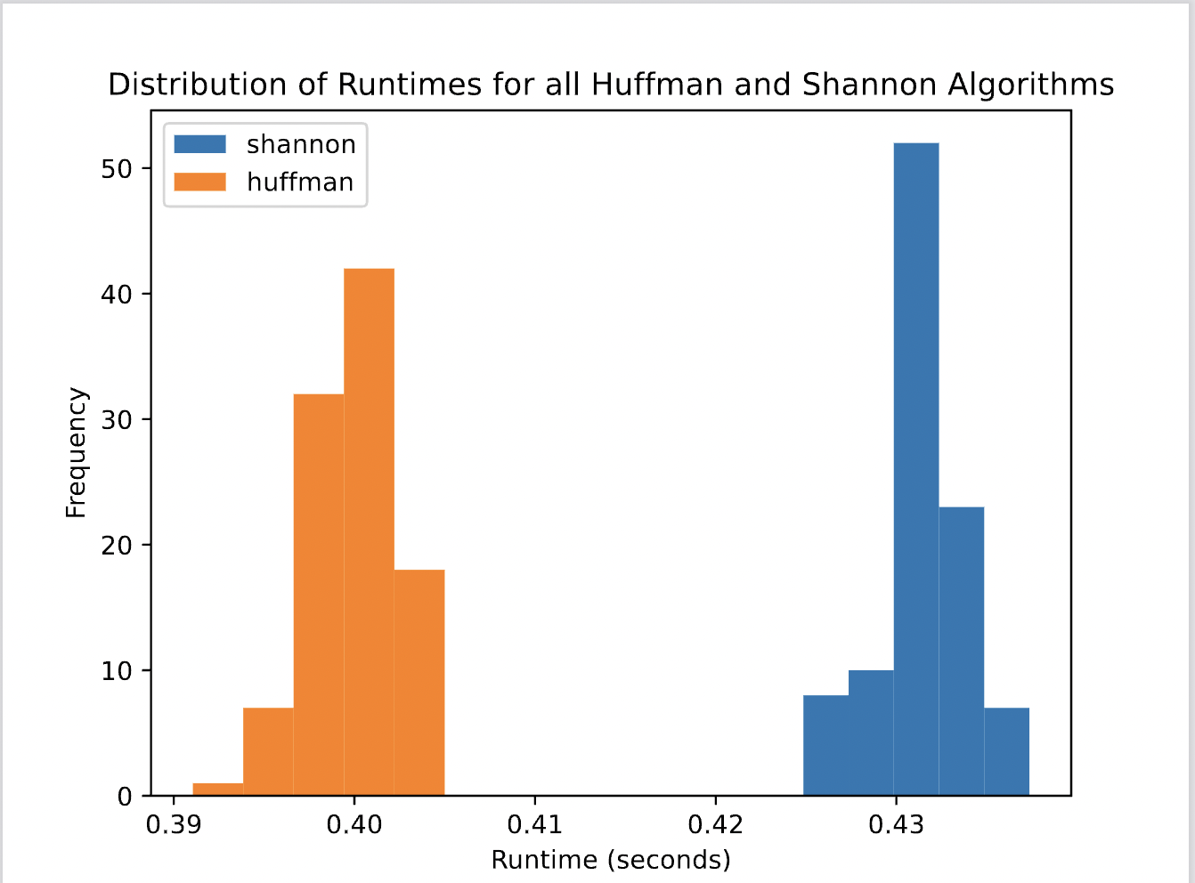
Distribution Graph - Encoders Trained and Tested on Great Gatsby

Slide 18
Results for Test
P-value : 6.512420248904337 x 10⁻¹⁶⁷ < 0.05
Thus, we can reject the null hypothesis
In this case, we have different test and train data
Can we conclude that Huffman is better than Shannon on all test data?
Pattern is similar in rest of Harry Potter books
Note: Runtimes are roughly normal and variances are similar
5.57 x 10⁻⁶ for Huffman, 5.57 x 10⁻⁶

Slide 19
Conclusions
In theory there is are certain values of n (number of unique characters to encode) where Fixed Length should be better than Shannon
In practice we did not see this play out – empirical results were what we initially expected. Why?
Randomizing high number characters over high number tests evens out
Shorter encodings perform better on test data for frequent characters
Can make more informed decisions about which algorithm is best with more information about train/test data
Can we “bootstrap” data that we want to test against better?

