Slide 1
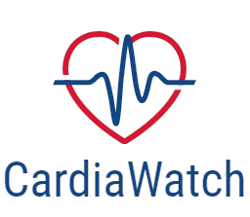
CardiaWatch

Slide 2
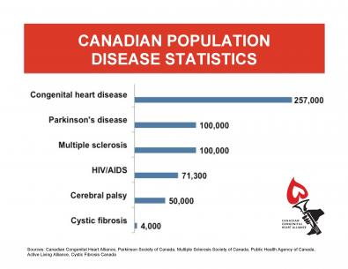
How dangerous are Heart Attacks
CDC estimates, 9.1 million affected in 2019 (85% Fatalities)
WHO classified it as an epidemic
No cure in medical science
Early diagnosis can save 92% of affected individuals
Susceptible patients need to be closely monitored
Current diagnosis techniques ( EKG ) very costly and often harder to obtain
Cost of Treating Heart Attack is between $65 000 and $164 000
Huge burden on medical infrastructure

Slide 3
Who are we
An AI powered tool that assists at risk individuals in early detection and management of heart attack
Get heart attack risk level
Use AI to Find what factors are contributing to heart attack
Monitor patient remotely for heart attack
Reducing the burden on hospital infrastructure

Slide 4
eXplainable Artificial Intelligence (XAI)
Machine Learning predictions cannot be trusted by the clinician
They need to know The WHY?
XAI gives risk factor based rankings in order to show which factor contributes how much to stroke risk.

Slide 5
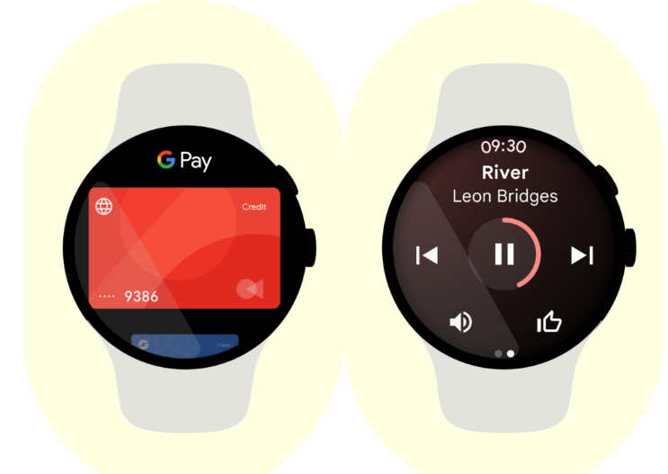
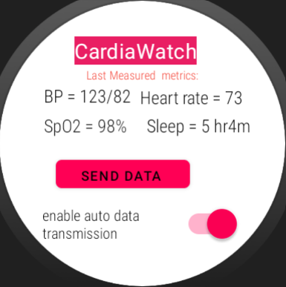
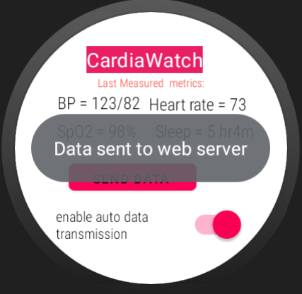
Continuous remote patient monitoring
Making heart attack prediction seamless
Monitors risk continuously
Can alert user and their doctor if risk levels
Increase
Can monitor patients remotely in far off
places

Slide 6
The HOW??
Our biggest challenge was to integrate our machine learning models which are written in python , into java based android studio framework
we had a couple of options -
SL4A (Scripting Layer for Android):
Jython
Chaquopy
Web scraping

Slide 7
Future Works
Our next plans before initial release :
train a context specific language learning model and integrate services with the application
using materials design to improve UI
dynamic data acquisition through smartwatch
Integrate other disease models
For instance diabetes prediction and management model

Slide 8
Pricing
Subscription based 3 tier model
Lite version - access to one time risk level generation and XAI analysis
free to access with ads
(0.20 cents/view)
Mid tier version - additional access to my health summary dashboard
5$/month
Pro version - access to smartwatch remote risk monitoring ,
my health summary , direct connection with registered healthcare professional
for 10$/month

Slide 9
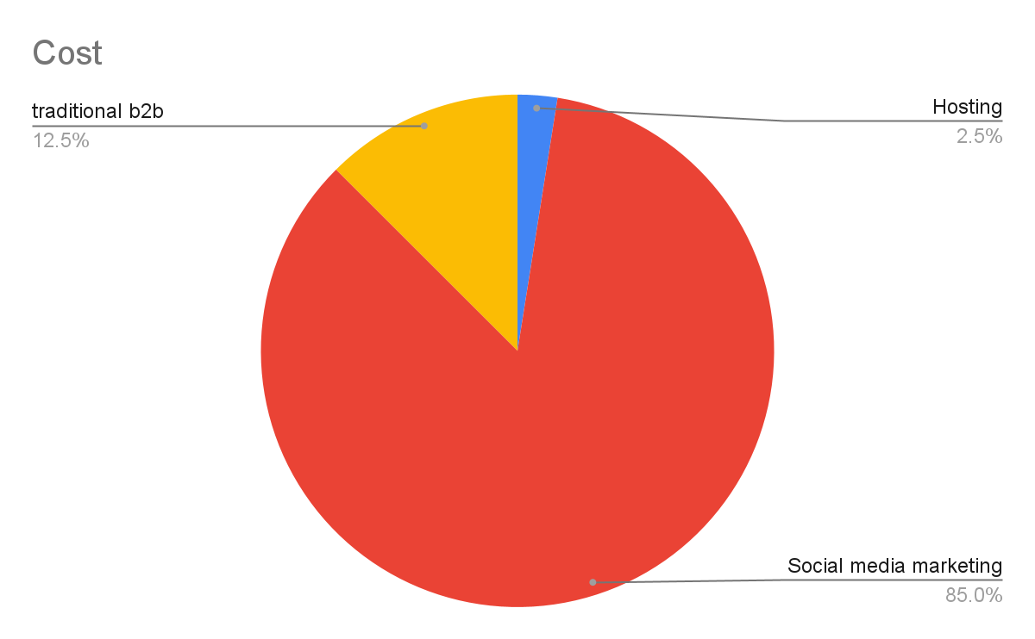
Our costs
Founder developed application = 0$
Hosting on an encrypted server = 100$/500 users
~800$/300,000 users ( AWS pricing)
Social media marketing =2000$ ( for an initial reach of 250,000
[20$ = 2500 reach, 1900 impressions
-> 25 signups in free tier , 5 mid tier signups , 2.5 paid
Traditional B2B marketing = 500$
Miscellaneous business expense = 500$
Total monthly cost = 3800 $

Slide 10
Customer Value
Customer acquisition cost = $8.2/ first 145 users
$5.6 / 145 to 50,000 users
Customer Life time Value (LTV) = $600 over a 5-year lifespan.

Slide 11
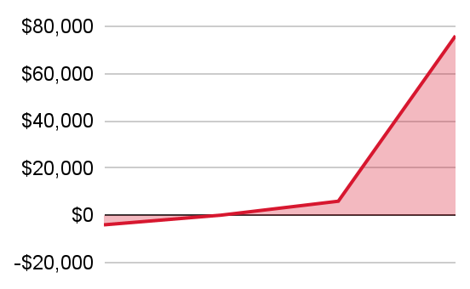
Break Even Analysis
Cost function =0.0266x+0.08x+1000
Revenue function =2x+5x+0.02x/2
Total monthly cost= 3800$
Break even at 145 users
Profit at 80,000 users (0.1% market share)= 560,800$

Slide 12
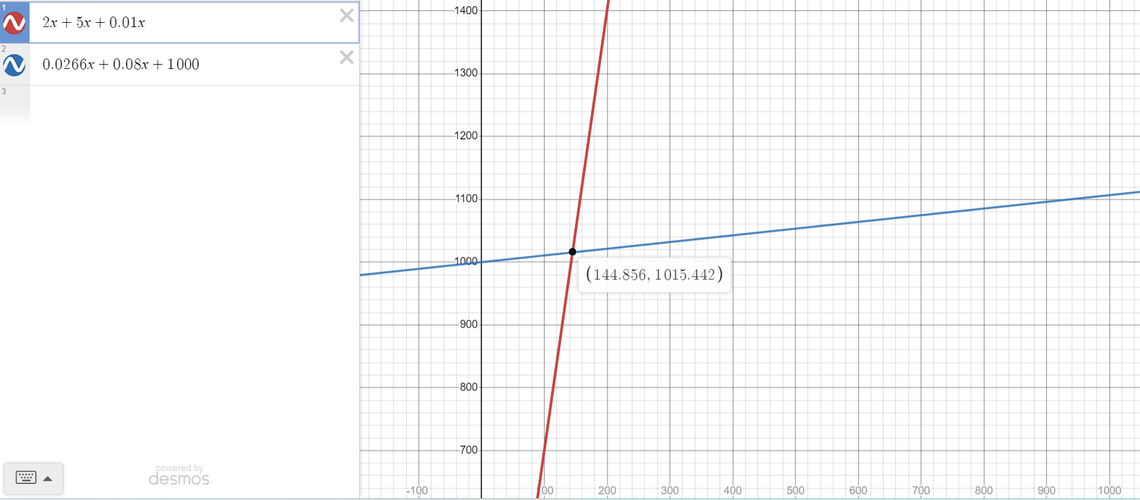
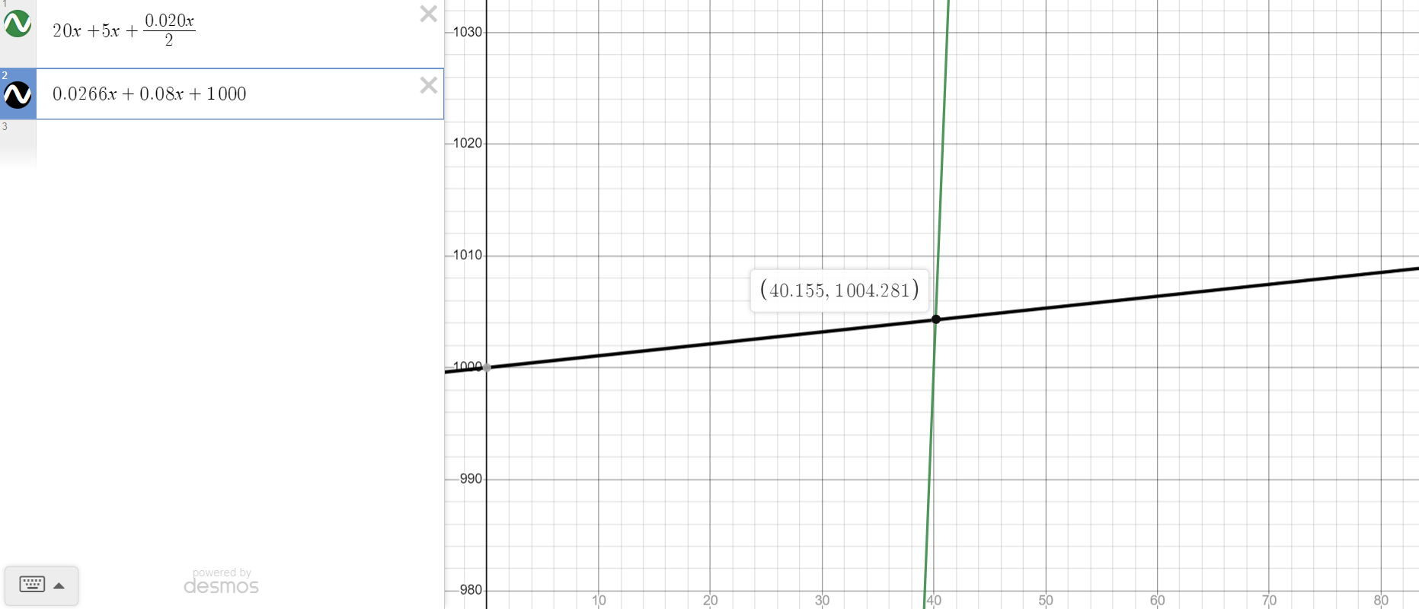

Slide 13
Launch Plan
8 million people are actively at risk for heart attack
Target : capture 1% of consumer market
Release plan
Deploy software application on an online server
Run social media marketing campaigns to reach monthly 50,000 impressions
Collaborate with medical personnel to integrate this system in medical infrastructure

Slide 14
CardiaWatch vs Doctors: What are the differences
Doctors
Quick
Non Invasive
Cheap
No specialized hardware needed
Autonomous
Pre diagnosis tool
Costly!
Have to wait way too long
Diagnosis using specialized equipments

Slide 15
Future Plans
Connect with medical professionals directly through the system thereby enabling direct health assistance
AI powered chatbot for personalized health tips
Integrate other disease models
For instance diabetes prediction and management model

Slide 16
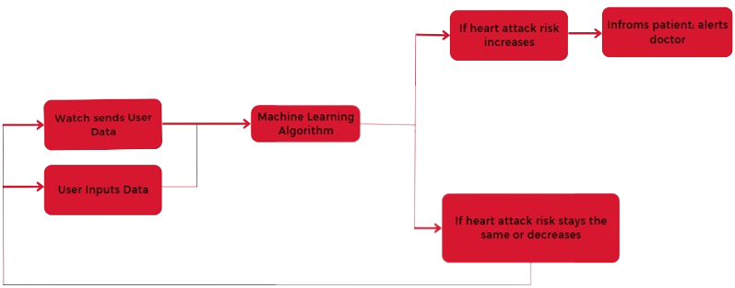
Recap

Slide 17
Our Product (breakdown)
A machine learning algorithm trained on 5000 patient dataset, to predict what level of heart attack risk you are at
XAI that ranks which of your factors are more contributing to your heart attack risk (Shapely additive analysis [SHAP])
Smart wearable device that automatically monitors your heart attack risk and can alert you and your doctor if risk levels change
An intuitive dashboard to manage your health data

