Slide 1

-by TheNightOwls

Slide 2
Problem Statement
To develop an Ecosystem to demonstrate the health care management system prototype.
User/Appointment manager can choose the doctor based on the symptoms and book an appointment from the given schedule. Doctor can submit the detailed report and Lab Manager can request for the lab test. Lab Reports will be sent to the user over mail.
Vaccination Centre & Blood Bank will manage the requirements of the Hospital Enterprise and manage the inventory.
Social CFR is a different approach to leverage the resources for raising funds for people who can’t afford to pay for terminal cases/transplants/costly surgeries.

Slide 3
Approach
HealthSpring is an java based application for hospital management.
The objective of this project is to demonstrate the Enterprise Resource model of a disruptive healthcare Startup organization that wants to change the efficiency & cost related to the Healthcare in USA.
Along with the management of patient data with real time deliverable in order to track a patient’s overall history and reduce the time consumption in treatment/detection under its Hospital enterprise, Health-Spring will have an enterprise each for Vaccination Centre, Blood Bank & Social Crowd-Funding which will cater to Terminal cases and raise full funds via CFR and philanthropic fundraising(connecting with various philanthropy Organizations).

Slide 4
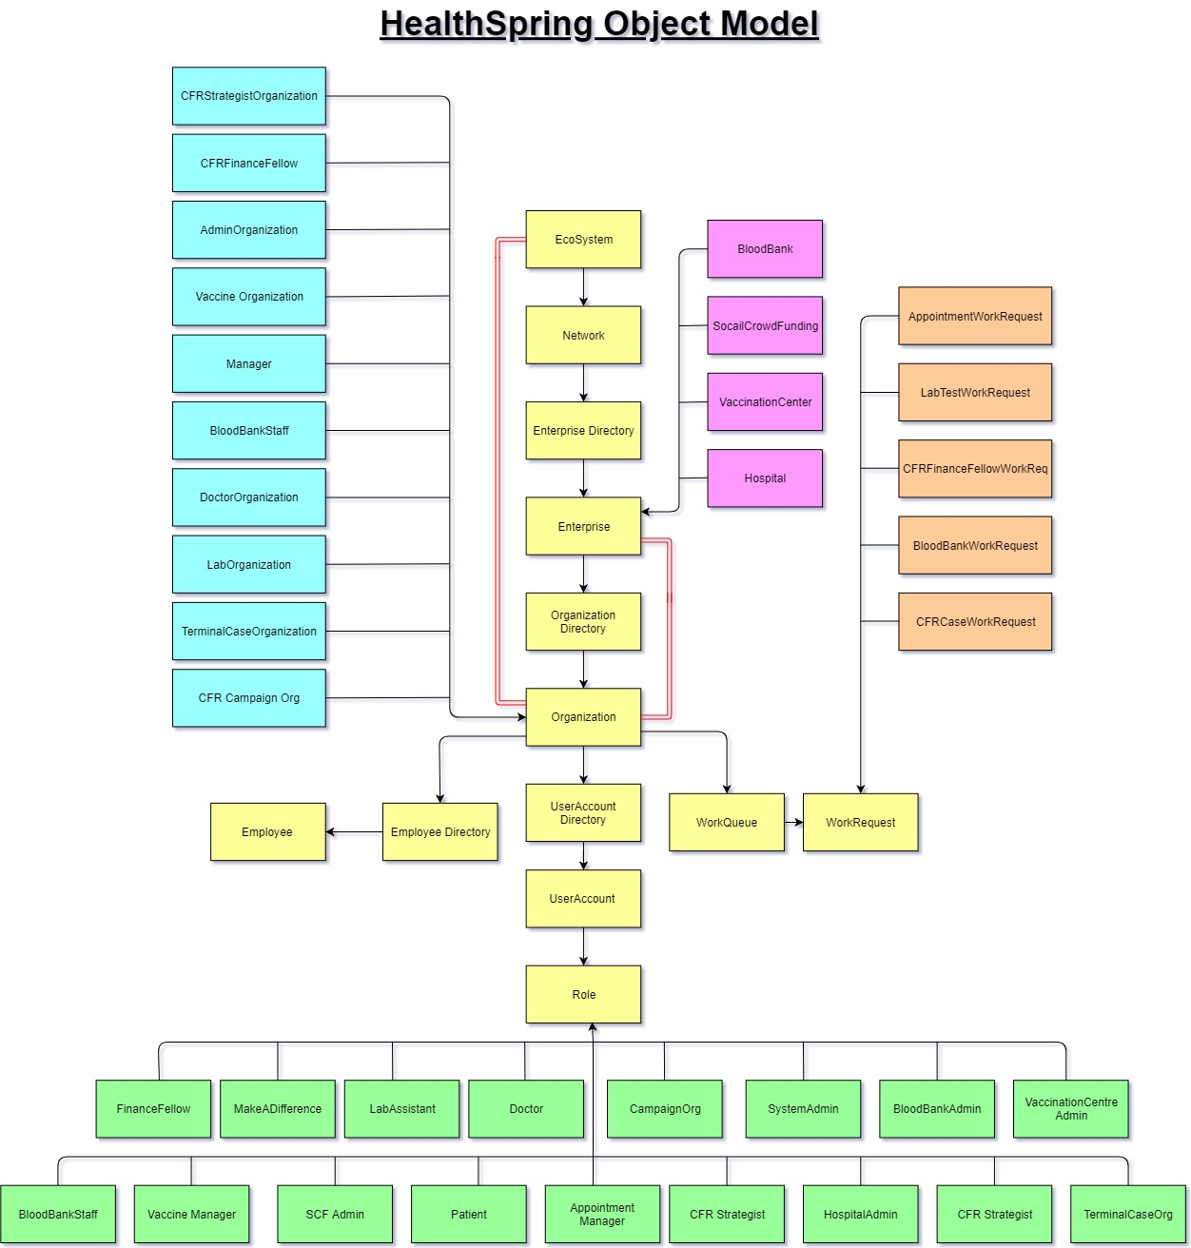

Slide 5
Crowd Funding
The objective of Crowd Funding is to raise the funds for hospitals which can be further used for needy patients and for research purpose

Slide 6
Blood Banks
The blood banks co-ordinate with the hospital to supply the blood when required.
The blood requirement of the hospital is fulfilled by by the blood donors through blood banks.

Slide 7
Vaccination Center
Vaccination centers are responsible to keep the hospital’s vaccine stock up to date.

Slide 8
Hospital
It maintains the data of all patients and helps them by providing necessary medication.
Hospital is a major link between all enterprises.

Slide 9
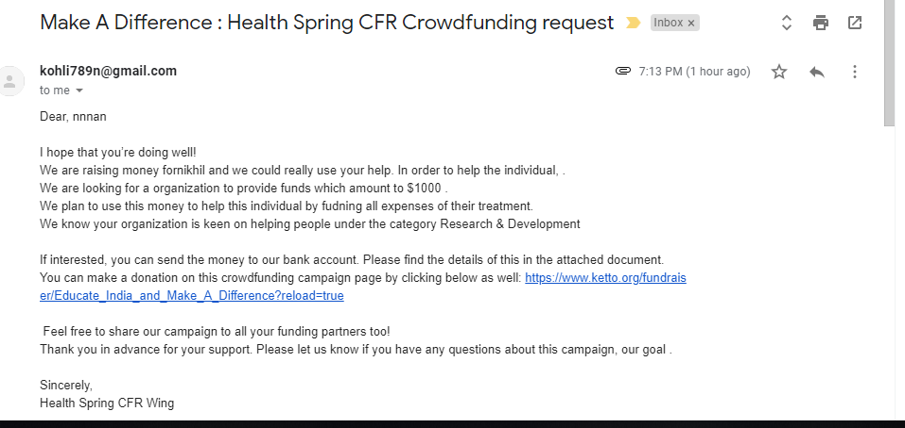
Additional Features
HealthSpring can ask for funds to the registered organizations via E-mail

Slide 10
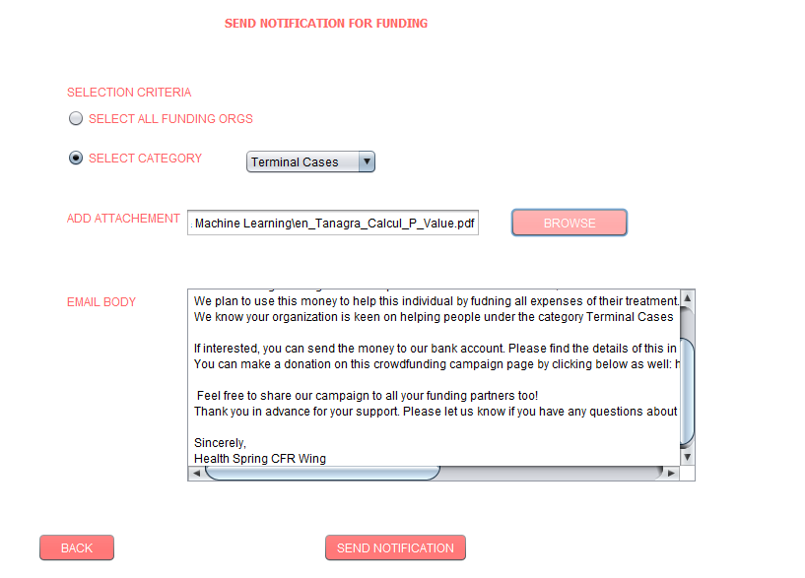
Requesting for funds via E-mail

Slide 11
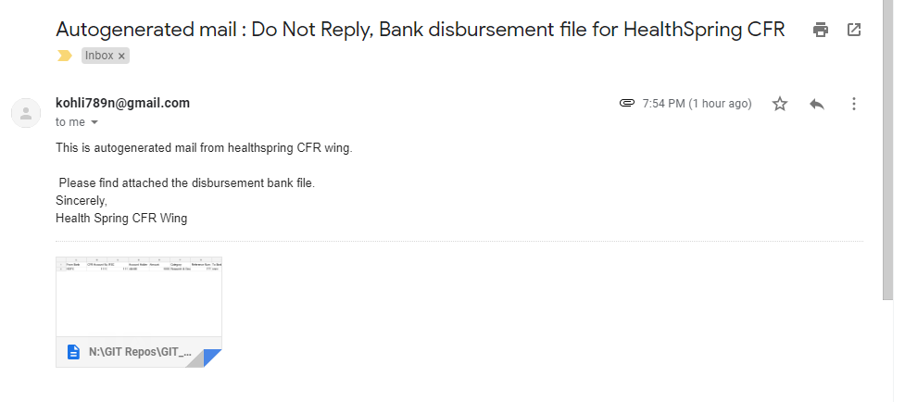
Additional Features
HealthSpring co-ordinates with the bank to disburse the funds raised by Crowd Funding

Slide 12
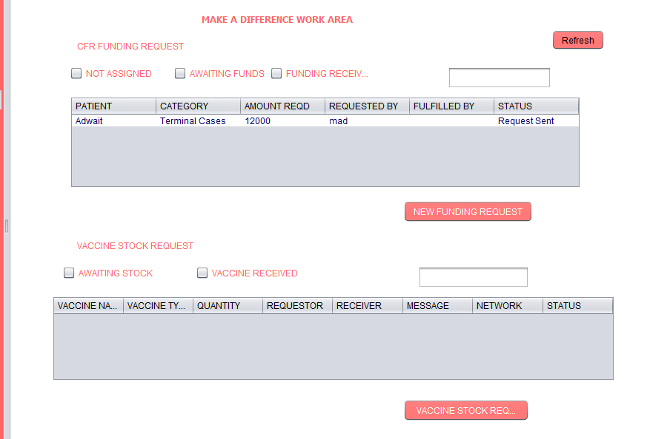
Funding and Vaccine(Work Request Handling)

Slide 13
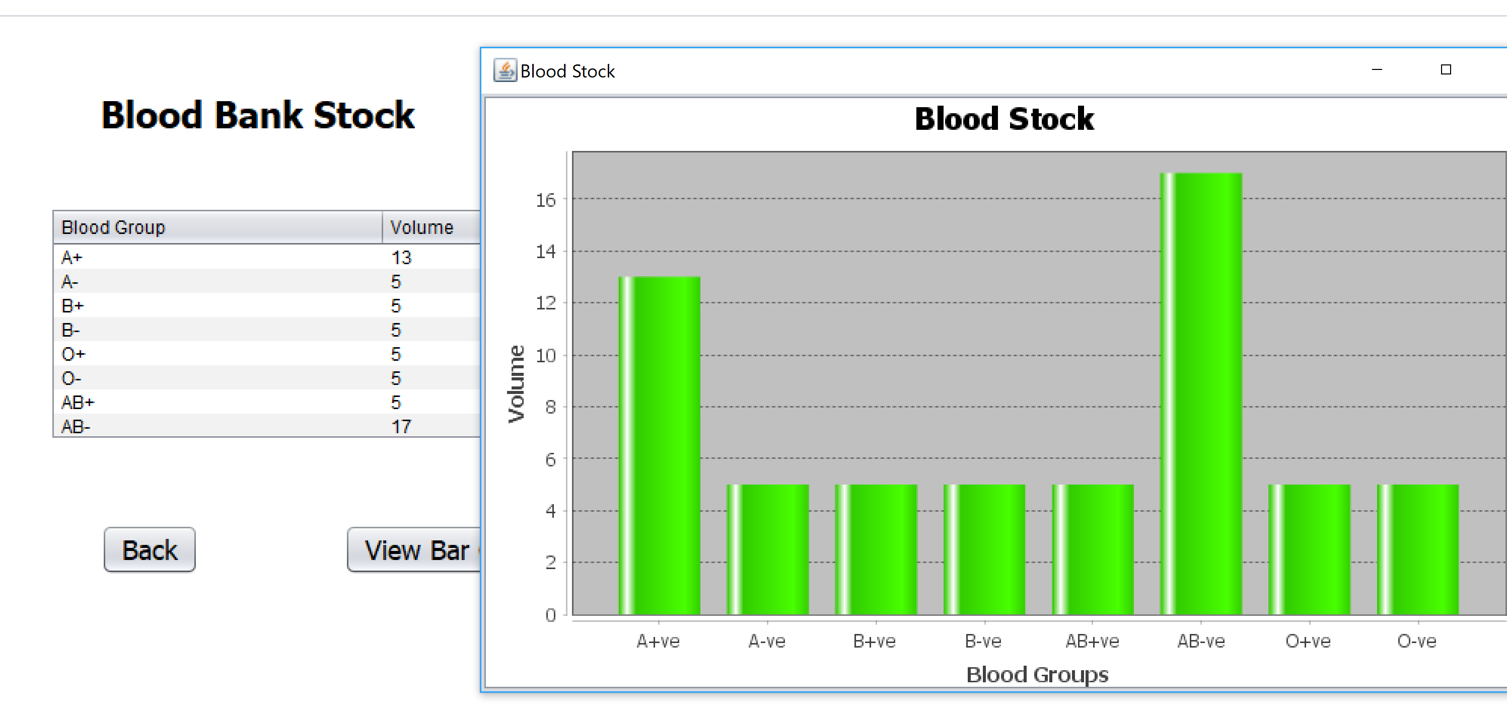
Additional Features
The blood banks maintains the record of quantity of blood available which is classified into 8 types as per it’s blood group.
The blood stock gets updated after donating blood to hospital as well as after receiving blood from donor.

Slide 14
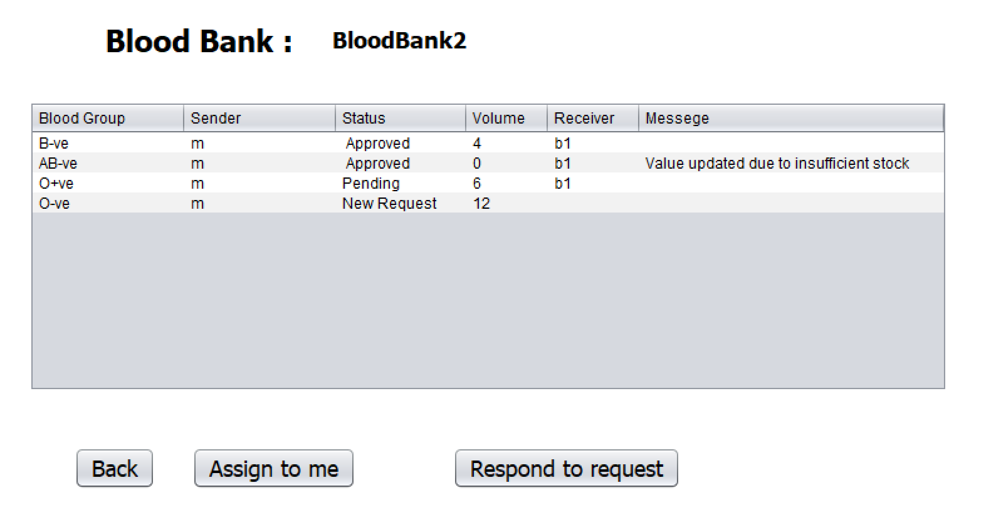
Blood Bank(Work Request Handling)

Slide 15
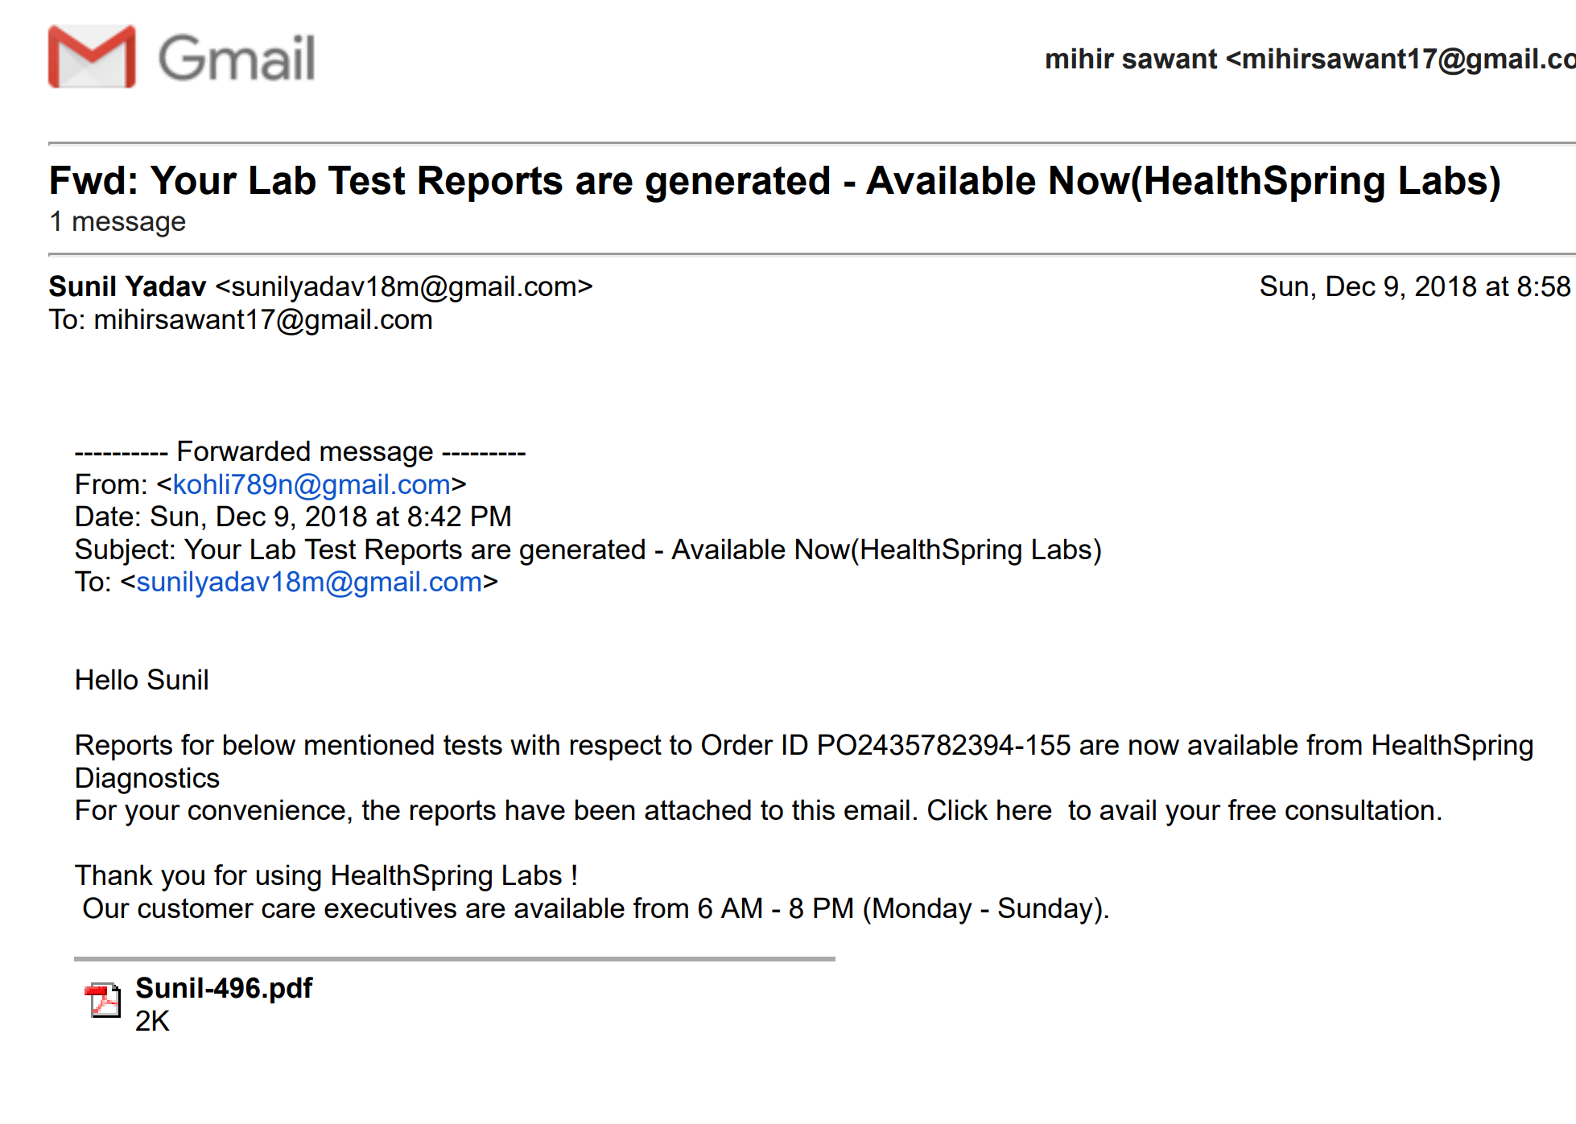
Additional Features
HealthSpring can send lab reports including a PDF attachment to it’s patients.

Slide 16
Thank you!!!

