Slide 1
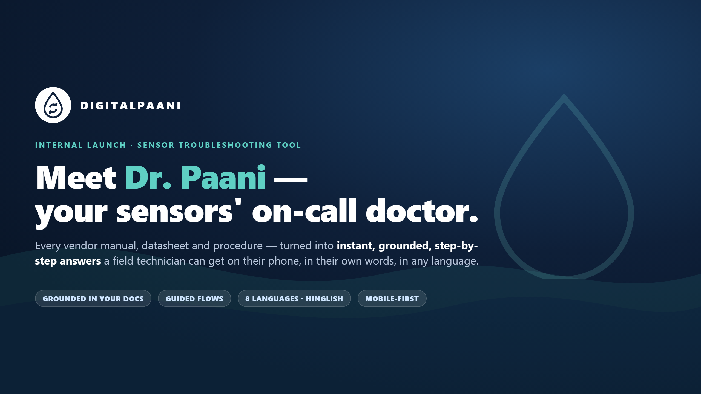
Notes:
Title. Dr. Paani turns every vendor manual into instant, grounded, step-by-step answers for field technicians — on their phone, in their own words, in any language.

Slide 2
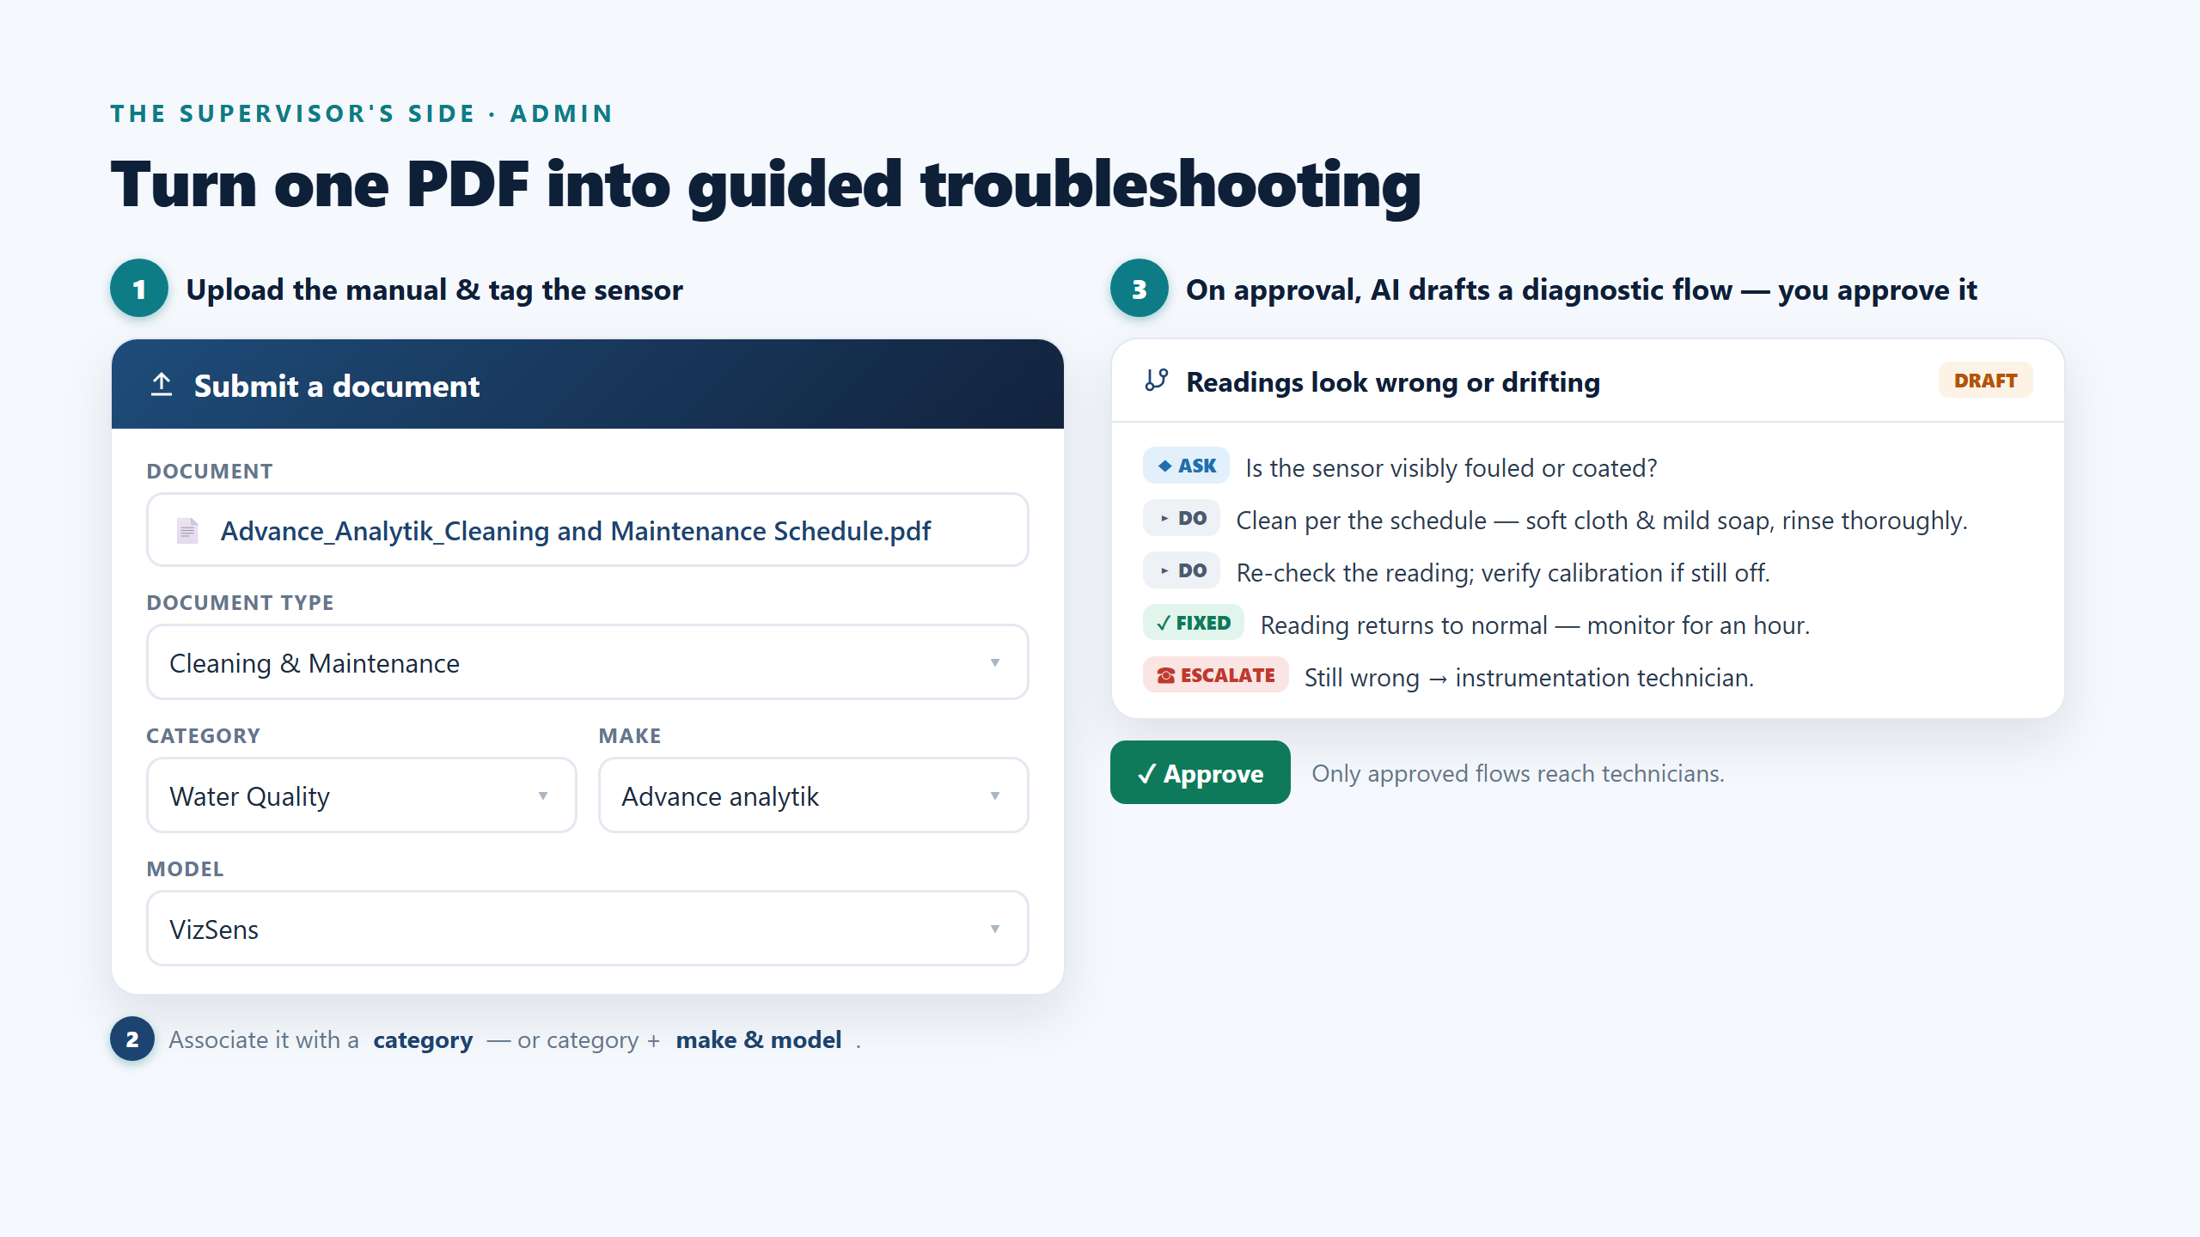
Notes:
Admin / supervisor flow. Upload a PDF, tag it to a category (or category + make & model). On approval the AI drafts a diagnostic flow; the admin reviews and approves it. Only approved flows reach technicians. Real example: Advance analytik VizSens, Water Quality, Cleaning & Maintenance.

Slide 3
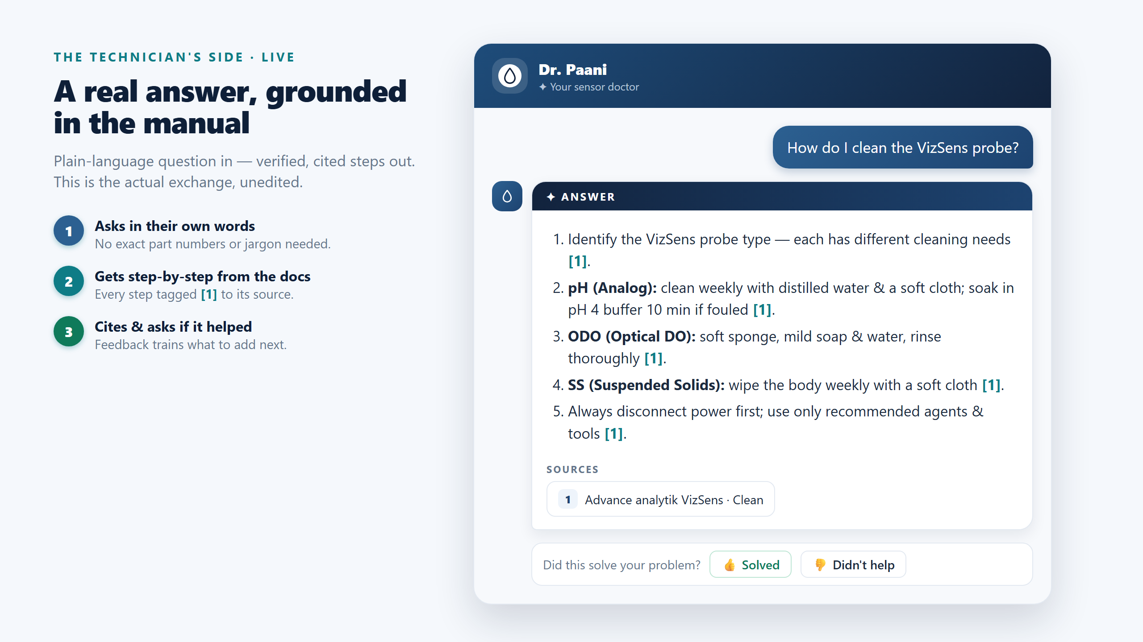
Notes:
Technician flow — a real, unedited exchange. "How do I clean the VizSens probe?" returns cited, step-by-step guidance from the approved manual, then asks if it helped.

Slide 4
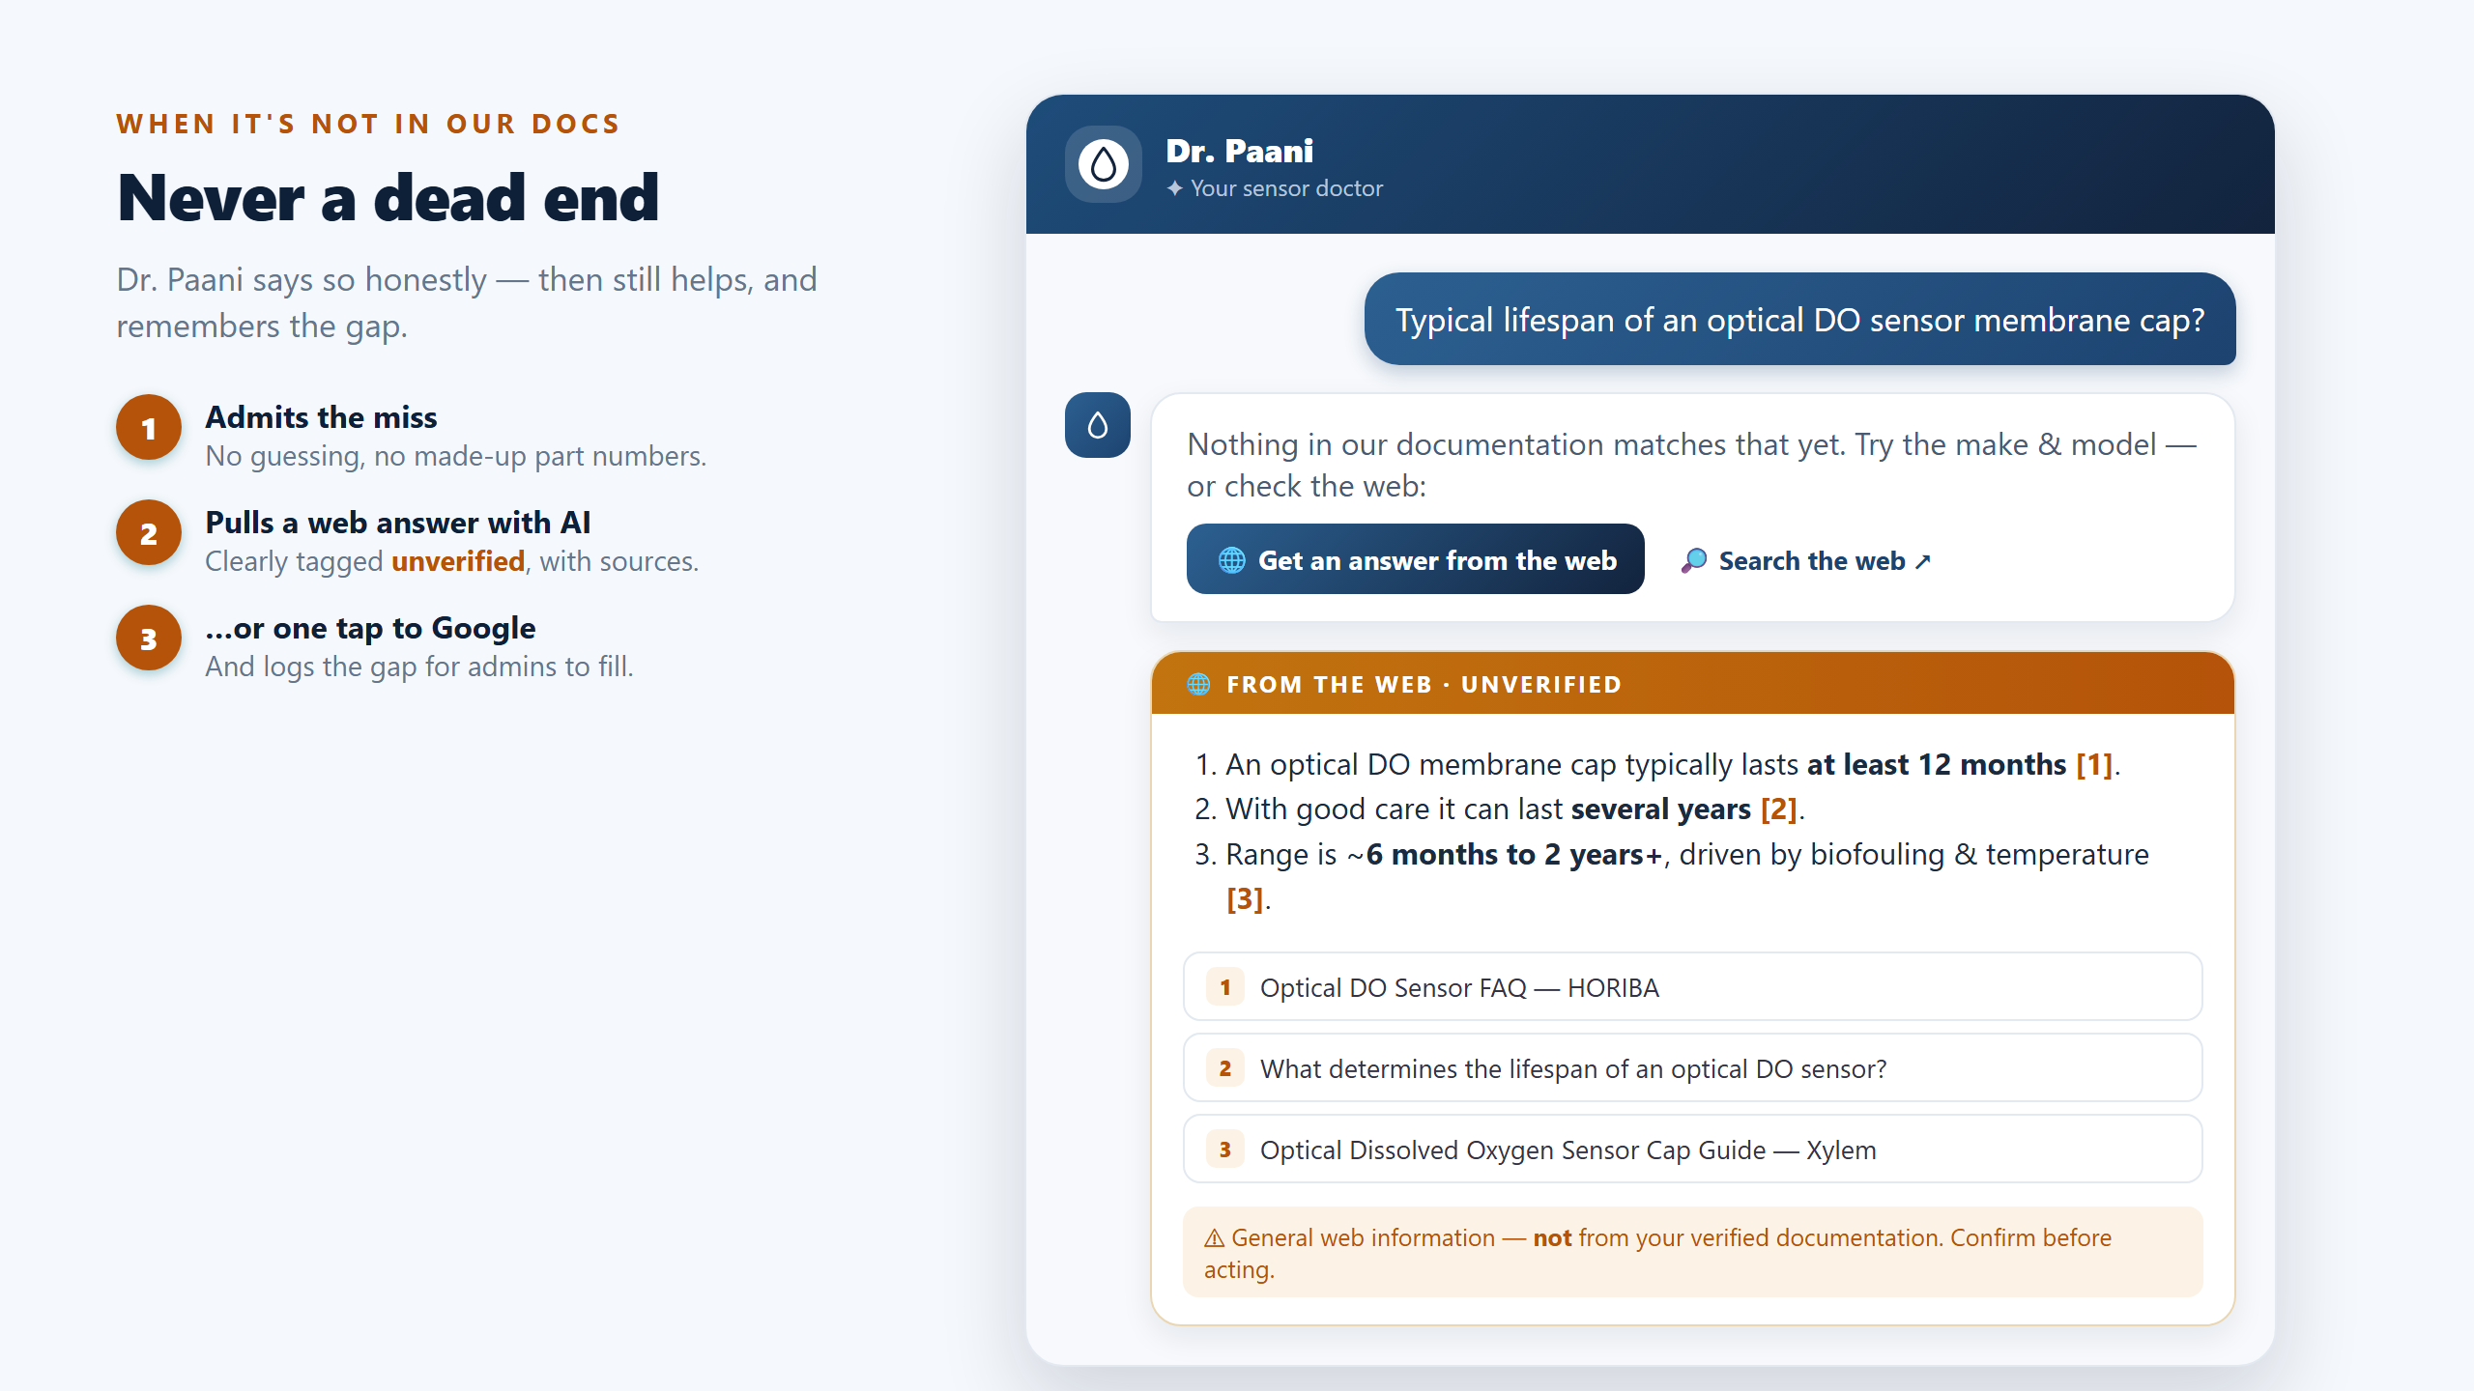
Notes:
Fallback. When the docs don't cover it, Dr. Paani says so, then pulls a web answer (clearly marked unverified, with sources) or offers a one-tap Google search — and logs the gap for admins.

Slide 5
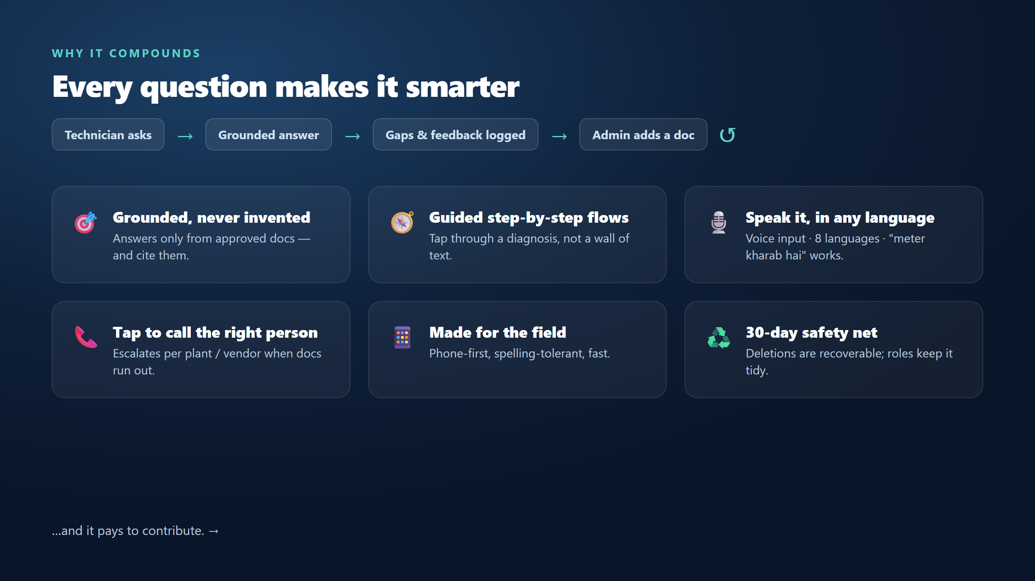
Notes:
Why it compounds: every question feeds the loop. Grounded, guided, speak-it-in-any-language (voice + 8 langs), tap-to-call the right person, mobile-first, 30-day safety net.

Slide 6
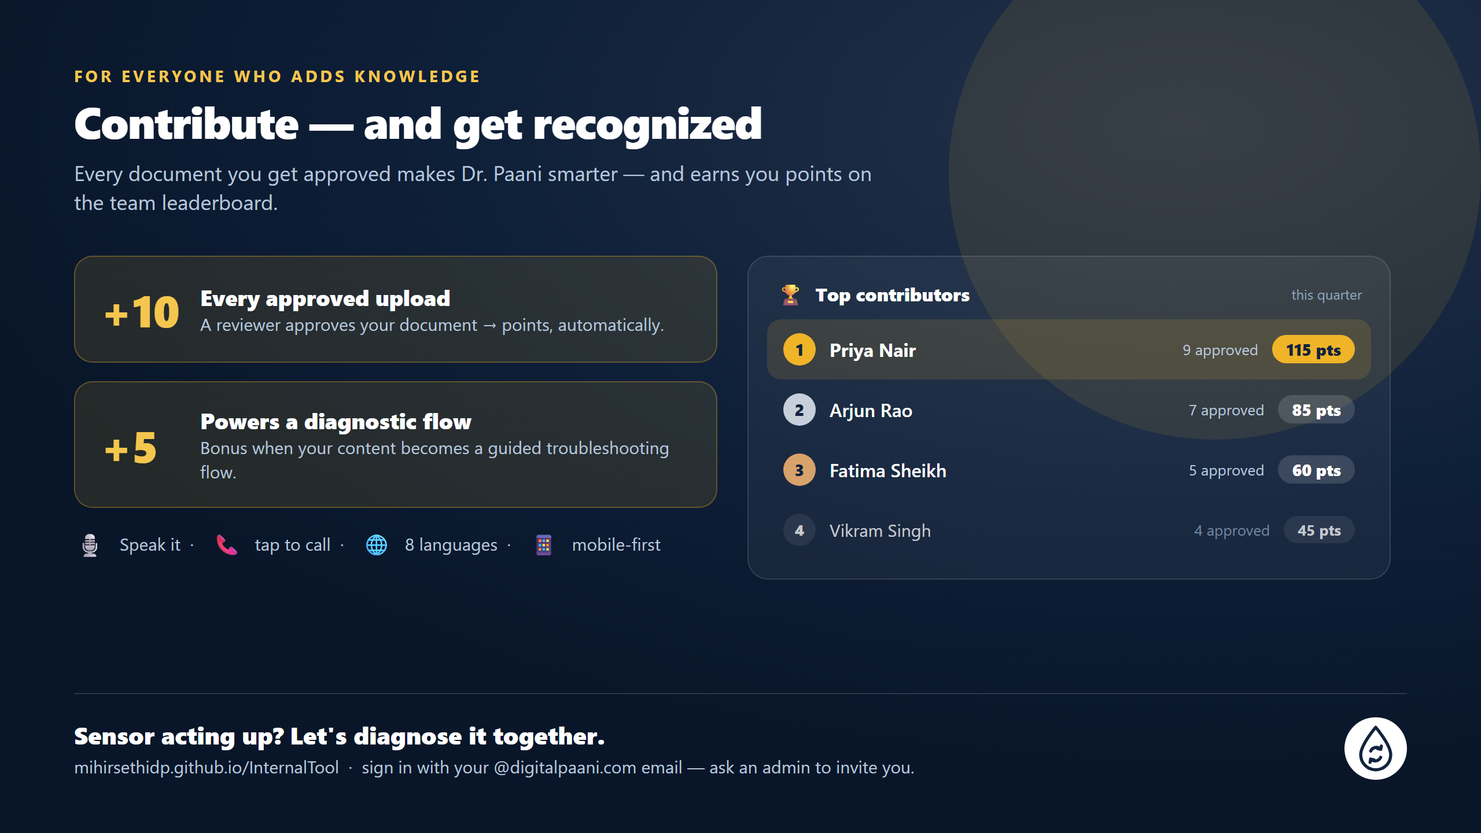
Notes:
The incentive: every approved upload earns +10 points, +5 more when it powers a diagnostic flow, tracked on a team leaderboard — so contributing is recognised. Plus accessibility: voice, tap-to-call, 8 languages, mobile. (Leaderboard names are illustrative.) CTA: sign in at mihirsethidp.github.io/InternalTool.

