Slide 1
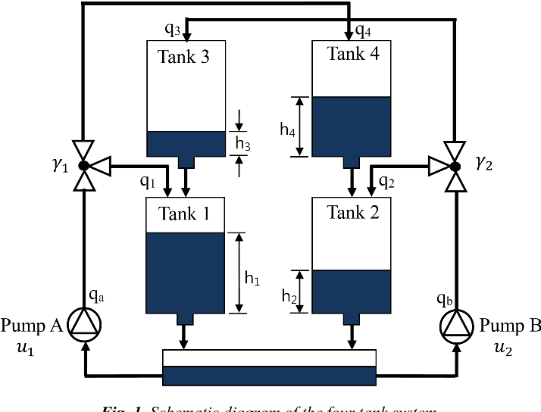
Mini-Project : Part-A & B
Based on the paper, titled, “The Quadruple-Tank Process: A Multivariable Laboratory Process with an Adjustable Zero”, by Karl Henrik Johansson (attached) and the diagram given below, where :
The measurements available are for tank-1 (h-1) and for tank-2 (h-2).
The governing equations, are as shown in slide # 2
A, B, & C matrices can be computed from the Linearized State & Measurement equations (around an operating point), as shown in slide # 3
You may take the initial values (obtained from the above paper) listed in slide # 4
Solve the questions Q-1, Q-2, Q-3 & Q-4, given below :
Data Generation for Part-A & B
Q-1 : Solve the set of non-linear equations of the four-tank system, as given below, using forward difference method or by using ODE-45 of Matlab (or equivalent in Python, etc.), for generating a typical data set of 10,000. This data set is to be used for comparing the performance of the Kalman Filter & Particle Filter.
Part-A : Kalman Filter
Q-2 : Formulate a Kalman Filter for this four tank problem, for estimating h-3 & h-4 (not measured) and obtaining the filtered values for h-1 & h-2 (measured). Verify the resulting values of h-1, h-2, h-3 & h-4, by comparing the same with the generated data set.
Q-3 : Obtain all the Plots, as indicated in slide # 5
Part-B : Particle Filter
Q-4 : Formulate a Particle Filter (use the algorithm, given in Slide # 6) for the above four tank problem for estimating h-3 & h-4 (not measured) and obtaining the filtered values for h-1 & h-2 (measured). Verify the resulting estimate by comparing the same with the generated data set (from Q-1).

Slide 2
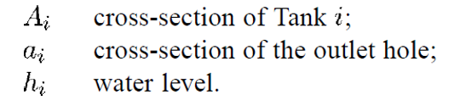
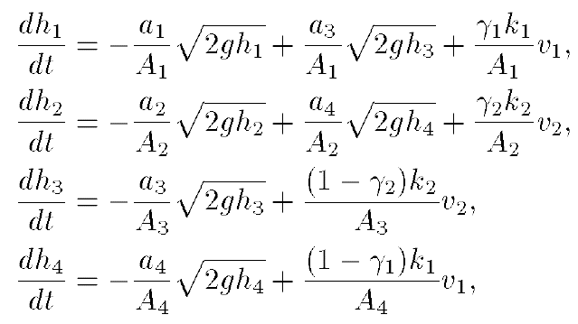
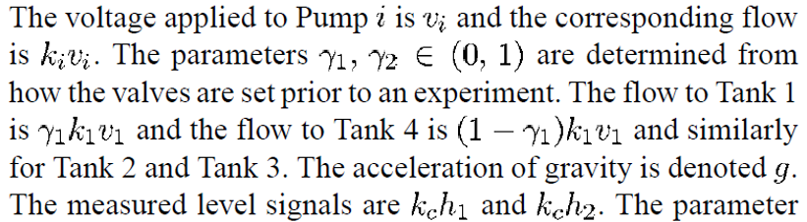
Slide # 2
The 4-Tank Governing Equations

Slide 3
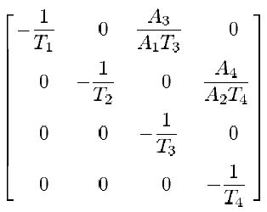
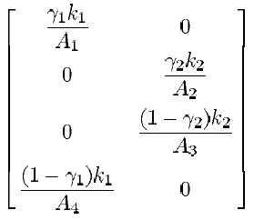
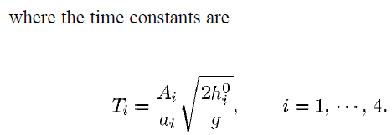

Slide # 3
Linearized State Eqn. & Meas. Eqn.
A =
B =
Compute A, B, C, Matrices, based on data provided, viz. the details of the tank size, area of orifice, voltage applied to pump, etc.
The water level in the tanks,
h1, h2, h3, h4, are considered as states, [x] is the state vector
H =

Slide 4
% initialization of all the parameters of the four tank system
clc; clear; close all;
A1 = 28; %(cm^2)
A2 = 32;
A3 = 28;
A4 = 32;
a1 = 0.071; a3 = 0.071; %(cm^2)
a2 = 0.057; a4 = 0.057;
kc = 0.5; % (V/cm)
g = 981; %(cm/s^2)
gamma1 = 0.7; gamma2 = 0.6; % constants, determined from valve position
k1 = 3.33; k2 = 3.35; %[cm^3/Vs]
kc = 0.5; % [V/cm]
v1 = 3; v2 = 3; % (V)
h0 = [12.4; 12.7; 1.8; 1.4];
Slide-4

Slide 5
Slide # 5
Prior Estimate of x(k-) (state variable), with k
Posterior Estimate of x(k+)(state variable), with k
Prior Estimate of Covariance, P(k-) with k
Posterior Estimate of Covariance, P(k+) with k
Kalman-Gain, K(k) with k
Prior Residues/Innovations, r(k-) with k
Posterior Residues, r(k+) with k
Understanding the Performance of the Kalman Filter, through Plots

Slide 6

Slide # 6
Initialisation, t = 0; (Prior Step)
For i = 1, …., N, sample x(0) ~ p{x(0)} & set t = 1
Importance Sampling
Prediction Step
For i = 1,…,N, sample x(t,i) ~ p{x(t)|x(t-1, i)}
Likelihood Step
For i = 1,…,N, evaluate importance weights : w(t,i) = p{z(t)|x(t,i)
Normalise the Importance Weights
Selection
Update Step/Resampling Step
Resample with replacement, according to Importance Weights
Set t = t + 1 and return to Prediction Step

