Slide 1

Tumor Classification
Objective: Developing a predictive model to classify tumors as Benign(B) or Malignant(M) using features derived from digitized images.
Focus: Building highly accurate and interpretable model for diagnosis.
By: Saad Chadrawala and Mihir Thakkar

Slide 2
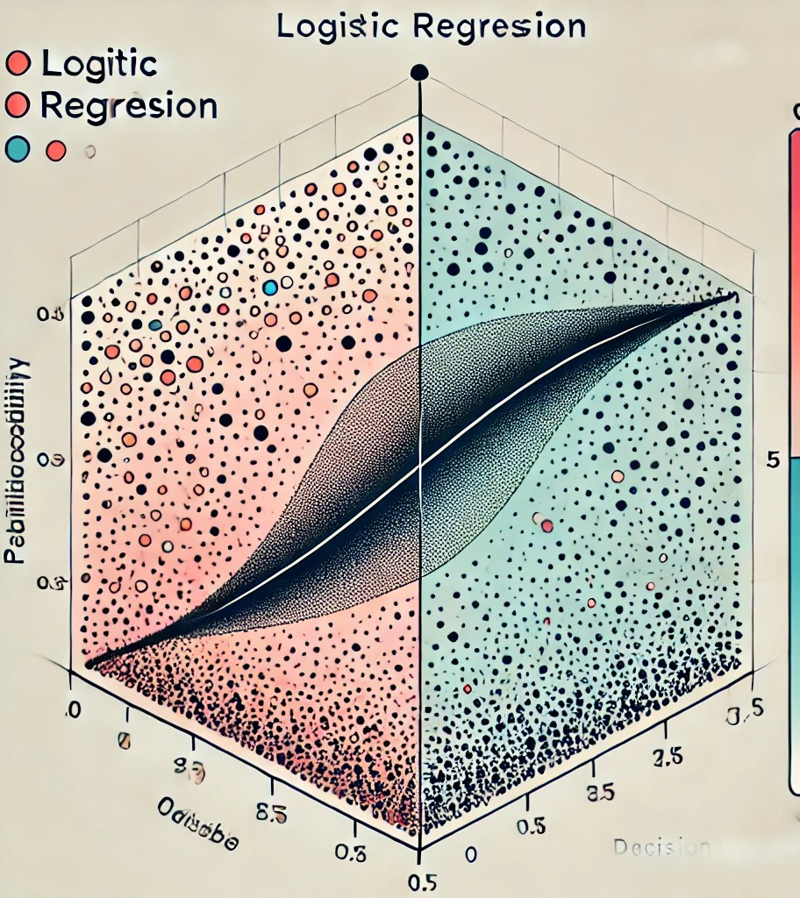
Logistic Regression
Logistic regression is commonly used when the dependent variable is categorical, particularly for binary classification tasks.
It models the probability of a certain class or event occurring, outputting values between 0 and 1, which is ideal for predicting outcomes. This is achieved by using the logistic function to transform linear predictions into probabilities. Logistic regression is straightforward, computationally efficient, and interpretable, making it a go-to model for classification problems.

Slide 3
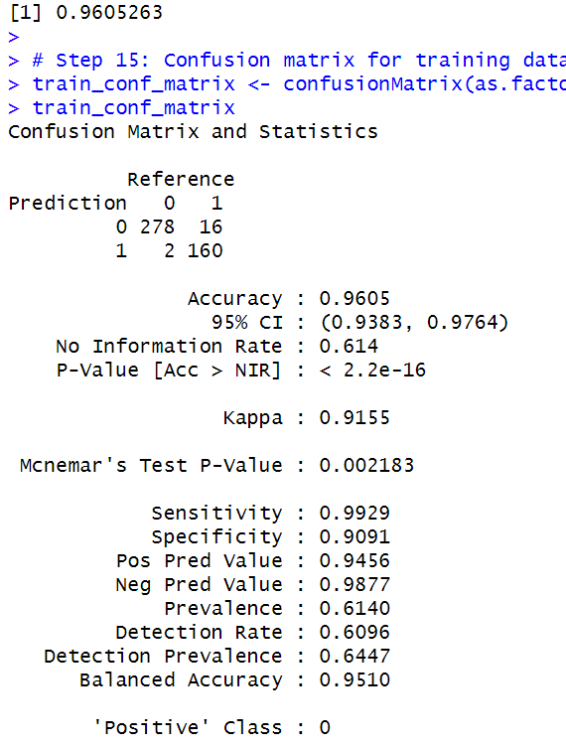
Training Results
Training Accuracy:
The model’s accuracy on the training data is 96.05%. This means that about 96% of the predictions on the training dataset were correct.
Training Confusion Matrix:
True Negatives (TN): 278 cases where the model correctly predicted benign.
False Positives (FP): 16 cases where the model wrongly predicted Malignant when it should have predicted benign.
False Negatives (FN): 2 cases where the model wrongly predicted Benign when it should have predicted Malignant.
True Positives (TP): 160 cases where the model correctly predicted Malignant (event occurred).
Accuracy: 96.05% of the predictions were correct.
AUC: 0.9958, which indicates excellent performance. The closer to 1, the better the model is at distinguishing between classes.

Slide 4
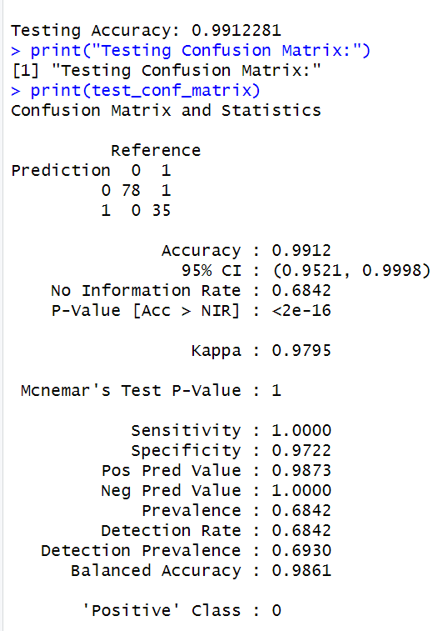
Testing Results
Testing Accuracy:
The model’s accuracy on the testing data is 99.12%, which is very good.
Testing Confusion Matrix:
True Negatives (TN): 78 cases where the model correctly predicted class Benign.
False Positives (FP): 1 case where the model wrongly predicted Malignant when it should have predicted Benign.
False Negatives (FN): 0 cases where the model wrongly predicted Benign when it should have predicted Malignant.
True Positives (TP): 35 cases where the model correctly predicted Malignant.
Accuracy: 99.12% of the predictions were correct.
AUC: 1, which indicates perfect performance on the test data, meaning the model is able to perfectly distinguish between the two classes
Conclusion: Applied lasso regression to penalized large coeffients. This helped reduce the complexity of the model and promoted feature selection, ensuring that only the most important features were used for prediction.

Slide 5

Decision Tree Model
Why?: Testing a decision tree model on a separate test dataset ensures it can generalize well to new, unseen data. Testing helps validate the robustness of the model.
Accuracy tells us how often the model correctly classifies instances, regardless of the class.
Sensitivity (Recall) measures how well the model identifies positive instances (e.g., identifying malignant tumors in the breast cancer dataset).
Specificity measures how well the model avoids false positives (e.g., correctly identifying benign cases).
The confusion matrix provides a detailed view of classification performance, breaking down the true positives, true negatives, false positives, and false negatives. It provides a granular view of the model's strengths and weaknesses, helping diagnose issues like class imbalance, overfitting, or bias toward one class.

Slide 6
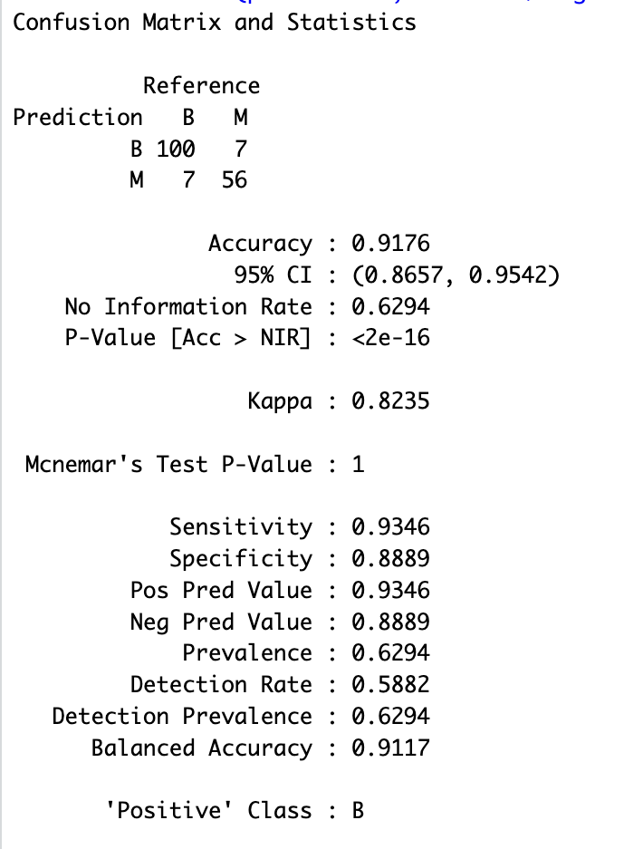
Columns represent predicted values, and rows represent actual values.
True Positives: 100 benign cases(B) are correctly identified as 'B'
False negatives: 7 malignant cases(M) are misclassified as 'B'
False positives: 7 benign cases (B) are misclassified as 'M'.
True negative: 56 malignant cases (M) are correctly identified as 'M'.
Accuracy is 0.9176 this is the proportion of correct predictions(both true positives and true negatives) to the total number of predictions.
The small p-value suggest that accuracy is highly significant and not due to random chance.
Sensitivity is 0.9346 this means the model correctly identified 93.46% of benign cases
Specificity is 0.8889 this means the model correctly identified 88.89 of malignant cases.

Slide 7
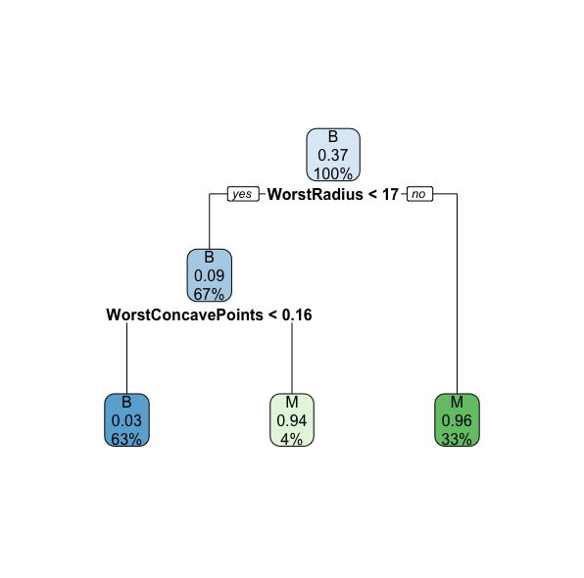
Decision Tree Graph
Root Node: The tree starts by splitting on WorstRadius < 17, identifying this feature as the most significant for separating benign and malignant cases.
Branching: The next split uses WorstConcavePoints < 0.16, further refining the predictions based on tumor shape.
Terminal Nodes: Each leaf represents a final classification (Benign or Malignant) with a percentage indicating confidence (e.g., B: 100%, M: 94%).
Decision Rules: A pathway like "If WorstRadius < 17 and WorstConcavePoints < 0.16 → Benign" shows how the tree makes predictions.
Model Confidence: Some nodes (e.g., B: 67%) highlight areas of uncertainty, suggesting room for further improvement.

Slide 8

Random Forest Model
Why?: Testing the Random Forest ensures that it generalizes well to new data and improves performance by combining multiple decision trees, which helps to reduce overfitting.
Using 500 trees ensures the Random Forest model achieves a balance between accuracy and stability, providing robust predictions while lowering the risk of overfitting. It also leverages the power of ensemble learning to outperform single decision tree

Slide 9
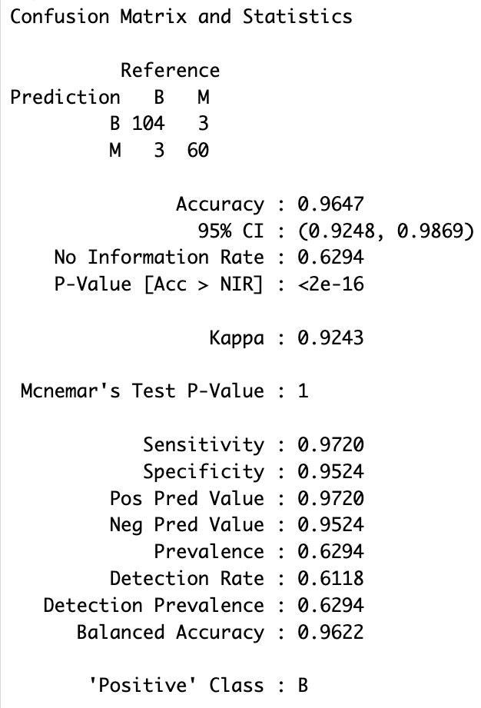
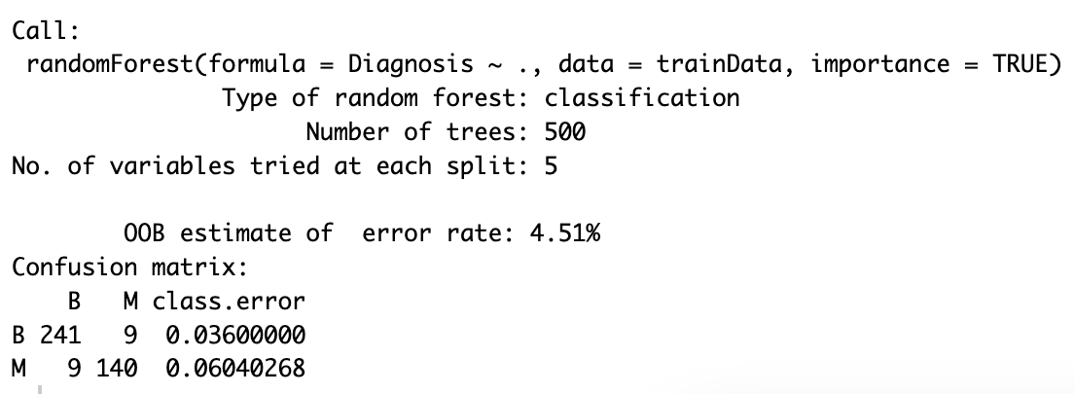
Random Forest Model
True Positives (B): 241 benign cases (B) correctly classified.
False Negatives (M): 9 malignant cases (M) misclassified as benign. False Positives (B): 9 benign cases (B) misclassified as malignant. True Negatives (M): 140 malignant cases (M) correctly classified.
Error Rates: The error rate for benign cases is 3.6% (0.036), and for malignant cases, it’s 6.04% (0.060).
Accuracy: 96.47% (0.9647)
Sensitivity (Recall): 97.20% (0.9720), indicating that the model correctly identified 97.20% of benign cases (B).
Specificity: 95.24% (0.9524), showing the model correctly identified 95.24% of malignant cases (M).
Balanced Accuracy: 96.22% (0.9622), combining sensitivity and specificity for a more balanced evaluation of the model's performance.
Error Rates: The error rate for benign cases is 3.6% (0.036), and for malignant cases, it’s 6.04% (0.060). Error rate gives insight into how well the Random Forest model handles each class.

Slide 10
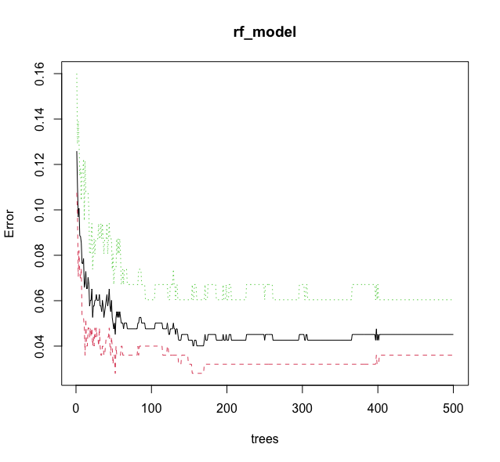
with fewer trees, the error rates for all lines are higher due to insufficient averaging and high variance
The OOB error rate (black line) decreases and stabilizes, indicating improved accuracy.
The class-specific error rates (red and green lines) also stabilize, showing the model's performance consistency across both classes.
Black line – out of bag error
Red line – benign cases
Green line – Malignant cases

Slide 11
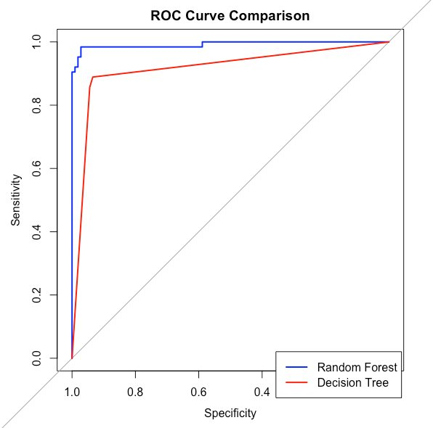
Decision tree vs Random Forest Model
The ROC curve is a plot of the true positive rate (sensitivity) against the false positive rate (1 - specificity) for different classification thresholds.
The graph shows that the Random Forest model (red line) has a higher area under the ROC curve (AUC) than the Decision Tree model (blue line), indicating that the Random Forest model has better overall classification performance. This means the Random Forest model is able to achieve higher true positive rates at lower false positive rates compared to the Decision Tree model.
The diagonal dashed line represents the performance of a random classifier, while curves above this line indicate better-than-random classification performance.

Slide 12
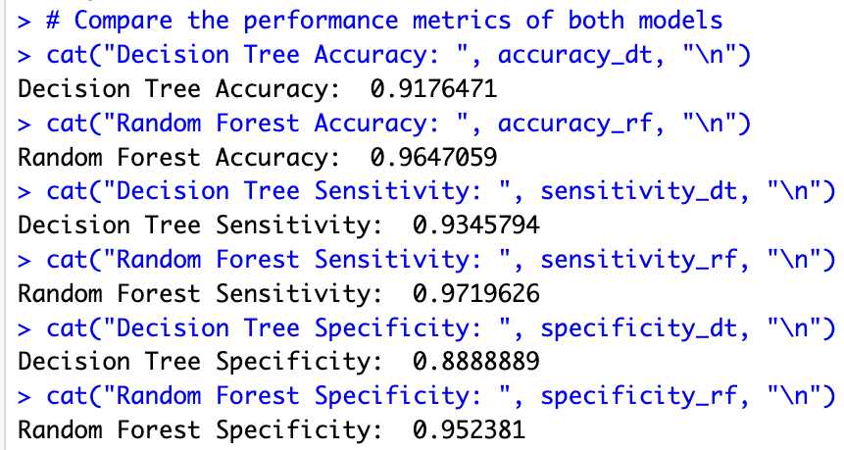
Decision tree vs Random Forest Model​
Accuracy: The Random Forest model performs better in terms of overall accuracy. The ensemble approach of Random Forest reduces overfitting and improves prediction on unseen data.
Sensitivity: Random Forest has higher sensitivity, meaning it correctly identifies more positive cases (malignant, in this context). This is crucial in applications where missing positive cases is costly or dangerous.
Specificity: Random Forest also outperforms the Decision Tree in identifying true negatives (benign cases), demonstrating better balance between detecting positive and negative cases.
For applications where false negatives (missed positive cases) are critical (e.g., cancer diagnosis), Random Forest is the better choice due to its higher sensitivity.
Ensemble: Random Forest combines predictions from multiple decision trees, reducing the variance and risk of overfitting, which is a common problem with standalone decision trees.
Robustness: By randomly selecting subsets of data and features, Random Forest avoids reliance on any specific feature or subset, making it more robust to noise.
Error Reduction: Random Forest minimizes classification errors for both classes (benign and malignant), leading to better sensitivity and specificity.

Slide 13
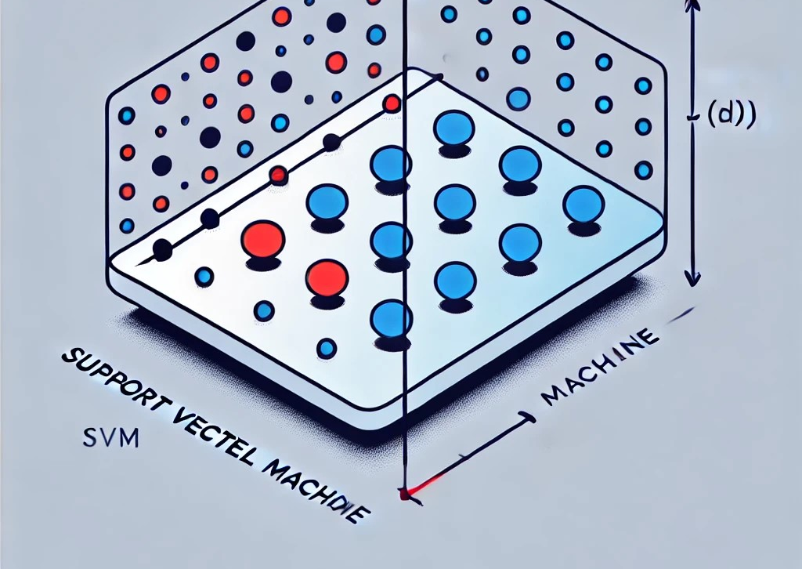
Support Vector Machine
Why?: We’re using the Support Vector Machine (SVM) model because it’s great for classifying data into two categories.
SVM works by finding the best boundary (hyperplane) that separates the classes with the widest gap, which helps the model make accurate predictions. It’s especially useful when the data isn’t easy to separate with a straight line, as it can use techniques like the Radial Basis Function (RBF) kernel to handle more complex patterns. This makes SVM a strong choice.

Slide 14
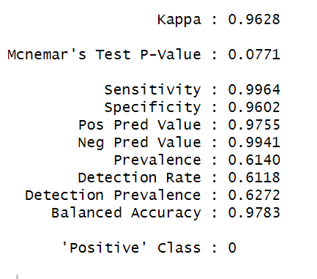
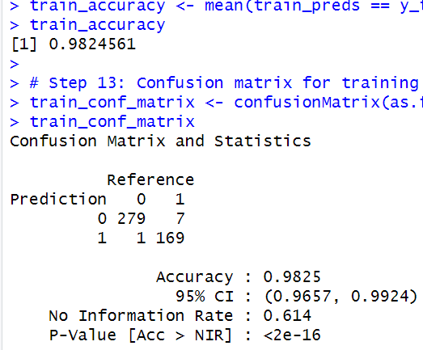
Training Results
Accuracy on training dataset: 98.24%
True Negatives: 279, This means 279 instances are correctly identified as negative as Benign(B).
False Positives: 7, This means 7 instances are incorrectly identified as Malignant(M) instead of Benign(B).
False Negatives: 1, This means 1 instances incorrectly identified as Benign instead of Malignant.
True Positives: 169, This means than 169 instances correctly identified as Malignant.
Classification metrics given in the image.
AUC: 0.9975 is outstanding, suggesting that model is able to distinguish between the positive and negative classes with near-perfect accuracy.

Slide 15
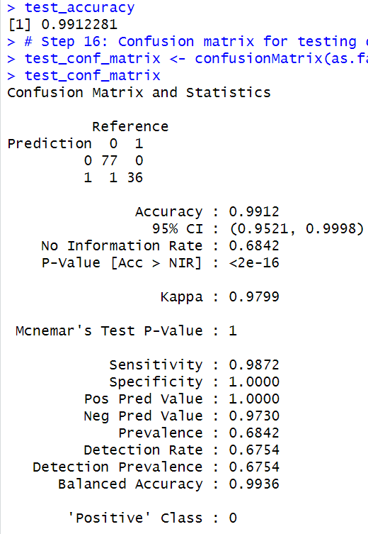
Testing Result
Accuracy in Testing Datset: 99.12% which suggest the model generalize the data well on unseen data.
True Negatives (TN): 77 instances where Benign was correctly predicted.
False Positives (FP): 0 instances where Malignant was incorrectly predicted as Benign.
False Negatives (FN): 1 cases where the model wrongly predicted Benign when it should have predicted Malignant.
True Positives (TP): 36 instances where Malignant was correctly predicted.
Area under curve is 1
Interpretation:
Perfect Specificity (1.0000): Your model correctly identified all the Class 1 instances without any false positives.
High Sensitivity (0.9872): The model identified 98.72% of the Class 0 instances correctly, though there's still one false negative (1 instance incorrectly predicted as Class 1).
Accuracy: The model achieved 99.12% accuracy on the test set, which is excellent.
Kappa: The Kappa value of 0.9799 reflects almost perfect agreement between the predicted and actual outcomes.
Balanced Accuracy: 0.9936 indicates that the model performs well across both classes, considering both sensitivity and specificity.

Slide 16

In medical settings, False negative is very important factor, because you cannot predict Malignant(cancerous) as benign(non-cancerous).
Models:
Logistic Regression: It Predicted 0 FN, that is 0 incorrect patient where acutal cancerous patient was detected as non-cancerous.
It's recall(sensitivity) value is 96%. Means 96% of time it predicted right True positive.
Decision Tree: 7 FN
Random Forest: 9 FN
SVM: It predicted 1 FN, that is 1 cases where the patient has Malignant(cancerous) but incorrectly predicted as Benign(non-cancerous).
It's recall(sensitivity) value is 98%. Means 98% if time it oredicted right True positive.

Slide 17

Any Question?

Slide 18

The end

