Slide 1
PEOPLE ANALYTICS / DECISION STORY
Why are people leaving—and where should HR act first?
An evidence-led investigation of attrition patterns, operational pressure and employee experience.
1,470 EMPLOYEES • 237 RECORDED EXITS
PYTHON / PANDAS MYSQL POWER BI
EVIDENCE → ACTION

Slide 2
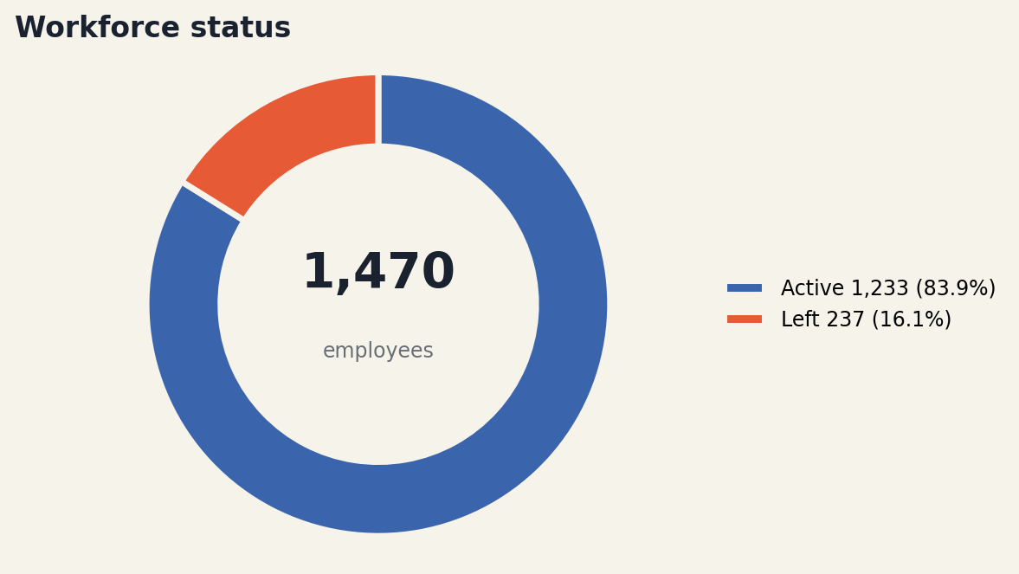
WORKFORCE INTELLIGENCE / 01 / THE PROBLEM
02
Attrition is a business signal—not just an HR KPI.
First quantify the scale of exits, then identify where a targeted response may matter most.
THE QUESTION
Which employee segments should HR investigate first?
THE EVIDENCE
237 of 1,470 employees left: a 16.12% attrition rate.
THE DECISION
Prioritise by both attrition rate and number of exits.
Active employees: 1,233 • Attrition rate = recorded exits ÷ total employees.
IBM HR Analytics sample • Descriptive patterns do not establish causation

Slide 3
WORKFORCE INTELLIGENCE / 02 / TRUST THE DATA
03
The analysis starts with a defensible data foundation.
Before reading patterns, remove fields that add no analytical value and validate key records.
35
32
0
0
original fields
retained fields
missing values
duplicate rows
Three constant fields removed: EmployeeCount, Over18 and StandardHours. EmployeeNumber is unique; business-rule checks passed.
Limit: this is a sample dataset, not a live HR system or a longitudinal employee history.
IBM HR Analytics sample • Descriptive patterns do not establish causation

Slide 4
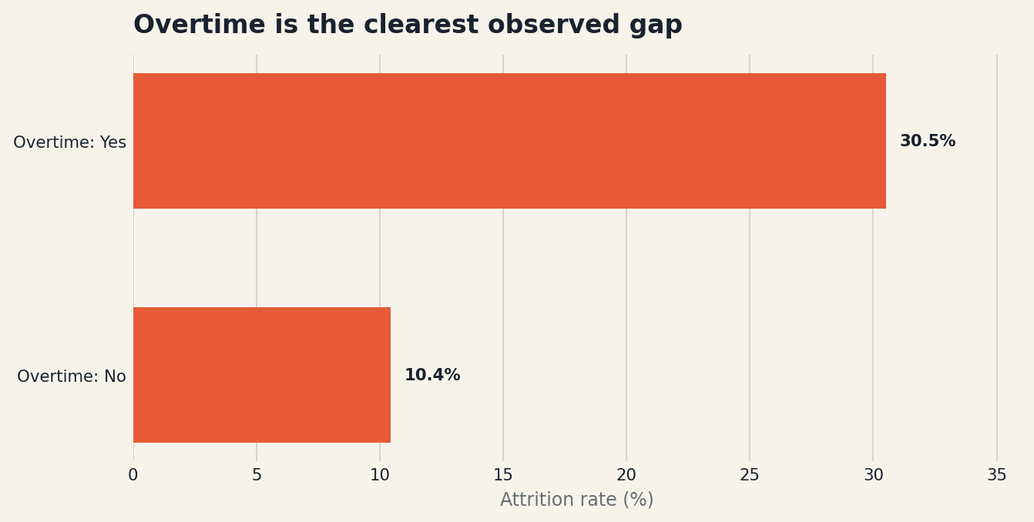
WORKFORCE INTELLIGENCE / 03 / THE STRONGEST SIGNAL
04
Employees working overtime leave at a much higher rate.
The observed rate is almost three times the rate among employees not working overtime.
2.9×
higher observed
attrition rate
Hypothesis to test: repeated overtime may indicate workload imbalance or insufficient coverage. This dataset cannot prove cause.
IBM HR Analytics sample • Descriptive patterns do not establish causation

Slide 5
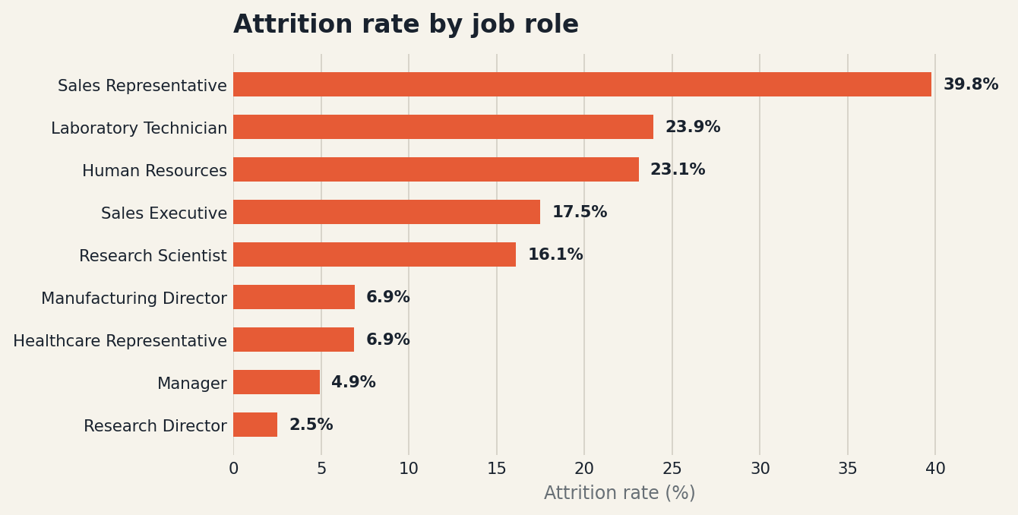
WORKFORCE INTELLIGENCE / 04 / LOCATE THE RISK
05
Sales Representatives are the highest-rate hotspot.
Rate identifies concentrated risk—but it should not be confused with total exit volume.
39.76%
Sales Representative attrition rate
23.94%
Laboratory Technician attrition rate
Next: compare manager, tenure, workload, travel and exit reasons in these roles.
IBM HR Analytics sample • Descriptive patterns do not establish causation

Slide 6
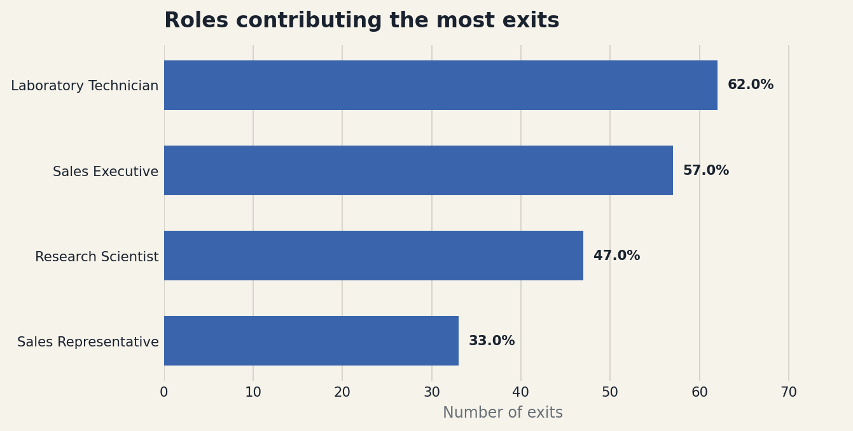
WORKFORCE INTELLIGENCE / 05 / WHERE EXITS ACCUMULATE
06
Four roles contribute the most recorded exits.
This answers a different question: where could retention work reach more people?
199 exits
across these four roles
Laboratory Technician: 62
Sales Executive: 57
Research Scientist: 47
Sales Representative: 33
Prioritise rate and volume together.
IBM HR Analytics sample • Descriptive patterns do not establish causation

Slide 7
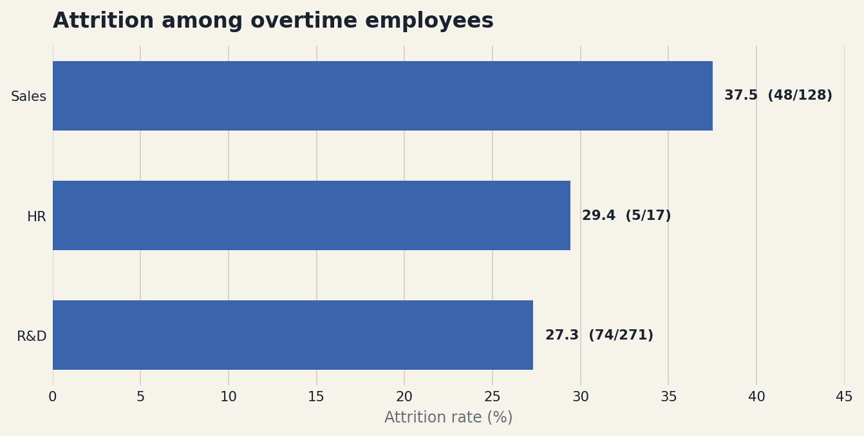
WORKFORCE INTELLIGENCE / 06 / ADD BUSINESS CONTEXT
07
The overtime signal appears across all three departments.
Rates are elevated among overtime employees in Sales, HR and R&D; team size matters.
SALES
48 of 128 overtime employees left
HR
5 of 17 overtime employees left
R&D
74 of 271 overtime employees left
These are overtime-group rates, not full department attrition rates.
IBM HR Analytics sample • Descriptive patterns do not establish causation

Slide 8
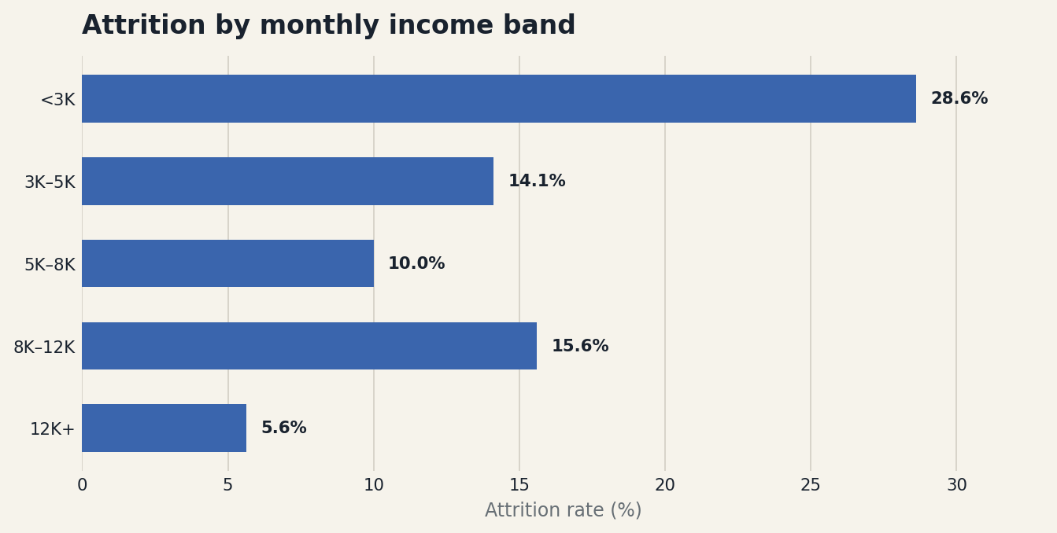
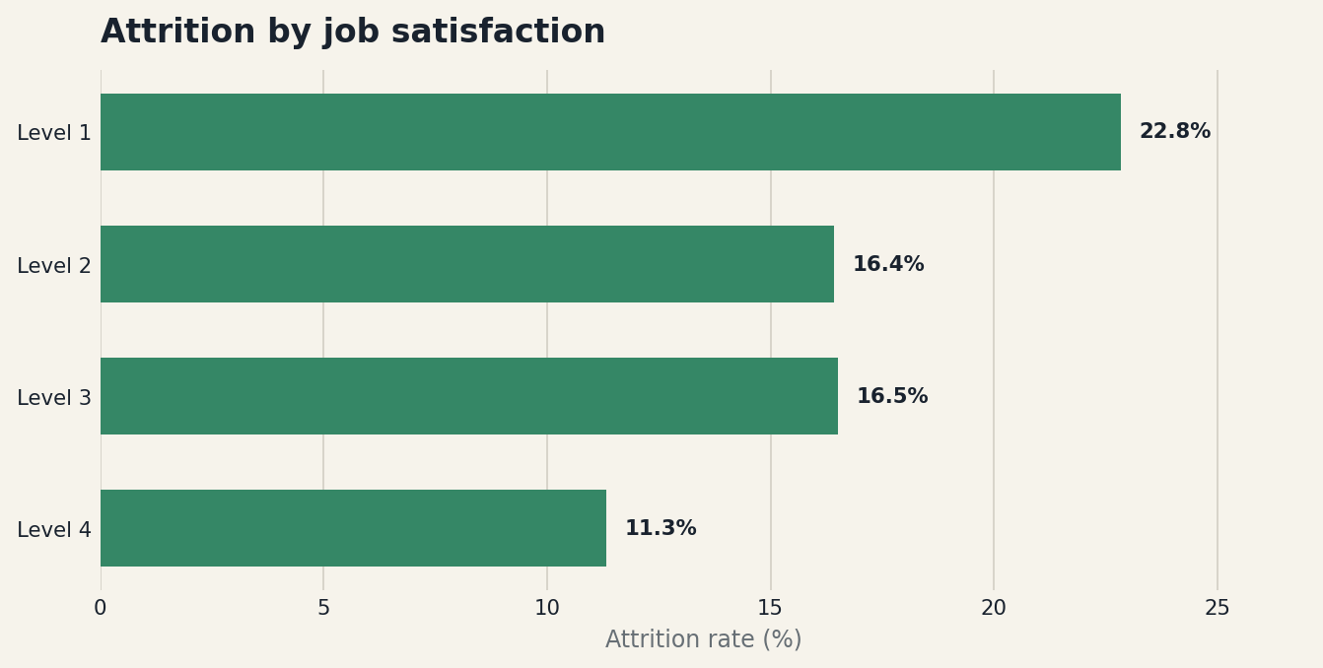
WORKFORCE INTELLIGENCE / 07 / CHECK THE OTHER SIGNALS
08
Income and job satisfaction add nuance to the story.
The gradients are informative, but the exceptions warn against simplistic explanations.
Lowest income band: 28.61% • Satisfaction 1: 22.84% • Satisfaction 4: 11.33%
IBM HR Analytics sample • Descriptive patterns do not establish causation

Slide 9
WORKFORCE INTELLIGENCE / BUSINESS INSIGHTS
09
What the evidence actually tells us
Four findings translate the charts into a business diagnosis.
01
Overtime is the strongest observed signal
30.53% attrition with overtime vs 10.44% without (about 2.9×).
SO WHAT
Investigate workload, staffing cover and recovery time.
02
Risk and volume point to different priorities
Sales Representatives have the highest role rate (39.76%); Lab Technicians contribute the most exits (62).
SO WHAT
Use role-specific retention diagnostics, not one company-wide intervention.
03
The overtime pattern spans departments
Overtime-group attrition: Sales 37.50%, HR 29.41%, R&D 27.31%. HR's rate represents 5 exits from 17 people.
SO WHAT
Review rates alongside group sizes and role mix.
04
Pay and satisfaction matter—but do not explain everything
The under-3K band has 28.61% attrition; satisfaction level 1 has 22.84% vs 11.33% at level 4. The 8K–12K band is a notable exception.
SO WHAT
Treat these as investigation leads, not proof of cause.
IBM HR Analytics sample • Descriptive patterns do not establish causation

Slide 10
WORKFORCE INTELLIGENCE / RECOMMENDATIONS & ACTION PLAN
10
What HR should do next—and how to know it worked
Start with low-regret diagnostics. Do not claim the intervention worked until outcomes are measured.
PRIORITY / OWNER
ACTION
SUCCESS MEASURE
1 Overtime review
HR + Operations
Identify teams and roles with repeated overtime; review staffing, shift coverage and recovery time.
Overtime exposure by team; attrition trend during pilot.
2 Role diagnostics
HR Business Partners
Run structured stay/exit interviews for Sales Representatives and Laboratory Technicians; segment by tenure and manager.
Top exit themes documented; actions assigned to accountable owners.
3 Early-tenure support
Line managers + HR
Review onboarding, role clarity and manager check-ins for employees in their first years.
Check-in completion; experience pulse; attrition by tenure band.
DECISION REQUEST Approve a focused retention diagnostic, then run a time-bound pilot with a baseline and review date.
Caveat: this sample has no time series or verified exit-reason field; pilot impact must be measured with future HR data.

