Slide 2
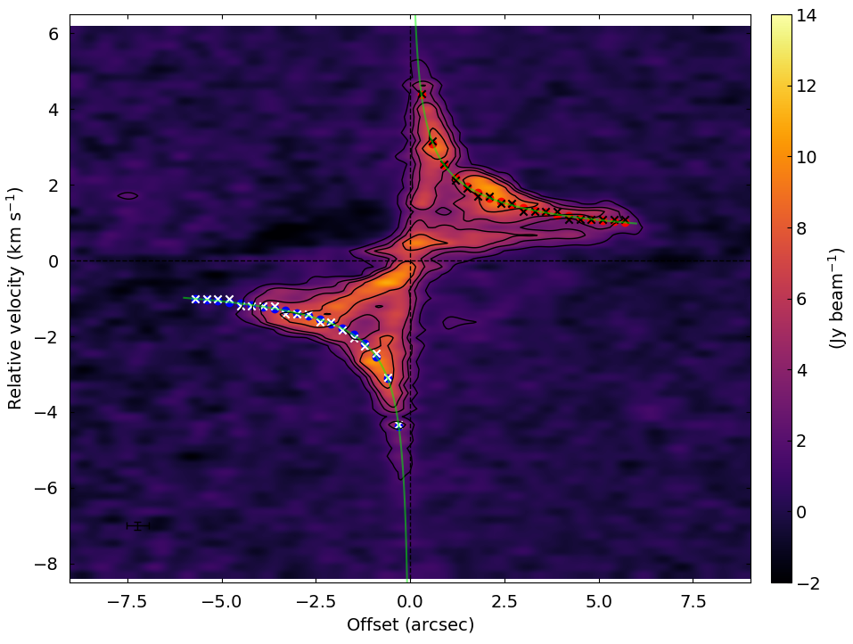
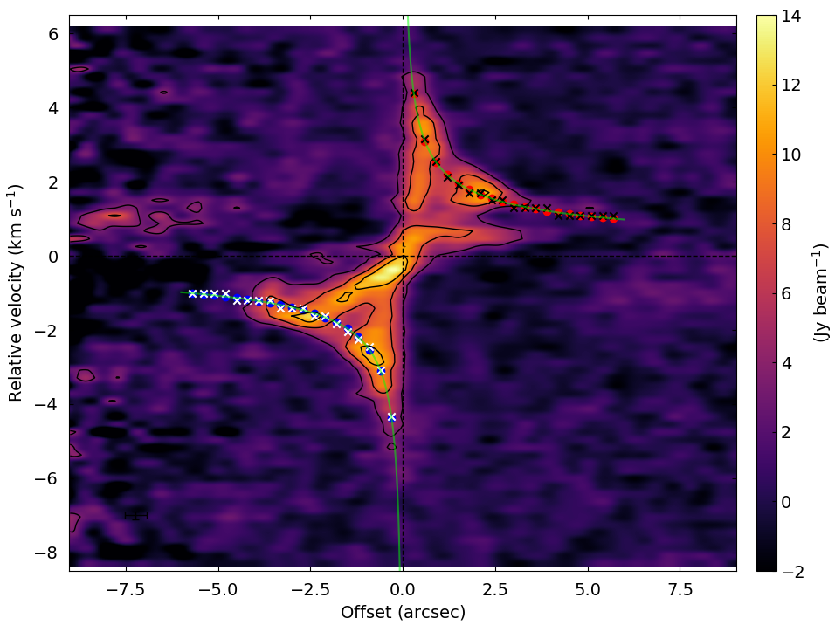
PV plots
C¹⁸O (J = 2-1)
C¹⁸O (J = 3-2)
SLAM fit parameters
V_{sys} = 7.33 (5) km/s
V₁₀₀ = 2.842 (2) km/s

Slide 3
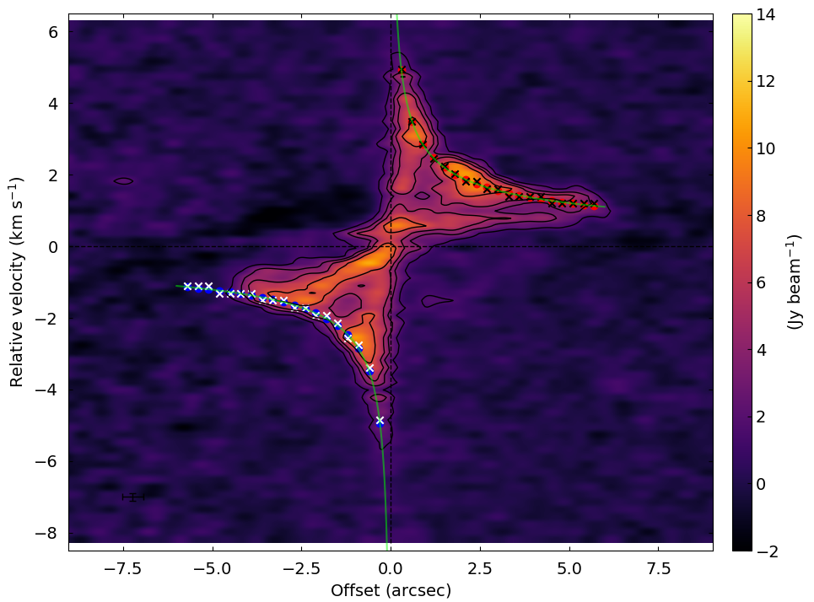
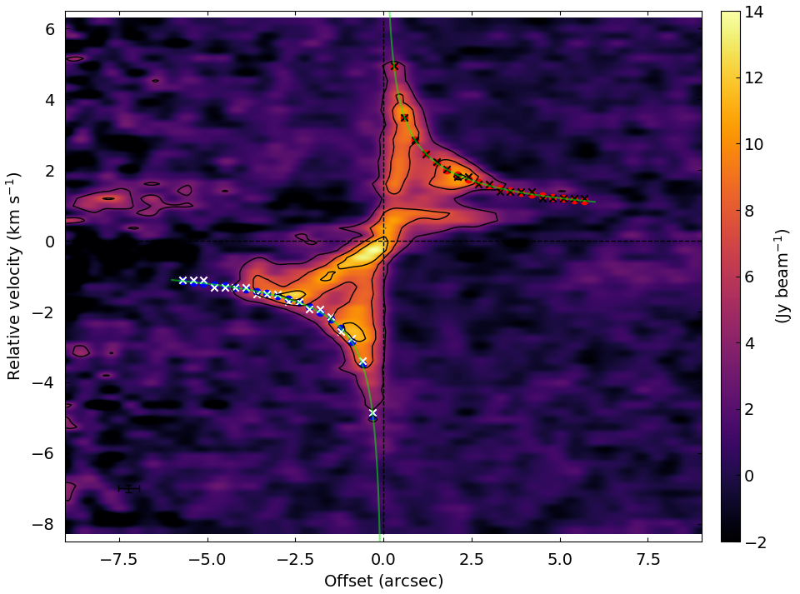
PV plots
C¹⁸O (J = 2-1)
C¹⁸O (J = 3-2)
C¹⁸O (J = 2-1)
SLAM fit parameters
V_{sys} = 7.22 (9) km/s
V₁₀₀ = 3.2 (2) km/s

Slide 4
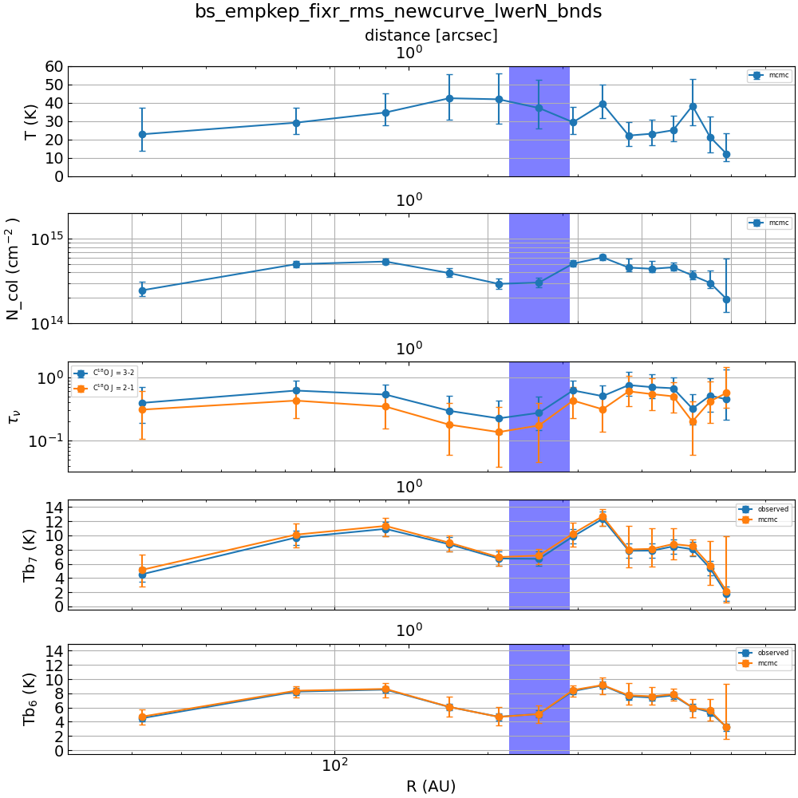
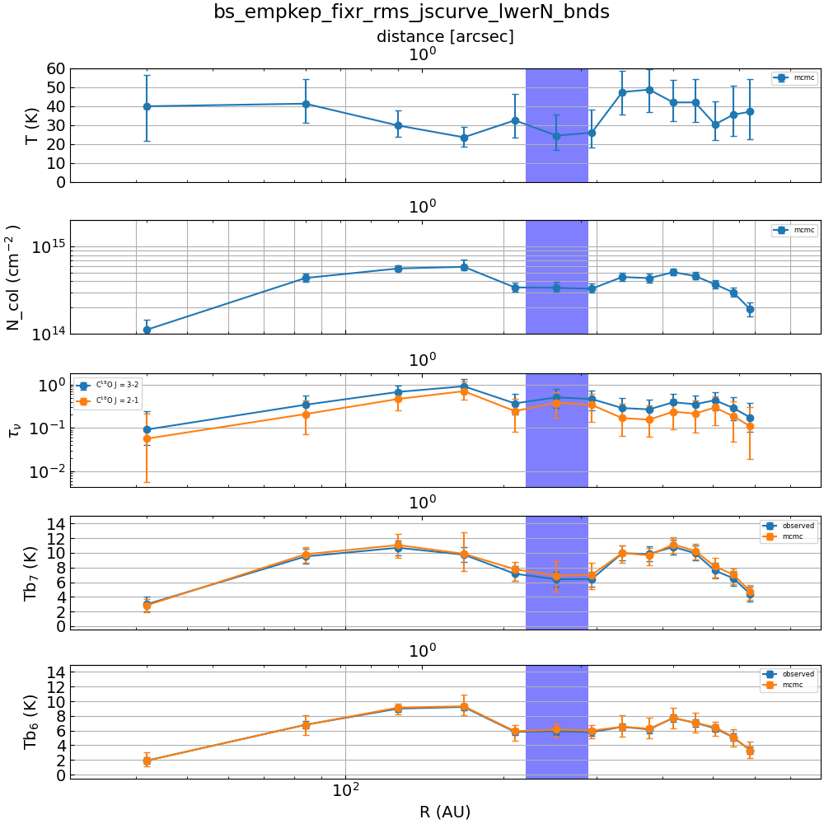
Results
C¹⁸O (J = 2-1)

Slide 5
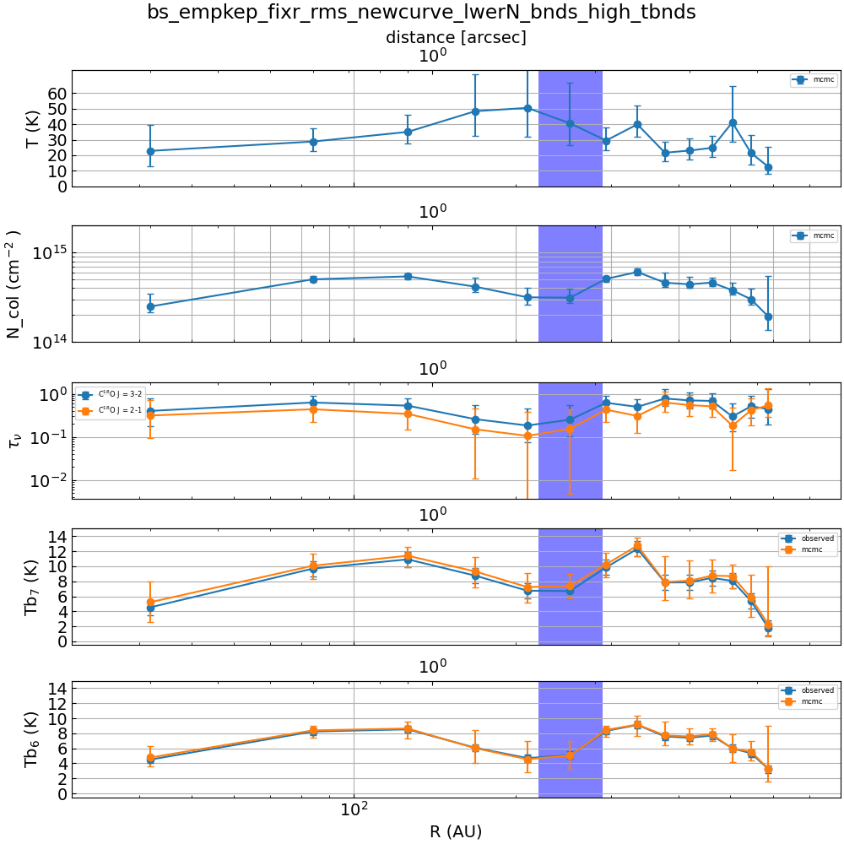
Results
C¹⁸O (J = 2-1)

Slide 6
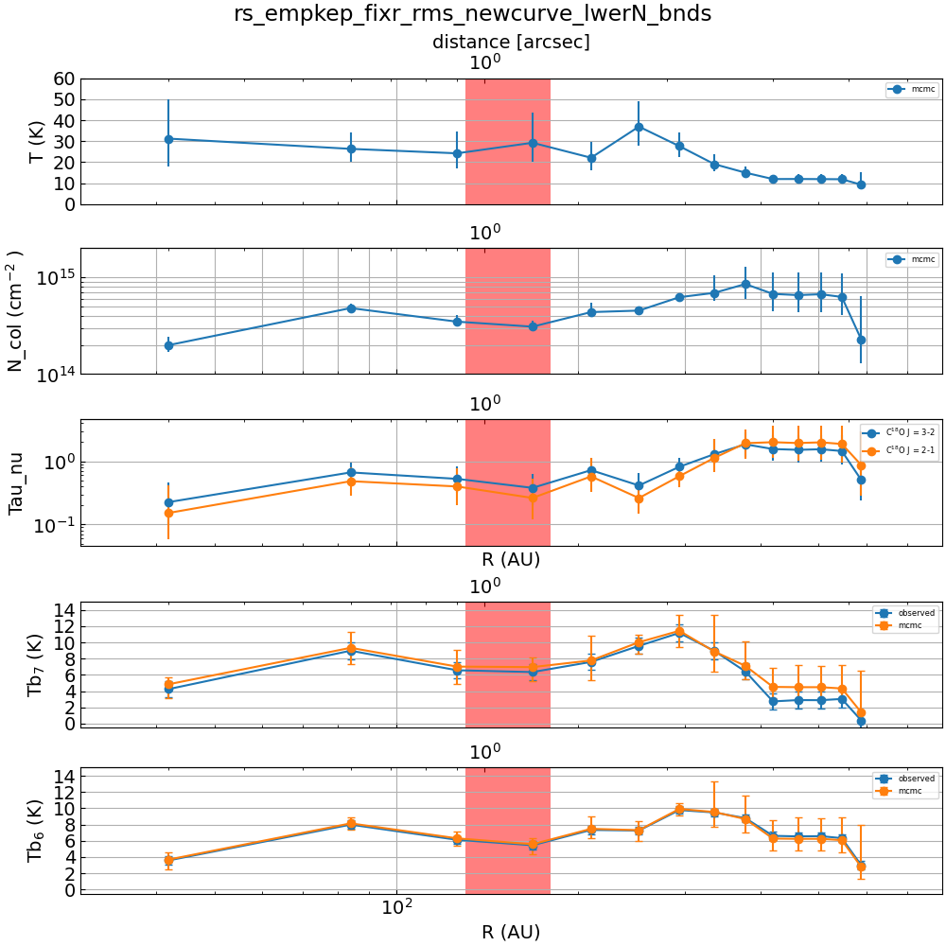
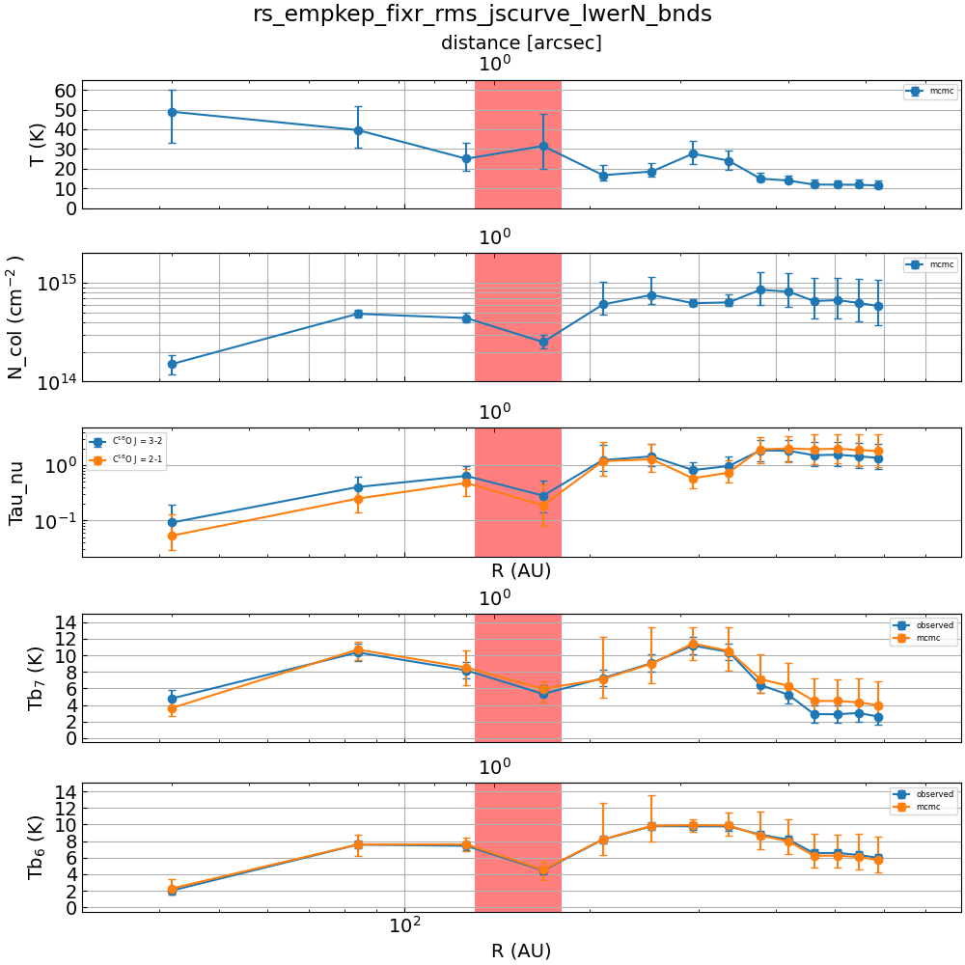
Results
C¹⁸O (J = 2-1)

Slide 7
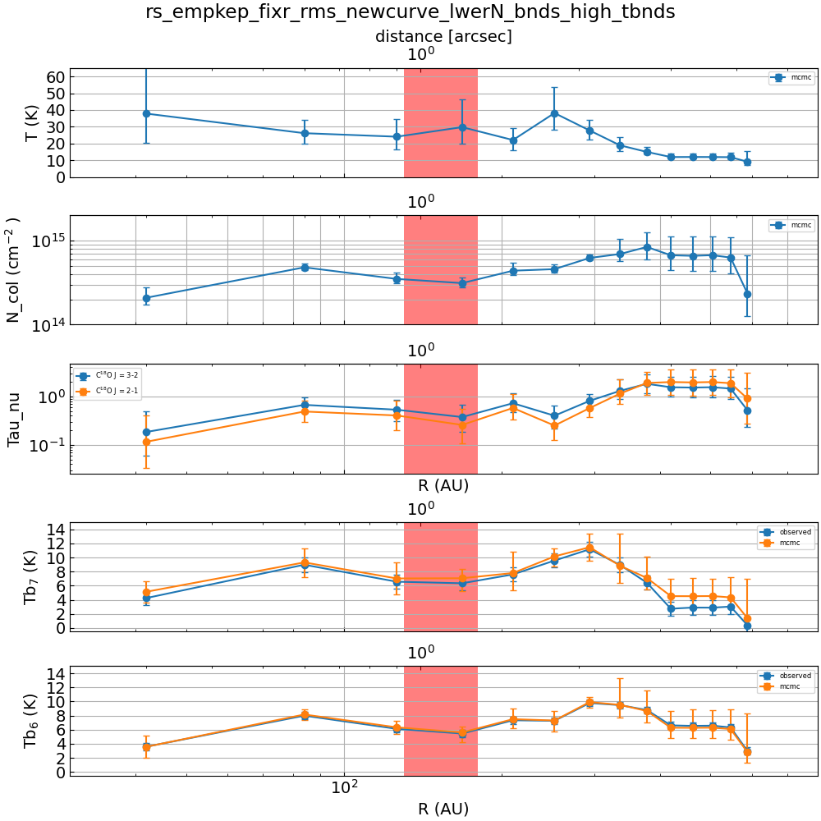
Results
C¹⁸O (J = 2-1)

