Slide 1

EVENT MANAGEMENT SYSTEM
“ Momento ”
Submitted By :
Name | Enrollment No
Mihir Vaidya | 202504104610024
Vivek Gosai | 202504104610023
Chirag Modi | 202504104610142
Viraj Patel | 202504104610086 .
Guided By:
Ms. Shivani Talaviya
For partial fulfilment of the requirements
For the Degree of Master of Computer Application,
Shrimad Rajchandra Institute of Management and Computer Application
Uka Tarsadia University
Feb , 2026

Slide 2

Event Management System — Momento
A web-based platform that centralises event discovery, package selection and bookings. Designed for event planners, operations teams and technical implementers who need a reliable, user-friendly system to digitise event workflows and reduce manual coordination.

Slide 3
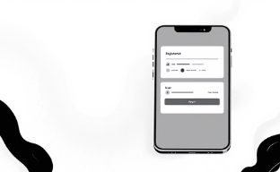
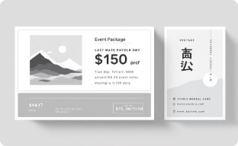

Introduction to Momento
Momento is a responsive web application that presents curated event packages, enables secure user registration, and streamlines bookings. It connects a simple frontend (React) with a robust backend (Node/Express) and MongoDB for centralised data management.
User Accounts
Package Browsing
Smooth Booking
Secure registration and login flows to personalise bookings and store preferences.
Step-by-step booking process with confirmation and centralised record keeping.
Rich package pages with images, catering options and clear pricing.

Slide 4


Problem Statement
Traditional event management is fragmented: manual bookings, phone-based coordination and disconnected records lead to errors, inefficiency and poor user experience. Planners need a single platform to explore packages, view details, book events and maintain accurate records.
Current pain points: time-consuming processes, inconsistent data, limited visibility across vendors.

Slide 5

Solution Overview
Momento addresses these issues with a web-based system that centralises package browsing, booking workflows and data storage. It reduces manual steps and gives planners a single source of truth for events, customers and bookings.
Key Features
Operational Benefits
Online event browsing and package selection
User registration & authentication
Detailed package pages with images and catering info
Event booking and centralised database
Reduced manual coordination
Faster booking turnaround
Improved data accuracy for reporting

Slide 6
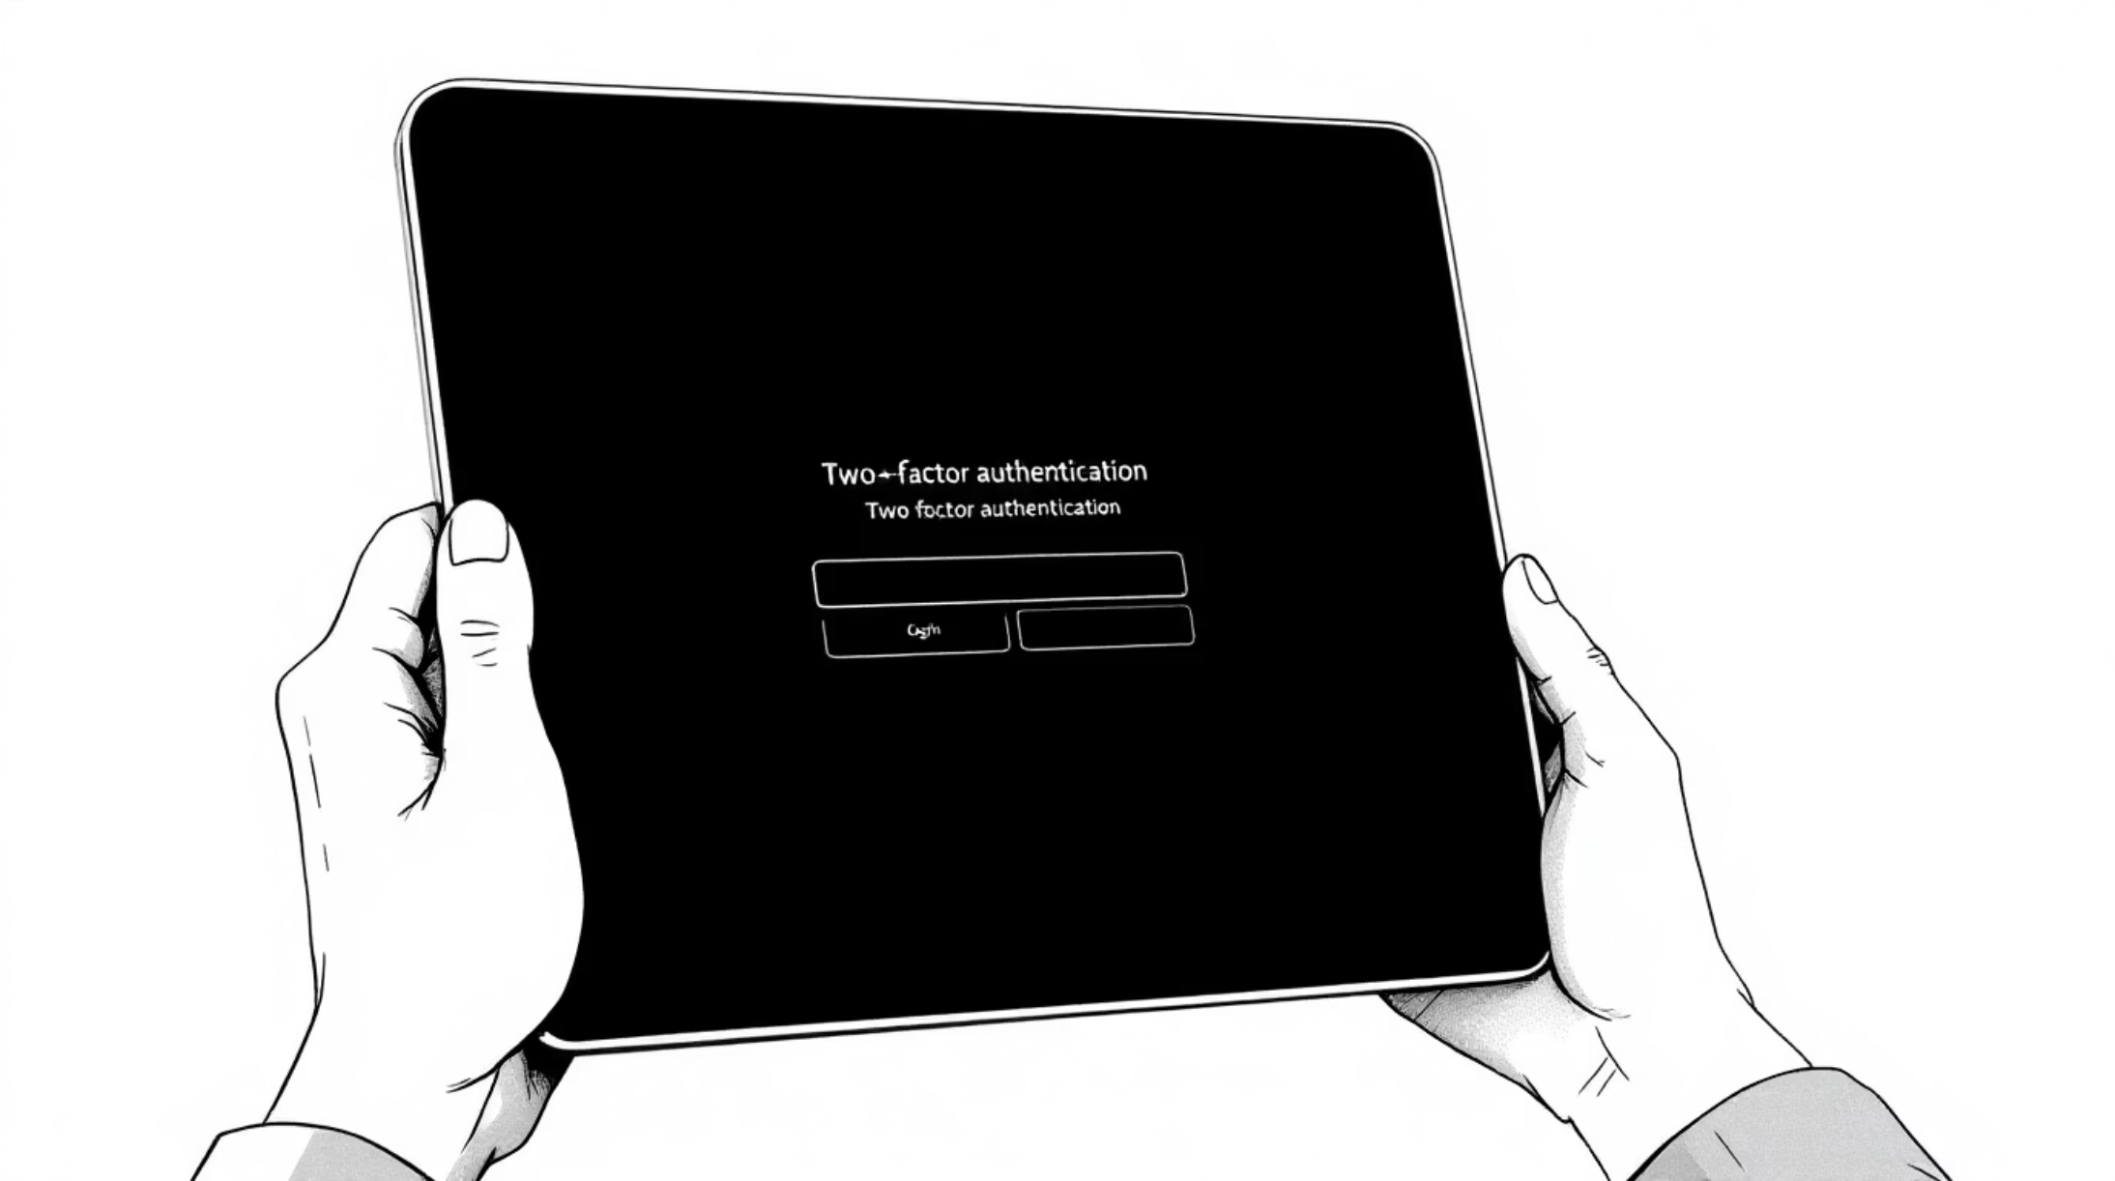


Proposed Solution — Technical Snapshot
A React frontend communicates with a Node.js + Express REST API. Data persistence is handled by MongoDB (via Mongoose). The architecture supports modular services for authentication, package management and bookings — enabling future integrations (payments, notifications).
Secure Auth
Central Data
JWT-based authentication and role checks for protected routes.
MongoDB stores users, packages and bookings for reliable queries and backups.

Slide 7

Objectives of the System
Online Bookings
Provide a fast, mobile-friendly booking flow for users and planners.
Streamlined Selection
Simplify choosing packages with photos, menus and clear options.
Secure Accounts
Manage users and authentication with audit-ready records.
Centralised Data
Store bookings and package data in one searchable database.

Slide 8
System Scope & Future Roadmap
In Scope
Future Scope
User registration & login
View and filter event packages
Package detail pages with images
Booking creation and storage in MongoDB
Backend APIs & authentication
Online payments and invoicing
Admin dashboard for bookings & inventory
Email / SMS notifications and reminders
Event scheduling and calendar sync
Role-based multi-user management
These phases prioritise core booking functionality first, then add commerce, admin tools and automation.

Slide 9

System Limitations (Current)
No Payment Gateway
Limited Admin Tools
No Notifications
Payments are out of scope for the initial release; bookings are recorded without online checkout.
Advanced admin panels and detailed booking management are not implemented yet.
Email/SMS notifications and cancellations are not available in version one.

Slide 10





Tools & Technologies
Frontend
React.js, HTML5, CSS3, JavaScript — component-driven UI for responsive experiences.
Backend
Node.js + Express for REST APIs, authentication and business logic.
Database
MongoDB with Mongoose for flexible, document-based data models (users, packages, bookings).
Dev Tools
Visual Studio Code, Thunder Client for API testing, and GitHub for version control.

Slide 11

System Requirements
Functional Requirements
1. User Management
User registration with email , Secure login & authentication.
2. Event Management
Handling.package catalog , Package details , Catering & Services
3. Booking Management
Aselect package → Choose data & options
4. Database Management
Store user records , Store event packages , Retrieve data dynamically

Slide 12
Data Model Description

Slide 13
Phases of Waterfall Model Applied in the Project
Requirement Analysis
In this phase, the requirements of the Event Management System were identified. The system needed to allow users to register, log in, view event packages, and book events. The administrator required functionality to manage events, packages, and users.
2. System Design
During the design phase, the overall structure of the system was planned. UML diagrams such as Use Case Diagrams, Activity Diagrams, and Data Models were created to represent the system architecture and interaction between components. The database structure was also designed using MongoDB collections.
3. Implementation
In this phase, the actual development of the system took place. The project was implemented using the MERN stack (MongoDB, Express.js, React.js, Node.js). Frontend interfaces were developed using React, while backend APIs were implemented using Node.js and Express.js to handle authentication, package management, and booking operations.
4. Testing
After implementation, the system was tested to ensure all functionalities worked correctly. Testing included checking user authentication, booking validation, package display, and database operations to verify that the system behaved as expected.
5. Deployment and Maintenance
In the final phase, the application was executed and demonstrated as a complete working system. Any minor errors discovered during testing were corrected to improve system performance and reliability.

Slide 14
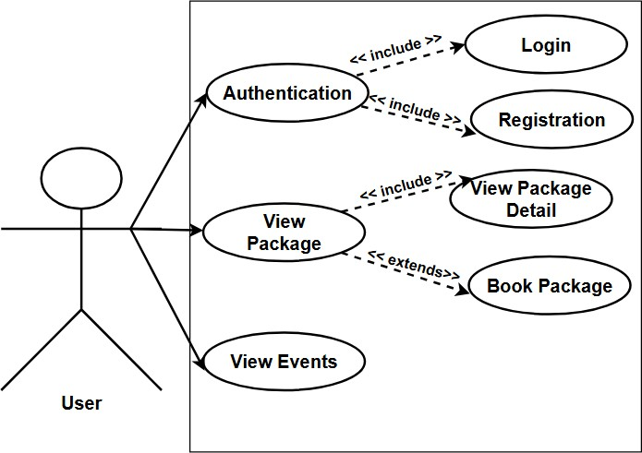
CONSEPTUAL DESIGN
User
Admin
Actors :
User :

Slide 15
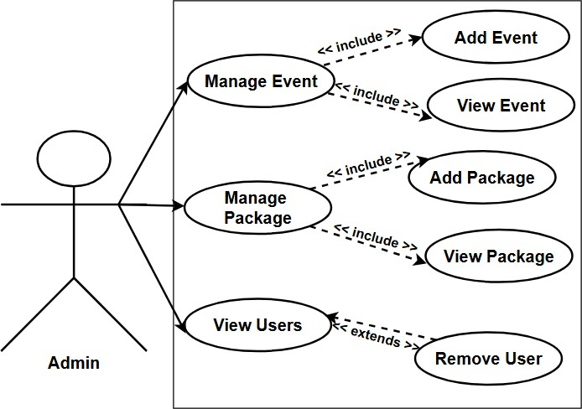
Admin :

Slide 16
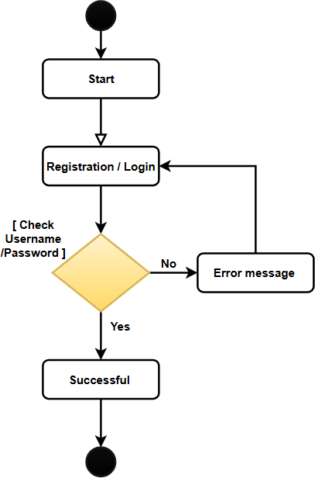
Activity Diagram :
Activity Diagram for Login / Registration :

Slide 17
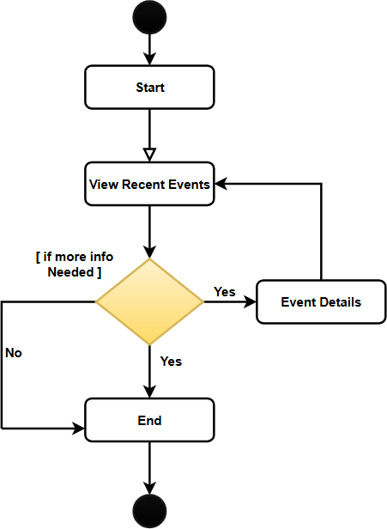
Activity Diagram of Browsing Package :

Slide 18
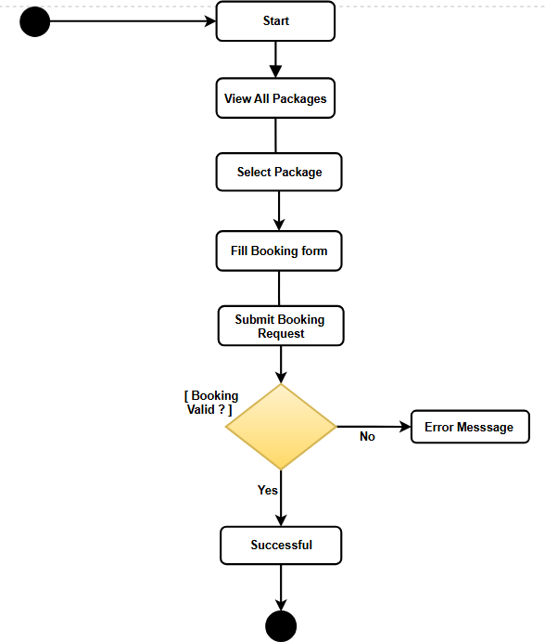
Activity Diagram of Booking Package :

Slide 19
Database Description
Event Collection :
Field | Field Type | Constraints | Description
id | ObjectId | Primary Key, Auto-generated | Unique identifier for each event document.
title | String | Required, Not Null | Stores the name or title of the event.
description | String | Required | Provides details about the event.
date | Date | Required | Stores the date on which the event will take place.
location | String | Required | Stores the venue or location of the event.
image | String | Optional | Stores the image file name or URL related to the event.
createdAt | Date | Default: Current Date | Records the date and time when the event was created.
updatedAt | Date | Auto Updated | Records the date and time when the event details were last updated.

Slide 20
Package Collection :
Field | Fild type | Constreint | Description
id | ObjectId | Primary Key, Auto- generated | Unique identifier for each package document.
name | String | Required, Not Null | Stores the name of the event package.
description | String | Required | Provides details about the services included in the package.
price | Number (Integer) | Required, Minimum Value | Stores the cost of the event package.
startDate | Date | Required | Indicates the starting date of the package availability.
endDate | Date | Required | Indicates the ending date of the package availability.
images | Array | Optional | Stores image URLs or file paths related to the package.
Catrering | Array | Optional | Stores catering items or food services included in the package.
createdAt | Date | Default: Current Date | Records the date and time when the package was created.
updatedAt | Date | Auto Updated | Records the date and time when the package details were last updated.
.

Slide 21
User Collection :
Field | Field type | Constraint | Description
Id | ObjectId | Primary Key, Auto- generated, Required | Unique identifier for each user document.
fullname | String | Required, Not Nul | Stores the full name of the user.
email | String | Required, Unique | Stores the user’s email address used for login and communication.
password | String | Required | Stores the encrypted/hashed password of the user.
phone | String | Required | Stores the user’s contact phone number.
createdAt | Date | Default: Current Date | Records the date and time when the user account was created.
updatedAt | Date | Auto Updated | Records the date and time when the user information was last updated.

Slide 22
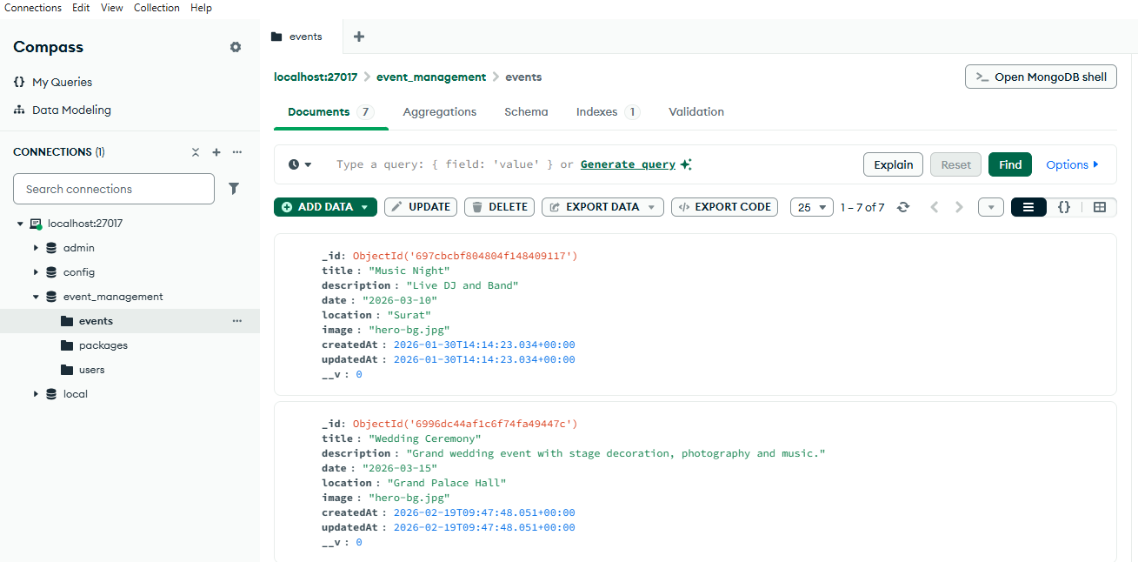
SYSTEM DESIGN
Database Design :
Event Collection :

Slide 23
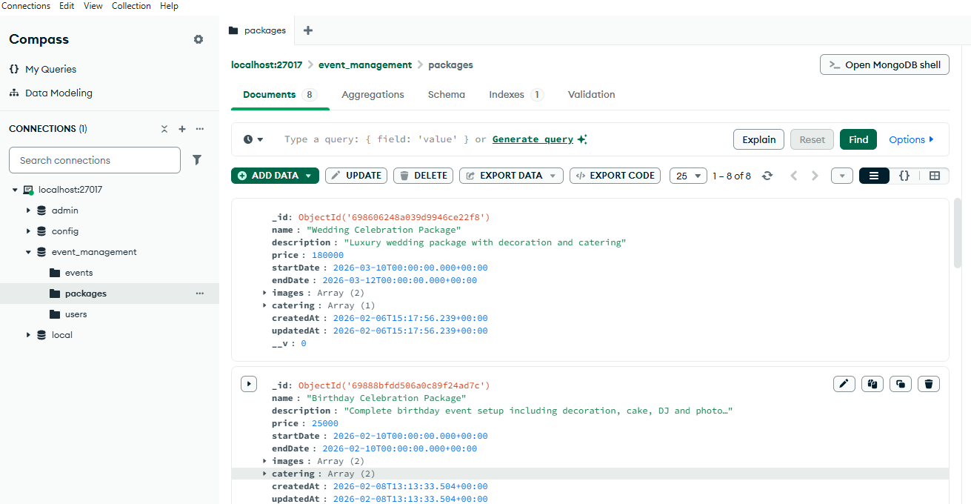
Package Collection :

Slide 24
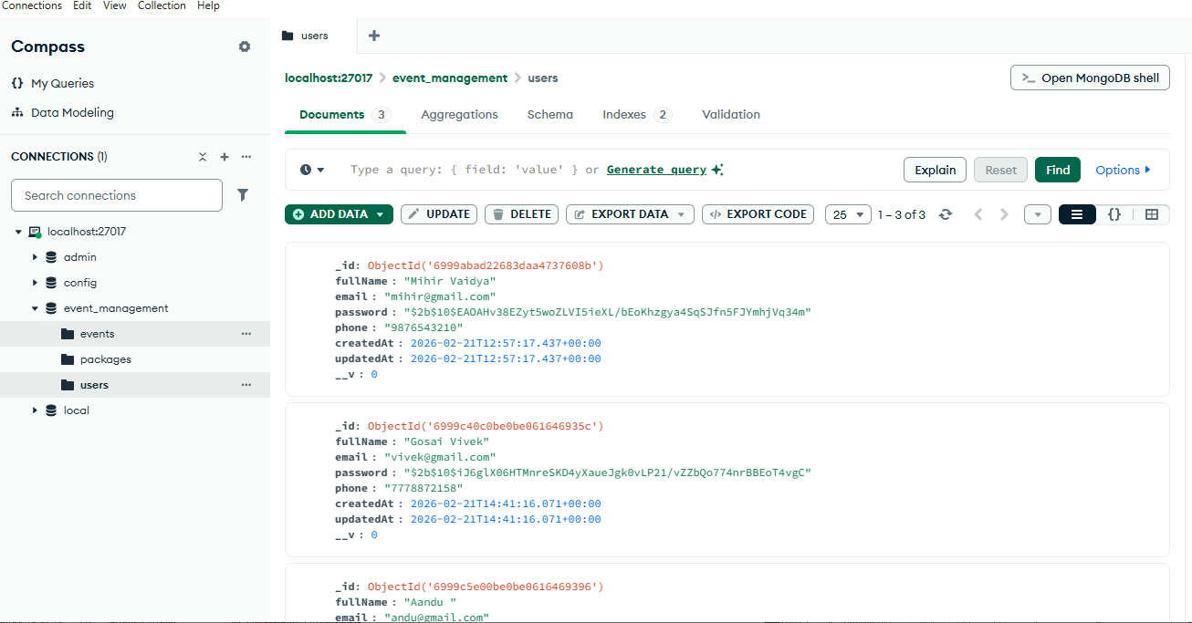
User Collection :

Slide 25
Event Document :
{
"_id": {
"$oid": "697cbcbf804804f148409117"
},
"title": "Music Night",
"description": "Live DJ and Band",
"date": "2026-03-10",
"location": "Surat",
"image": "hero-bg.jpg",
"createdAt": {
"$date": "2026-01-30T14:14:23.034Z"
},
"updatedAt": {
"$date": "2026-01-30T14:14:23.034Z"
},
"__v": 0
}

Slide 26
Package Collection Document :
{
"_id": {
"$oid": "698606248a039d9946ce22f8"
},
"name": "Wedding Celebration Package",
"description": "Luxury wedding package with decoration and catering",
"price": 180000,
"startDate": {
"$date": "2026-03-10T00:00:00.000Z"
},
"endDate": {
"$date": "2026-03-12T00:00:00.000Z"
},
"images": [
"hero-bg.jpg",
"hero-bg.jpg"
],
"catering": [

Slide 27
{
"thaliName": "Premium Wedding Thali",
"description": "Paneer, Dal Makhani, Butter Naan, Sweet",
"price": 1500,
"_id": {
"$oid": "698606248a039d9946ce22f9"
}
}
],
"createdAt": {
"$date": "2026-02-06T15:17:56.239Z"
},
"updatedAt": {
"$date": "2026-02-06T15:17:56.239Z"
},
"__v": 0
}

Slide 28
User Collection Document :
{
"_id": {
"$oid": "6999abad22683daa4737608b"
},
"fullName": "Mihir Vaidya",
"email": "mihir@gmail.com",
"password": "$2b$10$EAOAHv38EZyt5woZLVI5ieXL/bEoKhzgya4SqSJfn5FJYmhjVq34m",
"phone": "9876543210",
"createdAt": {
"$date": "2026-02-21T12:57:17.437Z"
},
"updatedAt": {
"$date": "2026-02-21T12:57:17.437Z"
},
"__v": 0
}

Slide 29
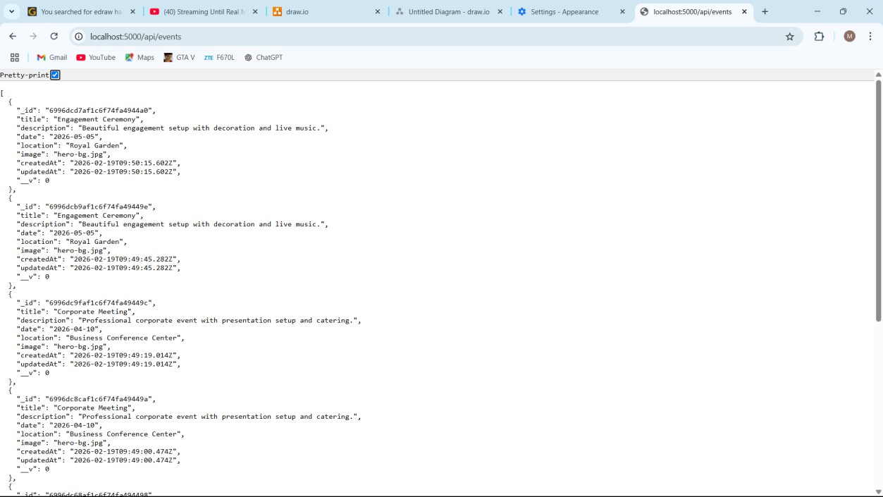
API Screenshots :
Events :
packages :
Events :

Slide 30
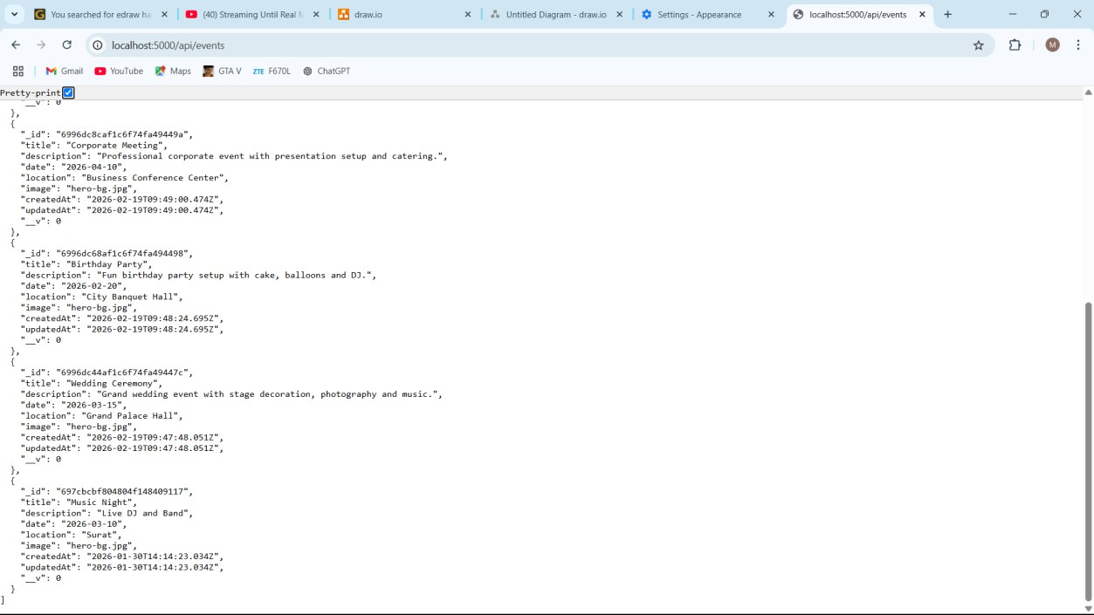

Slide 31
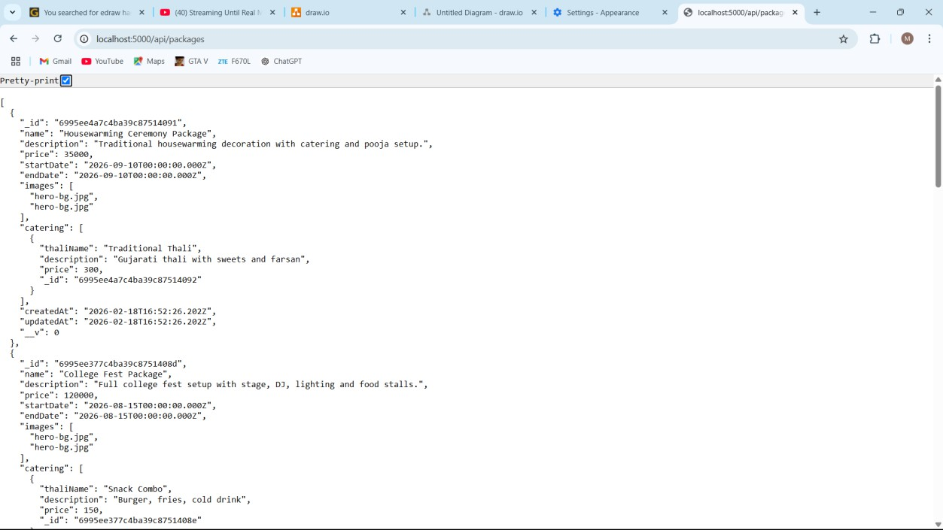
Packages :

Slide 32
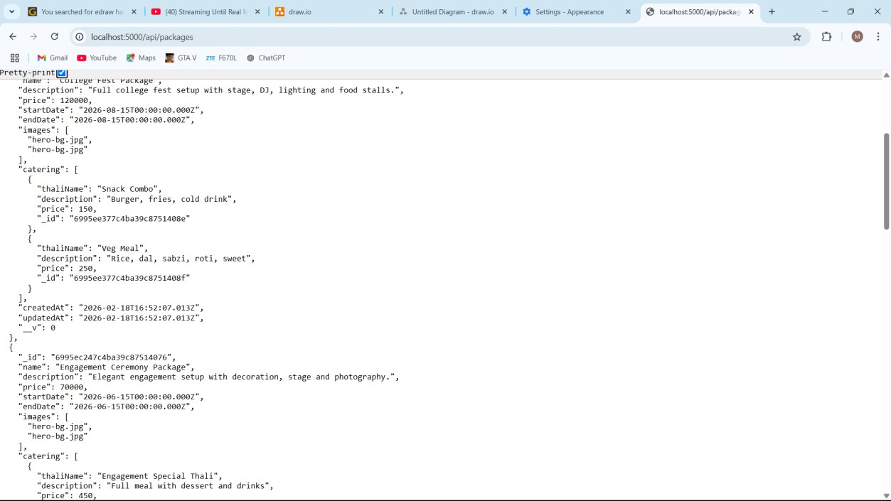

Slide 33
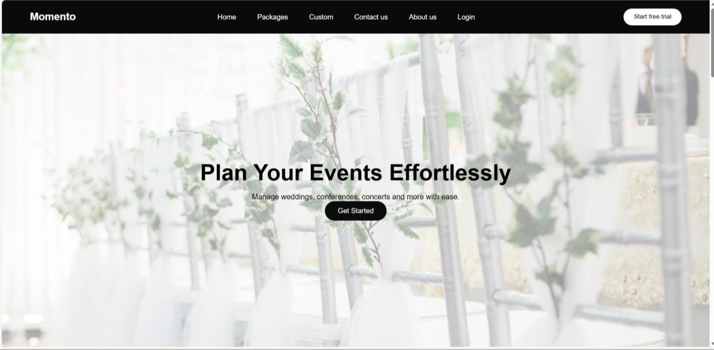
Frontend Design :
Home Page

Slide 34
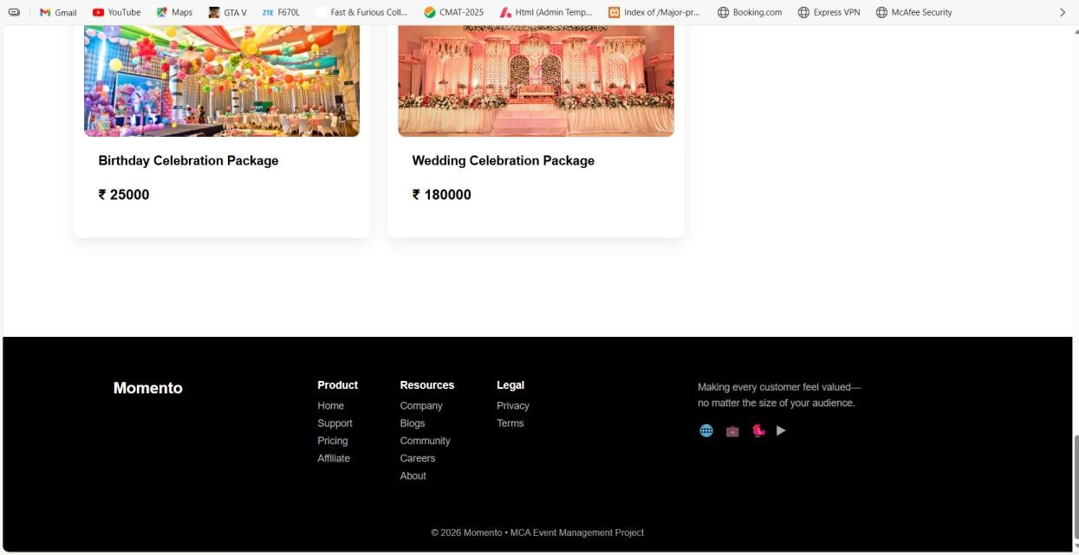

Slide 35
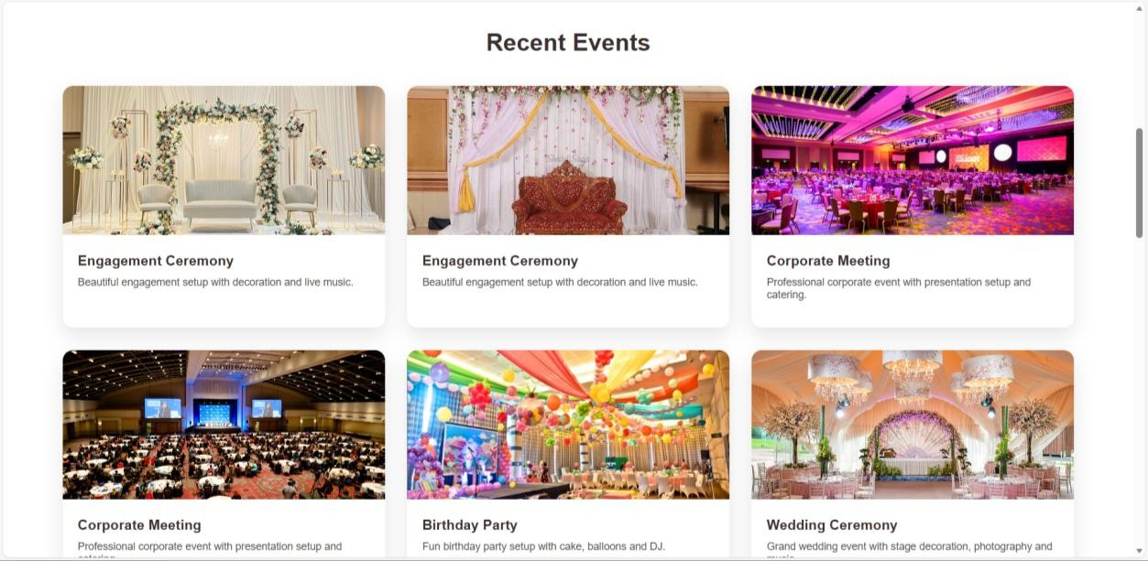
Recent Events :

Slide 36
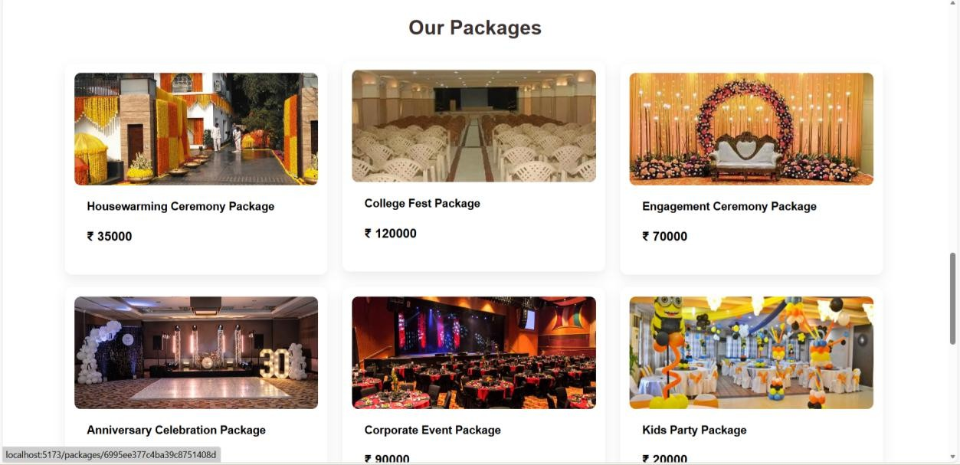
Package Display Page :

Slide 37
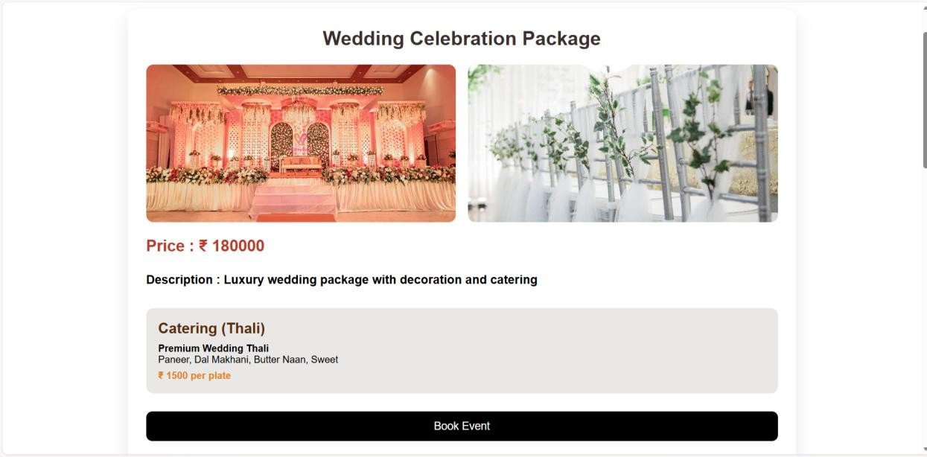
PackageDetail Page :

Slide 38
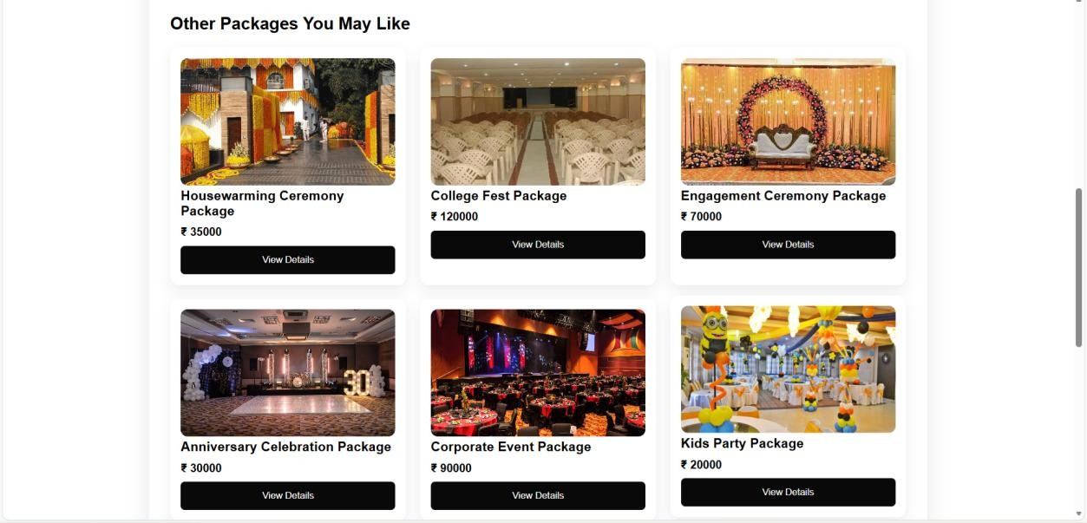

Slide 39
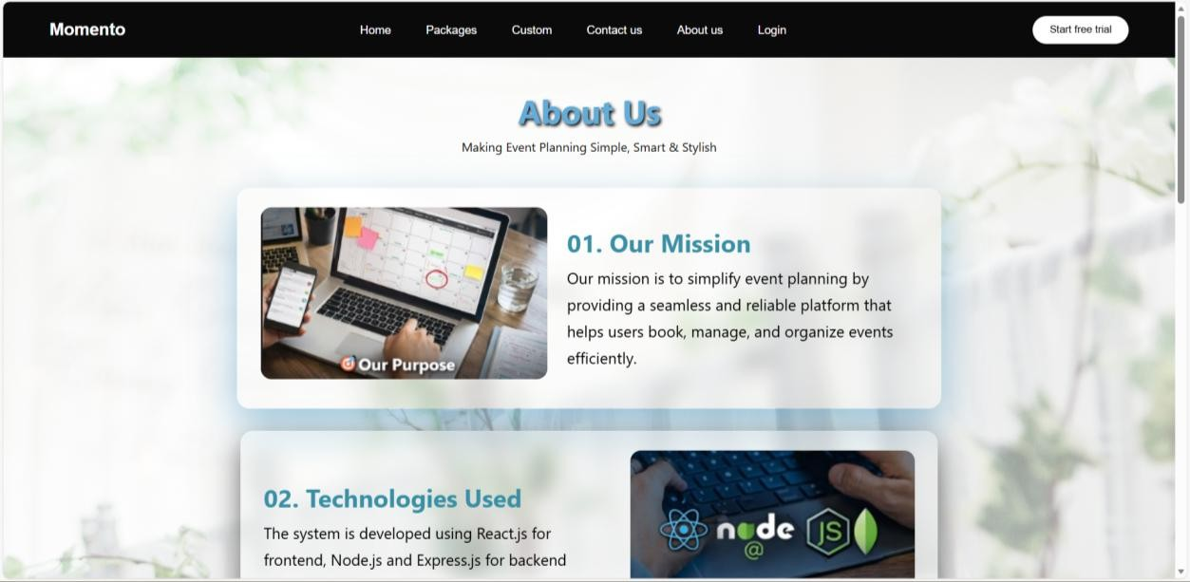
About Us Page :

Slide 40
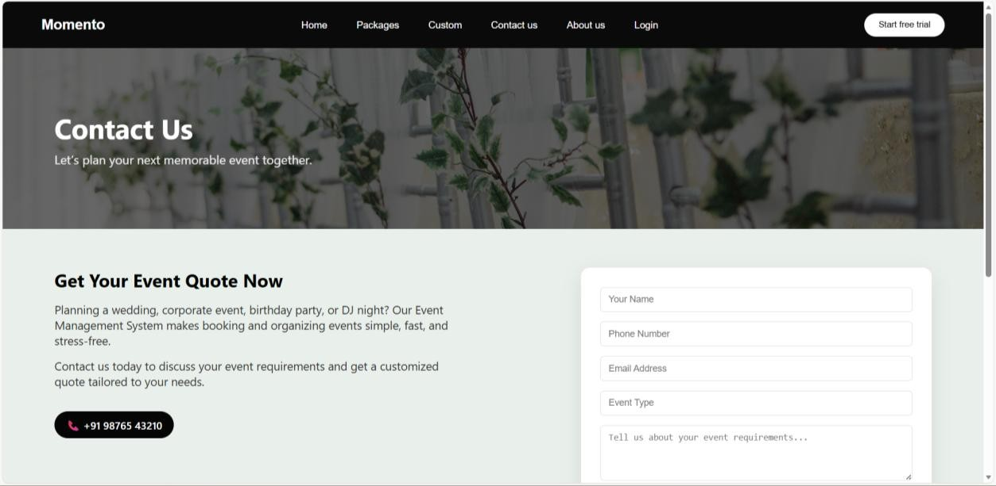
Contact Us Page :

Slide 41
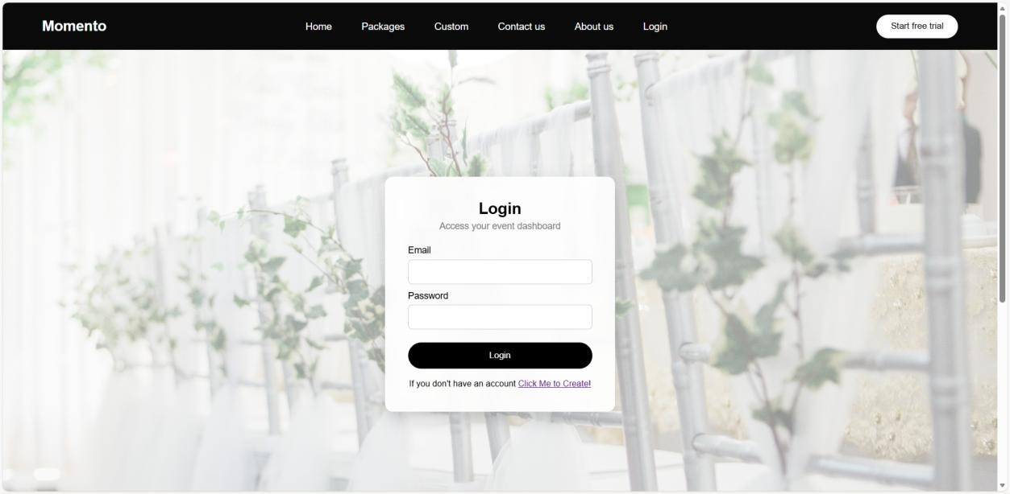
Login Page :

Slide 42
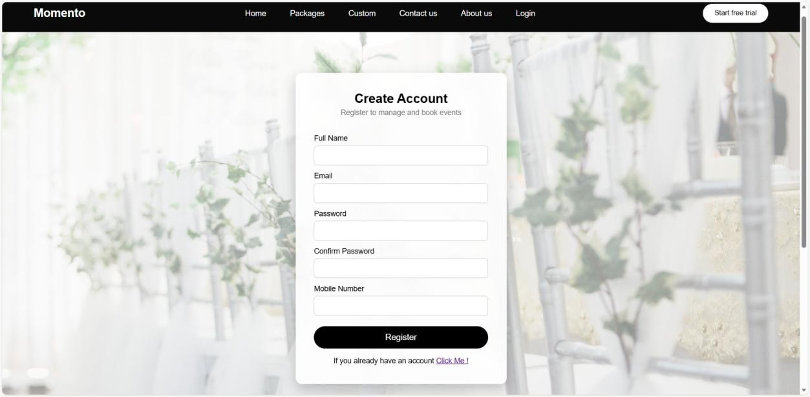
Register Page :

Slide 43
Thank You for Giving Your Precious Time
- Team Momento

