Slide 1
DEADLOCK

Slide 2
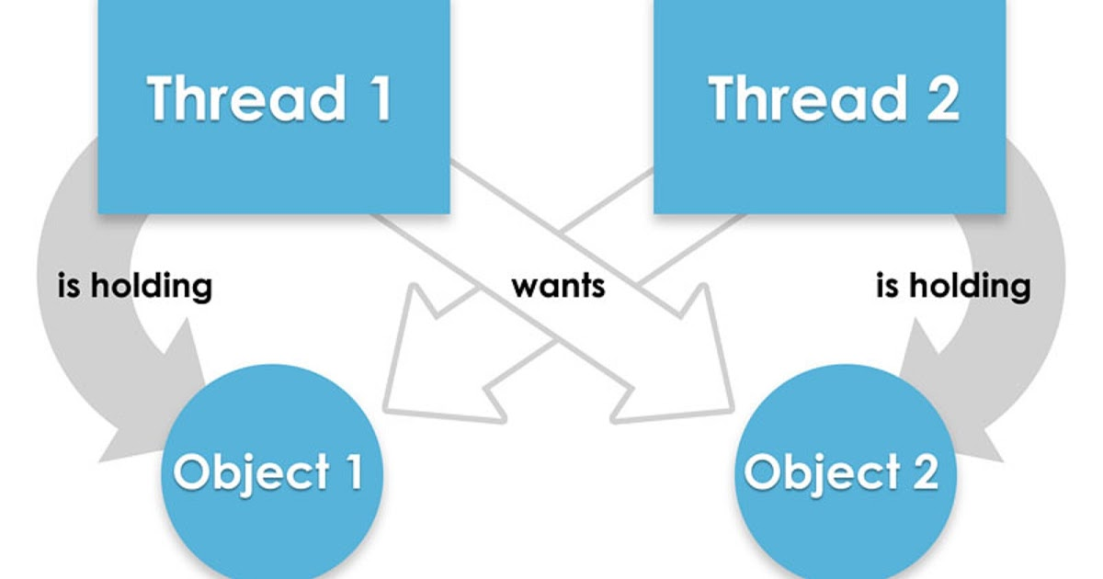
What is Deadlock?
Deadlock in java is a part of multithreading.
Deadlock can occur in a situation when a thread is waiting for an object lock, that is acquired by another thread and second thread is waiting for an object lock that is acquired by first thread. Since, both threads are waiting for each other to release the lock, the condition is called deadlock.

Slide 3
Example
<code />

Slide 4
Solution
Lock-ordering technique
Defining an order in which object is locked.
synchronized (firstLock) {
//TODO
synchronized (secondLock) {
//TODO
}
}

