Slide 1

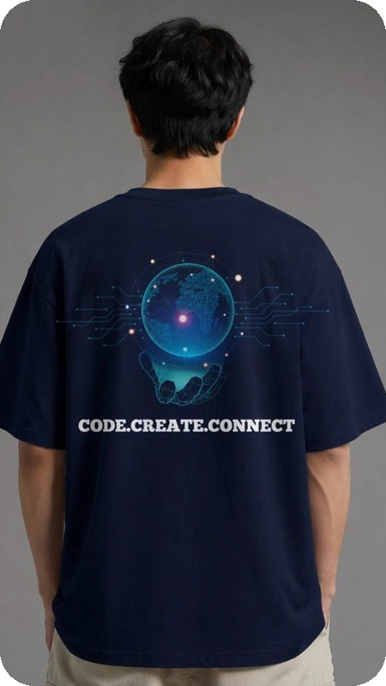
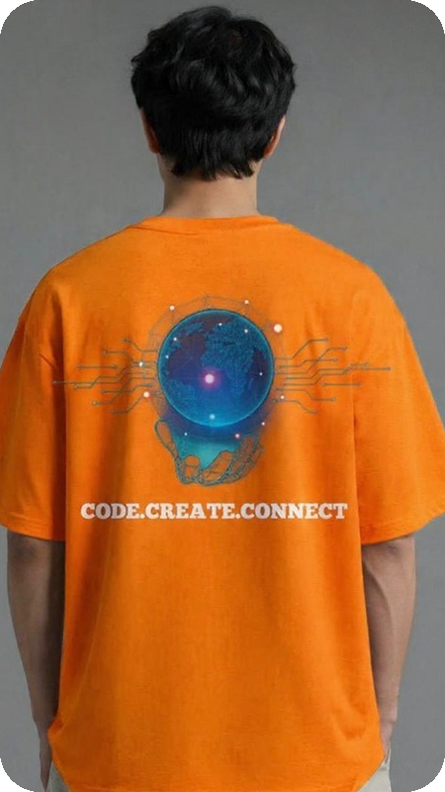
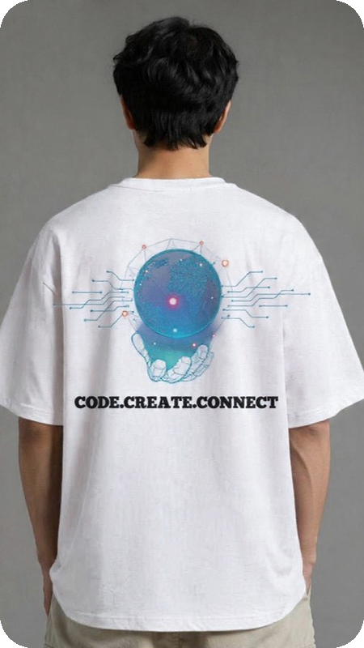
Wear your code.
ITEMHIVE | BUSINESS MODEL PITCH
ICT-branded student gear, ordered in minutes.
Siphokuhle Nyana | Olwethu Mtwazi | Mihle Nosilela | Sinobawo Nkomo | Athini Ngquke | Ricardo Mukwevho
Notes:
[~10s] Good day. We are the ICT Branded team, and this is ItemHive: the simplest way for ICT students to buy gear that shows who they are.

Slide 2



Student pride is easy. Buying it isn't
Orders buried in DMs and group chats
WHO FEELS IT
No live catalogue, no clear stock, no proper order record.
ICT students
Buying for themselves, their class or their society.
Paying a stranger feels risky
Students need safe card or EFT options and proof of purchase.
WHY IT MATTERS
Belonging drives campus merch demand, but students are cost and trust sensitive. If buying is clumsy, they simply don't buy.
Getting it is a hassle
Arranging delivery to residence or collecting across campus takes effort.
Notes:
[~35s] ICT students are proud of what they study, but buying that identity is a project. Orders get lost in DMs and group chats, stock is unclear, and paying a stranger feels risky. Then someone has to arrange delivery to residence or across campus. It matters because belonging drives merch demand, and students are cost and trust sensitive: if buying is clumsy, they simply don't buy.

Slide 3



One simple shop for ICT identity
TODAY: CHAT-BASED ORDERING
WITH ITEMHIVE
Orders buried in DMs and group chats
Live catalogue on one simple web app
Card or EFT checkout + email confirmation
Unclear stock, sizes and order status
Free residence delivery or PAXI store-to-store
Paying and collecting on your own
20% student discount
ICT gear in minutes: simpler and safer than ordering through chats
Notes:
[~35s] ItemHive replaces that chaos with one web app. Students browse a live catalogue, pay by card or EFT, get an email confirmation, and choose free residence delivery or PAXI store-to-store, with a 20% student discount. Our value proposition: ICT-branded gear in minutes, safely. Compared with ordering through chats, it is faster, simpler and easier to trust.

Slide 4



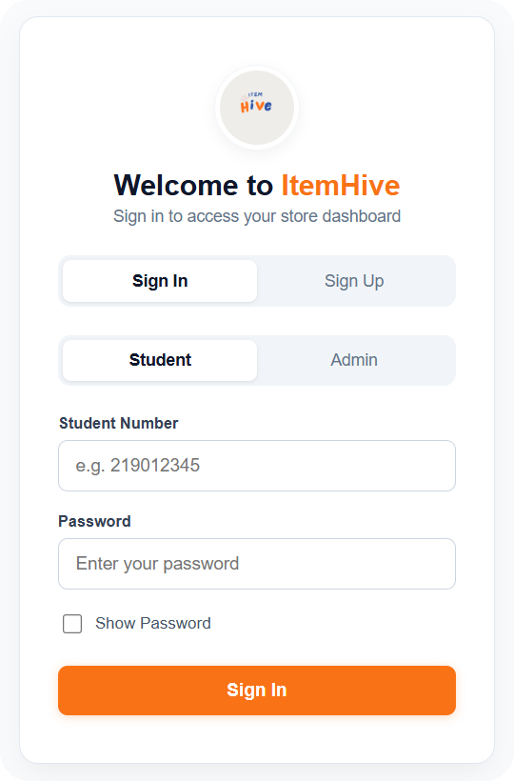

Who we serve and how we reach them
CUSTOMER SEGMENTS
VALUE PROPOSITION
CHANNELS
ICT-branded gear in minutes: simple, safe, student-priced
ItemHive web app
Free residence delivery
PAXI store-to-store
ICT students
First years to finalists
Classes & societies
CUSTOMER RELATIONSHIPS
Bulk and group orders
Next: alumni & staff
Self-service accounts
Order & verification emails
20% student discount
Later growth
Notes:
[~35s] Our customers are ICT students, plus classes and societies who order in bulk. We reach them through the web app and deliver where they live. We keep the relationship self-service and personal: verified accounts, confirmation emails and a student discount that gives them a reason to come back.

Slide 5





Behind the scenes: how it makes money
KEY PARTNERS
KEY ACTIVITIES
KEY RESOURCES
Garment & print supplier
PAXI courier
Yoco (card) & EFT payments
Design & curate ICT merch
Run the web store
Pack, ship & support
ICT brand & designs
React + Spring Boot platform
Admin dashboard for stock & orders
REVENUE STREAMS
COST STRUCTURE
R120 - R240
Product sales to students
Bulk orders: classes & societies
Limited drops & new designs
Stock & printing
Free residence delivery + 20% discount
Hosting, payment & email fees
per item: tees, hoodies, crop & drag tops
Notes:
[~40s] Behind the scenes, our key activities are designing and curating merch, running the store and fulfilling orders. Our resources are the brand, our React and Spring Boot platform and an admin dashboard. We partner with a print supplier, PAXI and payment providers. Revenue comes from item sales at roughly R120 to R240, plus bulk orders from classes and societies. Our main costs are stock and printing, free residence delivery and the student discount, while platform costs stay low.

Slide 6
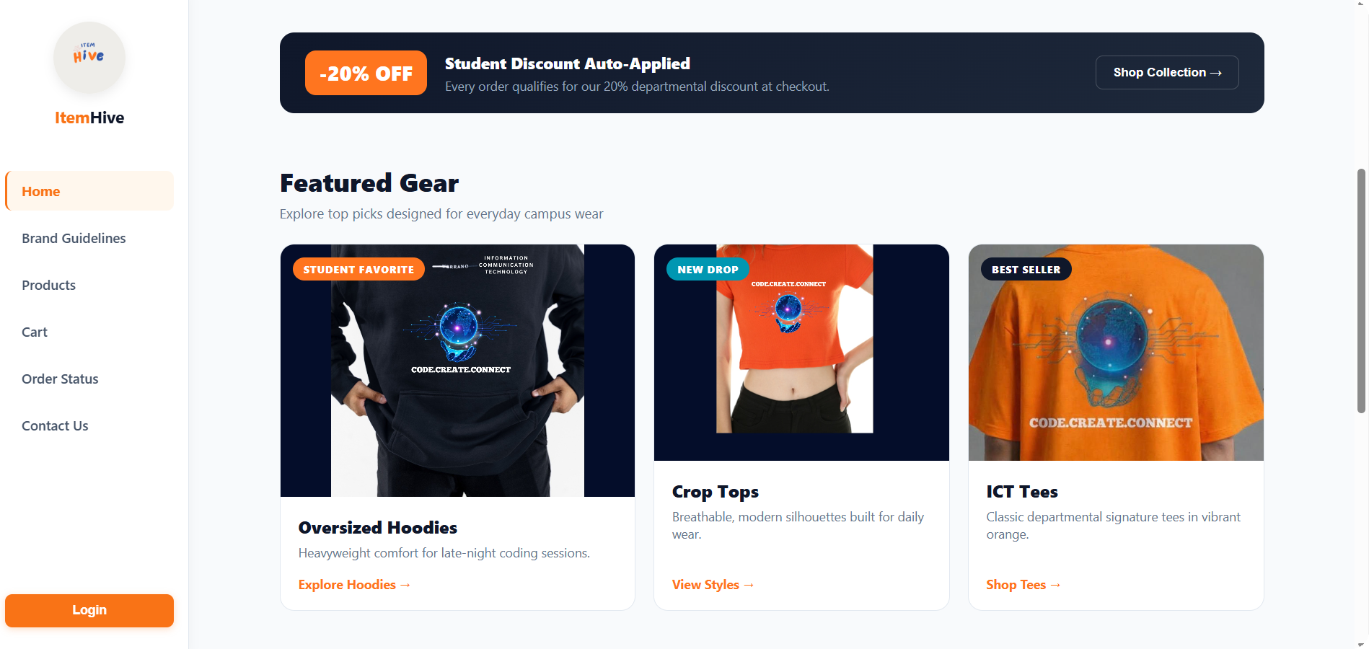
Wear your code.
IN SHORT
ItemHive gives ICT students a simple, safe way to buy gear that shows who they are, and gives us a lean shop that grows with every class, society and drop.
Simple
Safe
Student-priced
CODE.CREATE.CONNECT
Notes:
[~20s] In short: ItemHive makes buying ICT gear simple, safe and student-priced, and gives us a lean business that grows with every class, society and new design. Code. Create. Connect. Thank you.

