Slide 1
Sudoku
Bloțiu Mihnea-Andrei
Roșu Mihai-Cosmin
343C1

Slide 2
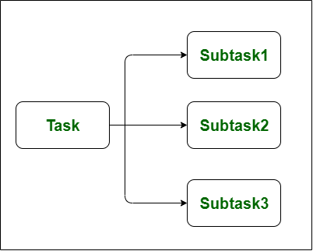
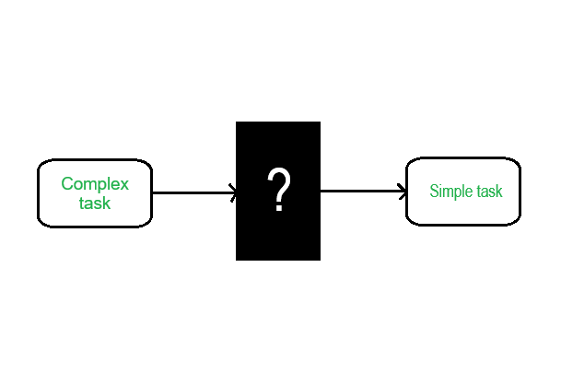
Project description
The purpose of our project was to implement an efficient sudoku solver for any given square-sized sudoku grid.
Parallel approach
Smarter serial approach
Notes:
Mihai

Slide 3
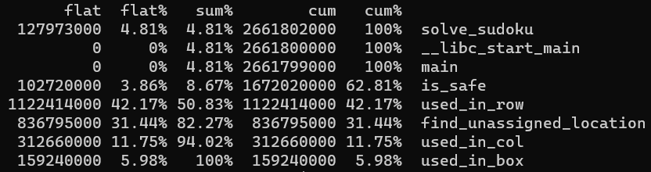
Parallel approach
Pthreads & OpenMP
Threadpool / Tasks
At certain depth level, switch to serial implementation
Notes:
Mihnea

Slide 4
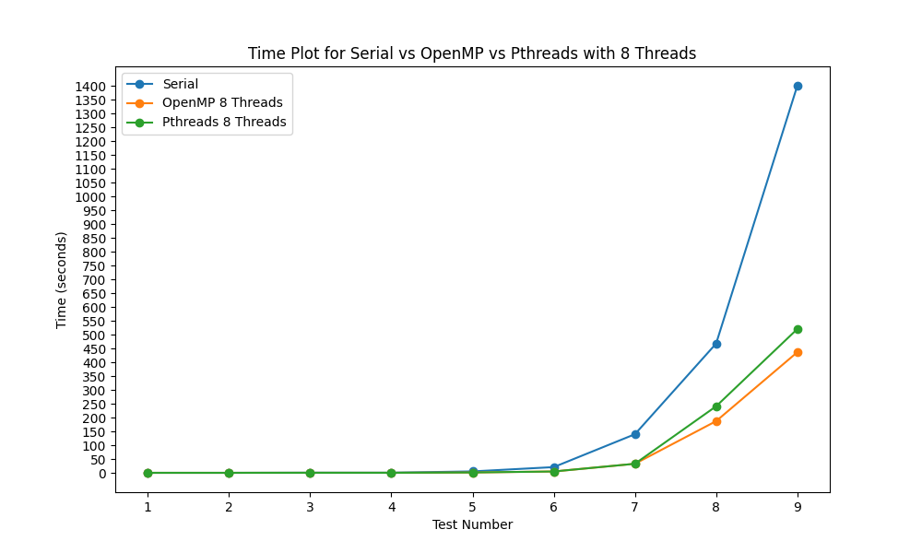
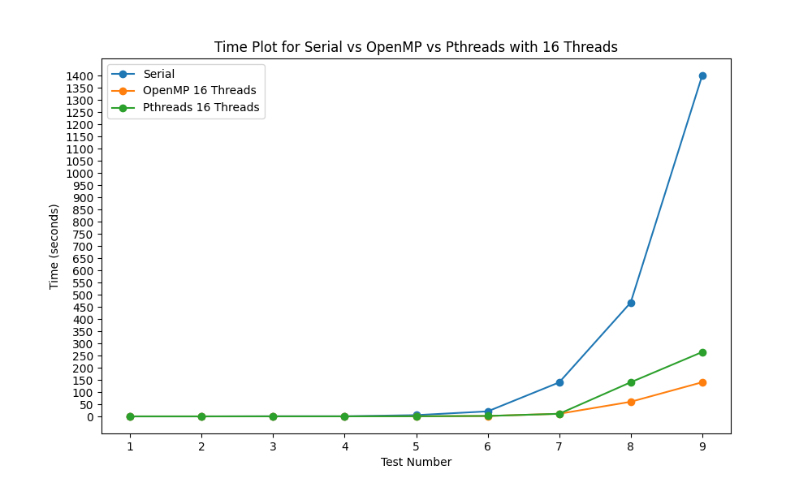
Time graphs
Notes:
Mihnea

Slide 5


Time graphs
Notes:
Mihnea

Slide 6
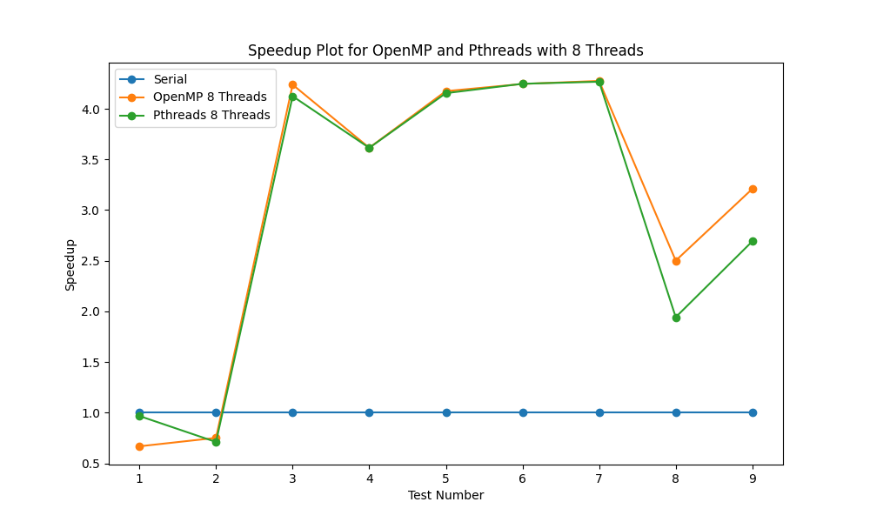
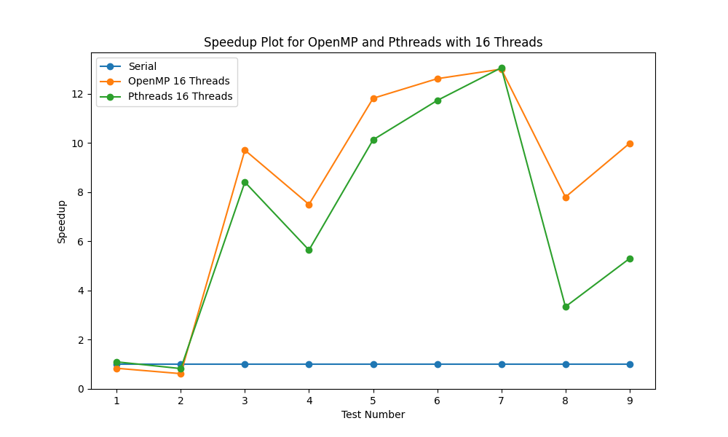
Speedup graphs
Notes:
Mihnea

Slide 7
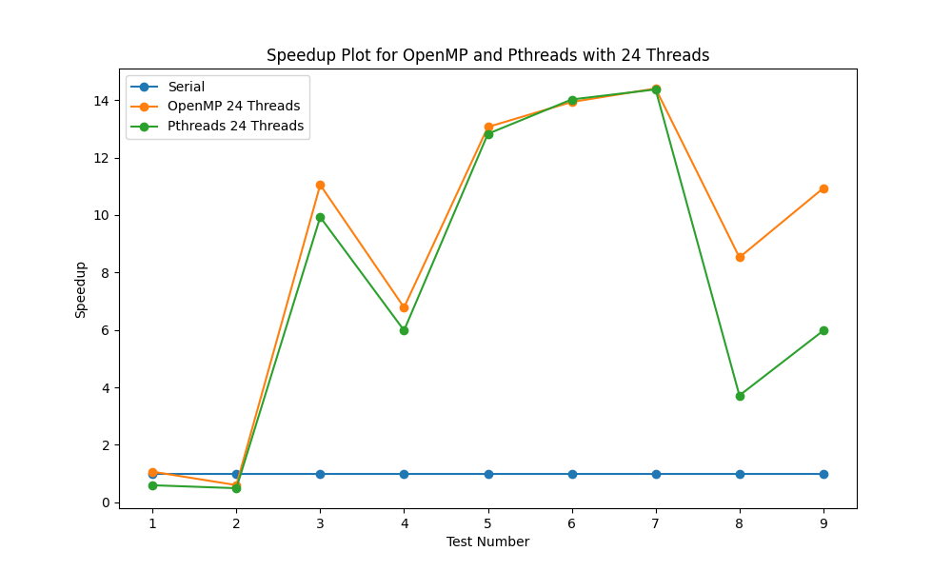
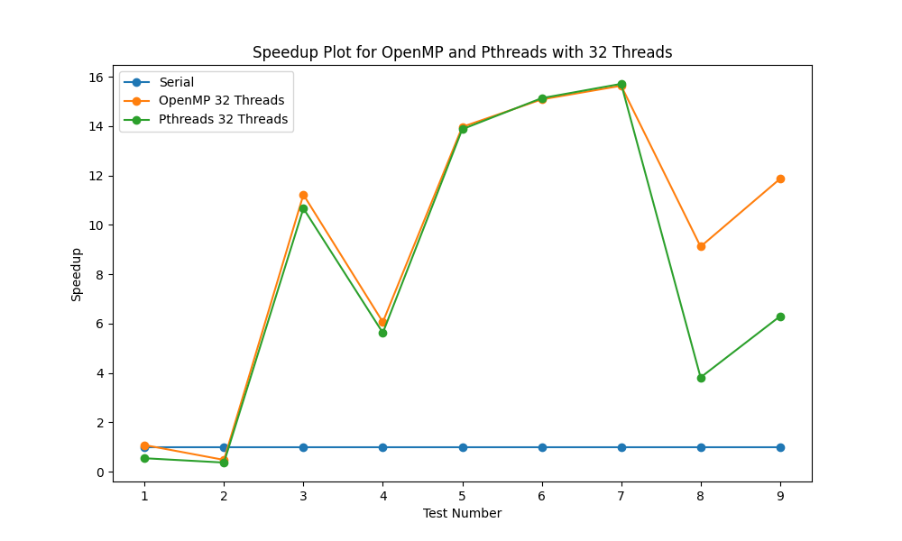
Speedup graphs
Notes:
Mihnea

Slide 8
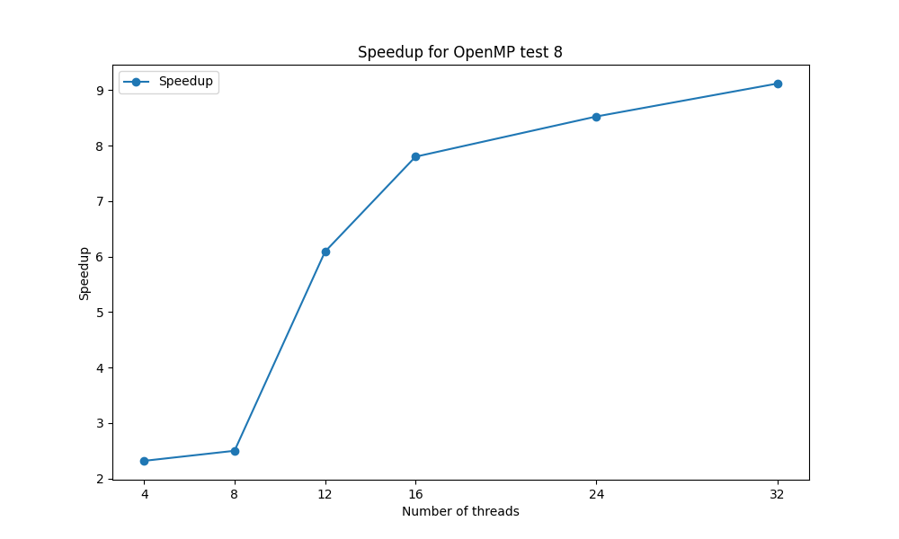
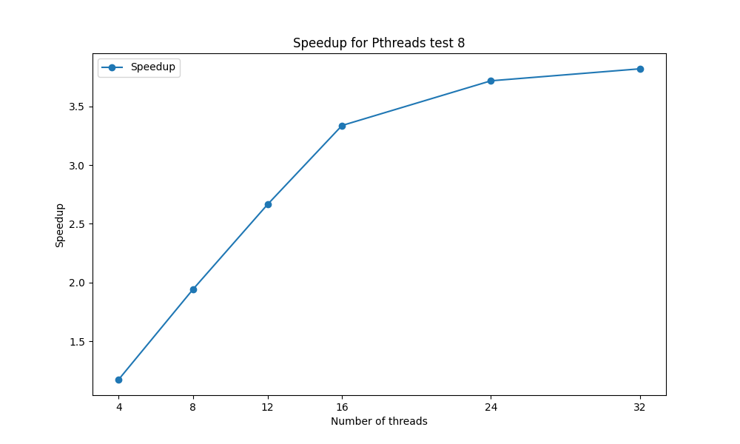
Parallel approach conclusion
Pthreads and OpenMP are both better than serial
OpenMP is better than Pthreads
Notes:
Mihnea

Slide 9


Smart serial approach
Use rules (strategies) to simplify the board:
Elimination strategy: This occurs when there is only one valid value for a cell
Lone ranger strategy: This is a number that is valid for only one cell in a row, column or box
Notes:
Mihai

Slide 10
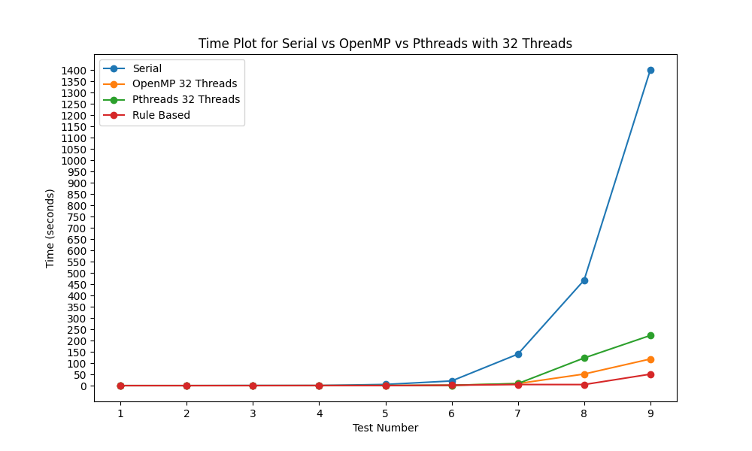
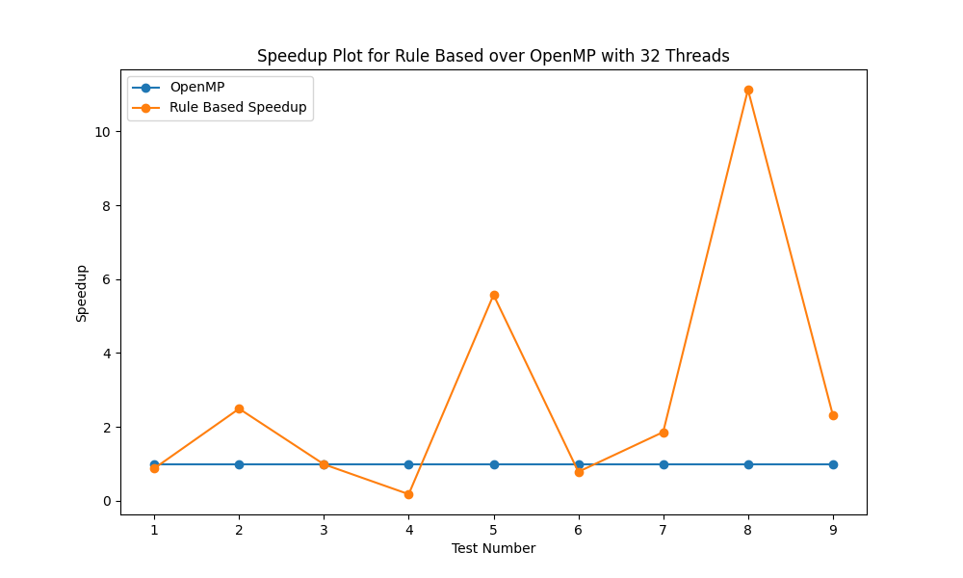
Time and Speedup graphs
Notes:
Mihai

Slide 11
Conclusions
More thought-out serial algorithms are better than brute force parallelism
Notes:
Mihai

