Slide 1
Computer Science 101
RGB Color System

Slide 2
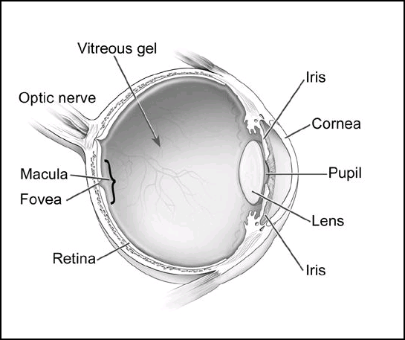
Simplified Introduction to Color Vision
Go to How We See: The First Steps of Human Vision or Color Vision for more information.

Slide 3
Wave Nature of Light
Light is transmitted as waves. The different wavelengths composing the light correspond to the colors of the light.
A red object absorbs wavelengths other than the red lengths.
The lens focuses the light on the retina.

Slide 4
Rod and Cone Cells
The retina contains two types of receptor cells.
  Rod cells: Detect the intensity of the light.
  Cone cells: Detect color of the light.

Slide 5
Cone Cells
In humans there are three kinds of cone cells (S, M, L) that are sensitive to different ranges of wavelengths.
Often these are labeled as R, G, B for red, green and blue. This is the best model for our purposes.

Slide 6

Red Green Blue - RGB
In this system colors are created from the primary colors Red, Green and Blue.
Widely used in computer systems.

Slide 7
RGB - Storage
A color is specified by giving three values in the range 0-255.
The first number is the Red value, the second is Green and third Blue.
Clearly there is a byte for each color, thus 24 bits in all.

Slide 8
RGB - Examples
R=212
G=88
B=200
R=240
G=244
B=56
R=150
G=150
B=150
R=255
G=255
B=255

Slide 9
RGB - In binary
R = 212 ≈ 11010100
G = 88 ≈ 01010100
B = 200 ≈ 11001000
Color stored in 3 eight bit groups:
11010100 01010100 11001000
Using 24 bits this way, there would be over 16 million colors.
R=212
G=88
B=200

Slide 10
RGB - In hexadecimal
R=212
G=88
B=200
R = 212 ≈ 11010100 ≈ D4
G = 88 ≈ 01010100 ≈ 54
B = 200 ≈ 11001000 ≈ C8

Slide 11
RGB - In hexadecimal
Color stored in 3 eight bit groups:
11010100 01010100 11001000
Note that each 8 bit group can be expressed with two hex digits
11010100 is given by D4
01010100 is 54
11001000 is C8
Color given by D454C8 in hexadecimal
R=212
G=88
B=200

Slide 12

I can’t visualize this
without a picture!

