Slide 1
Troubleshooting SQL Server high CPU usage
Lic. Salvador Sandoval
Sr. SQL Server | Ryder México

Slide 2

AGENDA
Tools
Detection
Causes
Resolution
Tips and Recommendations

Slide 3





¡ CPU
ALERT !

Slide 4

Overall CPU usage detection
Problem: Server Unexpectedly high CPU usage and low throughput
_______________________________ 15 Minutes ____________________________________
Find Root Cause
¿?
T
A
S
K
MA
N
A
G
E
R
Antivirus: 5 %
YES
SQL SERVER 90 %
NO
Other: 3 %
False Alert

Slide 5

¿ Where is the SQL DBA ?

Slide 6


¿ Yes, Its SQL, Where are the tools ?
Read Error Log
Read Cluster Log
Read Event Viewer
Check SQL Configuration
Check Server Configuration
Check Database Configuration
Use Third-party monitoring tool
Check history information
Get more details from APP Team
Get info from Affected team

Slide 7
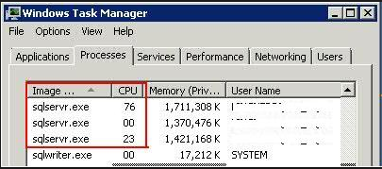
CPU Signs of the Problem
Once we have identified that SQL Server process is consuming CPU, we have to next find which inside SQL Server process is consuming this CPU.
Validate if server has more than one Instance running and work on the instance using more CPU %
¿ How Identify the instance using
more CPU on Server2008?
Process Identifier = PID
SELECT SERVERPROPERTY('processid') as PID
Take a look into
SQL Server Configuration Manager
Task Manager on Win2012 show the Instance name per Service.

Slide 8

Best way to start checking SQL SERVER
Sp_who2 | Sysprocesss | Activity Monitor |
Who_Is_Active | Sql Server Reports
OR
DMV
Extended
Events
Profiler
Execution
Analysis
Generate Execution Plan
DTA
Performace Counters
PssDiag / Pal / Nexus
AND

Slide 9




DETECTION
CAUSE
RESOLUTION

Slide 10

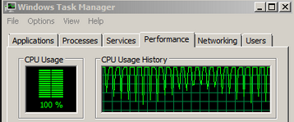



Identify SQL CPU Consumers Using SQL Server
DMVs IN ACTION
What is running right now
sys.dm_exec_requests
What is it executing?
sys.dm_exec_sql_text
Where is it from?
sys.dm_exec_sessions
sys.dm_exec_connections
Note: If your server is under severe stress and you are unable to login to SSMS, you can use another machine’s SSMS to login to the server through DAC.
What is its estimated plan?
sys.dm_exec_query_plan
What are they waiting for?
sys.dm_os_waiting_tasks

Slide 11



DEMO #1
DEMO 01

Slide 12





Slide 13


Slide 14
Troubleshooting SQL Server high CPU usage Part #2
¿ CPU ALERT GONE ?

Slide 15

sys.dm_exec_query_stats (Transact-SQL)
This DMV can help us to Returns aggregate performance statistics for cached query plans in SQL Server and identify those process using more Total Worker time. Performance statistics gone when SQL Server is restarted.
SQL Server (Starting with 2008)
Ring Buffer help to find SQL Server and system CPU usage history: Max last 256 Minutes. If CPU Spikes is caused by other application involve App team.
SQL RING BUFFERS

Slide 16
DEMO #2
DEMO 02

Slide 17
Tips and Recommendations
Check below instance configuration settings
Max degree of parallelism setting
Cost threshold for parallelism option
Processor affinity setting
Priority boost setting
Max worker threads setting
Lightweight pooling setting
TIPs:
POWER OPTION
Power-option settings below “High Performance” are still very common and shouldn’t be ignored for servers that host SQL Server instances.
Perfom concurrent maintenance activities (UPDATE stats with FULLSCAN)
Most Common Driver of CPU
High I/O operations (and in my experience this is the most common driver of CPU)
Cardinality estimate issues (and associated poor query plan quality)
Unexpected parallelism
Excessive compilation / recompilation
Running many traces

Slide 18



