Slide 1
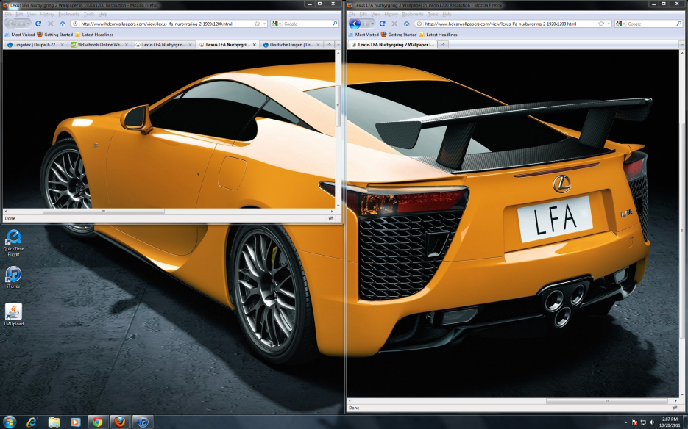
Text, Picture and Notes Test
There is a picture and some notes
Notes:
Here are my notes.

