Slide 1




Business Skills for Developers
Software Company Structure, Product Management, Marketing, Sales, Business Strategy and More
Margarita Antonova
IT
Business System Analyst
Telerik Corporation
Developers
Volunteer Trainer @ Telerik Academy
Business
Product
academy.telerik.com

Slide 2


Table of Contents
The Trainer
Course Format
Exams and Evaluation
Course Project
Introducing the Themes
Course Syllabus
Resources for the Course
HW Assignment

Slide 3



Trainer
Margarita Antonova – Maggie
MBA and BS in Commerce
Experience in Sales and
Marketing of Software
Business System Analyst
Product Manager
margarita antonova
maggie antonova

Slide 4
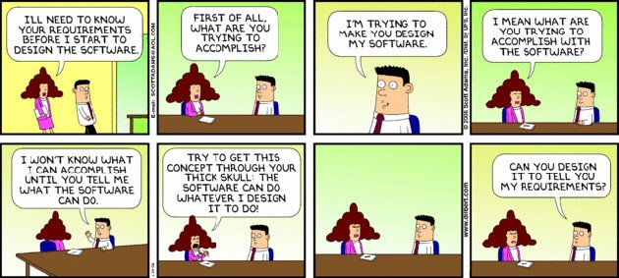
My Job

Slide 5

Course Goal
To familiarize software engineers with the basic business structures and processes that affect the development of software and hence their own work experience.

Slide 6




The Important Questions
If we are software engineers, why do we need business skills?

Slide 7

The Important Questions
Is software a house?

Slide 8
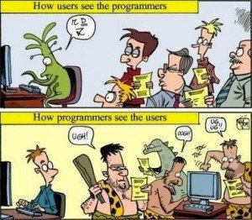
The Important Questions
Who do we sell to?
Who do we code for?

Slide 9
The Important Questions
The Software Challenge:
What is software?
How do you define software?
Is it a product, a service, an experience?
How do you know you need it?
How do you evaluate it?
How do you purchase it?
Build vs. Buy

Slide 10

The Important Questions
A Business Approach Can Help
What do we sell?
How are we making it?
Where do we sell?
How do we sell?
Are we making a profit?
How do we continue to sell at a profit?
Who do we sell to?

Slide 11
Who Do We Code for?
The End User
Looking to complete a task with our software product/service usually in the fastest easiest way.
In most cases is interested in an end result not the process or the details
In most cases will not have the expertise, knowledge and insight on the product we do.
It is good to have a middle-man – the business analyst, product manager and project manager – but YOU are important too

Slide 12
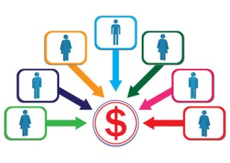
Who Do We Code for?
The End User
Is a CLIENT – the client is always right and usually paying or significantly contributing to our revenue
B2B vs. B2C

Slide 13

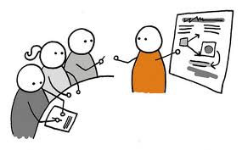

Course Format
How Is the Course Going to Be Conducted?

Slide 14



Evaluation
Project, Criteria, Certificates

Slide 15
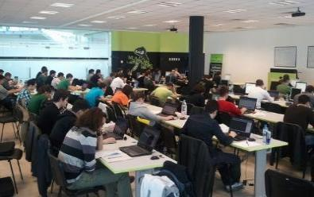

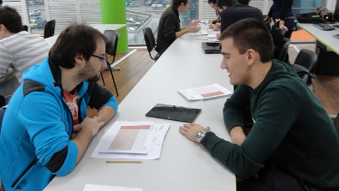
Business Skills – Evaluation
If you are here
Project: “Business Plan” – 70%
Attendance in class – 20%
Homework – 10%
If you are online
Project: “Business Plan” – 70%
Homework – 20%
Forum activity – 10%

Slide 16

Business Skills – Certificate
The best up to 5 teams
3-5 people per team

Slide 17

Practical Group Project
Business Plan for Your Own Product
Executive summary
Marketing Plan
Operations Plan
Financial Plan
Risk analysis
Decision Making Criteria
Due Date: July 2014

Slide 18

Homework Assignments
Warm Up: Answer the Business Questions
Cost-Benefit Analysis of Your Product Ideas
SWOT Analysis
Marketing Mix Analysis - 7Ps
Sales Force Operations Plan
Porter’s 5 forces
Your MVP

Slide 19


Course Syllabus
What Are We Going to Cover?

Slide 20
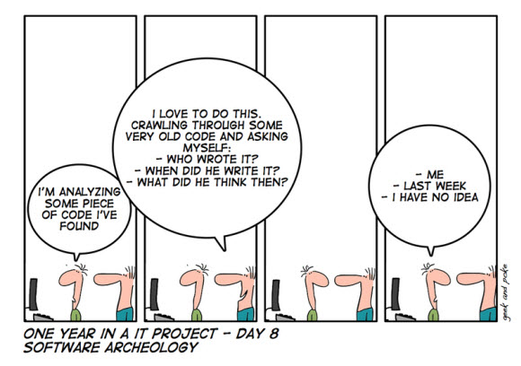
Syllabus
Role of the Software Engineers – Production & Support

Slide 21

Syllabus
How Does the Business Work?

Slide 22
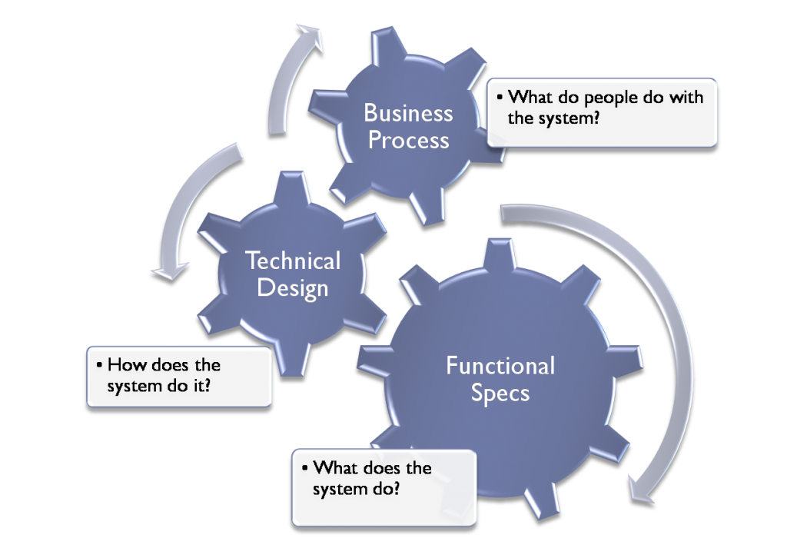
Syllabus
Product Development
The Kodak paradox: http://www.forbes.com/sites/chunkamui/2012/01/18/how-kodak-failed/

Slide 23
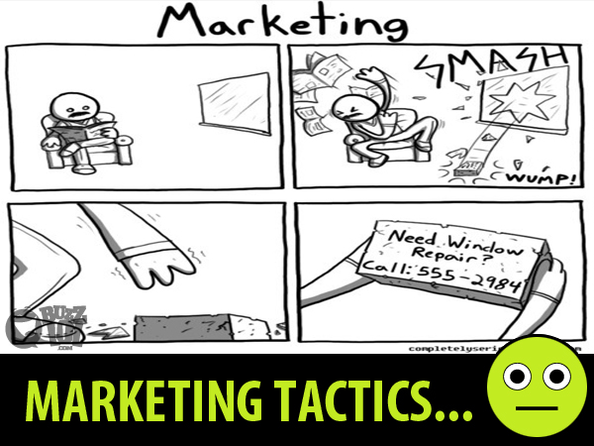
Syllabus
Marketing & Advertising

Slide 24

Syllabus
Gamification

Slide 25
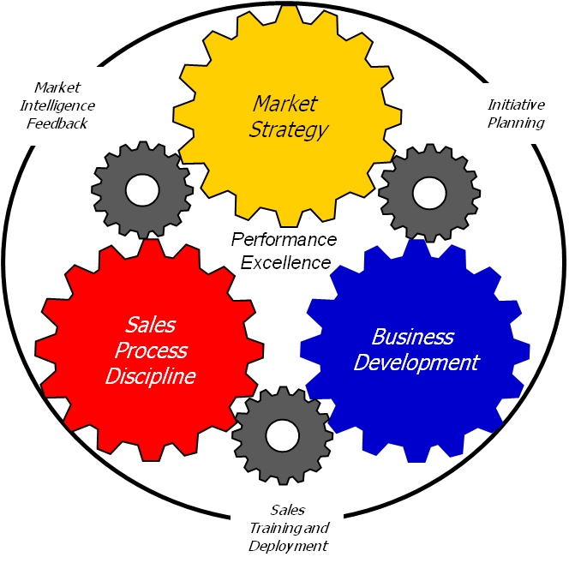
Syllabus
Sales Process & Sales Cycle

Slide 26
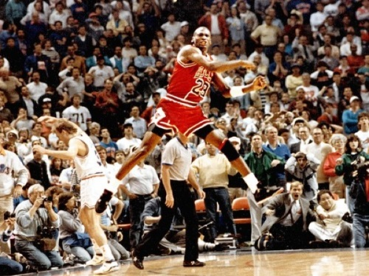
Syllabus
The Startup Culture – the MVP

Slide 27
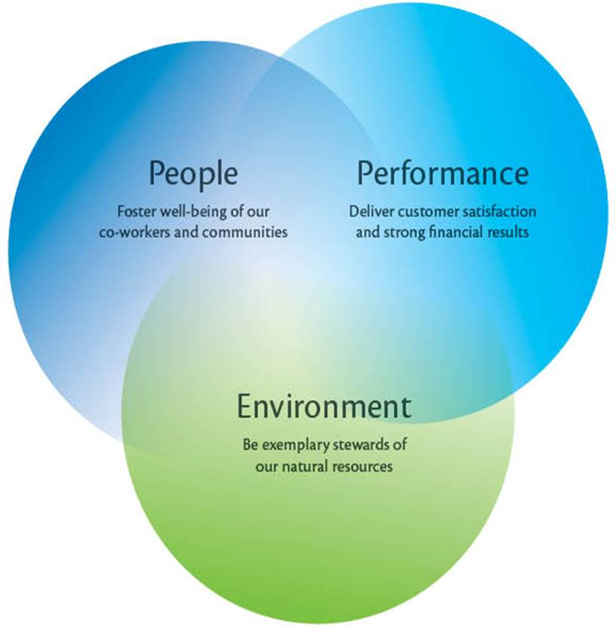
Syllabus
How to Sustain Our Business?

Slide 28



Summary
Defining software is hard
Selling software is hard
Software is for the user
Software development is a business

Slide 29
Business Skills for Developers: Course Intro
http://academy.telerik.com/student-courses/soft-skills-and-business-skills/business-skills-for-developers/about

Slide 30








Resources
What We Need in Addition to This Course Content?

Slide 31
Recommended Resources
Fast Company - www.fastcompany.com
Wired Magazine - www.wired.com
TechChrunch - http://techcrunch.com/
Wall Street Journal / Personal Technology - http://online.wsj.com
New York Times / Technology - http://www.nytimes.com/pages/technology/index.html
Business Week / Technology - www.businessweek.com/technology
CIO, international - www.cio.com
LinkDIn - topical groups
StatCounter Global Stats - http://gs.statcounter.com/
McKinsey Quarterly - http://www.mckinseyquarterly.com
Advertising Age - http://adage.com/

Slide 32
Course Web Site & Forums
The Business Skills course official web site
Register for the "Telerik Academy Forums":
Discuss the course exercises with your colleagues
Find solutions for the exercises
Share and discuss ideas and analysis
http://academy.telerik.com/student-courses/soft-skills-and-business-skills/business-skills-for-developers/about
Business Skills at the Academy Forums

Slide 33
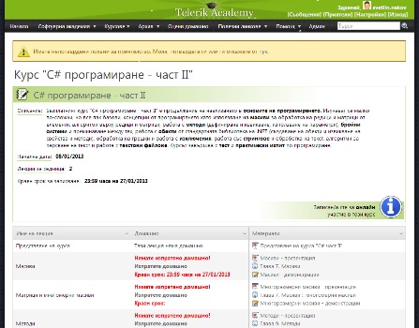
Telerik Integrated Learning System (TILS)
The Telerik Integrated Learning System (TILS)
www.telerikacademy.com
Important resource for all students
Homework submissions
Homework peer reviews
Presence cards with barcode
Reports about your results
http://telerikacademy.com/Courses/Courses/Details/39

Slide 34



Free Trainings @ Telerik Academy
Business Skills for Developers @ Telerik Academy
http://academy.telerik.com/student-courses/soft-skills-and-business-skills/business-skills-for-developers/about
Telerik Software Academy
academy.telerik.com
Telerik Academy @ Facebook
facebook.com/TelerikAcademy
Telerik Software Academy Forums
forums.academy.telerik.com

Slide 35

Homework Assignment
Answer the business questions for a startup of your liking.
Deadline – next lecture: discuss in class
A few sentences answering:
What do they sell?
How do they make it?
Who do they sell to?
Where do they sell?
How do they sell?
Are they profitable?
Are they sustainable?

Slide 36

Your Product

