Slide 1


Marketing
Positioning, Differentiation, Segmentation and Target Markets
Margarita Antonova
IT
Product Manager
Telerik Corporation
Developers
Volunteer Trainer @ Telerik Academy
Business
Product
academy.telerik.com

Slide 2


Table of Contents
Intro
Marketing Review
Segmentation
Targeting
Positioning
Differentiation
Marketing Strategy
HW: Target, Position, Difference

Slide 3
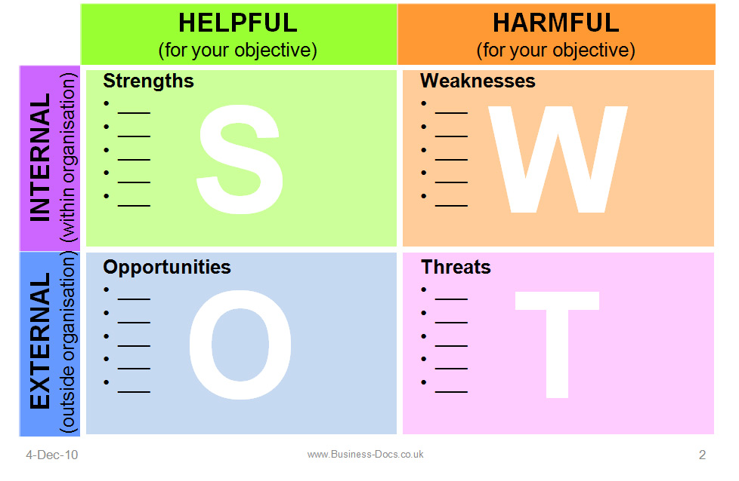
Review: SWOT

Slide 4
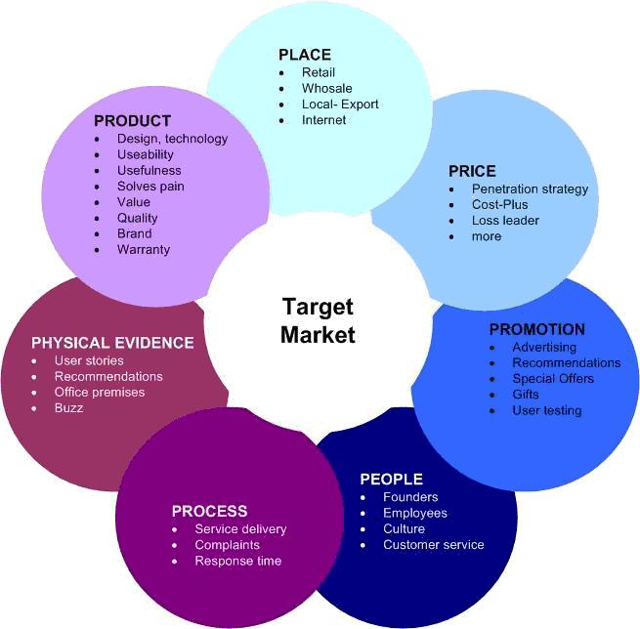
Review: Marketing Mix

Slide 5
Marketing
The concept of finding the people that are willing and capable of paying for our product or service and persuading them to do so.

Slide 6

Advertising
The act or practice of calling public attention to one's product, service, need, etc., especially by paid announcements.

Slide 7
Segmentation & Targeting
Finding the lucrative niche that wants not just needs your product.

Slide 8
Market Segmentation
Definition – the divide of the complete market into smaller subsets comprising of consumers with a similar taste, demand and preference. One market segment is totally distinct from the other segment.
Characteristics of individuals in a segment:
Similar thinking
Similar interests
Similar response to changes in the market

Slide 9
Market Segmentation
General Market Segmentation Basis:
Gender
Age – demographic groups
Income – purchasing power
Marital Status – think Caribbean cruise for singles and for couples
Occupation – student vs. white collar vs. blue collar, etc.

Slide 10
Market Segmentation
Types of Market Segmentation:
Geographic –nations, states, regions, countries, cities, neighborhoods, or zip codes
Walmart in China
McDonalds in India
Psychographic – social class, personality, lifestyle, attitudes, interests, value systems
Hustler for the Catholics

Slide 11
Market Segmentation
Types of Market Segmentation:
Behaviouralistic – based on individuals' knowledge of, attitude towards, use of or response to a product
Basis of Brand Loyalty – commitment to a brand resulting in repeated purchases over time
The iPhone iPod lines
Occasions – holidays, weddings, funerals or based on other special needs at an occasion
ДДС – due on the 15th of each month

Slide 12
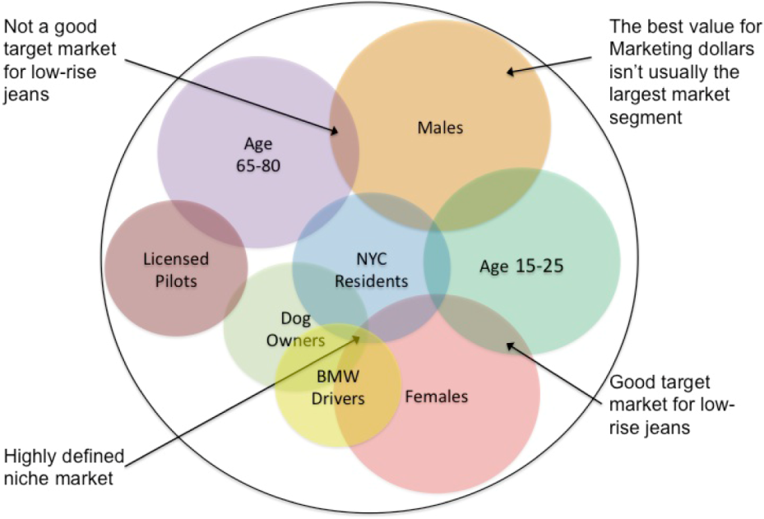
Market Segmentation

Slide 13
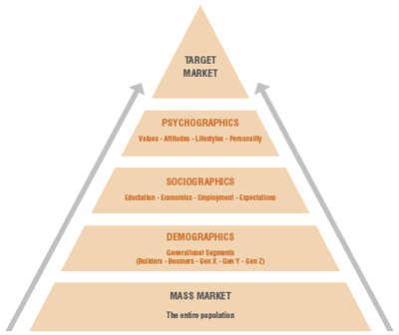
Target Market

Slide 14
Target Market
Definition - The consumers a company wants to sell its products and services to, and to whom it directs its marketing efforts.
The first element of the marketing strategy and the marketing plan
Who do we sell to?

Slide 15
Positioning & Differentiation
In the modern highly competitive consumer market you have to differentiate or die.

Slide 16
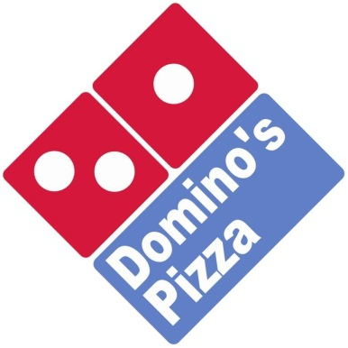
Brand Positioning
Definition – a brand occupies a distinct position, relative to competing brands, in the mind of the customer.
Key Characteristic – once a brand is positioned, it is very difficult to reposition it without destroying its credibility.
Example:

Slide 17
Product Differentiation
Definition - showcasing the differences between products. Differentiation looks to make a product more attractive by contrasting its unique qualities with other competing products. Successful product differentiation creates a competitive advantage for the seller, as customers view these products as unique or superior.

Slide 18
Product Differentiation
Competitive Advantage:
An edge over its rivals and an ability to generate greater value for the firm and its shareholders
If sustainable it is difficult for competitors to neutralize the advantage
Types:
Comparative – producing at lower cost
Differential – product is seen as better by customers

Slide 19
Positioning & Differentiation
Work together to present the product and the brand in the most profitable light
The objective of differentiation is to develop a position that potential customers see as unique
Differentiation = tool
Positioning = result

Slide 20
Differentiation Strategy
Quality
we provide high quality = I thought everybody was
Price
we provide the best price = we are cheap
Benefit
We give you what no one else can
Problem & Solution
We make your headache go away

Slide 21
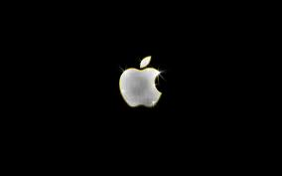

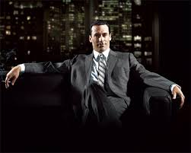
Differentiation Strategy
Competitor-based
We just do it better – Duracell
Emotional
We make you feel the way you like
Benefits:
High brand loyalty
Lower need for innovation
Charge premium

Slide 22
Marketing Strategy
Identifies customer groups, targets, which a particular business can better serve than its competitors, and tailors product offerings, prices, distribution, promotional efforts and services (the marketing mix) toward those segments. Ideally, the strategy should address unmet customer needs that offer adequate potential profitability.

Slide 23
Software Company Typical Structure
http://academy.telerik.com/student-courses/...

Slide 24

Examples
Intro 2
Vacuums
Carmina Burana
On a horse
About sweat
Want a dog?
The Devil Movie

Slide 25

Homework Assignment
Write & explain the target, positioning and differentiation strategy for your marketing plan
Try to use the 7Ps explanation & SWOT

Slide 26



Free Trainings @ Telerik Academy
Business Skills for Developers @ Telerik Academy
http://academy.telerik.com/student-courses/soft-skills-and-business-skills/business-skills-for-developers/about
Telerik Software Academy
academy.telerik.com
Telerik Academy @ Facebook
facebook.com/TelerikAcademy
Telerik Software Academy Forums
forums.academy.telerik.com

