Slide 1


The Sales Process
Sales Processes, Sales Cycle and the Sales Force
Margarita Antonova
IT
Business System Analyst
Telerik Corporation
Developers
Volunteer Trainer @ Telerik Academy
Business
Product
academy.telerik.com

Slide 2


Table of Contents
Sales Development Cycle
Sales Funnel
Pre-Sales Process
Post-Sales Process
Glengarry Glen Ross

Slide 3
Sales Development Cycle
The course of time between the initial contact and the sale. Essentially, a measure of the efficiency of the sales department.

Slide 4
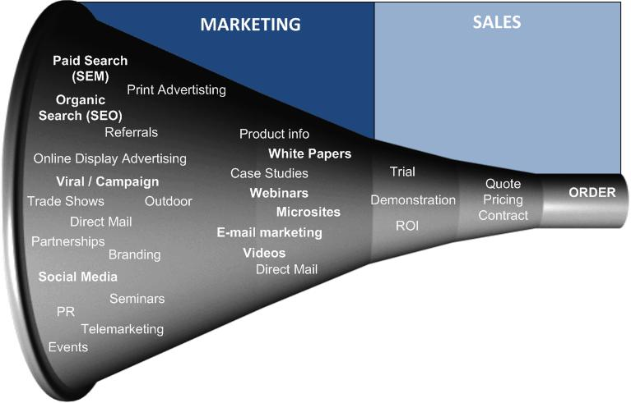
From Marketing to Sales

Slide 5
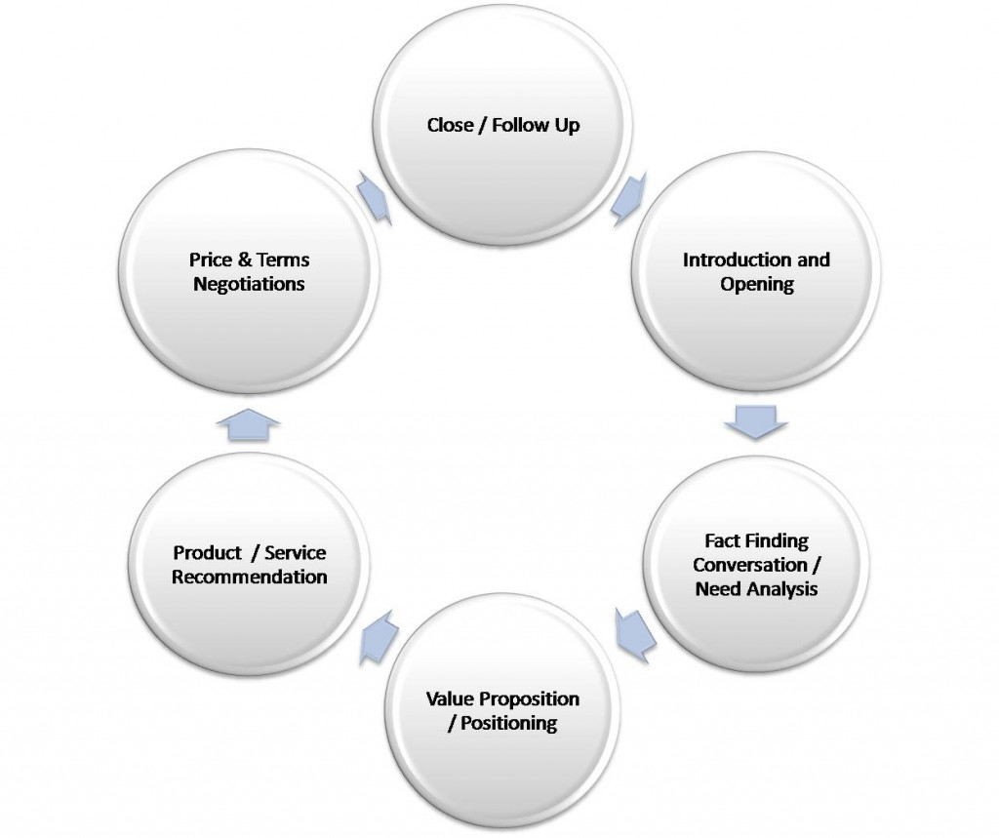
Sales Cycle - General

Slide 6
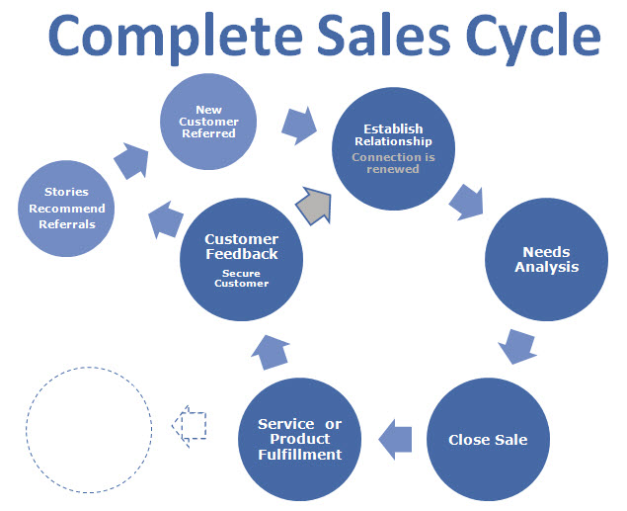
Sales Cycle – Customer Referral

Slide 7
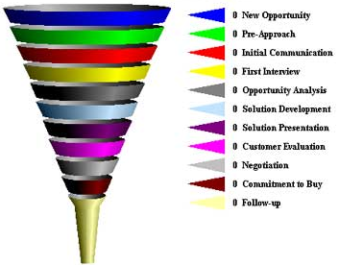
Sales Funnel

Slide 8
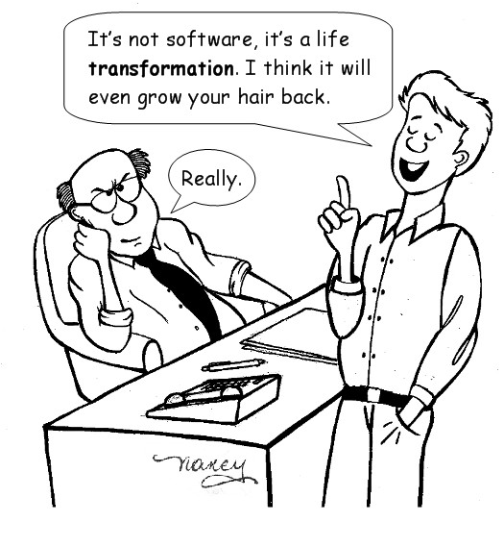
Sales Cycle
Prospecting and lead qualification
Pre-approach
Approach
Needs Discovery
Value Proposition
Handling Objections
Negotiation
Closing the sale
Follow up

Slide 9
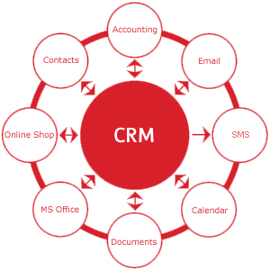
Pre – Sales Process
Prospecting
Nurturing Leads
Hot leads and Opportunities
Sales Pitch and ABC of Sales
CRM systems (Customer Relationship Management system):
Records and History
Leads and Opportunity Management

Slide 10
Post – Sales Process
Customer Retention
The amount of business a company keeps
Challenges – easy switch, first period retention (software is commonly purchased for try)
Benefits – difficult switch and certain revenue
Upsales, upgrades and new sales opportunities
Client relationship
Training and Customer Service
Potential partnership
Referral potential
Document communication – CRM systems (Customer Relationship Management system)

Slide 11
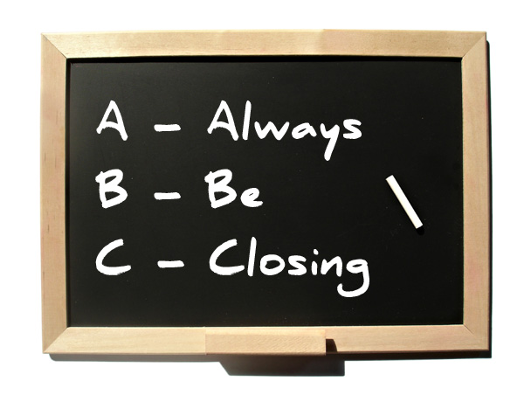
Sales Process Summary

Slide 12
Sales Process
http://academy.telerik.com/student-courses/...

Slide 13

Homework Assignment
What is your marketing and sales strategy?
How will you sell: direct sales, marketing and eCommerce, sales negotiations, other?
Why is that be4st for your product?

Slide 14



Free Trainings @ Telerik Academy
Business Skills for Developers @ Telerik Academy
http://academy.telerik.com/student-courses/soft-skills-and-business-skills/business-skills-for-developers/about
Telerik Software Academy
academy.telerik.com
Telerik Academy @ Facebook
facebook.com/TelerikAcademy
Telerik Software Academy Forums
forums.academy.telerik.com

