Slide 1


Product Development
Marketing Mix, SWOT Analysis and Stages of Developing an Idea
Margarita Antonova
IT
Business System Analyst
Telerik Corporation
Developers
Volunteer Trainer @ Telerik Academy
Business
Product
academy.telerik.com

Slide 2


Table of Contents
Product Development Stages
Marketing Mix
SWOT
Workshop: What’s your product?
HW: SWOT Analysis

Slide 3





Do you know those brands? You won't.

Slide 4
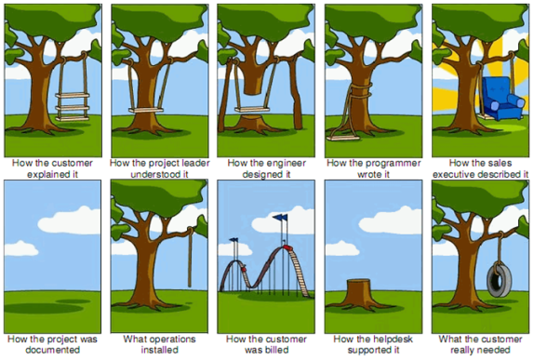
Stages of Product Development
The road an idea takes to start bringing in value

Slide 5
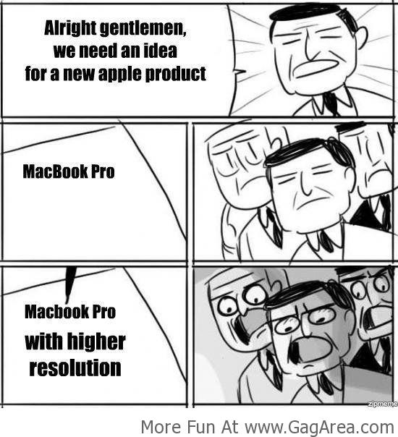
PD Stages
Product Development – definition:
The complete process of bringing a new product to market

Slide 6
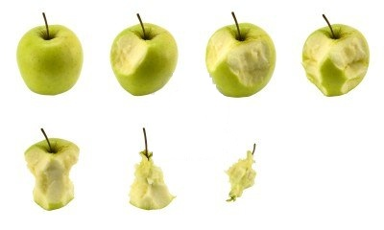
PD Stages
Stages – flexible, combine when needed:
Idea Generation
Idea Screening
Idea Development into Concept
Business Analysis
Concept Testing
Tech Implementation
Commercialization

Slide 7
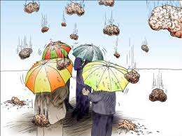
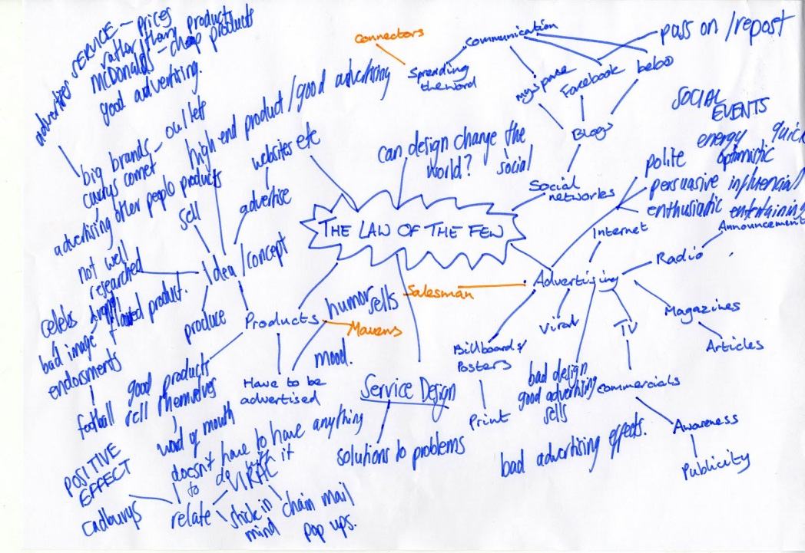

PD Stages
Idea Gathering

Slide 8
PD Stages
Idea Screening
Cost-benefit analysis
Will the customer benefit from the product?
What is the size and growth forecasts of the market segment / target market?
What is the current or expected competitive pressure for the product idea?
What are the industry sales and market trends the product idea is based on?
Is it technically feasible to manufacture the product?
Will the product be profitable when manufactured and delivered to the customer at the target price?

Slide 9
PD Stages
Idea Testing
Are there any intellectual property rights or patent we need to be aware of?
Who is the target market and who is the decision maker in the purchasing process?
What product features must the product incorporate?
What benefits will the product provide?
How will consumers react to the product?
How will the product be produced most cost effectively?
Is the idea feasible? – computer aided rendering and rapid prototyping
What will it cost to produce it?

Slide 10
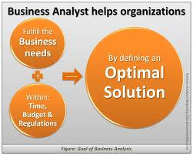
PD Stages
Business Analysis
Estimate costs
Estimate prices
Estimate sales volume
Estimate profitability and break-even point
Have a business model
Produce a business plan

Slide 11
PD Stages
Beta Testing – the product and the market
Have a [beta] testable version – MVP?
Test the product and its essential services and accessories in typical usage situations
Consult with the market – focus groups, customer interviews or trade shows
Make adjustments where necessary
Produce an initial run of the product and sell it in a test market area to determine customer acceptance – early adopters, loyal market, etc.

Slide 12
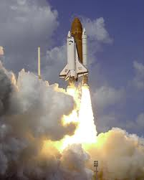
PD Stages
Technical implementation – the product is shippable and the distribution channels are set
Commercialization:
Launch
Promotion
Fill distribution channels

Slide 13
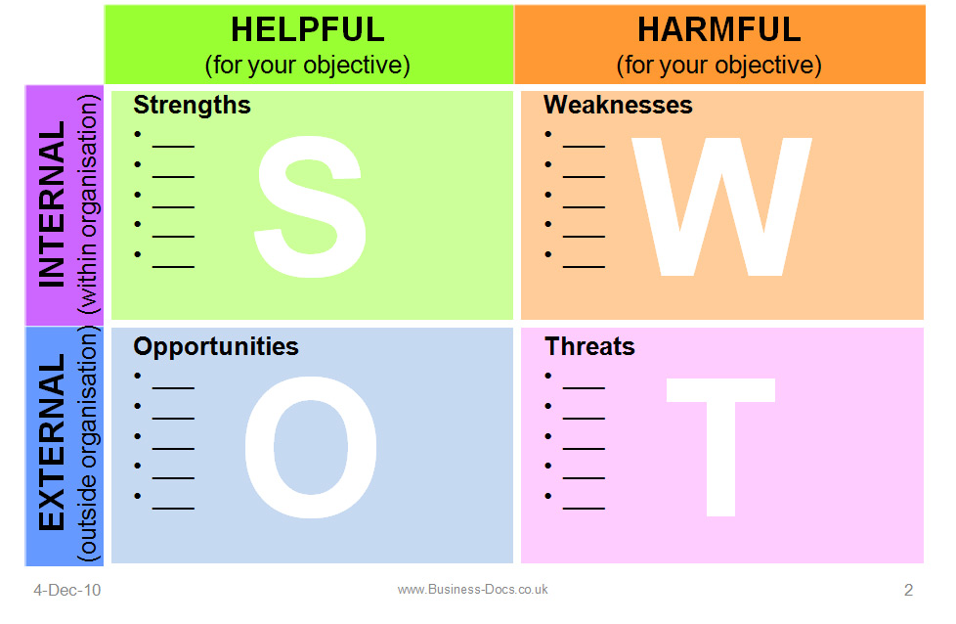
SWOT
Usage – to understand your product and your circumstances in order to carve an appropriate niche

Slide 14
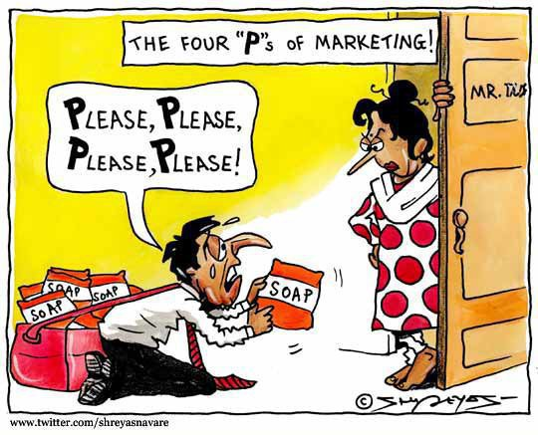
Marketing Mix
4Ps or 7Ps, 1 P is for Product

Slide 15
Marketing Mix
Borden’s “mixer of ingredients” – 1964
Definition:
Mix of controllable elements
Combined to address the needs of the target market
Goal of combination – to generate the highest return

Slide 16
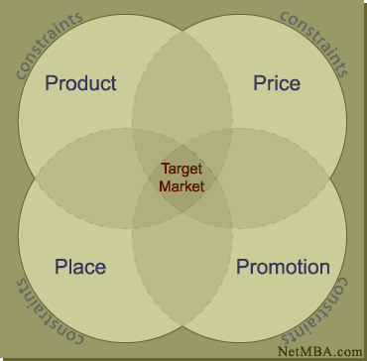
Marketing Mix
Traditional Marketing Mix – 4Ps

Slide 17
Marketing Mix
Traditional Marketing Mix – 4Ps:
Product – tangible, physical product, as well as services
Price – amount paid by customer
Placement – distribution of product to the customer
Promotion – communication of information aiming to generate a positive response

Slide 18
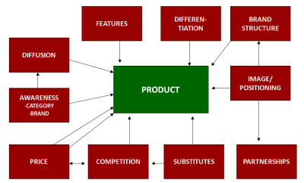
Marketing Mix
The Product Decisions:
Brand name
Functionality
Styling
Quality
Safety
Packaging
Support
Warranty
Accessories and other services

Slide 19

Marketing Mix
The Price Decisions:
Pricing strategy
Retail price
Volume discounts
Cash and early payment discounts
Seasonal pricing
Bundling
SaaS, support and other services price addition
Price flexibility – open to negotiations

Slide 20
Marketing Mix
Pricing strategy
Cost-plus – cost of production + % for profit
Skimming – sell high to break-even fast, limited timing
Penetration – sell low to grab market share
At-a-loss – sell at cost or lower to stimulate profitable sales
Market-oriented – based on competition
Value-based – what the target would pay
Discrimination – charge the same differently to different consumers
Premium – expensive means good
Predatory – drive competitors out with low prices
Pay what you want – up to the customer
Freemium – charge for advanced features and services
Retail price
Volume discount and retail price
Cash and early payment discounts
Seasonal pricing
Bundling
SaaS, support and other services price addition
Price flexibility – open to negotiations
Price

Slide 21
Marketing Mix
The Placement Decisions:
Distribution channels – consider their number, reach and mix
Channel intermediaries – outside organizations that bring the product or service to the client – consider their number
Coverage:
Mass – distribute product in all possible locations
Selective – limit locations to target market
Exclusive – high-end or distribution exclusivity
Warehouse, inventory, logistic and transportation

Slide 22

Marketing Mix
The Promotion Decisions:
Promotion Strategy
Inform
Create desire
Differentiate
Advertising
Sales force
Sales promotions
Public Relations
Marketing budget

Slide 23
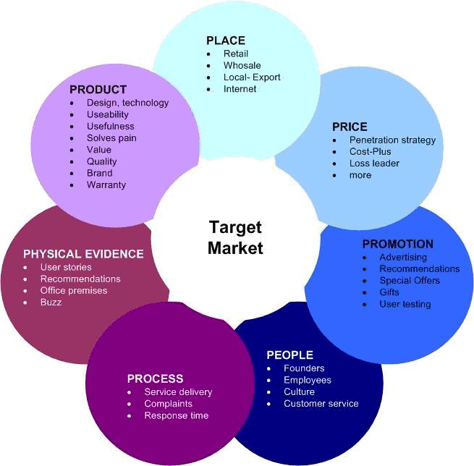
Marketing Mix
Recent Marketing Mix – 7Ps:

Slide 24
Marketing Mix
In the software industry all the Ps can be tightly connected to the product defining its properties:
Placement – web vs. desktop
Price – can it/do we want it to work in the Cloud and be sold on a subscription base?
Promotion – can we provide a test environment for the product without giving the product away?
People – Steve Jobs vs. who makes Dell?

Slide 25

Product/Market Fit
What it is – being in a good market with a product that can satisfy that market
What it isn’t – a product where the customers aren't quite getting value out of it, word of mouth isn't spreading, usage isn't growing that fast, press reviews are kind of "blah", the sales cycle takes too long, and lots of deals never close

Slide 26



America’s Top 10
Rubik’s Cube
Units sold/sales: 350 million units
iPhone
Units sold/sales: 250 million units
Harry Potter
Units sold/sales: 450 million units
Michael Jackson Thriller
Units sold/sales: 110 million units
Mario Franchise
Units sold/sales: 262 million units
Source: http://247wallst.com

Slide 27
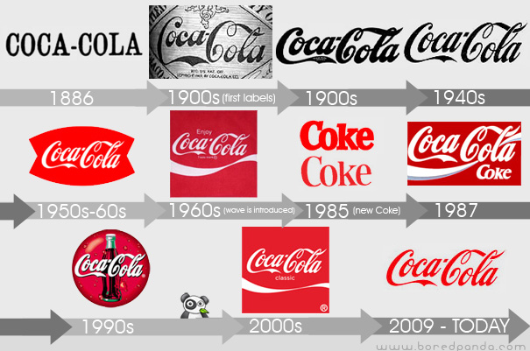
Lessons from the Best
Coca-cola – Promotion: relate to your audience
Google – Physical Evidence: employees are excited, so they excite me to buy
Apple – Product: easy to use, simple, and high quality
JetBlue – Process: make your product or service an experience, not just an expenditure
Comcast – Process: allow your customers to reach and engage with you and show them that you care

Slide 28
Product Development
http://academy.telerik.com/student-courses/...

Slide 29

Homework Assignment
Write out a SWOT analysis for your product.
After describing the Weaknesses & Threads, give ideas of how you will overcome them

Slide 30

Workshop: What is your product?
Can you answer the questions in Idea Testing and Idea Screening?

Slide 31



Free Trainings @ Telerik Academy
Business Skills for Developers @ Telerik Academy
http://academy.telerik.com/student-courses/soft-skills-and-business-skills/business-skills-for-developers/about
Telerik Software Academy
academy.telerik.com
Telerik Academy @ Facebook
facebook.com/TelerikAcademy
Telerik Software Academy Forums
forums.academy.telerik.com

