Slide 1
Dent - info
Tancho and niki

Slide 2

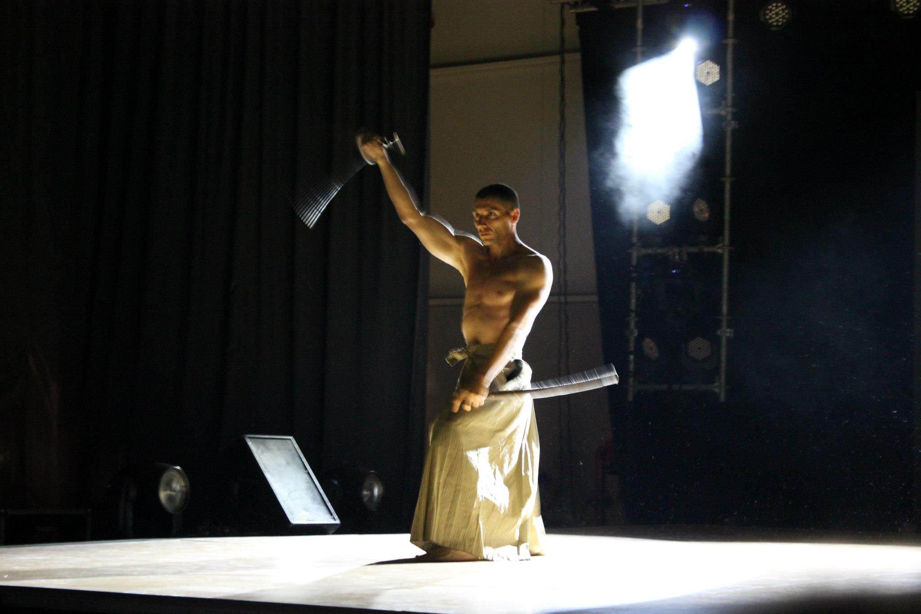
Who are we?
Tancho – major in the Bulgarian armmed forces
Niki – student in tehnical university sofiq, never programmed before

Slide 3

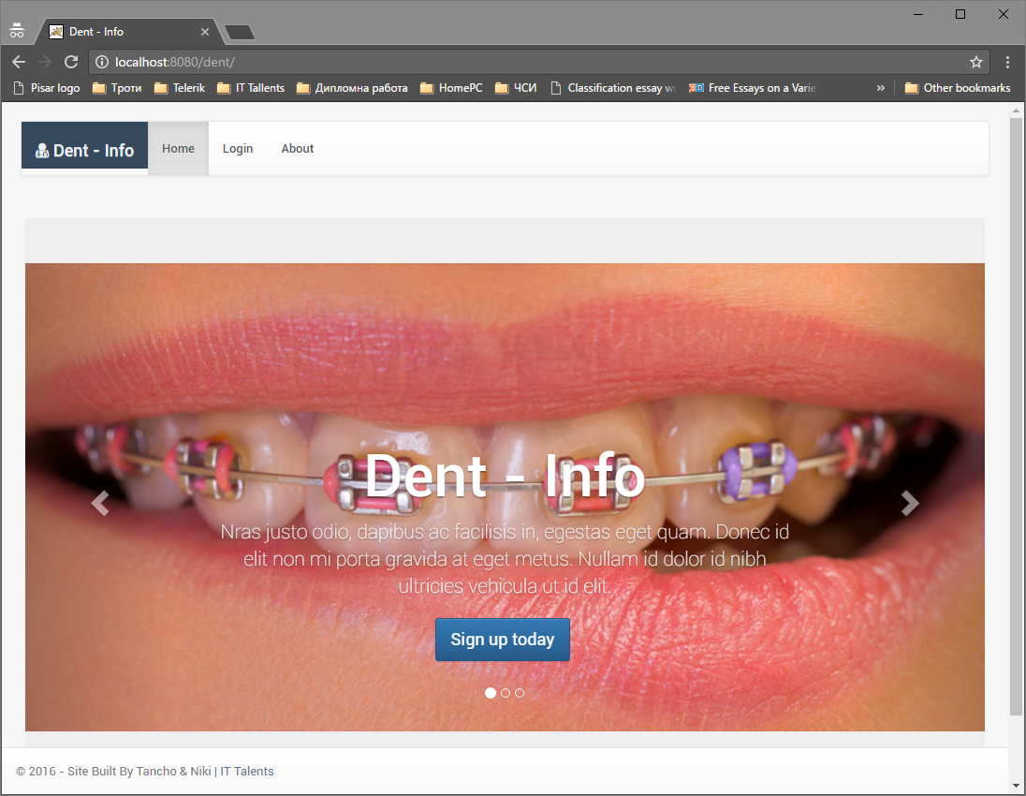

What does it do?
We have made a program that organizes workflow between dentist and dentist technicians

Slide 4
What technologies does it use?
Java
Servlets
JSP
HTML
CSS
JavaScript
MySQL

Slide 5
Future plans?
Make it restfull
Connect it to payment system
Connect it to NOI
Improve the interface

Slide 6
DEMO
Lets test it: httr://dent-info.net

