Slide 1
Microsoft Bot Framework 4.0
Munish Malhotra
Microsoft

Slide 2
V3 was good, wasn’t it?
Rewritten to be more generic
Parity between the active SDK flavors
e.g- Form flow in C# but not in JS
New joiners
New middleware capabilities
Built on .net core (for C# enthusiasts)
Overall service architecture(azure bot service) remains same

Slide 3
What changed?
Defining dialogs
Dialog Set – equivalent to dialogs in V3
Composite dialogs
Prompts
Waterfall steps
Adapter OnTurn & Turn context
State management accessors
Middleware

Slide 4
V4 – Middleware
General functionality which you want to apply to your bots
simply a class that sits between the adapter and your bot logic
When should I implement actions as middleware versus using my normal bot logic?
For example, you may want to log every message activity your bot receives or provide a fallback response
Logging
Conversational
Error
Enhancing the turn context

Slide 5
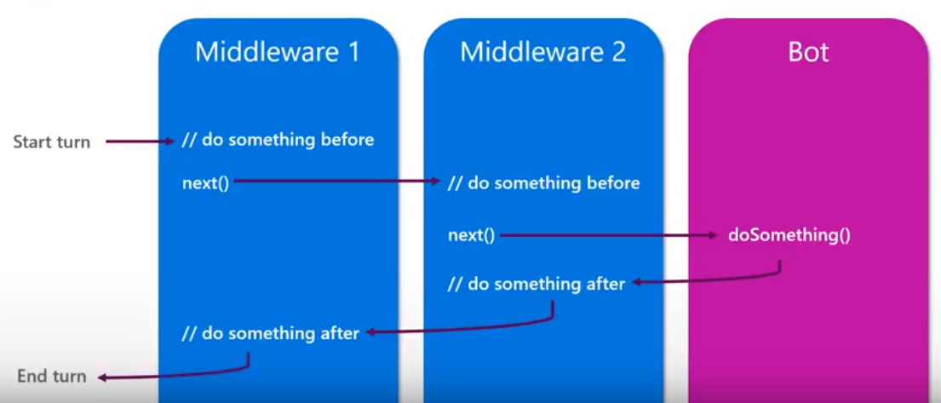
Middleware pipeline

Slide 6
What about the future?
https://github.com/Microsoft/botbuilder-js/wiki/Roadmap
V3 bots continue to work, Migration plan in progress:
Some tentative dates
Migration from V3 to V4 (Preview) – NOVEMBER’2018
Migration from V3 to V4 (GA) – DECEMBER’2018
Python/Java – NOT GA Yet!
SSO support

Slide 7
Enterprise bot template
Enterprise bot template download
https://docs.microsoft.com/en-us/azure/bot-service/bot-builder-enterprise-template-overview?view=azure-bot-service-4.0
Only available for C#, wait for JS.

Slide 8
Out of box tool set
ChatDown – for business decision makers
Prototype mock conversations in markdown and convert the markdown to transcripts
LUDown – Create JSON models for both LUIS & QA
Build LUIS language understanding models using markdown files
MSBot – Generate BOT file to include all services
Create and manage connected services in your bot configuration file
LUIS-CLI – Manage LUIS/QnA resources from CLI

Slide 9
Thank you

