Slide 1
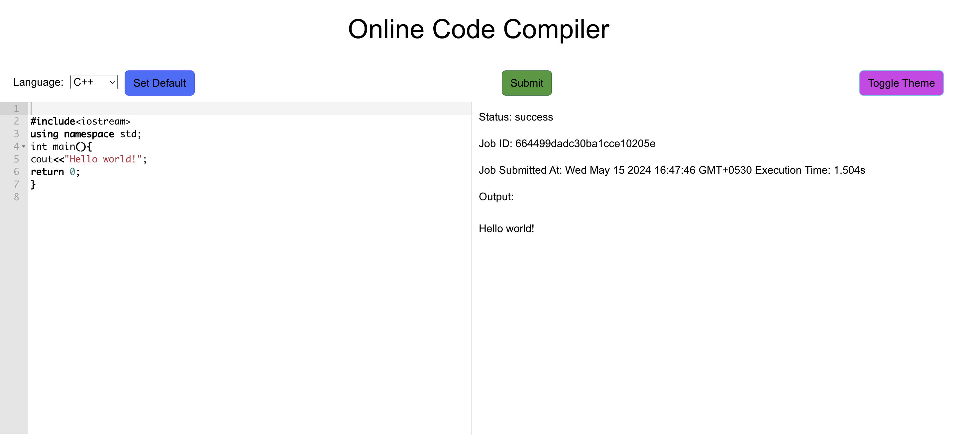
ONLINE CODE EDITOR
SUBMITTED TO:
MR. PRAMOD MEHRA
(SOFTWARE ENG. LAB)
By: Mihul Saxena
UNIVERSITY ROLL NO. 2018936
SECTION-E(44)

Slide 2

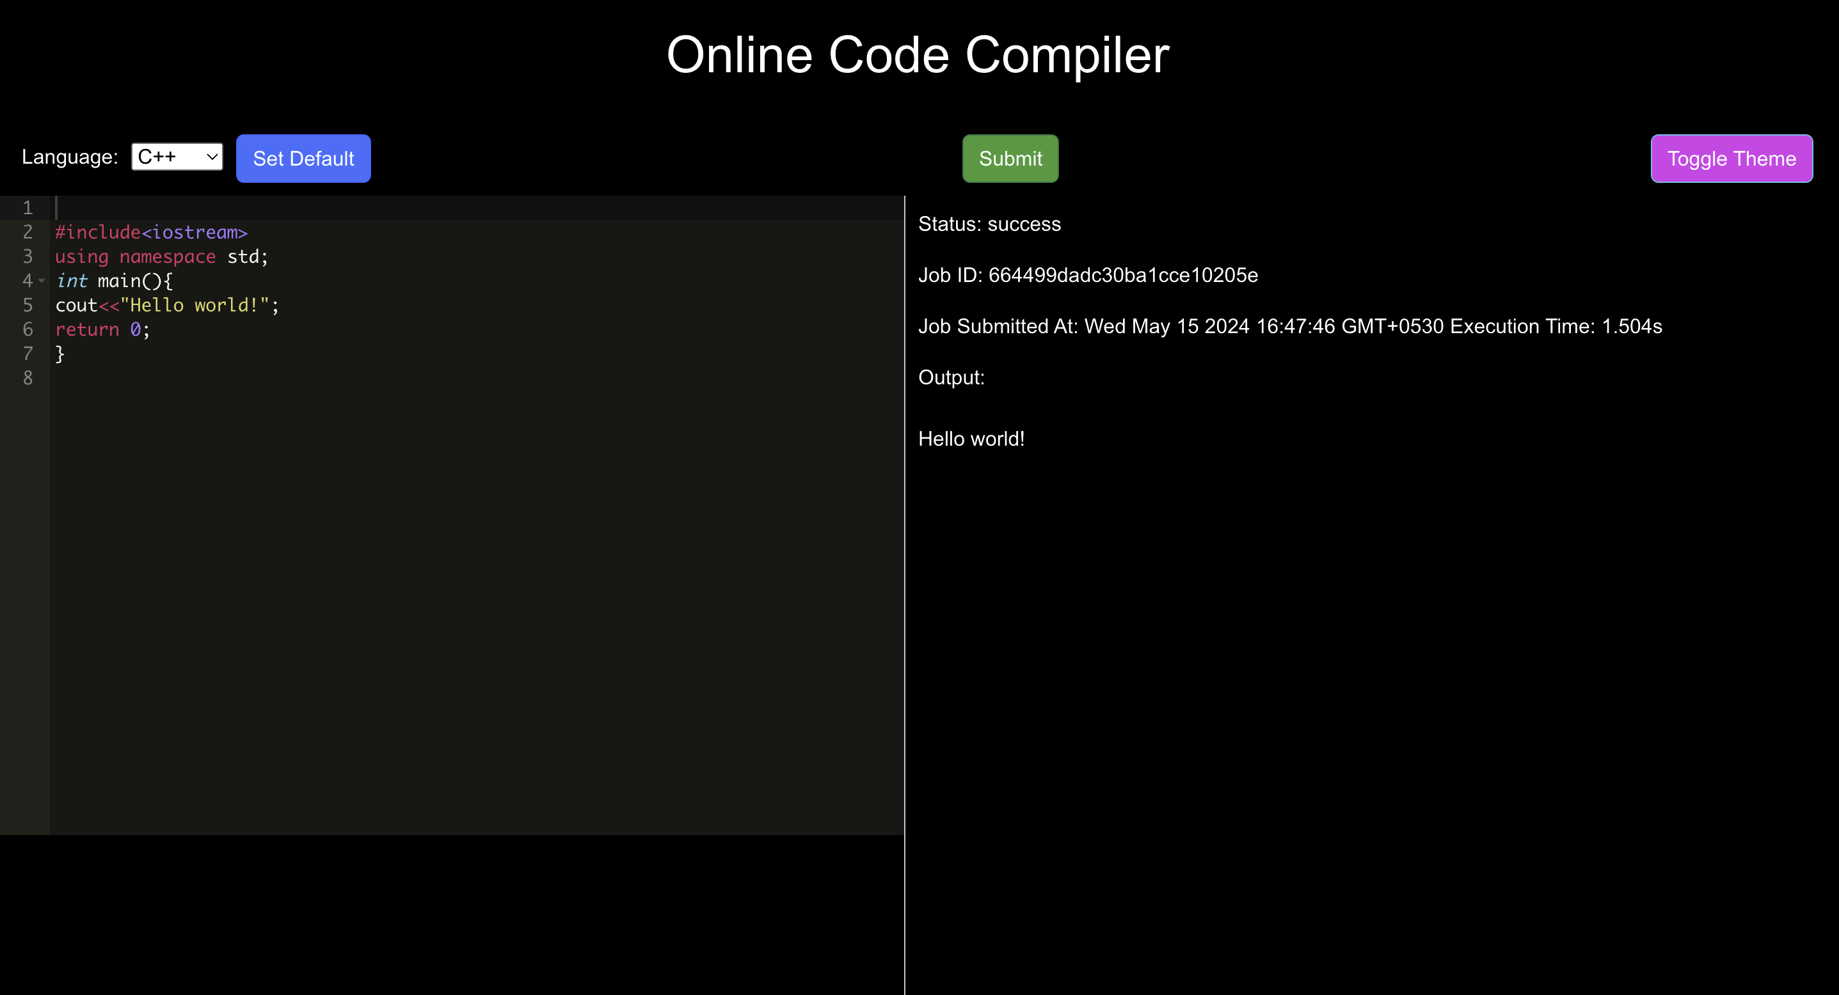
INtroduction
The Online Code Compiler is a revolutionary web-based platform designed to streamline coding tasks for developers, students, and programming enthusiasts. It offers a versatile environment for writing, testing, and sharing code in real-time, facilitating collaboration and accelerating the development process.
Problem Statement:
In today's digital era, the demand for remote collaboration and virtual learning has surged, necessitating the need for reliable online coding environments. Traditional desktop-based Integrated Development Environments (IDEs) often lack the flexibility and accessibility required for modern coding workflows. Moreover, setting up local development environments can be time-consuming and cumbersome, especially for beginners.

Slide 3
Literature Survey
The field of online code compilers has seen significant growth and innovation in recent years, driven by advancements in web development technologies and the increasing demand for remote coding solutions. This section explores existing literature and related work in the domain of online coding environments, highlighting key features, functionalities, and trends observed in popular platforms.
Online code compilers enable efficient resource utilization by dynamically allocating compute resources based on demand, thereby minimizing idle capacity and maximizing cost efficiency. This elasticity allows organizations to scale their development operations seamlessly, adapting to fluctuating workloads and project requirements.

Slide 4
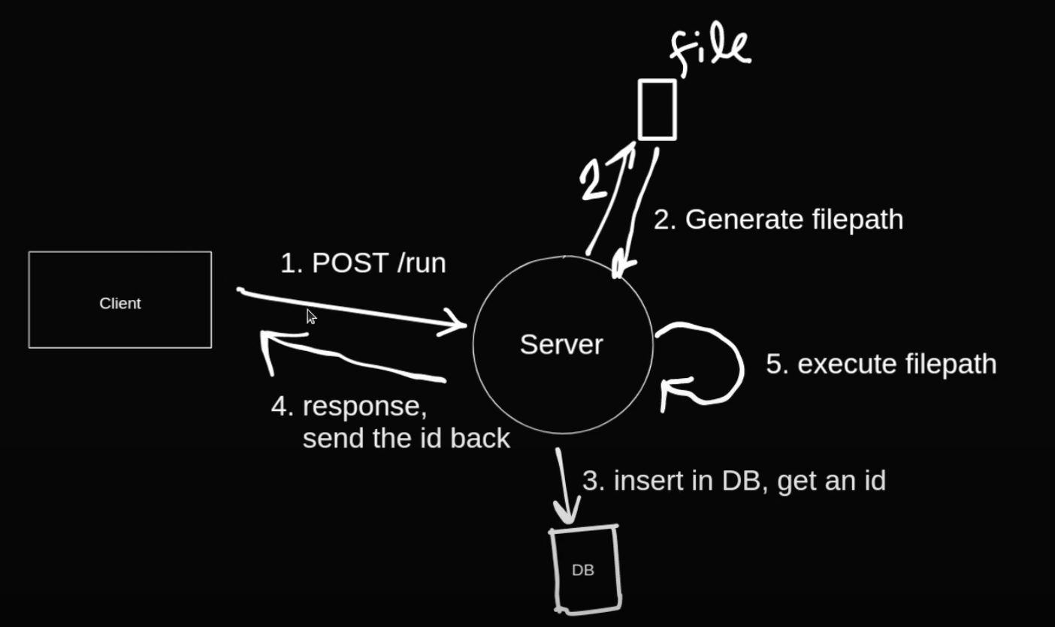
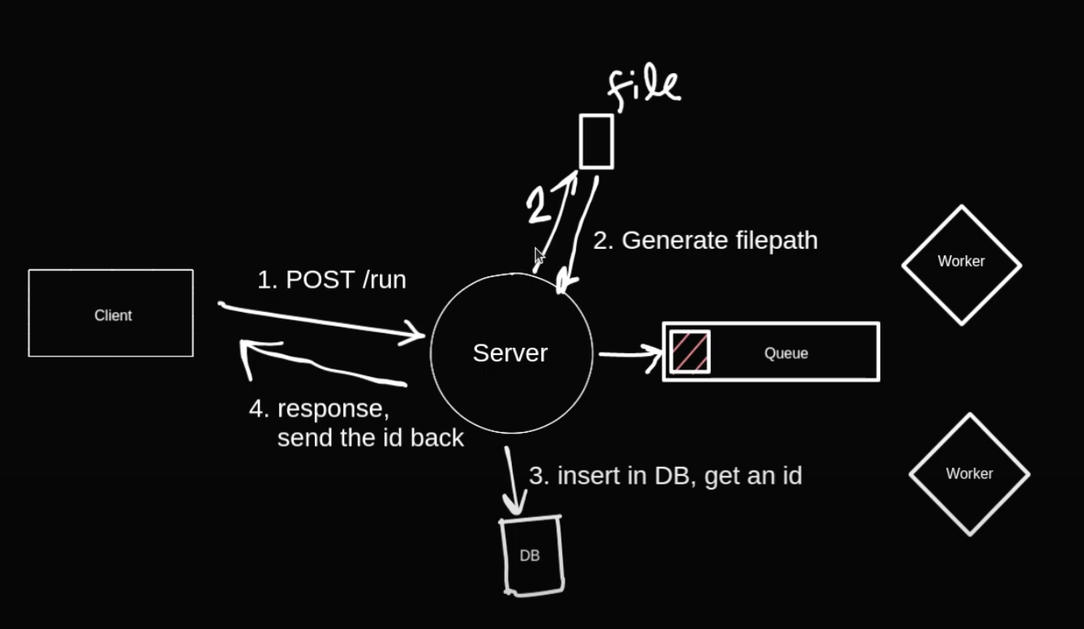
Methodology
The Online Code Compiler project follows a systematic approach to design, development, and deployment, guided by established methodologies and best practices in software engineering. This section outlines the methodology adopted for building the frontend and backend components of the application, as well as the tools, frameworks, and libraries used in the development process.
Libraries used: ReactJS, NodeJS, expressJS, Mongoose, Axios, Cors, Ace-editor, Redis, Moment.js, Bull, Bootstrap

Slide 5
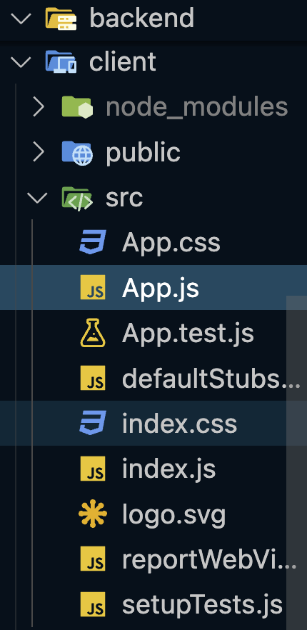
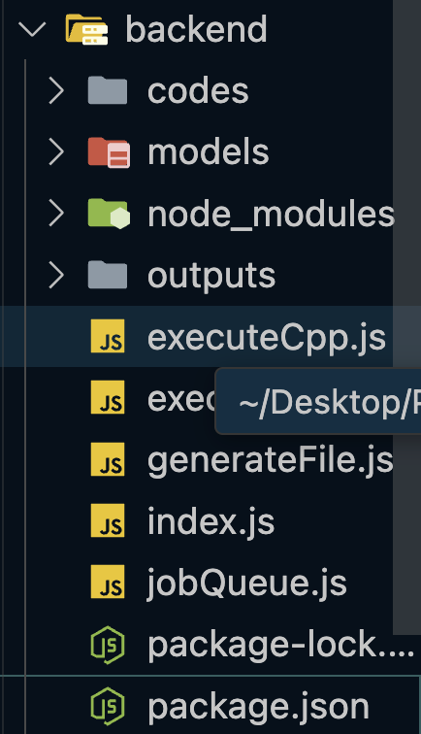
Project structure
Frontend Directory =>
Backend Directory =>

Slide 6
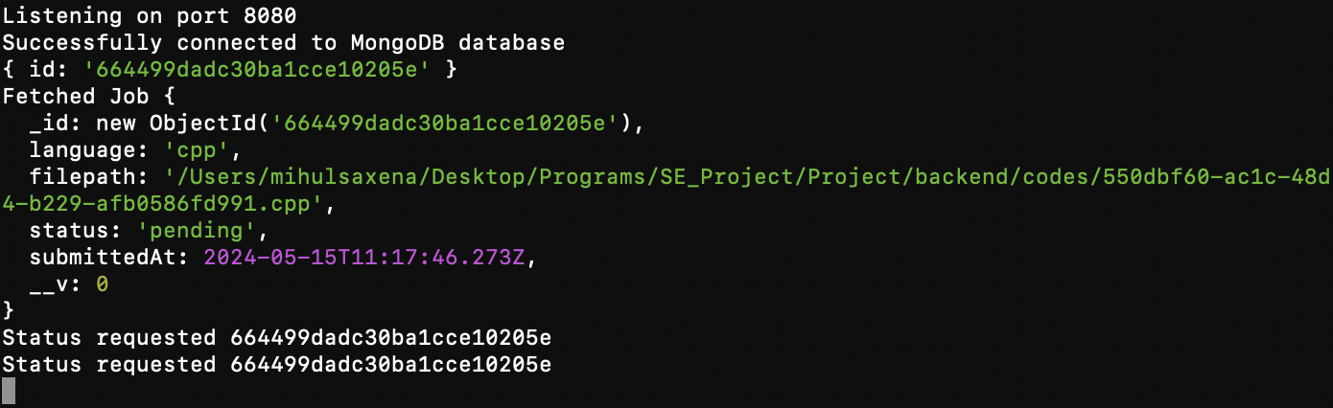
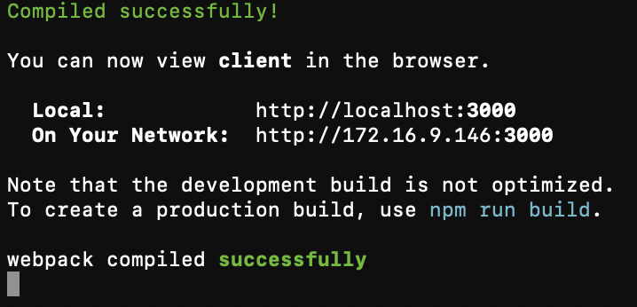
terminals
Backend Server at port:8080
Frontend Server at port:3000

Slide 7
Result
The Online Code Compiler project has successfully delivered a fully functional and user-friendly online coding environment, enabling users to write, compile, and execute code in real-time. This section presents the results of the project implementation, including screenshots, performance metrics, and user feedback collected during testing and evaluation.
The frontend of the application provides an intuitive interface for selecting programming languages, writing code in the provided editor, and submitting code for execution. Real-time status updates are displayed to users, including job ID, execution time, and output, enhancing the user experience and workflow efficiency.
The backend of the application efficiently handles code compilation and execution tasks, utilizing job queues and asynchronous processing to ensure optimal performance and scalability. The integration with MongoDB enables seamless storage and retrieval of job details, while Bull.js provides robust job queue management capabilities, ensuring reliable execution of code jobs.

Slide 9
Conclusion and Future Work
In conclusion, the Online Code Compiler project demonstrates the feasibility and effectiveness of building a modern and versatile online coding environment using contemporary web technologies and best practices in software engineering. The application offers a range of features and functionalities tailored to the needs of developers, students, and educators, providing a valuable resource for code development, testing, and collaboration.
Looking ahead, there are several opportunities for future enhancements and improvements to further enhance the functionality, usability, and performance of the Online Code Compiler. This section outlines potential areas for future work, including support for additional programming languages, integration with external APIs and services, and optimization of code execution and resource utilization.

Slide 10
References
React.js Documentation: https://react.dev/learn
Node.js Documentation: https://nodejs.org/en
Express.js Documentation: https://expressjs.com/
MongoDB Documentation: https://docs.mongodb.com/
Bull.js Documentation: https://optimalbits.github.io/bull/
Axios Documentation: https://optimalbits.github.io/bull/
React Ace Documentation: https://www.npmjs.com/package/react-ace
YouTube: https://youtu.be/RZ66yGyEKFg?si=Hid4M0lZccOmIqDi
YouTube: https://youtu.be/6tB7diwHZYQ?si=rJsM-2qRRgLD9hOV

Slide 11
THANK you

