Slide 1

Sentiment Indicators in Financial Time Series Analysis
Michael Langeder
Bernadett Neuhauser
Johannes Voraberger
https://github.com/miicchhii/fhtw-bdeng-project

Slide 2
Agenda
01 | Dataflow | 03 | Sentiment Analysis using FinBERT | 05
Motivation | 02 | Data Transformation | 04 | Results

Slide 3
Motivation
BDINF
Lack of Transparency in Alpha Vantage‘s Sentiment scoring
Desire for Full Control over data pipeline
Reproducibility for Academic Use
BEDENG

Slide 4
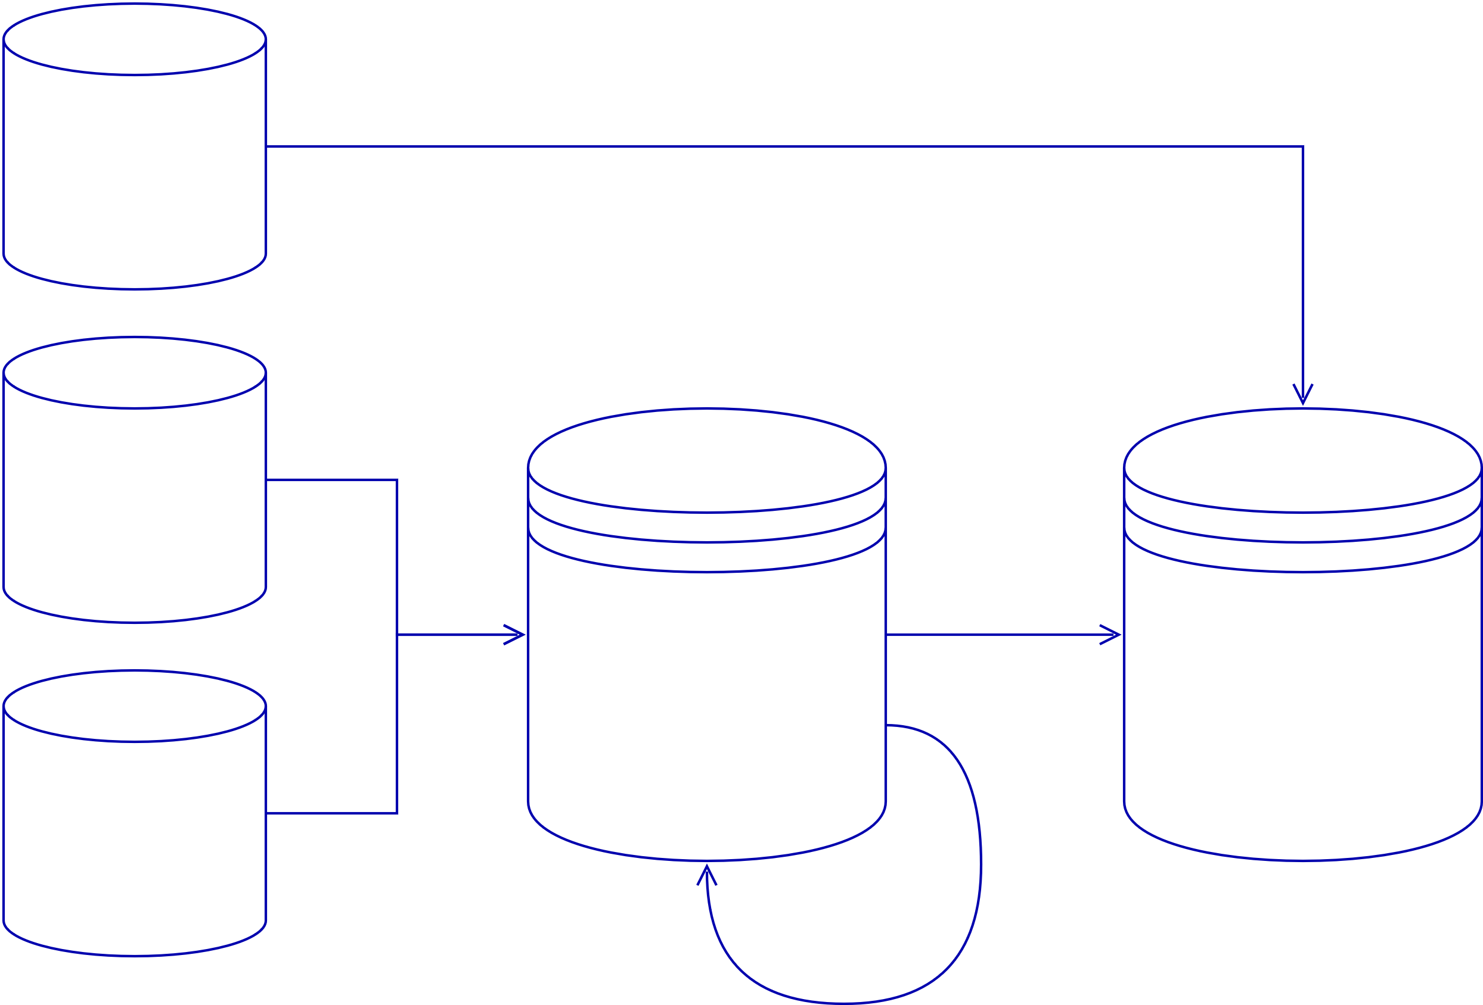










Dataflow

Slide 5
Transforming Scraped Articles
retrieve metadata | scraping | parsing | sentiment analysis | sentiment aggregation
use Alpha Vantage API to retrieve article metadata. | Extract URLs pointing to Zacks, Benzinga, and Motley Fool. scrape full HTML content of each article for analysis Save results to MinIO | Extract publishing date and article body from HTML process data using Spark. Save results to MinIO | a Kafka Producer pushes article data to the topic. a FinBERT Client listens to the topic and runs sentiment analysis per article | Group articles by publishing date and calculate average sentiment score per day using Spark. Sace results to InfluxDB

Slide 6

Sentiment Scoring using Finbert
pre-trained NLP model specialized in financial sentiment
Built on BERT, fine-tuned with Financial PhraseBank
Classifies sentiment as:
Positive (1)
Neutral (0)
Negative (-1)

Slide 7
Comparison of SentimentscorS

