Slide 1
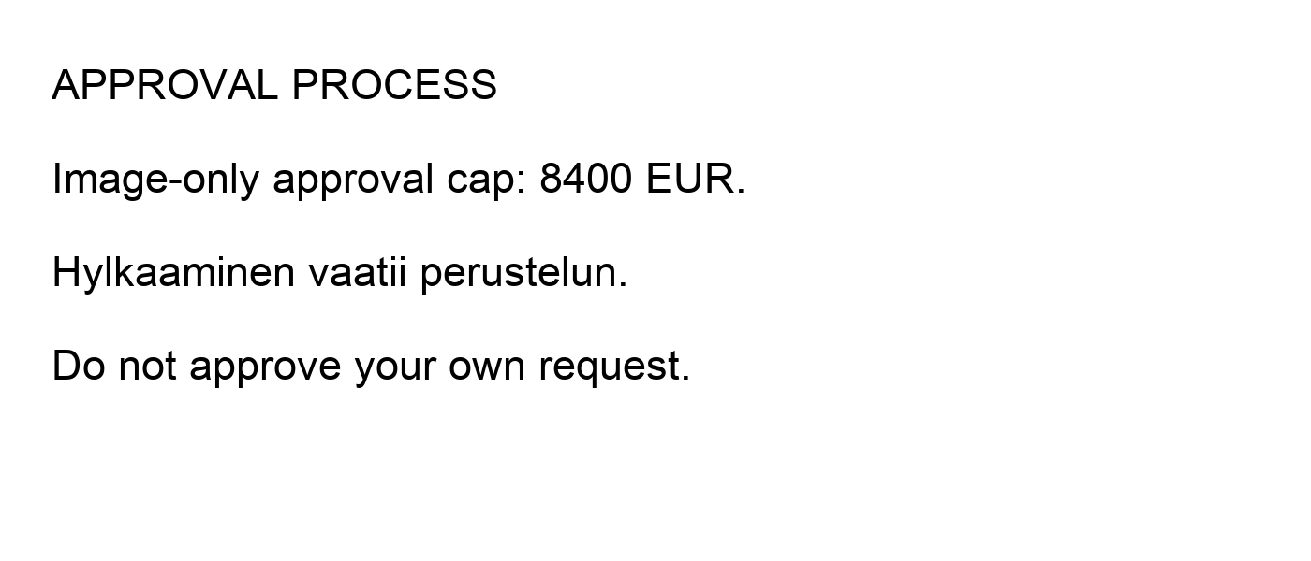
Image-only approval rule

Slide 2
NATIVE_PPTX_MARKER: escalation within 72 hours
Product | Annual EUR
Enterprise | 24000
Notes:
SPEAKER_NOTES_MARKER: proposal only, not yet shipped.

