Slide 1



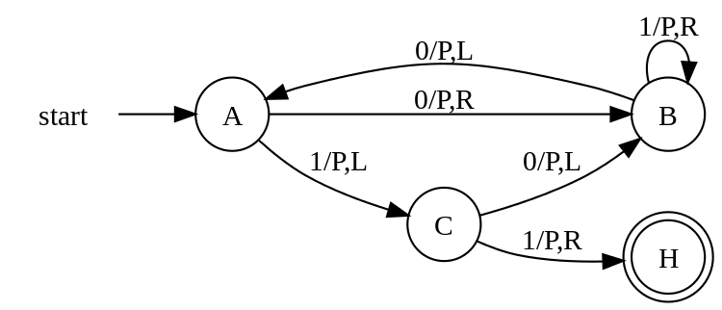
Digital Logic Design and Application
Topic 1 - Introduction
Yan Bo
School of Information & Communication Engineering, UESTC
Email: yanboyu@uestc.edu.cn

Slide 2



QQ Group

Slide 3
Topic1： Introduction
Why to do
What to do
How to do
Digital world
Info. for Course
Organization of CPU
Mathematic Foundations
EDA technology
Technology Related
Architecture of computer

Slide 4
Topic1： Introduction
Why to do
What to do
How to do
Digital world
Info. for Course
Organization of CPU
Mathematic Foundations
EDA technology
Technology Related
Architecture of computer

Slide 5
Topic1： Introduction
Why to do
What to do
How to do
Digital world
Info. for Course
Organization of CPU
Mathematic Foundations
EDA technology
Technology Related
Architecture of computer

Slide 6
What are you thinking about ？
Digital circuit, Logic circuit
Digital system, Logic system

Slide 7
What are you thinking about ？
Digital circuit, Logic circuit
Digital system, Logic system
Computer
Embedded Computer System
Embedded System

Slide 8
What are you thinking about ？
Digital circuit, Logic circuit
Digital system, Logic system
Computer
Embedded Computer System
Embedded System
Smart Device
Unmanned…
Auto…
AI…

Slide 9
The digital systems in a normal car

Slide 10
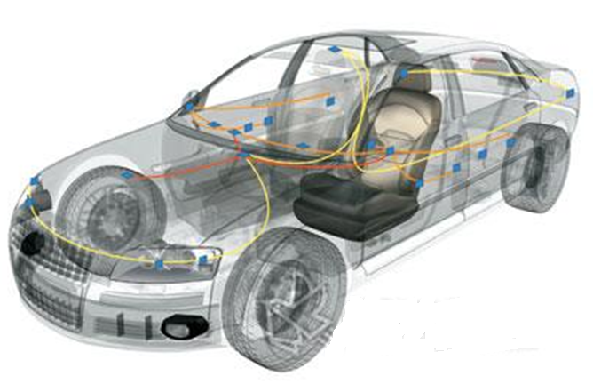
The digital systems in a normal car

Slide 11
The digital systems in a normal car
Windows

Slide 12
The digital systems in a normal car
Windows
Door locks

Slide 13
The digital systems in a normal car
Windows
GPS
Door locks

Slide 14
The digital systems in a normal car
Windows
GPS
Lights
Door locks

Slide 15
The digital systems in a normal car
Windows
GPS
Lights
Door locks
Anti-Brake

Slide 16
The digital systems in a normal car
Windows
GPS
Lights
Door locks
Centre controller
Anti-Brake

Slide 17
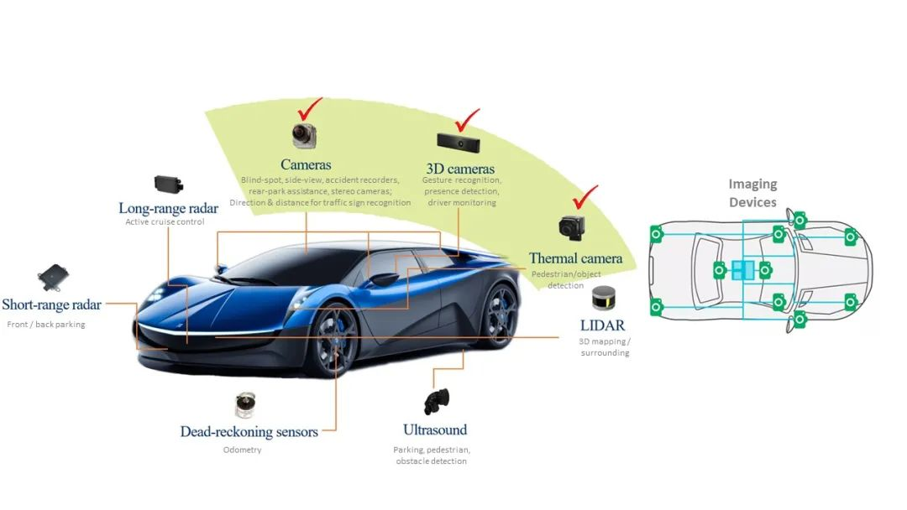
More digital systems in a self-driving car
Notes:
ded ˈrekənɪŋ/ 航位推算
navigation system 导航系统

Slide 18
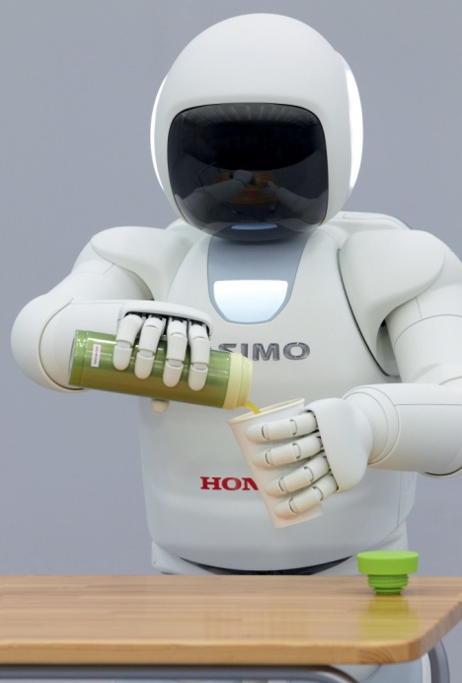
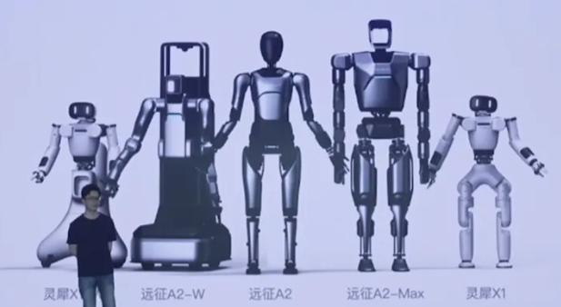
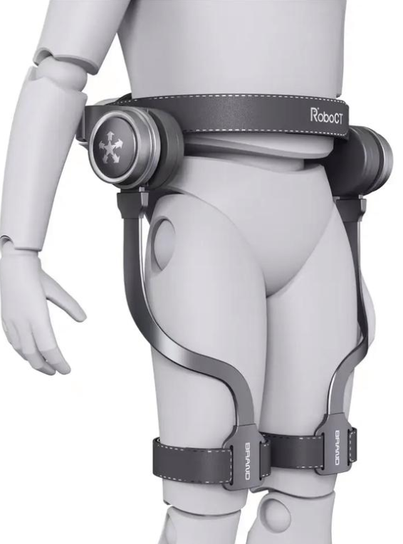
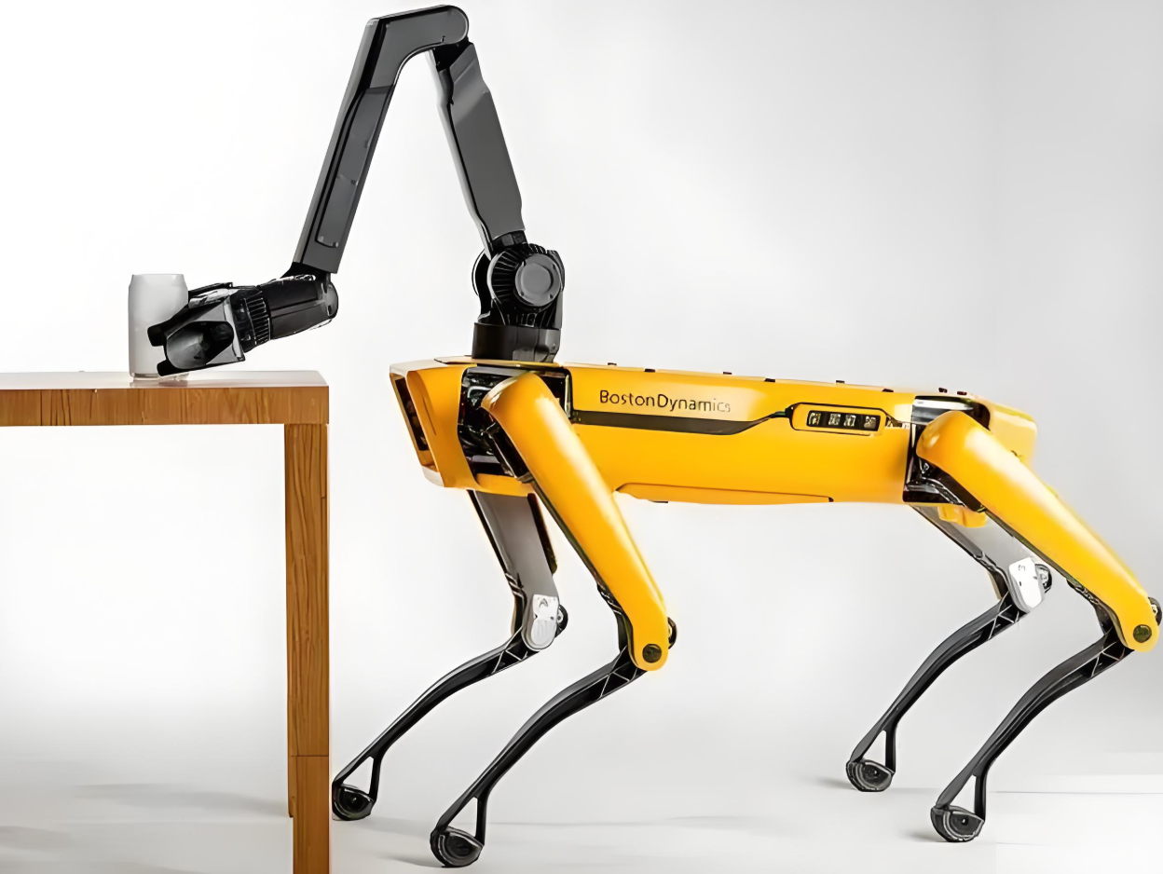
Digital systems are everywhere
Notes:
Exoskeleton robot
autonomous cart
unmanned vehicle
unmanned aerial vehicle (UAV)
unmanned drone
These objects all contain multiple computers inside.

Slide 19
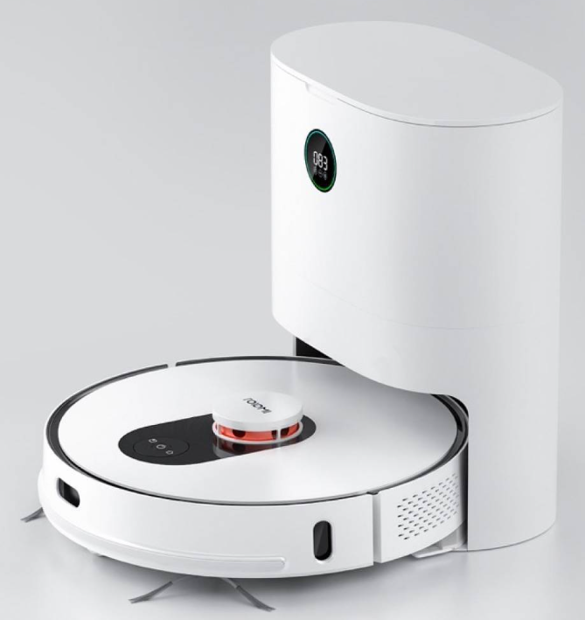
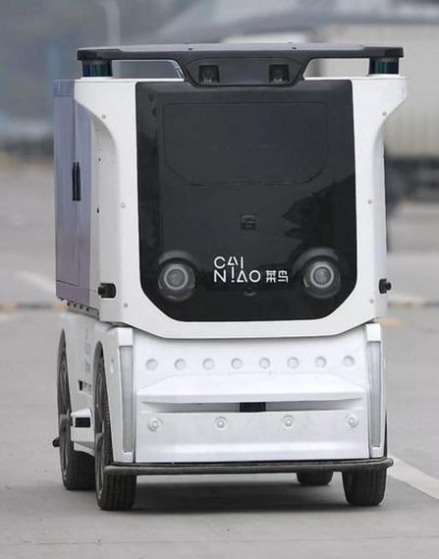
Digital systems are everywhere
Notes:
Exoskeleton robot
autonomous cart
unmanned vehicle
unmanned aerial vehicle (UAV)
unmanned drone
These objects all contain multiple computers inside.

Slide 20
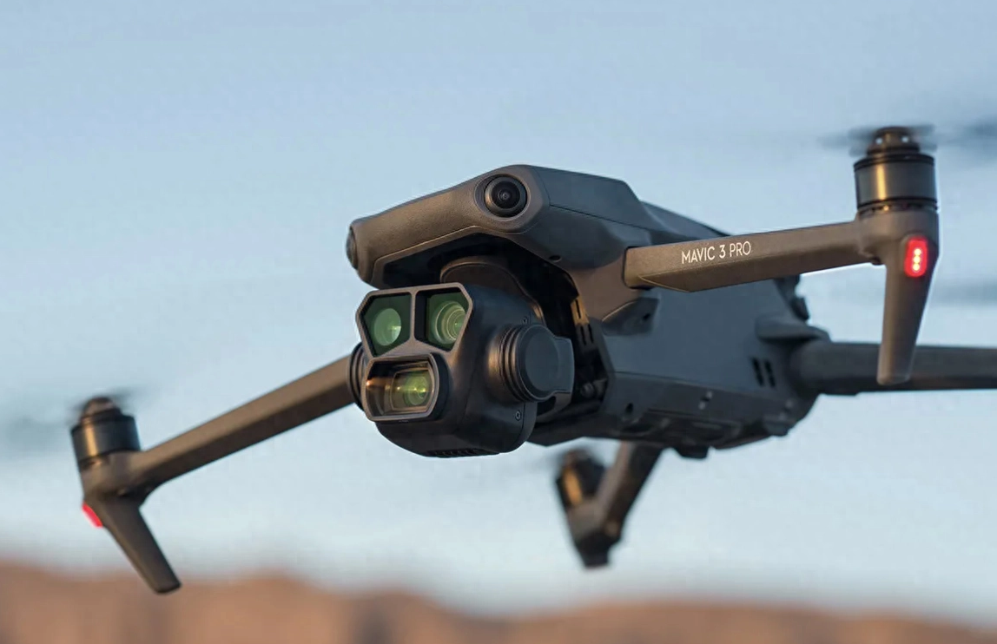

Digital systems are everywhere
Notes:
Exoskeleton robot
autonomous cart
unmanned vehicle
unmanned aerial vehicle (UAV)
unmanned drone
These objects all contain multiple computers inside.

Slide 21
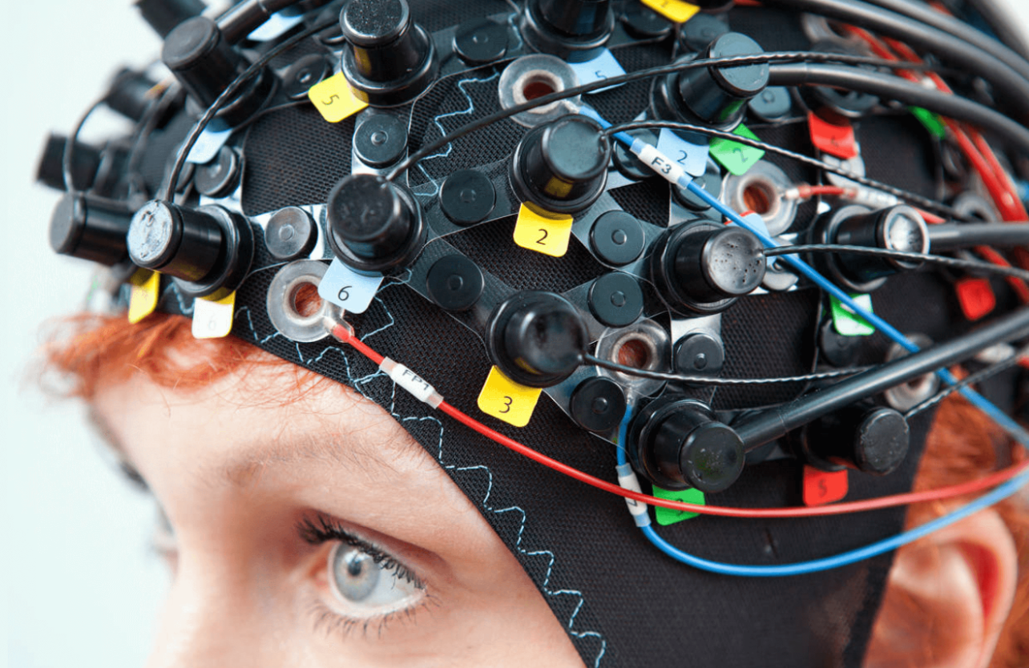
Digital systems are everywhere
Notes:
Exoskeleton robot
autonomous cart
unmanned vehicle
unmanned aerial vehicle (UAV)
unmanned drone
These objects all contain multiple computers inside.

Slide 22
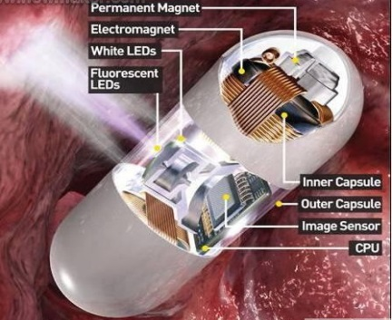
Digital systems are everywhere
Notes:
Exoskeleton robot
autonomous cart
unmanned vehicle
unmanned aerial vehicle (UAV)
unmanned drone
These objects all contain multiple computers inside.

Slide 23
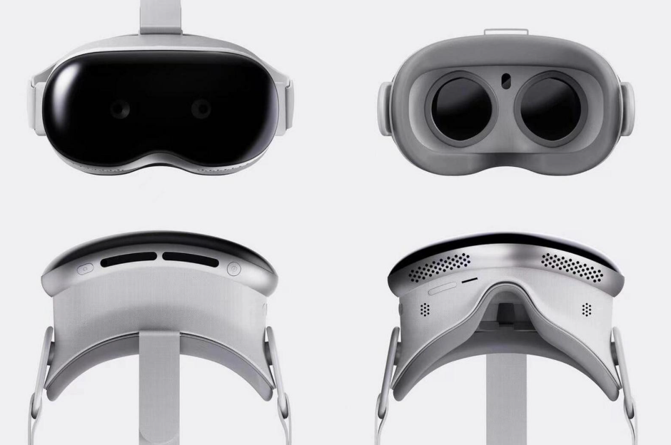
Digital systems are everywhere
Notes:
Exoskeleton robot
autonomous cart
unmanned vehicle
unmanned aerial vehicle (UAV)
unmanned drone
These objects all contain multiple computers inside.

Slide 24
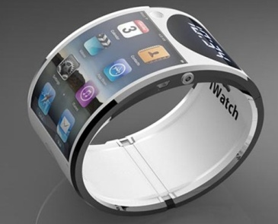
Digital systems are everywhere
Notes:
Exoskeleton robot
autonomous cart
unmanned vehicle
unmanned aerial vehicle (UAV)
unmanned drone
These objects all contain multiple computers inside.

Slide 25
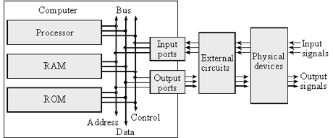
the computer world and the real world
2026-08-30
24

Slide 26
the computer world and the real world
Real World
Computer World
2026-08-30
25

Slide 27
the computer world and the real world
Real World
Digital
Computer World
2026-08-30
26

Slide 28
the computer world and the real world
Analogue
Real World
Digital
Computer World
2026-08-30
27

Slide 29
the computer world and the real world
Sound
Light
Smell
Temperature
Pressure
…….
Analogue
Real World
Digital
Computer World
2026-08-30
28

Slide 30
the computer world and the real world
Sound
Light
Smell
Temperature
Pressure
…….
Digital Signal
Analogue
Real World
Digital
Computer World
2026-08-30
29

Slide 31
the computer world and the real world
Sound
Light
Smell
Temperature
Pressure
…….
Digital Signal
Analogue
Real World
Digital
Computer World
2026-08-30
30

Slide 32
the computer world and the real world
Sound
Light
Smell
Temperature
Pressure
…….
Digital Signal
ADC(Sensors)
Analogue
Real World
Digital
Computer World
2026-08-30
31

Slide 33
the computer world and the real world
Sound
Light
Smell
Temperature
Pressure
…….
Digital Signal
ADC(Sensors)
DAC(Actuator)
Analogue
Real World
Digital
Computer World
2026-08-30
32

Slide 34
the computer world and the real world
Sound
Light
Smell
Temperature
Pressure
…….
Digital Signal
ADC(Sensors)
DAC(Actuator)
CPU
Analogue
Real World
Digital
Computer World
2026-08-30
33

Slide 35
the computer world and the real world
Sound
Light
Smell
Temperature
Pressure
…….
Digital Signal
ADC(Sensors)
DAC(Actuator)
CPU
MEM
Analogue
Real World
Digital
Computer World
2026-08-30
34

Slide 36
the computer world and the real world
Sound
Light
Smell
Temperature
Pressure
…….
Digital Signal
ADC(Sensors)
DAC(Actuator)
I/O
CPU
MEM
Analogue
Real World
Digital
Computer World
2026-08-30
35

Slide 37
the computer world and the real world
Sound
Light
Smell
Temperature
Pressure
…….
Digital Signal
ADC(Sensors)
DAC(Actuator)
I/O
CPU
MEM
Analogue
Real World
Digital
Computer World
2026-08-30
36
Notes:
The most common actuator is a motor

Slide 38
Topic1： Introduction
Why to do
What to do
How to do
Digital world
Info. for Course
Organization of CPU
Mathematic Foundations
EDA technology
Technology Related
Architecture of computer

Slide 39
Development of Information Process

Slide 40
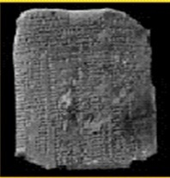
Development of Information Process
Stone

Slide 41

Development of Information Process
Stone
Abacus

Slide 42
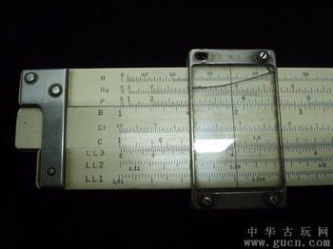
Development of Information Process
Stone
Abacus
Slide Rule

Slide 43
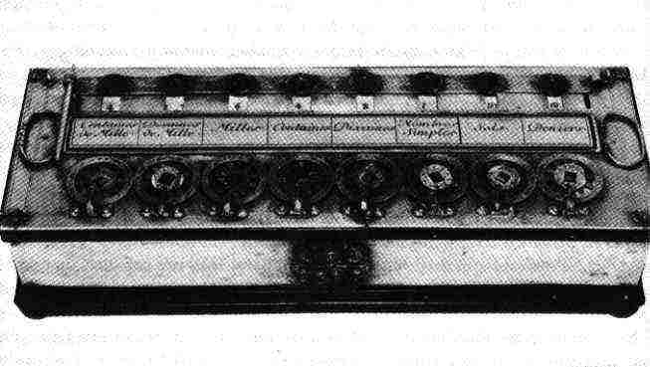
Development of Information Process
Stone
Abacus
Slide Rule
1st Mechanical Calculator (1642)

Slide 44
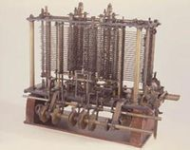
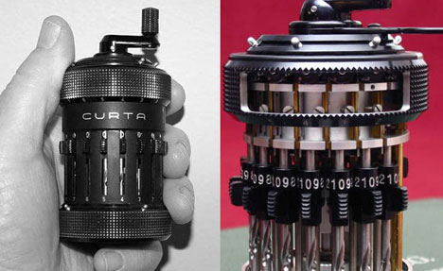
Development of Information Process
Stone
Abacus
Slide Rule
1st Mechanical Calculator (1642)
Improved Mechanical Calculator

Slide 45
Development of the Electromagnetic Tech.

Slide 46

Development of the Electromagnetic Tech.
Thunder

Slide 47
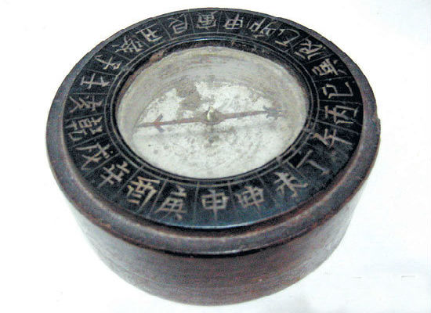
Development of the Electromagnetic Tech.
Thunder
Compass

Slide 48
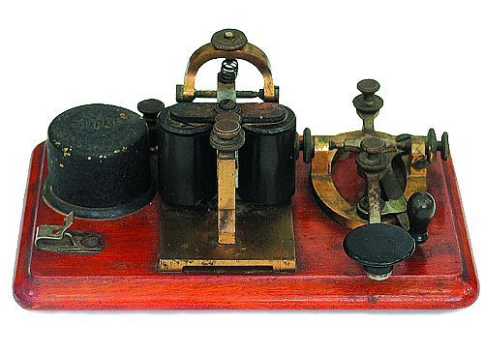
Development of the Electromagnetic Tech.
Thunder
Compass
1st Morse telegraph(1837)

Slide 49
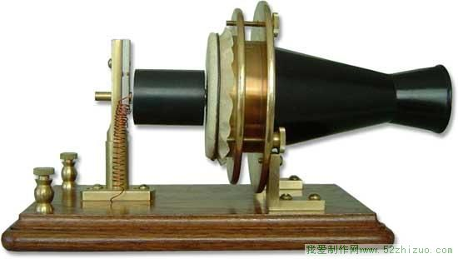
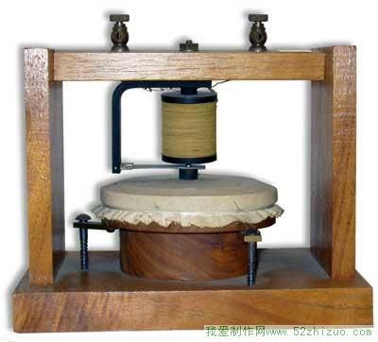
Development of the Electromagnetic Tech.
Thunder
Compass
1st Morse telegraph(1837)
1st Bell telephone
(1876)

Slide 50
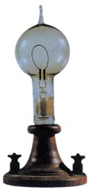
Development of the Electromagnetic Tech.
Thunder
Compass
1st Morse telegraph(1837)
1st Bell telephone
(1876)
1st Light Bulb
(1880)

Slide 51


Development of the Electromagnetic Tech.
Thunder
Compass
1st Morse telegraph(1837)
1st Bell telephone
(1876)
1st Light Bulb
(1880)
1st Vacuum
Diode (1904)
1st Vacuum
Triode (1907)

Slide 52
Information Process Meet Electronic Tech.

Slide 53
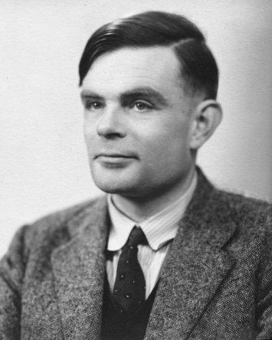
Information Process Meet Electronic Tech.

Slide 54
Information Process Meet Electronic Tech.
Alan M. Turing
(1912-1954）
Father of
Artificial Intelligence

Slide 55
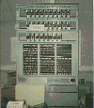
Information Process Meet Electronic Tech.
Turing Bombe（1940）
Alan M. Turing
(1912-1954）
Father of
Artificial Intelligence

Slide 56
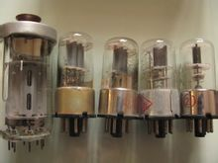
Information Process Meet Electronic Tech.
Vacuum tube (triode)
Turing Bombe（1940）
Alan M. Turing
(1912-1954）
Father of
Artificial Intelligence

Slide 57

Information Process Meet Electronic Tech.
Vacuum tube (triode)
Turing Bombe（1940）
Alan M. Turing
(1912-1954）
Father of
Artificial Intelligence

Slide 58
Information Process Meet Electronic Tech.
Vacuum tube (triode)
Turing Bombe（1940）
Alan M. Turing
(1912-1954）
Father of
Artificial Intelligence
Claude E. Shannon
(1916-2001)
Father of
Information Theory

Slide 59

Information Process Meet Electronic Tech.
Vacuum tube (triode)
Turing Bombe（1940）
Theoretical basis of digital world
(1938)
Alan M. Turing
(1912-1954）
Father of
Artificial Intelligence
Claude E. Shannon
(1916-2001)
Father of
Information Theory

Slide 60
Information Process Meet Microelectronic Tech.

Slide 61

Information Process Meet Microelectronic Tech.
Vacuum tube (triode)

Slide 62
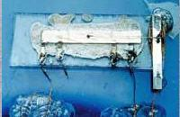
Information Process Meet Microelectronic Tech.
1st Integrated Circuit
By TI Corporation
（1958）
Solid-state circuit
Vacuum tube (triode)

Slide 63
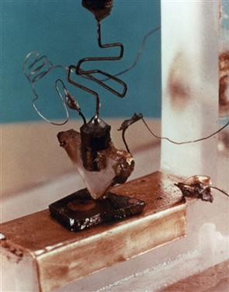
Information Process Meet Microelectronic Tech.
1st Integrated Circuit
By TI Corporation
（1958）
Solid-state circuit
Vacuum tube (triode)
1st Transistor
by Bell Laboratory (1947)

Slide 64
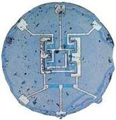
Information Process Meet Microelectronic Tech.
1st Integrated Circuit
By TI Corporation
（1958）
Solid-state circuit
Vacuum tube (triode)
1st Transistor
by Bell Laboratory (1947)
1st planar Integrated Circuit
by Fairchild Semiconductor （1960）

Slide 65
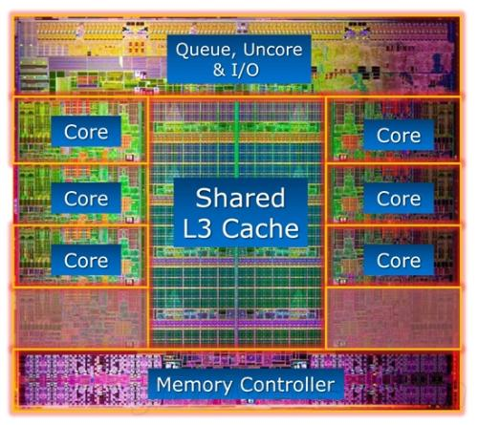
Information Process Meet Microelectronic Tech.
1st Integrated Circuit
By TI Corporation
（1958）
Solid-state circuit
Vacuum tube (triode)
1st Transistor
by Bell Laboratory (1947)
1st planar Integrated Circuit
by Fairchild Semiconductor （1960）
Modern CPU chip

Slide 66
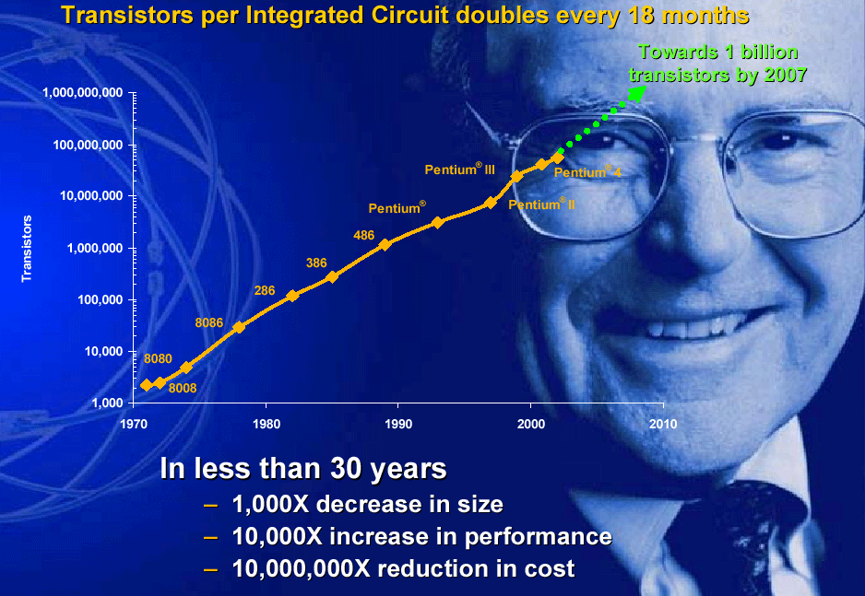
Development of Semiconductor Tech.
65

Slide 67
Development of Semiconductor Tech.
Transistors per Integrated Circuit doubles every 18 months.
---Gooden Moore, 1965
66

Slide 68
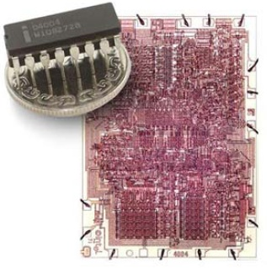
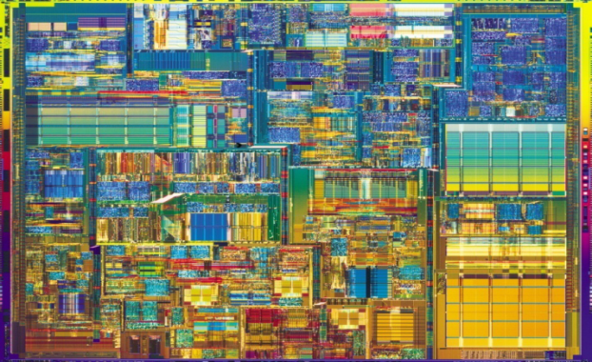
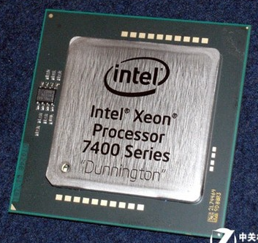
Development of Semiconductor Tech.
Pentium 4 Xeon （2000）
42 million transistors
Xeon（2008）
1900 million transistors
4004（1971）
2300 transistors
Transistors per Integrated Circuit doubles every 18 months.
---Gooden Moore, 1965
67

Slide 69
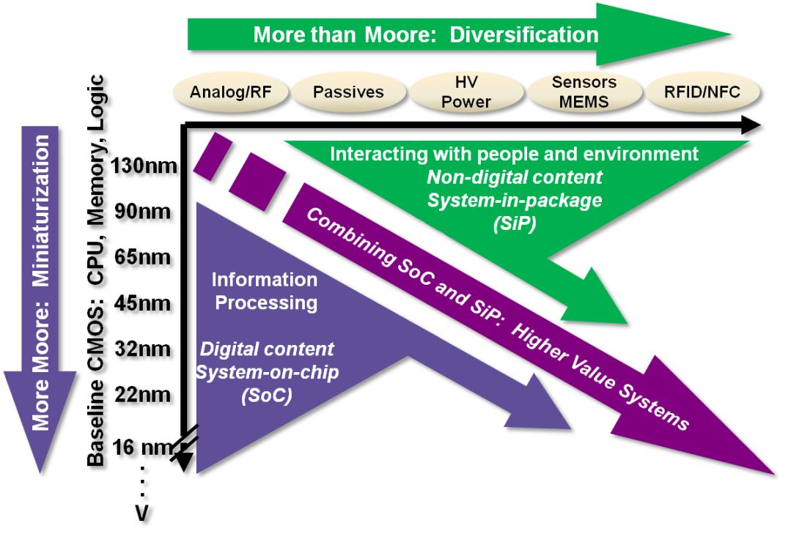
More Than Moore & Beyond Moore

Slide 70
More Than Moore & Beyond Moore
More Moore: Scaling as per Moore’s law.

Slide 71
More Than Moore & Beyond Moore
More Moore: Scaling as per Moore’s law.
More than Moore: Functional Diversification, Application driven components

Slide 72
More Than Moore & Beyond Moore
More Moore: Scaling as per Moore’s law.
More than Moore: Functional Diversification, Application driven components
Beyond Moore: Beyond CMOS

Slide 73
Topic1： Introduction
Why to do
What to do
How to do
Digital world
Info. for Course
Organization of CPU
Mathematic Foundations
EDA technology
Technology Related
Architecture of computer

Slide 74
Topic1： Introduction
Why to do
What to do
How to do
Digital world
Info. for Course
Organization of CPU
Mathematic Foundations
EDA technology
Technology Related
Architecture of computer

Slide 75
The overall plan of the whole course
Central Process Unit
TEST
Datapath
(ALU, MUX…)
Controller
(State Machine)
Combinational Circuit
Sequential
Circuit
Gates
Boolean Algebra
Notes:
This is the big picture for the whole course
This is the overall plan of the whole course

Slide 76
The overall plan of the whole course
Central Process Unit
TEST
Datapath
(ALU, MUX…)
Controller
(State Machine)
Combinational Circuit
Sequential
Circuit
Gates
1.Basic gates
2.Mninal complete set
3.Analogy feature:noise margin,fan in/out
Boolean Algebra
1.Notation of number, base conversion
2. Laws of Boolean algebra
Notes:
We’ll start with Boolean algebra and basic gates

Slide 77
The overall plan of the whole course
Central Process Unit
TEST
Datapath
(ALU, MUX…)
Controller
(State Machine)
STG, State transition/Output table
Design for Sequential Circuit
  F/F＋Combinational circuit
  On-shelf chips: shift register, counter
  HDL & EDA
Analysis for Sequetial Circuit
Analogy feature：
key path，setup time, hold time
Combinational Circuit
Sequential
Circuit
Truth table, K-map, logic expression
Design for Combinational circuit
  Gates
  On-shelf chip: Decoder, MUX
  HDL & EDA
Analysis for Combination Circuit
Analogy feature: hazard
Gates
1.Basic gates
2.Mninal complete set
3.Analogy feature:noise margin,fan in/out
Boolean Algebra
1.Notation of number, base conversion
2. Laws of Boolean algebra
Notes:
Then we’ll discuss how to analysis and design the simple combinational circuit modules and sequential circuit modules

Slide 78
The overall plan of the whole course
Specification： define ISA
Top-design：
  Port
  Datapath＋Controller＋Interconnect
Submodule-design according to ISA
Testbench, performance assessment
Central Process Unit
TEST
Datapath
(ALU, MUX…)
Controller
(State Machine)
STG, State transition/Output table
Design for Sequential Circuit
  F/F＋Combinational circuit
  On-shelf chips: shift register, counter
  HDL & EDA
Analysis for Sequetial Circuit
Analogy feature：
key path，setup time, hold time
Combinational Circuit
Sequential
Circuit
Truth table, K-map, logic expression
Design for Combinational circuit
  Gates
  On-shelf chip: Decoder, MUX
  HDL & EDA
Analysis for Combination Circuit
Analogy feature: hazard
Gates
1.Basic gates
2.Mninal complete set
3.Analogy feature:noise margin,fan in/out
Boolean Algebra
1.Notation of number, base conversion
2. Laws of Boolean algebra

Slide 79
From Boolean Algebra to CPU
Central Process Unit
规格定义： 指令集ISA
顶层设计：
  Port，
  Datapath＋Controller＋Interconnect
子模块设计：根据ISA分别设计
设计验证：testbench设计，性能评估
TEST
Datapath
(ALU, MUX…)
Controller
(State Machine)
Sequential
Circuit
基本描述方法：STG, 状态转移/输出表
时序电路设计方法
  用DFF＋组合电路实现
  用已有模块搭建：移位寄存器，计数器
  HDL语言描述，综合
时序电路分析方法
电路模拟特性：关键路径, 建立/保持时间
Combinational Circuit
基本描述方法：真值表，K图，逻辑式
组合电路设计方法
  用门电路实现
  用已有模块搭建：级联，译码器，复用器
  HDL语言描述，综合
组合电路分析方法
电路模拟特性：竞争冒险
Gates
1.基本门；
2.最小完全集：电路形式的变换；
3.门的模拟特性：噪声容限，扇入，扇出
Boolean Algebra
1.数的表示法，不同进制之间的转换；
2.布尔代数的公理、常用定理；

Slide 80
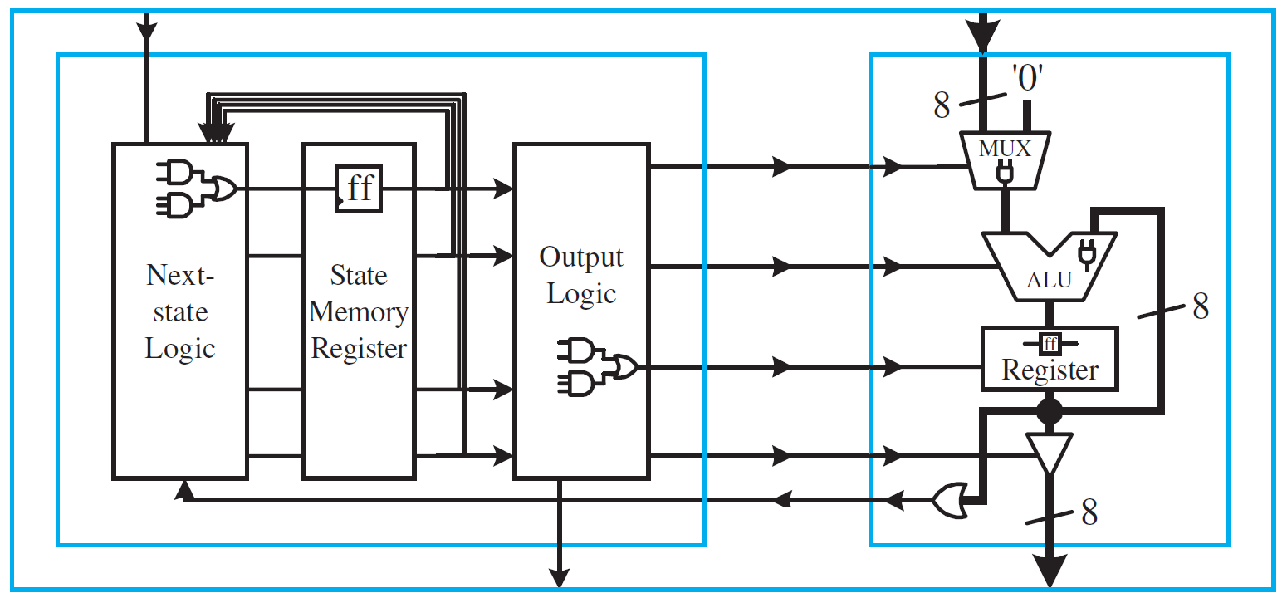
Organization of Center Processor Unit
Control Inputs
(Instruction)
Data Inputs
Controller
Datapath
Control Signals
Status Signals
Control Outputs
Data Outputs
2026-08-30

Slide 81
Schedule for Teaching & Learning
Every lecture and lab is last for 3 hours
Team up as you want: 5 persons/team
Totally we have 6 presentations
For every team & every presentation
  10min. for presentation
  10min. for discussion
Grading
  Homework (Set Exercise) 5%
  Project 20%
  Output 10%
  Presentation 5%
  Report 5%
  Final Exam (Written Exam) 75%

Slide 82
Schedule for Teaching & Learning
Every lecture and lab is last for 3 hours
Team up as you want: 3-5 persons/team
Totally we have 5 presentations
For every team & every presentation
  10min. for presentation
  10min. for discussion
Grading
  Homework (Set Exercise) 5%
  Project 20%
  Output 10%
  Presentation 5%
  Report 5%
  Final Exam (Written Exam) 75%

Slide 83
Schedule for Teaching & Learning
 | Main Task | 19:00~ 22:00
Lecture 01
Lecture 02 | Design of Dataflow (Team Presentation & Discussion)
Lecture 03 | Design of Datapath & Controller (Team Presentation & Discussion)
Lecture 04 | Verification of Datapath & Controller (Team Presentation & Discussion)
Lecture05
Lecture 06 | Integration & Verification of RISC CPU (Team Presentation & Discussion)
Lecture 07
Lecture 08
Lecture 09
Lecture 10 | RoadShow (Team Presentation & Discussion)
Lecture 11
Every lecture and lab is last for 3 hours
Team up as you want: 5 persons/team
Totally we have 5 presentations
For every team & every presentation
  10min. for presentation
  10min. for discussion
Grading
  Homework (Set Exercise) 5%
  Project 20%
  Output 10%
  Presentation 5%
  Report 5%
  Final Exam (Written Exam) 75%

Slide 84
Schedule for Teaching & Learning
 | Main Task | 19:00~ 22:00
Lecture 01
Lecture 02 | Design of Dataflow (Team Presentation & Discussion)
Lecture 03 | Design of Datapath & Controller (Team Presentation & Discussion)
Lecture 04 | Verification of Datapath & Controller (Team Presentation & Discussion)
Lecture05
Lecture 06 | Integration & Verification of RISC CPU (Team Presentation & Discussion)
Lecture 07 |  | Lab1
Lecture 08 |  | Lab2
Lecture 09 |  | Lab3
Lecture 10 | RoadShow (Team Presentation & Discussion) | Lab4
Lecture 11 |  | Lab5
Every lecture and lab is last for 3 hours
Team up as you want: 5 persons/team
Totally we have 5 presentations
For every team & every presentation
  10min. for presentation
  10min. for discussion
Grading
  Homework (Set Exercise) 5%
  Project 20%
  Output 10%
  Presentation 5%
  Report 5%
  Final Exam (Written Exam) 75%

Slide 85
Schedule for Teaching & Learning
 | Main Task | 19:00~ 22:00
Lecture 01 | Introduction
Lecture 02 | Design of Dataflow (Team Presentation & Discussion)
Lecture 03 | Design of Datapath & Controller (Team Presentation & Discussion)
Lecture 04 | Verification of Datapath & Controller (Team Presentation & Discussion)
Lecture05
Lecture 06 | Integration & Verification of RISC CPU (Team Presentation & Discussion)
Lecture 07 |  | Lab1
Lecture 08 |  | Lab2
Lecture 09 |  | Lab3
Lecture 10 | RoadShow (Team Presentation & Discussion) | Lab4
Lecture 11 |  | Lab5
Every lecture and lab is last for 3 hours
Team up as you want: 5 persons/team
Totally we have 5 presentations
For every team & every presentation
  10min. for presentation
  10min. for discussion
Grading
  Homework (Set Exercise) 5%
  Project 20%
  Output 10%
  Presentation 5%
  Report 5%
  Final Exam (Written Exam) 75%

Slide 86
Schedule for Teaching & Learning
 | Main Task | 19:00~ 22:00
Lecture 01 | Introduction
Lecture 02 | Design of Dataflow (Team Presentation & Discussion)
Lecture 03 | Design of Datapath & Controller (Team Presentation & Discussion)
Lecture 04 | Verification of Datapath & Controller (Team Presentation & Discussion)
Lecture05 | Design & Document
Lecture 06 | Integration & Verification of RISC CPU (Team Presentation & Discussion)
Lecture 07 |  | Lab1
Lecture 08 |  | Lab2
Lecture 09 |  | Lab3
Lecture 10 | RoadShow (Team Presentation & Discussion) | Lab4
Lecture 11 |  | Lab5
Every lecture and lab is last for 3 hours
Team up as you want: 5 persons/team
Totally we have 5 presentations
For every team & every presentation
  10min. for presentation
  10min. for discussion
Grading
  Homework (Set Exercise) 5%
  Project 20%
  Output 10%
  Presentation 5%
  Report 5%
  Final Exam (Written Exam) 75%

Slide 87
Schedule for Teaching & Learning
 | Main Task | 19:00~ 22:00
Lecture 01 | Introduction
Lecture 02 | Design of Dataflow (Team Presentation & Discussion)
Lecture 03 | Design of Datapath & Controller (Team Presentation & Discussion)
Lecture 04 | Verification of Datapath & Controller (Team Presentation & Discussion)
Lecture05 | Design & Document
Lecture 06 | Integration & Verification of RISC CPU (Team Presentation & Discussion)
Lecture 07 | Others about the Combinational Circuit | Lab1
Lecture 08 | Others about the Combinational Circuit | Lab2
Lecture 09 | Others about the Sequential Circuit | Lab3
Lecture 10 | RoadShow (Team Presentation & Discussion) | Lab4
Lecture 11 |  | Lab5
Every lecture and lab is last for 3 hours
Team up as you want: 5 persons/team
Totally we have 5 presentations
For every team & every presentation
  10min. for presentation
  10min. for discussion
Grading
  Homework (Set Exercise) 5%
  Project 20%
  Output 10%
  Presentation 5%
  Report 5%
  Final Exam (Written Exam) 75%

Slide 88
Schedule for Teaching & Learning
 | Main Task | 19:00~ 22:00
Lecture 01 | Introduction
Lecture 02 | Design of Dataflow (Team Presentation & Discussion)
Lecture 03 | Design of Datapath & Controller (Team Presentation & Discussion)
Lecture 04 | Verification of Datapath & Controller (Team Presentation & Discussion)
Lecture05 | Design & Document
Lecture 06 | Integration & Verification of RISC CPU (Team Presentation & Discussion)
Lecture 07 | Others about the Combinational Circuit | Lab1
Lecture 08 | Others about the Combinational Circuit | Lab2
Lecture 09 | Others about the Sequential Circuit | Lab3
Lecture 10 | RoadShow (Team Presentation & Discussion) | Lab4
Lecture 11 | Course Review | Lab5
Every lecture and lab is last for 3 hours
Team up as you want: 5 persons/team
Totally we have 5 presentations
For every team & every presentation
  10min. for presentation
  10min. for discussion
Grading
  Homework (Set Exercise) 5%
  Project 20%
  Output 10%
  Presentation 5%
  Report 5%
  Final Exam (Written Exam) 75%

Slide 89
Schedule for Teaching & Learning
 | Main Task | 19:00~ 22:00
Lecture 01 | Introduction
Lecture 02 | Design of Dataflow (Team Presentation & Discussion)
Lecture 03 | Design of Datapath & Controller (Team Presentation & Discussion)
Lecture 04 | Verification of Datapath & Controller (Team Presentation & Discussion)
Lecture05 | Design & Document
Lecture 06 | Integration & Verification of RISC CPU (Team Presentation & Discussion)
Lecture 07 | Others about the Combinational Circuit DDL for Homework 1+2: 11/10/2026, WEEK7 | Lab1
Lecture 08 | Others about the Combinational Circuit | Lab2
Lecture 09 | Others about the Sequential Circuit | Lab3
Lecture 10 | RoadShow (Team Presentation & Discussion) | Lab4
Lecture 11 | Course Review DDL for Homework 3+4+5: 15/11/2026, WEEK12 | Lab5
Every lecture and lab is last for 3 hours
Team up as you want: 5 persons/team
Totally we have 5 presentations
For every team & every presentation
  10min. for presentation
  10min. for discussion
Grading
  Homework (Set Exercise) 5%
  Project 20%
  Output 10%
  Presentation 5%
  Report 5%
  Final Exam (Written Exam) 75%

Slide 90
Schedule for Teaching & Learning
 | Main Task | 19:00~ 22:00
Lecture 01 | Introduction
Lecture 02 | Design of Dataflow (Team Presentation & Discussion)
Lecture 03 | Design of Datapath & Controller (Team Presentation & Discussion)
Lecture 04 | Verification of Datapath & Controller (Team Presentation & Discussion)
Lecture05 | Design & Document
Lecture 06 | Integration & Verification of RISC CPU (Team Presentation & Discussion)
Lecture 07 | Others about the Combinational Circuit DDL for Homework 1+2: 11/10/2026, WEEK7 | Lab1
Lecture 08 | Others about the Combinational Circuit | Lab2
Lecture 09 | Others about the Sequential Circuit | Lab3
Lecture 10 | RoadShow (Team Presentation & Discussion) DDL for Report: 13/12/2026, WEEK16 | Lab4
Lecture 11 | Course Review DDL for Homework 3+4+5: 15/11/2026, WEEK12 | Lab5
Every lecture and lab is last for 3 hours
Team up as you want: 5 persons/team
Totally we have 5 presentations
For every team & every presentation
  10min. for presentation
  10min. for discussion
Grading
  Homework (Set Exercise) 5%
  Project 20%
  Output 10%
  Presentation 5%
  Report 5%
  Final Exam (Written Exam) 75%

Slide 91
  For Project(Pres. & Disc.) 20%
Basic Instruction Set for RISC CPU
Opcode 4bit | Rd 2bit | Rs 2bit | Imme 8bit | Assembly | Function Description
0000 0001 | 01 10 | xx 01 | 00000010 xxxxxxxx | mov r1 #02 mov R2 R1 | R1<= 2 R2<=(R1)
0010 0011 | 01 01 | xx 10 | 00001000 xxxxxxxx | add r1 #08 add R1 R2 | R1<=(R1)+8 R1<=(R1)+(R2)
0101 | 01 | 10 | xxxxxxxx | sub R1 R2 | R1<=(R1)-(R2)
0111 | 01 | 10 | xxxxxxxx | and R1 R2 | R1<= (R1) bit_and (R2)
1001 | 01 | 10 | xxxxxxxx | or R1 R2 | R1<=(R1) bit_or (R2)
1010 | xx | xx | 00000001 | jump #01 | PC<= 1

Slide 92
  For Project(Pres. & Disc.) 20%
16-bit RISC CPU with:
at most 16 instructions (4-bit for Opcode )
at most 4 registers (2-bit for Rd and Rs)
Basic Instruction Set for RISC CPU
Opcode 4bit | Rd 2bit | Rs 2bit | Imme 8bit | Assembly | Function Description
0000 0001 | 01 10 | xx 01 | 00000010 xxxxxxxx | mov r1 #02 mov R2 R1 | R1<= 2 R2<=(R1)
0010 0011 | 01 01 | xx 10 | 00001000 xxxxxxxx | add r1 #08 add R1 R2 | R1<=(R1)+8 R1<=(R1)+(R2)
0101 | 01 | 10 | xxxxxxxx | sub R1 R2 | R1<=(R1)-(R2)
0111 | 01 | 10 | xxxxxxxx | and R1 R2 | R1<= (R1) bit_and (R2)
1001 | 01 | 10 | xxxxxxxx | or R1 R2 | R1<=(R1) bit_or (R2)
1010 | xx | xx | 00000001 | jump #01 | PC<= 1

Slide 93
  For Project(Pres. & Disc.) 20%
Technical level (team)
C_Level(only support basic instructions): 6’
16-bit RISC CPU with:
at most 16 instructions (4-bit for Opcode )
at most 4 registers (2-bit for Rd and Rs)
Basic Instruction Set for RISC CPU
Opcode 4bit | Rd 2bit | Rs 2bit | Imme 8bit | Assembly | Function Description
0000 0001 | 01 10 | xx 01 | 00000010 xxxxxxxx | mov r1 #02 mov R2 R1 | R1<= 2 R2<=(R1)
0010 0011 | 01 01 | xx 10 | 00001000 xxxxxxxx | add r1 #08 add R1 R2 | R1<=(R1)+8 R1<=(R1)+(R2)
0101 | 01 | 10 | xxxxxxxx | sub R1 R2 | R1<=(R1)-(R2)
0111 | 01 | 10 | xxxxxxxx | and R1 R2 | R1<= (R1) bit_and (R2)
1001 | 01 | 10 | xxxxxxxx | or R1 R2 | R1<=(R1) bit_or (R2)
1010 | xx | xx | 00000001 | jump #01 | PC<= 1

Slide 94
  For Project(Pres. & Disc.) 20%
Technical level (team)
B_Level(can run on a real FPGA): 7’ C_Level(only support basic instructions): 6’
16-bit RISC CPU with:
at most 16 instructions (4-bit for Opcode )
at most 4 registers (2-bit for Rd and Rs)
Basic Instruction Set for RISC CPU
Opcode 4bit | Rd 2bit | Rs 2bit | Imme 8bit | Assembly | Function Description
0000 0001 | 01 10 | xx 01 | 00000010 xxxxxxxx | mov r1 #02 mov R2 R1 | R1<= 2 R2<=(R1)
0010 0011 | 01 01 | xx 10 | 00001000 xxxxxxxx | add r1 #08 add R1 R2 | R1<=(R1)+8 R1<=(R1)+(R2)
0101 | 01 | 10 | xxxxxxxx | sub R1 R2 | R1<=(R1)-(R2)
0111 | 01 | 10 | xxxxxxxx | and R1 R2 | R1<= (R1) bit_and (R2)
1001 | 01 | 10 | xxxxxxxx | or R1 R2 | R1<=(R1) bit_or (R2)
1010 | xx | xx | 00000001 | jump #01 | PC<= 1

Slide 95
  For Project(Pres. & Disc.) 20%
Technical level (team)
A_Level(can support more instructions): 8’ B_Level(can run on a real FPGA): 7’ C_Level(only support basic instructions): 6’
16-bit RISC CPU with:
at most 16 instructions (4-bit for Opcode )
at most 4 registers (2-bit for Rd and Rs)
Basic Instruction Set for RISC CPU
Opcode 4bit | Rd 2bit | Rs 2bit | Imme 8bit | Assembly | Function Description
0000 0001 | 01 10 | xx 01 | 00000010 xxxxxxxx | mov r1 #02 mov R2 R1 | R1<= 2 R2<=(R1)
0010 0011 | 01 01 | xx 10 | 00001000 xxxxxxxx | add r1 #08 add R1 R2 | R1<=(R1)+8 R1<=(R1)+(R2)
0101 | 01 | 10 | xxxxxxxx | sub R1 R2 | R1<=(R1)-(R2)
0111 | 01 | 10 | xxxxxxxx | and R1 R2 | R1<= (R1) bit_and (R2)
1001 | 01 | 10 | xxxxxxxx | or R1 R2 | R1<=(R1) bit_or (R2)
1010 | xx | xx | 00000001 | jump #01 | PC<= 1

Slide 96
  For Project(Pres. & Disc.) 20%
Technical level (team)
A_Level(can support more instructions): 8’ B_Level(can run on a real FPGA): 7’ C_Level(only support basic instructions): 6’
16-bit RISC CPU with:
at most 16 instructions (4-bit for Opcode )
at most 4 registers (2-bit for Rd and Rs)
Basic Instruction Set for RISC CPU
Opcode 4bit | Rd 2bit | Rs 2bit | Imme 8bit | Assembly | Function Description
0000 0001 | 01 10 | xx 01 | 00000010 xxxxxxxx | mov r1 #02 mov R2 R1 | R1<= 2 R2<=(R1)
0010 0011 | 01 01 | xx 10 | 00001000 xxxxxxxx | add r1 #08 add R1 R2 | R1<=(R1)+8 R1<=(R1)+(R2)
0101 | 01 | 10 | xxxxxxxx | sub R1 R2 | R1<=(R1)-(R2)
0111 | 01 | 10 | xxxxxxxx | and R1 R2 | R1<= (R1) bit_and (R2)
1001 | 01 | 10 | xxxxxxxx | or R1 R2 | R1<=(R1) bit_or (R2)
1010 | xx | xx | 00000001 | jump #01 | PC<= 1
Some idea for enlarging the basic Instruction Set:
Memory access instructions
ldr, str
Conditional branch instructions
jz, jnc, …
Other data operation instructions
  xor, cmp, acc (add 1 to N)

Slide 97
  For Project(Pres. & Disc.) 20%
Technical level (team) |  |  | Workload (individual)
A_Level(can support more instructions): 8’ B_Level(can run on a real FPGA): 7’ C_Level(only support basic instructions): 6’ |  |  | Distributed by yourself Average 2’ for each people Up to 4’ for each, no negative marks
16-bit RISC CPU with:
at most 16 instructions (4-bit for Opcode )
at most 4 registers (2-bit for Rd and Rs)
Basic Instruction Set for RISC CPU
Opcode 4bit | Rd 2bit | Rs 2bit | Imme 8bit | Assembly | Function Description
0000 0001 | 01 10 | xx 01 | 00000010 xxxxxxxx | mov r1 #02 mov R2 R1 | R1<= 2 R2<=(R1)
0010 0011 | 01 01 | xx 10 | 00001000 xxxxxxxx | add r1 #08 add R1 R2 | R1<=(R1)+8 R1<=(R1)+(R2)
0101 | 01 | 10 | xxxxxxxx | sub R1 R2 | R1<=(R1)-(R2)
0111 | 01 | 10 | xxxxxxxx | and R1 R2 | R1<= (R1) bit_and (R2)
1001 | 01 | 10 | xxxxxxxx | or R1 R2 | R1<=(R1) bit_or (R2)
1010 | xx | xx | 00000001 | jump #01 | PC<= 1
Some idea for enlarging the basic Instruction Set:
Memory access instructions
ldr, str
Conditional branch instructions
jz, jnc, …
Other data operation instructions
  xor, cmp, acc (add 1 to N)

Slide 98
  For Project(Pres. & Disc.) 20%
Technical level (team) |  | Pres. & Disc. (individual) | Workload (individual)
A_Level(can support more instructions): 8’ B_Level(can run on a real FPGA): 7’ C_Level(only support basic instructions): 6’ |  | +0~5’ Clearly | Distributed by yourself Average 2’ for each people Up to 4’ for each, no negative marks
16-bit RISC CPU with:
at most 16 instructions (4-bit for Opcode )
at most 4 registers (2-bit for Rd and Rs)
Basic Instruction Set for RISC CPU
Opcode 4bit | Rd 2bit | Rs 2bit | Imme 8bit | Assembly | Function Description
0000 0001 | 01 10 | xx 01 | 00000010 xxxxxxxx | mov r1 #02 mov R2 R1 | R1<= 2 R2<=(R1)
0010 0011 | 01 01 | xx 10 | 00001000 xxxxxxxx | add r1 #08 add R1 R2 | R1<=(R1)+8 R1<=(R1)+(R2)
0101 | 01 | 10 | xxxxxxxx | sub R1 R2 | R1<=(R1)-(R2)
0111 | 01 | 10 | xxxxxxxx | and R1 R2 | R1<= (R1) bit_and (R2)
1001 | 01 | 10 | xxxxxxxx | or R1 R2 | R1<=(R1) bit_or (R2)
1010 | xx | xx | 00000001 | jump #01 | PC<= 1
Some idea for enlarging the basic Instruction Set:
Memory access instructions
ldr, str
Conditional branch instructions
jz, jnc, …
Other data operation instructions
  xor, cmp, acc (add 1 to N)

Slide 99
  For Project(Pres. & Disc.) 20%
Technical level (team) | Document (team) | Pres. & Disc. (individual) | Workload (individual)
A_Level(can support more instructions): 8’ B_Level(can run on a real FPGA): 7’ C_Level(only support basic instructions): 6’ | +0~5’ Completely | +0~5’ Clearly | Distributed by yourself Average 2’ for each people Up to 4’ for each, no negative marks
16-bit RISC CPU with:
at most 16 instructions (4-bit for Opcode )
at most 4 registers (2-bit for Rd and Rs)
Basic Instruction Set for RISC CPU
Opcode 4bit | Rd 2bit | Rs 2bit | Imme 8bit | Assembly | Function Description
0000 0001 | 01 10 | xx 01 | 00000010 xxxxxxxx | mov r1 #02 mov R2 R1 | R1<= 2 R2<=(R1)
0010 0011 | 01 01 | xx 10 | 00001000 xxxxxxxx | add r1 #08 add R1 R2 | R1<=(R1)+8 R1<=(R1)+(R2)
0101 | 01 | 10 | xxxxxxxx | sub R1 R2 | R1<=(R1)-(R2)
0111 | 01 | 10 | xxxxxxxx | and R1 R2 | R1<= (R1) bit_and (R2)
1001 | 01 | 10 | xxxxxxxx | or R1 R2 | R1<=(R1) bit_or (R2)
1010 | xx | xx | 00000001 | jump #01 | PC<= 1
Some idea for enlarging the basic Instruction Set:
Memory access instructions
ldr, str
Conditional branch instructions
jz, jnc, …
Other data operation instructions
  xor, cmp, acc (add 1 to N)

Slide 100
Project assessment (20 marks in total)
Part1: Team assessment Technical level 6~8’+ Document 0~5’
Class A(8~13’): Support more instruction and simulation signals could be explained.
Class B(7~12’): The design can run on a real FPGA board (e.g. as a LED Controller), and the internal signals could be observed through ILA IP core.
Class C(6~11’): Support basic instructions and simulation signals could be explained.
** Code can be simulated and synthesized directly.
** Codes and reports will be checked for duplicates.
** The marks is better if pipeline or instruction accelerator could be added to Class A
Part2: Individual assessment Pres.&Dissc. 0~5’+ Workload 0~4’
Pres.&Dissc (0~5’): Assess separately for each student
Workload(0~4’): Distributed by yourself.
Average 2’ for each people; up to 4’ for each one; no negative marks.

Slide 101
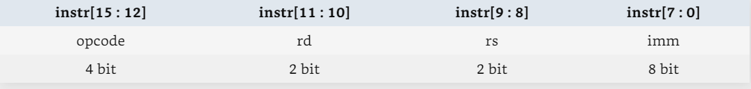
Task description: Class C (6`)
1. Familiar with EDA software
2. Complete the structure design (Datapath + Controller) according to the basic instruction set
3. Compose Verilog code for design and do synthesis
4. Compose Verilog code for testbench and do simulation
Instruction Format
Basic Instruction Set
Opcode 4bit | Rd 2bit | Rs 2bit | Imme 8bit | Assembly | Function Description
0000 0001 | 01 10 | xx 01 | 00000010 xxxxxxxx | mov r1 #02 mov R2 R1 | R1<= 2 R2<=(R1)
0010 0011 | 01 01 | xx 10 | 00001000 xxxxxxxx | add r1 #08 add R1 R2 | R1<=(R1)+8 R1<=(R1)+(R2)
0101 | 01 | 10 | xxxxxxxx | sub R1 R2 | R1<=(R1)-(R2)
0111 | 01 | 10 | xxxxxxxx | and R1 R2 | R1<= (R1) bit_and (R2)
1001 | 01 | 10 | xxxxxxxx | or R1 R2 | R1<=(R1) bit_or (R2)
1010 | xx | xx | 00000001 | jump #01 | PC<= 1

Slide 102
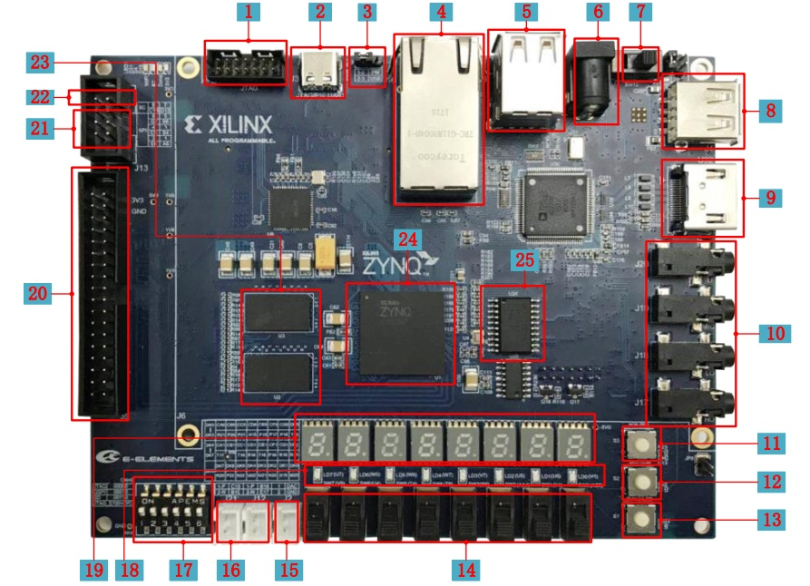
Task description: Class B (7`)
1. Design a application demo (LED controller, etc.) base on your CPU chip
2. Download the bitstream to a real FPGA board
3. Use ILA IP core to do debug

Slide 103
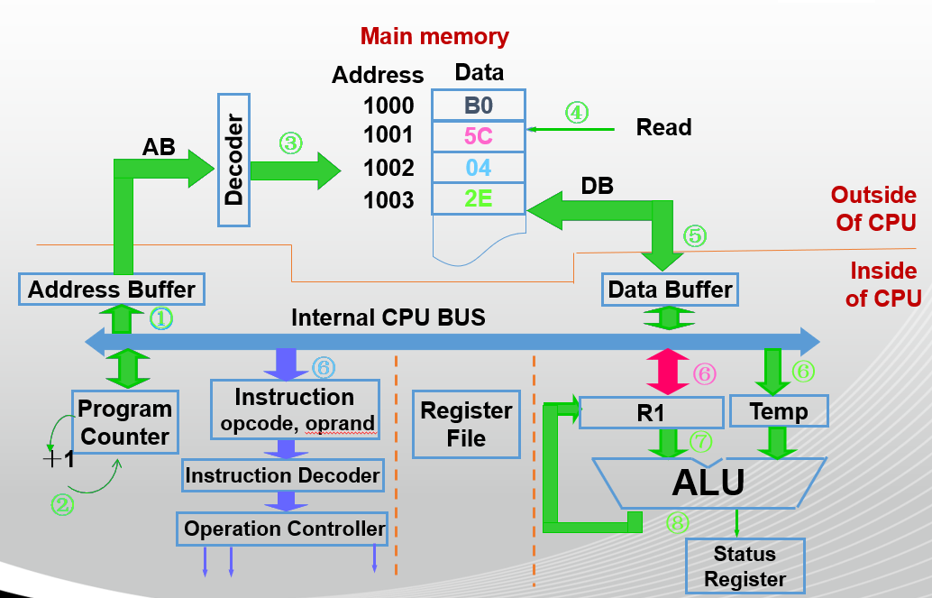
Task description: Class A (8`)
1. Add more instruction (load/ store, etc.) to basic instruction set.
2. Modify hardware structure and design code to implementing new instruction set.
3. Modify testbench code, do simulation and implement on a FPGA.
Add memory or I/O ports to testbench

Slide 104
项目实践一共20分，包括两个部分：
Part1: 团队分 实现难度6~8’ + 设计文档0~5’
A档(8~13分)：支持更多指令（如load/store），并完成仿真测试
B档(7~12分)：能够下板运行（如控制流水灯），会用ILA进行指令抓取
C档(6~11分)： 支持基本指令集，并完成仿真测试
PS：代码必须能直接仿真综合否则视为无效；
代码与报告均会查重；
在A档基础上做下流水线或指令加速器，可进一步提高分数
Part2: 个人分 报告讨论0~5’ + 组内工作0~4’
平时研讨(0~5分)：每个同学分别打分
组内工作(0~4分)：由组内自行讨论分配
平均每人2’, 每人分数最高不超过4’，没有负分

Slide 105
C档任务说明
6’
指令格式
1. 熟练使用EDA软件
2. 根据基础指令集完成硬件结构 设计： 数据通路+控制通路
3. 编写Verilog代码，并完成综合
4. 编写TestBench ，并完成仿真验证
基本指令集
Opcode 4bit | Rd 2bit | Rs 2bit | Imme 8bit | Assembly | Function Description
0000 0001 | 01 10 | xx 01 | 00000010 xxxxxxxx | mov r1 #02 mov R2 R1 | R1<= 2 R2<=(R1)
0010 0011 | 01 01 | xx 10 | 00001000 xxxxxxxx | add r1 #08 add R1 R2 | R1<=(R1)+8 R1<=(R1)+(R2)
0101 | 01 | 10 | xxxxxxxx | sub R1 R2 | R1<=(R1)-(R2)
0111 | 01 | 10 | xxxxxxxx | and R1 R2 | R1<= (R1) bit_and (R2)
1001 | 01 | 10 | xxxxxxxx | or R1 R2 | R1<=(R1) bit_or (R2)
1010 | xx | xx | 00000001 | jump #01 | PC<= 1

Slide 106
B档任务说明
7’
1. 设计好的CPU电路下板测试
2. 使用ILA抓取信号，验证功能的正确性
3. 加入流水灯控制，完成应用演示

Slide 107
A档任务说明
8’
TestBench考虑添加内存或I/O端口
在基础指令集基础上：
1. 增加新指令，如load/ store
2. 修改硬件架构及Verilog代码
3. 编写TestBench，并完成仿真验证
4. 完成下板测试及应用演示

Slide 108
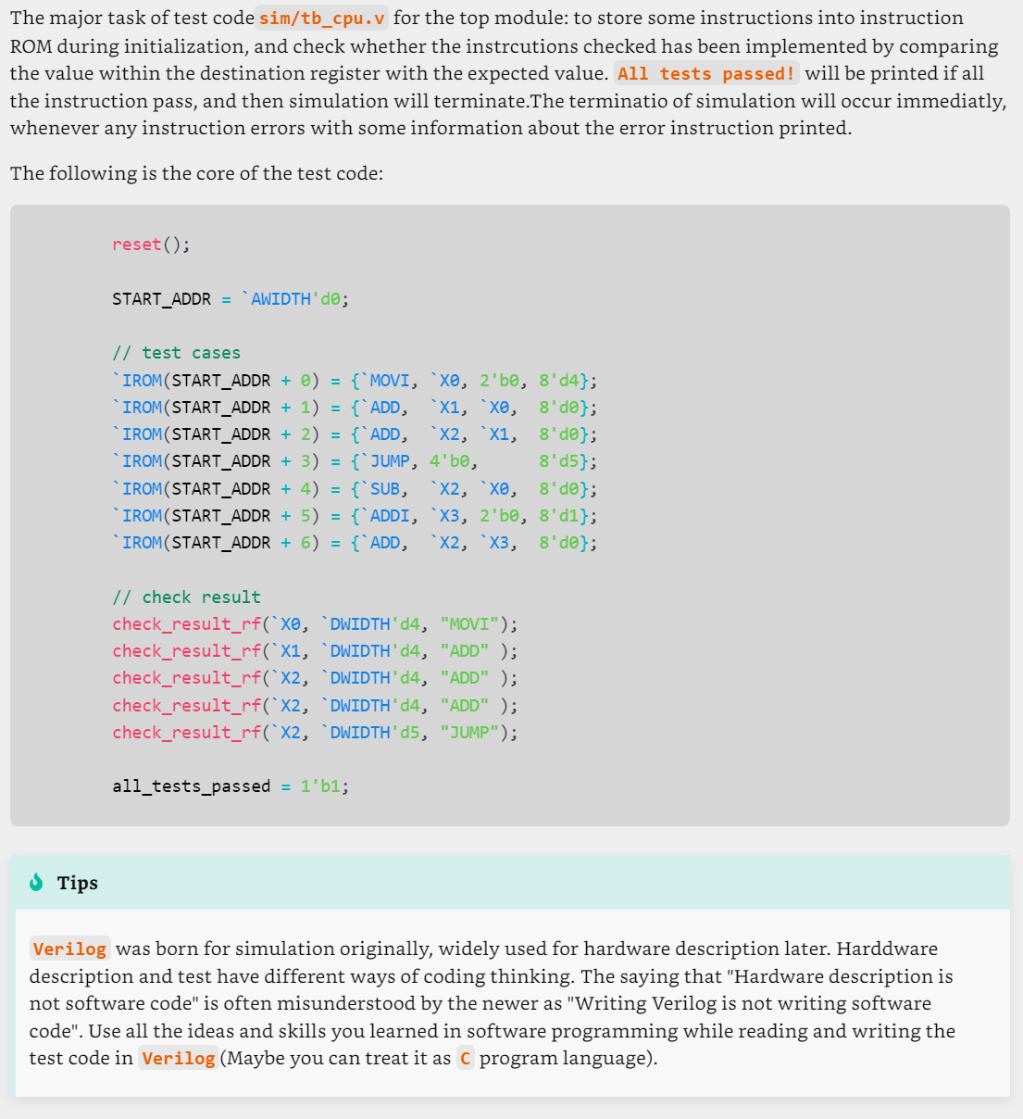
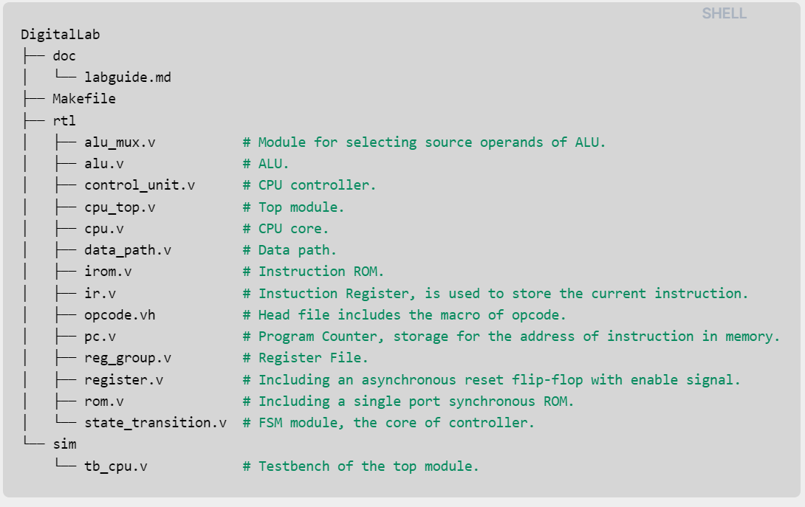
Files for Project
Vivado Project
Testbench Code example

Slide 109
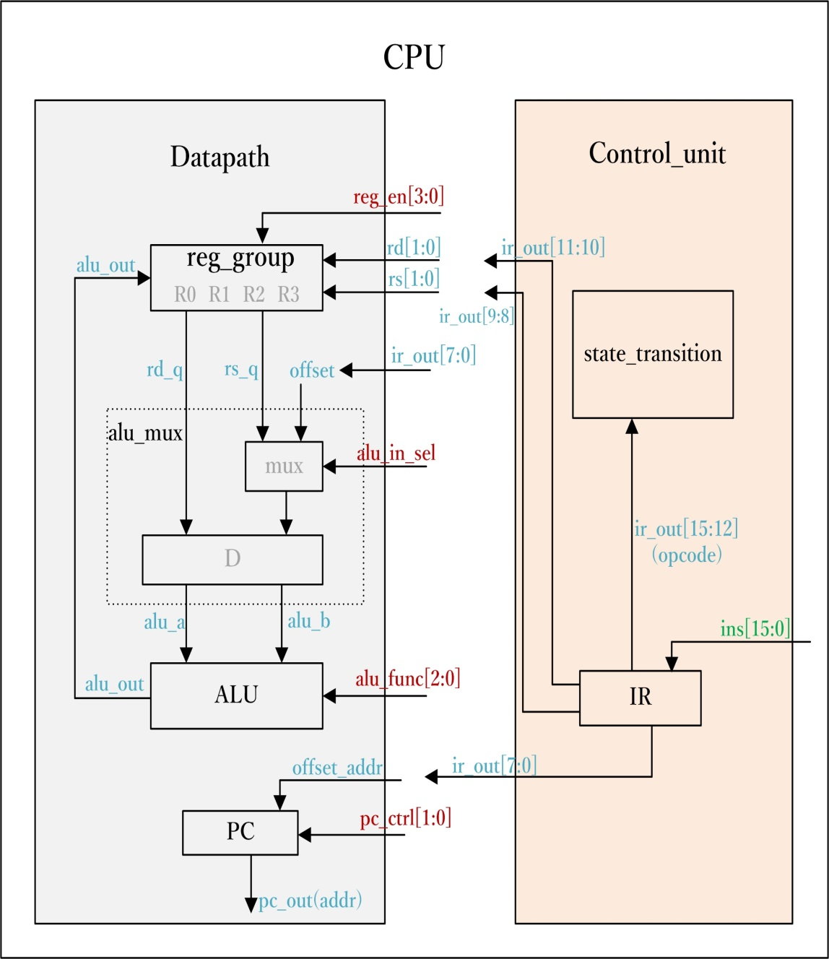
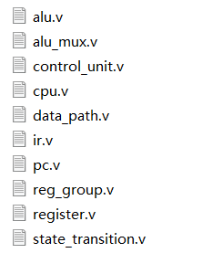
Files for Project

Slide 110
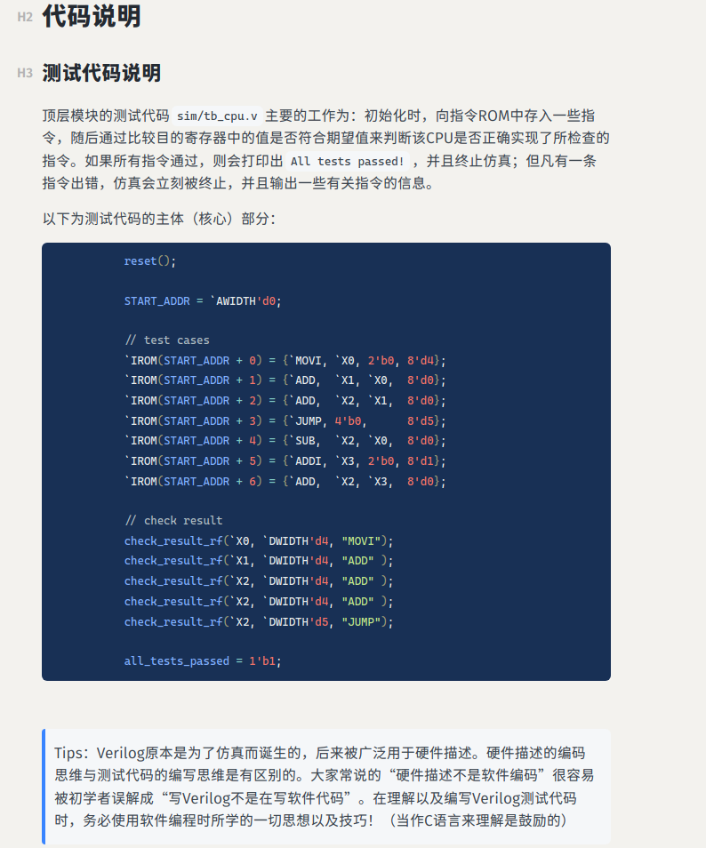
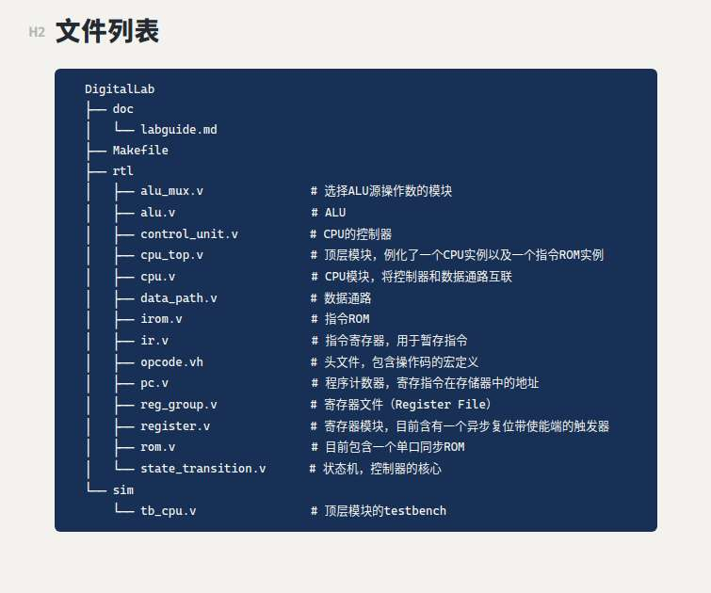
2026-08-30
109

Slide 111
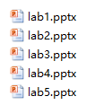
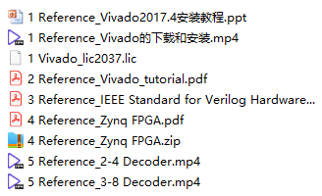

  参考材料的使用
1.Lab_Refrence（先浏览一遍，琢磨下跟项目任务的关系）
CPU设计实验课件（普通班）
3. For_IC_Newer
Vivado软件及Verilog语言入门
2. Design_Doc_Template（设计文档模板）
大框架不变，小节可自行补充或删减

Slide 112
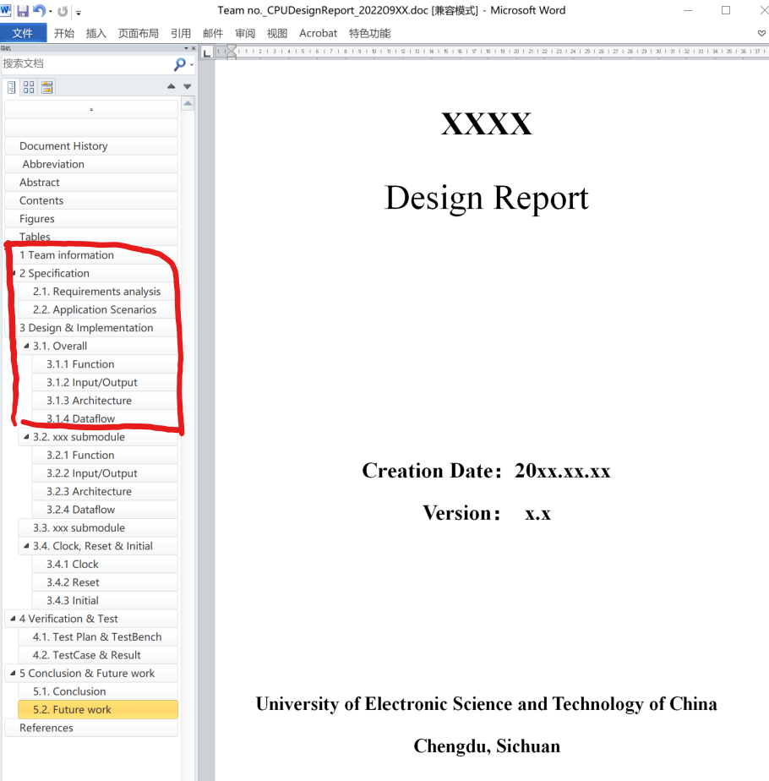

  项目文档(doc+ppt)编写说明
第一次研讨课需分组用ppt汇报的部分
设计文档和演示文档统一命名为“班号组号_日期”，如：12_20240214
设计文档（doc）只有一个，大家在学习过程中不断补充和完善其内容即可；
演示文档（ppt）每次研讨时都应重新做，把本次上课需要讲的内容（主要是图、表）从doc文件中取出来做成ppt。当然，ppt文件也应该是个相对独立和完整的文件，有些内容（比如系统大框图）可能每次ppt文件都需要，保留下来就行。
2026-08-30

Slide 113
Requirements
Textbook
“Digital System Design with Verilog & VHDL”
2nd Edition，Enoch O.Hwang著，阎波 朱晓章 姚毅改编
Publishing House of Electronics Industry，2018
Reference books
  “Digital Design: Principles and Practices"
4th Edition, John F. Wakerly，
  “数字逻辑设计及应用”,姜书艳等，电子科大出版社，2014
  “微处理器系统结构与嵌入式系统设计”
  第三版，阎波，李广军等，电子工业出版社，2020
  “数字集成电路与系统设计”
  李广军 郭志勇等，电子工业出版社，2015
  MOOC
  https://www.icourse163.org/learn/UESTC1-1458202164 （英文版数电）https://www.icourse163.org/course/UESTC-234014 （中文版数电）
  https://www.icourse163.org/course/UESTC-234015 （中文版ASIC设计）
2026-08-30
112

Slide 114
Office hours
Office Hour
Monday 13：00-14：00
Office Address
  KB 224
  Email
  yanboyu@uestc.edu.cn (阎波)
2026-08-30
113

Slide 115
Topic1： Introduction
Why to do
What to do
How to do
Digital world
Info. for Course
Organization of CPU
Mathematic Foundations
EDA technology
Technology Related
Architecture of computer

Slide 116
    Architecture of Von Neumann computer
2026-08-30
115

Slide 117

    Architecture of Von Neumann computer
Computer：
2026-08-30
116

Slide 118
    Architecture of Von Neumann computer
Computer：
Operator
(ALU)
2026-08-30
117

Slide 119
    Architecture of Von Neumann computer
Computer：
Operator
(ALU)
Controller
2026-08-30
118

Slide 120
    Architecture of Von Neumann computer
Computer：
Operator
(ALU)
Controller
Memory
2026-08-30
119

Slide 121
    Architecture of Von Neumann computer
Computer：
Operator
(ALU)
Controller
Memory
Input
Output
2026-08-30
120

Slide 122
    Architecture of Von Neumann computer
Computer：
Operator
(ALU)
Controller
Memory
Input
Output
2026-08-30
121

Slide 123

    Architecture of Von Neumann computer
Computer：
Operator
(ALU)
Controller
Memory
Input
Output
2026-08-30
122

Slide 124
    Architecture of Von Neumann computer
Computer：
Operator
(ALU)
Controller
Memory
Input
Output
2026-08-30
123

Slide 125
    Architecture of Von Neumann computer
Computer：
Operator
(ALU)
Controller
Memory
Input
Output
CPU：
2026-08-30
124

Slide 126
    Architecture of Von Neumann computer
Computer：
Operator
(ALU)
Controller
Memory
Input
Output
CPU：
2026-08-30
125

Slide 127
    Architecture of Von Neumann computer
Computer：
Operator
(ALU)
Controller
Memory
Input
Output
CPU：
2026-08-30
126

Slide 128
    Architecture of Von Neumann computer
Computer：
Operator
(ALU)
Controller
Memory
Input
Output
CPU：
2026-08-30
127

Slide 129
    Architecture of Von Neumann computer
Computer：
Operator
(ALU)
Controller
Memory
Input
Output
Datapath
CPU：
2026-08-30
128

Slide 130
    Architecture of Von Neumann computer
Computer：
Operator
(ALU)
Controller
Memory
Input
Output
Datapath
CPU：
Controller
Datapath
2026-08-30
129

Slide 131
Topic1： Introduction
Why to do
What to do
How to do
Digital world
Info. for Course
Organization of CPU
Technology Related
Architecture of computer
Mathematic Foundations
EDA technology

Slide 132
Organization of Center Processor Unit
Controller
Datapath
2026-08-30
131

Slide 133
Organization of Center Processor Unit
Controller
Datapath
2026-08-30
132

Slide 134
Organization of Center Processor Unit
Controller
Datapath
2026-08-30
133

Slide 135
Organization of Center Processor Unit
Data Inputs
Controller
Datapath
Data Outputs
2026-08-30
134

Slide 136
Organization of Center Processor Unit
Data Inputs
Controller
Datapath
Data Outputs
2026-08-30
135

Slide 137
Organization of Center Processor Unit
Data Inputs
Controller
Datapath
Control Signals
Data Outputs
2026-08-30
136

Slide 138
Organization of Center Processor Unit
Data Inputs
Controller
Datapath
Control Signals
Status Signals
Data Outputs
2026-08-30
137

Slide 139
Organization of Center Processor Unit
Control Inputs
(Instruction)
Data Inputs
Controller
Datapath
Control Signals
Status Signals
Control Outputs
Data Outputs
2026-08-30
138

Slide 140
Organization of Center Processor Unit
P1
Control Inputs
(Instruction)
Data Inputs
Controller
Datapath
Control Signals
Status Signals
Control Outputs
Data Outputs
2026-08-30
139

Slide 141
Program Execution Process
Fetch, Decoder, Execute
Assembly language program
……
MOV 0x5C, R1
ADD R1, 0x2E, R1
……
Internal Memory
Address
Data
Address Decoder
1000
B0
④
④
④
1001
5C
④
Read
③
③
③
AB
③
1002
04
1003
2E
DB
⑤
Outside of CPU
⑤
⑤
⑤
Inside of CPU
Address Buffer
Data Buffer
①
Internal BUS
①
①
①
⑥
⑥
⑥
⑥
Program Couter (PC)
Instruction Register (IR)
Opcode, Operand
Register1(R1)
Temp Reg
Register File
(RF)
＋1
⑦
Instruction Decoder (ID)
ALU
②
②
②
②
Operator Controller (OC)
⑧
Flag Register (FR)
2026-08-30
140
Notes:
Principle of CPU

Slide 142
Topic1： Introduction
Why to do
What to do
How to do
Digital world
Info. for Course
Organization of CPU
HDL Language
EDA technology
Technology Related
Architecture of computer

Slide 143
Topic1： Introduction
Why to do
What to do
How to do
Digital world
Info. for Course
Organization of CPU
HDL Language
EDA technology
Technology Related
Architecture of computer

Slide 144
VHDL vs. Verilog
Government Developed in 1981 | Commercially Developed in 1985
Ada based | C based
Strongly Type Cast | Mildly Type Cast
Case-insensitive | Case-sensitive
Difficult to learn | Easier to Learn
Chap1.4
  VHDL is an acronym for :
  VHSIC (Very High Speed Integrated Circuit) Hardware Description Language
HDLs is used to describe a HARDWARE!
They are quite different with the tradition program language!

Slide 145
TOP-DOWN Design
Digital circuit
Top-level module
port-function
Control Module
PART 1
(combination)
Datapath Module
PART 1
(combination)
PART 4
(Register)
PART 3
(sequential
FSM)
module
port-function
module
port-function
module
port-function
module
port-function
PART 2
(combination)
PART 2
(combination)
PART 5
(Counter)
Interconnect
module
port-function
module
port-function
PART 4
(sequential
FSM)
module
port-function
PART 3
(combination)
module
port-function
Interconnect
module
port-function
Interconnect

Slide 146
Basic Verilog Modeling
module is a most basic building block of a design.
port declarations describes the interface of the component, i.e. input and output ports.
circuit functionality describes an implementation of the corresponding module.
port_mode port_name1;
port_mode port_name2;
…………
module module_name (port_name1,_port_name2, …);
port declarations
wire interconnect_name1;
wire interconnect_name1;
…………
Interconnect declarations
assign statements;
always @(sensitive signals list)
begin
functionality code
end
circuit functionality
endmodule

Slide 147
Fundamental rules of Verilog
module name
module ports
module MultiplexerC (w，a, b, s);
output reg w;
input a，b，s;
wire m;
assign m = a+b;
always @(a, b, s)
begin
if (s) w = b;
else w = m;
end
endmodule
The signal assigned in always block should be ‘reg’ type
Declare port and inter-connect signal
reserved words
lowercase
Continuous Assignment statement is used if the unit is simple
Semicolon
Procedural Block(always)
statement with sensitivity list is used when the unit is too complex
No Semicolon

Slide 148

Verilog Design Styles
Chap1.2
Testbenches
module dataflow (Result, A, B, C);
output Result;
input A, B, C;
assign Result = (A ^ B) ^ C;
endmodule
structural
dataflow
behavioral
(sequential)
Components and
interconnects
Concurrent statements
Subset most suitable for synthesis
module behavioral (Result, A, B, C);
output reg Result;
input A, B, C;
always @ (A, B, C)
begin
Result = (A ^ B) ^ C;
end
endmodule
module structural (Result, A, B, C);
output Result;
input A, B, C;
wire U1_OUT;
xor U1(U1_OUT,A,B);
xor U2(Result,U1_OUT,C);
endmodule
U1_OUT
I1
I1
Y
Y
I2
I2

Slide 149
Octal 2-to-1 MUX
module Mux8 (
);
endmodule
output[7:0] bus1,
input sel,
input [7:0] data1, data0
assign ;
bus1 = sel ? data1 : data0
8
data₀
0
8
8
bus1
condition ？true_expression：false_expression
data₁
1
sel

Slide 150
3-to-1 MUX
module Mux31a ( q, a , b, c, sel ) ;
endmodule
module Mux31b ( q, a , b, c, sel ) ;
endmodule
output q;
input a, b, c;
input [ 1:0 ] sel;
output q;
input a, b, c;
input [ 1:0 ] sel;
reg q;
Assigned in Procedural Block
Assigned in Procedural Block
reg q;
always @ ( * )
begin
end
always @ ( * )
begin
end
case ( sel )
endcase
0: q = a ;
1: q = b;
2: q = c;
default: q = a;
if ( sel[0] == 1 ) q = b;
else if ( sel[1] == 1 ) q = c;
else q = a;
No priority
Priority!
Default alternative
Else alternative
HARDWARE!
a
0
a
0
q
b
c
q
c
1
b
1
sel[1]
sel
2
sel[0]

Slide 151
Topic1： Introduction
Why to do
What to do
How to do
Digital system
Architecture of computer
Organization of CPU
HDL Language
EDA Design Flow
Info. for Course
Technology Related

Slide 152
IC design methodology & EDA flow
Chap1.4~1.6

Slide 153
IC design methodology & EDA flow
Chap1.4~1.6
Design specification

Slide 154
IC design methodology & EDA flow
Chap1.4~1.6
Design specification
Design partition

Slide 155
IC design methodology & EDA flow
Chap1.4~1.6
Design specification
Design partition
Design entry: HDL
Behavioral modeling

Slide 156
IC design methodology & EDA flow
Chap1.4~1.6
Design specification
Design partition
Design entry: HDL
Behavioral modeling
Functional Verification

Slide 157
IC design methodology & EDA flow
Chap1.4~1.6
Design specification
Design partition
Design entry: HDL
Behavioral modeling
Functional Verification
Design integration and
functional verification

Slide 158
IC design methodology & EDA flow
Chap1.4~1.6
Design specification
Design partition
Design entry: HDL
Behavioral modeling
Functional Verification
Design integration and
functional verification
Synthesize (implement)
and map Gate-level netlist

Slide 159
IC design methodology & EDA flow
Chap1.4~1.6
Design specification
Postsynthesis
timing verification
Design partition
Design entry: HDL
Behavioral modeling
Functional Verification
Design integration and
functional verification
Synthesize (implement)
and map Gate-level netlist
Postsynthesis
functional verification

Slide 160
IC design methodology & EDA flow
Chap1.4~1.6
Design specification
Postsynthesis
timing verification
Design partition
Test generation and
Fault simulation
Design entry: HDL
Behavioral modeling
Functional Verification
Design integration and
functional verification
Synthesize (implement)
and map Gate-level netlist
Postsynthesis
functional verification

Slide 161
IC design methodology & EDA flow
Chap1.4~1.6
Design specification
Postsynthesis
timing verification
Design partition
Test generation and
Fault simulation
Design entry: HDL
Behavioral modeling
Cell placement, scan chain and
clock tree insertion ,cell routing
Functional Verification
Design integration and
functional verification
Synthesize (implement)
and map Gate-level netlist
Postsynthesis
functional verification

Slide 162
IC design methodology & EDA flow
Chap1.4~1.6
Design specification
Postsynthesis
timing verification
Design partition
Test generation and
Fault simulation
Design entry: HDL
Behavioral modeling
Cell placement, scan chain and
clock tree insertion ,cell routing
Functional Verification
Verify physical and Electrical design rules
Design integration and
functional verification
Synthesize (implement)
and map Gate-level netlist
Postsynthesis
functional verification

Slide 163
IC design methodology & EDA flow
Chap1.4~1.6
Design specification
Postsynthesis
timing verification
Design partition
Test generation and
Fault simulation
Design entry: HDL
Behavioral modeling
Cell placement, scan chain and
clock tree insertion ,cell routing
Functional Verification
Verify physical and Electrical design rules
Design integration and
functional verification
Extract parasitic
Synthesize (implement)
and map Gate-level netlist
Postsynthesis
functional verification

Slide 164
IC design methodology & EDA flow
Chap1.4~1.6
Design specification
Postsynthesis
timing verification
Design partition
Test generation and
Fault simulation
Design entry: HDL
Behavioral modeling
Cell placement, scan chain and
clock tree insertion ,cell routing
Functional Verification
Verify physical and Electrical design rules
Design integration and
functional verification
Extract parasitic
Synthesize (implement)
and map Gate-level netlist
Design sign-off
Postsynthesis
functional verification

Slide 165
IC design methodology & EDA flow
Chap1.4~1.6
Design specification
Postsynthesis
timing verification
Design partition
Test generation and
Fault simulation
Design entry: HDL
Behavioral modeling
Cell placement, scan chain and
clock tree insertion ,cell routing
Functional Verification
Verify physical and Electrical design rules
Design integration and
functional verification
Extract parasitic
Synthesize (implement)
and map Gate-level netlist
Design sign-off
Postsynthesis
functional verification
Production-ready masks

Slide 166
IC design methodology & EDA flow
Chap1.4~1.6
Design specification
Postsynthesis
timing verification
Design partition
Test generation and
Fault simulation
Design entry: HDL
Behavioral modeling
Front-End
Cell placement, scan chain and
clock tree insertion ,cell routing
Back-End
Functional Verification
Verify physical and Electrical design rules
Design integration and
functional verification
Extract parasitic
Synthesize (implement)
and map Gate-level netlist
Design sign-off
Postsynthesis
functional verification
Production-ready masks

Slide 167
IC design methodology & EDA flow
Chap1.4~1.6
Design specification
Postsynthesis
timing verification
Design partition
FPGA
Test generation and
Fault simulation
Design entry: HDL
Behavioral modeling
Front-End
Cell placement, scan chain and
clock tree insertion ,cell routing
Back-End
Functional Verification
Verify physical and Electrical design rules
Design integration and
functional verification
Extract parasitic
Synthesize (implement)
and map Gate-level netlist
Design sign-off
Postsynthesis
functional verification
Production-ready masks

Slide 168
IC design methodology & EDA flow
Chap1.4~1.6
Design specification
Postsynthesis
timing verification
Design partition
FPGA
Test generation and
Fault simulation
Design entry: HDL
Behavioral modeling
Front-End
Cell placement, scan chain and
clock tree insertion ,cell routing
Back-End
Functional Verification
ASIC
Verify physical and Electrical design rules
Design integration and
functional verification
Extract parasitic
Synthesize (implement)
and map Gate-level netlist
Design sign-off
Postsynthesis
functional verification
Production-ready masks

Slide 169
Hierarchy for IC design
Chap1.2
SYSTEM
Chap1.3
MODULE
+
GATE
CIRCUIT
DEVICE
G
S
D
n+
n+

Slide 170

Hierarchy for IC design
Chap1.2
SYSTEM
Chap1.3
MODULE
+
GATE
CIRCUIT
DEVICE
G
S
D
n+
n+

Slide 171

Hierarchy for IC design
Chap1.2
SYSTEM
Chap1.3
MODULE
+
GATE
CIRCUIT
DEVICE
G
S
D
n+
n+

Slide 172
Hierarchy for IC design
Chap1.2
SYSTEM
Chap1.3
MODULE
+
GATE
CIRCUIT
DEVICE
G
S
D
n+
n+

Slide 173

Hierarchy for IC design
Chap1.2
SYSTEM
Chap1.3
MODULE
+
GATE
CIRCUIT
DEVICE
G
S
D
n+
n+

Slide 174

CPU Design & Implement

Slide 175
CPU Design & Implement
an idea
(By Manual)

Slide 176
CPU Design & Implement
A declarative statement or written expression to specifying the idea in text, diagram or HDL language (By Manual)
an idea
(By Manual)

Slide 177
CPU Design & Implement
MIH R0 1
MIL R0 0
ADD R0 R1
SUB R0 R1
CMP R0 R1
MUL R0 R1
AND R0 R1
ORR R0 R1
NOT R0
SHL R0
SHR R0
JNZ 10
JPA 10
LDA R0 R1
STR R0 R1
INP R0 R1
OUP R0 R1
A declarative statement or written expression to specifying the idea in text, diagram or HDL language (By Manual)
an idea
(By Manual)
The ISA
for a CPU

Slide 178
CPU Design & Implement
A declarative statement or written expression to specifying the idea in text, diagram or HDL language (By Manual)
an idea
(By Manual)

Slide 179
CPU Design & Implement
Partitioning problem into functional blocks, balancing tradeoff between costs and benefits (By Manual)
A declarative statement or written expression to specifying the idea in text, diagram or HDL language benefits (By Manual)
an idea
(By Manual)

Slide 180
    RTL design for A Typical Digital circuit
Chap1.1
Control Inputs
Data Inputs
Controller
Datapath
Control Signals
Status Signals
Control Outputs
Data Outputs
2026-08-30
179

Slide 181
    RTL design for A Typical Digital circuit
Chap1.1
Control Inputs
Data Inputs
Controller
Datapath
Control Signals
Status Signals
Control Outputs
Data Outputs
2026-08-30
180

Slide 182
    RTL design for A Typical Digital circuit
Chap1.1
Control Inputs
Data Inputs
Controller
Datapath
Control Signals
Status Signals
Control Outputs
Data Outputs
2026-08-30
181

Slide 183
    RTL design for A Typical Digital circuit
Register Transfer Level Design
Chap1.1
Control Inputs
Data Inputs
Controller
Datapath
Control Signals
Status Signals
Control Outputs
Data Outputs
2026-08-30
182

Slide 184
CPU Design & Implement
Partitioning problem into functional blocks, balancing tradeoff between costs and benefits (By Manual)
A declarative statement or written expression to specifying the idea in text, diagram or HDL language benefits (By Manual)
an idea
(By Manual)

Slide 185
CPU Design & Implement
Partitioning problem into functional blocks, balancing tradeoff between costs and benefits (By Manual)
A declarative statement or written expression to specifying the idea in text, diagram or HDL language benefits (By Manual)
an idea
(By Manual)
Register Transfer Level (RTL) (By Tools) Logic Level (Gate) (By EDA tools) Transistor level (By EDA tools)

Slide 186
An HDL file
P8
P9
Verilog
VHDL

Slide 187
An HDL file
P8
LIBRARY IEEE;
USE IEEE.STD_LOGIC_1164.ALL;
USE IEEE.STD_LOGIC_UNSIGNED.ALL;
ENTITY adder8 IS
…………….
END adder8;
ARCHITECTURE one OF adder8 IS
SIGNAL ……;
BEGIN
PROCESS(……)
BEGIN
……………
END PROCESS;
PROCESS(……)
BEGIN
……………
END PROCESS;
END one;
P9
Verilog
VHDL
module adder8 (
input …… ,
output ……….
);
wire …… ;
always@(……)
begin
……………
end;
always@(……)
begin
……………
end;
endmodule

Slide 188
An HDL file
P8
LIBRARY IEEE;
USE IEEE.STD_LOGIC_1164.ALL;
USE IEEE.STD_LOGIC_UNSIGNED.ALL;
ENTITY adder8 IS
…………….
END adder8;
ARCHITECTURE one OF adder8 IS
SIGNAL ……;
BEGIN
PROCESS(……)
BEGIN
……………
END PROCESS;
PROCESS(……)
BEGIN
……………
END PROCESS;
END one;
P9
Verilog
VHDL
module adder8 (
input …… ,
output ……….
);
wire …… ;
always@(……)
begin
……………
end;
always@(……)
begin
……………
end;
endmodule

Slide 189
An HDL file
P8
LIBRARY IEEE;
USE IEEE.STD_LOGIC_1164.ALL;
USE IEEE.STD_LOGIC_UNSIGNED.ALL;
ENTITY adder8 IS
…………….
END adder8;
ARCHITECTURE one OF adder8 IS
SIGNAL ……;
BEGIN
PROCESS(……)
BEGIN
……………
END PROCESS;
PROCESS(……)
BEGIN
……………
END PROCESS;
END one;
P9
Verilog
VHDL
module adder8 (
input …… ,
output ……….
);
wire …… ;
always@(……)
begin
……………
end;
always@(……)
begin
……………
end;
endmodule

Slide 190
An HDL file
P8
LIBRARY IEEE;
USE IEEE.STD_LOGIC_1164.ALL;
USE IEEE.STD_LOGIC_UNSIGNED.ALL;
ENTITY adder8 IS
…………….
END adder8;
ARCHITECTURE one OF adder8 IS
SIGNAL ……;
BEGIN
PROCESS(……)
BEGIN
……………
END PROCESS;
PROCESS(……)
BEGIN
……………
END PROCESS;
END one;
P9
Verilog
VHDL
module adder8 (
input …… ,
output ……….
);
wire …… ;
always@(……)
begin
……………
end;
always@(……)
begin
……………
end;
endmodule

Slide 191
CPU Design & Implement
Partitioning problem into functional blocks, balancing tradeoff between costs and benefits (By Manual)
A declarative statement or written expression to specifying the idea in text, diagram or HDL language benefits (By Manual)
an idea
(By Manual)
Register Transfer Level (RTL) (By Manual) Logic Level (Gate) (By EDA tools) Transistor level (By EDA tools)

Slide 192
CPU Design & Implement
Partitioning problem into functional blocks, balancing tradeoff between costs and benefits (By Manual)
A declarative statement or written expression to specifying the idea in text, diagram or HDL language benefits (By Manual)
an idea
(By Manual)
Register Transfer Level (RTL) (By Manual) Logic Level (Gate) (By EDA tools) Transistor level (By EDA tools)
Check whether implementation matches spec. in a Iterative process (By Manual and EDA tools )

Slide 193





    Test for a digital circuit
Hardware
Final Prod.
Verification
test
Simulation
2026-08-30

Slide 194
TestBench Anatomy
module My_tb; --TestBench module has no ports
    reg ……….; --Local signals and constants
    wire ……….;
Instantiating module; -- Instantiations of DUT
initial begin ……… end -- Input stimuli: reset
always begin ……… end -- Input stimuli: clock
initial begin ……… end -- Input stimuli: other signals
always @ ( posedge clock ) begin
……… -- Compare results
end
always @ ( posedge clock ) begin
……… -- Display results
end
endmodule
TestBench Module
Stimulus Generater
Apply Inputs
Design Module
Design Under Test
Response Monitor
Observe Outputs

Slide 195
A Simple Tester
`timescale 1ns/100ps
module Detector110Tester;
reg aa, clock, rst;
wire ww;
Detector110 UUT (aa, clock, rst, ww);
initial begin
aa = 0; clock = 0; rst = 1;
end
initial repeat (44) #7 clock = ~clock;
initial repeat (15) #23 aa = ~aa;
initial begin
#31 rst = 1;
#23 rst = 0;
end
always @(ww) if (ww == 1)
$display ("A 1 was detected on w at time = %t", $time);
endmodule
Time unit
No input or output ports
Inputs & Outputs of DUT
The Instantiation of DUT (Detector110 Module)
An initial statement
Generates a periodic signal :
repeats (44) times with (7time steps) delay,
Generates a no-periodic signal
A Verilog System Task: reports the Times at which the ww Variable becomes 1

Slide 196
Digital Logic Design and Application
Topic 1 - Introduction
Yan Bo
School of Information & Communication Engineering, UESTC
Email: yanboyu@uestc.edu.cn
THE END OF TOPIC1
2026-08-30
195

Slide 197

Homework 1
P59 2.1 （ e ）、2.2 （ e ）、2.3 （ f ）
2.6（ c ）、 2.8（ d ）
Additional question
Decide the radix used from the equation:
$√41$=5

Slide 198
Homework 2
P17 1.9、1.10
P60 2.4（ b ）、 2.5（ c ）、2.7（ d ）、 2.10（ c ）
2.12（ c ）、2.14（ d ） 、2.27（a）（b）、
2.28（ C ）、 2.34、 2.35
P106 3.1 （ d ） 、3.2（ d ） 、3.4（a）,（e）
3.23（c）（f）、3.26 （a）、3.11、3.17（b）
3.36
P151 4.2、4.25 、4.28、4.32

Slide 199

Homework 2（ Additional questions ）
1. Using Karnaugh maps, find a minimal SOP expression and a minimal POS expression for each of the following logic functions. Indicate the distinguished 1-cells (or 0-cells) in each map.
(a) F= Σ_{x,y,z}(1,3,5,6,7)
(b) F= Σ_{W,X,Y ,Z}(0,1,2,8,11)+ d(3,9,15)
2. Please finish the function as below:
1) Consider the 8-to-1 MUX as a single component shown here
2) Use 1 pcs 74LS138 to finish the same F(x,y,z), other basic gates are also allowed to be used.
F (x, y, z) = x'y'z' + x'yz' + xy'z + xyz' + xyz.

Slide 200
Homework 3
P211
5.1、5.3、5.4、5.8、5.10
P270
6.1（a）、 6.3（a）、6.4、6.7

Slide 201
Homework 4
P111 3.30、3.31
P212 5.7

Slide 202
Homework 5
A benchmark program runs on a 40MHz processor. The executed program consists of 100,000 instruction, with the following instruction mix and clock cycle count. Determine the effective CPI, MIPS rate and execution time T for this program.
Instruction type | Instruction count | Cycles per instruction
Integer arithmetic | 45000 | 1
Data transfer | 32000 | 2
Floating point | 15000 | 2
Control transfer | 8000 | 2

