Slide 1
Digital Logic Design and Application
Lab Course 1
Lecturer:
TA:
Lab Room:

Slide 2
Fundamental
  Digital Logic + Computer Architecture
  Verilog Language
  Tools
  EDA software: Vivado 2017.1
  Evaluation board: EES331
Reference
  IEEE Standard Verilog Language Reference Manual
  Vivado Introduction Using Verilog Design
  EES331 User manual （Zynq Book）
  Slices & Codes for Lab

Slide 3
Content
EDA tools
  Development Environment
  Coding, Synthesis and simulation
  Testbench and Verification
Datapath Design
Controller Design
CPU Integration
CPU Verification and Improvement

Slide 4
Implement for a 3-8 Decoder
Traditional method VS Programmable logic device

Slide 5
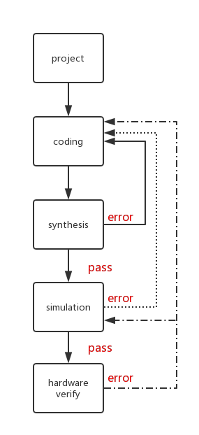
FPGA Design Flow

Slide 6
FPGA Design Flow

Slide 7
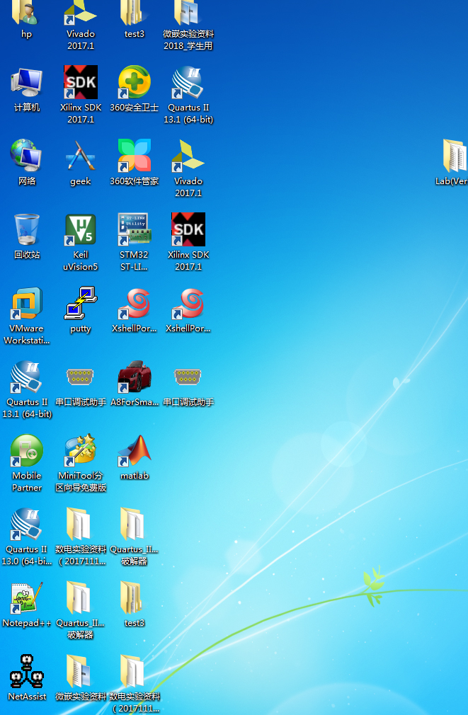
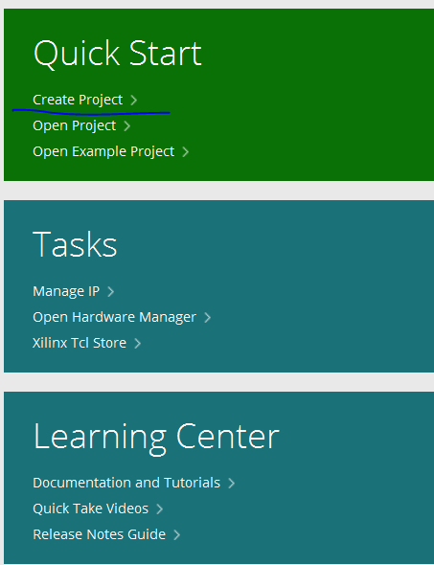
1. Create New Hardware Project
-step1
1. Open VIVADO 2017.1
2. Click here
→

Slide 8
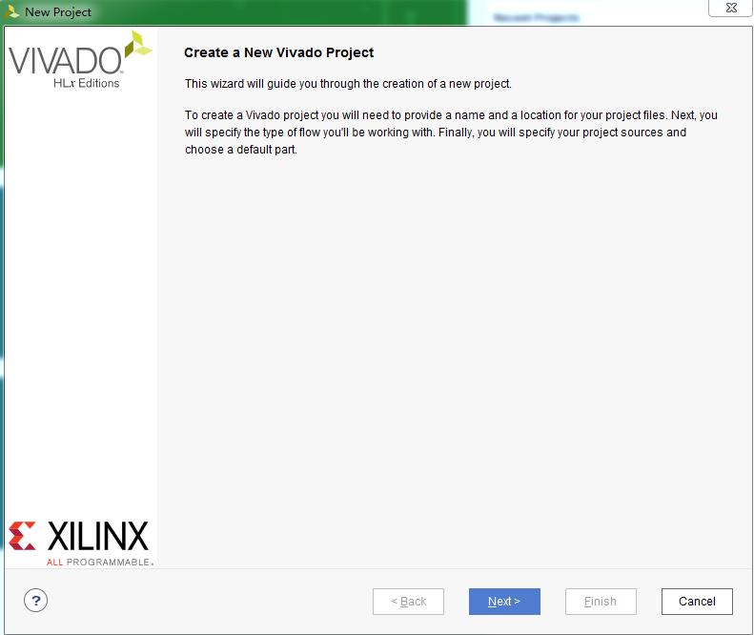
1. Create New Hardware Project
-step2
Click here

Slide 9
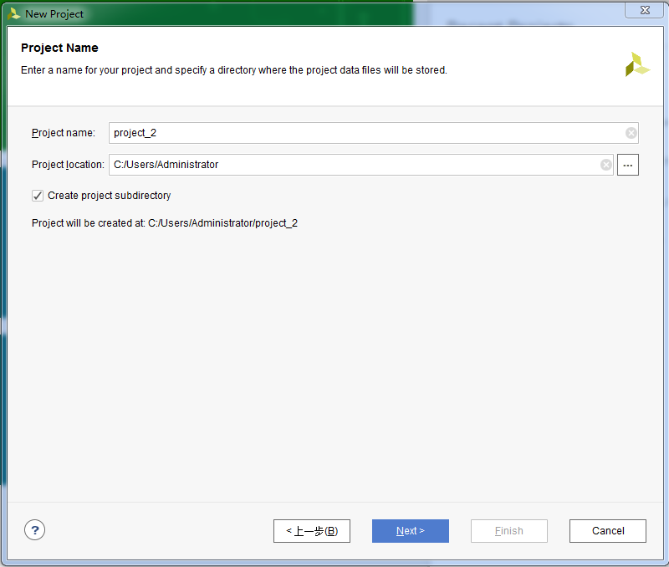
1. Create New Hardware Project
-step3
1. Rename new project，select the save path for project
2. Click here

Slide 10
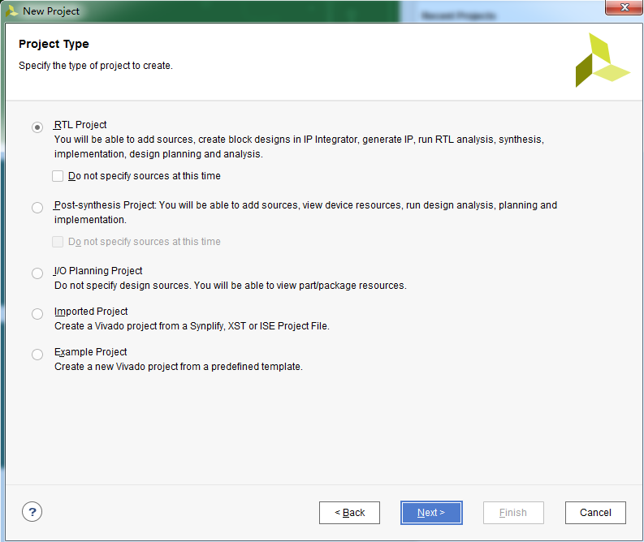
1. Create New Hardware Project
-step4
1. Select RTL Project
2. Click here

Slide 11
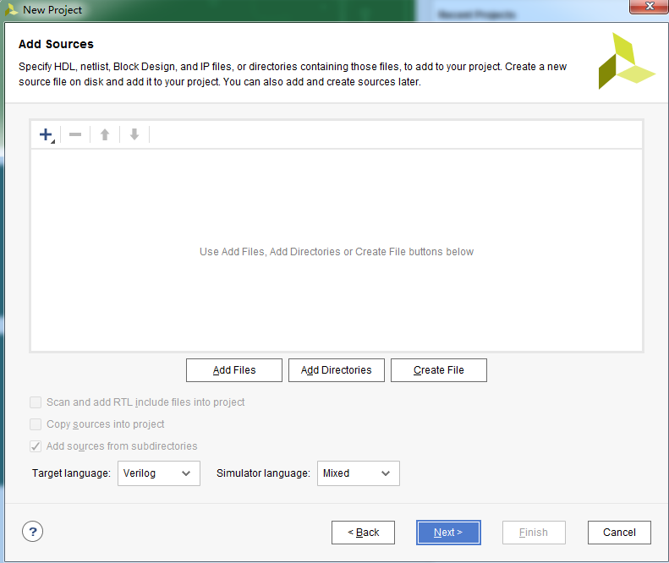
1. Create New Hardware Project
-step5
Directly Click here.
Don’t add any other files.

Slide 12
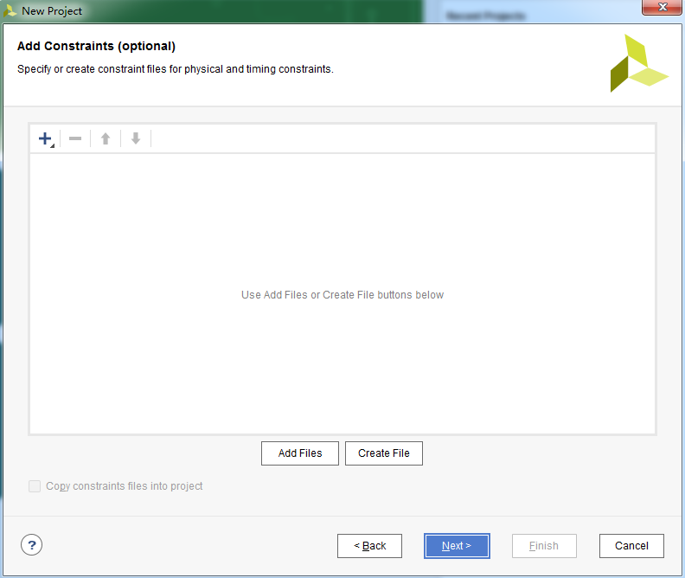
1. Create New Hardware Project
-step6
Directly Click here.
Don’t add any other files.

Slide 13
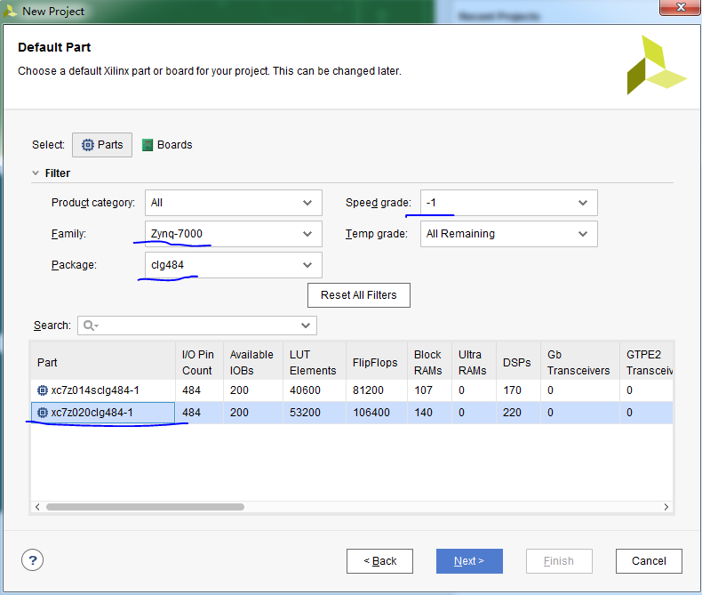
1. Create New Hardware Project
-step7
1. Select xc7z020clg484-1 as the following part
2. Click here

Slide 14
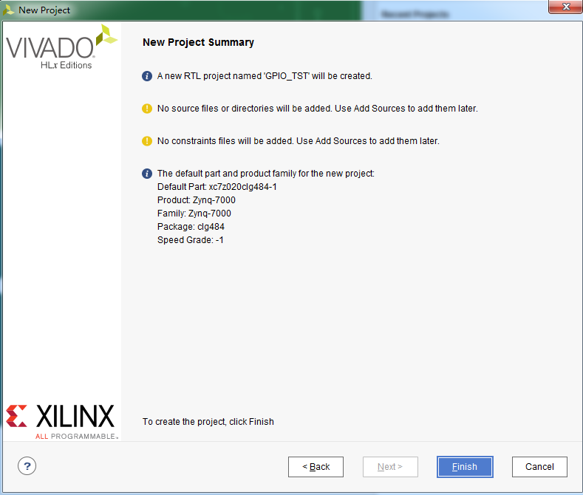
1. Create New Hardware Project
-step8
Check the project information，then click here

Slide 15
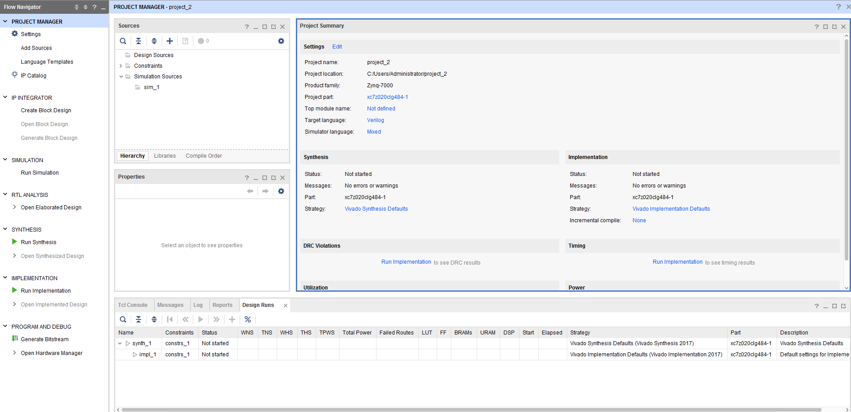
1. Create New Hardware Project
-step9
After finished, you can see this window
Source Menu
Simulation Menu
Synthesis Menu
Hardware Program Menu

Slide 16
FPGA Design Flow

Slide 17
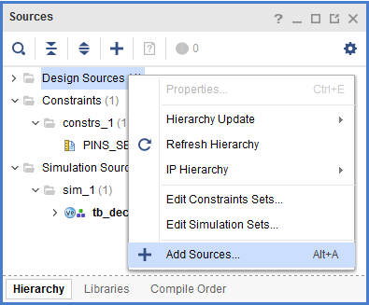
1. Right-click
2. Create New Source File
-step1
2. Click here

Slide 18
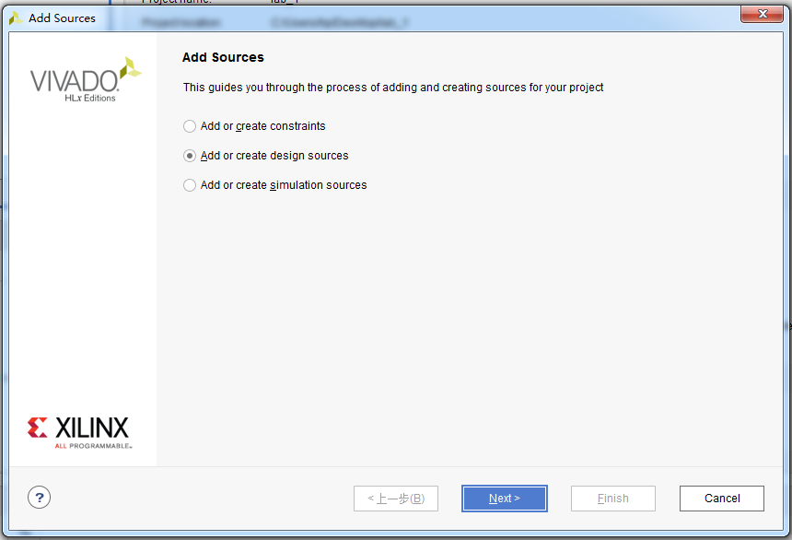
2. Create New Source File
-step2
1.Choose it
2. Click here

Slide 19
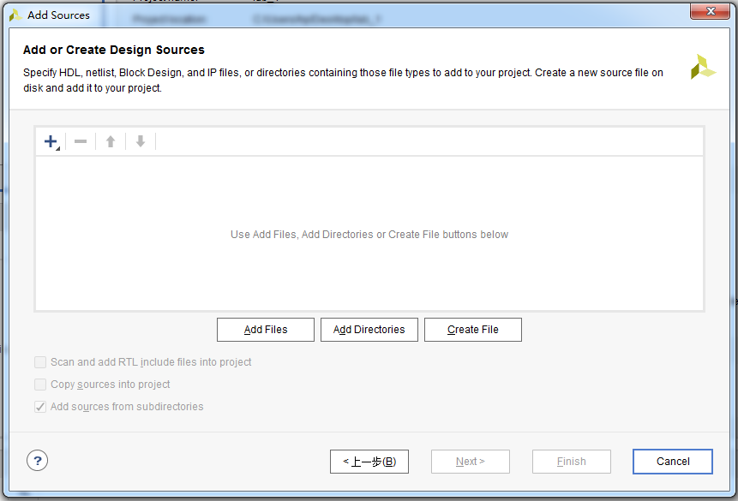
2. Create New Source File
-step3
Click here

Slide 20
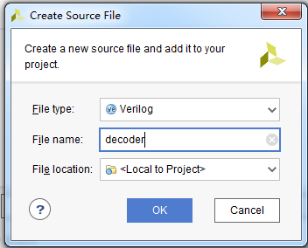
2. Create New Source File
-step4
1. Add file name
2. Click here

Slide 21
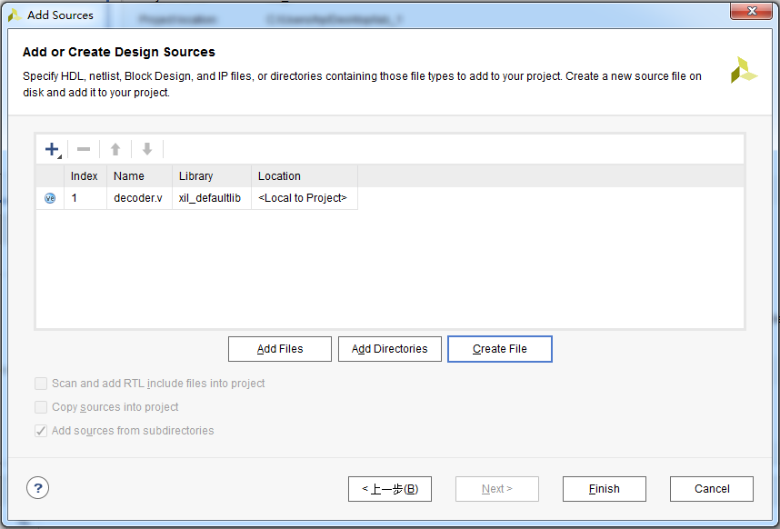
2. Create New Source File
-step5
Click here

Slide 22
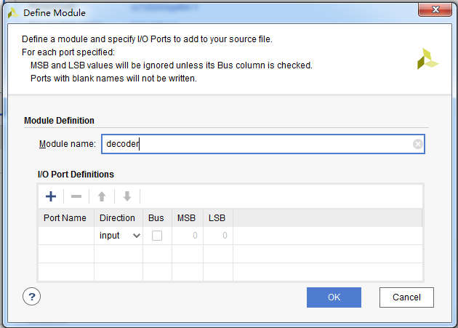
2. Create New Source File
-step6
1. Add module name
2. Click here

Slide 23
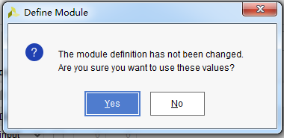
2. Create New Source File
-step7
Click here

Slide 24
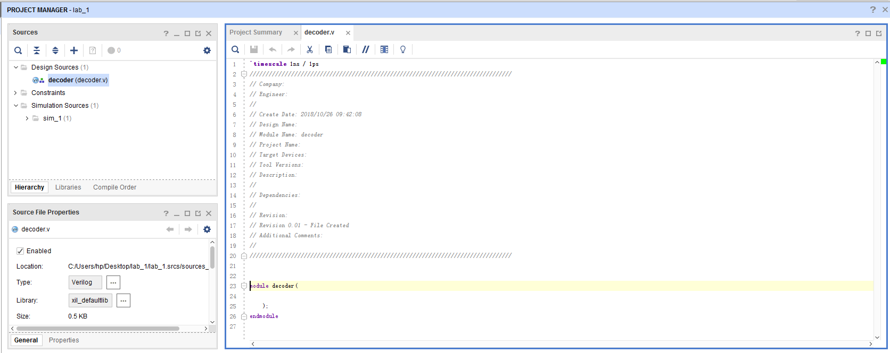
2. Create New Source File
-step8
Double click
Add your Verilog here.
The input and output can refer to the next page.

Slide 25
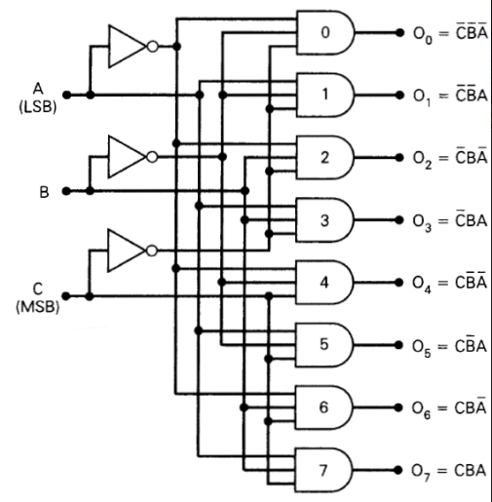
3-8 decoder
2. Create New Source File
-step9
module decoder(A,B,C,Y);
input A,B,C;
output reg [7:0] Y;
always@(*)
begin
xxxxxx
xxxxxx
end
endmodule

Slide 26
FPGA Design Flow

Slide 27

3. Do Synthesis and get the circuit -step1
Click here

Slide 28
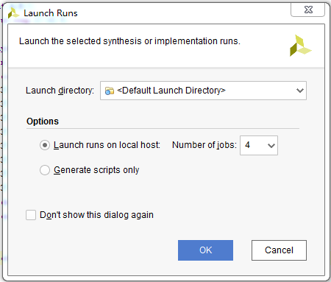
3. Do Synthesis and get the circuit -step1
Click here

Slide 29
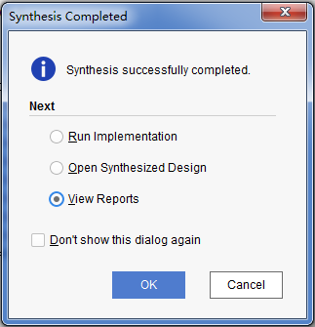
3. Do Synthesis and get the circuit –step2
1.Choose it
After finishing, you can see
this window
2.Click here

Slide 30
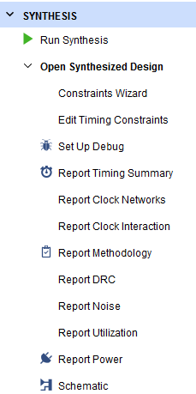
1.Click here
3. Do Synthesis and get the circuit –step3
2.Click here

Slide 31
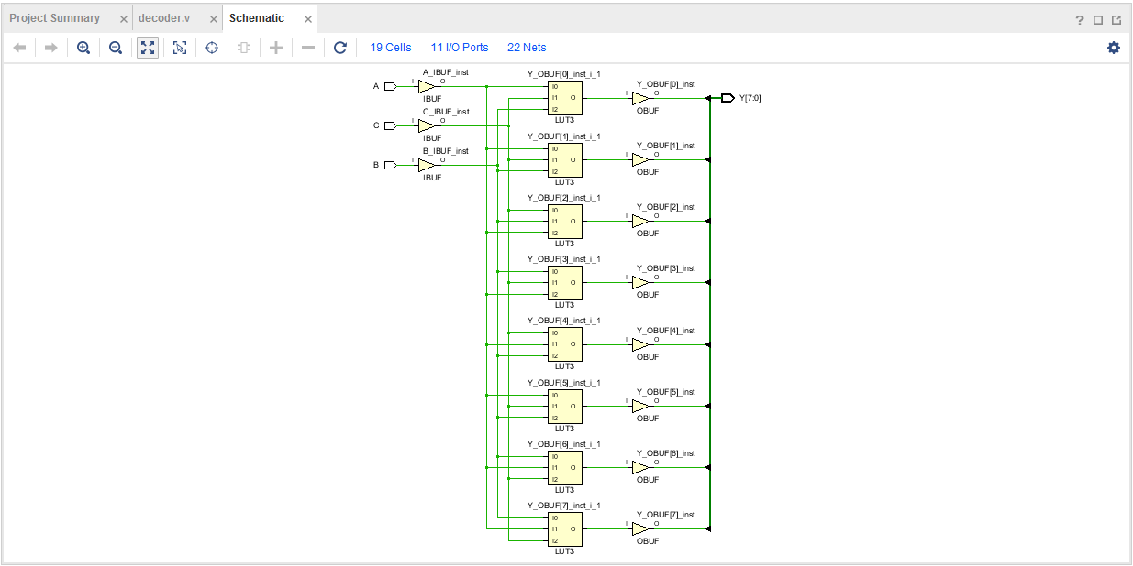
3. Do Synthesis and get the circuit –step4
your circuit based the Verilog code

Slide 32
FPGA Design Flow

Slide 33
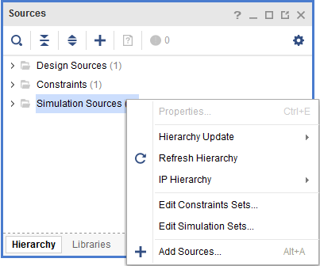
4. Create Simulation Source
File
-step1
1. Right-click
2. Click here

Slide 34
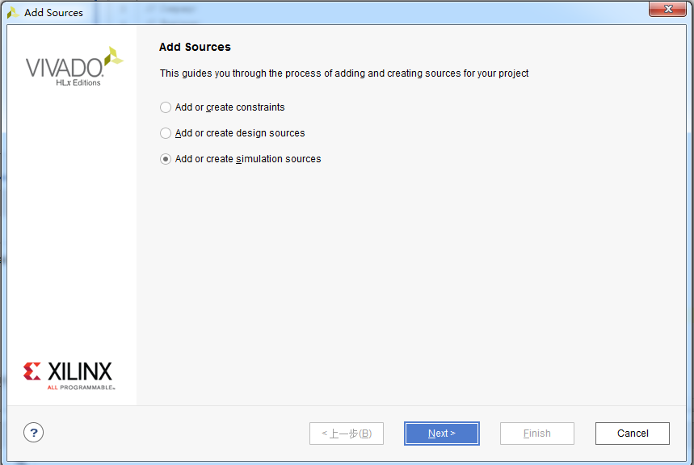
4. Create Simulation Source
File
-step2
1.Choose it
2. Click here

Slide 35
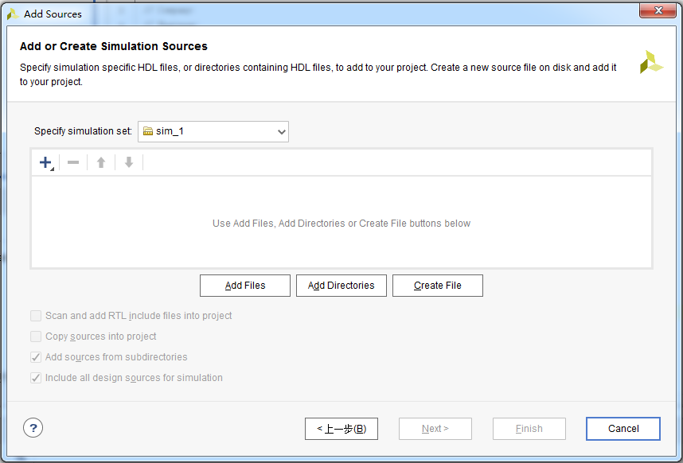
4. Create Simulation Source
File
-step3
Click here

Slide 36
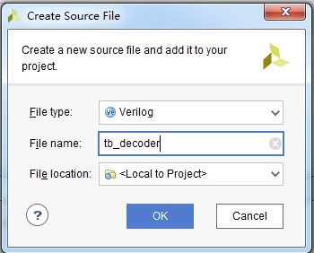
4. Create Simulation Source
File
-step4
1. Add file name
2. Click here

Slide 37
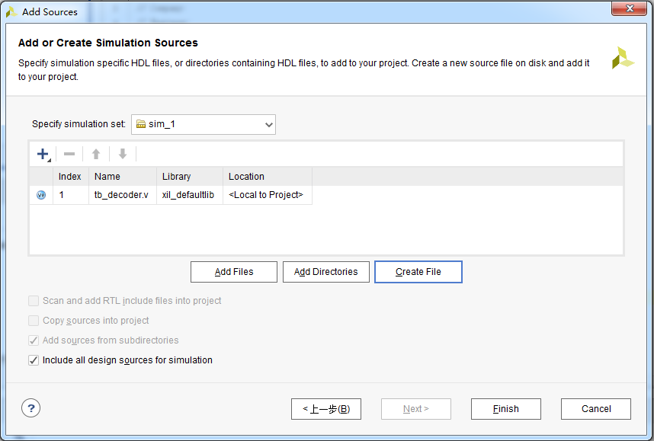
4. Create Simulation Source
File
-step5
Click here

Slide 38
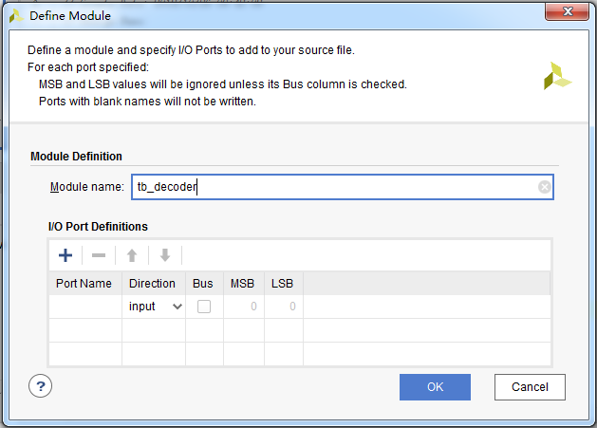
4. Create Simulation Source
File
-step6
1. Add module name
2. Click here

Slide 39
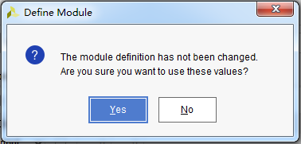
4. Create Simulation Source
File
-step7
Click here

Slide 40
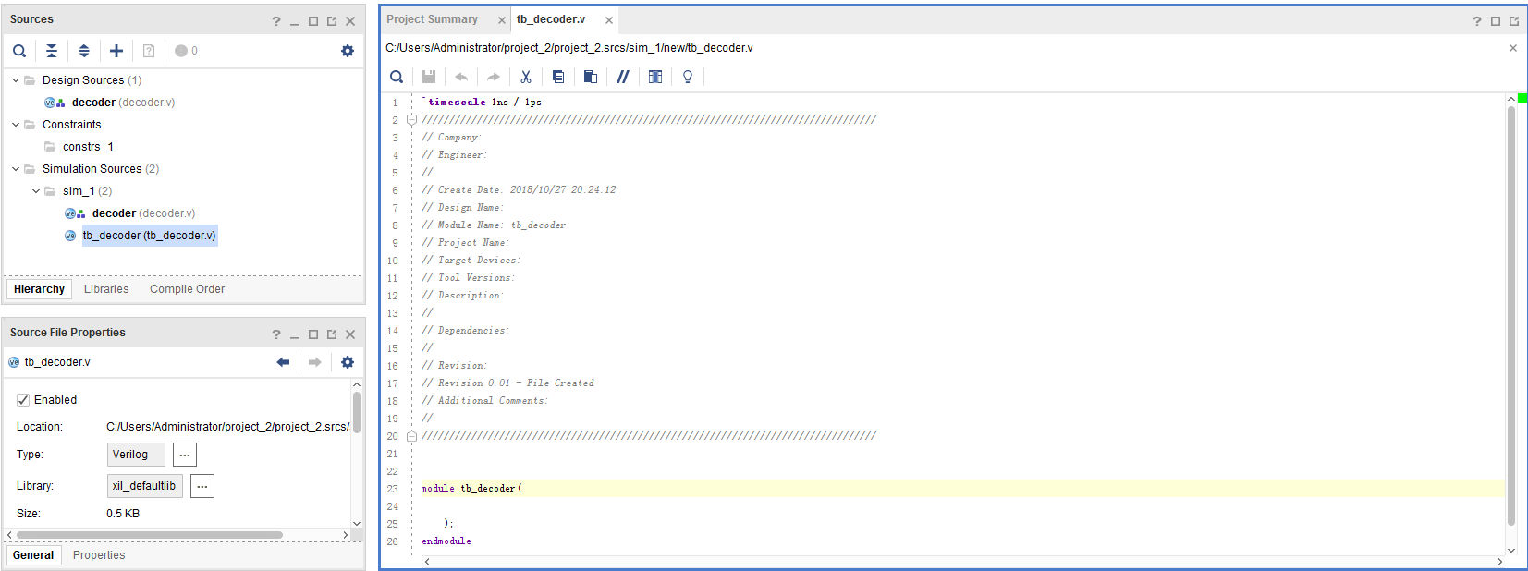
4. Create Simulation Source
File
-step8
1. Double click
2. Copy the content in tb_decoder.txt to this window, and complete the code

Slide 41
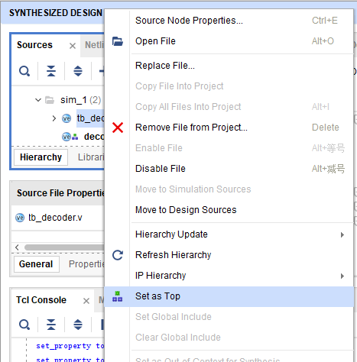
4. Create Simulation Source
File
-step9
1.Right- click
2.Click

Slide 42
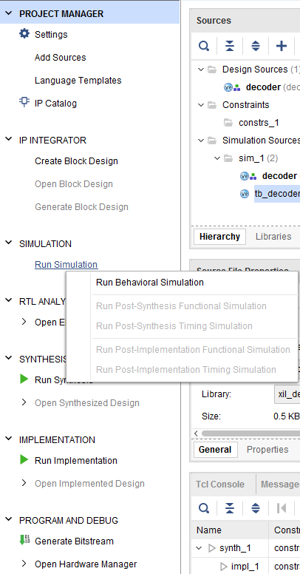
1. Click here
4. Create Simulation Source
File
-step10
2. Click here

Slide 43
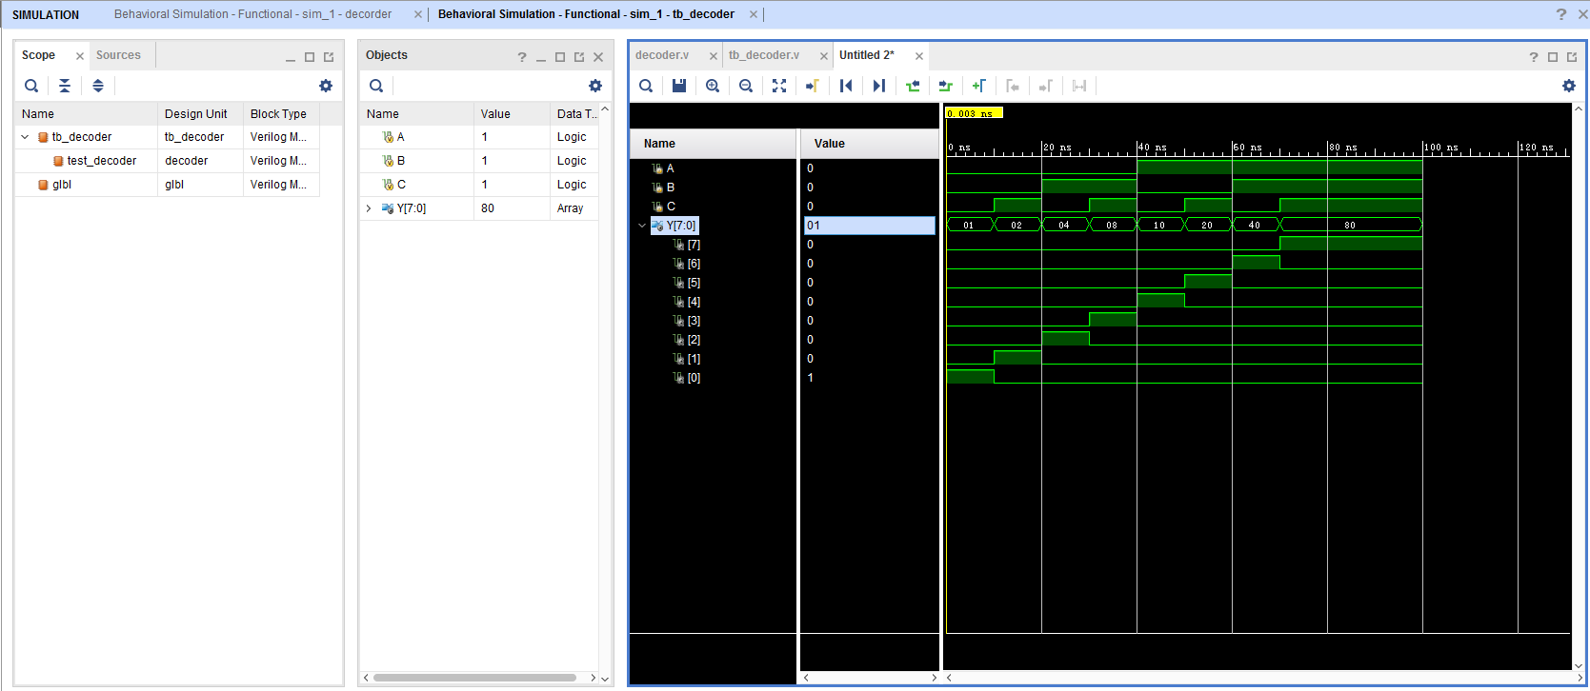
Click here to zoom the window
5. Do the simulation and debug.
Click here to see bit 0~7
Observe the variation of signals. Make sure all of these are right.

Slide 44
FPGA Design Flow

Slide 45
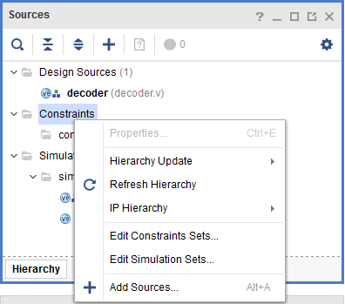
6. Create Constraint Source
File
-step1
1. Right-click
2. Click here

Slide 46
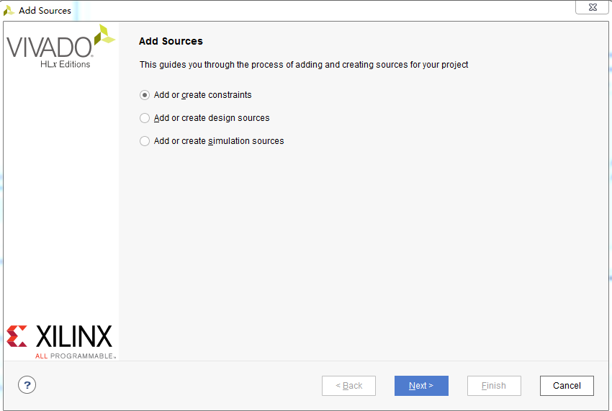
6. Create Constraint Source
File
-step2
1.Choose it
2. Click here

Slide 47
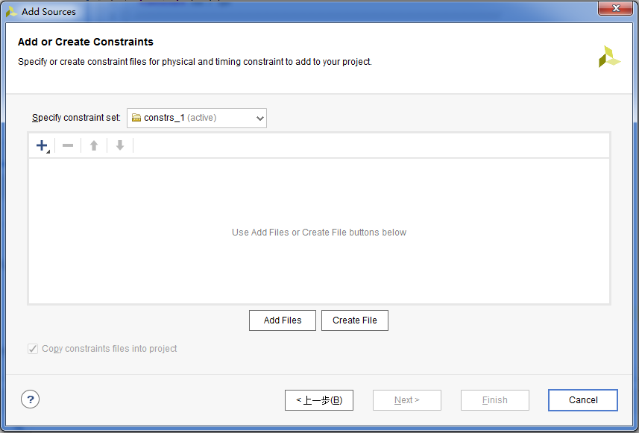
6. Create Constraint Source
File
-step3
Click here

Slide 48
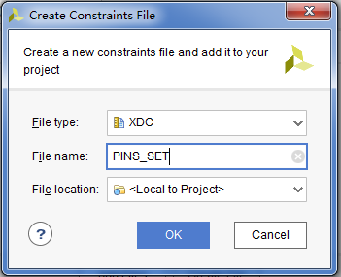
6. Create Constraint Source
File
-step4
1. Add file name
2. Click here

Slide 49
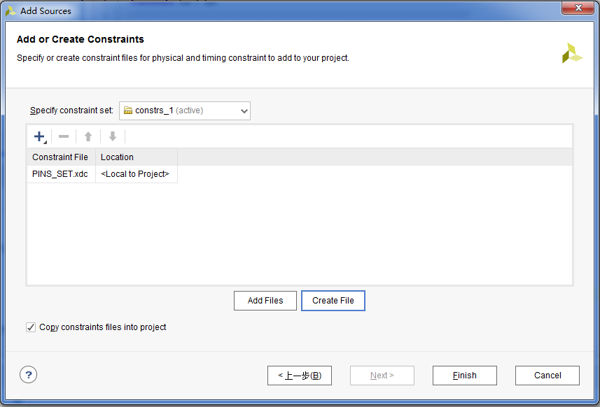
6. Create Constraint Source
File
-step5
Click here

Slide 50
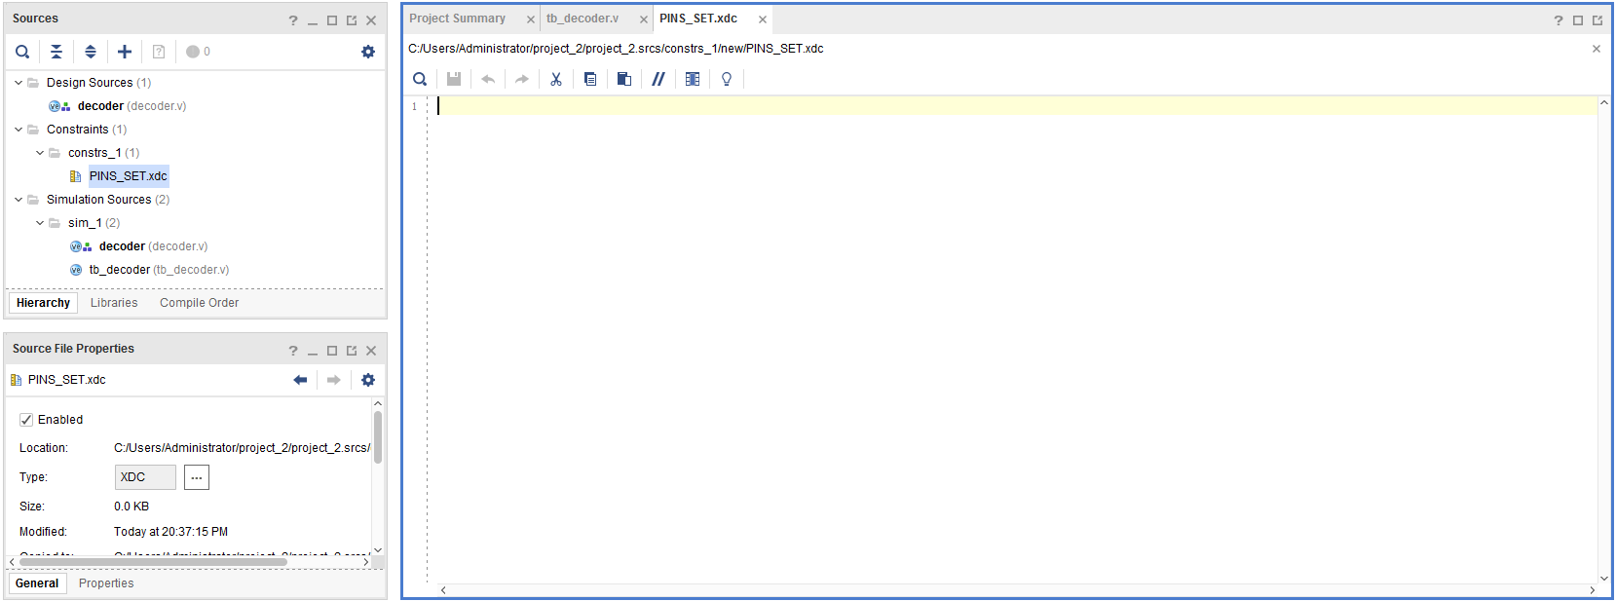
1. Double click
6. Create Constraint Source
File
-step6
2. Copy the content in PINS_SET.txt to this window

Slide 51
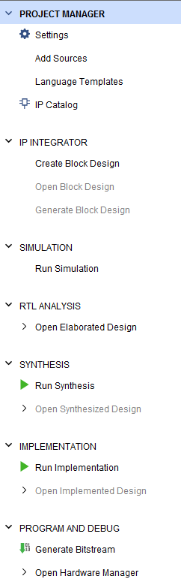
7. Generate Bitstream
File for FPGA
-step1
Click here

Slide 52
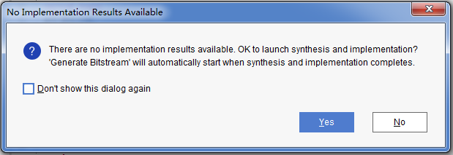
7. Generate Bitstream
File for FPGA
-step2
Click here

Slide 53
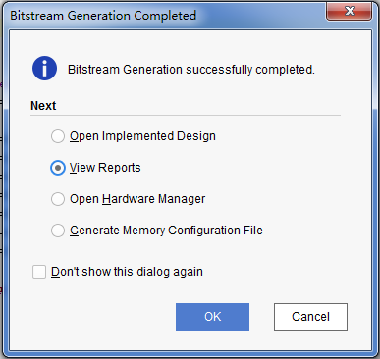
7. Generate Bitstream
File for FPGA
-step3
1.Choose this
You can see
on the top right corner.
2.Click here
After finishing, you can see this window

Slide 54
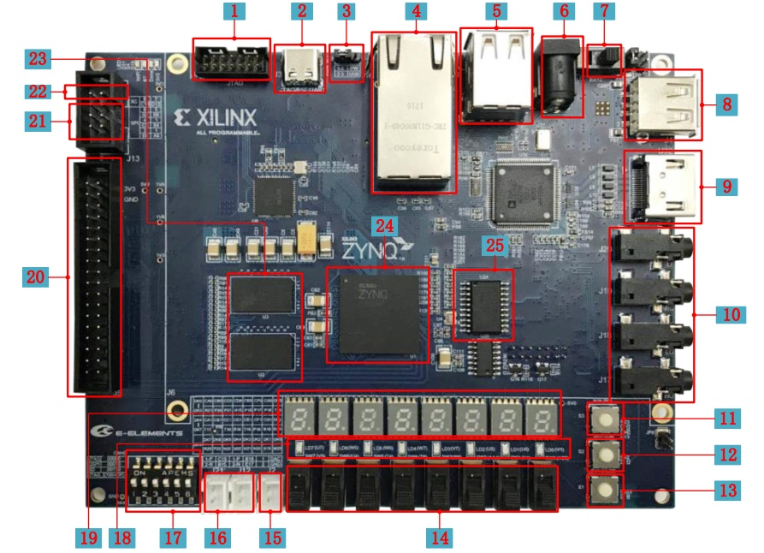
8.Connect FPGA Target Board With Computer
1. Put all switch(17 ) to ON
2.Connect J3(2) and USB port of computer with USB cable
3. Power on with switch (7)

Slide 55
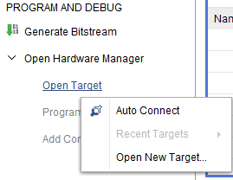
9. Program device
-step1
1. Click here
2. Right-click
3. Click here

Slide 56
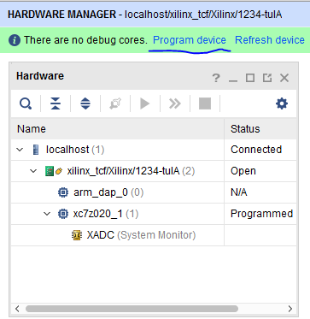
8. Program device
-step2
Click here

Slide 57
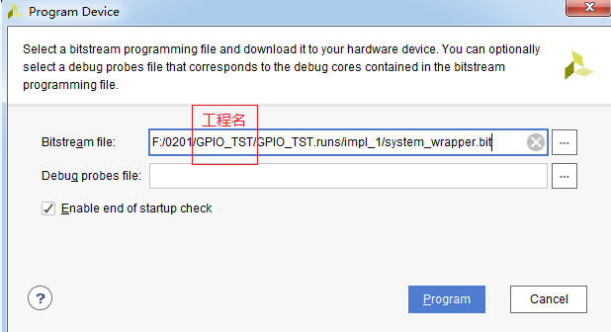
8. Program device
-step3
Find you bit file
Click here

Slide 58
9. Observe phenomena
1. Switch(0,1,2) are the inputs (A,B,C), led(0~7) are the outputs (Y0~Y7)
2. Use the switch to control the led light

Slide 59
Appendix: implement and verify a register group
module register(clk, rst, en, d, q, XX,XX);
input clk,rst,en;
input wire[15:0]d;
output reg[15:0]q;
always@(XXX)
if(rst==0)
XXX
else
begin
XXX
end
endmodule
  The Verilog code for your own register group can be composed and modified base on the register.txt file.

Slide 60
Digital Logic Design and Application
Lab Course 1
~~End~~

